Slide 1
AN/SPQ-15(V) Data Distribution Systems (DDS)
Industry
Ausra Zemaitiene
Contracting Officer, NSWC Dahlgren Division
April 30, 2026

Slide 2
Agenda
Introduction/Purpose
Acquisition Overview
Project Overview(s)
Support Requirements(s)
Questions & Answers

Slide 3
Purpose of Industry Day
Promote competition
Encourage the exchange of information
Improve the understanding of the acquisition requirement
Provide networking opportunities

Slide 4
Disclaimer
Information Purposes Only
All information provided prior to the release of the Request for Proposal (RFP) is considered to be non-binding.
Comments provided by industry will be considered and included in the final RFP at the discretion of the Contracting Officer.
The Government is bound only by the information contained in the Final RFP and its amendments.

Slide 5
Ground Rules for Question and Answer (Q&A) Session
NSWCDD will not have a direct verbal exchange during the question and answer session.
What to provide on the index cards:
Name and Company Name
Slide Number
Question
Any additional questions after this event must be posted in the SAM.gov portal.

Slide 6
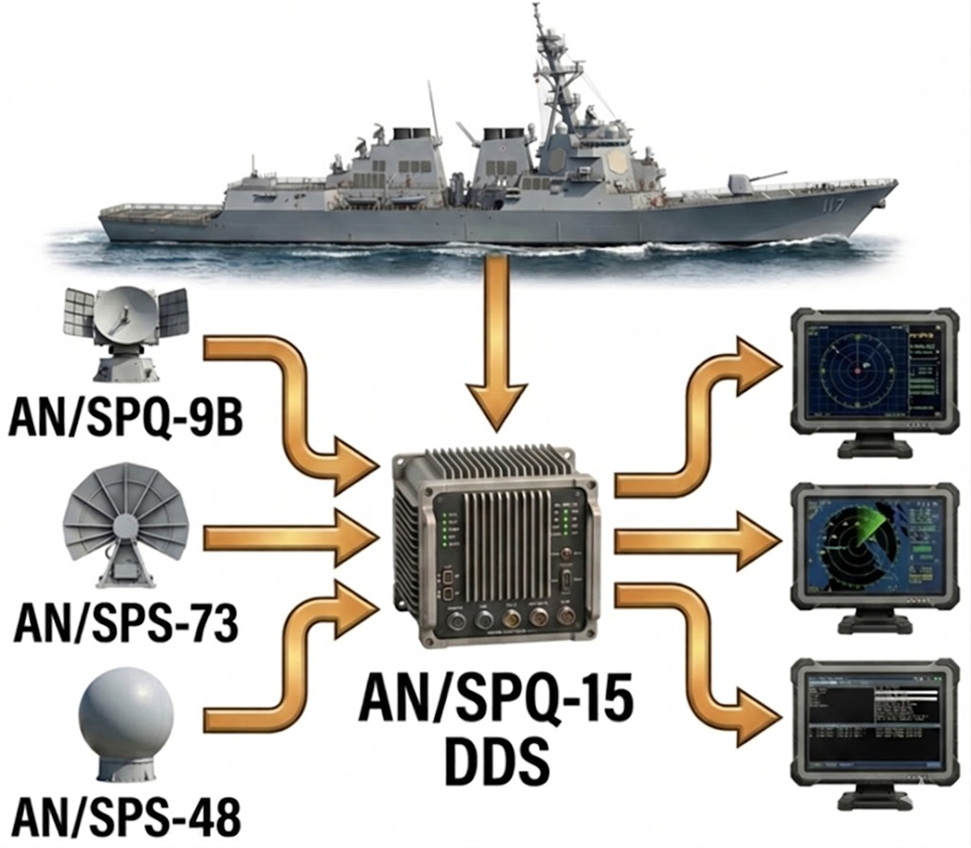
Project Overview
NSWCDD Dam Neck Activity Combat Systems Division, DNA30 is responsible for the production and sustainment of the AN/SPQ-14(V) Advanced Sensor Distribution Systems (ASDS), AN/SPQ-15(V) Data Distribution Systems (DDS), and future distribution systems and components fielded on U.S. Navy ships, Land based sites and Foreign Military Sales (FMS) ships.
AN/SPQ-15 Data Distribution System is a critical link, distributing sensor data to tactical displays and converts naval surface and air search radar information into a standard digitized format and distributes this data to radar navigation and tactical displays. This requirement provides production, development, engineering services, obsolescence mitigation, configuration management, sustainment support, and integrated logistics support in the manufacturing, fabrication, assembly, production, delivery, repair, and installation of the AN/SPQ-14(V) ASDS and AN/SPQ-15(V) units required to support the mission of NSWCDD DNA.

Slide 7
Acquisition Strategy
Acquisition Approach – TBD
New Requirement, consolidation of N0017823D4501 & N0017824D4500
Contract Type – IDIQ, FFP, CPFF, ODCs; 5-Year (Base, 4 Option Periods)
Sources Sought Close – 5/11/2026
Solicitation Number – N0017826D4506
Anticipated Solicitation Release:
Draft 10/08/2026 - 10/27/2026
Final: 12/9/2026 - 12/9/2026
Anticipated Award: 4/24/2028
Anticipated PoP Start Date: 5/30/2028

Slide 8
AN/SPQ-15(V) Data Distribution Systems (DDS)
Industry
Mary Armbruster
Electrical/Systems Engineer, NSWC Dahlgren Division, Dam Neck Activity
April 30, 2026

Slide 9
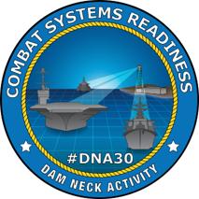
DNA35 – Sensor Distribution and Display Systems
Mission: Provide Sensor Data Distribution Engineering, Acquisition & Life Cycle Support and Fleet Readiness solutions for Warfare Systems.
Products
AN/SPQ-12(V) Radar Data Distribution System (RADDS)
AN/SPQ-14(V) Advanced Sensor Distribution Systems (ASDS)
AN/SPQ-15(V) Data Distribution Systems (DDS)
AN/SPA-25G/H/J/K Radar Indicators
Warfare System Integration Diagrams
Services
Design Engineering
Acquisition Engineering
Software Engineering
Logistics Analysis and Product Development
Alteration & Installations (HW&CP)
Fleet Support
In-Service Engineering
ECM CCB Coordination's and WSIDS
Notes:
RDDS distributes Radar Data from shipboard Radars to Common Display Consoles (CDS), AN/SPA-25s and other Legacy Indicators.
DNA35 provides Cradle to Grave support for AN/SPQ-12(V) RADDS, AN/SPQ-14(V) Advanced Sensor Distribution Systems (ASDS), AN/SPQ-15(V) Sensor Distribution Systems (SDS), as well as AN/SPA-25 consoles.

Slide 10
Anticipated Requirements
Accomplish the performance requirements and provide the deliverables specifically described in the Technical Instructions (TIs) to be placed against the resultant contract issued by the Procuring Contracting Officer (PCO). These TIs shall be within the parameters of one or more of the tasks described below. Performance objectives are based on the following disciplines:
Production and Delivery
Engineering Services
Technical Services
Configuration Management and Integrated Logistics Support (CM and ILS)
Obscolescence Management
Cybersecurity Support

Slide 11
Production and Delivery
Objective: Establish a reliable manufacturing process that ensures product quality and is backed by a comprehensive warranty.
Key Requirements & Capabilities:
The ability to produce and deliver AN/SPQ-14(V) and AN/SPQ-15(V) equipment in strict accordance with government-approved Technical Data Packages (TDPs).
A disciplined process for managing changes, including the use of an Engineering Change Proposal (ECP) process for any modifications and conducting sufficient regression testing to validate fixes.
A commitment to quality demonstrated by a mandatory 24-month warranty on all produced or repaired equipment, covering all labor, parts, and shipping costs for warranty-related failures.
A transparent production process managed through regular In-Process Reviews (IPRs) and detailed Production Status Reports that provide metrics on progress and quality.
Notes:
Defined manufacturing process and tests.

Slide 12
Production and Delivery
Objective: Execute a multi-layered testing strategy to verify and validate that every system meets all performance and security requirements prior to delivery.
Key Requirements & Capabilities:
A rigorous testing process beginning with First Article Qualification Testing (FAQT) on initial and modified production units to validate the manufacturing process and design.
The development and execution of government-approved Factory Acceptance Test (FAT) plans to verify functionality, with all test data and tools provided to the government for independent evaluation.
Execution of a Production Acceptance Test (PAT) on every production cabinet, culminating in a mandatory 72-hour, error-free System Burn-in Test (SBT) before any unit is accepted.
Notes:
This system is a redline system on the ship, so it needs to be ready to go after installation and testing so factory testing needs to be up to snuff. They get installed with the combat system equipment, long run times are needed.

Slide 13
Production and Delivery
Objective: Ensure total asset visibility and safe delivery through meticulous data management and a robust logistics plan.
Key Requirements & Capabilities:
A meticulous configuration management process, including the creation of a detailed As-Built Bill of Materials (BOM) list for every single production unit, subsystem, and component.
Full compliance with Department of Defense asset tracking mandates by implementing an approved Item Unique Identification (IUID) Marking Plan and submitting all required data to the IUID Registry.
The development and execution of a government-approved Packaging, Handling, Storage, and Transportation (PHS&T) plan to ensure all equipment is delivered free from damage.

Slide 14
Engineering Services
Systems Engineering: Provide comprehensive systems engineering leadership to guide the product from concept to a fully validated and documented system.
Key Requirements & Capabilities:
The ability to determine the feasibility of proposed systems by using simulations, Analyses of Alternatives (AoAs), and design trade studies, documenting the results in formal reports.
Expertise in employing modern industry standards such as Model-Based Systems Engineering (MBSE) to develop system models and functional flow diagrams.
The application of a formal human factors development approach to ensure all hardware and software is designed for effective, safe, and usable operation by the end-user.
A robust process for product verification and product validation to prove the end product conforms to all requirements (RTM, SRD, etc.) and stakeholder expectations.
The implementation of a formal technical risk management plan for the continuous identification and mitigation of risks associated with the project.
The capability to propose, coordinate, and submit formal Engineering Change Proposals (ECPs) through the established Configuration Control Board (CCB) process according to Government requirements.
The ability to delivery a complete Technical Data Package (TDP).

Slide 15
Engineering Services
Hardware Engineering: Deliver expert hardware engineering for the design, development, and sustainment of rugged, shipboard-ready electronic systems.
Key Requirements & Capabilities:
The proficiency to prepare, deliver, and implement Engineering Change Proposals (ECPs) and other change requests, while maintaining all data in a government-accessible repository.
Advanced design and development expertise for shipboard applications, including digital signal processing, power systems, and embedded systems like FPGAs and SoCs.
The ability to develop complete TDPs for all mechanical enclosures, rackmount equipment, cable assemblies, and structural supports required for installation.
A commitment to high-reliability manufacturing, including the design of all Printed Circuit Boards (PCBs) and Circuit Card Assemblies (CCAs) to meet IPC Class 2 and Class 3 acceptance criteria.
A proactive strategy for managing hardware lifecycle challenges by providing solutions for obsolete or end-of-life (EOL) components, including the capability to reverse engineer legacy parts.
Notes:
Printed circuit boards (CCAs) are custom to the system and TDP.
SPQ-14(V) CCAs are obsolete so a solution will be needed, most likely custom

Slide 16
Engineering Services
Software Engineering: Develop, test, and maintain secure, compliant, and high-performance software solutions for radar distribution applications.
Key Requirements & Capabilities:
A mature and security-focused software development process that strictly follows the Application Security and Development STIG for all custom-developed software.
The mandatory use of static and/or dynamic code analysis on all source code to rigorously test for and mitigate any discovered vulnerabilities before delivery.
Full-stack software engineering support, including the development and maintenance of applications in C, C++, Java, and Python for operating systems, HMIs, and digital processing.
A comprehensive testing approach covering both functional testing (unit, integration, system) and non-functional testing (security, performance, usability) with formal reporting.
The ability to provide end-to-end cybersecurity services to ensure all software complies with Department of Defense (DoD) directives throughout its lifecycle.
The development and delivery of all required software documentation, including Version Description Documents (VDD) and Software Development Plans (SDP).
The ability to integrate software into hardware configurations for future variations and cybersecurity requirements.

Slide 17
Technical Services
Objective: Provide expert, hands-on installation support and execute a comprehensive testing program to ensure systems are fully qualified for shipboard and shore-based environments.
Key Requirements & Capabilities:
The ability to perform shipboard and shore-based hardware and software installations, repairs, and post-installation testing using government-approved test procedures.
The capability to conduct and report on a full suite of Environmental Qualification Testing (EQT), including EMI/EMC, vibration, shock, and salt spray testing, performed at a government-approved facility.
The execution of platform installation testing, including formal Stage 1-7 testing in accordance with DOD-STD-2106A, to validate system integration.
The development, delivery, and maintenance of a comprehensive Test and Evaluation Master Plan (TEMP) and all detailed test plans and procedures.
A commitment to detailed reporting, including the delivery of a final test report after each event and providing Object Quality Evidence (OQE) for all environmental qualification tests.
The capability to provide reclamation support to test, repair, and certify assets recovered from fleet and shore installations.
Notes:
Talk about ILO and SOVT.
EQT – MIL_STD-810 and 461 – all of our equipment has to meet these standards

Slide 18
Technical Services
Objective: Deliver responsive, long-term technical support to ensure the operational availability and lifecycle sustainment of all fielded systems.
Key Requirements & Capabilities:
The ability to provide rapid technical assistance for fleet casualties, both at a distance and on-site, and to perform repairs or replacements as directed by the government.
A proactive approach to obsolescence management, including performing authorized lifetime buys of End-of-Life (EOL) components in coordination with NAVSUP and/or DLA.
The hands-on technical skill to build, fabricate, and assemble components in accordance with an approved Technical Data Package (TDP), including the assembly of cables, harnesses, and mechanical enclosures.
The specialized capability to repair or assemble PCBs and CCAs, including all required inspection, troubleshooting, soldering, and testing activities.
The expertise to test, assemble, and integrate repaired or newly-built radar distribution systems with other existing fleet or shore-based systems.
Notes:
FMS customers – new variations of the TDP are put together according to requirements for radar distribution systems.
Damaged PCBS or CCAs are damaged so the specialized capability to inspect and repair.

Slide 19
CM and ILS
Objective: Establish and execute a comprehensive framework for Configuration Management (CM) and Integrated Logistics Support (ILS) across the system's entire life cycle.
Key Requirements & Capabilities:
The ability to provide overarching Integrated Logistic Support (ILS) for the life cycle management of all radar distribution system equipment, from development to disposal.
The development and delivery of a detailed Configuration Management Plan (CMP) that defines all processes for CM planning, identification, control, audits, and status accounting.
The development and delivery of a Life Cycle Sustainment Plan (LCSP) that ensures sustainment considerations are fully integrated into all acquisition and engineering activities.
A commitment to provide critical logistics data for affordability, reliability, maintainability, and supportability analyses.
Notes:
Emphasize we take care of the system for its whole lifecycle – SPQ-14 in sustainment
Work very closely alongside our logistics leads

Slide 20
CM and ILS
Objective: Implement disciplined configuration control to ensure absolute traceability and management of all system hardware, software, and documentation.
Key Requirements & Capabilities:
The establishment and maintenance of a robust Configuration Management (CM) system to provide control and traceability over every item defined in the Technical Data Package (TDP).
The ability to manage the developmental configuration through iterative design and release until all functional and allocated requirements are satisfied and documented.
A formal process for Configuration Identification, including defining the product structure, assigning identifiers to all Configuration Items (CI), and establishing their specification baselines.
The expertise to provide technical input through the Configuration Control Board (CCB) process to properly manage design changes and adjudicate any impacts to ILS products.

Slide 21
CM and ILS
Objective: Develop, deliver, and maintain the full suite of technical data products required to train operators and maintainers and to provision the fleet.
Key Requirements & Capabilities:
The development and delivery of operation and maintenance technical manuals, specifically Interactive Electronic Technical Manuals (IETMs), using the S1000D format or other directed standards.
The ability to develop and update Allowance Parts Lists (APL) for new equipment and provide all necessary provisioning data to reflect changes to the approved configuration baseline.
The technical expertise to develop and update all required training data products in accordance with MIL-PRF-29612B to support life cycle maintenance.
The capability to provide technical expertise to resolve Preventative Maintenance System (PMS) Feedback Reports and ensure maintenance procedures remain accurate and effective.
Notes:
Highlight S1000D and IETM usage in the fleet

Slide 22
Obscolesence Management
Objective: To proactively identify, report, and mitigate all supply chain risks associated with component obsolescence to ensure system sustainability and availability.
Key Requirements & Capabilities:
The development, delivery, and execution of a formal Diminishing Manufacturing Sources and Material Shortages (DMSMS) Plan in accordance with TA-STD-0016.
The establishment of a formal process to continuously identify pending and emergent obsolescence issues and to immediately notify the Government of any risks affecting the approved baseline.
The capability to investigate, evaluate, develop, and replace obsolete or non-obtainable parts to mitigate program supply chain risks and ensure continued compliance with all performance requirements.
A commitment to disciplined configuration control, ensuring all obsolescence-driven changes are made in strict accordance with the Government-approved Configuration Management (CM) Plan.
Notes:
This is a good spot to talk about examples like the in rush limiter. Government working hand in hand with the contractor to come up with the solution.

Slide 23
Cybersecurity Support
Objective: Manage the full Risk Management Framework (RMF) lifecycle and implement a robust continuous monitoring program to obtain and maintain the system's Authority to Operate (ATO).
Key Requirements & Capabilities:
The expertise to develop complete RMF packages as the designated ISO/ISSE and Navy Qualified Validator (NQV), consistent with NAVSEA Functional Authorizing Official (FAO) guidelines.
The ability to conduct Annual Security Reviews (ASR) for each RMF package, including all testing, package updates, and management of any conditions tied to the ATO.
A commitment to provide robust continuous monitoring support, including quarterly assessments using DISA STIGs, SCAP, and vulnerability scanning with tools like the Assured Compliance Assessment Solution (ACAS).
The systems engineering expertise to provide technical planning and design analysis to ensure core cyber requirements are met, including availability, integrity, authentication, and confidentiality.
A formal process for vulnerability management, including performing technical assessments of discovered vulnerabilities and maintaining the system Plan of Actions and Milestones (POA&M).
The ability to provide a robust software development process such as DevSecOps.

Slide 24
Cybersecurity Support
Objective: Ensure the system is designed, configured, and hardened from the ground up to meet all DoD, DoN, and Combat System cybersecurity standards.
Key Requirements & Capabilities:
A forward-leaning design approach that aligns the system with Combat System TA standards, PEO IWS Cyber Requirements, and Zero Trust principles, using DISA STIGs as the primary configuration standard.
The hands-on technical skill to perform operating system patching and system hardening in accordance with the latest DoD and DoN requirements.
The ability to develop and deliver all required RMF documentation, including system Network Diagrams, SOPs, and Security Assessment Plans.
The proficiency to manage system and application registration in official repositories such as DITPR-DON, DADMS, and for Ports, Protocols, and Services Management (PPSM).
A commitment to ensure all personnel supporting shipboard systems meet all Cyber Security Workforce (CSWF) and privileged access requirements.
A comprehensive understanding of acquisition security, ensuring system design is compliant with DFARS requirements for safeguarding covered defense information.

Slide 25

Thank You

Slide 26
Back-up Slides

