Slide 1
MHS Information Platform (MIP) Overview of Data Products and Services
Chris Nichols MHA, BSN, LSSBB
Program Manager,
Enterprise Intelligence and Data Solutions (EIDS)

Slide 2
Conflict of Interest/Disclosure
Speakers have no relevant financial or non-financial relationships to disclose relating to the content of this activity.
The views expressed in this presentation are those of the author and do not necessarily reflect the official policy or position of the Department of Defense, nor the U.S. Government.
This continuing education activity is managed and accredited by the Defense Health Agency, J-7, Continuing Education Program Office (DHA, J-7, CEPO). DHA, J-7, CEPO and all accrediting organizations do not support or endorse any product or service mentioned in this activity.
DHA, J-7, CEPO staff, as well as activity planners and reviewers have no relevant financial or non-financial interest to disclose.
Commercial support was not received for this activity.

Slide 3

Speaker Introduction
Mr. Chris Nichols
Program Manager
Enterprise Intelligence & Data Solutions (EIDS), PEO DHMS
Mr. Chris Nichols serves as program manager for the EIDS program management office. In his role, Mr. Nichols is responsible for delivering secondary data solutions around a digital health hub model; rationalizing legacy data capabilities; orchestrating integration for systems such as MHS GENESIS; and providing enterprise clinical intelligence to include clinical support applications, readiness reporting, research, ‘big data’ techniques, and dashboards for the entire Military Health System (MHS) and other federal partners.

Slide 4
Learning Objectives
1
Discuss the current and future state of the MHS Information Platform (MIP).
Elaborate on the MIP Core Capabilities including workflow applications, analytics / business intelligence workbench, precision medicine, core platform services, information platform, and complex registries use cases.
2
3
Explain how clinical data from legacy system is seamlessly exchanged through Health Information Archive (HIA) viewer.
4
Discuss how organizations can leverage the capabilities of the MIP.
5
Elaborate how the MIP supports MHS leadership strategic priorities.

Slide 5








Scale of MHS Data
Total MHS GENESIS + TRICARE Data Since 2017
Daily
12.7M
1.6B
140K
# Patients
# Diagnoses
# Clinical Notes
839M
782M
20+M
# of Messages
# Encounters
# Procedures
961M
88M
165K
# Observations
# Medications
# of Encounters

Slide 6
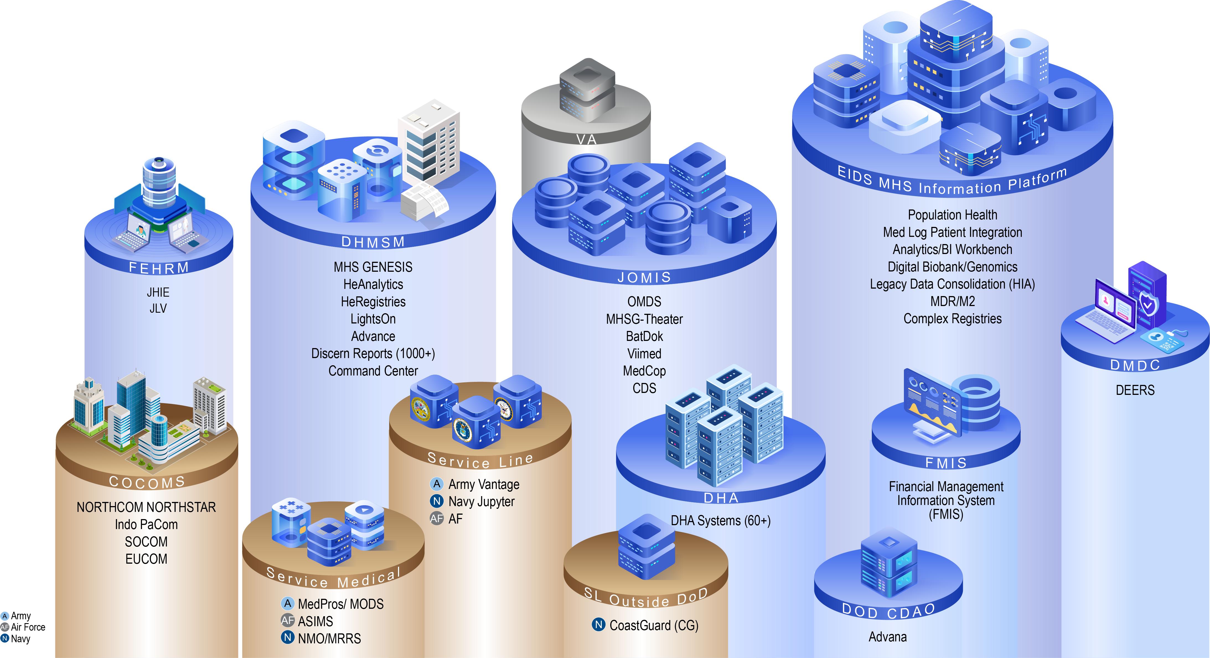
Complexity of Current Data Ecosystem
*MIP - 130+ Interfaces
23 Warehouses / 19 systems rationalized in the last 4 years

Slide 7
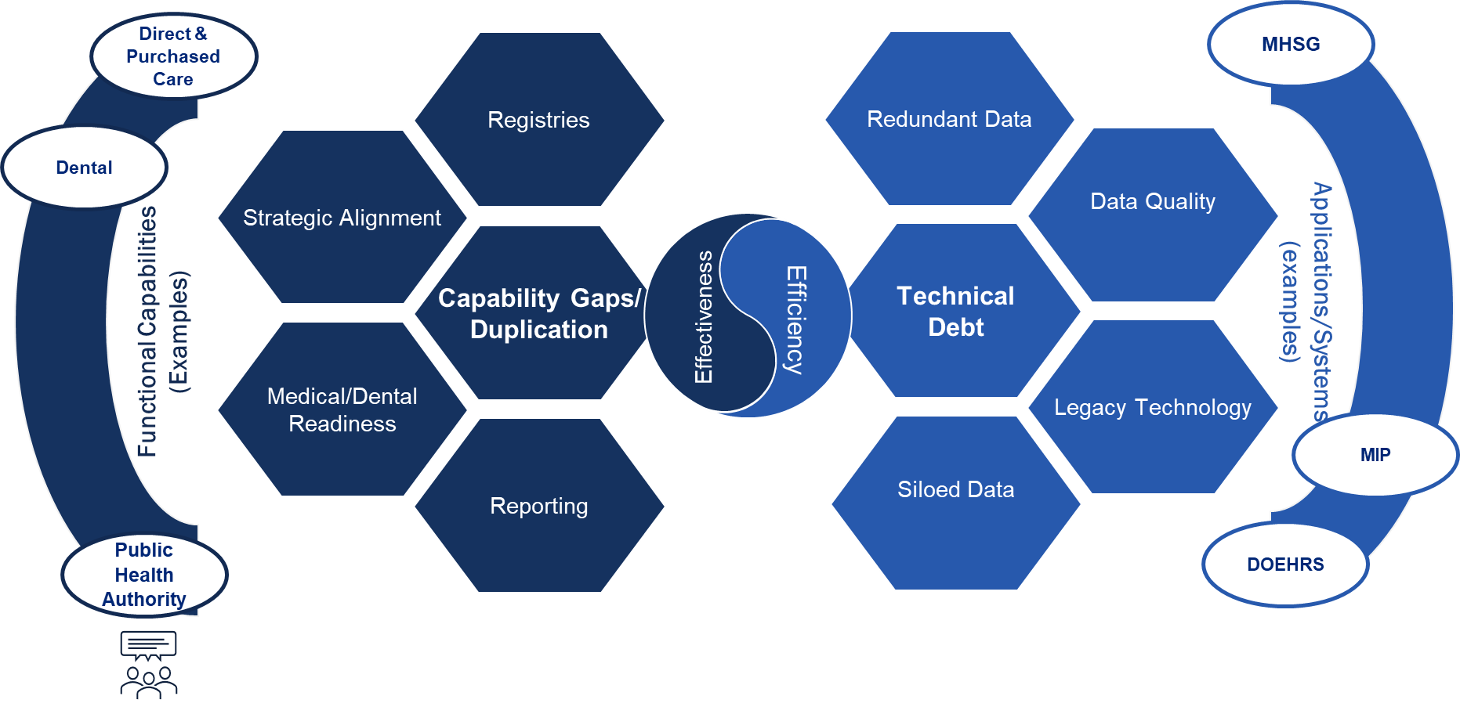



What is Driving Prioritization for Military Health?
CDS
Research
OMDS
Reserves

Slide 8





How Do We Organizationally Manage the Data Demand?
AD-R&PI
J-1, J-8
J-3/5/7
AD-HCA
MA, HCO, Tricare, USPHS
AD-S/CAE
J-4, J-6, R&E (Service Labs/GME)
CDAO
Advana/Maven
USUHS
P&R
COCOMs/ OJSS
DOD-Wide
P&R
DHA
Customers
Health Affairs
Customers
Project Requests
Army
Med
Navy
Med
AF
Med
PEO
DHMS
???
Reserves
VA
Project Requests
NIH
CMS
CDC
HHS
MHS GENESIS Leadership Group (MGLG)
MHS Data
& AI Policy Council
(MDAPC)
Requirement
Costing
Internal Prioritization
EIDS Delivery and Integration

Slide 9




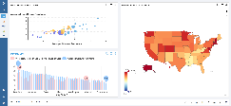

Evolution of EIDS and the MIP
Since 2018, EIDS has provided access to increasing amounts of data across domains, enabling downstream data flow and advanced analytic capability to produce new insights.
MILPERS
Purchased care
Dental readiness data from MHSG
Research
New analytic capabilities
Add data from Reserves
Medical Readiness
Interface with electronic health record data / direct care
Evolution of data availability
MHS Information Platform
Service Readiness Systems
2018
2018
2019
2021-2025
2022-2026
EIDS PMO Formed | Enterprise Services Rationalization | Program of Record | Legacy Data | Purchased Care | Data Accessibility
EIDS PMO stood up within DHA Solution Delivery Division as Services’ systems migrated into DHA HSDW, CEIP, AFCHIPS | NDAA 2017/MHS Reform: Consolidates multiple legacy data warehouses and secondary data stores into a unified data architecture 30+ systems rationalized into EIDS PMO | MIP established as an ACAT IAC Program of Record to integrate disparate data and modernized applications | Establish the program for storing and accessing legacy clinical health data | MDR replatform Pharmacy data warehouse | Data Quality Data Pipeline OMOP Data Catalog
Rationalization, Optimization and Cost Reduction
Modernization
& Services
Data
Analytics
Applications

Slide 10







MIP Services at the Intersection of Data...
Today the MIP compiles over 5 PB of data from 130+ sources on a scalable platform
MIP Outcomes
Accessible Data for Functional Decision Making
Legacy Clinical Systems Data
Population Health
Data as a Service
Data as a Service: Health surveillance data
Analytics as a Service: Data workbench for Population Health Analytics
Applications as a Service: DMSS (PROMIS, DMED, DODSR, DMS-MT), ESSENCE, Digital BioBank
ASIMS,
NMO,
MEDPROS
+ others
High trust, governed data ecosystem
Health Data
Service Medical Readiness Systems
Health Surveillance
Corporate Metrics / Measures
External Partner Data
OPMED
Clinical Decision Support Tools
Readiness
Big Data Analytics
Operational Medicine Systems
Clinical Research
Healthcare Ops Data
DMSS
Analytics as a Service
Applications as a Service
Operational Analytics
ESSENCE
Medical Readiness
Dental
Digital BioBank
Machine Learning & AI

Slide 11


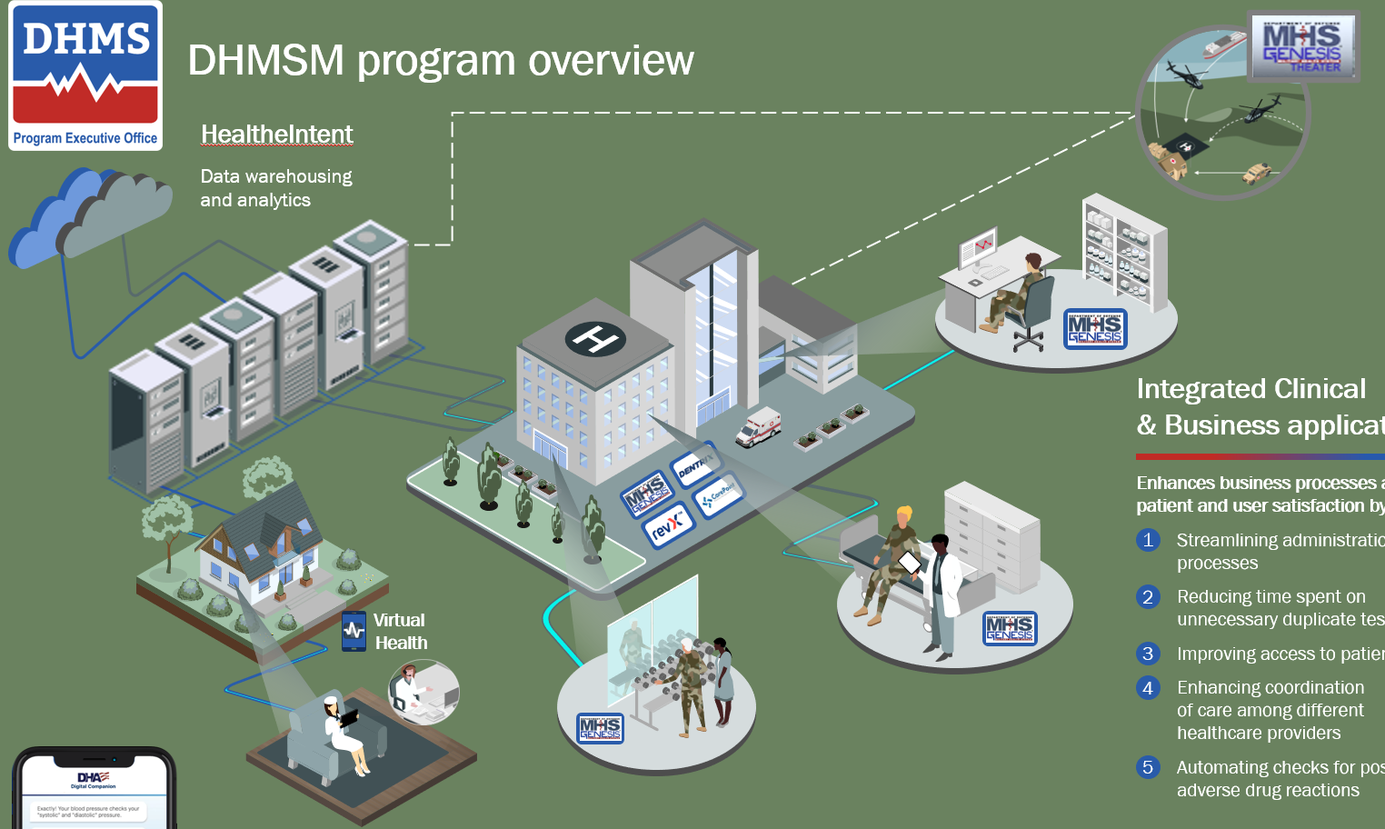



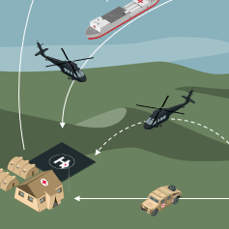

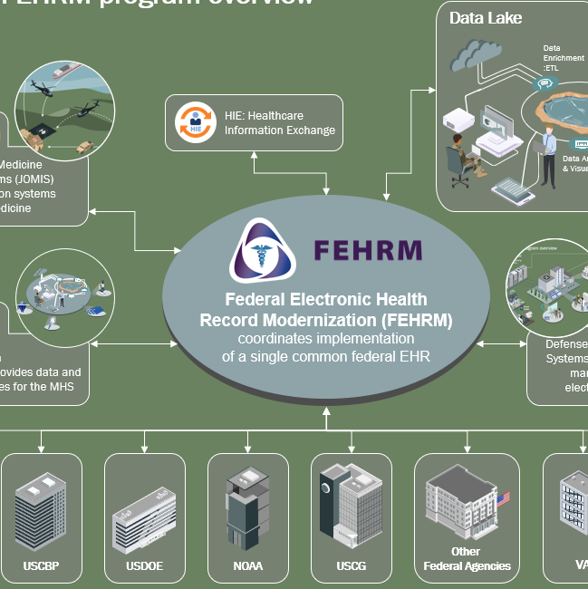

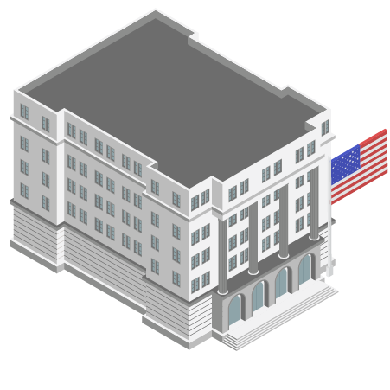
MHS Information Platform
EIDS delivers, connects, integrates, and curates health data to enable informed decisions, research, and innovation
FY24 Top 5 Key Accomplishments
FY25 Top 5 Goals
HIE
Key Accomplishment 1: MIP-ITR
MHS Information Platform Immunization Tracking & Reporting (MIP-ITR) successfully went live on 26 May 2022, taking over immunization data broker functions from DEERSi and becoming the single source of truth for immunization records across DoD. MIP-ITR creates a near real-time flow of immunizations between EHRs and IMRs and integrates PDTS commercial market records, providing a comprehensive view of vaccination status for force health and readiness.
Key Accomplishment 2: FY22 RDT&E Investment
Virtual Data Environment (VDE) initiative was invested to develop a proof-of-concept for a self-service, low/no code data research environment, housing a research-ready DHA dataset, available to end-user researchers for insight and analytics.
MDClone's platform was evaluated from a cyber security standpoint as an approach for clinicians to rapidly discover information to improve patients' health leveraging synthetic data.
De-identification project purpose was to demonstrate proof of concept of a cost efficient, time efficient, automated de-identification process for unique data types data types utilizing a prototype of an "off-the-shelf" pipeline process to readily access de-identified data within the Healthcare API.
MITRE continues to make strides with Bulk Data Extract 3.0
Key Accomplishment 3: Health Information Archive (HIA)
Launched Health Information Archive for CHCS at IOC sites (29 July 2022)
LDCS successfully completed Joint Longitudinal Viewer (JLV) cutover for Mountain Home Air Force Base, which pointed the Data Exchange Service (DES) interface to the MHS Information Platform (MIP) HIA for retrieving MT Home CHCS legacy data
Decommissioned CHCS at Mountain Home AFB, DES/JLV cutover at LeMoore (September 2022)
Conducted HIA training to over 300 clinical end users; user traffic will increase as CHCS sites continue to decommission (September 2022)
MIP Health Information Archive status: CHCS 2/99; Essentris (GDR and nonGDR) 0/59; S3 3/55; ARMD 4/64; EBMS-T 1/1
Key Accomplishment 4: Operation Helios
On 15 September 2022, EIDS completed the transition of the MHS Mart's (M2) 4.5 Terabyte database from IBM DB2 in DISA Capacity Services to the MHS Information Platform (MIP) Amazon GovCloud Redshift database. M2 is an MHS Data Repository (MDR)-derived data mart designed for self-service access to over 600 fiscal year tables for a variety enterprise data types using Business Common Services (BCS) as the front end user interface. It serves as a powerful ad-hoc query tool leveraged by over 2,500 users to manage and oversee operations worldwide. As of 2 November 2022 there have been over 50,300 M2 queries run against the MIP AWS Redshift database. DISA Capacity Services completed the decommission of the IBM DB2 database on 24 October 2022. This transition will save the DHA $2.5M over the next five years.
In October 2020, EIDS kicked off the Operation Helios project to migrate the MHS Data Repository (MDR) from DISA Capacity Services to the MIP. The MDR is an approximately 1 Petabyte data warehouse containing over 46 million data files about healthcare provided to beneficiaries of the MHS, and grows at an average of 5 Terabytes per month. The Operation Helios project team is leveraging Talend Extract, Transform, Load (ETL) features to automate 35 data type processors, implementing technical data governance and establishing over 85 inbound and outbound data connections to interface partners throughout the enterprise. As of 2 November 2022, EIDS has migrated over 800TB of MDR data using AWS Snowball Edge devices and is currently on track to cutover MDR to the MIP on 17 January 2023.
Key Accomplishment 5: DES/CHDR
Deployed CHDR in the GovCloud (21 SEPT) allowing CHDR to decommission at DISA (30 SEPT)
MIP Modernization
Transform 80% of MIP product delivery to DevSecOps model
Deploy enterprise tools required for DSO oversight and planning
Continue to migrate sites to the Health Information Archive in conjunction with providing PMOs historical data storage service
Improve data literacy
Deliver normalized data sets based on OMOP standards
Elaborate Data Catalog
Improve operations
Integrate DES/CHDR
Complete AWS account consolidation
Provide PMO standards for test, release, and configuration mgt
MHS Information Platform (MIP)
EIDS
DHMSM
Provides a comprehensive analytics solution with flexible tools
Compiles aggregated data from 130+ DOD data sources on a scalable platform
MHS’ Analytics & Data Visualization Platform
HS Disease surveillance, early detection, and rapid response
JOMIS
DOD MTFs
(MHS GENESIS)
CDC
FEHRM
MIP
HIA Access to legacy healthcare data after system archival and decommissioning
Other Partners
Digital Exchange Service (DES)
Joint Longitudinal Viewer (JLV)
DES/JLV Real time data interoperability across disparate systems
Pulls information from disparate health-care systems in real time
Allows authorized users throughout DOD and the VA to view clinical information
USDOE
Big Rocks
Health Information Archive (HIA)
Finalize FY23 Bio Surveillance Scope & Funding
Transfer COR duties to EIDS on EIDS efforts
Contract actions: Essence and OMOP
Multiple Hiring actions
Complete M2/MDR migration
Enables the archival and decommission of DHA legacy systems
Provides clinicians with direct access to a patient’s historical medical record
NOAA
USCG
Health Surveillance (HS)
Maintains LARGEST repository of secondary data in the DOD through rationalization of
Modernized the Reserve Health Readiness Program (RHRP) for
Collects near real-time data from MHS medical facilities to support the early detection and monitoring of health events
Provides prompt notifications of actionable and emerging health concerns
130+
30+
data sources
800,000+
data warehouses
Remote component servicemembers and DoD Civilians
Notes:
-EIDS stood MIP up in 2018 – Intent & purpose 1) to consolidate disparate data capabilities under 1 PMO and into 1 platform 2) J6 data/system consolidation and financial recoupment 3) Data integration point for clinical, business and administrative data to include medical personnel (MILPER/CIVPER) data
-Without MIP – no integration of direct, purchased care data (60% of care provided via Tricare Managed Care Support contractors) and legacy health data nor integration with Readiness systems or other federal agencies (VA, etc)
-MIP also hosts Data Exchange Service (DES) and is the query backbone of JLV and VA partnerships for data

Slide 12







MIP Offerings: Data Products and Services
MIP Data Products
Data Services
Data Apps as a Service
Data & Analytics Advisory
Data as a Service
MIP Customer Care
Analytics as a Service

Slide 13


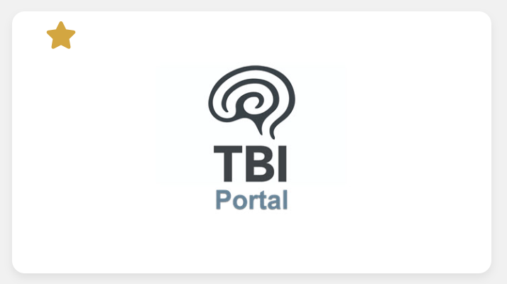


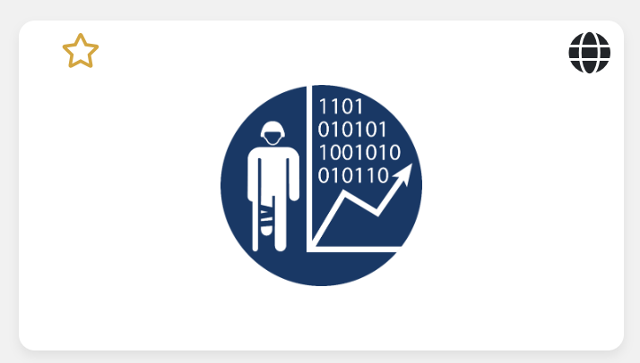




Data Products: Data Apps as a Service
MIP Data Products
Complex Registries
Opioid Registry
Data Apps as a Service
Data as a Service
Readiness
RHRP
Analytics as a Service
Hercules
Hercules
Research
Clinical

Slide 14

Data Products: Data as a Service
MIP Data Products
MHS GENESIS Data
Bulk Data Extract (BDE)
MIP FHIR API
HealtheIntent API
HL7 API
Data Apps as a Service
Transactional Data
Legacy Data
Data Exchange Service
Joint Longitudinal Viewer (JLV)
Data as a Service
Data as a Service
Analytics as a Service
Normalized Data
MHS Common Data Model (CDM)
DAVINCI

Slide 15






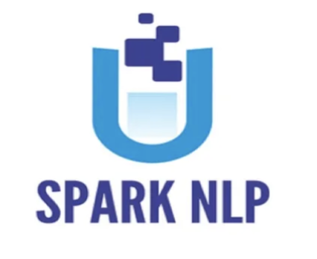

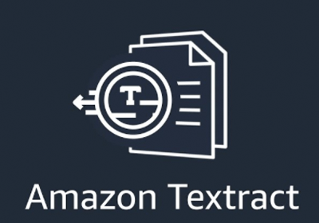
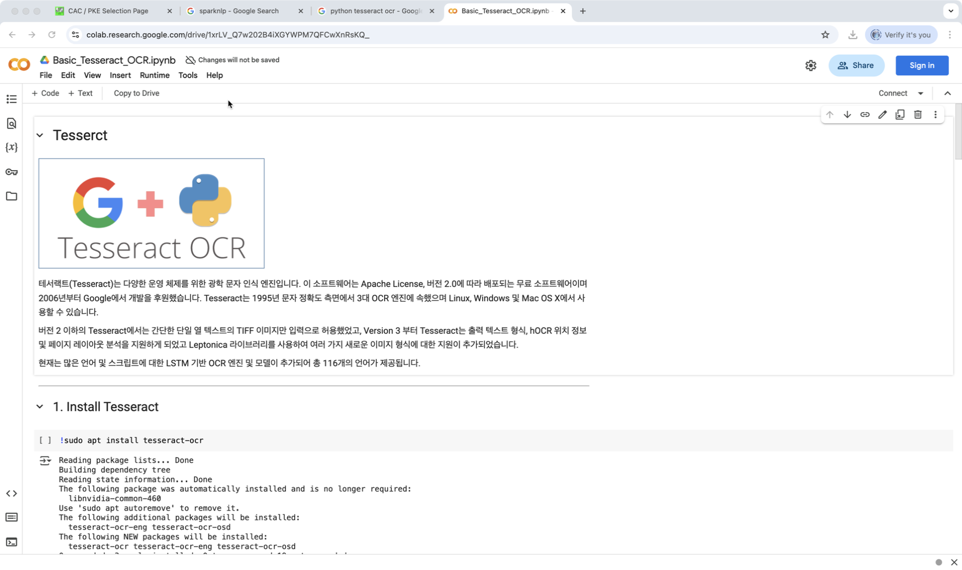






Data Products: Analytics as a Service
MIP Data Products
Machine Learning
MIP
NLP / OCR
Data Apps as a Service
Comprehend
Data as a Service
Analytics Workbench
Analytics as a Service
Analytics as a Service
Omics / Genomics

Slide 16
Data Products Enabler: Platform Service & Portfolio Management
MIP Data Products
Data Products
Portfolio Management
OPMED and CCMD Products
DHA Data Domain
Emergent Capabilities
Data Transfer and Archival
Information Portal
Data Apps as a Service
Platform Services
Data Exchange Service
Cloud Services
Data as a Service
Data Solutions Service
UI/UX Service
Analytics as a Service
Analytics as a Service
Cyber Services

Slide 17

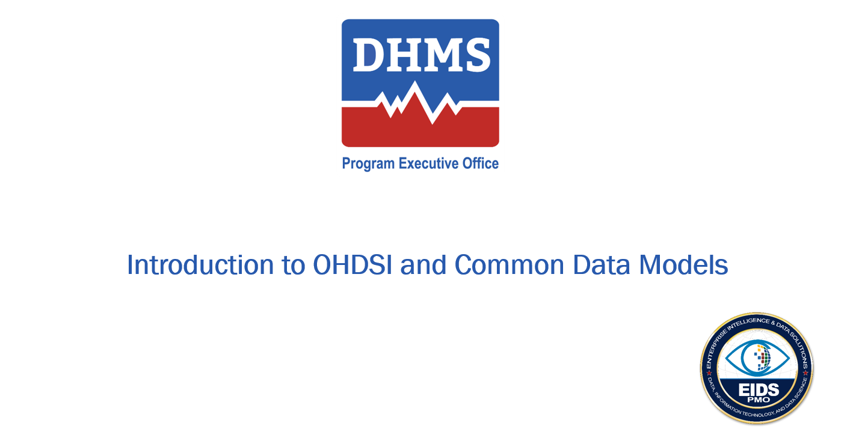
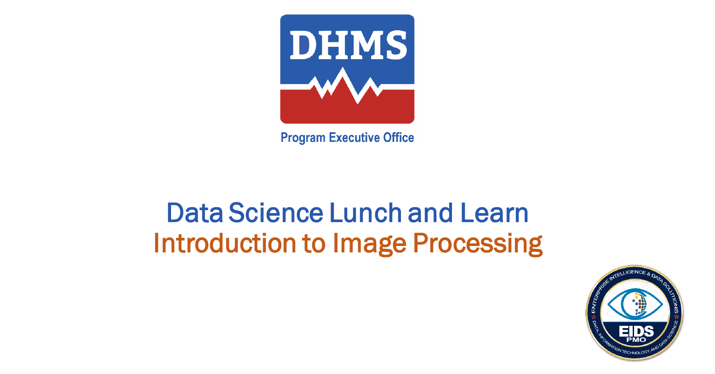

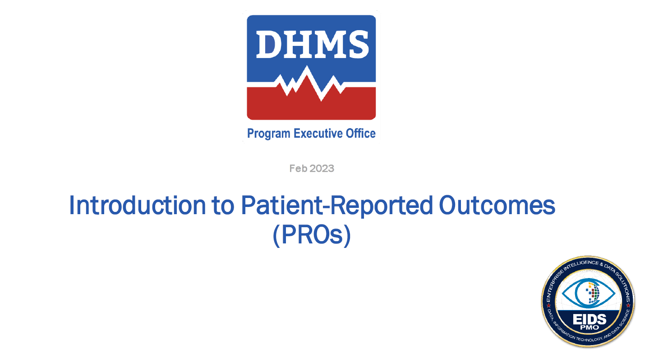
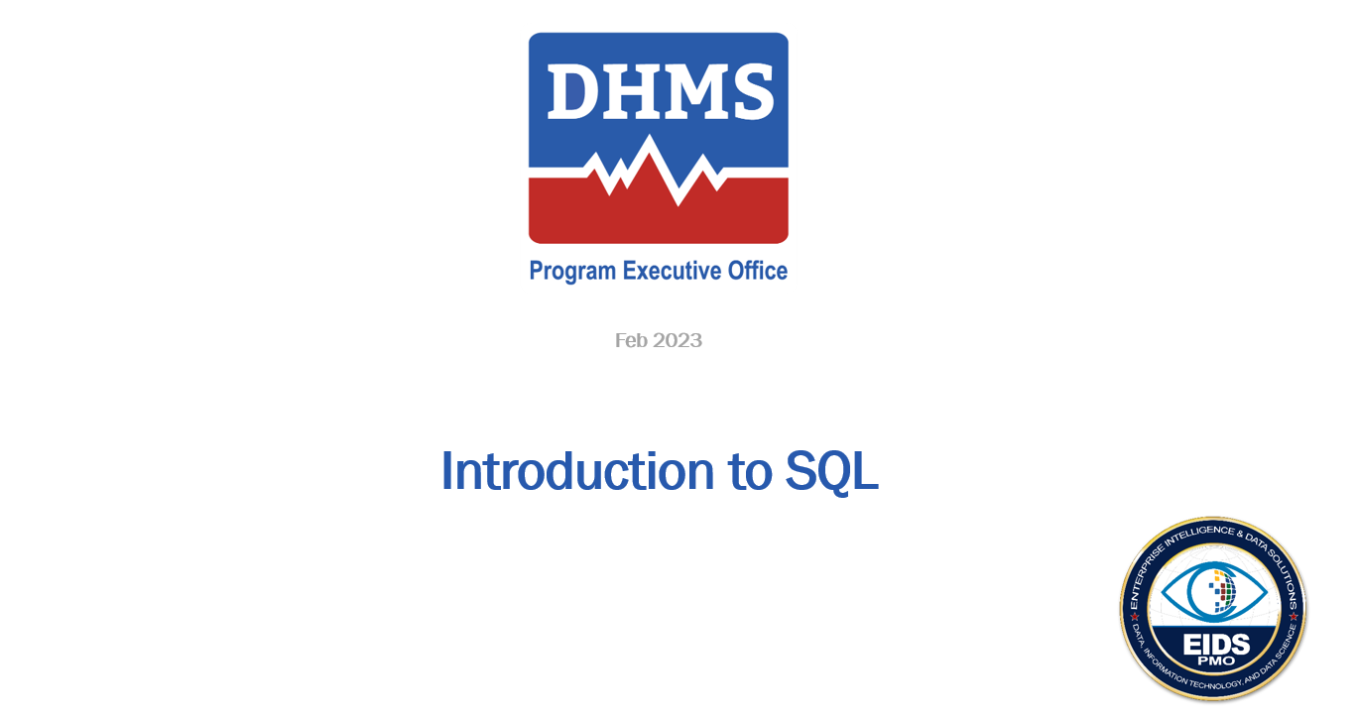
Data Services: Data & Analytics Advisory
Data Services
Weekly Data Literacy and Data Science Meetings
Data & Analytics Advisory
Data & Analytics Advisory
MIP Customer Care
Consultation Services
Support Initiatives to Foster a data-driven culture
Assist with organizational data literacy
Support policy and procedure development
Bridge the gap between business and technology
Consult on data-related strategies

Slide 18
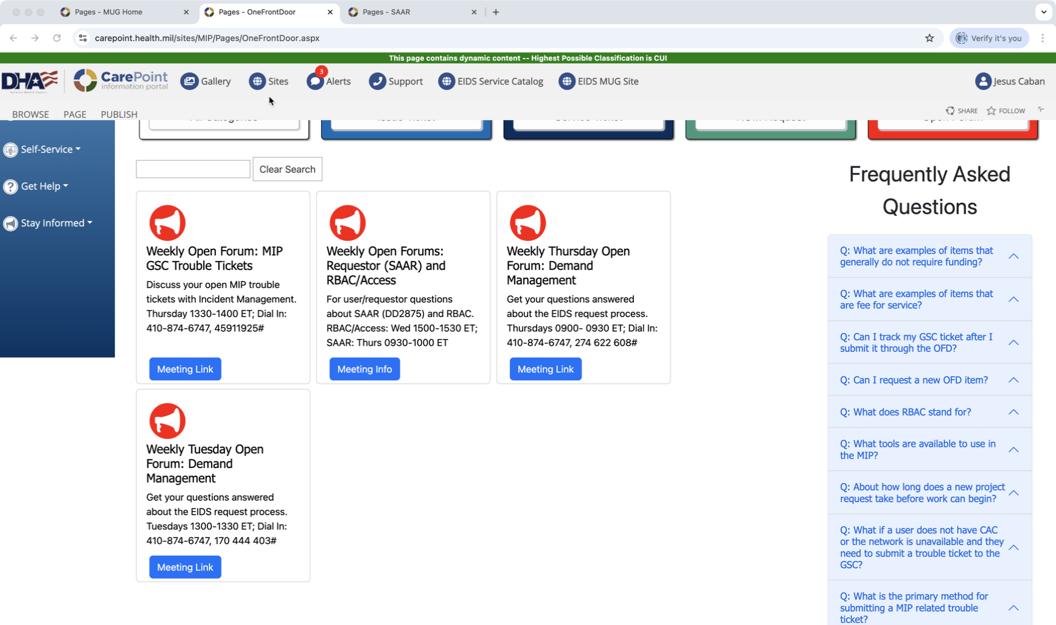
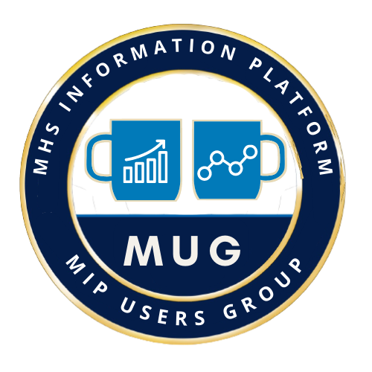
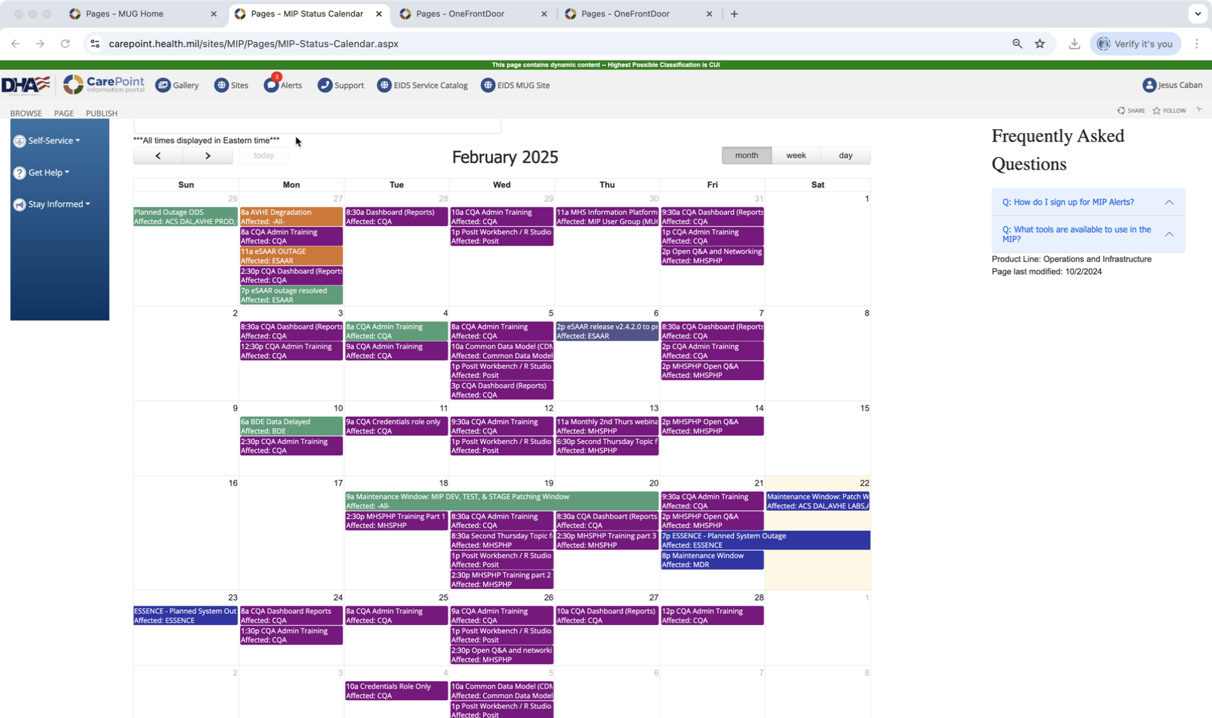
Data Services: MIP Customer Support
Data Services
Weekly Meetings
Data & Analytics Advisory
MIP User Group
MIP User Group Monthly Call
MIP Customer Care
MIP Customer Care
MIP Status Calendar

Slide 19



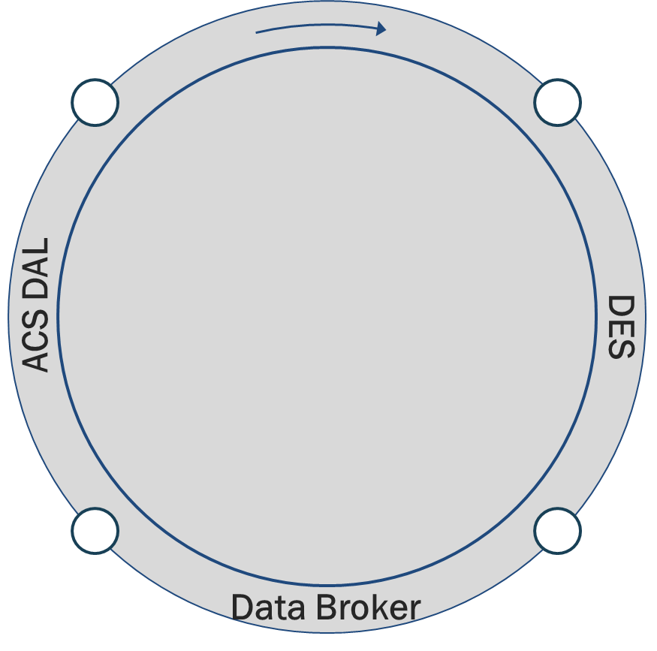

MIP Data Flow and Usage
MHS GENESIS
Future state - mix of real time data & extracts based upon customer need
Expect 80+% of day-to-day data needs to be accomplished via MHS GENESIS tools
MIP Potential Warehouses
Ex: Financial, Personnel, Other…
Service Medical Readiness
Operational Medicine Systems
Application Data
~Legacy Clinical Systems’ Data
CHCS – NRT from all sites
AHLTA – Nightly CDR extract
Essentris – Streaming data Q3
S3/ARMD – aligns with Decom
EBMS-T – aligns with Decom
ASIMS
NMO
Unstructured Data
Genomics
Financial, Personnel, Other….
VA
Purchased Care
MEDPROS
Others
MIP-Immunization Tracking Record
NRT MIP to Readiness Systems
Joint Longitudinal Viewer
Art of the Possible
Contact Tracing Data
Bio-Medical Data Wearables Data Social Determinant Data
Bulk data extract (BDE) 350 tables nightly
MHS Information Platform (MIP)
(118+ data sources & growing)
Future bidirectional FHIR APIs
~Near-real time HL7 feed (Admission/Dispositions/Transfer, Lab, Vaccinations, Problem list, Clinical notes)
Data as a Service
Data Use
Data Partners
Data Solutions
Bio Surveillance
DOD Trauma Registry
Health Information Archive
Complex Registries
Clinical Decision Support Tools
Digital Biobank
Others…
Population Health
Corporate Metrics/Measures
Clinical Decision Support tools
Big Data Analytics (Predictive/ Prescriptive)
Clinical Research
Operational Analytics
Medical Readiness
Innovation
Artificial Intelligence (AI)
Machine Learning (ML)
DOD CDAO
Public Health Partners
Research Institutions
Services
Other Federal Health Partners

Slide 20
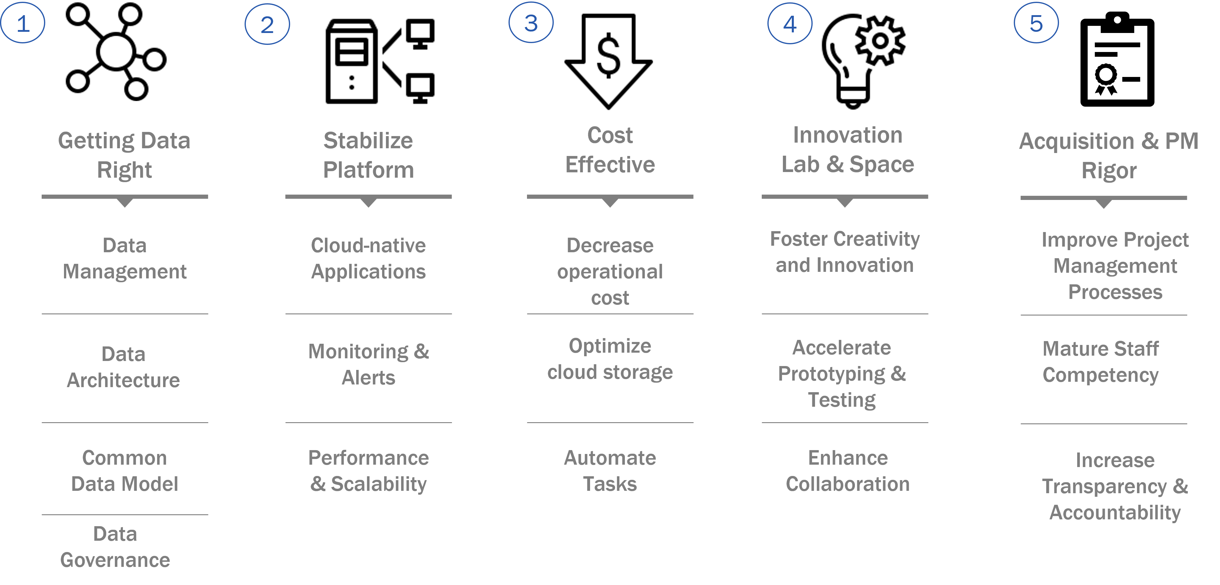
Current EIDS PMO Priorities

Slide 21



Contributing Factors: Data Quality
1
3
Clinical Factors
Business Factors
Standardization
Consistent clinical workflows
Patient Identity
Unique and accurate patient identifiers
EDIPN vs SSN vs CernerID vs DEERS
Temporal Consistency
Consistency after policy changes
Consistency in documentation
Clinical Documentation
Completeness of clinical notes
Accuracy of provider’s coding
Data aligned to standards (ICD-10-CM, LOINC, etc.)
Code Mapping
Diagnosis to billing or surveillance codes
Codes alignment to patient care
Revenue Cycle
Workflows
Governance
Billing and claims processes
Claims audit
Standardized clinical workflows
Consistent scheduling, admission, discharge
Define standards
Set policies
Completeness
All required fields are populated
No critical data is missing
2
Timeliness
Data is available when needed
Up-to-date information
Technical Factors
Consistency
Data matches across system
Uniform formats and definitions.
MHS Common Data model deployed Q4 Fy24
Validity
Adheres to predefined rules or ranges
Uses correct formats and standards
Traceability
Source and history are documented
Enables auditing and lineage tracking

Slide 22
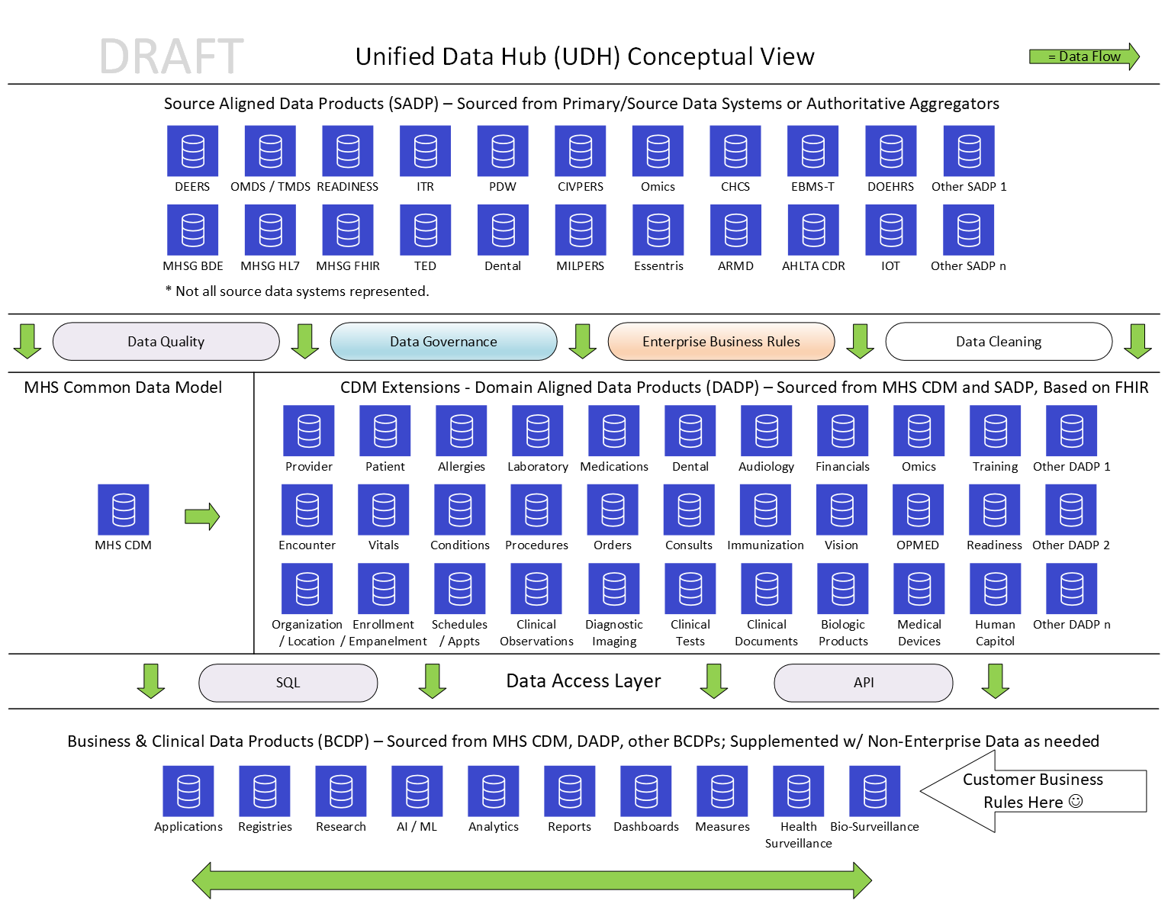
MIP: From Data Sources to Domains to Products

Slide 23
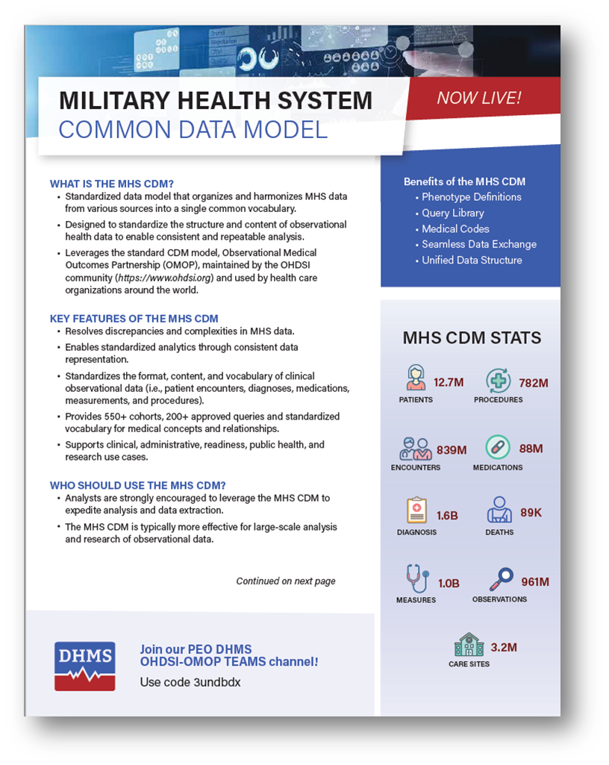
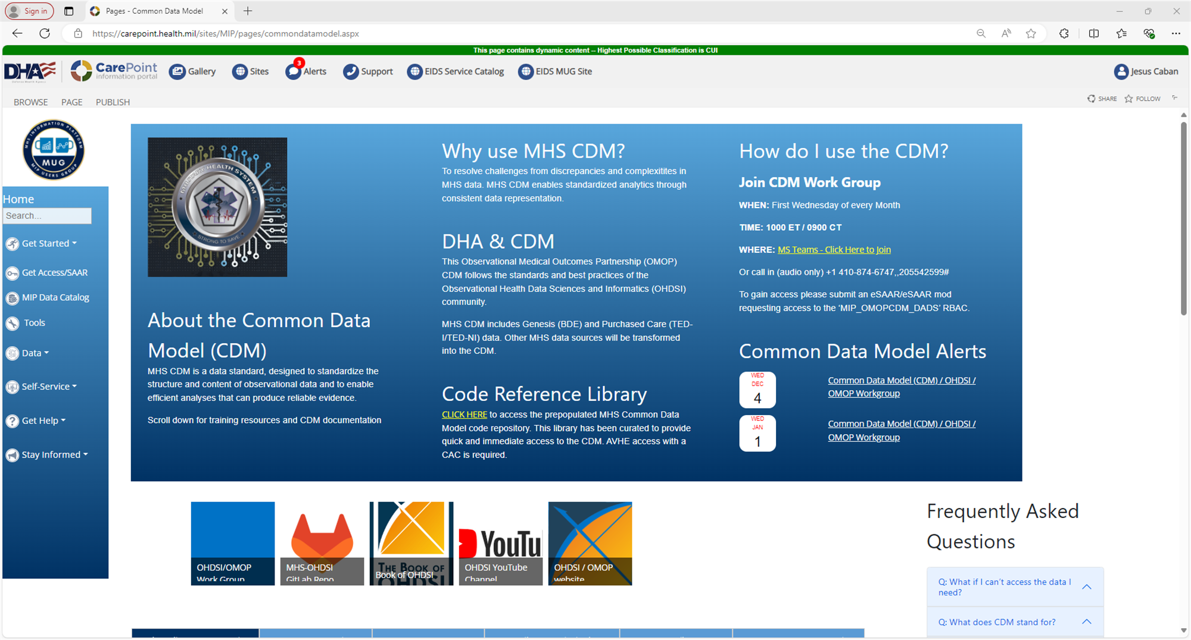
MHS Common Data Model Information and Resources
https://health.mil/Military-Health-Topics/Technology/PEO-DHMS
https://carepoint.health.mil/sites/MIP/pages/commondatamodel.aspx

Slide 24
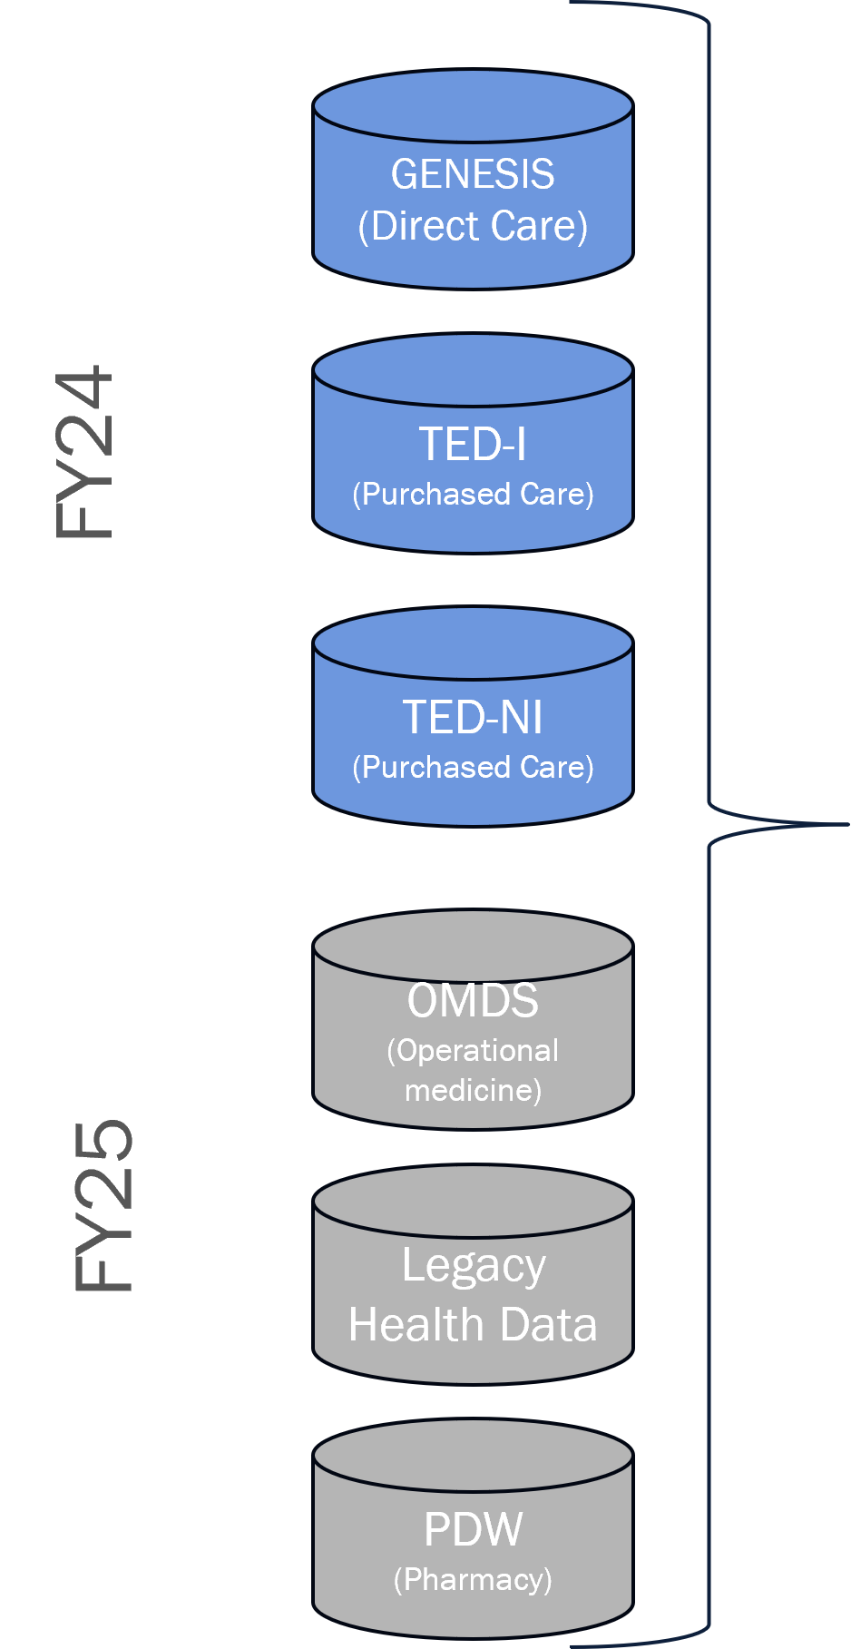
MHS Common Data Model
Data Sources
MHS CDM Maps to Standardized Definitions and Vocabulary in the following areas:
Person
Clinical Events
Health Economics
Person
(e.g., demographics)
Visit Occurrence
Cost
Condition Occurrence
Location
(e.g., zip code over time)
Observation
Measurement
Care Site
(e.g., facilities)
Procedure Occurrence
Provider
(e.g., provider type)
Drug Exposure
Device Exposure

Slide 25
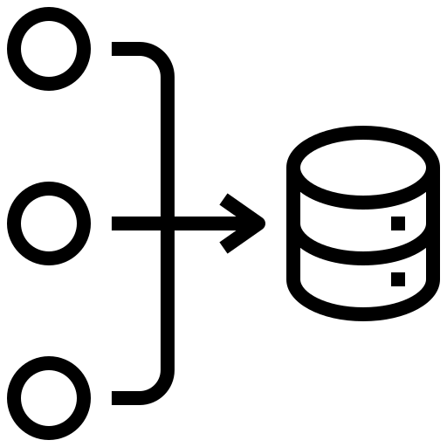


MHS CDM 3.0
Quarterly Refreshes of MHS CDM
Monthly Refreshes of MHS CDM
MHS
GENESIS
Clinical Notes
MHS CDM 1.0
Q2 Refresh & QA of MHS CDM
(MHS GENESIS & Tricare)
Q4 Refresh & QA
(MHS GENESIS + Tricare +
DEERS + PDW)
Death Files
Q3 Refresh & QA
Q1 Refresh & QA
TED-I
PROs
**
TED-NI
Oct 2024
Jan 2025
April 2025
July 2025
Sept 2025
Accession / Waivers
MHS CDM 2.0
PDW + DEERS
OMDS/TMDS Discovery
TMDS +
OMDS (HL7 / FHIR) +
DAVINCI Merge
PDW
ITR
FY26
MHS CDM 2.0
MHS CDM 3.0
TMDS
Personnel / Financial
**
OMDS
Oct 2025
Jan 2026
April 2026
July 2026
Sept 2026
ITR + Clinical Notes
Death Files/Acc/Waiv Discovery

Slide 26
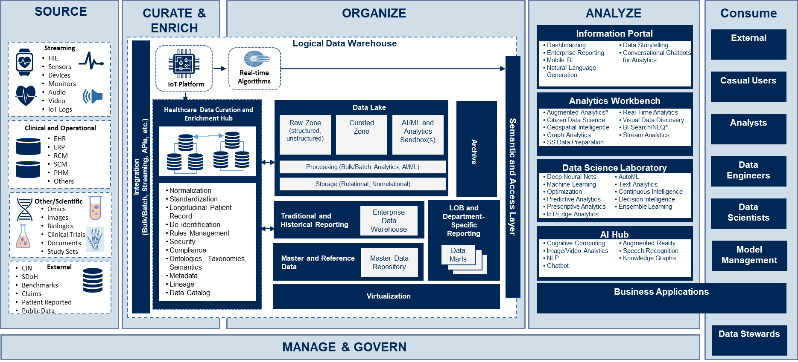
MIP Target State Architecture
Key Benefits for the Federal Digital Health Hub:
Allows EIDS to seamlessly integrate, access and share a diverse set of data (structured, unstructured, internal and external) within a single cohesive environment
Supports a broad range of users – from business users to data scientists and external consumers
Provides self-service access to high trust, governed data
Enables traditional reporting and dashboarding capabilities (which are the primary need of PMO EIDS data consumers)
Enables analysts to explore a broad set of data and provides analytics tools for preparing and analyzing it
Enables AI/ML use cases and requirements (including NLP) – including operationalization and governance of AI/ML models
Enables users to quickly understand what data is available, what it means and how to find it (Data Catalog)
Ensures seamless (and where possible, automated) compliance with data governance policy and provisions data access to those who have appropriate permissions
Provides PMO EIDS business applications the benefits of leveraging analytics and PMO EIDS master data
Target State Data Architecture
The Target State Data Architecture for PMO EIDS future D&A platform capabilities and how they fit together to satisfy all stakeholder use cases

Slide 27
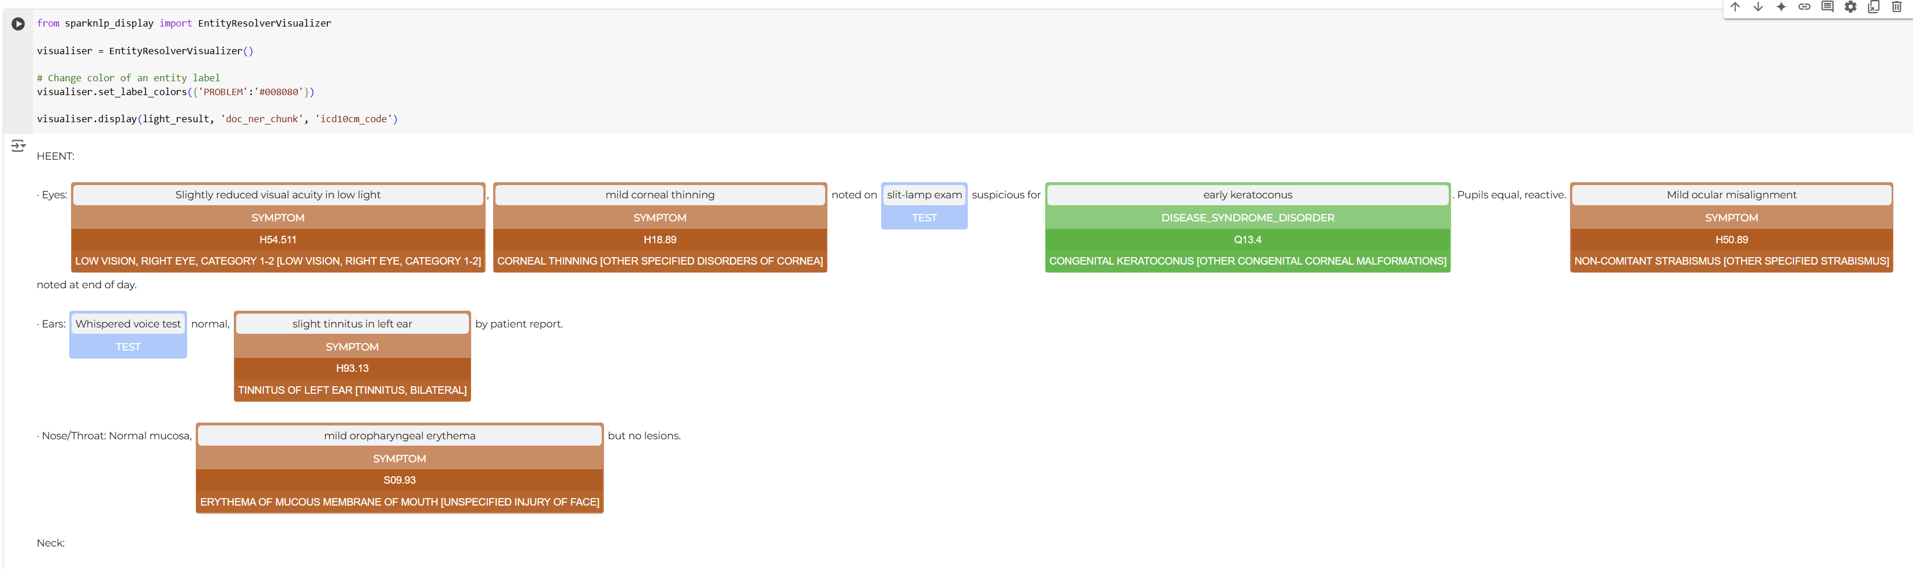
2024 by the Numbers: NLP on MHS GENESIS Clinical Notes
36M+
3.6B
Clinical Notes processed with National Language Processing
NLP Annotations

Slide 28
Key Takeaways
The MIP enables data knowledge action for military medicine by providing:
Connection to external systems, data feeds, and data exchanges; capabilities for customers through the data, logic, and presentation layers; underpinned by data security, compliance, and role-based access control (RBAC)
Core Data Products:
Data as a Service - Provide standardized data products (i.e., creating usable data sets) made accessible and available via a user-friendly data marketplace/catalogue
Analytics and as Service - Provide scalable analytics tools and capabilities to support BI/AI/ML
Data Applications as a Service - Design and deploy data applications that have a custom UI/UX interface to support MHS clinical and operational decision
Governance and Priorities – Documented and Assumptive Demand vs Capacity
Internal Platform demand (development, data management, data science, AI/ML etc.) to keep up with the continuous technological pace
External Customer demand – Lack of Governance and Prioritization (HA, DHA + suborganizations, COCOMS / OJSS, DOD, Services, VA, etc.)
Internal PEO demand and tradeoffs
EIDS priorities include data accuracy & validity, stabilizing the platform, maintaining cost efficiencies, and creating an innovation space in line with overarching DOD VAULTIS data strategy (Visible, Accessible, Understandable, Linked, Trustworthy, Interoperable, Secure)
EIDS is constantly looking to help our customers solve challenges by leveraging data as a strategic asset through external use cases such as clinical, readiness, surveillance, research, federal and connections to external systems

Slide 29
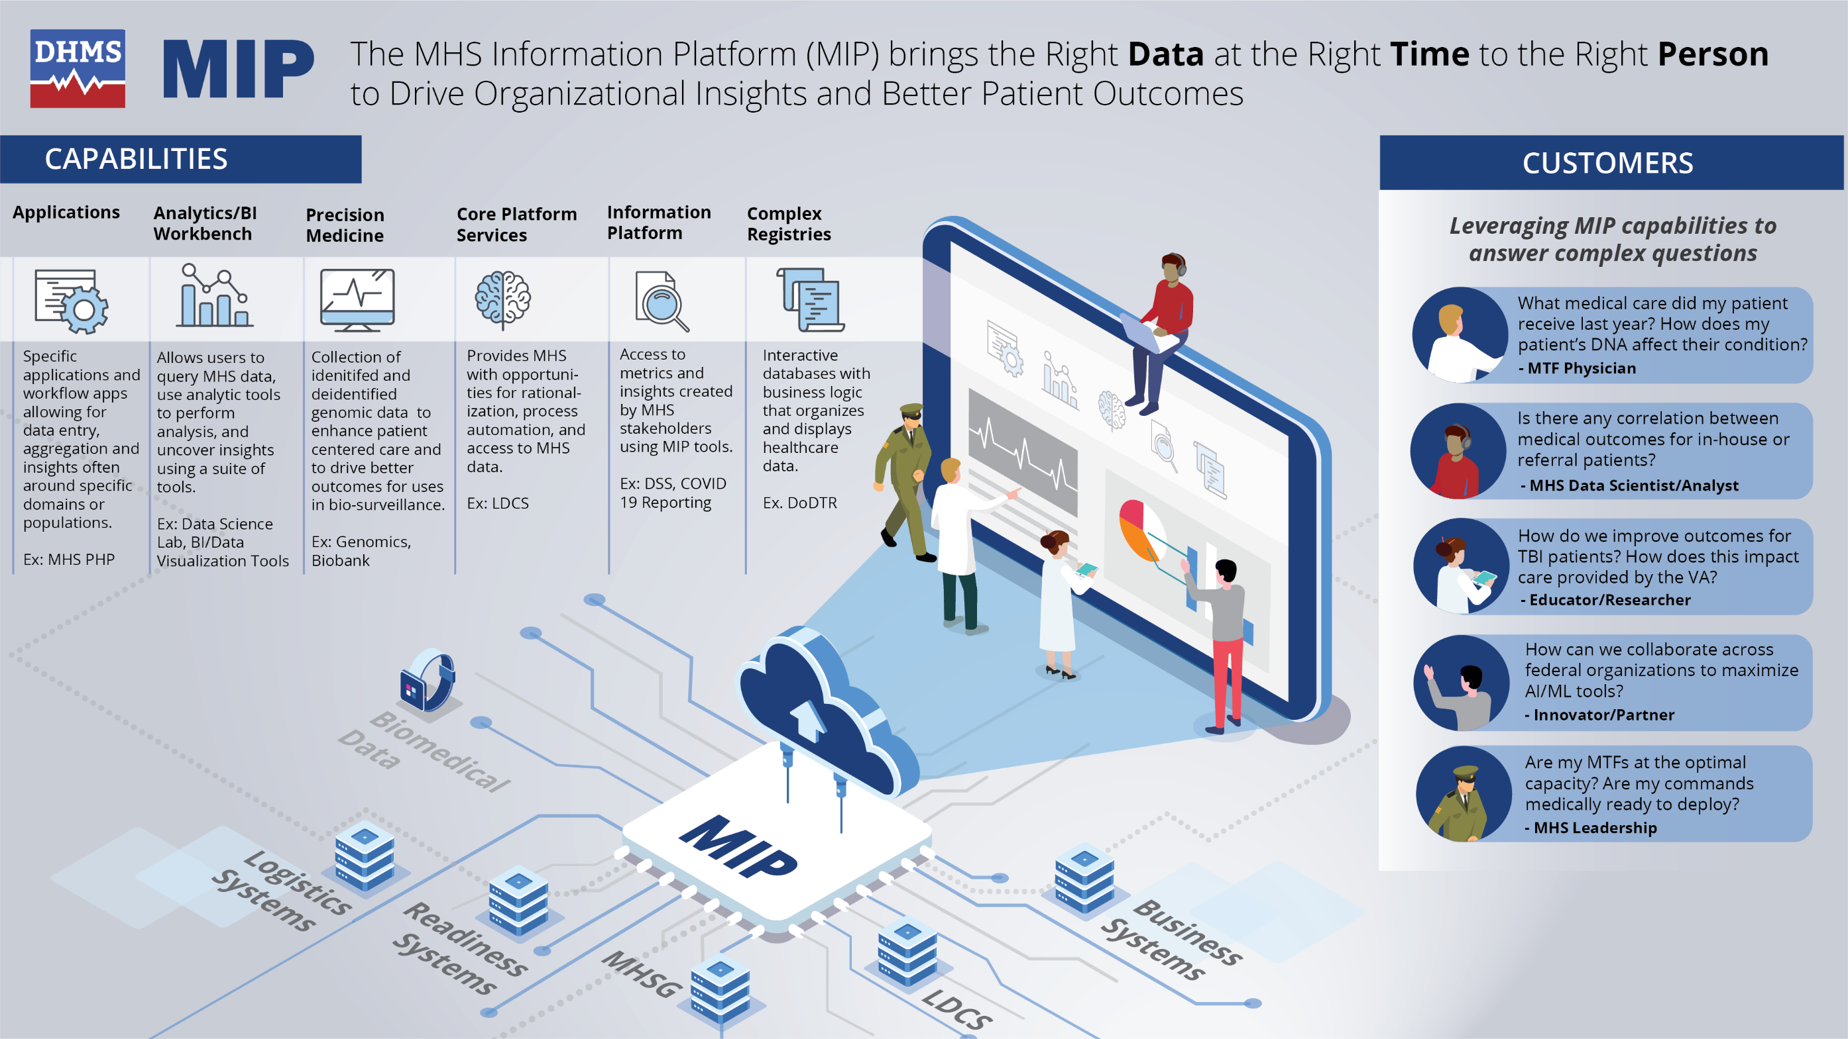
Conclusion
The MIP as the Digital Health Hub integrating disparate data and unlocking new knowledge and insights to accelerate innovation by providing Data Products and Services.
130+
data sources
Core Data Products
Data as a Service (DaaS) - Ex: MHS Common Data Model, JOMIS Patient Data Seeding, Real time Readiness integration
Data Science & Analytics enabler – Ex: Analytics Workbench, pre-built AI/ML models, 400+ data visualization and metrics, MILPER/CIVPER analytics
Data Applications as a Service – Ex: Joint Longitudinal Viewer/DES, Digital Biobank, Patient facing questionnaires, Complex Registries, Essence, J4 contracting repository

Slide 30
REQUIRED - Continuing Education Placeholder
This slide will be added later if the session is accredited for CEU

Slide 31
Contact
Mr. Chris Nichols
Program Manager, EIDS
chris.e.nichols.civ@health.mil

Slide 32
Thank You!

