Slide 1
DLA Distribution Expeditionary Capabilities Contract (DECAP) Pre-Proposal Conference
Eric Jensen, Distribution J7 AF​
May 15, 2025
Updated as of Feb 19, 2025

Slide 2
DECAP Pre-Proposal Conference
To provide prospective offerors with details and background of the DECAP concept enabling the preparation of acceptable proposals.
Administrative and Introductions
DLA Strategic Plan
Mission, Vision, Values
WMS Introduction
Contract Overview
Performance Work Statement Overview
Solicitation Overview
(Copy or move the radio button into your choice).

Slide 3
Administrative and Introductions
Administrative
Introductions
Breaks
Rules of Engagement
Introductions
Headquarters DLA Distribution, New Cumberland, PA
Meg Ross, DLA Distribution J7 Director
Karen Ghani, Chief Contracting Officer
David Gilson, Contracting Officer
Scott Lesh, Contract Specialist
Sean Tighe, Chief Acquisition Management
Cullen Powers, Supervisor Acquisition Assistance
Eric Jensen II, Functional Service Manager / COR

Slide 4
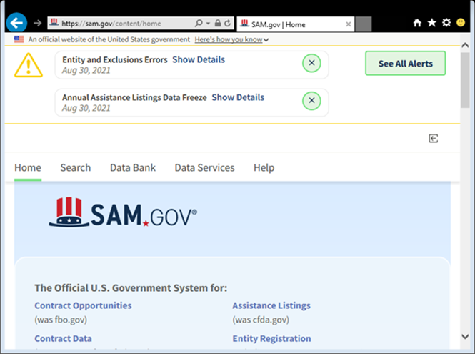
Administrative and Introductions
Administrative Remarks
The written information contained in the final solicitation and amendments overrules and supersedes any information presented at this conference which conflicts with the written documentation.
The attendance roster, as well as this presentation, will be posted to the SAM.Gov website.

Slide 5
Administrative and Introductions
A Question and Answer session will be held at the conclusion of this presentation.
Index cards will be provided
Not all questions will be answered at this time; however, all questions will be answered and posted in an amendment to the solicitation
Written questions and answers received before the 20 May 2025 12:00PM Eastern Daylight Time deadline will be posted to SAM.Gov via an amendment to the solicitation.
Attendees are asked to submit their questions in the format specified in Section L-29 of the RFP, to the Contracting Officer and Acquisition Specialist:
David Gilson (David.Gilson@dla.mil)
Scott Lesh (Scott.Lesh@dla.mil)

Slide 6
Mission Brief Overview
DLA Strategic Plan
DLA Distribution Mission, Vision, Values
DLA Disposition Mission, Vision, Values
Distribution Leadership and Organization Chart
Disposition Leadership and Organization Chart
WMS Introduction
Contract Overview
Performance Work Statement Overview
Solicitation Overview

Slide 7
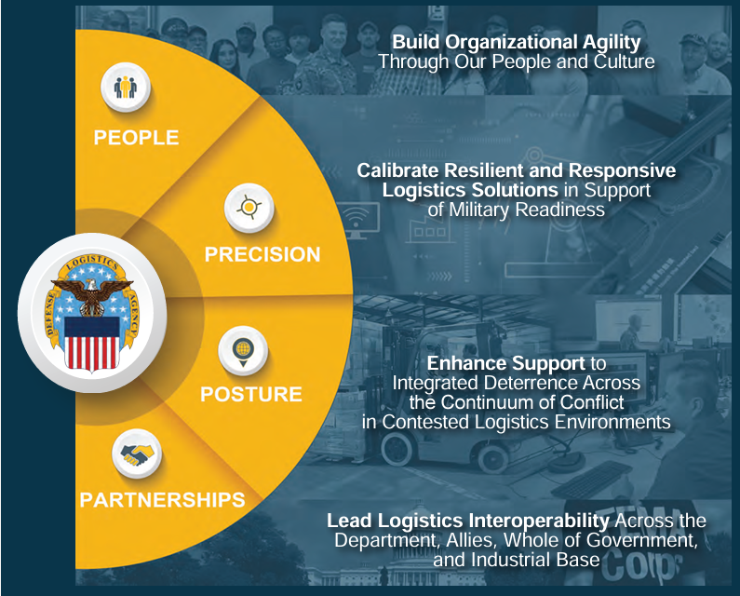
DLA Strategic Plan 2025-2030
MISSION
Drive and sustain Warfighter readiness by delivering unmatched global support as the Nation’s Logistics Combat Support Agency
VISION
DLA delivers agile, adaptive, and resilient logistics support across the continuum of conflict.
VALUES
Respect, Trust, Service, Excellence, Innovation
OPERATING PRINCIPLES
Agility, Readiness, Collaboration, Transparency, Empowerment, Data Driven

Slide 8

DLA Distribution
DLA Distribution Mission
Provide agile, global storage and distribution services to enable readiness and lethality to the Warfighter and support Whole of Government.
DLA Distribution's Vision
To lead DoD global distribution into the future through modernized capability, agile organization, a highly skilled workforce, and compelling innovation in support of the Warfighter.
Core Values
Leadership, Professionalism and Technical Knowledge through Dedication to Duty, Integrity, Ethics, Honor, Courage and Loyalty
DoD’s Joint Storage &
Distribution Provider!

Slide 9
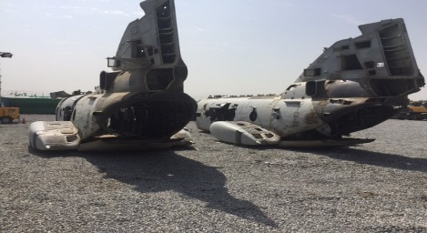

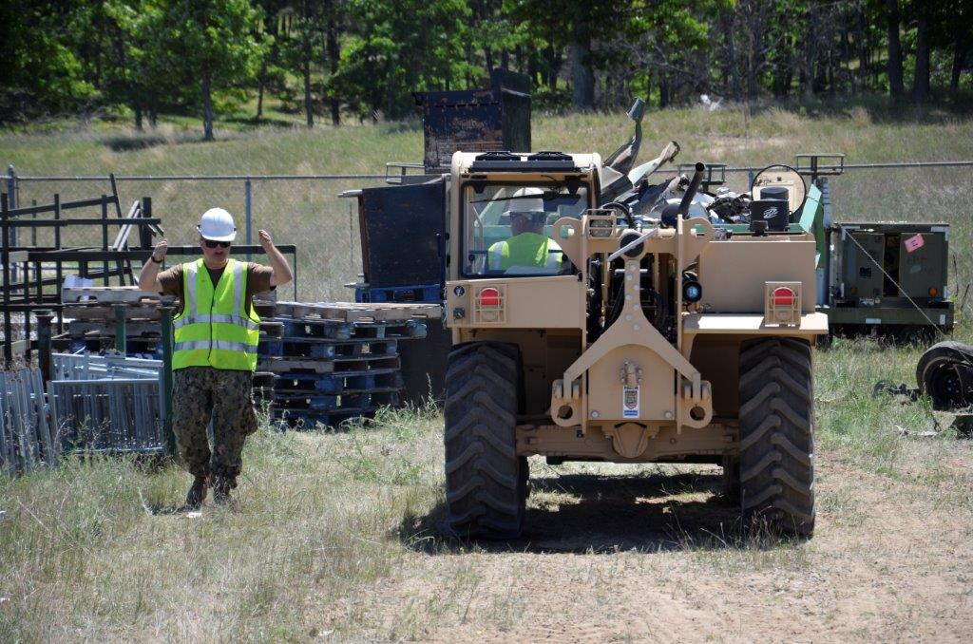

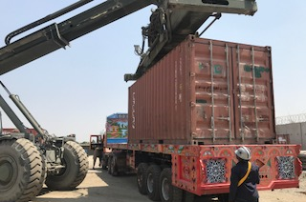
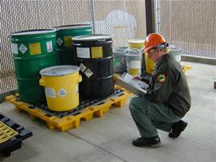
DLA Disposition
Our Mission
Executes the worldwide Defense Materiel Disposition Program for excess and surplus property, supports hazardous waste disposal through contracted services on a reimbursable basis at enduring and contingency locations; and provides DLA customers with disposition solutions and best value support for the efficient and timely disposition of personal property.​
Our Vision
An innovative, learning, and adaptable organization which delivers optimum reverse logistics solutions that improves warfighter readiness and sustains value added materiel disposition support within a band of excellence.
DoD’s Reverse Logistics Expert!
Our Values
Respect, Service, Trust, Excellence, and Innovation

Slide 10
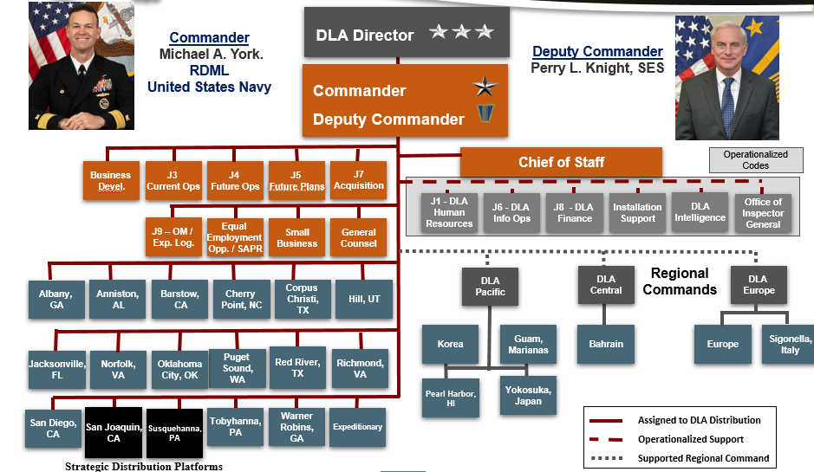
DLA Distribution

Slide 11
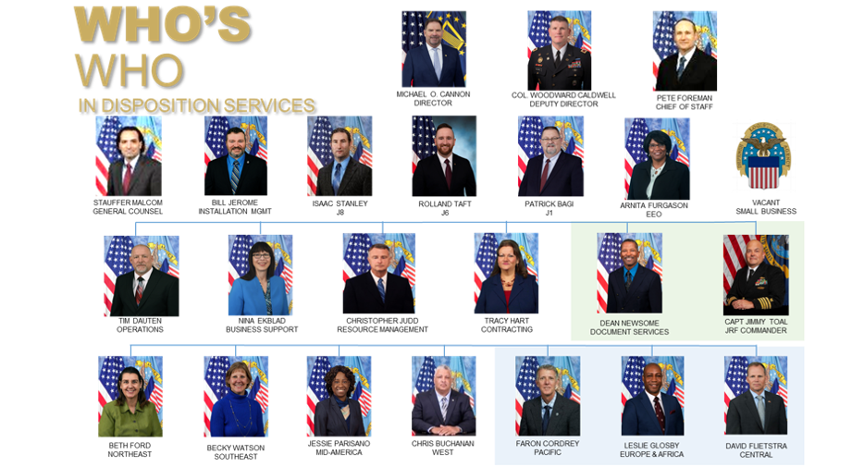
DLA Disposition Services

Slide 12
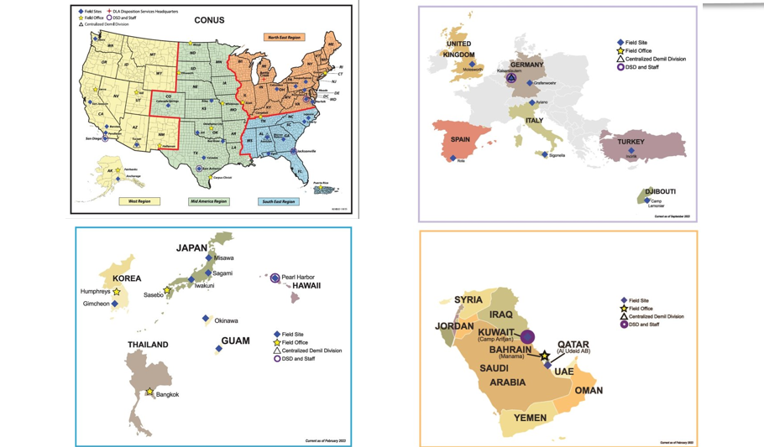
DLA Disposition Services
Enduring Locations

Slide 13
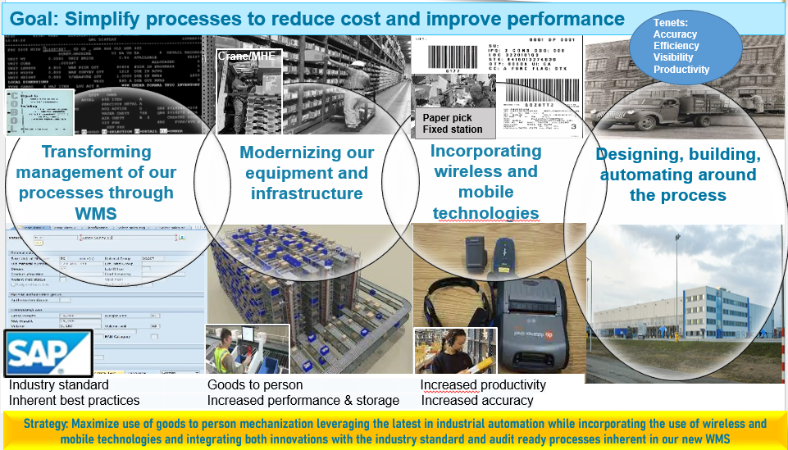
WMS Introduction
We are Modernizing

Slide 14
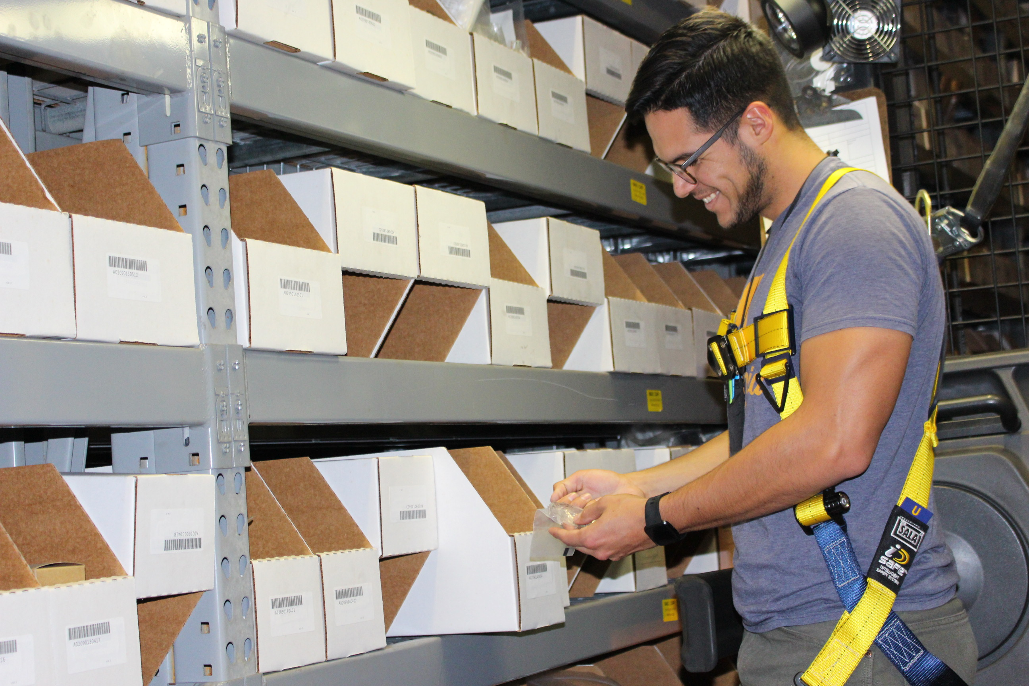
WMS Introduction
Why a New WMS?
WMS is key to improving:
Productivity
Reputation
Bottom line
Relevancy
WMS strengthens:
Internal controls
Financial practices, processes, and systems
Audit readiness
Records physical inventory counts at bin level
Supports recording gains/losses to specific owner
Readily integrates new automation

Slide 15
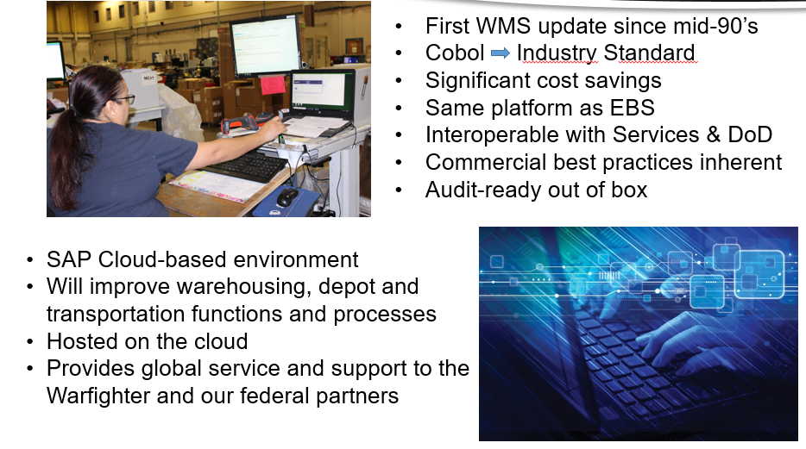
WMS Introduction
Why this WMS?

Slide 16
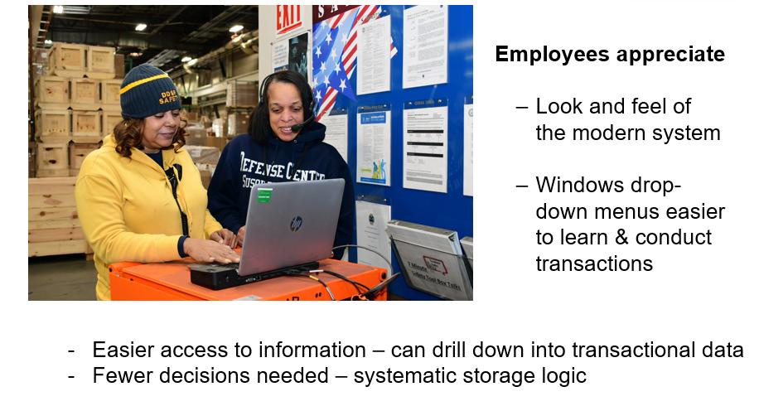
WMS Introduction
WMS Feedback

Slide 17
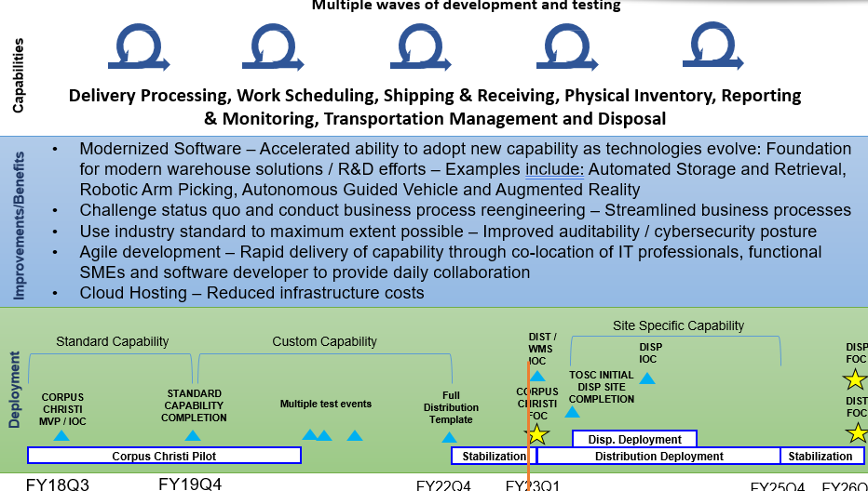
Warehouse Management System
WMS

Slide 18
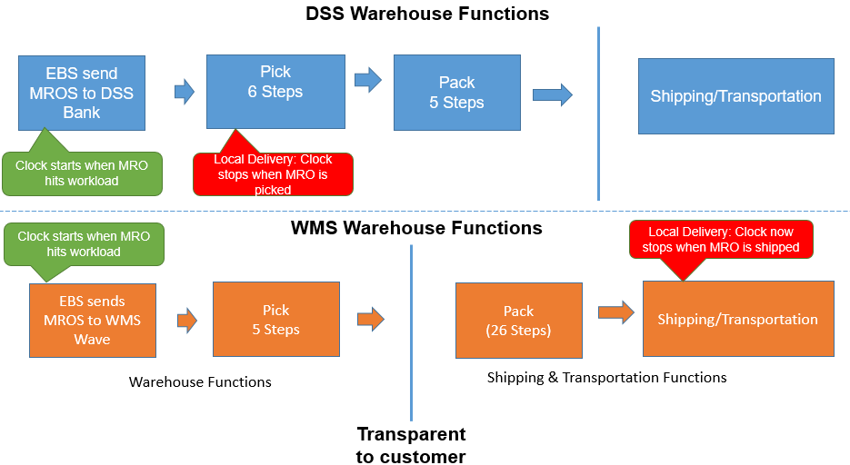
WMS Impacts
Pick-Pack-Ship DSS vs WMS

Slide 19
WMS Impacts
Metrics
In DSS, the mission ship date is set based on rules specific to the mode of shipment, as follows:
At DSS sites local deliveries are set for “pick to ship” with the mission ship date and time assigned at pick. This is earlier in the process than the departure date and time in WMS.
For small parcel, the DSS mission ship date and time is assigned at manifest print. This is earlier in the process than the departure date and time in WMS, but assuming that the site starts the TU load process an hour or so before small parcel pickup, the difference between the mission ship dates/times in DSS and the departure dates/times in WMS should be minimal.
For freight shipments, the mission ship date and time is set at driver pickup. As with small parcel, the site does the TU load process shortly before or when the driver arrives, so the difference between the mission ship dates/times in DSS and departure dates/times in WMS should be minimal.
Of note, the WMS outbound re-design changes (scheduled for release 30 November at DDCT and at other sites TBD) will no longer require local deliveries to go through the pack process so the amount of time to complete/depart locals should be greatly reduced.

Slide 20
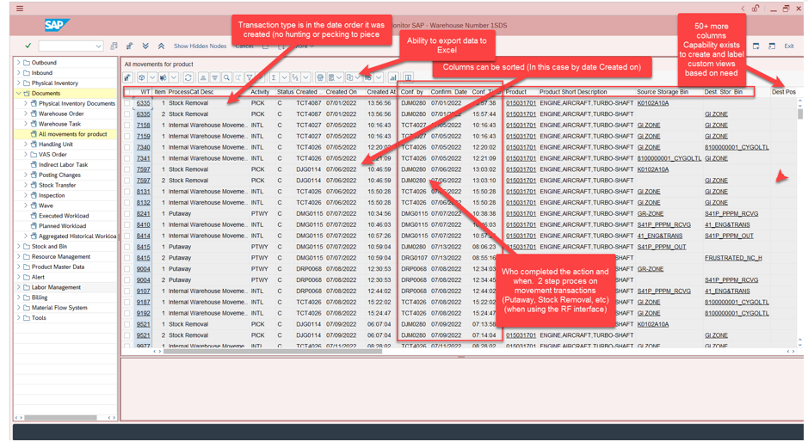
WMS Causative Research
PIES vs All Movements for Product - WMS

Slide 21
DLA Distribution Expeditionary Capabilities Contract (DECAP)
Overview
Requirements executed under the DLA Distribution Expeditionary Capabilities Contract (DECAP) encompass support of worldwide storage and distribution, and disposition and reutilization services in both peacetime and war. Operations may include but are not limited to:
Mission-critical storage and distribution services for the United States (U.S.) military. To include contingency and expeditionary requirements.
A “warm” Distribution workforce able to deploy globally within 48 hours.*
Establishing new locations – either Government Owned/Contractor Operated (GOCO) or Contractor Owned/Contractor Operated (COCO)
Mission-critical disposition and reutilization services for the U.S. military. To include contingency and expeditionary requirements.
Humanitarian assistance/disaster relief (HA/DR)
Foreign disaster relief (FDR)
Defense Support of Civil Authorities (DSCA)
Interagency support operations (DOD and Whole of Government (WOG))
Government Exercise Support
4PL Support (Distribution as a Service)*
DLA Distribution and Disposition require a rapid response capable Contractor work force that can be called upon to perform dynamic storage and distribution and disposition and reutilization operations support for requirements globally

Slide 22
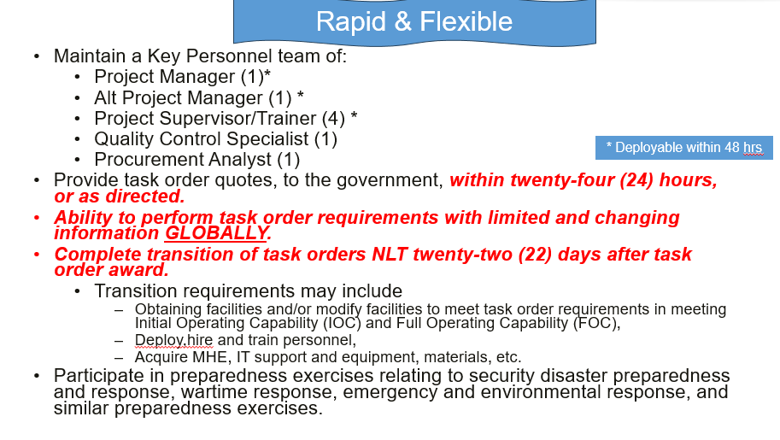
DECAP Overview
Distribution PMO Task Order

Slide 23
DECAP Overview
Disposition PMO Task Order
Maintain a Key Personnel team of:
Project Manager (1)
Alt Project Manager/Quality Control Specialist (1)
Project Supervisor/Trainer (2)
Ability to perform task order requirements with limited and changing information GLOBALLY.
Complete transition of task orders NLT sixty (60) days after task order award.
Transition requirements may include
Obtaining facilities and/or modify facilities to meet task order requirements in meeting Initial Operating Capability (IOC) and Full Operating Capability (FOC),
Deploy, hire and train personnel,
Acquire MHE, IT support and equipment, materials, etc.
Participate in preparedness exercises relating to security disaster preparedness and response, wartime response, emergency and environmental response, and similar preparedness exercises.

Slide 24
DECAP Overview
Distribution Warm Capability Task Order
Maintain a deployable team of 34 FTEs at DDSP:
Globally deployable within 48 hours
Fully trained on WMS and MHE
Maintain any CRC requirements
Will support various distribution requirements around DDSP.
Procure and maintain MHE, Generators, and mobile shelter/tents
5K forklift (9)
11K forklift (1)
33K Forklift (1)
50K RTCH (1) (Likely GFE)
30KW Generator Set (2)
60KW Generator Set (2)
60KW Generator Trailer (1)
Various tents, expandable shelters, and Inflatable Airbeam warehouse tent
IT and Transportation support provided by Government.

Slide 25
DECAP Pre-Proposal Conference
SP3300-25-R-5001 Solicitation Overview

Slide 26
Section A Solicitation, Offer, and Award
Key Points
Ensure the Documents (SF33, SF30, proposal) are signed.
The Government intends to evaluate proposals and award a contract in accordance with DFARS 215.306(c)(1), which states “For acquisitions with an estimated value of $100 million or more, contracting officers should conduct discussions.” However, the Offeror's initial proposal should contain the Offeror's best terms from a cost and technical standpoint.
Provide valid POC and Alternate POC with current contact information

Slide 27
Section B Supplies or Services & Price/Cost
Contract Type - Period of Performance
The resultant contract will be an Indefinite Delivery/Indefinite Quantity (IDIQ) Hybrid with Firm-Fixed-Price (FFP), Cost Reimbursement (CR) No Fee, and Cost-Plus-Fixed-Fee (CPFF) line items.
The resultant contract will have a two-year base ordering period and four two-year optional ordering periods.
This acquisition is solicited as an unrestricted requirement.

Slide 28
Section B Supplies or Services & Price/Cost
Minimum and Maximum:
Minimum and Maximum Quantities:
As specified in Section B, IDIQ MINIMUM AND MAXIMUM QUANTITIES: The minimum value of the services is $1,500,000 for the entire contract. The maximum value of the services is $477,913,568.07.
Ordering
Any services to be furnished under this contract shall be ordered by issuance of task orders by the individuals or activities designated in the Schedule.
Task Orders issued under the resultant contract may be issued unilaterally or bilaterally as determined by the Contracting Officer.

Slide 29
Section B Supplies or Services & Price/Cost
CLIN X001
Cost-Plus-Fixed-Fee: Services to perform Distribution Labor Support Services as described in the Performance Work Statement (PWS) Attachment J.1.
Costs for Labor shall include all direct labor costs. Costs shall be reimbursed at actual cost plus applicable indirect costs and fixed fee.
CLIN X002
Cost-Plus-Fixed-Fee: Services to perform Disposition Services Labor Support Services as described in the Performance Work Statement (PWS) Attachment J.1.
Costs for Labor shall include all direct labor costs. Costs shall be reimbursed at actual cost plus applicable indirect costs and fixed fee.
CLIN X003
Cost Reimbursement (No Fee) – Material Support Costs (supportive of CLIN X001)

Slide 30
Section B Supplies or Services & Price/Cost
CLIN X004
Cost Reimbursement (No Fee) – Material Support Costs (supportive of CLIN X002)
CLIN X005
Contract Data Requirements Lists (CDRLs) (Not Separately Priced)
CLIN 0006
Services to Perform Distribution Phase-In per C.1.8 of the PWS.
CLIN 0007
Services to Perform Disposition Services Phase-In per C.1.8 of the PWS

Slide 31
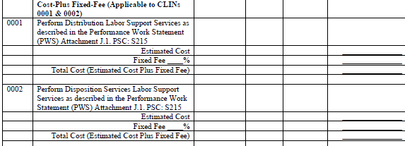
Section B Instructions
COST-PLUS-FIXED-FEE (CPFF) - CLINs X001 and X002: Costs for Labor shall include all direct labor costs. Costs shall be reimbursed at actual cost plus applicable indirect costs and fixed fee. In accordance with FAR 15.404-4(c)(4)(i)(C), the fixed fee shall not exceed 10% of the contract’s estimated cost, excluding fee.
Offerors shall enter their Estimated Cost. Offerors shall insert and apply their applicable Fixed Fee to their estimated cost to arrive at the Total Estimated Cost Plus Fixed Fee. For evaluation purposes, offerors shall utilize the Government estimated total productive labor hours per year and per labor position as reflected in the table in Section L, Paragraph L-30, E-File V - Cost Proposal of this RFP.

Slide 32
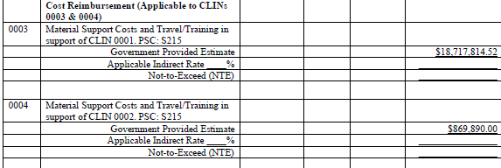
Section B Instructions
COST REIMBURSEMENT (NO FEE) - CLINs X003 and X004:
Offerors shall apply their applicable indirect rate to the estimated cost to arrive at the Not-To-Exceed (NTE) amount. The Contractor shall be reimbursed for actual cost and indirect rate as proposed only.
Offerors shall enter the Government provided Estimated Cost located in Section L, Paragraph L-30, E-File V - Cost Proposal. Offerors shall insert and apply their applicable indirect rate, supported by their accounting system, to this estimated cost to arrive at the NTE. Offerors shall enter the applicable indirect rate, dollar amount, and the NTE in Section B. No fee shall be applied.

Slide 33
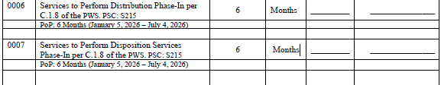
Section B Instructions
REPORTING REQUIREMENTS - CLIN X005 (NSP):
Reporting requirements. Not Separately Priced (NSP)
While these CLINs are not separately priced, it is anticipated and it is acceptable that the Contractor will be reimbursed for the execution of this CLIN.
Costs associated with this effort shall be captured under CLINs X001 or X002, only.
FIRM-FIXED-PRICE (FFP) - CLINs 0006 and 0007:
All labor shall be paid on firm fixed price per month basis. Offerors shall propose a Quantity * Unit Price to arrive at a Total Amount. For evaluation purposes, offerors shall utilize the Government estimated total productive labor hours per year and per labor position as reflected in the table in Section L, Paragraph L-30, E-File V - Cost Proposal of this RFP.

Slide 34
Section B Narrative
Key Points
Service Contract Act
Minimum direct labor rate and benefits specified in applicable Wage Determination must be paid
Offerors are encouraged to propose rates and benefits necessary to perform in accordance with the Offeror’s overall proposal
Offerors may escalate SCA rates and benefits
Invoicing and excess funds
Invoice within 90 days of performance completion
Excess funds removed unilaterally after 90 days
Limitation on Indirect Cost Rates

Slide 35
Section B Narrative
Key Points
Task Orders
A request for quote will be issued and the Contractor will submit a quote based on the Government provided Performance Work Statement, which may provide applicable labor categories and hours, and the applicable Other Direct Cost categories.
The exempt labor rates and applicable indirect rates will remain as proposed for the basic contract, while non-exempt labor rates will be derived from the applicable Wage Determination based on the location of task order performance.
Incentives may be utilized in unique circumstances (e.g. short duration, short suspense, security clearance requirements) and inclusion will be negotiated on a task order basis. See Section L-30, E-File V - COST PROPOSAL, for additional information regarding incentives.
The only exception to deviate from the base labor rates for exempt employees will be for Cost of Living Allowances for OCONUS requirements.

Slide 36
Section C Performance Work Statement Review
Performance Work Statement Review
Key Points

Slide 37


Section C Key Points
Key points – please read:
The entire PWS in Attachment J.1
Proposed WMS Training Attachment J.2
Contract Data Requirement Lists (CDRL) – J.5
Technical Exhibits (TEs) – J.6 – J.17
Task Order 01 – Distribution PMO TO Attachment – J.18
Task Order 02 – Disposition PMO TO Attachment – J.19
The TEs, CDRLs, and other Attachments were posted to SAM.Gov. If you are unable to open any document in SAM.Gov, please contact the Acquisition Specialist immediately
Technical Library (TL) Documents and site photos will be sent via DoD SAFE site, upon request
LOOK OUT FOR CHANGES

Slide 38
Performance Work Statement Review Section C
Scope (C-1.1)
Perform worldwide storage and distribution, and disposition and reutilization services in support of DLA Distribution, DLA Disposition and their customers IAW the requirements in the PWS, Attachments in Section J, and SOPs.
Maintain a fully trained and ready warm capability ready to deploy within 48 hours.
The Contractor shall perform storage and distribution and disposition and reutilization functions IAW the specific requirements identified in individual Task Orders. Task Order requirements will primarily consist of expeditionary, contingency, emerging, surge and/or other distribution/disposition services.
Requires the use of various military service or commercial warehouse management systems (WMS) to include but not limited to:
Logistics Modernization Program (LMP)
Industrial Logistics Support Management System (ILSMIS)
Material Access Technology (MAT)
Commercial off the Shelf (COTS) WMS
WMS system owned and operated by the Contractor.

Slide 39
Performance Work Statement Review Section C
Key Personnel (C-1.3.1 & 1.3.5) – The resumes of the proposed Distribution and Disposition Key Personnel will be evaluated on how well qualifications and experience align with the position descriptions in this section.
Distribution Project Manager, Distribution Alternate Project Manager, Distribution Project Supervisor/Trainer, Disposition Project Manager, Disposition Alt Project Manager/QC Manager, and Disposition Project Supervisor/Trainer resumes to be submitted with proposal
Distribution QC Manager and Procurement Analyst resumes are to be submitted NLT 10 calendar days after the start of transition to the KO or designee.
Standing Trained and Deployable Distribution Workforce (C-1.3.2)
34 Warm FTEs
Fully trained and capable of deploying globally withing 48 hours
Provides MHE, Generators, and Shelters/Tents
Stationed at DDSP
Non-Key Personnel (C-1.3.3 – 1.3.6)
The Government developed their approach for performing the requirements of this contract using labor categories as listed in Section C.1.3.3 – 1.3.6 in developing the Government’s approach for performing the requirements of this contract. This approach does not prohibit the Contractor from using different labor categories.

Slide 40
Performance Work Statement Review Section C
Deploying OCONUS Personnel(C-1.3.7)
Deployable Key Personnel – 48-hour notice deployment capability – Advanced Team
Identify/obtain warehouse facilities if not Government furnished,
Establish supply vendor agreements
Establish initial contact with customer(s) in the AOR .
Standing Trained and Deployable Distribution Workforce ready to deploy in 48 hours.
Identify no less than 26 non-key personnel fully prepared to deploy and perform the specific task order requirements NLT 22 days after task order award. (Separate from Trained and Deployable Distribution Workforce personnel.
Deployed personnel support surge and non-recurring services that may range from a specific distribution function, such as establishing and operating a Material Processing Center to establishing and operating a fully functional distribution capability.
Comply with all United States Command Area of Responsibility rules and regulations.
Contractor personnel deploying OCONUS shall meet all deployment requirements IAW Combatant Commanders requirements and policies.
Requires a Synchronized Pre-deployment and Operational Tracker (SPOT)-generated Letter of Authorization (LOA).
Expatriates process through an approved deployment center prior to travel to and from task order's location.
Deployable contractor personnel required to have all necessary passports, visas, and other documentation required to enter and exit location of the task order.
When deployed Contract personnel shall be considered emergency essential.
Personnel may be deployed to semi-permissive environment

Slide 41
Performance Work Statement Review Section C
Personnel Clearances (C-1.4.1)
A favorable Personnel Security Investigations (PSI) required to obtain a Common Access Card (CAC) and for access to the DLA Network and Government Data Systems.
When determined by task order Contractor employee shall obtain and possess a DoD Common Access Card (CAC) and/or an Access ID Badge, as required by HSPD-12 dated 27 September 2012.
The Government requires T3 Personnel Security Investigations (PSI) to establish that applicants or incumbents either employed by the Government or working for the Government under contract are suitable for the job and are eligible for a public trust or sensitive position.
Contractor employee(s) shall possess the required Facility Clearance necessary for accessing classified information or material, and initiate PSI for its employees requiring classified access.
Distribution PMO, Disposition PMO and Distribution Trained and Deployable workforce shall possess SECRET Clearances.
Task Order Project and Alt Project Supervisor’s and any Contractor employee(s) the Offeror proposes who will have access to or handle classified information or material to perform requirements identified in Section C and DLA Distribution SOPs
The Contractor will need to possess a Defense Security Service (DSS) approved facility clearance or a statement confirming at time of Final Proposal Revisions.

Slide 42
Performance Work Statement Review Section C
Information System Security(C-1.4.3)
Upon favorable review and initiation of the PSI to establish the suitability of an employee for the job and the approval for temporary Information Technology (IT) access pending final adjudication, but not less than fourteen (14) working days prior to the employee’s start date, the Contractor shall request IT eligibility for an employee requiring access and passwords to the Government-Furnished data systems.
All positions involving computer activities require a minimum IT III category eligibility. (IT eligibility categories are defined in Section C-2.1, General Definitions.) The Contractor shall submit a CIR and a DD Form 2875 (See CIR and System Authorization Access Requests (SAAR) document in Technical Library) for temporary IT III eligibility, with final IT III eligibility contingent upon receiving a favorably adjudicated T1 (see paragraph C-1.4.1, Personnel Clearance).

Slide 43
Performance Work Statement Review Section C
Transition Plan (C-1.8)
Smooth and orderly transition
90 calendar days (1 Jan 2026 thru 31 Mar 2026)
Govt reserves right to extend if and as needed
Personnel Hiring Actions and Training (C-1.8.1)
Identify when Key Personnel on-boarded during transition.
Completing job offers to attend Distribution & Disposition Operations Training during Transition
Distribution at DDSP
Disposition in Battle Creek, Michigan
Initiate all necessary personnel clearance actions and SAARs using AMPs
Provide plan for executing TO03 Trained and Deployable Workforce
Government Property (GP) (C-1.8.2) – Inventory during Transition if required
PMO Task orders will not have GP
GP may be provided for other task orders
Cell phones, laptops and/or tablets provided by the Government will be handled as Government Property (GP) IAW applicable clauses.
Transition Reports (C-1.8.3) IAW CDRL A001 Transition Plan and Weekly Reports
Required Plans, Programs and Procedures (C-1.8.4)
Continuation of Essential Contractor Services (C-1.9)
The Contractor shall perform Distribution Center operations during adverse situations or disruptions of normal workload assuring continuity of operations until the event causing the disruption is over
Contractor shall provide a Mission Essential Contractor Services Plan (MESCP) with their technical proposal and update as necessary (CDRL A004)

Slide 44
Performance Work Statement Review Section C
Contractor Furnished Facilities
The Contractor shall provide all facilities with IT infrastructure, outdoor storage with improved surface, facility and grounds maintenance, storage racks and storage aids, material handling equipment (MHE) to include, but not limited to, forklifts, stock selectors, pallet jacks and container handlers, flatbed and stake trucks for local delivery, pick-up trucks and vans; operating materials and supplies, training, and support necessary to perform the requirements in this contract. Contractor shall acquire CONUS facilities NLT thirty days after task order award and OCONUS facilities NLT forty-five days after task order award. Facilities may be required in expedited timeframes NLT twenty-two (22) days after task order award. Facility transition requirements may include, but is not limited to, obtaining facilities, modifying facilities to meet task order requirements in meeting Initial Operating Capability (ICO) and Full Operating Capability (FOC).
Contractor Training (C-4.7)
Enterprise-Wide Training identified in TE 3.2 and TE 3.2DS will be tracked in the Learning Management System (LMS).
List of contract employees include Name, SSN, EDIPI, Job Title – CDRL A021 Attachment 1, 60 working days after start of full performance and within 15 calendar days for changes, additions or deletions.
Contractor responsible for determining which courses in TE 3.2 and TE 3.2DS Government Training and the Distribution/Disposition Operations Course Catalog, contractor employees shall attend to ensure the right employees are receiving training commensurate to their positions at the right time for Audit Sustainment and passing Independent Public Accountants (IPAs) audits.

Slide 45
Performance Work Statement Review Section C
Distribution Operations Training (C-4.7.1)
For new Contractor employees or employees reassigned to another functional area, provide training (OJT or formal) within 30 calendar days after obtaining system access or date of reassignment
Validated in a “P” status NLT 30 working days
Obtain a “Trained” status after 180 days and sustain throughout all performance period.
Obtain and maintain “Trained” Status for Distribution Operations Functional Areas for employees using WMS for job functions:
65% of within 30 days after the start of full performance, based on the Contractor taking full advantage of the Distribution Operations WMS Training provided during the Transition Period.
90% within 60 days after the start of full performance and maintained throughout all performance periods.

Slide 46
Performance Work Statement Review Section C
Disposition Operations Training (C-4.7.2)
For the Disposition Operations Training, the Contractor shall provide training as identified by requiring task order. This training includes, but is not limited to, Equipment Demilitarization (DEMIL), Property Accounting, DLA DS Basic Operations, and MHE Operations.
DLA Disposition Government Personnel may provide additional training as required. This training may require travel to DLA Disposition HQ Battle Creek, MI.
Hazardous Material and Hazardous Waste Training (C-4.7.3)
IAW 49 CFR Transportation, Volume II, Part 172.704, Training Requirements, a new HAZMAT employee, or a HAZMAT employee who changes job functions, may perform those functions prior to the completion of Contractor or Government provided training and receipt of certification provided that:
The employee shall perform those functions under the direct supervision of a properly trained and certified HAZMAT employee; and
The employee shall complete the training within 90 calendar days after employment or a change in job function.
At a minimum, the Contractor shall provide the HAZMAT and HW training identified in TE 4.1, Contractor Training.
Upon successful completion of the HAZMAT Preparer Certification training, the Contractor shall submit a request for an appointment letter.
If trained Contractor employees leave contractor employment prior to working a minimum of 2 years after receiving and obtaining the HAZMAT Preparer Certification, the Contractor shall be responsible for additional training costs to train and maintain the number or personnel in the Contractor’s accepted proposal.

Slide 47
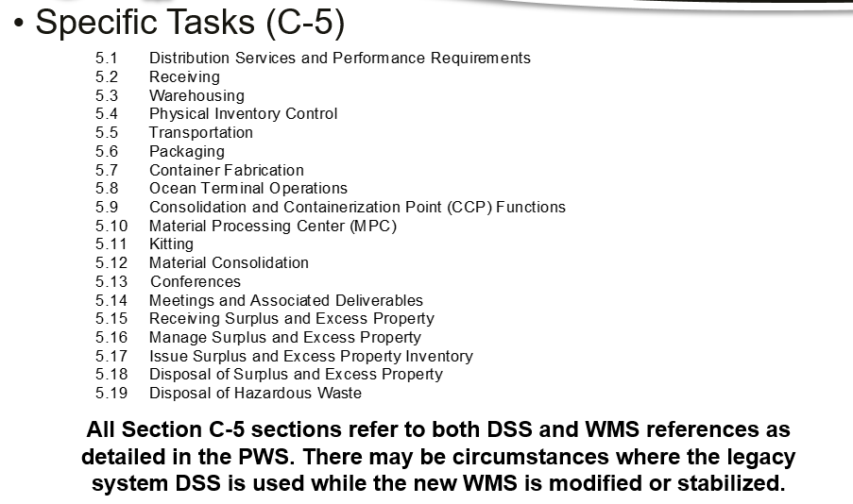
Performance Work Statement Review Section C

Slide 48
Performance Work Statement Review Section C
DLA Distribution and DLA Disposition Services and Performance Requirements (C-5.1)
The Contractor shall sustain an auditable environment by performing the daily operations of all warehousing and distribution functions IAW the current versions and all updates of the DLA Distribution SOPs and any communications (e.g., FRAGO) issued that changes the SOP requirements, and all other references as set forth in this contract using the DLA Warehousing Management System Inventory Requirements applicable to both wholesale and retail processes.
Enclosure 2 of each SOP provides the step-by-step standard process, ensuring compliance with Audit Sustainment manual controls.
Process Manuals provide additional details.
Requires use of WMS or applicable system and WMS changes in the performance of warehouse and distribution operations and shall complete all required transactions in WMS (C-5.1.3.1).
Use of RF handheld equipment in the performance of all WMS functions when and where the functionality exists.

Slide 49
Performance Work Statement Review Section C
DLA Distribution and DLA Disposition Services and Performance Requirements (C-5.1)
The Government provides its best estimate for projected workload for each Task Orders period of performance. However, workload factors change constantly. The Contractor shall provide appropriate leadership with management tools and processes to effectively manage the distribution and disposition operations to successfully fulfill the DLA distribution and disposition requirements to our customers IAW all contract requirements. The Contractor shall provide the skills and expertise necessary to perform detailed analysis and monitoring of all:
Physical distribution and disposition processes,
Operations workflow,
Interrelationships between functions and;
Using the DLA WMS, the actual incoming workload. This is to obtain valuable insight enabling the ability to schedule optimization and maximum workforce effectiveness required for processing the actual workload IAW the APLs and all other contract requirements.
The Contractor shall assume the responsibility for meeting all contract terms and conditions as specified in awarded task orders, upon completion of the transition period.

Slide 50
Performance Work Statement Review Section C
DLA Distribution and DLA Disposition Services and Performance Requirements (C-5.1)
The Contractor does not need to propose the specific labor categories included in any of the DLA Standard Operating Procedures (SOP). The labor categories in paragraph C-1.3, Personnel and task orders take precedence.
The Contractor shall obtain and retain access to the QLIK Sense application to manage the Distribution Centers/Disposition Sites performance. Service Providers can be granted section access which will provide view only access to the data for the distribution center/Disposition Site at which you are performing services.
DLA Distribution QLIK Sense section access will provide the user with the DIST_SAAD file for their site. DLA Disposition QLIK access and requirements will be identified by requiring task order.

Slide 51
Performance Work Statement Review Section C
DLA Distribution and DLA Disposition Services and Performance Requirements (C-5.1)
DLA is in Audit Sustainment IAW DoD’s Financial Improvement and Audit Readiness (FIAR) Plan. Key to maintaining auditability is focusing efforts on the continuous standardized end-to-end processes.
Each time performance of the contract requirements deviate from documented and standardized processes there is an inherent risk to sustained audit readiness.
As a Contractor entity performing DLA Distribution requirements, the Contractor’s activities impact the integrity of DLA’s and each Military Service’s financial record/general ledger transactions.
Monthly Audit Assertion Program with the intent of shifting the focus from training to holding employees accountable for adhering to standard procedures
CDRL A009 Assertion Memo – based on future ability to pass audit in upcoming month
To be completed, based on the honest and accurate ability of the Contractor operated distribution areas to pass an audit
Corrective Action Plan Quality CAP required for areas where Contractor cannot assert or can only somewhat assert
Always Under Audit

Slide 52
Performance Work Statement Review Section C
DLA Distribution and DLA Disposition Services and Performance Requirements (C-5.1)
Period End Inventory Cut-Off Procedures
The Contractor implements cut-off procedures IAW DLA Distribution SOP/Guidance/FRAGO on a quarterly basis.
During Cut-Off, the Contractor shall:
Process all work in progress (WIP) – offloaded, receipted, stowed, picked, packed, offered and physically shipped by end of day for the identified period end cut-off.
Perform a total sweep of all Contract Distribution Center workload and footprint to validate that no inventory is in any state of WIP
Ensure all material is physically and systemically stowed into location or physically shipped
Indemnification and Limitation of Liability (C-5.1.2)
Information Technology (IT) Data Systems (C-5.1.3)

Slide 53
Performance Work Statement Review Section C
Quality Control Plan(C-5.1.4)
Requirements to support DLA’s Quality Management System (QMS) which includes
Service Provider Quality Control (QC)
Government Quality Assurance (QA)
Independent DLA Distribution Review of Performance Data and QC/QA outcomes
Independent Public Auditor (IPA) to support Audit Sustainment IAW the Financial Improvement and Audit Readiness (FIAR)
Managers Internal Control Program (MICP)/Annual Statement of Assurance (SOA)
The above outcomes support Distribution’s Audit Sustainment resulting in an audit compliant environment and documented in the Assertion Memo CDRL A009 requirement.
Be compliant with FAR 52.246-4(b) and IAW CDRL A006
Quality Assurance Surveillance Plan (QASP) - The QASP documents QCP effectiveness and provides a systematic method to evaluate the Contractor’s services. The Government’s QA team will use a variety of tools and surveillance methods to evaluate Contractor performance ranging from reviews of documents and reports to actually observing processes as they occur.
Customer Service Plan and Support (C-5.1.5)
NAVSUP Weapons Systems Support (NAVSUP WSS) In-Transit Accountability (NITA) /Electronic Retrograde Management System (eRMS) – Distribution Only (C-5.1.6)

Slide 54
Performance Work Statement Review Section C
Receiving(C-5.2)
Distribution Centers receive material for storage and distribution that is transported by a variety of commercial and Government carriers. Characteristics of material received are included in TE 2.1 Definitions and Acronyms. Dependent upon system functionality and availability. The contractor shall receipt material IAW knowledge, skills, and documents acquired in WMS training and the applicable references e.g. SOPs, Guidance, Instructions, and Regulations:
In-Bound Traffic Management (C-5.2.1)
Off-Load and Tally (C-5.2.2)
Receipt Process Documentation (C-5.2.3)
Product Receipt Evaluation (C-5.2.4)
Additional Receiving Requirements (C-5.2.5)

Slide 55
Performance Work Statement Review Section C
Warehousing(C-5.3)
Stow of Receipts (C-5.3.1)
General Warehousing/Storage Requirements (C-5.3.2)
Care of Supplies In Storage (COSIS) (C-5.3.3)
Maintain all material in storage in a Ready for Issue (RFI) condition
Additional Storage Requirements (C-5.3.4)
Material Potentially Possessing Explosive Hazard (MPPEH)
Controlled Material
Hazardous Material (HAZMAT)
Radioactive Material (RAM)
Shelf-Life Material
Reserved (C-5.3.5)
Weight and Cube National Stock Numbers (C-5.3.6
Rewarehousing of material (bin to Bin) (C-5.3.7
Issue of Material (C-5.3.8)
Transshipments (C-5.3.9)
Local Delivery (C-5.3.10)
Issues to DLA Disposition Services (C-5.3.11)
Shipment Preparation/Outloading (C-5.3.12)

Slide 56
Performance Work Statement Review Section C
Physical Inventory(C-5.4)
Physical Inventory Control Programs (PICP) goal is to provide a reasonable assurance of the existence and completeness of DLA and service owned material.
The Physical Inventory process consists of the following sub-processes:
Inventory count planning and scheduling
Execute inventory count procedures
Inventory adjustments review and recordation
Pre-adjustment research, denial research, iSDR research
Resolution and logistical reassignment
Contractor performs PICP services that maintain integrity in mission stock asset balances IAW all applicable SOPs, instructions, guidance, and regulations .
In addition to the physical inventories, the contractor shall perform denial research, adjustment research, and retain appropriate documentation to support correcting the accountable record imbalances.
The contractor is responsible for:
identifying repetitive processing errors;
analyzing current inventory accuracy results;
developing corrective action plans to include in the QCP to resolve problems and mitigate future inaccuracies in supply system work processes.
The contractor shall maintain inventory accuracy for warehoused stock IAW TE 5.0, APLs.

Slide 57
Performance Work Statement Review Section C
Traffic Management / Transportation(C-5.5)
The contractor shall accomplish traffic management/transportation functions to support shipment processing and Government handling IAW the applicable references, e.g. SOPs, Guidance, Instructions, and Regulations
The Contractor shall provide traffic management for all issue transactions and traffic management support for other federal activities on request, to include deployment support, in a manner that provides for the efficient, economical, on-time delivery of material to customers.
Defense Freight Transportation Services (C-5.5.1)
Traffic Management (C-5.5.2)
Shipping (C-5.5.3)
Astray Freight (Government Cargo Recovery Effort (GOCARE)) Program(C-5.5.4)
Security Assistance Program (SAP) Shipments: Foreign Military Sales (FMS) and Grant Aid(C-5.5.5)
Additional Traffic Management / Transportation Requirements (C-5.56)
Deployment Support (C-5.5.7)

Slide 58
Performance Work Statement Review Section C
Packaging – (C-5.6)
The Contractor shall perform preservation, packaging, packing and marking material received, stored and issued to a minimum military packaging IAW applicable guidance. Contractor shall package to level A or B when exception data on the MRO or a disposition instruction from the item manager is received. PPP&M will be performed IAW the referenced SOPs and Regulations within the PWS.
Preservation, Packaging, Packing and Marking (PPP&M) (C-5.6.1)
Container Reclamation (C-5.6.2)
Container Fabrication Support (C-5.6.3)
Specialized Container Fabrication Support (C-5.6.4)
Wood Packaging Material (WPM) (C-5.6.5)

Slide 59
Performance Work Statement Review Section C
RESERVED – (C-5.7)
Ocean Terminal Operations – (C-5.8)
Consolidation and Containerization Point – (C-5.9)
Material Processing Center (C-5.10)
Kitting – (C-5.11)
Material Consolidation (C-5.12)
Conferences (C-5.13)
Meetings and Associated Deliverables (C-5.14)

Slide 60
Performance Work Statement Review Section C
Receiving Surplus and Excess Property – (C-5.15)
The contractor shall perform tasks related to the execution of three interdependent and sequential processes to receive surplus and excess property correctly, safely.
Accepting Property Turn-Ins. The Contractor shall verify all arriving property turn-ins have required documentation, and ensure it matches the property being turned in for disposition. The Contractor shall notify the customer of any discrepancies, and the customer will correct discrepancies before the turn-in can be accepted. If the turn-in arrives on commercial transport, a Transportation Discrepancy Report (TDR) is created for any discrepancies before accepting the turn-in IAW DLA SOP 4500.01-002-WMS, Transportation Discrepancy Report. At this point, turn-ins are known as unprocessed receipts, which are staged in the unprocessed receipt area in a sequential manner (first-in, first-out). Unprocessed receipts are moved to the property receiving area as soon as there is capacity to process unprocessed receipts.
Processing Property Turn-Ins. The Contractor shall verify the Kind, Condition, and Count (KCC) for all items listed on the Disposal Turn-in Document (DTID) and resolve any discrepancy found IAW DLA SOP 4160.01-033, Receipt of Property.
The Contractor shall record processed property in WMS. Processed property will generally be segregated into four categories: usable property, scrap, hazardous property, and DEMIL property.
Stowing Processed Property. After property is processed, it is moved from the property receiving area to a designated “put away” location in a storage area. Storage areas consist of permanent structures, (warehouse building), temporary structures (soft wall shelter or container), and outdoor yards.

Slide 61
Performance Work Statement Review Section C
Manage Surplus and Excess Property Inventory – (C-5.16)
The contractor shall perform tasks related to three independent and concurrent processes to manage and account for property from when it is stowed in a warehouse location until it is pulled from inventory.
Rewarehousing. This process involves tasks related to the changes affecting storage areas and locations, and relocation property within the storage areas.
Inventorying. This is process ensures 100% accountability of surplus property, scrap materials, and hazardous waste physically on site and on record in WMS. The accountable officer will be a government employee. Personnel will assist in conducting six types of inventories.
Picking (aka Pulling) Property. There are several similar processes to pull property from inventory. The processes fall within four categories: Materiel Release Orders (MROs); Delivery Orders (DOs), Transfer Orders (TOs), and Workload List (WLL) / Pull List. The property being pulled must match the order or pull list, and then be placed in the respective designated pick-up, shipping, or work location.

Slide 62
Performance Work Statement Review Section C
Issue Surplus and Excess Property Inventory – (C-5.17)
The contractor shall perform tasks related to two independent and concurrent processes to issue property, which starts upon pulling property from inventory to fill orders (MROs, DOs, and TOs) and until the customer pickups orders or consignees receive shipments with orders. Tasks include sorting, preparing, staging, and shipping of property, along with documenting the completion of orders.
Customer Pick-Ups. The Contractor shall stage pulled property items for pickup in a designated area by customer’s unique identifier (e.g., DODAAC) and respective orders (e.g. MRO). Pickup procedures will be followed to ensure customer’s personnel are authorized to pick up orders and remaining steps to complete orders is done correctly IAW below SOPs.
Shipments. The Contractor shall stage pulled property items to be shipped in a designated area by the respective customer and order(s). Orders to be shipped will include MROs, Dos, and Tos. Tasks associated to prepare shipments may include packing, banding, crating, or boxing items. Shipment procedures will be followed to create and submit a Transportation Movement Request (TMR); load transportation conveyance; and complete shipment documentation and postings IAW the DLA Disposition SOPs.

Slide 63
Performance Work Statement Review Section C
Disposal of Surplus and Excess Property – (C-5.18)
The contractor shall perform tasks related to the disposal of surplus and excess property that has no further use or value to the USG by either abandonment or destruction (A/D) of property. Destruction is done through demilitarization and mutilation processes, which destroy the item’s original identity, utility, form, fit, and function. The destruction of property generates recyclable scrap materials and refuse. The best destruction method for the respective property is to be used in order to generate the largest volume of recyclable materials for the precious metals’ recovery program or public sales, while minimizing the amount of refuse requiring landfill disposal.
Destruction Methods:
Demilitarization (DEMIL)
Mutilation (MUT).
Abandonment.
Handling Scrap
Issuing Scrap.

Slide 64
Performance Work Statement Review Section C
Disposal of Hazardous Waste – (C-5.19)
The contractor shall perform tasks related to the disposal of hazardous waste (HW), when the DS activity or field site generates HW from operations on-site (e.g., maintenance/ repair of equipment; property not properly purged) or establishes a HW collection point to consolidate HW from customers within the same EL or CL. The Contractor may be tasked to remove HW from customer’s collection points and transport to a commercial Treatment, Storage, and Disposal Facility (TSDF) or DS controlled collection point for consolidation and export.

Slide 65
Performance Work Statement Review Section C
Technical Exhibits and J Attachments
Provides pertinent information required to be addressed in the proposal.
All Technical Exhibits and J Attachments are important and need to be read and addressed in proposals.
Posted on SAM.Gov
Contract Data Requirements List (CDRL)
For reports, programs, plans, procedures, cost reports, Standard Operating Procedures (SOP)
Posted on SAM.Gov

Slide 66
Inspection and Acceptance Section E
Key Points
FAR and DFARS clauses for Inspection of Services
E-6 Quality/Performance Evaluation
Government will use a Quality Assurance Surveillance Plan (QASP) to monitor compliance with the contract terms and conditions; identify conforming and nonconforming services to determine appropriate action under terms of the contract.
QASP will be tailored from the Contractor’s QCP and sets forth the method and manner by which the Government intends to conduct surveillance of work under the contract.
Contractor shall use the Government’s Quality Management Tool (QMT) High Gear, to acknowledge results, propose corrective and preventive actions and timelines as required by the COR, and/or respond to surveillance results.

Slide 67
Deliveries or Performance Section F
Key Points
F-3 Ordering Period – two year base ordering period and four two-year option ordering periods
F-4 Acceptable Performance Levels
Technical Exhibit 5.0
Waiver Process
Details surrounding waiver and request submitted by 5th working day of the following month
Submitted to KO or designee and Contract Specialist
Disposition by 15th working day of the following month
Late requests may not be considered
F-7 Deductions
Acceptable Performance Levels (APLs) are tiered IAW F-6
Each APL will be subject to the applicable monthly deduction based on tier designation

Slide 68
Deliveries or Performance Section F
Key Points
F-5 Letters of Concern
Relay contractual compliance issues requiring attention or formal resolution
KO will determine when a letter will be sent
Will contain a formal due date and time response
If no response or Contractor concurs, LOC is finalized
Contractor may non-concur within the due date
KO will review and determine if Contractor response is valid and disposition the LOC.
Section does not limit the ability to pursue deductions

Slide 69
Contract Administration Data Section G
Key Points
This contract will be paid in accordance with G-2 DFARS Clause 252.232-7006 Wide Area WorkFlow Payment Instructions (JAN 2023) as provided in G-3, WAWF INVOICING PROCEDURES
G-4 Invoicing Instructions
Provides invoice preparation and submission instructions by CLIN set
G-6 Payment, Selected Items of Cost Reimbursement Contracts
Materials – Contractor provided items (PPE, uniforms, boots, etc.) are to be included in indirect costs.
G-7 Contractor Performance Assessment Reporting System (CPARS) Requirements - The Contractor, in performing this contract, will be subject to a past performance assessment in accordance with FAR 42.15 and the CPARS Guide
G-9 Contract Administration Plan – Provides POCs for various contract administration functions

Slide 70
Special Contract Requirements Section H
Key Points
H-1 Competition in Supplies
Requires the Contractor to obtain competition for items purchased over $3,500 for which reimbursement will be sought under the contract
H-2 Accounting System
Subject to Accounting Standards
Requires Acceptable Accounting System
H-3 Hiring
Must maintain records
Made available to the KO or designee upon request
H-4 Substitution or Addition of Key Personnel
Requires Contractor to notify the KO prior to any Contractor personnel changes
Any removals/replacements for Contractor’s convenience shall be at no cost to the Government
Key Personnel identified in PWS
No changes in first 180 days except limited circumstances
H-8 Insurance
Contractor, at its own expense, provide and maintain insurance during the entire period of performance
Potential Contractor liability for incidents, including those in the FLIPL process
Contractor may maintain higher levels

Slide 71
Contract Clauses Section I
Key Points
Contractors shall familiarize themselves with the clauses
As clauses are revised or new clauses are required, modifications will be issued

Slide 72
List of Attachments Section J
Key Points:
Outlined in Section J
J.1 PWS
J.2 WMS Transitional Training Schedule
J.3 Wage Determination
J.4 DD254
J.5 Contract Data Requirements List (CDRL)
J.6 – J.17 Technical Exhibits
J.18 DLA Distribution Program Management Office (PMO) PWS
J.19 DLA Disposition Services Program Management Office (PMO) PWS
J.20 Small Business Participation Commitment Document
J.21 Subcontracting Plan Template
J.22 Past Performance Questionnaire

Slide 73
Representations, Certifications & Other Statements of Offerors or Respondents Section K
Key Points:
The North American Industry Classification System (NAICS) code for this acquisition is 561210 – Facilities Support Services
The Small Business Size Standard is $47M
Response to provisions shall be provided in E-File I, Solicitation, Offer and Award Documents (SF-33), under Tab 3

Slide 74
Instructions, Conditions & Notices to Offerors or Respondents Section L
Key Points
DFARS 252.204-7019 – Notice of NIST SP 800-171 DoD Assessment Requirements (NOV 2023)
To be considered for award, if the Offeror is required to implement NIST SP 800-171, the Offeror shall have a current assessment (not more than 3 years old), with scores posted in the SPRS
L-29 Communications Between the Government and Offerors
Procedure and Deadline for submitting questions
All questions shall be submitted by email
Preproposal and Solicitation question submittal due date is 12:00 P.M. Eastern Daylight Time on May 20, 2025
Proposal due date is June 3, 2025, at 12:00 P.M. Eastern Daylight Time.

Slide 75
Instructions, Conditions & Notices to Offerors or Respondents Section L
Key Points
Electronic submission through PIEE is required
Instructions provided in Section L-30 Proposal Preparation Requirements
Offerors must register as a Contract Administrator (CAM) within the PIEE Solicitation Module and appoint a Proposal Manager.
Please note that it can take several days for the Proposal Manager appointment to become effective in the system, thereby causing proposal submission delays if not promptly appointed.
All parts of the proposal must be uploaded to the PIEE Solicitation Module prior to the date and time of proposal closing deadline to be considered on time.
All received submissions will be acknowledged with a reply email from the PIEE Solicitation Module.

Slide 76
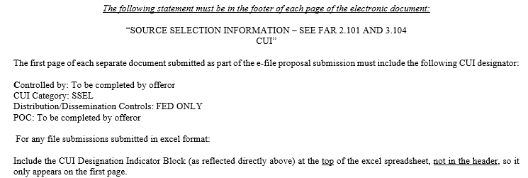
Instructions, Conditions & Notices to Offerors or Respondents Section L
Key Points
Proposal Markings
Each page of the documents submitted must be clearly marked with the Offeror’s Name and solicitation number.
The following statement must be in the header of each page of the electronic document when determined applicable by the Offeror:

Slide 77
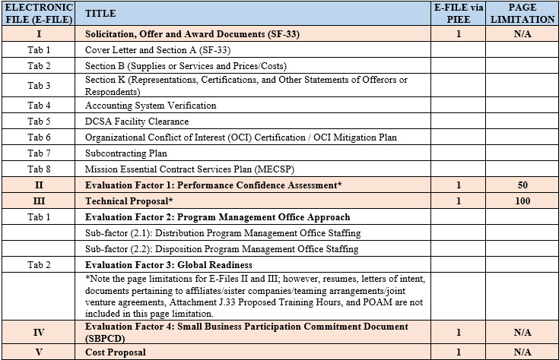
Instructions, Conditions & Notices to Offerors or Respondents Section L
Key Points:
L-30 Proposal Preparation Requirements

Slide 78
Instructions, Conditions & Notices to Offerors or Respondents Section L
Key Points:
Please stay within the page limitations
50 for Performance Confidence Assessment
100 for Technical Proposal
Please ensure the table of contents page numbers correlate to the correct pages
Ensure resumes are marked “PERSONALLY IDENTIFIABLE INFORMATION (PII)”
Ensure each section is tabbed

Slide 79
E-FILE I Solicitation, Offer, and Award Documents Section L
E-FILE I
SOLICITATION, OFFER AND AWARD DOCUMENTS

Slide 80
E-FILE I Solicitation, Offer, and Award Documents Section L
Tab 1: Cover Letter, Completed and Signed Standard Form 33, Signed Amendment(s)
Tab 2: Completed Section B
Unit prices no more than 2 decimal places
Tab 3: Section K - Representations and Certifications
Tab 4: Accounting System Verification
Include POC or letter from DCAA showing office information
Tab 5: DCSA Facility Clearance Verification
Tab 6: OCI Certification or Mitigation Plan
Tab 7: Subcontracting Plan
Tab 8: Missions Essential Contract Services Plan

Slide 81
E-File II - Factor 1: Performance Confidence Assessment
E-FILE II
PAST PERFORMANCE PROPOSAL

Slide 82
E-File II - Factor 1: Performance Confidence Assessment
Evaluation Factor 1: Performance Confidence Assessment
Limited to 50 pages.
Evaluated on recency, relevancy, and quality
Performance within five (5) years of the solicitation issuance date
Relevance is defined as those efforts similar in terms of scope, magnitude of effort, and complexity.
Quality of performance on the contracts
If an Offeror has no past performance, please state so
Proposals should provide examples of the offeror’s experience providing a trained and ready Contractor work force to perform storage and distribution and/or disposition services in support of expeditionary and/or augmentation requirements globally, either in Government Owned/Contractor managed and operated or Contractor Owned/Contractor managed and operated facilities, supporting military, contingency, humanitarian assistance/disaster relief (HA/DR), foreign disaster relief (FDR), Defense Support of Civil Authorities (DSCA), and Interagency support operations using Standard Operating Procedures (SOPs).
Attachment J.22 Past Performance Questionnaire
Offeror/Major Subcontractor shall ask their customer to complete the questionnaire and return directly to the Acquisition Specialist.

Slide 83
E-File II - Factor 1: Performance Confidence Assessment
Evaluation Factor 1: Performance Confidence Assessment
Major Subcontractors
If utilizing major subcontractor experience, the Past Performance Proposal MUST include:
A signed commitment letter from the Offeror and the Major Subcontractor
Certifies that if awarded the contract, the parties commit to joint performance as proposed
Data must be provided for Offeror and any major subcontractors. This is defined as “those providing twenty percent (20%) of total dollar threshold AND/OR twenty-five percent (25%) of total man-hour effort”. Only prime Offeror and major subcontractors information will be evaluated.
Other Arrangements
Affiliate companies, sister companies, teaming arrangements, joint ventures, etc. will be considered provided sufficient documentation is in the Past Performance Proposal.
Documentation may include: a copy of the documented arrangement such as documented affiliation, a copy of the teaming agreement, a copy of the joint venture agreement, etc.

Slide 84
E-File III – Technical Proposal
E-FILE III
TECHNICAL PROPOSAL

Slide 85
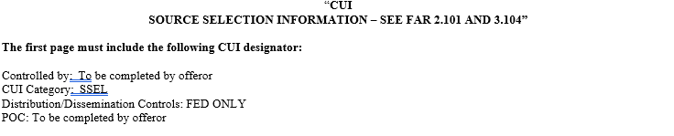
E-File III – Technical Proposal Factor 2: Program Management Office Approach
Tab 1 - Evaluation Factor 2: Program Management Office (PMO) Approach
Task Order 0001 Distribution PMO and Task Order 0002 Disposition PMO represent actual work requirements. The Government intends to issue these work requirements as the first two task orders under this contract. The PMO Approach has two (2) subfactors: Distribution PMO Staffing, and Disposition PMO Staffing. All subfactors will be evaluated.
Subfactor 2.1: Distribution PMO Staffing:
The Offeror shall provide a management and staffing plan which demonstrates an understanding of the requirements of the RFP and demonstrates how the approach will successfully accomplish the requirements of the RFP. The Offeror shall provide Key Personnel resumes for one (1) Project Manager, one (1) Alternate Project Manager, one (1) Quality Control Specialist, four (4) Trainer/Project Supervisor, and one (1) Procurement Analyst, not to exceed three (3) pages, that provides summary information in sufficient detail to clearly demonstrate that the key personnel proposed meet the minimum requirements as required in Attachment J.1 – Section C – Performance Work Statement Section C-1.3.1, Key Personnel. All pages of the resume shall be marked “PERSONALLY IDENTIFIABLE INFORMATION (PII) SAFEGUARD IAW DOD PRIVACY PROGRAM AND PRIVACY ACT OF 1974” if PII is included in the resume. In addition, if PII is included then the following CUI markings must also be included on each page of the resume(s):

Slide 86
E-File III - Factor 2: Program Management Office Approach
Subfactor 2.1: Distribution PMO Staffing: (Continued)
To be considered, all personnel shall either be current employees of the Offeror or have letters of intent in the proposal and otherwise comply with the requirements for personnel. The letters of intent must include acknowledgement of the requirements in clause H-4 of the RFP. Offerors shall respond to the separate requirements for each personnel labor category for experience. All personnel resumes submitted shall include a description of past experience and accomplishments.
The Offeror must propose the labor categories listed in Attachment J.1 – Section C – Performance Work Statement Section C-1.3.1 as key personnel. If the Offeror chooses to propose additional labor categories, the Offeror shall discuss which proposed alternative labor categories differ from the Government’s suggested personnel labor categories. The Offeror shall clearly show the link between the Offeror’s proposed alternative labor categories and which Government suggested labor categories the proposed alternative position replaces.
The Government estimates that the following minimum level of effort will be required by the Offeror for Key Personnel in the performance of Task Order 0001. This is the Government minimum estimate only and offerors are encouraged to propose the labor positions, hours, and skill mix they determine necessary to complete staffing of the Key Personnel requirements. If the Offeror proposes different labor categories and labor hours from those identified below the Offeror shall describe their rationale for proposing different labor categories and/or productive hours and provide any productivity analysis used to determine their staffing and the associated measurement methodology used to arrive at proposed productive labor hours by labor category. The Offeror shall include the skill mix and the leadership skill mix that will be used to implement the processes, methods, and tools proposed to perform the requirements in the task order, with particular attention to the DLA Distribution Process Manuals, Standard Operating Procedures (SOPs), and Flowcharts.

Slide 87
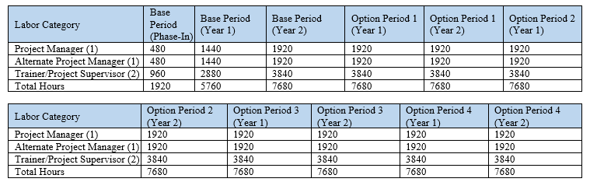
E-File III - Factor 2: Program Management Office Approach
Subfactor 2.1: Distribution PMO Staffing: (Continued)

Slide 88
E-File III - Factor 2: Program Management Office Approach
Subfactor 2.2: Disposition PMO Staffing:
The Offeror shall provide a management and staffing plan which demonstrates an understanding of the requirements of the RFP and demonstrates how the approach will successfully accomplish the requirements of the RFP. The Offeror shall provide Key Personnel resumes for the Project Manager, Alternate Project Manager, and two (2) Trainer/Project Supervisors, not to exceed three (3) pages, that provides summary information in sufficient detail to clearly demonstrate that the key personnel proposed meet the minimum requirements as required in Attachment J.1 – Section C – Performance Work Statement Section C-1.3.1, Key Personnel. All pages of the resume shall be marked “PERSONALLY IDENTIFIABLE INFORMATION (PII) SAFEGUARD IAW DOD PRIVACY PROGRAM AND PRIVACY ACT OF 1974” if PII is included in the resume. In addition, if PII is included then the following CUI markings must also be included on each page of the resume(s):

Slide 89
E-File III - Factor 2: Program Management Office Approach
Subfactor 2.2: Disposition PMO Staffing: (Continued)
To be considered, all personnel shall either be current employees of the Offeror or have letters of intent in the proposal and otherwise comply with the requirements for personnel. The letters of intent must include acknowledgement of the requirements in clause H-4 of the RFP. Offerors shall respond to the separate requirements for each personnel labor category for experience. All personnel resumes submitted shall include a description of past experience and accomplishments.
The Offeror must propose the labor categories listed in Attachment J.1 – Section C – Performance Work Statement Section C-1.3.1 as key personnel. If the Offeror chooses to propose additional labor categories, the Offeror shall discuss which proposed alternative labor categories differ from the Government’s suggested personnel labor categories. The Offeror shall clearly show the link between the Offeror’s proposed alternative labor categories and which Government suggested labor categories the proposed alternative position replaces.
The Government estimates that the following minimum level of effort will be required by the Offeror for Key Personnel in the performance of Task Order 0001. This is the Government minimum estimate only and offerors are encouraged to propose the labor positions, hours, and skill mix they determine necessary to complete staffing of the Key Personnel requirements. If the Offeror proposes different labor categories and labor hours from those identified below the Offeror shall describe their rationale for proposing different labor categories and/or productive hours and provide any productivity analysis used to determine their staffing and the associated measurement methodology used to arrive at proposed productive labor hours by labor category. The Offeror shall include the skill mix and the leadership skill mix that will be used to implement the processes, methods, and tools proposed to perform the requirements in the task order, with particular attention to the DLA Distribution Process Manuals, Standard Operating Procedures (SOPs), and Flowcharts.

Slide 90
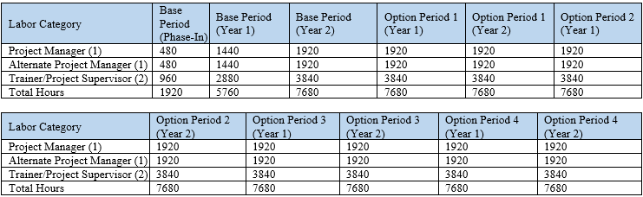
E-File III - Factor 2: Program Management Office Approach
Subfactor 2.2: Disposition PMO Staffing: (Continued)

Slide 91
E-File III - Factor 3: Global Readiness
Factor 3: Global Readiness
The offeror shall describe their ability to respond to urgent global task order requirements. The proposal shall address how the offeror will:
Identify qualified candidates.
Hire and onboard candidates.
Train to standard and maintain trained to standard status for all personnel.
Expedite requirements, which may require full performance to commence in less than 30 days and may require responses to Request for Quotes within 24 hours of the request.
Deploy PMO staff, and Task Order 0003 warm contingent personnel, within 48 hours of notice.
Deploy non-key/non-TO 0003 warm contingent personnel within 22 days.
Ability to coordinate and maintain acceptable performance of distribution, disposition and warehousing support at multiple sites while establishing new locations.
Identify what realistic reach-back capabilities the offeror’s firm maintains and what other resources are readily available to support urgent or contingent requirements.
Ability to operate within various political and diplomatic climates, policies, and requirements when working within varying CONUS and OCONUS locations.

Slide 92
E-FILE IV – Factor 4: Small Business Participation Commitment Document
E-FILE IV
SMALL BUSINESS PARTICIPATION COMMITMENT DOCUMENT

Slide 93
E-File IV - Factor 4: Small business Participation Commitment Document
Factor 4: Small Business Participation Document
Other than small businesses must complete and provide all the information required of this section.
This is in addition to the Subcontracting Plan.
Will be incorporated into the resultant contract.

Slide 94
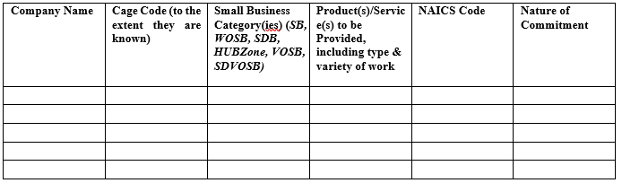
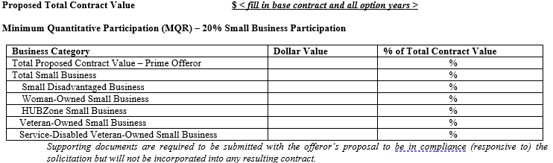
E-File IV - Factor 4: Small business Participation Commitment Document
Factor 4: Small Business Participation Document (continued)
Complete table and provide documentation supporting the nature of commitment.
The Government’s Small Business Minimum Quantitative Requirement (MQR) for this effort is as follows: Overall Total Small Business – 20 percent (to include all socioeconomic categories). There is no MQR established at the socioeconomic category level. Use the table/format below in proposing this required information.

Slide 95
E-File V –Cost Proposal
E-FILE V
COST PROPOSAL

Slide 96
E-File V – Cost Proposal
Key Points:
Submit all required tables in MS EXCEL. Do not hide formulas or cells. Do not lock cells. The Government must be able to replicate the calculations.
Cost Proposal Summary is required.
Cost Breakdown is required for ALL CLINs.
For any major subcontractor (defined as those providing 20% of total dollar threshold AND/OR 25% of total man-hour effort) proposal shall include subcontractor cost data in the same level of detail as provided by the prime contractor.
If a subcontractor elects to submit the detailed breakdown for their labor costs directly to the Government, the prime Offeror must still complete portions of the Subcontracting Labor Tables. This will ensure that the Offeror’s proposal contains an accurate price.

Slide 97
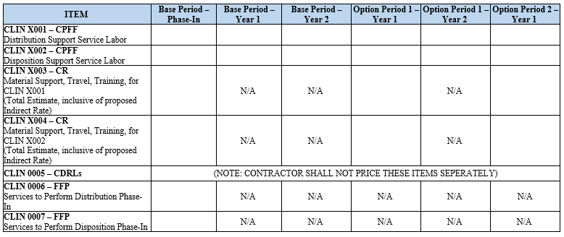
E-File V – Cost Proposal
Cost/Price Proposal Summary Table
Offerors shall insert their total estimated cost inclusive of fixed fee per year for CLINs X001 and X002. Offerors shall insert and apply their G&A, Material Handling Rate or applicable indirect rate supported by the offerors accounting system to the Government Provided Estimated Cost for CLINs X003 and X004. The Offeror’s proposed Estimated Value is equal to the Government Provided Estimated Cost plus the Offeror’s G&A or Material Handling cost. The Estimated Cost is provided in the spreadsheet requirements for CLINs X003 and X004 listed below. Fee is not allowable under CLINs X003 and X004. Offerors shall insert their proposed Firm-Fixed-Price for CLINs 0006 and 0007.

Slide 98
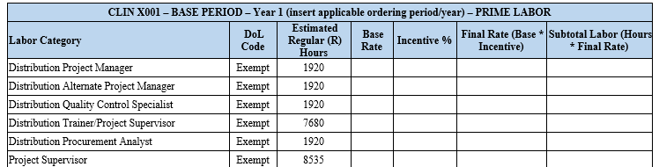
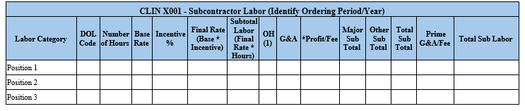
E-File V – Cost Proposal
CLIN X001 – DISTRIBUTION SUPPORT SERVICE LABOR
Offerors shall complete the tables below for each performance period utilizing the labor categories and hours provided by the Government for the base IDIQ contract.

Slide 99
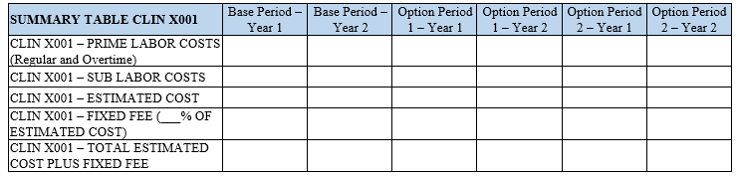
E-File V – Cost Proposal
CLIN X001 – DISTRIBUTION SUPPORT SERVICE LABOR
Summary Table:

Slide 100
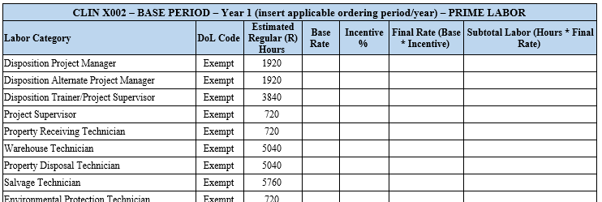
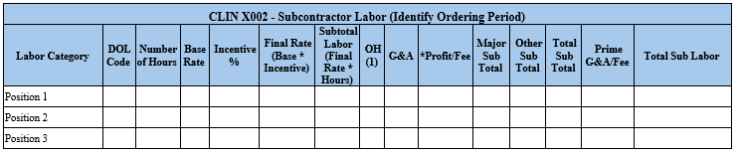
E-File V – Cost Proposal
CLIN X002 – DISPOSITION SERVICES SUPPORT SERVICE LABOR
Offerors shall complete the tables below for each performance period utilizing the labor categories and hours provided by the Government for the base IDIQ contract.

Slide 101
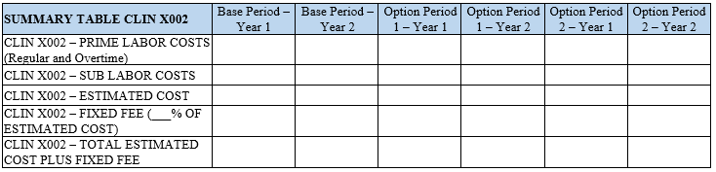
E-File V – Cost Proposal
CLIN X002 – DISPOSITION SERVICES SUPPORT SERVICE LABOR
Summary Table:

Slide 102

E-File V – Cost Proposal
CLIN X003 – MATERIAL SUPPORT, TRAVEL & TRAINING COSTS FOR CLIN X001
Offerors shall complete the dollar amount of the information requested by the header row in the table located below. Offerors shall identify the specific rate applied to the Government Provided Estimated Cost (G&A rate, Material Handling Rate, or other Indirect Rate supported by the Offeror’s accounting system) in the header row. Offerors shall sum the Government provided Estimated Cost and their G&A, Material Handling Rate or other Indirect Rate to arrive at the proposed Not-to-Exceed (NTE) amount in the last column. No fee is allowed under this CLIN.

Slide 103

E-File V – Cost Proposal
CLIN X004 – MATERIAL SUPPORT, TRAVEL & TRAINING COSTS FOR CLIN X002
Offerors shall complete the dollar amount of the information requested by the header row in the table located below. Offerors shall identify the specific rate applied to the Government Provided Estimated Cost (G&A rate, Material Handling Rate, or other Indirect Rate supported by the Offeror’s accounting system) in the header row. Offerors shall sum the Government provided Estimated Cost and their G&A, Material Handling Rate or other Indirect Rate to arrive at the proposed Not-to-Exceed (NTE) amount in the last column. No fee is allowed under this CLIN.

Slide 104
E-File V – Cost Proposal
CLIN X004 – MATERIAL SUPPORT, TRAVEL & TRAINING COSTS FOR CLIN X002
Offerors shall complete the dollar amount of the information requested by the header row in the table located below. Offerors shall identify the specific rate applied to the Government Provided Estimated Cost (G&A rate, Material Handling Rate, or other Indirect Rate supported by the Offeror’s accounting system) in the header row. Offerors shall sum the Government provided Estimated Cost and their G&A, Material Handling Rate or other Indirect Rate to arrive at the proposed Not-to-Exceed (NTE) amount in the last column. No fee is allowed under this CLIN.

Slide 105
E-File V – Cost Proposal
CLIN X005 – Contract Data Requirements List (CDRL) in accordance with DD Form 1423.
(NOTE: CONTRACTOR SHALL NOT PRICE THESE ITEMS SEPERATELY)

Slide 106
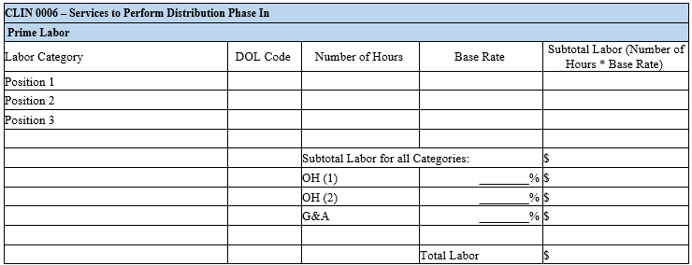
E-File V – Cost Proposal
CLIN 0006 - SERVICES TO PERFORM DISTRIBUTION PHASE IN
Offerors shall complete the tables below.

Slide 107
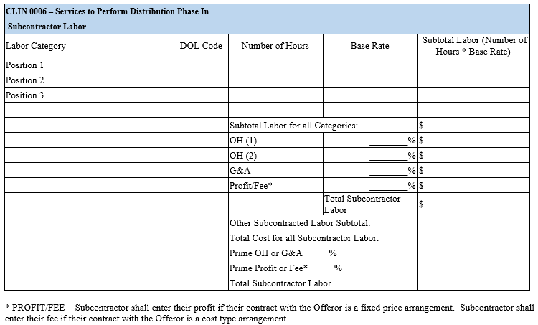
E-File V – Cost Proposal
CLIN 0006 - SERVICES TO PERFORM DISTRIBUTION PHASE IN
(Continued)

Slide 108

E-File V – Cost Proposal
CLIN 0006 - SERVICES TO PERFORM DISTRIBUTION PHASE IN
Summary Table:

Slide 109
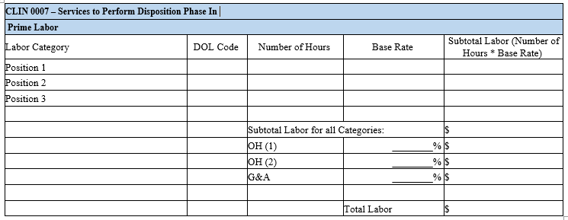
E-File V – Cost Proposal
CLIN 0007 - SERVICES TO PERFORM DISPOSITION PHASE IN
Offerors shall complete the tables below.

Slide 110
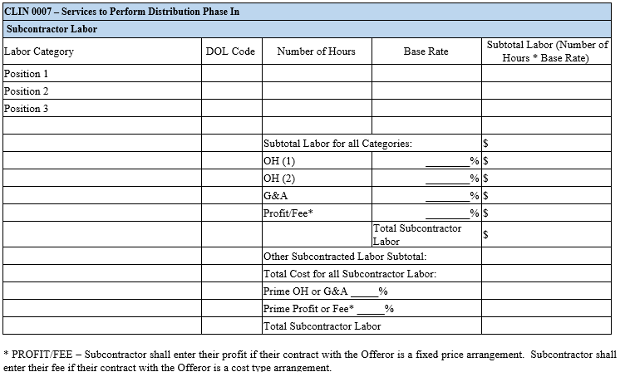
E-File V – Cost Proposal
CLIN 0007 - SERVICES TO PERFORM DISPOSITION PHASE IN
(Continued)

Slide 111

E-File V – Cost Proposal
CLIN 0007 - SERVICES TO PERFORM DISPOSITION PHASE IN
Summary Table:

Slide 112
Section M – Evaluation Factors for Award
Section M
Evaluation Factors for Award

Slide 113
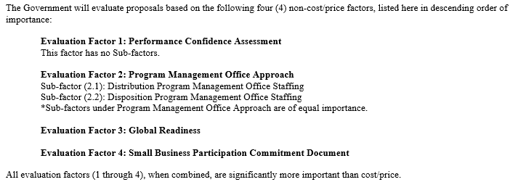
Section M – Evaluation Factors for Award
Key Points:
Best Value / Trade-Off
The SSA will make a tradeoff assessment based on the results of the evaluation utilizing the relative importance of the evaluation factors as indicated below.

Slide 114
Section M – Evaluation Factors for Award
Acceptable Accounting System
In order to eligible for award, the Offeror shall have an accounting system, determined by the Government to be acceptable to support the non-fixed-price line items on the resultant contract.
DCSA approved facility clearance
Required at time of proposal submission
Acceptable OCI Mitigation Plan
Acceptable subcontracting plan (Large Businesses only)
The Offeror shall have an active, approved Disclosure Statement or a substantiated exception to Cost Accounting Standards.
Evaluation of Cost Proposal
Price analysis will be conducted in accordance with FAR 15.404-1(a)(2). Cost analysis in accordance with FAR 15.404-1(c) and cost realism analysis in accordance with FAR 15.404-1(d) will be conducted on the CR CLINs.

Slide 115
Section M – Evaluation Factors for Award
Proposal Tips:
Be sure to read entire solicitation
Technical Approach must be your methods and plans for performing the requirements
Shall not be a reiteration of the requirements in the PWS
Shall not be a description of how you perform on current contracts or have performed on past contracts
Address this in your Past Performance Proposal (E-File II)
Address all requirements in Section L
Address all requirements with detailed descriptions
Use of Section L numbering outline in proposals is expected to ensure all requirements are addressed and easily identified / crossed referenced.

Slide 116
Conclusion
Keep questions relevant to the issues in the solicitation
Reading and understanding the solicitation reduces questions
Monitor Sam.Gov for Amendments
Make the initial proposal your best offer
Communicate through the proper channels (Contracting Officer and Acquisition Specialist)

Slide 117

End Slide 1

