Slide 1
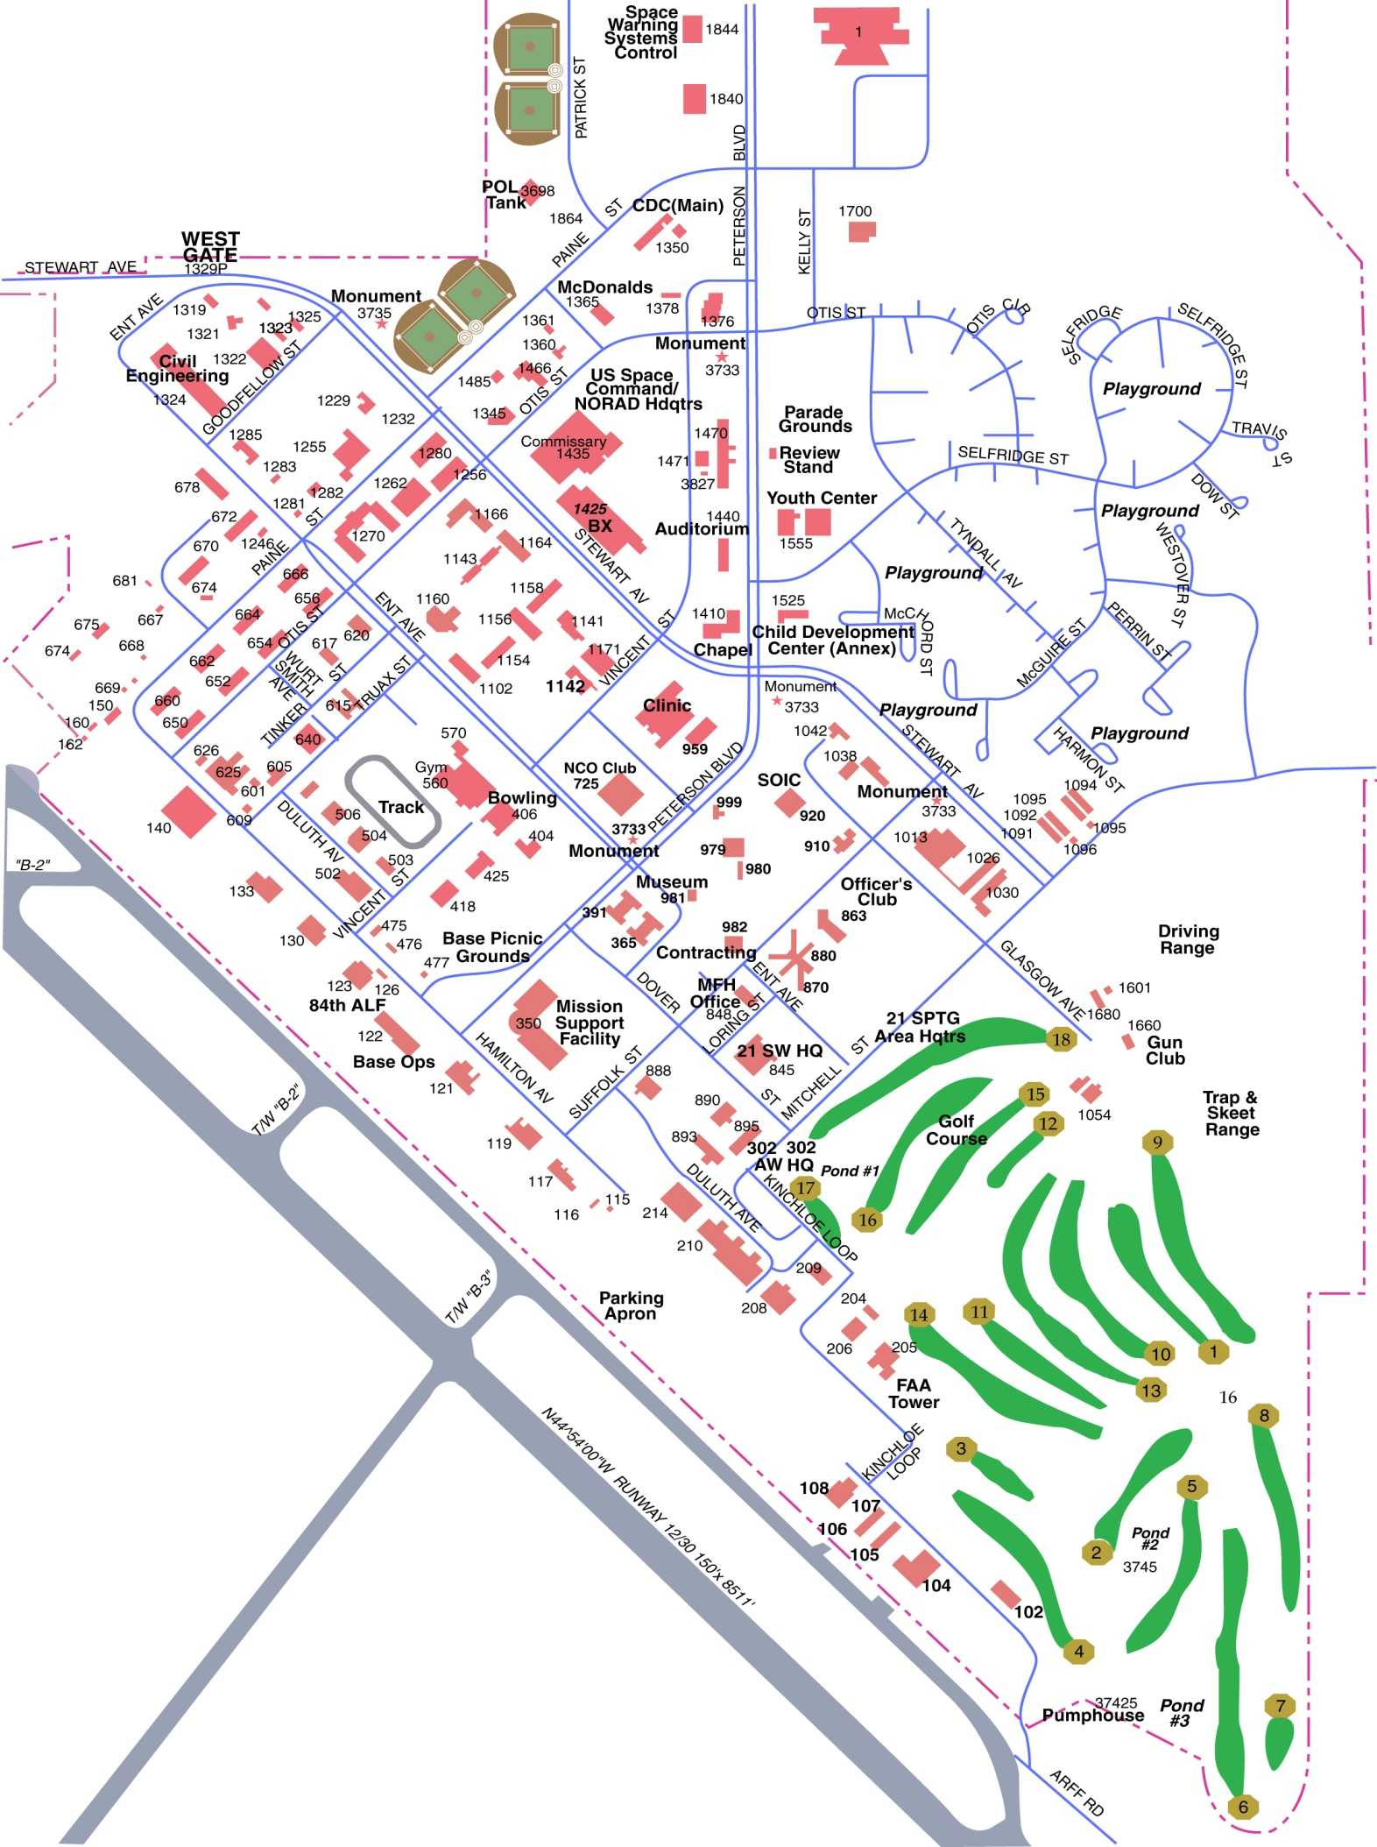
NORTH GATE
BLDG 2
2
SOCNORTH HQ
Building 30
3
Parking
Parking
30
Parking
Parking
TO EAST GATE
TLF
Gate Hours:
West Gate: (Main gate w/ Visitors Center) Open 24/7
East Gate: Mon-Fri: 0500-1800; Sat: 0600-1800; Sun: 0830-1800
North Gate: (Closest to SOCNORTH) Mon-Fri: In & Out: 0600-0900; Outbound: 0600-1800

