Slide 1
Solicitation No. W912EP25BA017 FORT PIERCE, BEACH RENOURISHMENT, ST. LUCIE County, Florida
Pre-Bid Conference
Presented by:
Jacksonville District
July 30, 2025
Thank you for joining, we will begin shortly.
Please mute your microphone.

Slide 2
PRE-Bid CONFERENCE: AGENDA
INTRODUCTION
PROJECT OVERVIEW
CONTRACTING OVERVIEW
OTHER ADMINISTRATIVE ITEMS
RESOURCES
CLOSING REMARKS

Slide 3
Project OVERVIEW

Slide 4
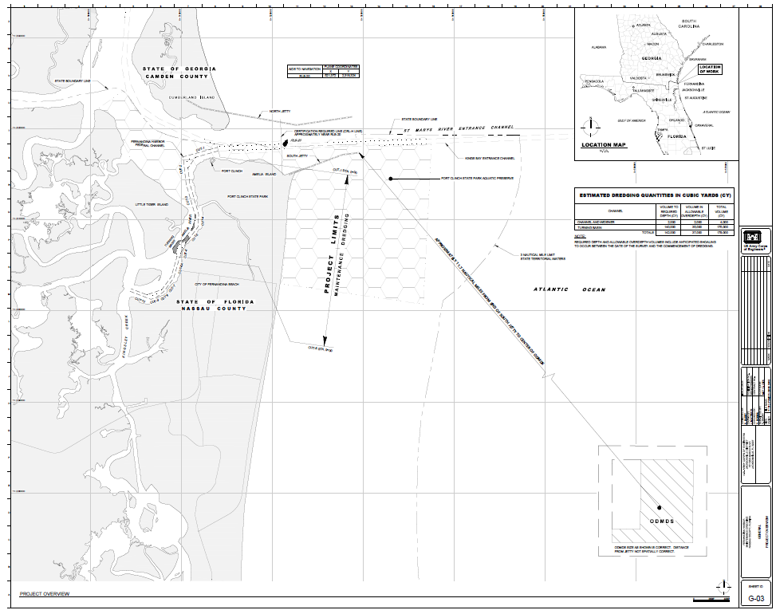
PRE-bid CONFERENCE: PROJECT OVERVIEW
SOLICITATION NUMBER: W912EP25BA017
PROJECT TITLE: Fort Pierce Beach
Renourishment, St. Lucie County, Florida
DESCRIPTION OF WORK: Project work includes
construction of a beach berm along approximately
7,000 feet of shoreline immediately south of Fort
Pierce Inlet between FDEP Range Monuments
R-34 and T-41. Beach compatible sand for the
project will be dredged from Capron Shoal,
located approximately four miles southeast of the
project site in state waters. Work also includes but
is not limited to environmental species monitoring,
sea turtle trawling (hopper dredges only), turbidity
monitoring, beach tilling, beach fill quality control, screening, MEC construction support, and vibration control and monitoring. The project work is subdivided into a base and one option as indicated on the drawings

Slide 5
CONTRACTING OVERVIEW
Griselle Gonzalez-Aquino, Contracting Officer
Email: Griselle.Gonzalez@usace.army.mil
Meredith Coad, Contract Specialist
Email: Meredith.C.Coad@usace.army.mil

Slide 6
PRE-bid CONFERENCE: Acquisition APPROACH
Solicitation No. W912EP25BA017
Contracting Method: FAR Part 14 Sealed Bidding - Invitation for Bid (IFB), Unrestricted.
Type of Contract: Firm-Fixed Price (FFP). (FAR clause 52.216-1)
Transmission Method: Electronically via Procurement Integrated Enterprise Environment (PIEE). Bids must be received by the Government no later than August 19, 2025, at 1:00 pm (EDT). Please see Section 00 21 13 Instructions to Bidders, for more details.
ALL AMENDMENTS MUST BE ACKNOWLEDGED (IF ANY)
FAILURE TO COMPLETE AND RETURN ALL REQUIRED SUBMISSION (SF 1442, SECTION 00 10 00 SOLICITATION, SECTION 0045 00 REPRESENTATION AND CERTIFICATIONS, CONTRACT LINE ITEM NUMBER (CLIN) SCHEDULE, AND BID BOND) COULD RENDER YOUR BID NON-RESPONSIVE.
Bid Opening: August 19, 2025, at 2:00 pm (EDT) via Microsoft Teams. You must be registered in the system for award management (SAM) to receive an award from this solicitation.

Slide 7
PRE-bid CONFERENCE: GENERAL INFORMATION
Estimated Magnitude of Construction: $10,000,000.00 - $25,000,000.00.
Applicable North American Industry Classification System (NAICS): 237990 (Exception), Dredging and Surface Cleanup Activities. The Small Business Size Standard for dredging is $37.0 million.
Estimated Period of Performance: The Contractor shall be required to (a) commence work under this contract within SIXTY (60) calendar days after the date the Contractor receives the Notice to Proceed (NTP), (b) prosecute the work diligently, and (c) complete the entire work ready for use not later than 15 May 2026 for Area B and be off the beach, 30 May 2026 for Area A and be off the beach, and 30 June 2026 for the entire contract work. The time stated for completion shall include final cleanup of the premises.
The completion date is based on the assumption that the successful offeror will receive the notice to proceed by 17 October 2025. The completion date will be extended by the number of calendar days after the above date that the Contractor receives the notice to proceed, except to the extent that the delay in issuance of the notice to proceed results from the failure of the Contractor to execute the contract and give the required
performance and payment bonds within the time specified in the offer. (FAR clause 52.211-10)

Slide 8
PRE-bid CONFERENCE: GENERAL INFORMATION
Liquidated Damages: $6,363.00 for each calendar day of delay until the work is completed or accepted. (FAR clause 52.211-12)
Performance of Work by the Contractor: 40% (FAR clause 52.236-1)
Bid Guarantee: electronic copy of the bid guarantee shall be submitted with the bid. The bid guarantee shall be 20% of bid price or $3,000,000.00, whichever is less. (FAR 52.228-1)
Payment and Performance Bonds: awardee must submit payment and performance bonds equal to the total bid price within 10 days of contract award. (SF1442 block 12)

Slide 9
PRE-bid CONFERENCE: OTHER ADMINISTRATIVE ITEMS
SITE VISIT:
Held on Tuesday, July 29, 2025, at 10:00 am EDT.
TECHNICAL INQUIRIES AND QUESTIONS:
ProjNet closes on August 8, 2025, at 5:00 pm, EDT.
All Inquiries must be submitted via ProjNet for an official answer.

Slide 10
PRE-bid CONFERENCE: resources
System for Award Management (SAM):
www.sam.gov
Procurement Integrated Enterprise Environment (PIEE):
https://piee.eb.mil/
ProjNet:
www.projnet.org

Slide 11
PRE-bid CONFERENCE: Questions
Please submit any questions via ProjNet.
ProjNet closes on August 8, 2025, by 5PM EDT.
Solicitation Number is: W912EP25BA017
Bidder Inquiry Key is: KAHJVW-ZZ7C6P

Slide 12
PRE-bid CONFERENCE: CLOSING REMARKS
Thank you!

Slide 13
PRE-bid CONFERENCE: Attendance
William Hussin, Cashman Dredging & Marine Contracting Co.
James Frazier - Callan Marine Limited
William House- Manson Construction Co.
Austin Idle - Manson Construction Co.
Armand Riehl - Great Lakes Dredge & Dock Co.
Steven Lawrence - Great Lakes Dredge & Dock Co.
Mike Jones – Marinex Construction
Chris Gillespie - Marinex Construction

