Slide 1
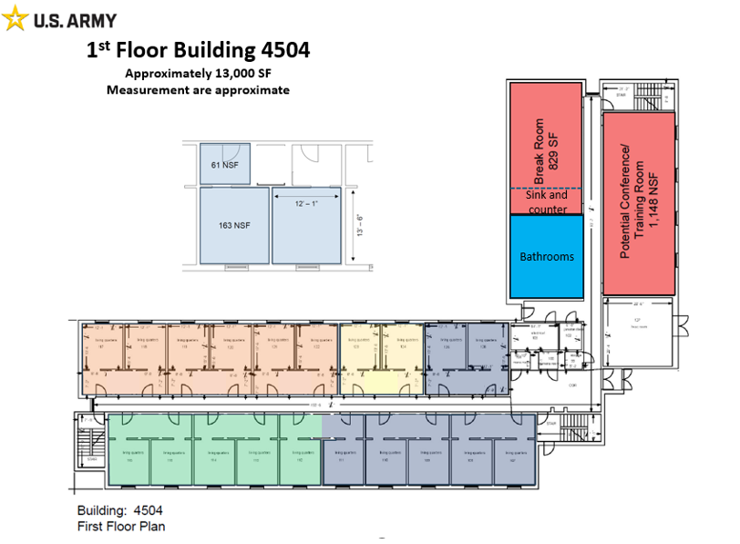

Standard Office
Kitchen
Conference
Room

Slide 2
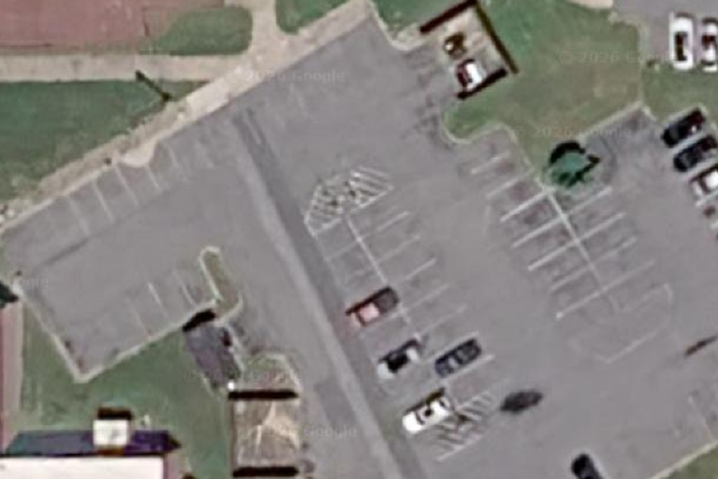
New ADA Parking Area
Building being Renovated
Laydown Area available

Slide 3
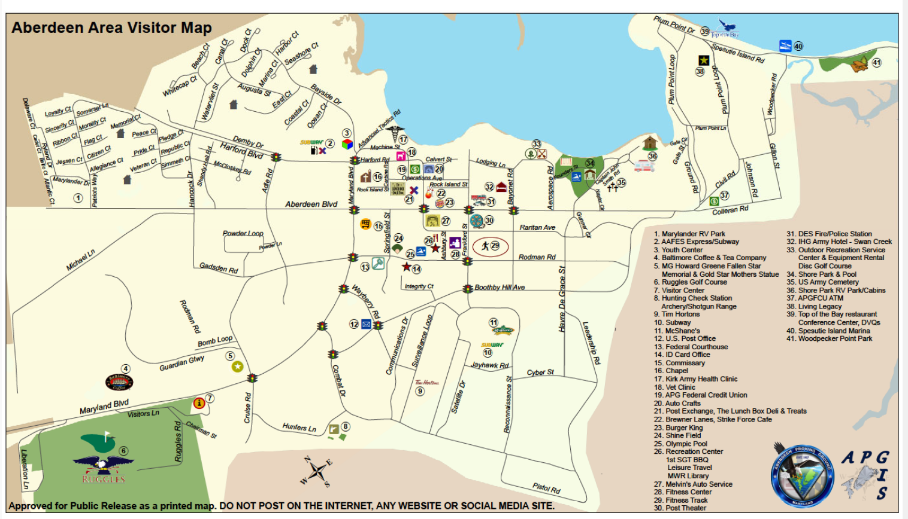

Hauling Route

