Slide 1
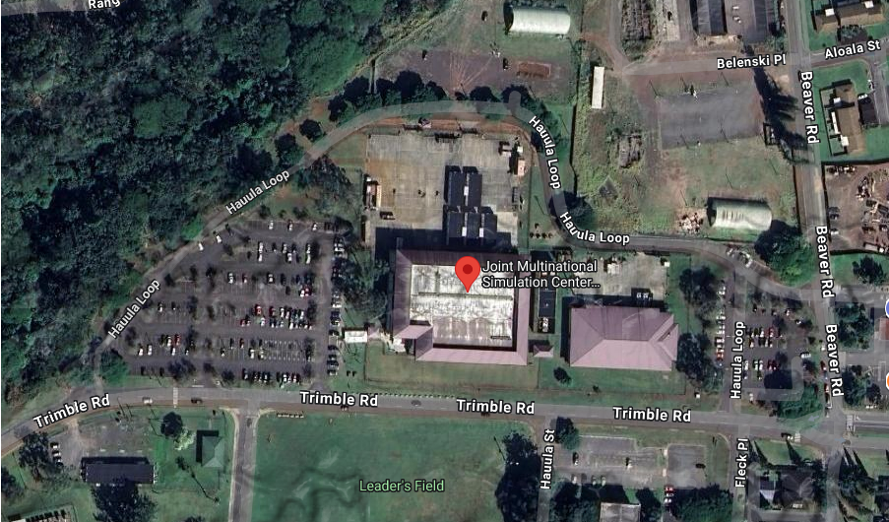

Install JMSC-IP Signs, Bldg. 1503, SB POC: Greg Henderson, Phone No. 808-787-2856 Alternate POC:
SB 1503

Slide 2
STATEMENT OF WORK
1. Scope of Work:
The scope of work includes the following:
Slide #3:
- USARPAC Logo (L 36” x H 36”).
- Joint Multinational Simulation Center Indo-Pacific (Large enough visible from Trimble Road).
b. Slide #4:
- Logo Mock-Up
c. Slide #5:
- Sign Mock-Up

Slide 3
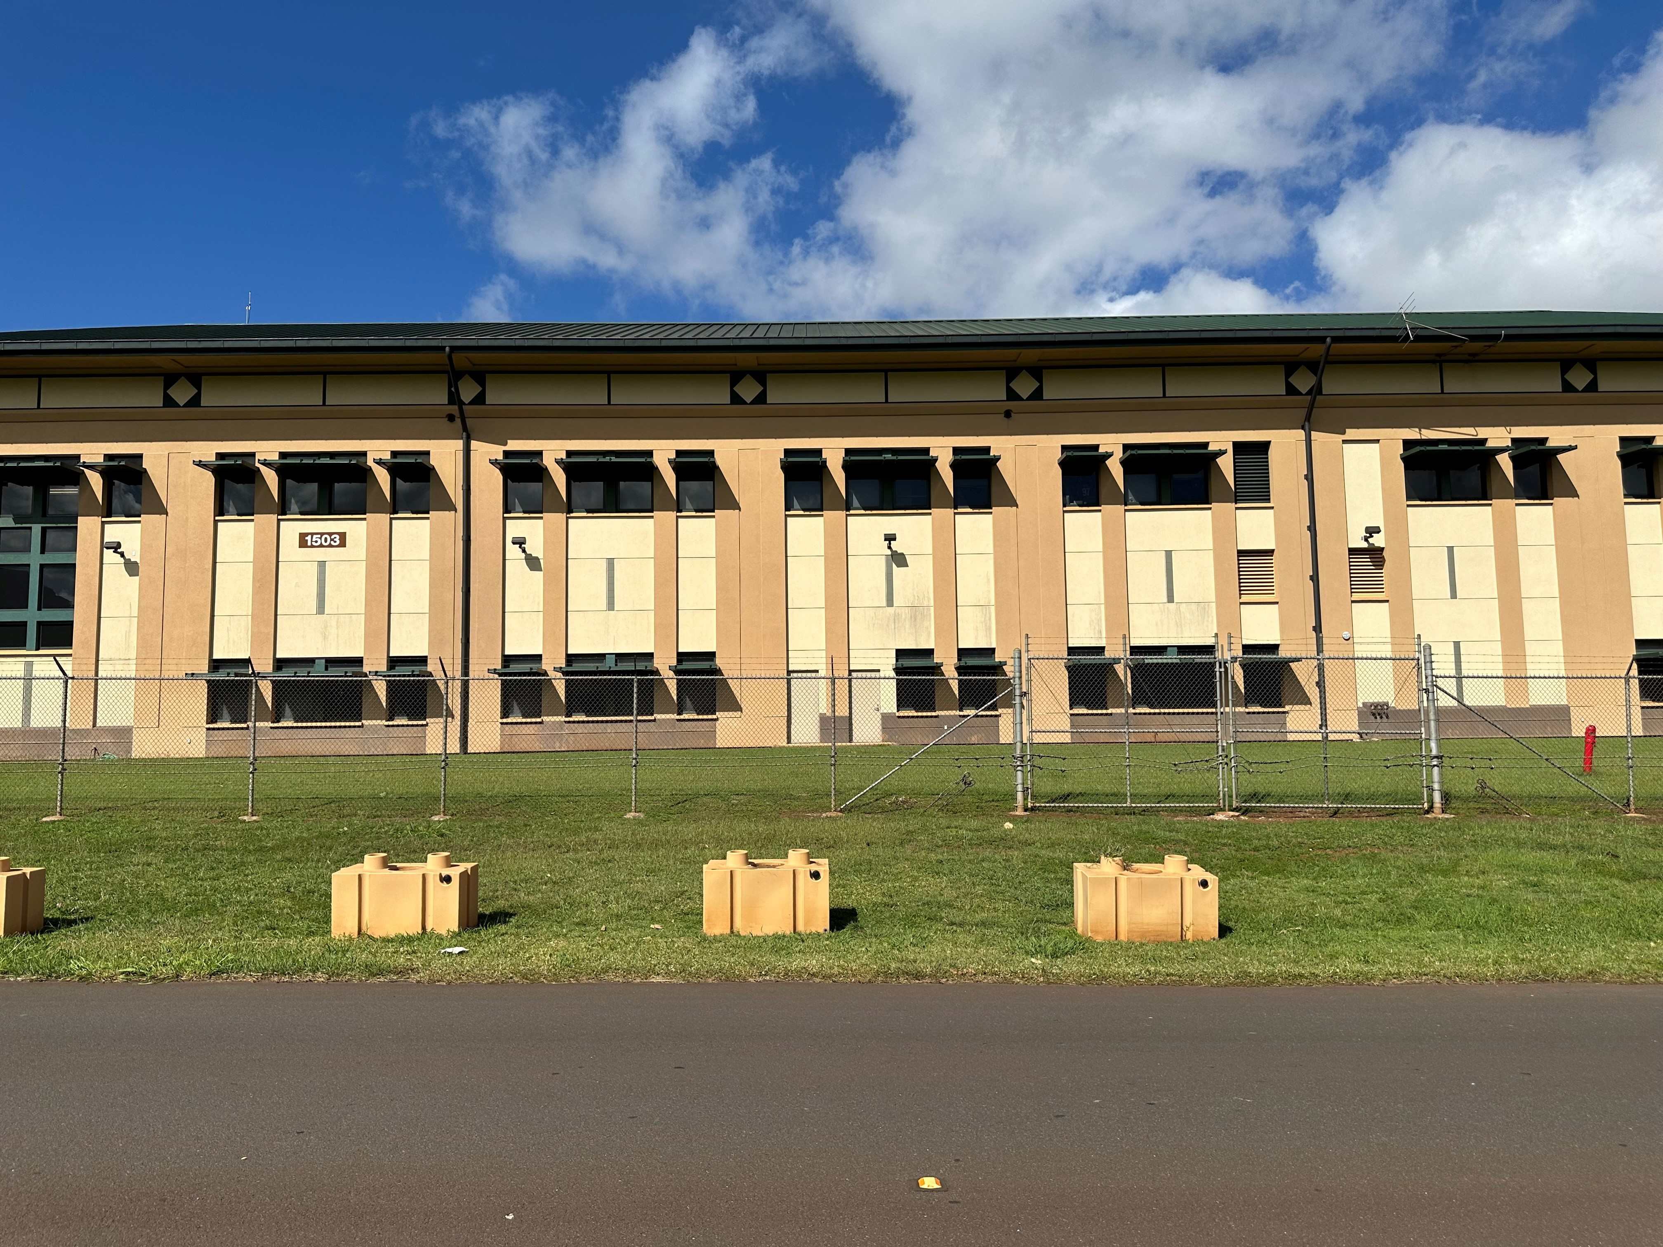


Logo: L 36” x H 36”
Sign installation on the South-Side of the building

Slide 4

USARPAC Logo (L 36” x H 36”)
Logo Mock-up

Slide 5
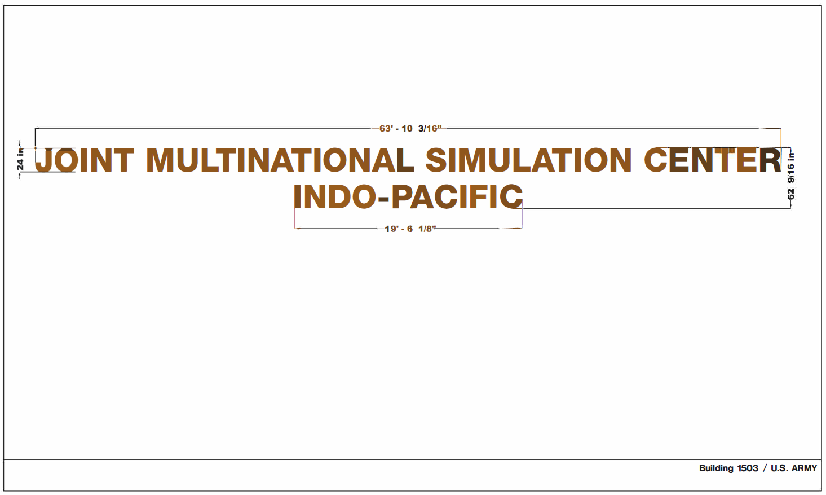
Sign Mock-Up

