Slide 1
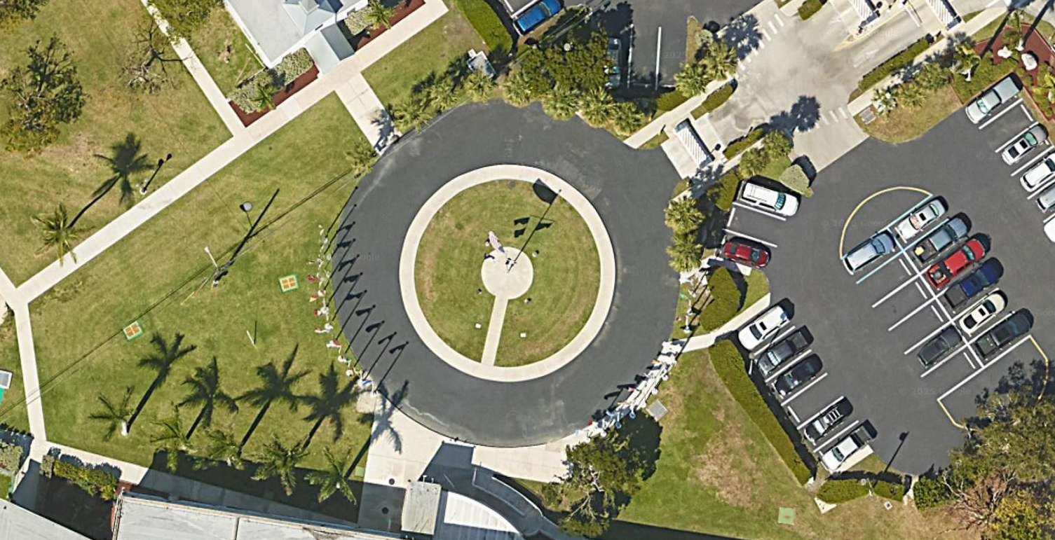
Flagpole in the Circle

