Slide 1
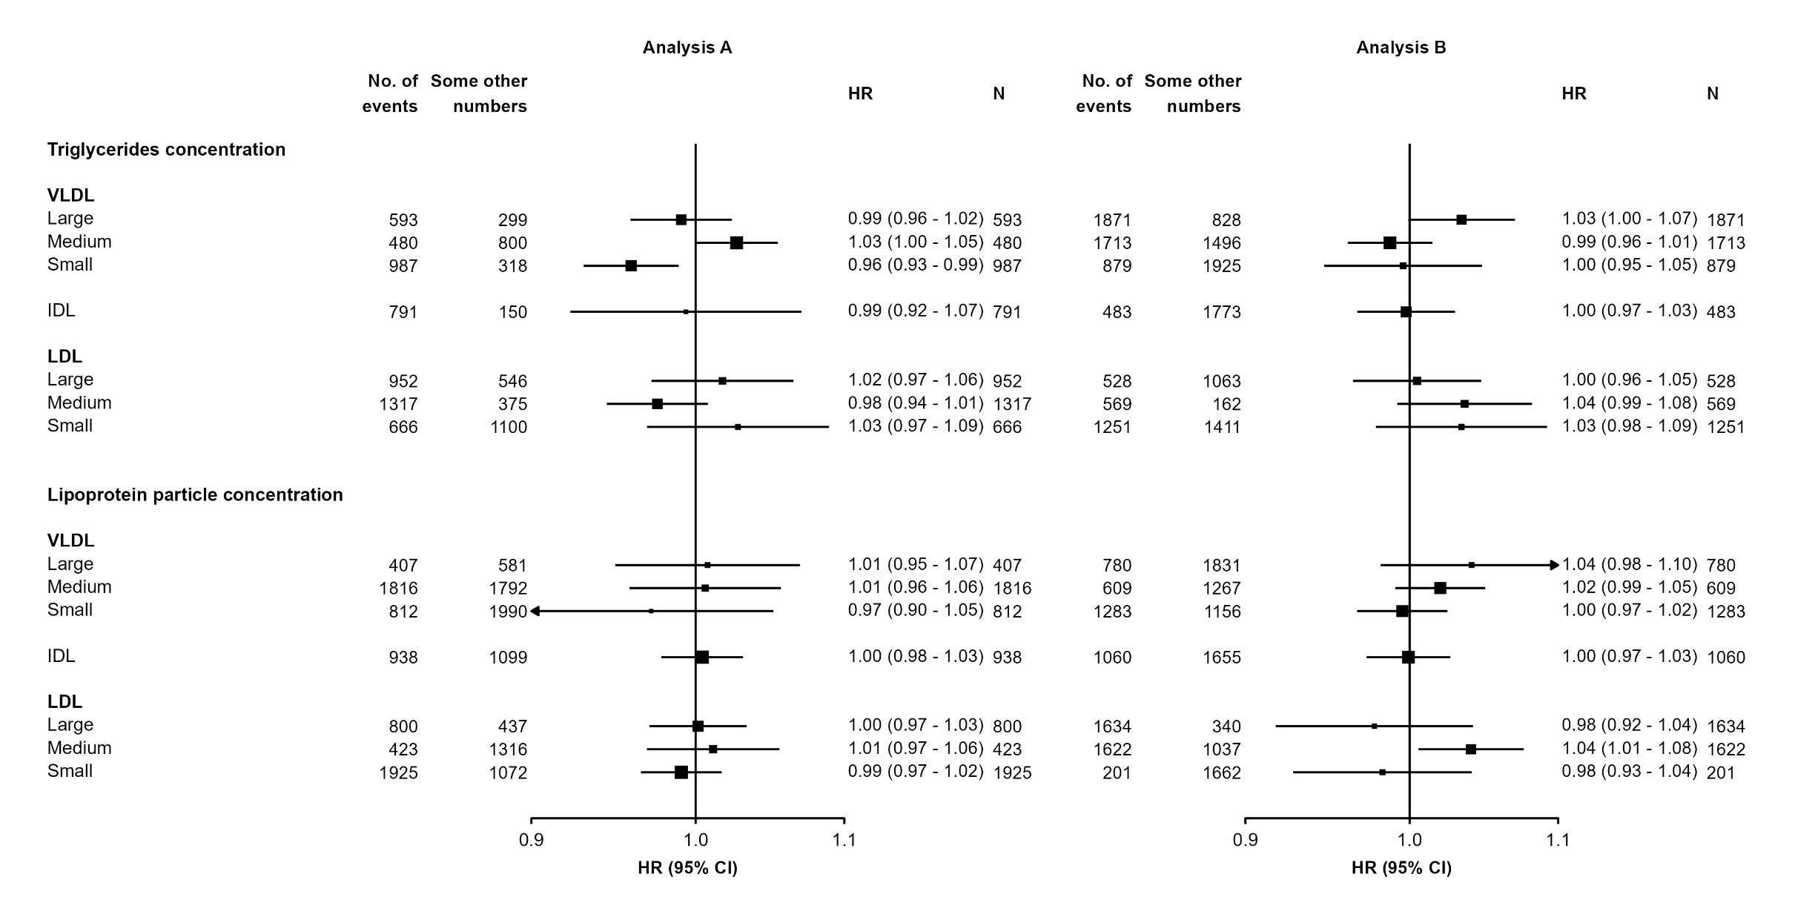
▲ left.space
= unit(30.9, "mm")
▲ right.space
= unit(34.7, "mm")
mid.space
= unit(5, "mm")
▲ col.left.pos
= unit(c(0.6, 19.2), "mm")
▲ col.right.pos
= unit(c(0.6, 27.7), "mm")
▲ If not specified, will be estimated automatically.

Slide 2
col.heading.space
= 1.5
Rows will spread out to fill the space available.
Set the number of blank rows after headings and at the end of sections:
blankrows = c(1, 1, 0, 1) [Default: c(1,1,0,0)]
Margin around the forest plot:
plot.margin = margin(8, 8, 8, 8, “mm”)
top
bottom
right
left

