Slide 1
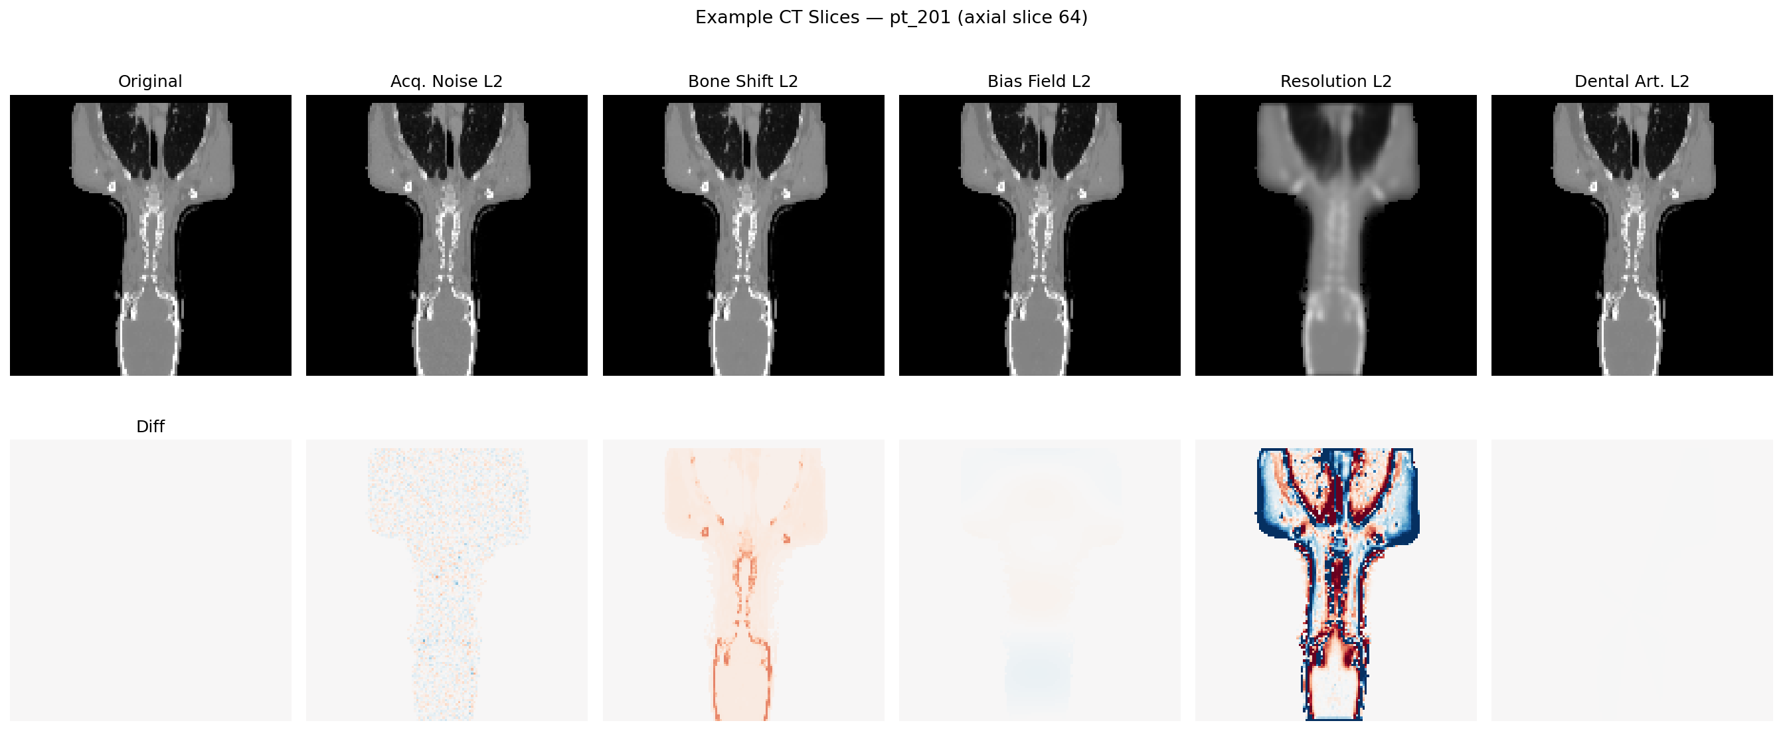
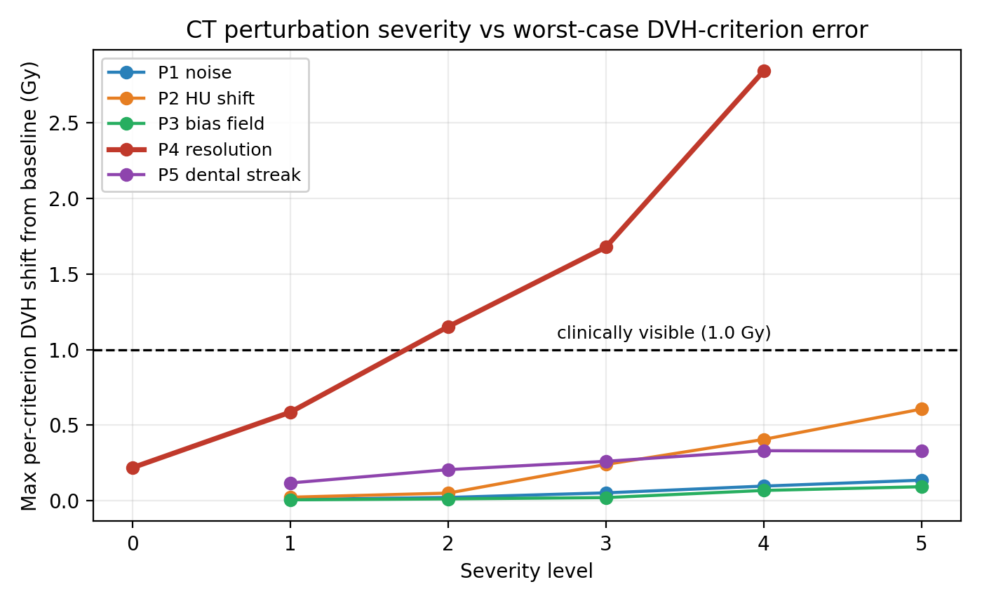
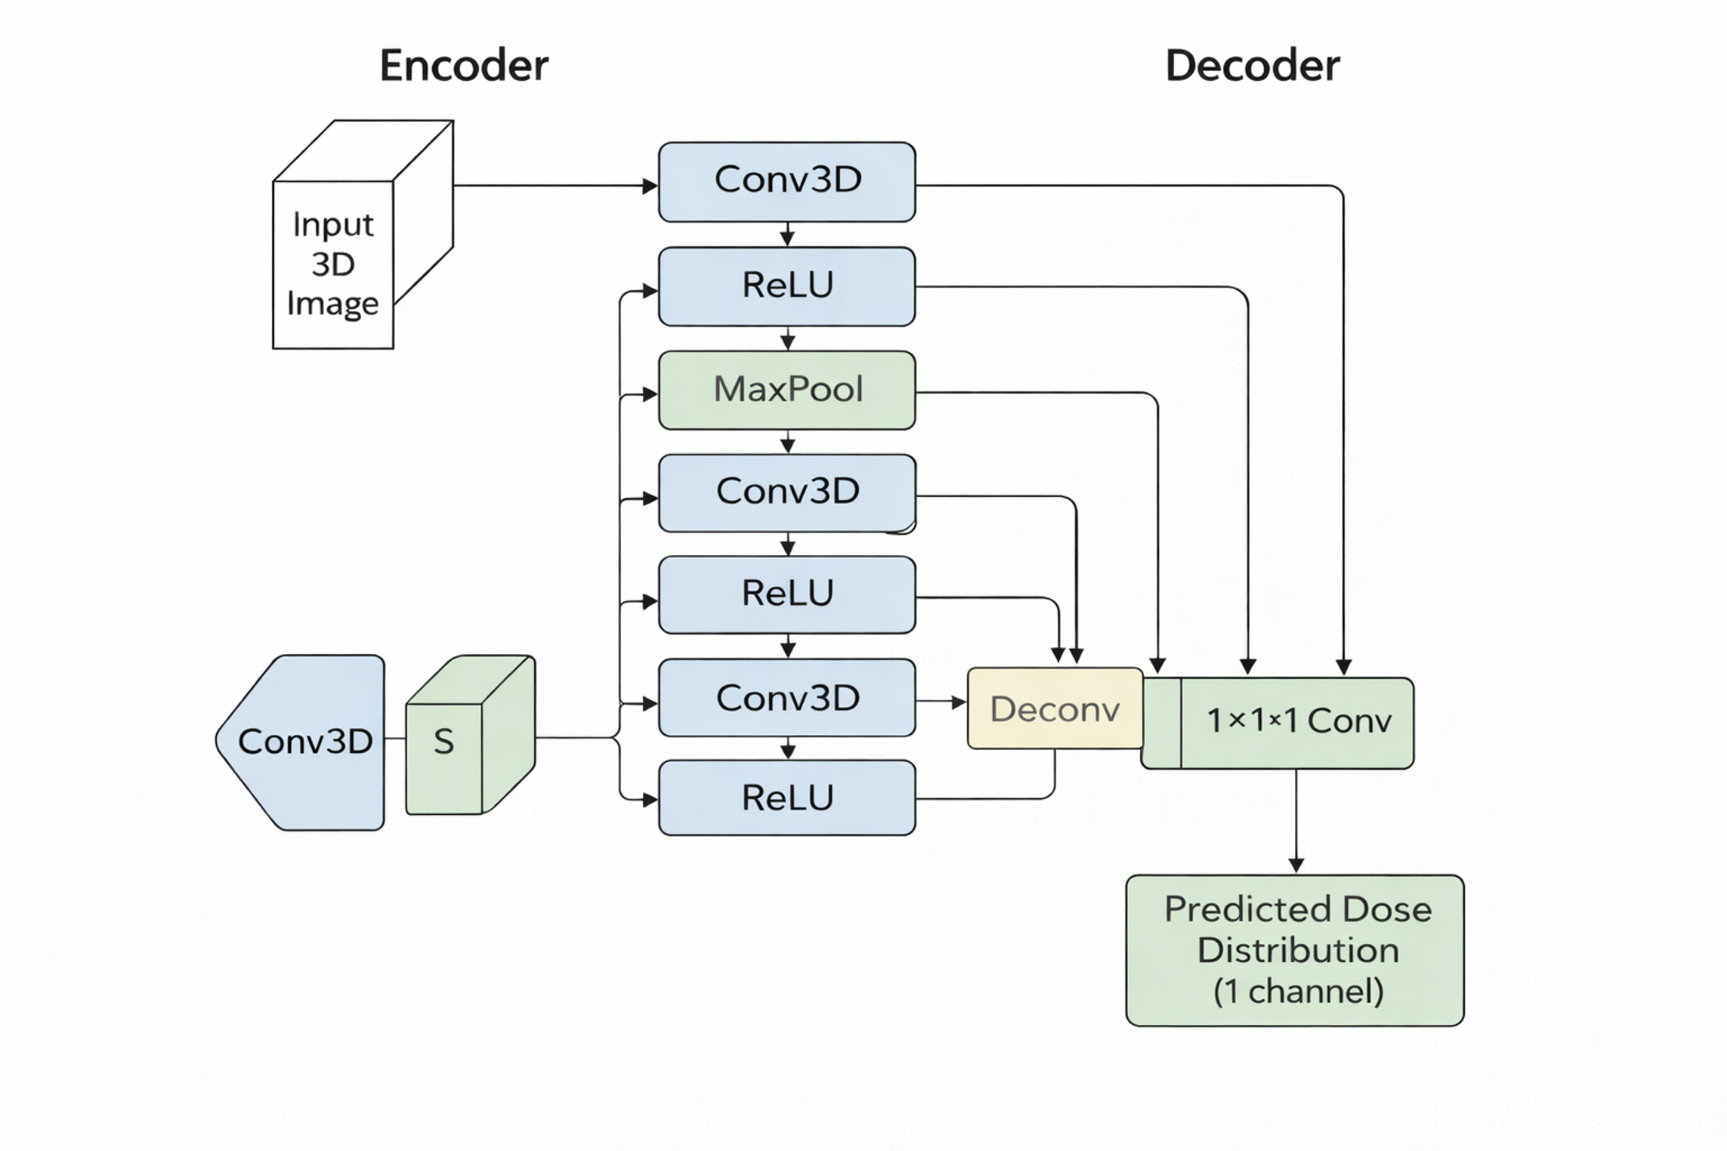
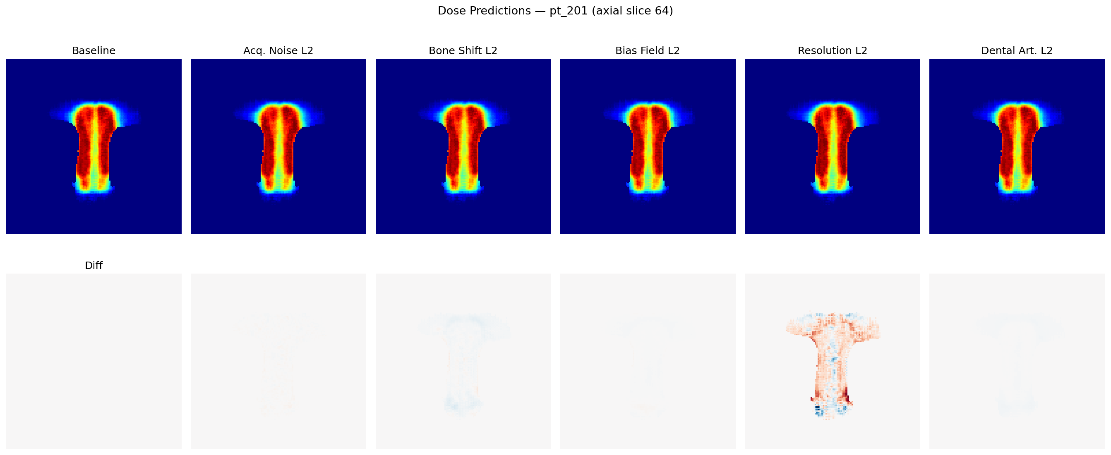
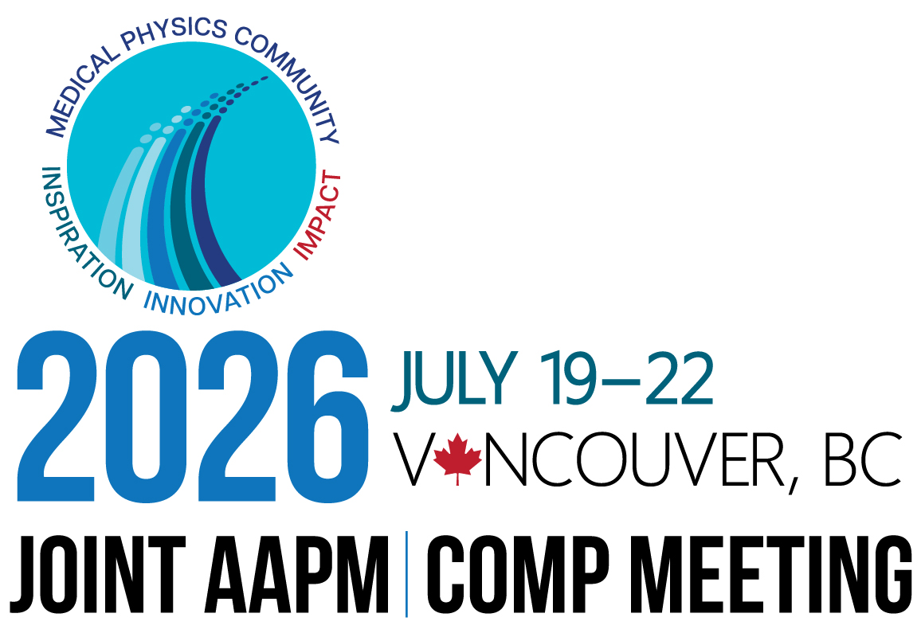
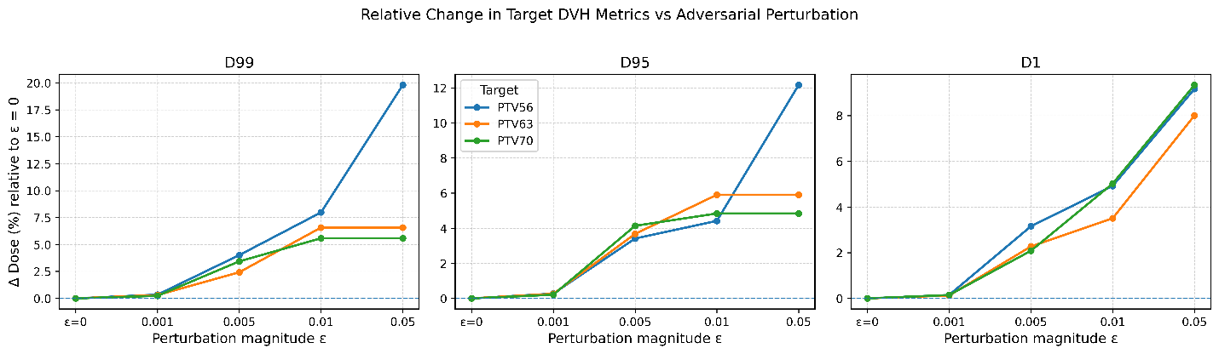
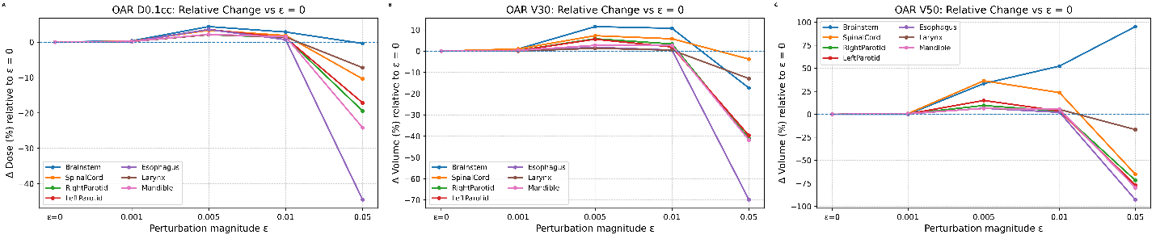
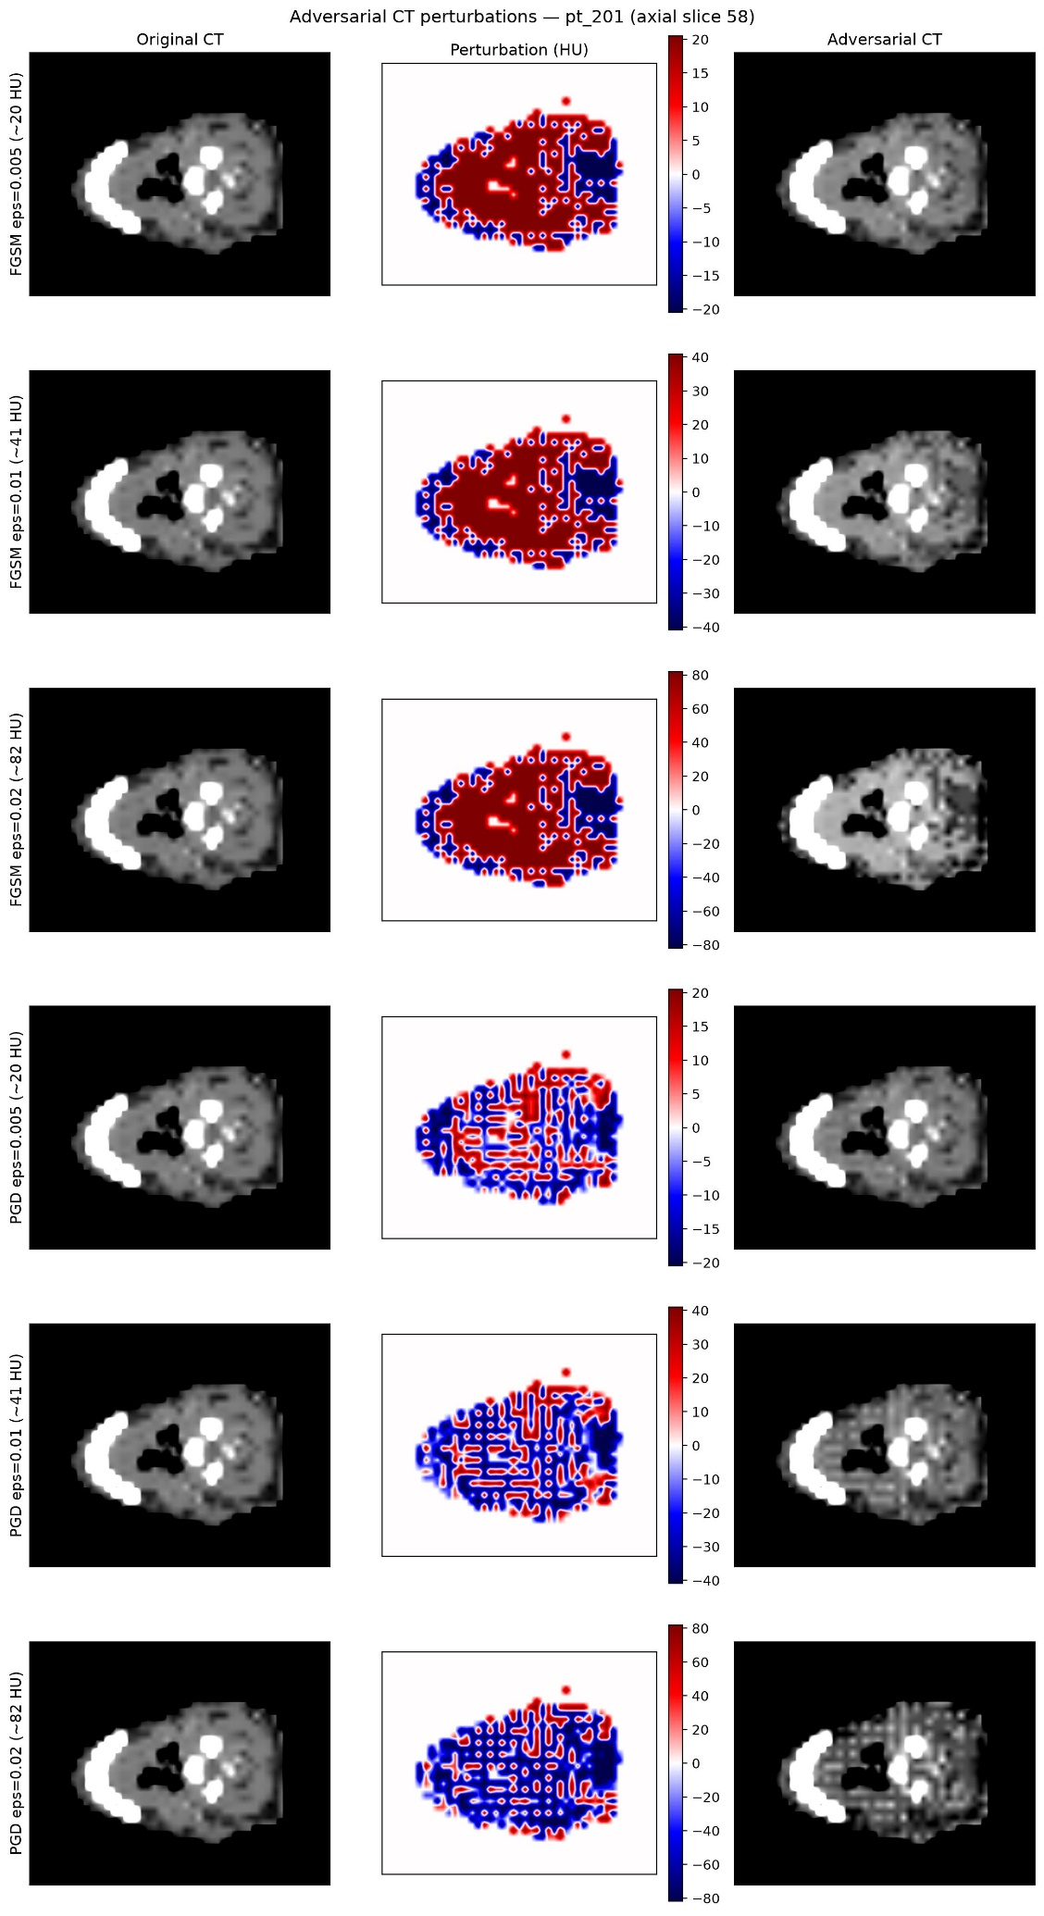
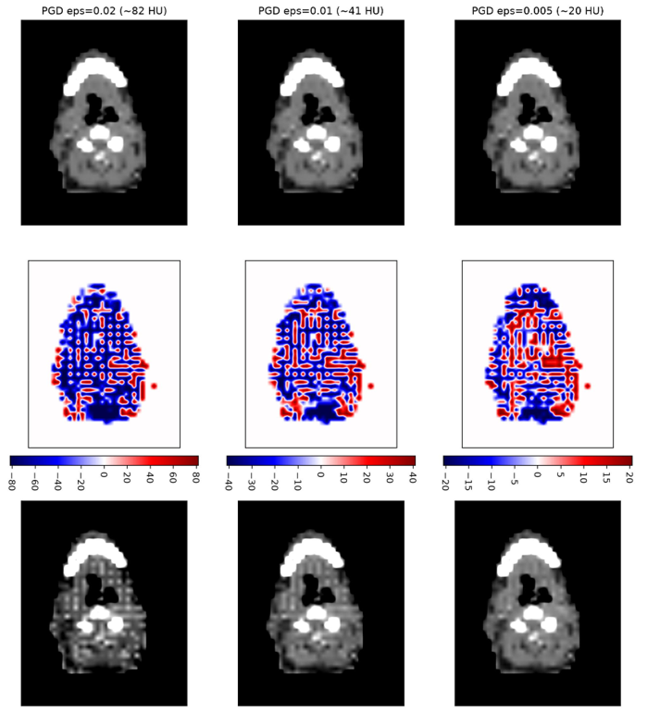
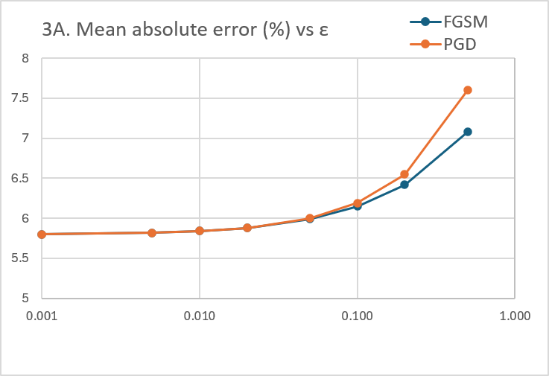
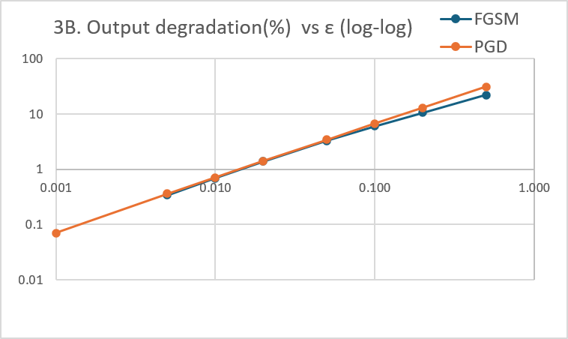
Assessing the Generalizability and Robustness of Deep-Learning Dose Prediction in Head-and-Neck Radiotherapy to Clinically Realistic CT Perturbations
Neil Tripathi¹, Rahim Chowdhury², Lei Ren³, Amit Sawant³, Birjoo Vaishnav³
¹New York University ²UMD St. Joseph Medical Center ³University of Maryland School of Medicine, Department of Radiation Oncology
ABSTRACT
INTRODUCTION
RESULTS
DISCUSSION
Purpose. Deep-learning dose prediction models are increasingly deployed across institutions, where they encounter CT images from different scanners, reconstruction kernels, and acquisition protocols. This study quantifies the robustness of a head-and-neck dose prediction model to five families of clinically realistic CT perturbations and identifies the image-quality factors that materially affect predicted dose.
Methods. A 3D U-Net dose predictor was evaluated on 40 test patients under 26 CT conditions spanning acquisition noise, HU calibration shift, low-frequency bias field, spatial-resolution loss, and dental streak artifacts, at severities meeting or exceeding ACR CT-simulation quality-assurance limits. A perturbation level was defined as clinically visible when the cohort-mean change in any dose-volume-histogram (DVH) criterion exceeded 1.0 Gy relative to each patient's unperturbed prediction.
Results. Four of five perturbation families produced no clinically visible change at any tested severity. Spatial-resolution degradation was the only family to exceed the 1.0 Gy threshold, reaching 2.84 Gy at the larynx (+18.2% DVH score) at the highest severity.
Conclusions. The model is robust to intensity-based CT variability but sensitive to spatial-resolution loss. Multi-institution quality assurance should prioritize CT spatial-resolution and reconstruction-kernel consistency.
Deep-learning dose prediction is increasingly used to support automated and adaptive treatment planning. A model trained at one institution must generalize to CT images acquired under different conditions, including variation in scanner hardware, reconstruction kernel, dose level, and imaging artifacts. In contrast to worst-case adversarial perturbations, these represent benign, physically plausible sources of image variability.
This study characterizes the sensitivity of a head-and-neck dose prediction model to five families of clinically realistic CT perturbations and determines the severity at which each produces clinically significant changes in predicted dose, in order to identify the CT image-quality factors relevant to safe multi-institution deployment.
Four of five perturbation families left every DVH criterion below the 1.0 Gy visibility threshold across the full tested range. Spatial-resolution loss (P4) was the sole family to exceed it: the most affected criterion, larynx near-maximum dose, crossed 1.0 Gy at severity level L2 (2.0/1.0-voxel Gaussian blur) and reached 2.84 Gy at L4 (+18.2% DVH score). Bone-weighted HU calibration shift became measurable only at an implausible 1000 HU offset (0.61 Gy, below threshold). Acquisition noise, bias field, and dental artifacts did not exceed 0.34 Gy on any criterion, even beyond ACR-level severities.
The model was robust to intensity-based CT variability, including acquisition noise, calibration drift, bias field, and dental artifacts, at severities beyond typical clinical ranges. These perturbations preserve the structural boundaries the network uses to localize anatomy.
Spatial-resolution loss degrades this boundary information, producing spatially structured dose errors that increase approximately linearly with blur and appear first in geometrically complex structures such as the larynx, parotid glands, and mandible.
Because realistic inter-scanner differences in slice thickness and reconstruction kernel span the severities at which resolution loss becomes clinically visible, spatial resolution, rather than intensity calibration, is the principal robustness concern for cross-institution deployment.
METHODS
Dataset. The OpenKBP head-and-neck cohort (Babier et al., 2021) was used: 200 training and 40 test patients, each with a 128³ CT, ten organ-at-risk and target structures, and dose normalized to a 70 Gy prescription.
Perturbations. Five families were applied to the test-input CT at five severity levels each (26 conditions total), with parameter ranges meeting or exceeding ACR CT-simulation quality-assurance limits: P1 heteroscedastic acquisition noise; P2 bone-weighted HU calibration shift; P3 low-frequency bias field; P4 anisotropic spatial-resolution loss; P5 dental metal streak artifacts.
Analysis. Impact was quantified as the change in DVH metrics and voxel-wise mean absolute error relative to each patient's unperturbed prediction. A level was deemed clinically visible when the cohort-mean shift in any DVH criterion exceeded 1.0 Gy.
Figure 1. Representative axial CT for one patient: unperturbed image and each perturbation family at intermediate severity (top row), with corresponding difference maps (bottom row). Spatial-resolution loss visibly blurs tissue boundaries, whereas intensity-based perturbations preserve structural edges.
CONCLUSIONS
A head-and-neck deep-learning dose prediction model tolerates clinically realistic intensity-based CT perturbations but is systematically sensitive to spatial-resolution degradation, which becomes clinically visible within the range of realistic inter-scanner variation.
Multi-institution quality assurance should prioritize CT spatial-resolution and reconstruction-kernel consistency, and dose-based rather than image-quality metrics should be used to assess CBCT and synthetic-CT suitability.
Model. A 3D U-Net with squeeze-and-excitation blocks was trained with a masked mean-absolute-error loss and 4× planning-target-volume weighting (baseline DVH score 2.54; dose score 3.73 Gy).
Figure 2. Maximum per-criterion DVH shift versus perturbation severity for each family; the dashed line marks the 1.0 Gy clinical-visibility threshold. Spatial-resolution loss (P4) crosses the threshold between levels L1 and L2; all other families remain near zero.
CONTACT
Birjoo Vaishnav, PhD, DABR
University of Maryland School of Medicine,
Baltimore MD
bvaishnav@som.umaryland.edu
410-427-2039(o)
Figure 3. Predicted dose (top row) and difference-from-baseline maps (bottom row) for each perturbation family. Spatial-resolution loss produces spatially structured dose errors concentrated at organ boundaries; other families produce negligible change.
FUTURE WORK
REFERENCES
Planned extensions include CBCT-characteristic degradations (scatter and cupping, ring artifacts, limited-field-of-view truncation) to establish commissioning tolerances for online adaptive radiotherapy; distribution-free (conformal) and certified per-patient DVH prediction intervals under bounded CT perturbation; and training-time augmentation to improve resolution robustness.
1. Babier A, Mahon R, McNiven A, Diamant A, Chan TCY. Med Phys. 2021;48:4932-4948 (OpenKBP).
2. Gao Y, et al. Phys Med Biol. 2025;70:115006.
3. American College of Radiology. CT Quality Control and Accreditation guidelines.

