Slide 1
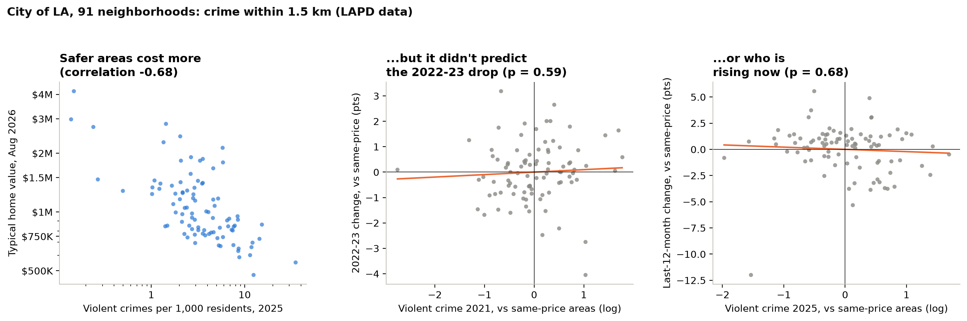
APPENDIX · ONLY IF ASKED ABOUT CRIME
Crime tracks price, but it didn't predict the 2022 drop or today's winners
WHY IT'S IN THE APPENDIX Crime data covers only the City of LA (91 of 496 neighborhoods), and it adds nothing to price prediction: at the same price level, p = 0.59 and 0.68. Price already carries it.
MGMTMSA 437 · Forecasting LA Home Values · Data: Zillow ZHVI, FRED, BLS
1
Notes:
Appendix slide, only if Professor Yu asks about crime. Two reasons it is not in the main talk: it covers only part of our neighborhoods, and it does not help predict prices. LAPD data only covers the City of LA, so this is 91 neighborhoods. We counted crimes within 1.5 kilometers of each neighborhood per 1,000 residents, and split them into violent crime (murder, rape, robbery, aggravated assault) and property crime, using the FBI definitions so 2021 and 2025 count the same things. On the left, violent crime and home value go together strongly: safer neighborhoods cost more, correlation minus 0.68. But the question for forecasting is whether crime tells us anything beyond price. The middle and right panels compare neighborhoods at the same price level. Crime did not predict which neighborhoods fell more in 2022 and 2023, p equals 0.59, or which are rising over the last year, p equals 0.68. Without the price control, high-crime areas did grow less this year, but that is just because they are the cheaper areas, and cheaper areas grew less. Same answer for total crime and property crime.

Slide 2
APPENDIX · ONLY IF ASKED ABOUT INCOME
Why income is not in our monthly ARIMAX
01
Used in the ZIP-level panel
Income enters the cross-sectional panel analysis across ZIP codes.
02
Too slow for a monthly model
IRS income is annual, starts in 2011 and is released with a lag, so it adds little month-to-month variation.
03
No forecast gain
Lagged income growth did not improve out-of-sample forecasts in the panel (RMSE 3.77 vs 3.79).
04
So ARIMAX uses the mortgage rate
The rate is the one outside driver that is monthly, timely and leads prices.
MGMTMSA 437 · Forecasting LA Home Values · Data: Zillow ZHVI, FRED, BLS
2
Notes:
Only if asked about income. We did use income, in the ZIP-level panel. We left it out of the monthly ARIMAX because IRS income is annual, only starts in 2011, and comes out with a lag, so it barely varies month to month. And when we tested lagged income growth out of sample in the panel, it did not help: RMSE 3.77 versus 3.79. So the monthly model uses the mortgage rate.

