Slide 1
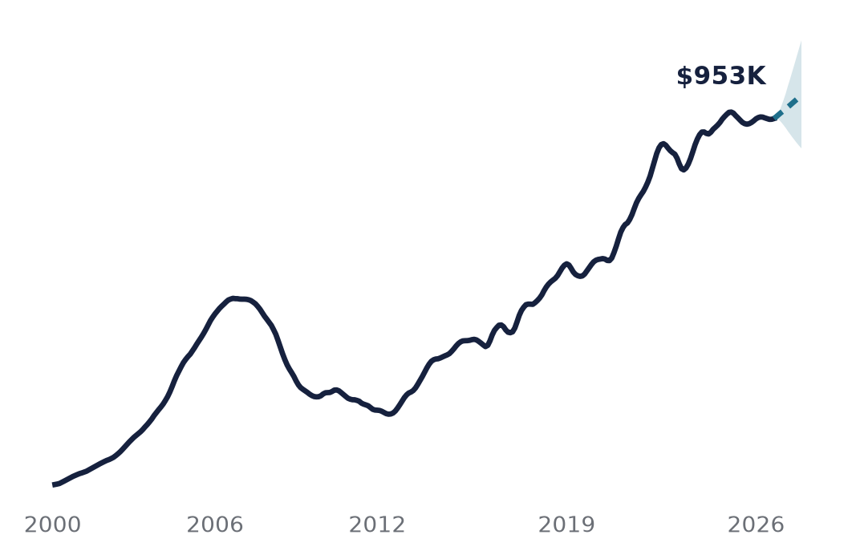
MGMTMSA 437 · FINAL PROJECT · OCTOBER 2026
Forecasting LA Home Values
Mortgage rates more than doubled after 2021. Did LA home values get harder to predict?
Yang Liu · Jinwoo Roh
Yiu-Hon Lee · Thanapol Doungsaeng
Zillow Home Value Index, LA metro, Jan 2000 to Aug 2026, plus 499 neighborhoods and the 30-year mortgage rate
Solid: actual · Dashed: our forecast to Aug 2027
Notes:
Hi everyone. Our project forecasts home values in the Los Angeles metro using Zillow's Home Value Index from January 2000 to August 2026. The line on the right is the whole story in one picture: a boom and bust in the 2000s, a long recovery, a pandemic surge, and then a stall. That stall lines up with mortgage rates more than doubling. So we asked two questions. Which forecasting method predicts LA home values best? And do mortgage rates help the forecast? We also went below the metro level to 499 neighborhoods, because the average hides a lot.

Slide 2
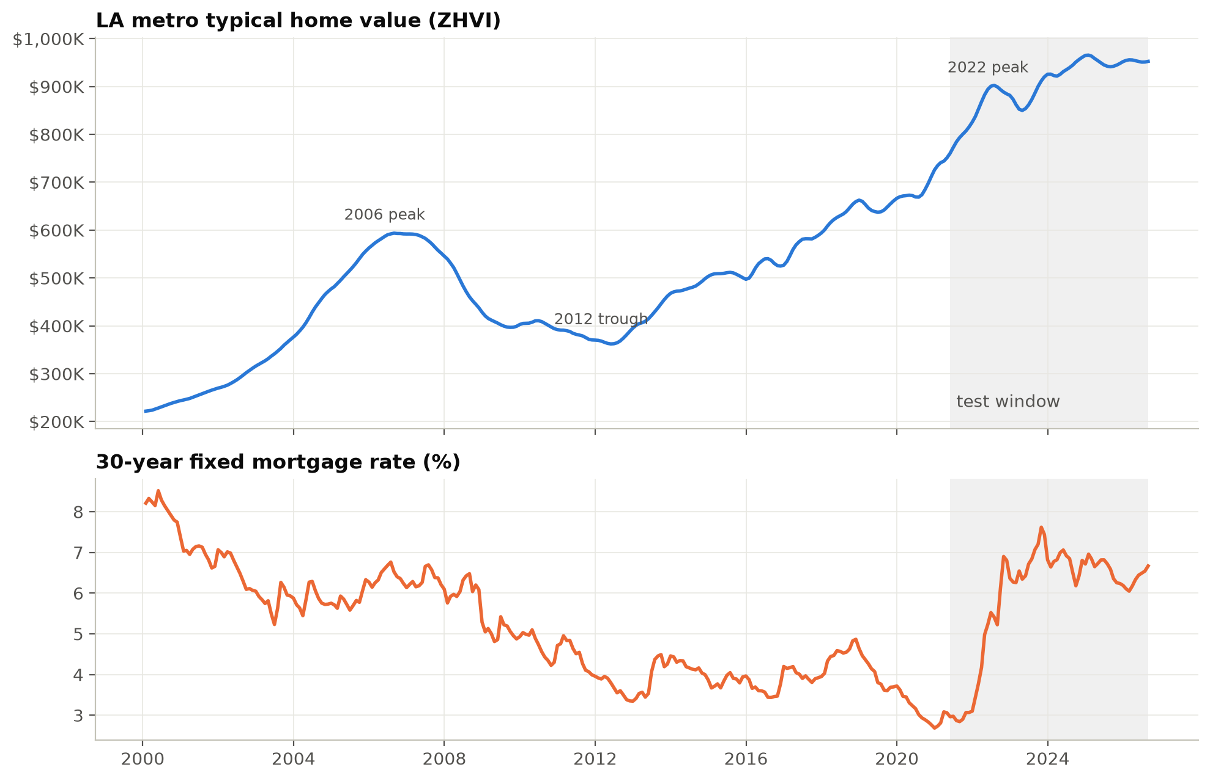
THE QUESTION
LA values grew 5.6% a year for 26 years, then stalled when rates hit 7%
$952,601
typical LA-metro home, August 2026
-1.3%
vs the January 2025 peak of $965,634
2.7% → 7.6%
30-year mortgage rate, 2021 low to 2023 high
MGMTMSA 437 · Forecasting LA Home Values · Data: Zillow ZHVI, FRED MORTGAGE30US
2
Notes:
From 2000 to 2026, LA home values grew about 5.6 percent a year, with a 37 percent crash between 2006 and 2012 along the way. Today the typical home is worth about 952 thousand dollars, which is 1.3 percent below the January 2025 peak. The bottom panel shows why this period is interesting: the 30-year mortgage rate went from 2.7 percent in 2021 to 7.6 percent in 2023. The shaded area is our test window, so every model has to forecast through that rate shock.

Slide 3
DATA AND DESIGN
We tested 11 models two ways, so no model could win by luck
DATA
11 MODELS
2 TESTS
Zillow ZHVI, LA metro
Baselines
Blind 80/20
320 months, Jan 2000 to Aug 2026
Naive drift
Train to Apr 2021, forecast 64 months in one shot
499 LA neighborhoods
Classical
Zillow neighborhood index
ARIMA · Holt · Prophet
Rolling origin
Refit every 3 months, forecast 12 months ahead, 18 times
30-year mortgage rate
Machine / deep learning
FRED, monthly
XGBoost · LightGBM · LSTM · GRU
Outside information
ARIMAX (rates) · VAR · factor VAR
WHY NOT 1-MONTH ERRORS Zillow smooths this index, so every decent model is about 0.1% off one month ahead. We judge models at 6 to 12 months instead.
MGMTMSA 437 · Forecasting LA Home Values · Data: Zillow ZHVI, FRED MORTGAGE30US
3
Notes:
Here is the setup. Three data sources: the Zillow index for the metro, 499 neighborhoods from Zillow's neighborhood file, and the 30-year mortgage rate from FRED. We compared eleven models in four families, from a naive drift baseline to LSTM and GRU networks, plus three models that use outside information. And we scored them two ways. A blind 80/20 split, like most projects use, and a rolling-origin test where we refit every three months and forecast twelve months ahead, eighteen times. One warning: Zillow smooths this index, so next month is almost the same as this month and every decent model is about 0.1 percent off one month ahead. That tells us nothing, so we judge models at six to twelve months.

Slide 4
RESULT 1 · ROLLING TEST
In the fair test, ARIMA-family models beat machine learning
LOWEST ERROR
2.67%
ARIMAX, average error 1 to 12 months ahead. ARIMA 2.77%. LSTM 3.02%, XGBoost 3.65%, Prophet 6.89%.
MGMTMSA 437 · Forecasting LA Home Values · Data: Zillow ZHVI, FRED MORTGAGE30US
4
Notes:
This is the main result, the rolling test. ARIMAX, which is ARIMA plus mortgage rates, had the lowest average error at 2.67 percent, with plain ARIMA right behind at 2.77. The neural networks landed in the middle, the tree models near the bottom, and Prophet last at almost 7 percent, mostly because it fits a smooth trend and does not start from the latest value. Our read: with about 250 monthly observations of a smooth index, there just is not much nonlinear structure for machine learning to find.

Slide 5
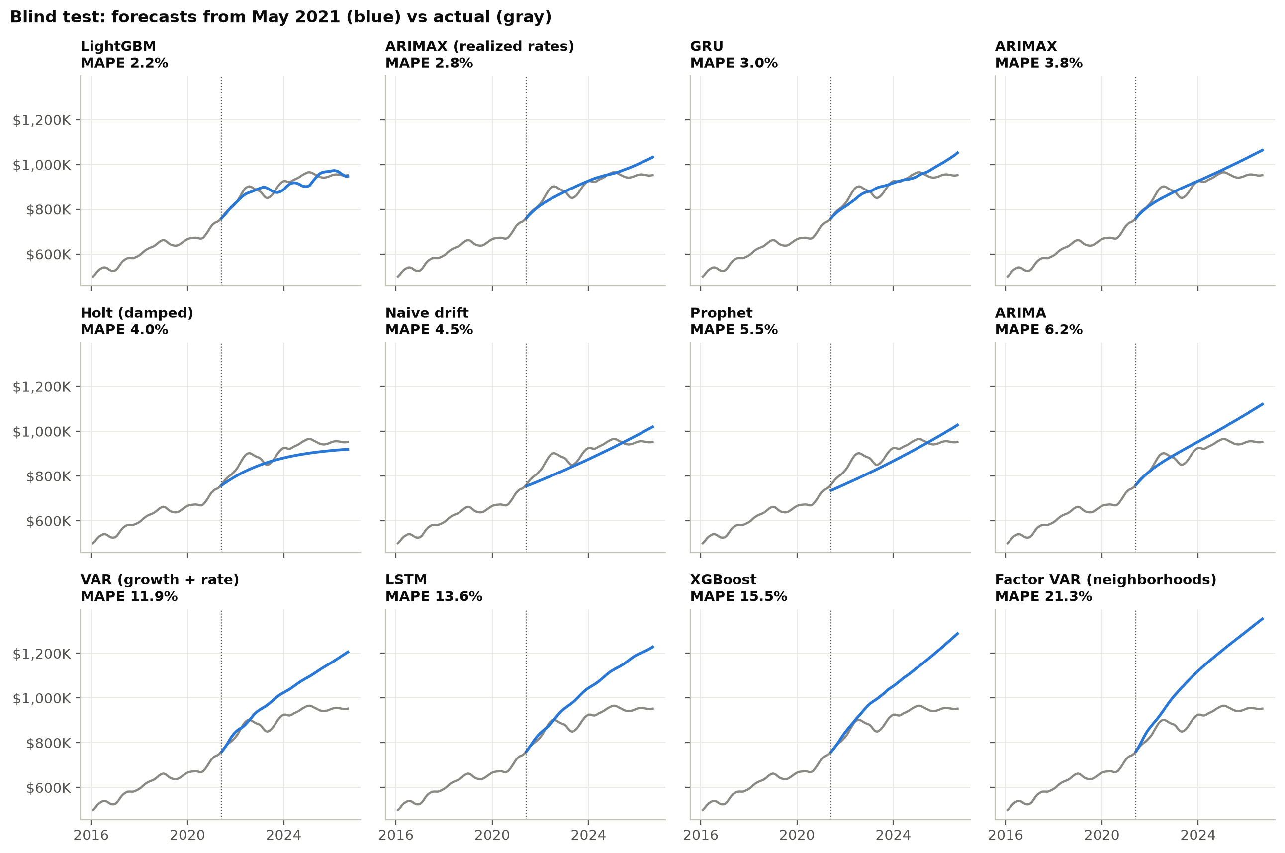
RESULT 2 · TEST DESIGN
One test window crowned LightGBM; 18 windows ranked it eighth
SAME MODEL, TWO TESTS
1st → 8th
LightGBM won the single 64-month test (2.2% error) but ranked 8th across 18 rolling tests: it got lucky in the one window that counted.
MGMTMSA 437 · Forecasting LA Home Values · Data: Zillow ZHVI, FRED MORTGAGE30US
5
Notes:
Here is why the test design matters. In the single blind test, LightGBM won with a 2.2 percent error. It was the only model whose forecast bent, and it happened to bend in the right years. Across eighteen rolling tests it ranked eighth. Meanwhile VAR, LSTM and XGBoost took the 2021 boom and kept going, ending 25 to 35 percent too high. The lesson for us: one test window can crown the wrong model, so we trust the rolling test.

Slide 6
RESULT 3 · MORTGAGE RATES
Mortgage rates help at 12 months, but nothing beats naive drift a year out
RATES WORK SLOWLY
24 months
Rate rises hit LA values about two years later (coefficient -0.063, p = 0.16: real but weak). At 12 months ARIMAX is 4.98% off vs 5.37% for ARIMA, but naive drift scores 4.92%.
MGMTMSA 437 · Forecasting LA Home Values · Data: Zillow ZHVI, FRED MORTGAGE30US
6
Notes:
Do mortgage rates help? A little, and slowly. In the training data, a rise in rates shows up in LA home values about two years later, so our ARIMAX uses the rate change lagged 24 months. The coefficient has the right sign but a p-value of 0.16, so it is weak evidence. The chart shows where it helps: ARIMAX and ARIMA are tied at short horizons, and ARIMAX pulls ahead at 12 months, 4.98 versus 5.37 percent. But the honest finding is that a naive drift, just extending LA's long-run growth, is as good as anything we built a year out.

Slide 7
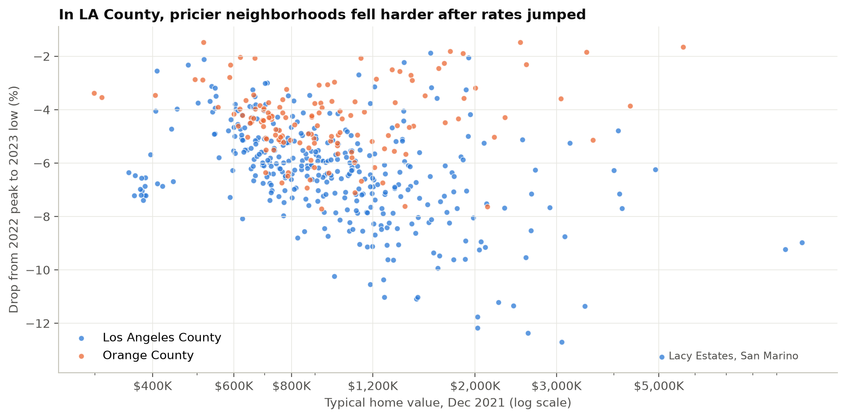
NEIGHBORHOODS · 2022 SHOCK
In LA County, pricier neighborhoods fell hardest after rates jumped
STILL BELOW 2022 PEAK
152 of 496
neighborhoods are still below their 2022 peak. Median today vs that peak: LA County +1.2%, Orange County +15.3%.
MGMTMSA 437 · Forecasting LA Home Values · Data: Zillow ZHVI, FRED MORTGAGE30US
7
Notes:
Now below the metro level. Each dot is a neighborhood. Across the bottom is its home value before the shock, and up the side is how far it fell from the 2022 peak to the 2023 low. In LA County the expensive neighborhoods fell the most, which makes sense: a buyer of a two-million-dollar home feels a jump from 3 to 7 percent much more in dollars. Orange County, in orange, held up better. Four years later many neighborhoods are still below their 2022 peak, mostly in LA County.

Slide 8
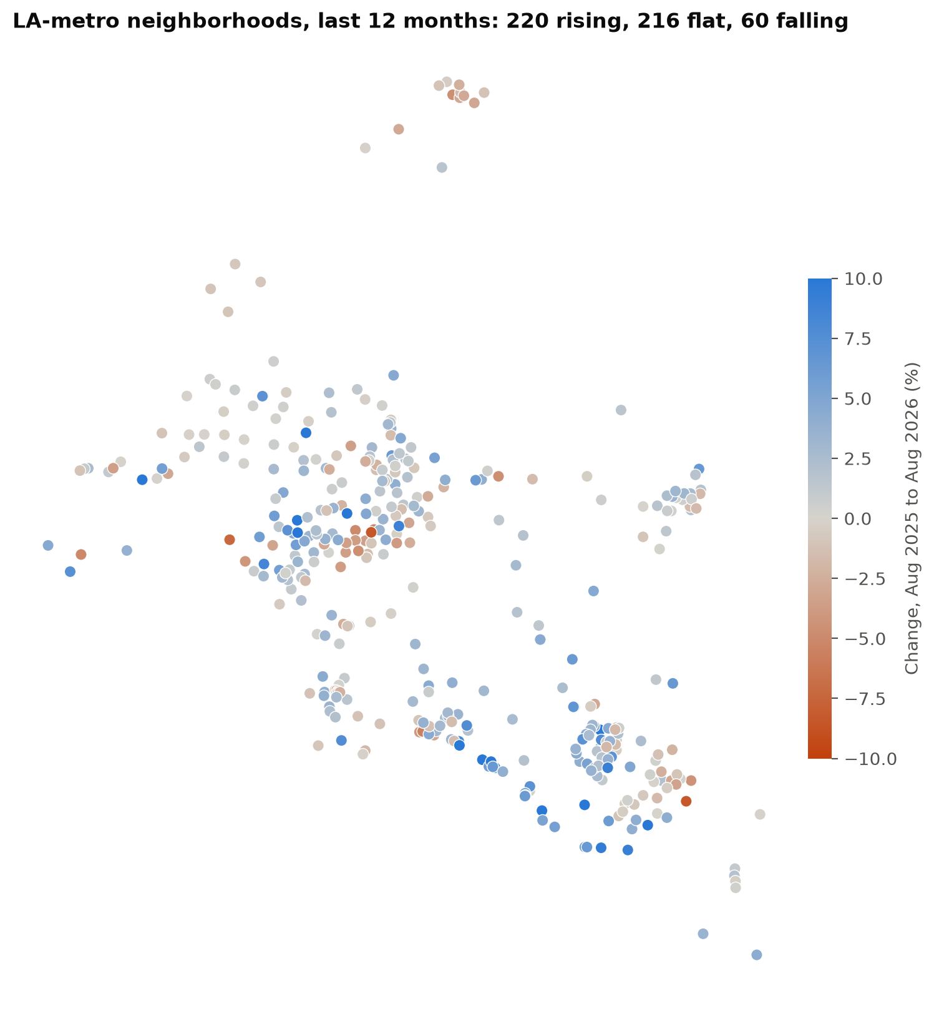
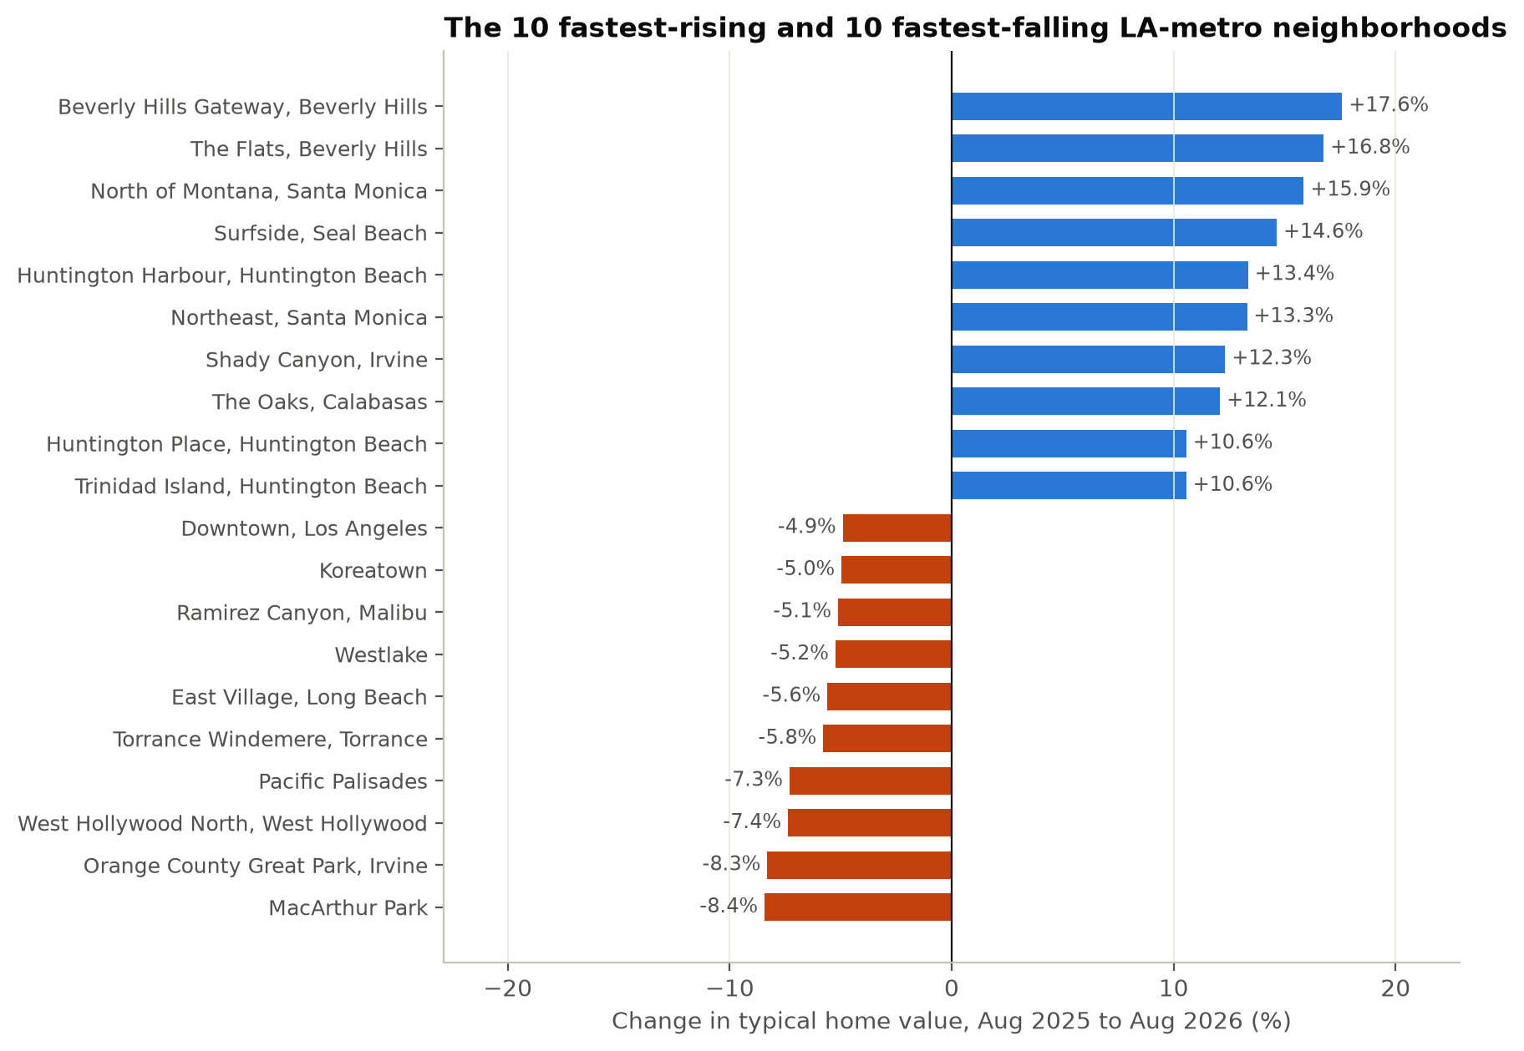
NEIGHBORHOODS · LAST 12 MONTHS
Right now coastal neighborhoods are rising while central LA falls
MGMTMSA 437 · Forecasting LA Home Values · Data: Zillow ZHVI, FRED MORTGAGE30US
8
Notes:
Which neighborhoods are going up and down right now? Over the last twelve months, 220 LA-metro neighborhoods rose more than 2 percent, 216 were flat, and 60 fell more than 2 percent. Blue on the map is rising and red is falling. The pattern is a reversal of 2023: the coastal, high-end areas that fell hardest are now leading. The weakest areas are central LA, places like MacArthur Park, Koreatown, Downtown and Westlake. Pacific Palisades also fell, but that reflects the January 2025 fire rather than the market.

Slide 9
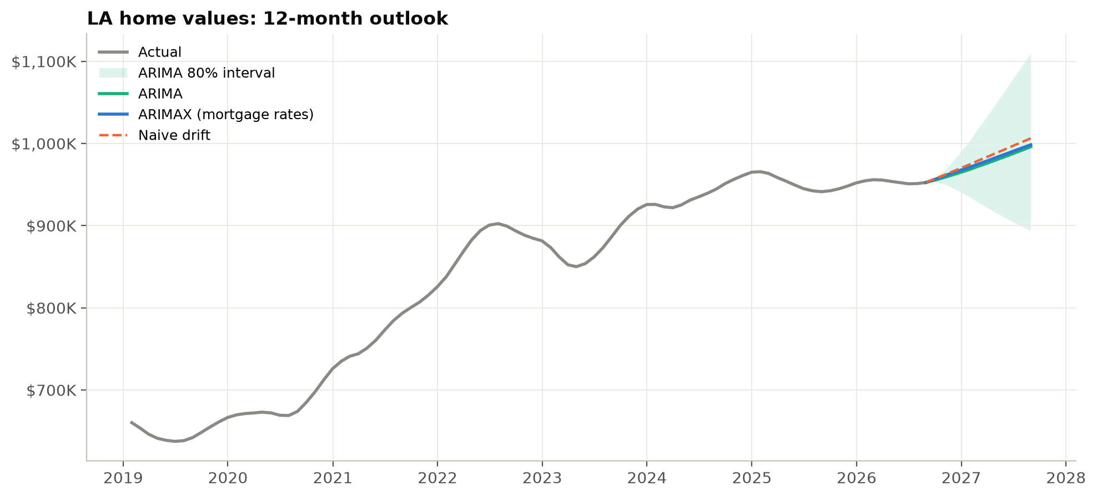
OUTLOOK
Our forecast: about 5% higher by August 2027, with a wide range
$998,391
ARIMAX forecast, Aug 2027 (+4.8%)
-6% to +17%
80% range for the next 12 months
+4.8% / +6.5%
median neighborhood forecast, LA County / Orange County
MGMTMSA 437 · Forecasting LA Home Values · Data: Zillow ZHVI, FRED MORTGAGE30US
9
Notes:
So what happens next? Our best model forecasts the typical LA home at about 998 thousand dollars in August 2027, up 4.8 percent. ARIMA and naive drift agree closely. The honest headline is the range: the 80 percent interval runs from a 6 percent fall to a 17 percent rise. Neighborhood forecasts are a bit stronger in Orange County than in LA County. Because rates act with a two-year lag, today's rates mostly affect 2028, not this forecast.

Slide 10
TAKEAWAYS
What we learned
01
Simple beats complex for a smooth monthly index
ARIMA-family models won; LSTM, GRU and boosted trees never beat them.
02
How you test decides who wins
One blind window ranked LightGBM 1st; 18 rolling windows ranked it 8th.
03
Mortgage rates matter, slowly and modestly
About a two-year lag and a small gain at 12 months. Naive drift is as good a year out.
04
The metro average hides a split market
One shared factor drives most neighborhood movement, yet separate ARIMA models per neighborhood forecast better (2.8% vs 4.1% error).
MGMTMSA 437 · Forecasting LA Home Values · Data: Zillow ZHVI, FRED MORTGAGE30US
10
Notes:
Four takeaways. First, for a smooth monthly housing index, simple models beat complex ones. Second, how you test decides who wins: one blind window would have picked the wrong model. Third, mortgage rates matter, but slowly, with about a two-year lag and a modest gain. And fourth, the metro average hides a split market. One common factor drives most of the movement across neighborhoods, but each neighborhood's own trend is what you need to forecast it. If you are buying or lending in LA, look at the neighborhood, not the metro number. Thank you.

