Slide 1
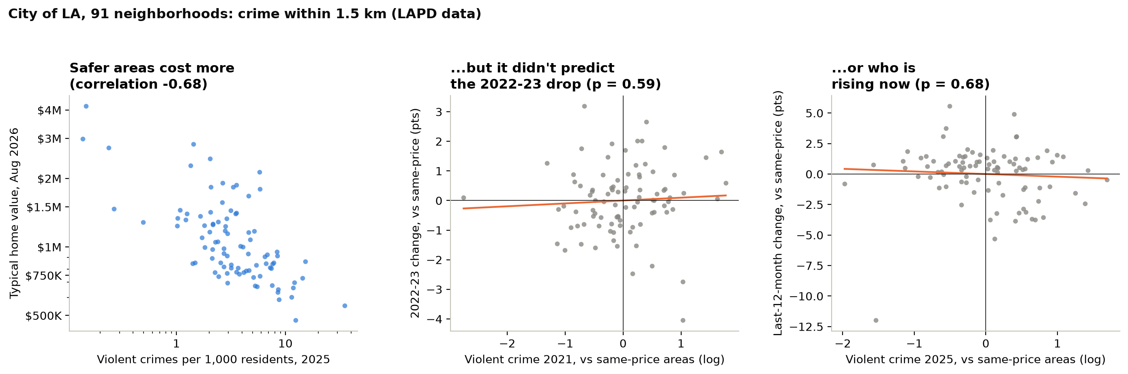
BACKUP · CRIME IN THE CITY OF LA
Crime tracks price, but it didn't predict the 2022 drop or today's winners
WHAT IT MEANS Violent crime is strongly linked to lower prices (r = −0.68). Compare neighborhoods at the same price, though, and crime adds nothing (p = 0.59 and 0.68). Price already carries it.
MGMTMSA 437 · Forecasting LA Home Values · Data: Zillow ZHVI, FRED, BLS
1
Notes:
A backup slide in case someone asks about crime. LAPD data only covers the City of LA, so this is 91 neighborhoods. We counted crimes within 1.5 kilometers of each neighborhood per 1,000 residents, and split them into violent crime (murder, rape, robbery, aggravated assault) and property crime, using the FBI definitions so 2021 and 2025 count the same things. On the left, violent crime and home value go together strongly: safer neighborhoods cost more, correlation minus 0.68. But the question for forecasting is whether crime tells us anything beyond price. The middle and right panels compare neighborhoods at the same price level. Crime did not predict which neighborhoods fell more in 2022 and 2023, p equals 0.59, or which are rising over the last year, p equals 0.68. Without the price control, high-crime areas did grow less this year, but that is just because they are the cheaper areas, and cheaper areas grew less. Same answer for total crime and property crime.

