Slide 1
APPENDIX A1 · INFORMATION SETS
What each method knew at each forecast date
Method | Price history | Real dates | Place | Mortgage rate | Jobs
ARIMA, naive drift, ML models | 2000 to forecast date | no | no | no | no
ARIMAX | 2000 to forecast date | no | no | yes, lag 24 | no
ARIMAX + jobs | 2000 to forecast date | no | no | yes, lag 24 | yes, lag 12
AI, named prompt | 2000 to forecast date | yes | yes | yes | no
AI, blind prompt | 2000 to forecast date | no | no | yes | no
AI, masked prompt | last 10 years | no | no | no | no
AI, masked, all history (Claude only) | 2000 to forecast date | no | no | no | no
MGMTMSA 437 · Forecasting LA Home Values · Data: Zillow ZHVI, FRED, BLS
1
Notes:
Only if asked what each method could see. Every method saw only data up to its forecast date. Models and the masked AI never see the place or the dates. Named and blind AI see the real mortgage rate, which is enough to date the series.

Slide 2
APPENDIX A2 · MODELS
The 14 models in one line each
Model | Family | In one line
Naive drift | Baseline | Last value, grown at the average monthly growth since 2000 (a random walk with drift).
ARIMA | Classical | Forecasts from the series' own recent values and recent surprises, after differencing once; ARIMA(1,1,2) on log price.
Holt (damped) | Classical | Exponential smoothing of the level and trend, with the trend slowly flattening out.
Prophet | Classical | Meta's curve-fitting model: one smooth trend line plus changepoints; does not start from the latest value.
Prophet + COVID & rates | Classical | Prophet with the 2020-22 boom marked as a one-off and the mortgage rate (lagged 24 months) added.
XGBoost | ML | Boosted decision trees predicting next month's growth from the last 12 months of growth.
LightGBM | ML | A faster boosted-tree method, same inputs as XGBoost.
LSTM | Deep learning | A recurrent neural network that reads the last 24 months of growth and predicts the next.
GRU | Deep learning | A simpler recurrent network, same setup as the LSTM.
Chronos (foundation model) | AI, pretrained | Amazon's pretrained time-series model, used as is: it reads the price history and forecasts, never trained on our data.
ARIMAX | Outside info | ARIMA on monthly growth plus the 12-month change in the mortgage rate, lagged 24 months.
ARIMAX + jobs | Outside info | ARIMAX plus 12-month payroll job growth in LA and Orange County, lagged 12 months.
VAR (growth + rate) | Outside info | Home growth and rate changes forecast each other (11 monthly lags).
Factor VAR (neighborhoods) | Outside info | Summarizes ~400 neighborhoods into 2 common factors and forecasts them together with metro growth.
MGMTMSA 437 · Forecasting LA Home Values · Data: Zillow ZHVI, FRED, BLS
2
Notes:
Only if asked about a specific model. One line each, in plain English.

Slide 3
APPENDIX A3 · ROLLING-ORIGIN TEST
Full rolling-origin results, 14 models
Model | 1 mo | 3 mo | 6 mo | 12 mo | Avg 1-12 | RMSE $ | RMSE rank
ARIMAX | 0.09 | 0.81 | 2.45 | 4.98 | 2.67 | 35.8K | 1
ARIMA | 0.09 | 0.78 | 2.53 | 5.37 | 2.77 | 38.1K | 4
ARIMAX + jobs | 0.12 | 0.94 | 2.63 | 5.12 | 2.81 | 36.2K | 2
VAR (growth + rate) | 0.14 | 0.94 | 2.56 | 5.74 | 2.93 | 47.6K | 10
LSTM | 0.12 | 0.89 | 2.95 | 5.58 | 3.02 | 43.3K | 6
GRU | 0.11 | 0.93 | 2.99 | 5.86 | 3.18 | 41.5K | 5
Naive drift | 0.69 | 1.93 | 3.48 | 4.92 | 3.27 | 37.6K | 3
Holt (damped) | 0.28 | 1.15 | 3.04 | 6.34 | 3.39 | 44.3K | 7
Chronos (foundation model) | 0.69 | 1.61 | 3.44 | 6.13 | 3.56 | 45.3K | 8
LightGBM | 0.22 | 1.23 | 3.32 | 6.97 | 3.60 | 46.5K | 9
Factor VAR (neighborhoods) | 0.16 | 1.15 | 3.56 | 6.60 | 3.64 | 50.7K | 12
XGBoost | 0.25 | 1.25 | 3.40 | 6.82 | 3.65 | 47.8K | 11
Prophet + COVID & rates | 3.27 | 4.08 | 5.32 | 6.45 | 5.12 | 53.5K | 13
Prophet | 5.00 | 5.76 | 6.73 | 8.62 | 6.89 | 70.2K | 14
MGMTMSA 437 · Forecasting LA Home Values · Data: Zillow ZHVI, FRED, BLS
3
Notes:
Mean absolute percentage error at 1, 3, 6 and 12 months ahead and averaged over months 1 to 12, across 18 forecast dates. RMSE is in dollars, averaged over months 1 to 12.

Slide 4
APPENDIX A4 · AI RECOGNITION CHECKS
Memory checks on Claude
Check (Claude only) | Result
Name the blind series | Los Angeles 16 of 18, California 17 of 18; dates exact every time
Name the masked series | Los Angeles 0 of 18; guesses: unknown 7, Seattle 6, Portland 2, San Francisco 1, Dallas 1, Denver 1
Date the masked series | median 1 month off, max 4
Masked, all history since 2000 | 2.47% avg error (ARIMAX 2.67%), DM p = 0.25; April 2022 forecast -4.7% (actual -3.7%)
Earlier run through Claude Code | named 1.58%, masked 2.67%; the clean API rerun changed little
MGMTMSA 437 · Forecasting LA Home Values · Data: Zillow ZHVI, FRED, BLS
4
Notes:
Only if asked how we know the AI recognized the period. These checks ran on Claude only.

Slide 5
APPENDIX A5 · TREND CHECK
Named and blind AI tracked what happened; masked AI tracked the trend
Prompt | Claude | GPT | Gemini | Follows
Named | 0.97 / 0.14 | 0.91 / 0.16 | 0.90 / 0.28 | what happened
Blind | 0.89 / 0.19 | 0.94 / 0.23 | 0.83 / 0.15 | what happened
Masked | 0.21 / 0.83 | 0.26 / 0.87 | 0.15 / 0.49 | recent trend
ARIMAX | 0.37 / 0.66 |  |  | recent trend
NOTE Each cell: correlation of the 12-month forecast with the actual 12-month change / with the last 3 months' growth, across 18 forecast dates.
MGMTMSA 437 · Forecasting LA Home Values · Data: Zillow ZHVI, FRED, BLS
5
Notes:
Only if asked. A forecaster that recalls the outcome tracks what actually happened; one that forecasts from the data tracks the recent trend, as ARIMAX does.

Slide 6
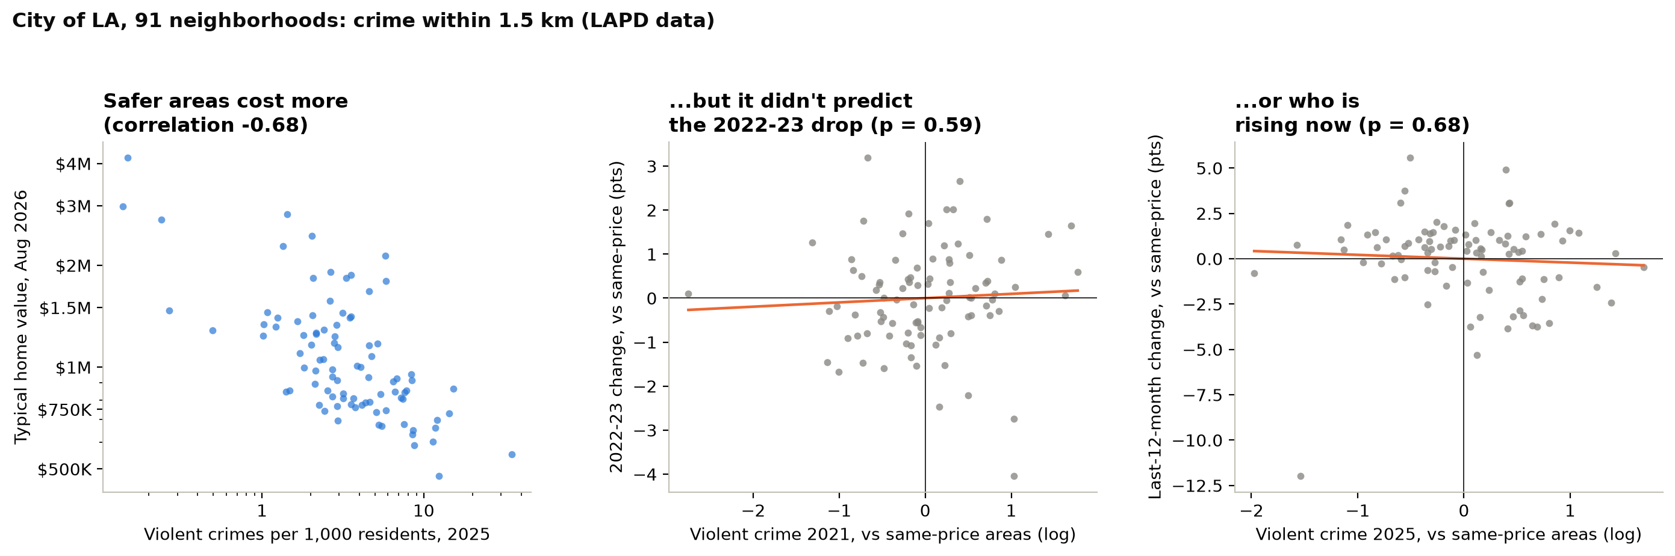
APPENDIX A6 · ONLY IF ASKED ABOUT CRIME
Crime tracks price, but it didn't predict the 2022 drop or today's winners
WHY IT'S IN THE APPENDIX Crime data covers only the City of LA (91 of 496 neighborhoods), and it adds nothing to price prediction: at the same price level, p = 0.59 and 0.68. Price already carries it.
MGMTMSA 437 · Forecasting LA Home Values · Data: Zillow ZHVI, FRED, BLS
6
Notes:
Appendix slide, only if Professor Yu asks about crime. Two reasons it is not in the main talk: it covers only part of our neighborhoods, and it does not help predict prices. LAPD data only covers the City of LA, so this is 91 neighborhoods. We counted crimes within 1.5 kilometers of each neighborhood per 1,000 residents, and split them into violent crime (murder, rape, robbery, aggravated assault) and property crime, using the FBI definitions so 2021 and 2025 count the same things. On the left, violent crime and home value go together strongly: safer neighborhoods cost more, correlation minus 0.68. But the question for forecasting is whether crime tells us anything beyond price. The middle and right panels compare neighborhoods at the same price level. Crime did not predict which neighborhoods fell more in 2022 and 2023, p equals 0.59, or which are rising over the last year, p equals 0.68. Without the price control, high-crime areas did grow less this year, but that is just because they are the cheaper areas, and cheaper areas grew less. Same answer for total crime and property crime.

