Slide 1
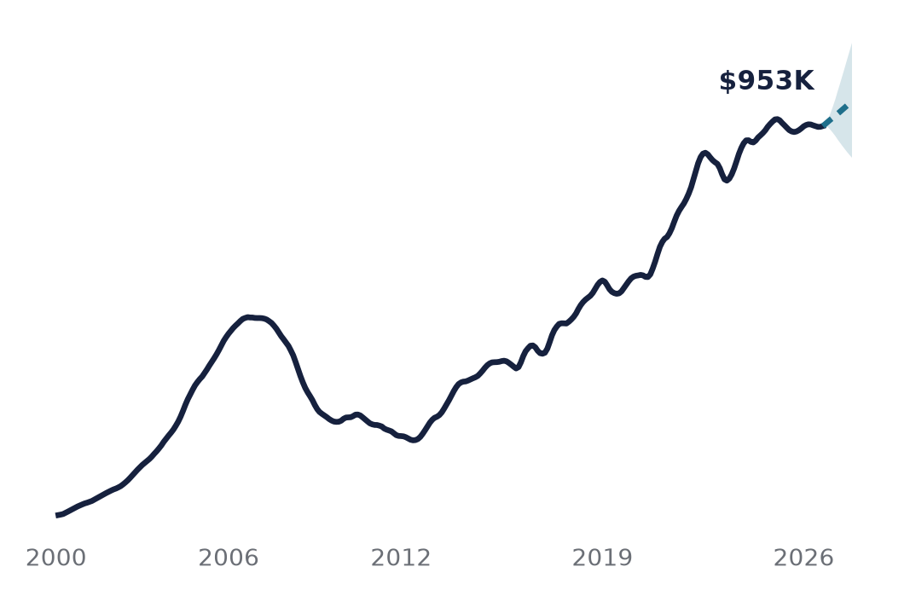
Forecasting LA
Home Values
MGMTMSA 437 · Final project · October 2026
How well can we forecast LA home values up to a year ahead, and which works best: time-series models or AI?
Yang Liu · Jinwoo Roh
Yiu-Hon Lee · Thanapol Doungsaeng
Monthly Zillow home values for the LA metro, January 2000 to August 2026, with mortgage rates and neighborhood data
Solid: actual · Dashed: our forecast to Aug 2027
Notes:
[Yang] Hi everyone. We forecast home values in the Los Angeles metro, using Zillow's monthly index from 2000 to August 2026. The line shows the whole story: a boom and bust in the 2000s, a long recovery, a pandemic surge, then a stall. Our question: how well can we forecast LA home values up to a year ahead, and what works best? We compare traditional time-series models with an alternative many people now try first: asking an AI chatbot. From here on we just say AI, or LLM. We asked each one through its API, one fresh question at a time, with no conversation history.

Slide 2
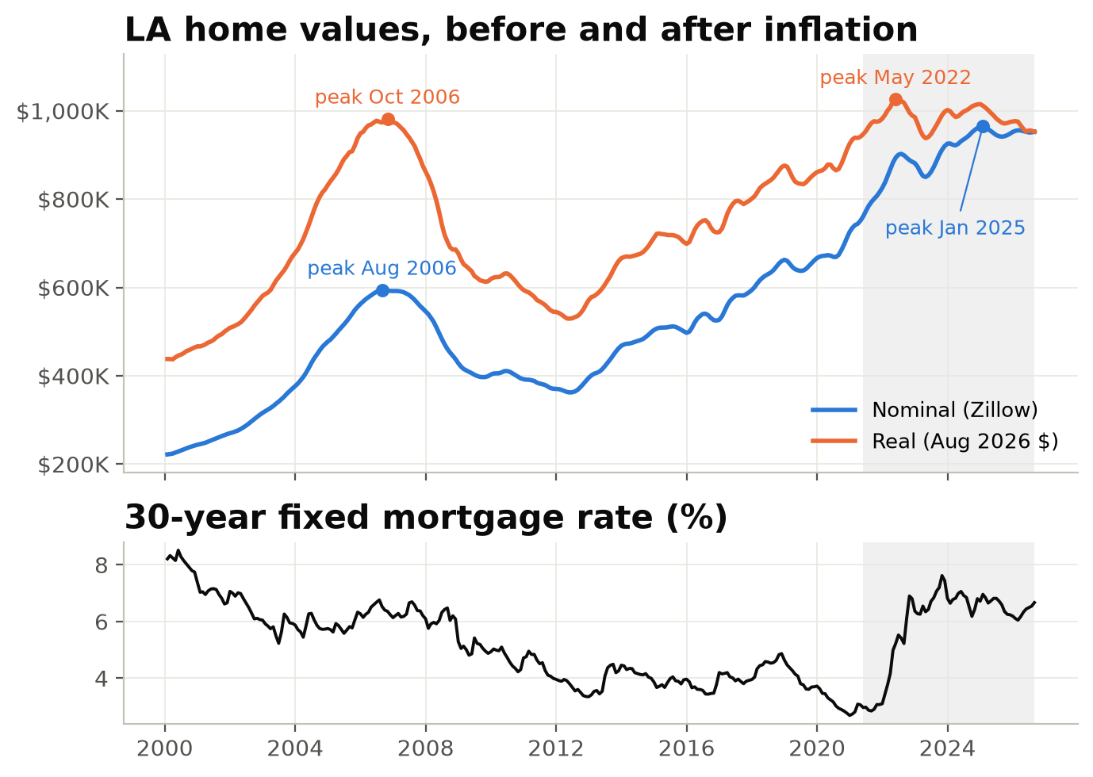
After decades of growth, LA home values have stalled
Why LA, why now
$952,601
Typical home value, LA metro, August 2026
-1.3%
Below the January 2025 peak, before inflation
-7.1%
Below the May 2022 peak, after inflation
2.7% → 7.6%
30-year mortgage rate, 2021 low to 2023 high
MGMTMSA 437 · Forecasting LA Home Values · Data: Zillow ZHVI, FRED, BLS
2
Notes:
[Yang] From 2000 to 2026, LA home values grew about 5.6 percent a year on average, with a 39 percent crash from 2006 to 2012. The typical home is worth about 952 thousand dollars, 1.3 percent below the January 2025 peak. The orange line takes out inflation: in today's dollars, LA is about 7 percent below its 2022 peak, not 1 percent. The bottom panel shows why this is a hard test: the 30-year mortgage rate went from 2.7 percent in 2021 to 7.6 percent in 2023, and the shaded test window runs right through that shock.

Slide 3
We tested 14 models at 18 forecast dates
Data and design
Data
14 models + 3 AI
How we tested
Zillow ZHVI, LA metro
Baseline and classical
1. Rolling-origin test (main)
320 months, Jan 2000 to Aug 2026
Naive drift · ARIMA · Holt · Prophet ×2
Repeated 12-month forecasts: update every 3 months, 18 start dates
499 LA neighborhoods
ML, deep learning, AI
Zillow neighborhood index
XGBoost · LightGBM · LSTM · GRU · Chronos
2. One long forecast
Train on the first 80% (to April 2021), then forecast the next 64 months in one shot
Mortgage rate and payroll jobs
Outside information
FRED and BLS, LA and Orange County
ARIMAX ×2 · VAR · factor VAR
Plus 3 AI models (LLMs)
Claude · GPT · Gemini
How we score MAPE measures how far forecasts are from actual values, in percent. We average the absolute errors across months 1 to 12 and all 18 start dates. Lower is better.
MGMTMSA 437 · Forecasting LA Home Values · Data: Zillow ZHVI, FRED, BLS
3
Notes:
[Yang] That history gives us a difficult forecasting test. Our data: the Zillow index, about 500 neighborhoods, the mortgage rate, and payroll jobs for LA and Orange County. We compared fourteen models, from a simple naive-drift benchmark to neural networks and Amazon's Chronos foundation model, plus three AI models. Every model setting, including the mortgage-rate lag, was chosen on training data only. Our main test is a rolling-origin test: we repeat a twelve-month forecast at eighteen start dates, every three months. The score is the average absolute percentage error across those months and dates. Lower is better.

Slide 4
ARIMAX had the lowest average forecast error
Result 1 · Rolling-origin test
Lowest error (MAPE)
ARIMAX
ARIMA
2.67%
ARIMAX + jobs
VAR (growth + rate)
LSTM
average error across months 1 to 12.
ARIMAX adds mortgage-rate information
to ARIMA; plain ARIMA was close, at
2.77%. At month 12 alone: ARIMAX 5.0%,
naive drift 4.9%.
GRU
Naive drift
Holt (damped)
Chronos (foundation model)
LightGBM
Factor VAR (neighborhoods)
XGBoost
Prophet + COVID & rates
Prophet
Avg % error, 1-12 months
MGMTMSA 437 · Forecasting LA Home Values · Data: Zillow ZHVI, FRED, BLS
4
Notes:
[Neil] ARIMAX, which is ARIMA plus the mortgage rate, had the lowest average error, 2.67 percent, just ahead of plain ARIMA at 2.77. The gap is small. Neural networks landed in the middle, tree models lower, and Prophet had the highest error in our test. The ranking holds in dollars too. One honest point: at twelve months ahead, ARIMAX and naive drift, which just extends the historical average growth, both have errors of about five percent: 5.0 and 4.9.

Slide 5
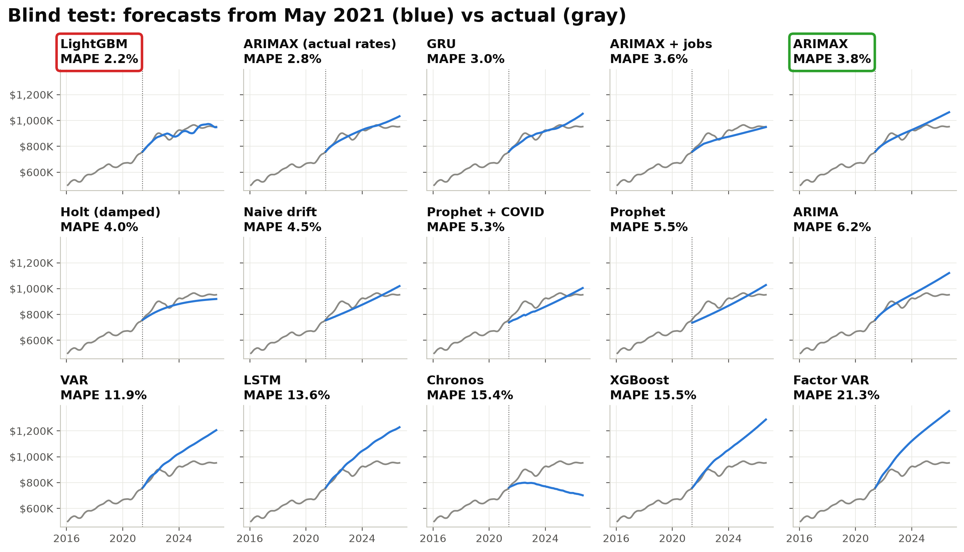
LightGBM ranked first in one long test, but tenth in repeated 12-month tests
Result 2 · One long forecast
Same model, two tests
1st → 10th
1st in the 64-month test (2.2% error), 10th in repeated 12-month tests. LightGBM's lead did not hold under our main evaluation.
MGMTMSA 437 · Forecasting LA Home Values · Data: Zillow ZHVI, FRED, BLS
5
Notes:
[Neil] Why test at eighteen dates instead of one? In a single 80/20 split, LightGBM, circled in red, won with 2.2 percent error. Across our rolling tests it ranked tenth, and ARIMAX, in green, was first. The long test forecasts 64 months at once, so it is a different task. The ranking depends on the forecast period and horizon, so we put more weight on repeated tests.

Slide 6
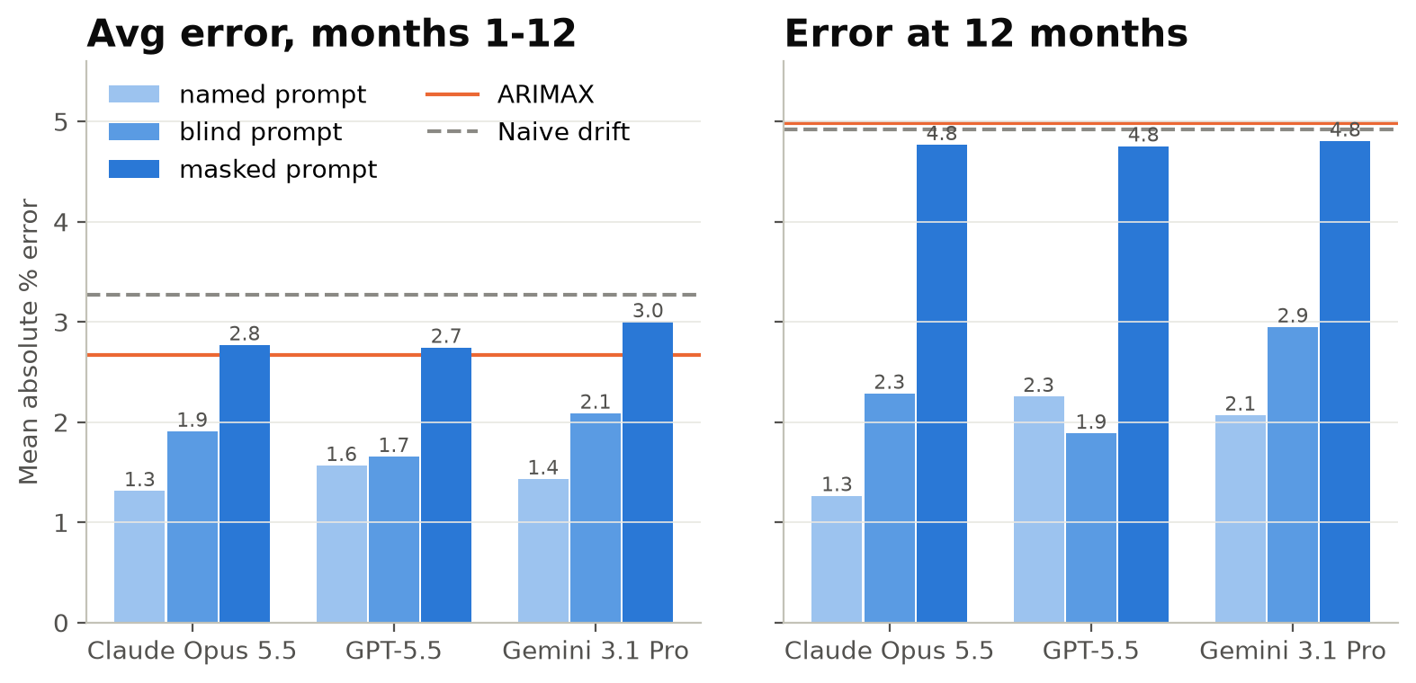
An alternative tool: AI's edge faded once we removed the clues
Result 3 · AI as an alternative
Claude: named → masked
1.3 → 2.8%
Claude's average error rose from 1.3% to 2.8%, close to ARIMAX's 2.67%. These historical periods may already be familiar to the AI.
MGMTMSA 437 · Forecasting LA Home Values · Data: Zillow ZHVI, FRED, BLS
6
Notes:
[Jeremy] We then asked whether AI could improve on these results. AI introduces another testing problem: they may recognize the historical period. We asked Claude, GPT and Gemini to forecast the same eighteen dates, each as a fresh API request with only the data up to that date. At first they looked brilliant: 1.3 to 1.6 percent error, better than every model. But all eighteen dates are before their training cutoff, so these periods may already be familiar to them. When we hid the place, the dates and the mortgage rate, Claude's error rose to 2.8 percent, GPT's to 2.7 and Gemini's to 3.0. Their average errors were close to ARIMAX's, and at month 12 our statistical test did not detect a difference.

Slide 7
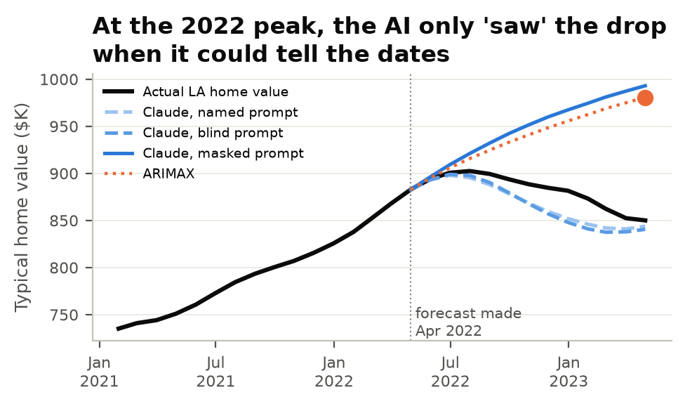
Masking cut recognition, but didn't remove it
Result 3 · AI as an alternative, how we tested
Named
LA, real dates, dollars, rates
Most clues
Blind
Place, dates hidden; rates kept
Rates can reveal dates
Masked
10 years, rescaled; no place, dates, rates
Fewest clues
Name this series Claude named LA in 16/18 blind and 0/18 masked prompts, yet dated masked data to about a month. Given 26 years, not 10, it called the 2022 fall (2.47% error).
MGMTMSA 437 · Forecasting LA Home Values · Data: Zillow ZHVI, FRED, BLS
7
Notes:
[Jeremy] Here is how we gave the AI fewer clues. Named says Los Angeles, with real dates. Blind hides the place and dates but keeps the real mortgage rate, and that is enough: asked to identify the blind series, Claude named Los Angeles 16 times out of 18 and got the dates exactly right. Masked shows only the last ten years, rescaled, with no rate. Claude never named LA, though it could still guess the period from the shape, so masking reduces the clues rather than removing them. The chart shows a forecast made in April 2022, just before the downturn. With the clues, Claude forecast a fall, close to what happened. With the masked prompt, Claude predicted continued growth, as ARIMAX did. The masked forecast and ARIMAX both missed the downturn. One more check: given 26 years of masked data instead of 10, Claude called the 2022 fall and scored 2.47 percent. A longer history gives the dates away, so masking is a dial, not a switch.

Slide 8
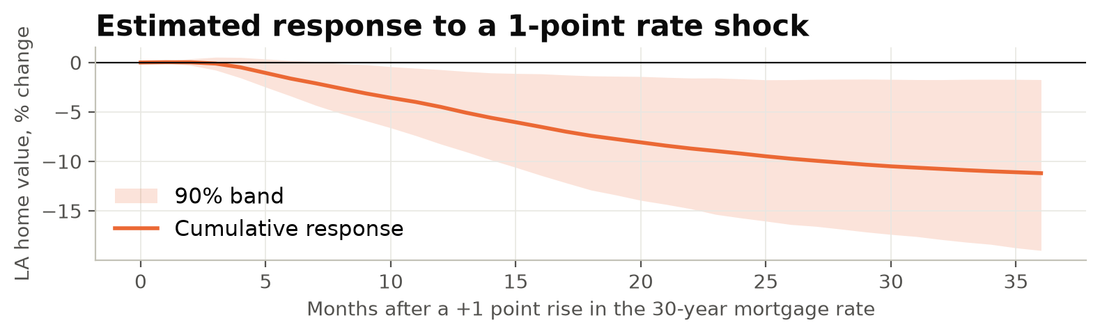
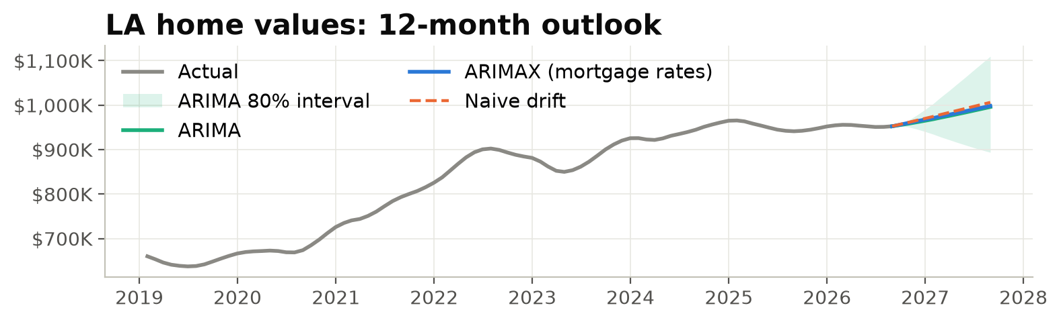
Rates act with a delay; we forecast +4.8%
Result 4 · Mortgage rates and outlook
Estimated home-value response to a 1-point mortgage-rate shock
−9.2%
p = 0.052
VAR-estimated response after two years (−4.5% after one)
Granger: borderline. ARIMAX: rate p = 0.16, jobs p = 0.29
Our forecast: about 5% higher by August 2027, with a wide range
$998K (+4.8%)
-6% to +17%
ARIMAX forecast, August 2027
for context: ARIMA's 80% interval by August 2027
MGMTMSA 437 · Forecasting LA Home Values · Data: Zillow ZHVI, FRED, BLS
8
Notes:
[Neil] We also examined the relationship with rates and produced a forecast for August 2027. Top: our VAR estimates how LA values respond after a one-point rise in the mortgage rate: little at first, about 4.5 percent lower after a year and 9 after two. That is a predictive relationship, not a proven causal effect, and the Granger test is borderline, p equals 0.052. Inside ARIMAX neither the rate nor jobs is significant on its own, and jobs, income and crime didn't improve the forecast. Still, the rate helps out of sample. It enters with a two-year lag, so a twelve-month forecast never needs future rates. Bottom: ARIMAX forecasts about 998 thousand dollars by August 2027, up 4.8 percent. The band is the ARIMA 80 percent interval, for context: from minus 6 to plus 17 percent.

Slide 9
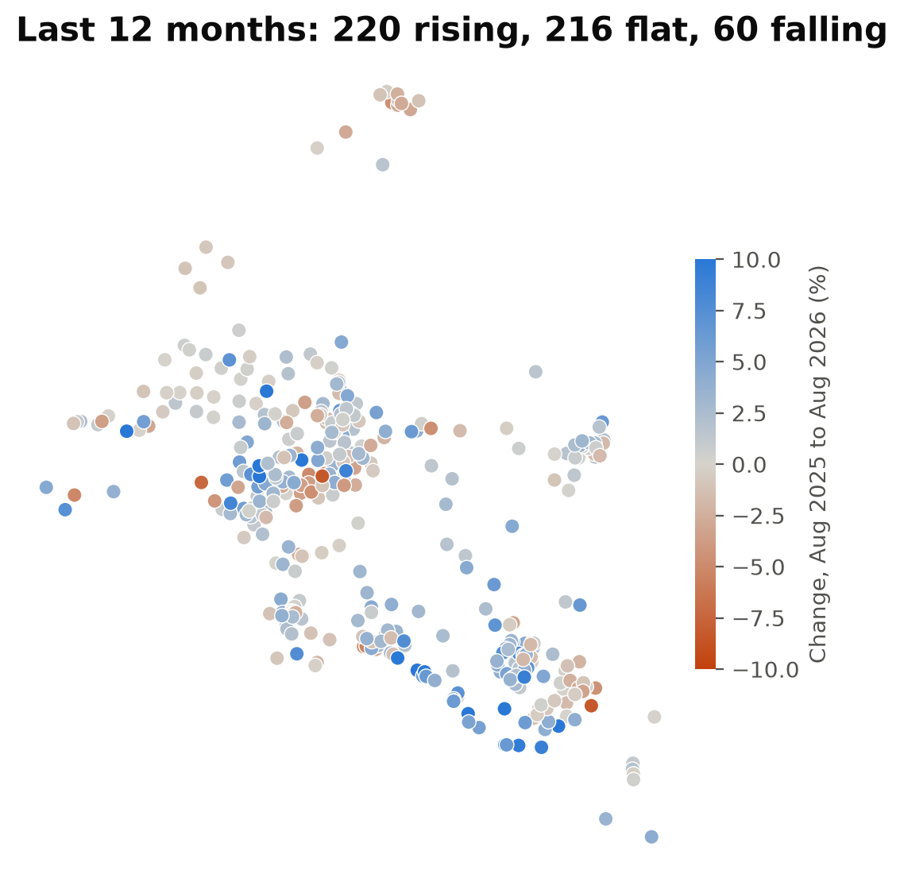
Some neighborhoods are rising while others are falling
Neighborhoods · Live map
220 / 216 / 60
rising >2% · within ±2% · falling >2%, last 12 months (496 neighborhoods with recent data)
152 of 496
still below their 2022 peak, mostly in LA County
−1.2 pts
in LA County, doubling the starting home value went with a 1.2-point larger decline after the 2022 peak
Live map: neiltd.github.io/la-housing-forecast
MGMTMSA 437 · Forecasting LA Home Values · Data: Zillow ZHVI, FRED, BLS
9
Notes:
[Jin] That forecast describes the metro average. Individual neighborhoods look very different. Of 496 neighborhoods with recent data, 220 rose more than 2 percent in the last year, 216 stayed within 2 percent, and 60 fell. [Switch to the browser.] Blue is rising, red is falling. The map shows gains in selected coastal neighborhoods, including North of Montana, Point Dume and Corona del Mar, and declines in parts of central LA such as Koreatown and Downtown. [Click one neighborhood.] Each shows its value, its change and our 12-month forecast. [Back to the slides.] Higher starting prices were associated with larger declines in LA County after 2022. We tested neighborhood forecasts the same rolling way, at five yearly dates for about 400 neighborhoods: ARIMA for each neighborhood had 2.8 percent error, the naive benchmark 3.5.

Slide 10
Our answer: simple models held up best
Takeaways
01
Simple models were competitive
ARIMAX had the lowest average error; naive drift was equally competitive at month 12.
02
Test AI on outcomes it cannot know
Historical AI tests can be affected by recognition of past events.
03
Mortgage rates matter, slowly
Jobs, income and crime didn't improve the forecast; turning points stayed hard to call.
04
The metro average is only part of the picture
Results varied; per-neighborhood ARIMA beat naive drift (2.8% vs 3.5%).
Next steps Test more cities; score the AI live on months after its training cutoff.
MGMTMSA 437 · Forecasting LA Home Values · Data: Zillow ZHVI, FRED, BLS
10
Notes:
[Yang] Our answer: a simple ARIMAX had the lowest average error, about 2.7 percent; a full year out, the naive benchmark was just as good; and masked AI showed no clear advantage. Four takeaways. Simple models were competitive. AI needs tests on new outcomes before we can judge its forecasting value; the recognition checks suggest historical familiarity contributed to its apparent advantage. Mortgage rates matter, slowly, while jobs, income and crime didn't improve the forecast. And the metro average is only part of the picture. Next, we would test more cities, and score the AI live after its training cutoff. Thank you.

Slide 11
What each method knew at each forecast date
Appendix A1 · Information sets
Method | Price history | Real dates | Place | Mortgage rate | Jobs
ARIMA, naive drift, ML models | 2000 to forecast date | no | no | no | no
ARIMAX | 2000 to forecast date | no | no | yes, lag 24 | no
ARIMAX + jobs | 2000 to forecast date | no | no | yes, lag 24 | yes, lag 12
AI, named prompt | 2000 to forecast date | yes | yes | yes | no
AI, blind prompt | 2000 to forecast date | no | no | yes | no
AI, masked prompt | last 10 years | no | no | no | no
AI, masked, all history (Claude only) | 2000 to forecast date | no | no | no | no
MGMTMSA 437 · Forecasting LA Home Values · Data: Zillow ZHVI, FRED, BLS
11
Notes:
Only if asked what each method could see. Every method saw only data up to its forecast date. Models and the masked AI never see the place or the dates. Named and blind AI see the real mortgage rate, which is enough to date the series.

Slide 12
The 14 models in one line each
Appendix A2 · Models
Model | Family | In one line
Naive drift | Baseline | Last value, grown at the average monthly growth since 2000 (a random walk with drift).
ARIMA | Classical | Forecasts from the series' own recent values and recent surprises, after differencing once; ARIMA(1,1,2) on log price.
Holt (damped) | Classical | Exponential smoothing of the level and trend, with the trend slowly flattening out.
Prophet | Classical | Meta's curve-fitting model: one smooth trend line plus changepoints; does not start from the latest value.
Prophet + COVID & rates | Classical | Prophet with the 2020-22 boom marked as a one-off and the mortgage rate (lagged 24 months) added.
XGBoost | ML | Boosted decision trees predicting next month's growth from the last 12 months of growth.
LightGBM | ML | A faster boosted-tree method, same inputs as XGBoost.
LSTM | Deep learning | A recurrent neural network that reads the last 24 months of growth and predicts the next.
GRU | Deep learning | A simpler recurrent network, same setup as the LSTM.
Chronos (foundation model) | AI, pretrained | Amazon's pretrained time-series model, used as is: it reads the price history and forecasts, never trained on our data.
ARIMAX | Outside info | ARIMA on monthly growth plus the 12-month change in the mortgage rate, lagged 24 months.
ARIMAX + jobs | Outside info | ARIMAX plus 12-month payroll job growth in LA and Orange County, lagged 12 months.
VAR (growth + rate) | Outside info | Home growth and rate changes forecast each other (11 monthly lags).
Factor VAR (neighborhoods) | Outside info | Summarizes ~400 neighborhoods into 2 common factors and forecasts them together with metro growth.
MGMTMSA 437 · Forecasting LA Home Values · Data: Zillow ZHVI, FRED, BLS
12
Notes:
Only if asked about a specific model. One line each, in plain English.

Slide 13
Full rolling-origin results, 14 models
Appendix A3 · Rolling-origin test
Model | 1 mo | 3 mo | 6 mo | 12 mo | Avg 1-12 | RMSE $ | RMSE rank
ARIMAX | 0.09 | 0.81 | 2.45 | 4.98 | 2.67 | 35.8K | 1
ARIMA | 0.09 | 0.78 | 2.53 | 5.37 | 2.77 | 38.1K | 4
ARIMAX + jobs | 0.12 | 0.94 | 2.63 | 5.12 | 2.81 | 36.2K | 2
VAR (growth + rate) | 0.14 | 0.94 | 2.56 | 5.74 | 2.93 | 47.6K | 10
LSTM | 0.12 | 0.89 | 2.95 | 5.58 | 3.02 | 43.3K | 6
GRU | 0.11 | 0.93 | 2.99 | 5.86 | 3.18 | 41.5K | 5
Naive drift | 0.69 | 1.93 | 3.48 | 4.92 | 3.27 | 37.6K | 3
Holt (damped) | 0.28 | 1.15 | 3.04 | 6.34 | 3.39 | 44.3K | 7
Chronos (foundation model) | 0.69 | 1.61 | 3.44 | 6.13 | 3.56 | 45.3K | 8
LightGBM | 0.22 | 1.23 | 3.32 | 6.97 | 3.60 | 46.5K | 9
Factor VAR (neighborhoods) | 0.16 | 1.15 | 3.56 | 6.60 | 3.64 | 50.7K | 12
XGBoost | 0.25 | 1.25 | 3.40 | 6.82 | 3.65 | 47.8K | 11
Prophet + COVID & rates | 3.27 | 4.08 | 5.32 | 6.45 | 5.12 | 53.5K | 13
Prophet | 5.00 | 5.76 | 6.73 | 8.62 | 6.89 | 70.2K | 14
MGMTMSA 437 · Forecasting LA Home Values · Data: Zillow ZHVI, FRED, BLS
13
Notes:
Mean absolute percentage error at 1, 3, 6 and 12 months ahead and averaged over months 1 to 12, across 18 forecast dates. RMSE is in dollars, averaged over months 1 to 12.

Slide 14
Memory checks on Claude
Appendix A4 · AI recognition checks
Check (Claude only) | Result
Name the blind series | Los Angeles 16 of 18, California 17 of 18; dates exact every time
Name the masked series | Los Angeles 0 of 18; guesses: unknown 7, Seattle 6, Portland 2, San Francisco 1, Dallas 1, Denver 1
Date the masked series | median 1 month off, max 4
Masked, all history since 2000 | 2.47% avg error (ARIMAX 2.67%), DM p = 0.25; April 2022 forecast -4.7% (actual -3.7%)
Earlier run through Claude Code | named 1.58%, masked 2.67%; the clean API rerun changed little
MGMTMSA 437 · Forecasting LA Home Values · Data: Zillow ZHVI, FRED, BLS
14
Notes:
Only if asked how we know the AI recognized the period. These checks ran on Claude only.

Slide 15
Named and blind AI tracked what happened; masked AI tracked the trend
Appendix A5 · Trend check
Prompt | Claude | GPT | Gemini | Follows
Named | 0.97 / 0.14 | 0.91 / 0.16 | 0.90 / 0.28 | what happened
Blind | 0.89 / 0.19 | 0.94 / 0.23 | 0.83 / 0.15 | what happened
Masked | 0.21 / 0.83 | 0.26 / 0.87 | 0.15 / 0.49 | recent trend
ARIMAX | 0.37 / 0.66 |  |  | recent trend
Note Each cell: correlation of the 12-month forecast with the actual 12-month change / with the last 3 months' growth, across 18 forecast dates.
MGMTMSA 437 · Forecasting LA Home Values · Data: Zillow ZHVI, FRED, BLS
15
Notes:
Only if asked. A forecaster that recalls the outcome tracks what actually happened; one that forecasts from the data tracks the recent trend, as ARIMAX does.

Slide 16
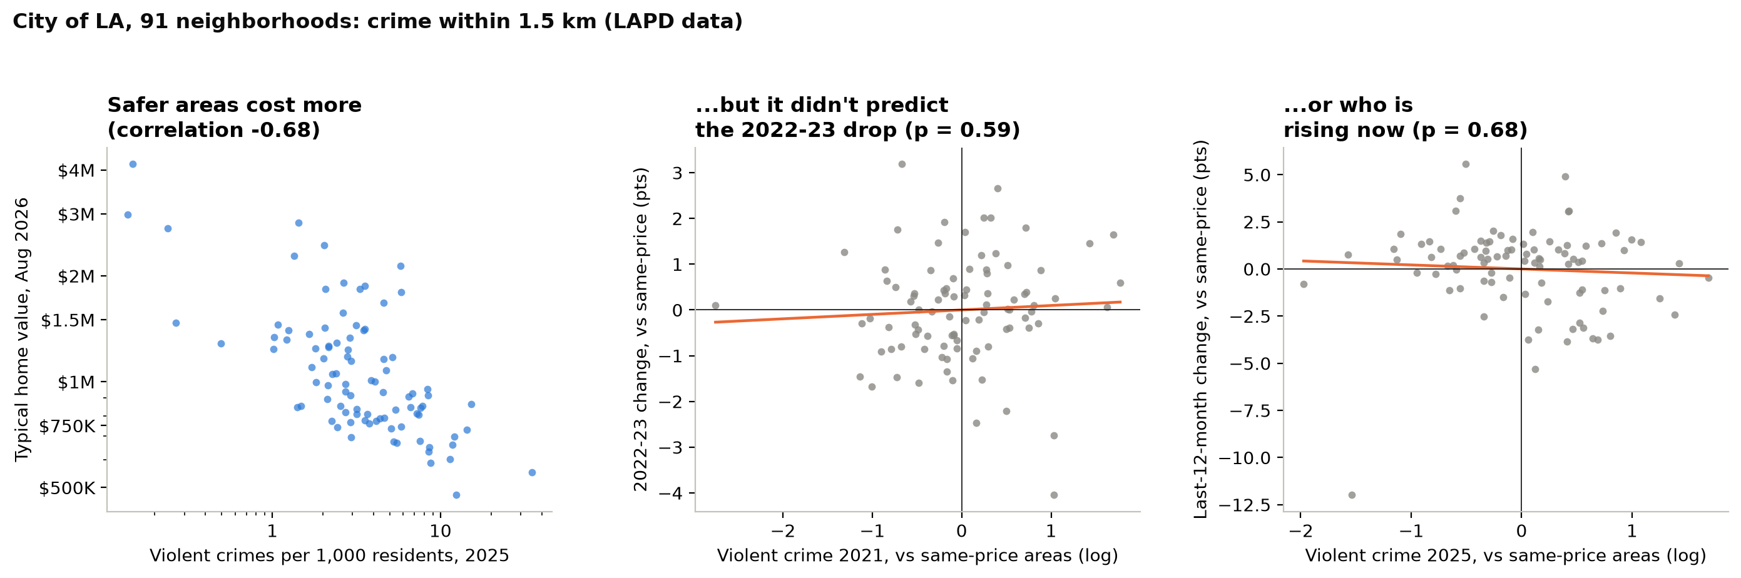
Crime tracks price, but it didn't predict the 2022 drop or today's winners
Appendix A6 · Only if asked about crime
Why it's in the appendix Crime data covers only the City of LA (91 of 496 neighborhoods), and it adds nothing to price prediction: at
the same price level, p = 0.59 and 0.68. Price already carries it.
MGMTMSA 437 · Forecasting LA Home Values · Data: Zillow ZHVI, FRED, BLS
16
Notes:
Appendix slide, only if Professor Yu asks about crime. Two reasons it is not in the main talk: it covers only part of our neighborhoods, and it does not help predict prices. LAPD data only covers the City of LA, so this is 91 neighborhoods. We counted crimes within 1.5 kilometers of each neighborhood per 1,000 residents, and split them into violent crime (murder, rape, robbery, aggravated assault) and property crime, using the FBI definitions so 2021 and 2025 count the same things. On the left, violent crime and home value go together strongly: safer neighborhoods cost more, correlation minus 0.68. But the question for forecasting is whether crime tells us anything beyond price. The middle and right panels compare neighborhoods at the same price level. Crime did not predict which neighborhoods fell more in 2022 and 2023, p equals 0.59, or which are rising over the last year, p equals 0.68. Without the price control, high-crime areas did grow less this year, but that is just because they are the cheaper areas, and cheaper areas grew less. Same answer for total crime and property crime.

