Slide 1

Presented by
Gregory Tolkachev, Maihesuti Minawaer, Neil Wick

Slide 2
Presentation Outline
Introduction, installation, and starting a project (Neil)
Sample app #1: polls app (Maihesuti)
Sample app #2: blog app (Gregory)
General impressions and conclusion

Slide 3
Introduction
Django is a Python-based web framework
Django was developed in the fall of 2003 by Adrian Holovaty and Simon Willison
It follows a model-template-views (MTV) pattern, essentially MVC with different terminology
Public release in July 2005

Slide 4
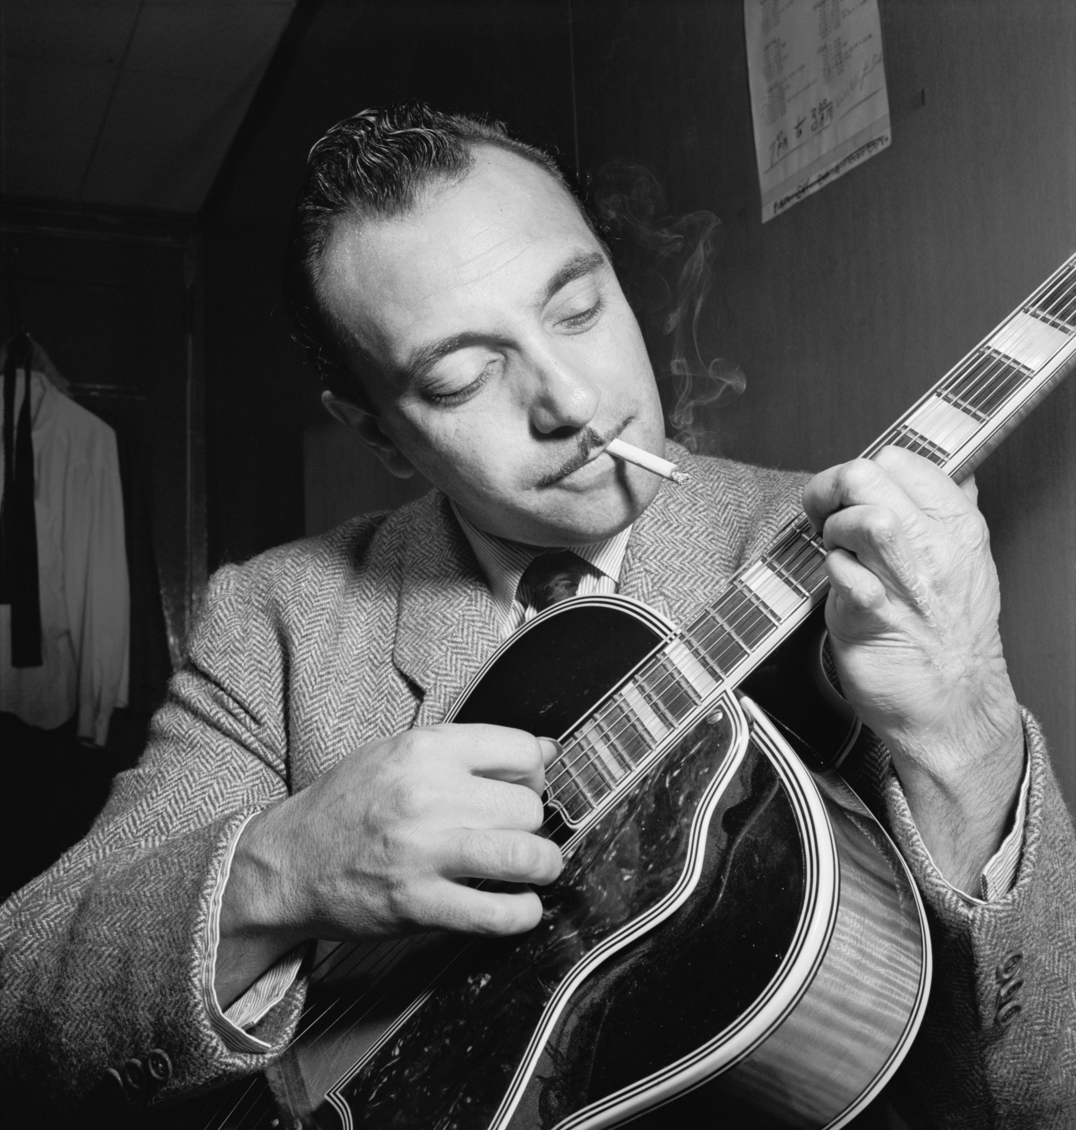
Adrian Holovaty is a guitarist and named the framework after gypsy (Romani) jazz guitarist Django Reinhardt (1910-1953) of whom he’s a big fan.
A film about Django Reinhardt was released in 2017, available from Criterion.

Slide 5
Installation
Install Python from https://www.python.org/downloads/
At a command prompt:
See if we already have pip. It should come with Python
python -m pip –version
Otherwise download get-pip.py and run
python get-pip.py

Slide 6
Installation
Install Django
python -m pip install Django
Check the version of Django to make sure it's installed
py -m django –version
Optional: Install mysqlclient for possible use of MariaDB
pip install mysqlclient

Slide 7
Making a project
Make a new directory and change to that folder
django-admin startproject mysite
Creates:
rp-portfolio/
└── personal_portfolio/ project container, rename to whatever
├── personal_portfolio/ project directory, Python package name
│ ├── __init__.py empty file, shows this is a Python package
│ ├── settings.py project settings/config
│ ├── urls.py "table of contents"
│ ├── asgi.py for ASGI-compatible web servers
│ └── wsgi.py for WSGI-compatible web servers
└── manage.py cmd line utility (for admin)

Slide 8
Testing
python manage.py runserver
http://127.0.0.1:8000/

Slide 9
Adding an app to the project
Add an app called "polls" as a top level module:
python manage.py startapp polls
Creates:
polls/
__init__.py
admin.py
apps.py
migrations/
__init__.py
models.py
tests.py
views.py

Slide 10
Views:
In polls/views.py
from django.http import HttpResponse
def index(request):
return HttpResponse("Hello, world. You're at the polls index.")

Slide 11
URLs:
In polls/urls.py
from django.urls import path
from . import views
urlpatterns = [
path('', views.index, name='index'),
]

Slide 12
URLconf:
In mysite/urls.py
from django.contrib import admin
from django.urls import include, path
urlpatterns = [
path('polls/', include('polls.urls')), # route, view
path('admin/', admin.site.urls),
]

Slide 13
Models:
In polls/models.py
from django.db import models
class Question(models.Model):
question_text = models.CharField(max_length=200)
pub_date = models.DateTimeField('date published')

Slide 14
Include the app in the project:
In mysite/settings.py
INSTALLED_APPS = [
'polls.apps.PollsConfig',
....

Slide 15
Include the app in the project:
# store model changes as a migration
python manage.py makemigrations polls
# run the migrations -- create the model tables
python manage.py migrate
1. change models in models.py
2. python manage.py makemigrations to create migrations for the changes
3. python manage.py migrate to apply the changes to the db

