Slide 1
Arm 1
Feasibility of phonocardiography during NIPE
Both arms
Carers of newborn babies consented on postnatal ward by Neil Lawrence before NIPE
NIPE midwife trained to record phonocardiogram by Neil Lawrence
Phonocardiogram obtained by midwife conducting NIPE
Carer survey following phonocardiogram, and interview/survey with midwives conducting NIPE to assess logistical challenges
(secondary objective)
Assessment of phonocardiograms analysed by Eko software to define proportion of interpretable traces (primary objective)
Follow up telephone call after 1 year of age for outcome data
(appendix 1)
Arm 2
Phonocardiography in babies referred from NIPE with a murmur
Babies attending echocardiogram clinic due to murmur on NIPE
Consent, observations and phonocardiogram obtained by Neil Lawrence directly before clinic appointment.
Carer survey about phonocardiogram recording.
Standard clinic appointment and echo with consultant neonatologist, with consent for sharing of data from echocardiogram
Analysis of dynamic time warping algorithm and multivariable predictions to assess candidate predictors for follow up diagnostic accuracy study
(secondary objectives)

Slide 2
BabyPHONO feasibility study: Jessops Wing Hospital, Sheffield, UK
Arm 1
Feasibility of phonocardiography during NIPE
Both arms
Eligibility:
Born > 37 weeks undergoing NIPE on postnatal ward
NIPE midwife trained to record phonocardiogram
Phonocardiogram obtained by midwife conducting NIPE
Carer survey following phonocardiogram, and interview/survey with midwives conducting NIPE to assess logistical challenges
Assessment of phonocardiograms to define proportion of interpretable traces (primary objective)
Follow up telephone call after 1 year of age for outcome data (any diagnosis of CHD)
Arm 2
Phonocardiography in babies referred from NIPE with a murmur
Babies undergoing echocardiogram < 28 days of age
Consent, observations and phonocardiogram obtained within 6 hours of echocardiogram
Echocardiogram by consultant neonatologist
Pilot prediction modelling to assess candidate predictors for follow up diagnostic accuracy study
NIPE = Newborn Infant Physical Examination

Slide 3
BabyPHONO study protocol
Arm 1
Digital heart sound recordings during baby check
Baby having baby check
Midwife records heart sounds
Mothers fill out questionnaire
Midwives interviewed
Follow up phone call after 1 year of age to check any diagnosis of heart disease in baby
Arm 2
Digital heart sound recordings to predict results from heart scans
Babies scheduled for heart scans
Doctor records heart sounds
Heart scan performed
Preliminary prediction algorithm

Slide 4
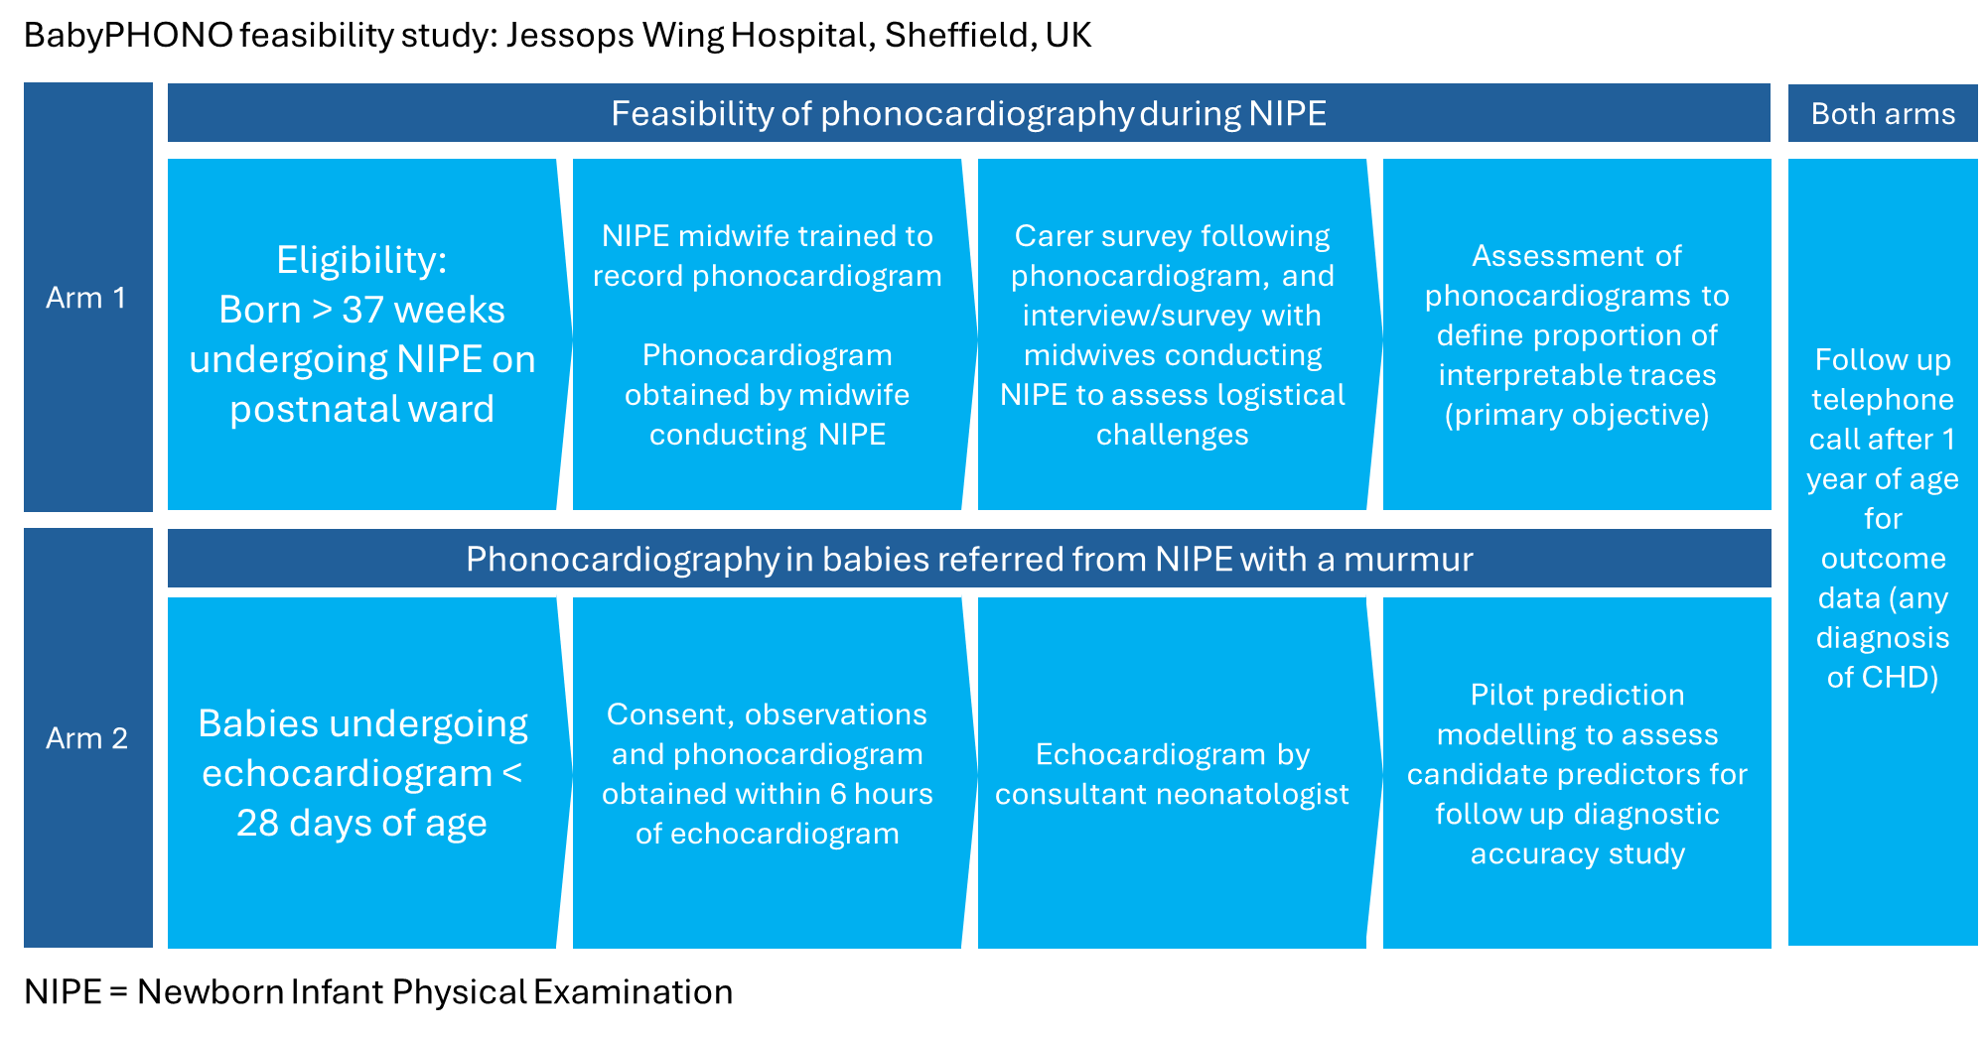

Slide 5
>100 Babies undergoing NIPE in first 72 hours
NIPE practitoner records heart sounds of at least 5 babies
Qualitative surveys/interviews of clinicians and carers
Recordings assessed for quality by interpretation with existing Eko+ application
Arm 1
>50 babies with previous structural findings on echocardiogram
of PDA / VSD / valve stenosis
Heart sounds recorded within 6 hours of repeat echocardiogram
Heart sound recordings on further repeat echocardiogram for at least 20 babies
Basic exploratory repeated measures analysis
>100 Babies < 3m old undergoing echocardiogram
Arm 2
Assessment of accuracy of heart sound recordings used to predict echocardiogram findings via machine learning
>50 babies >37 weeks gestation referred for echocardiogram due to new murmur
Heart sounds recorded directly before or after echocardiogram
Underlying data:
Babies with murmur on NIPE from echo requests: 70/year
Babies on the neonatal unit having an echo for a new murmur: 72/year
Babies treated with ibuprofen / paracetamol from badger: 50/year
Number of echos of babies on treatment for PDA from echo requests 106/year

Slide 6
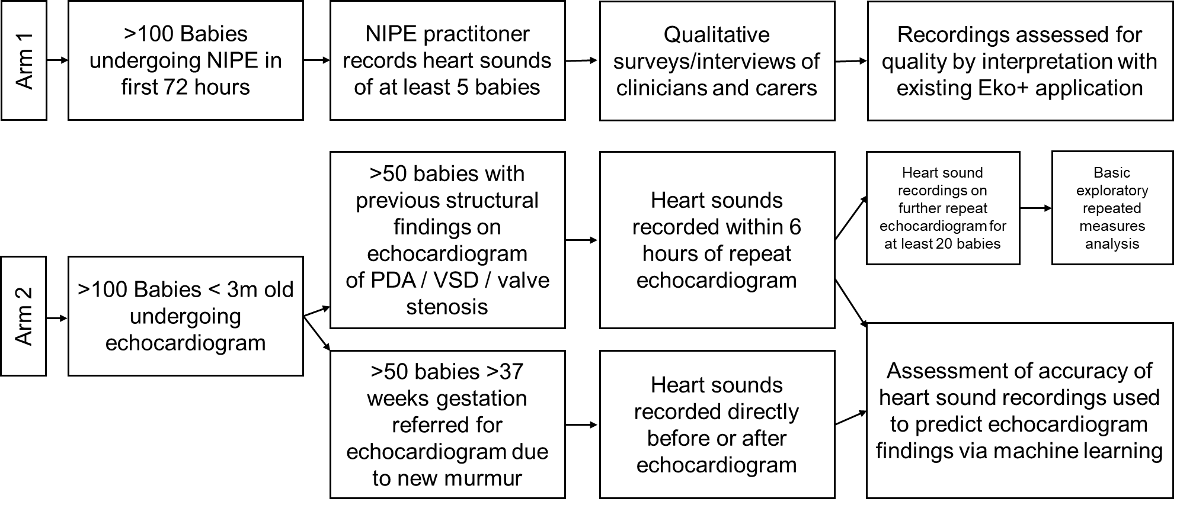

Slide 7
Clinical pathway for baby remains the same
Baby eligible for arm 2 if referred for echocardiogram due to clinician auscultation of murmur
>100 Babies undergoing NIPE in first 72 hours
NIPE practitoner records heart sounds of at least 5 babies
Qualitative surveys/interviews of clinicians and carers
Recordings assessed for quality by interpretation with existing Eko+ application
Arm 1
>50 babies with previous structural findings on echocardiogram
of PDA / VSD / valve stenosis undergoing repeat echocardiogram
Heart sounds recorded within 6 hours of echocardiogram alongside heart rate, respiratory rate, oxygen saturations from right arm and foot
Qualitative survey of carers
Assessment of accuracy of heart sound recordings used to predict echocardiogram findings via machine learning
>100 Babies < 3m old undergoing echocardiogram
Arm 2
>50 babies >37 weeks gestation referred for echocardiogram due to new murmur
Basic exploratory analysis targeting >20 babies to assess whether repeated phonocardiograms on different days improve prediction of congenital heart disease
Clinical pathway for baby remains the same
Baby eligible for repeat phonocardiogram if standard clinical pathway involves repeat echocardiogram <3 months of age

Slide 8
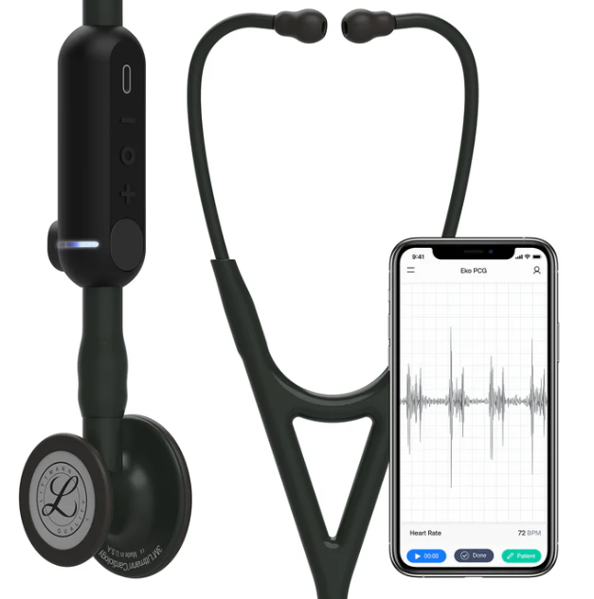
Babies have the newborn infant physical examination (‘baby check’) as normal
Babies have the newborn infant physical examination (‘baby check’) as normal
Heart sounds are recorded during baby check with digital stethoscope
Heart sounds are recorded during baby check with digital stethoscope
Recorded heart sounds assessed for quality
Parent/carer asked to fill out a short survey
(6 questions)
Recorded heart sounds used for research
Parent/carer asked to fill out a short survey
(6 questions)
Anything discovered on the baby check will be assessed as normal – there will be no change to the baby’s tests or treatment
Anything discovered on the baby check will be assessed as normal – there will be no change to the babies tests or treatment

Slide 9
Babies already having an echocardiogram
(ultrasound scan of the heart)
Heart sounds are recorded with a digital stethoscope just before or after the scan. Heart rate, breathing rate and oxygen levels are recorded
Recorded heart sounds analysed against images for research
Parent/carer asked to fill out a short survey
(6 questions)
If baby booked for repeat heart scan, heart sounds recorded again
Heart sound recordings will not affect what is done about the results of the heart scan. There will be no change to the baby’s future tests or treatment

Slide 10
Babies having their newborn infant physical examination or an echocardiogram (ultrasound scan of the heart)
Heart sounds are recorded with a digital stethoscope
Heart rate, breathing rate and oxygen levels are recorded
Recorded heart sounds analysed against images for research
Parent/carer asked to fill out a short survey
(6 questions)
Heart sound recordings will not affect what is done after the baby check or heart scan. There will be no change to the baby’s future tests or treatment

Slide 11
Clinician agrees to take part in study to record heart sounds during newborn infant physical examination
Member of study team gains consent from mothers/carers on day of newborn infant physical examination
Member of study team shows clinician participant how to take the recordings and use the Eko+ app during first examination
Clinician records heart sounds of babies during NIPE for approximately 10 babies to understand challenges/feasibility of building this assessment into the workflow
Recorded heart sounds assessed for quality of recording
Clinician completes a survey, and is invited to an interview after recording approximately 10 babies
Heart sound recordings will not affect what is done for the baby after the examination, referrals and clinical course remain the same

Slide 12
Clinical pathway for baby remains the same
Baby eligible for arm 2 if referred for echocardiogram due to clinician auscultation of murmur
>100 Babies undergoing NIPE in first 72 hours
NIPE practitoner records heart sounds of at least 5 babies
Qualitative surveys/interviews of clinicians and carers
Recordings assessed for quality by interpretation with automated heart rate detection algorithm
Arm 1
>50 babies with previous structural findings on echocardiogram
of PDA / VSD / valve stenosis undergoing repeat echocardiogram
Heart sounds recorded within 6 hours of echocardiogram alongside heart rate, respiratory rate, oxygen saturations from right arm and foot
Qualitative survey of carers
Assessment of accuracy of heart sound recordings used to predict echocardiogram findings via machine learning
>100 Babies < 3m old undergoing echocardiogram
Arm 2
>50 babies >37 weeks gestation referred for echocardiogram due to new murmur
Basic exploratory analysis targeting >20 babies to assess whether repeated phonocardiograms on different days improve prediction of congenital heart disease
Clinical pathway for baby remains the same
Baby eligible for repeat phonocardiogram if standard clinical pathway involves repeat echocardiogram <3 months of age

Slide 13
Clinical pathway for baby remains the same
Baby eligible for arm 2 if referred for echocardiogram due to clinician auscultation of murmur
>100 Babies undergoing NIPE in first 72 hours
NIPE practitoner records heart sounds of at least 5 babies
Qualitative surveys/interviews of clinicians and carers
Recordings assessed for quality by interpretation with automated heart rate detection algorithm
Arm 1
>50 babies with previous structural findings on echocardiogram
of PDA / VSD / valve stenosis undergoing repeat echocardiogram
Heart sounds recorded within 6 hours of echocardiogram alongside heart rate, respiratory rate, oxygen saturations from right arm and foot
Qualitative survey of carers
Follow up phone call with carer at 1 year of age to check for later diagnosis of congenital heart disease
Assessment of accuracy of heart sound recordings used to predict echocardiogram findings via machine learning
>100 Babies < 3m old undergoing echocardiogram
Arm 2
>50 babies >37 weeks gestation referred for echocardiogram due to new murmur
Basic exploratory analysis targeting >20 babies to assess whether repeated phonocardiograms on different days improve prediction of congenital heart disease
Clinical pathway for baby remains the same
Baby eligible for repeat phonocardiogram if standard clinical pathway involves repeat echocardiogram <3 months of age

