Slide 1
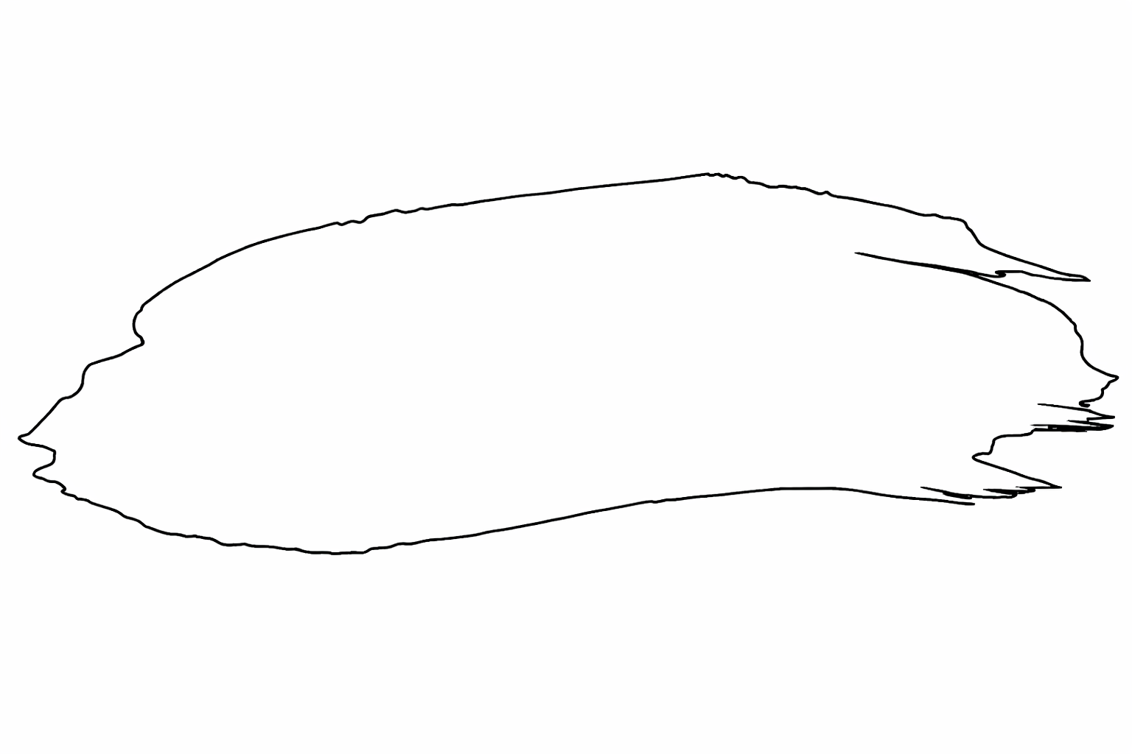


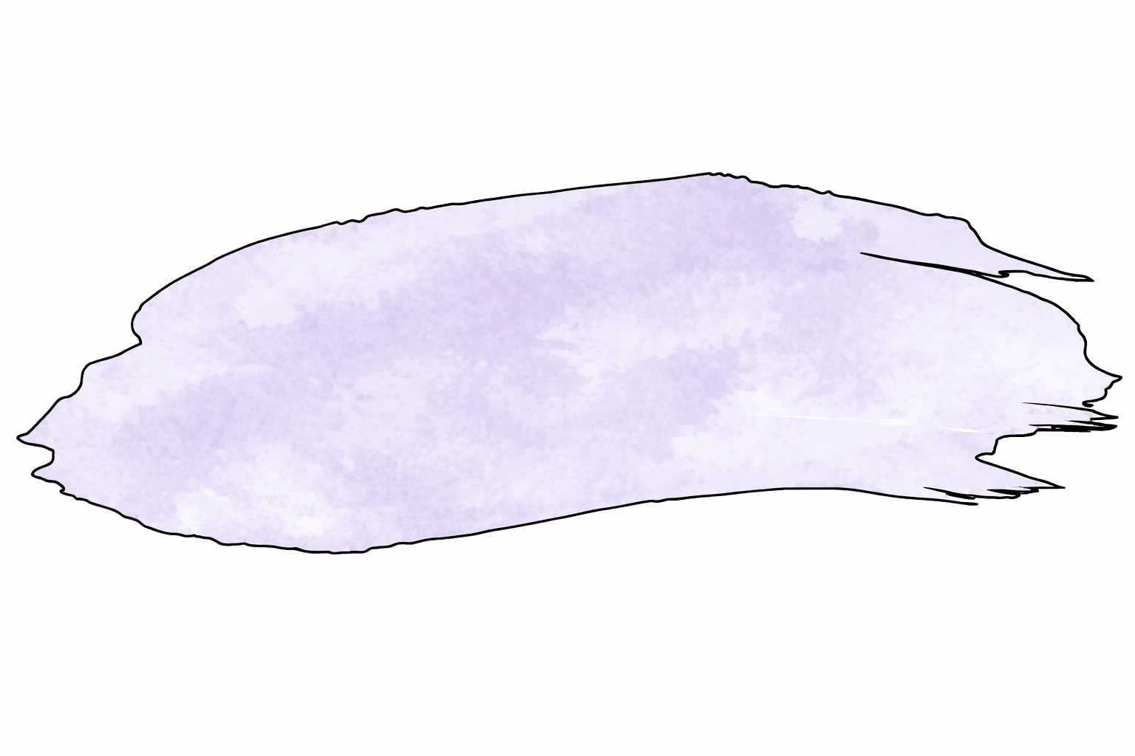
Effective printing width 48mm labels are 50x30mm
#day21

Slide 2
Effective printing width 48mm labels are 50x30mm
Effective printing width 48mm labels are 50x30mm
#day21.org

Slide 3
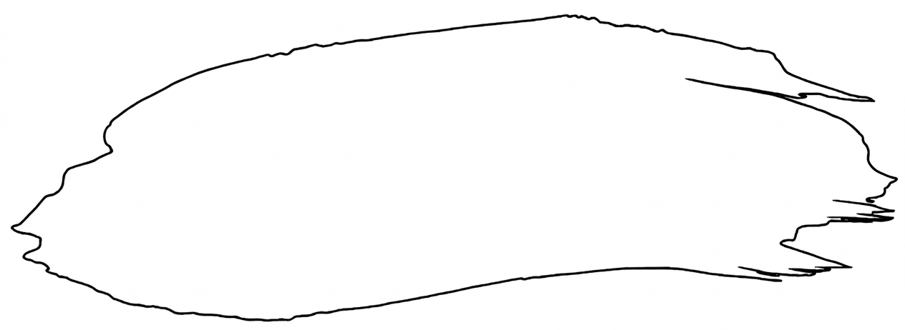

#day21.org
Fertility returns 21 days after childbirth

Slide 4
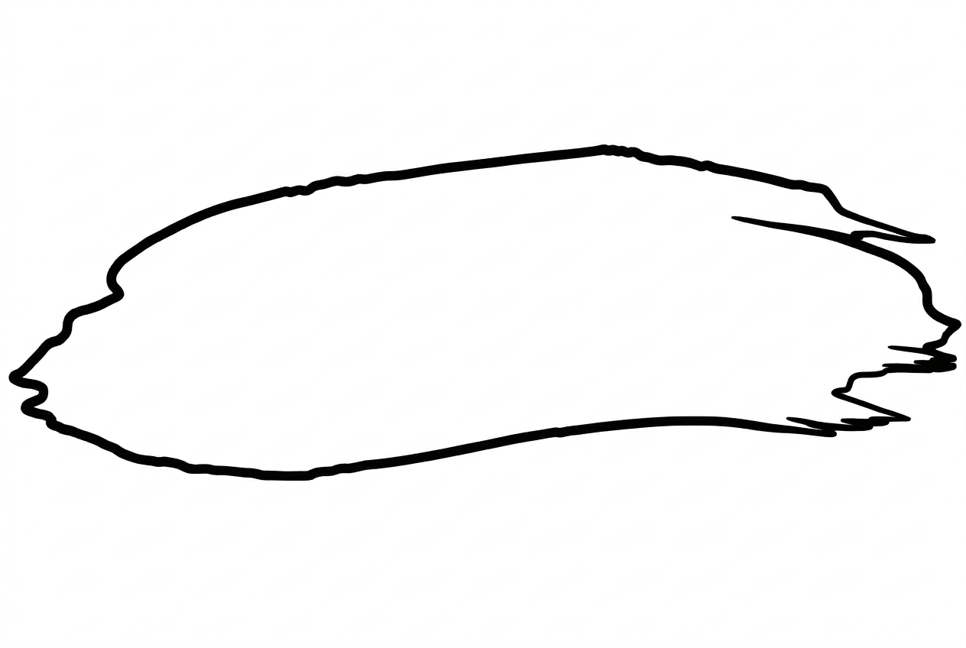
day21.org
Fertility returns 21 days after childbirth

Slide 5
Fertility returns at
#day21
after
childbirth
day21.org

Slide 6
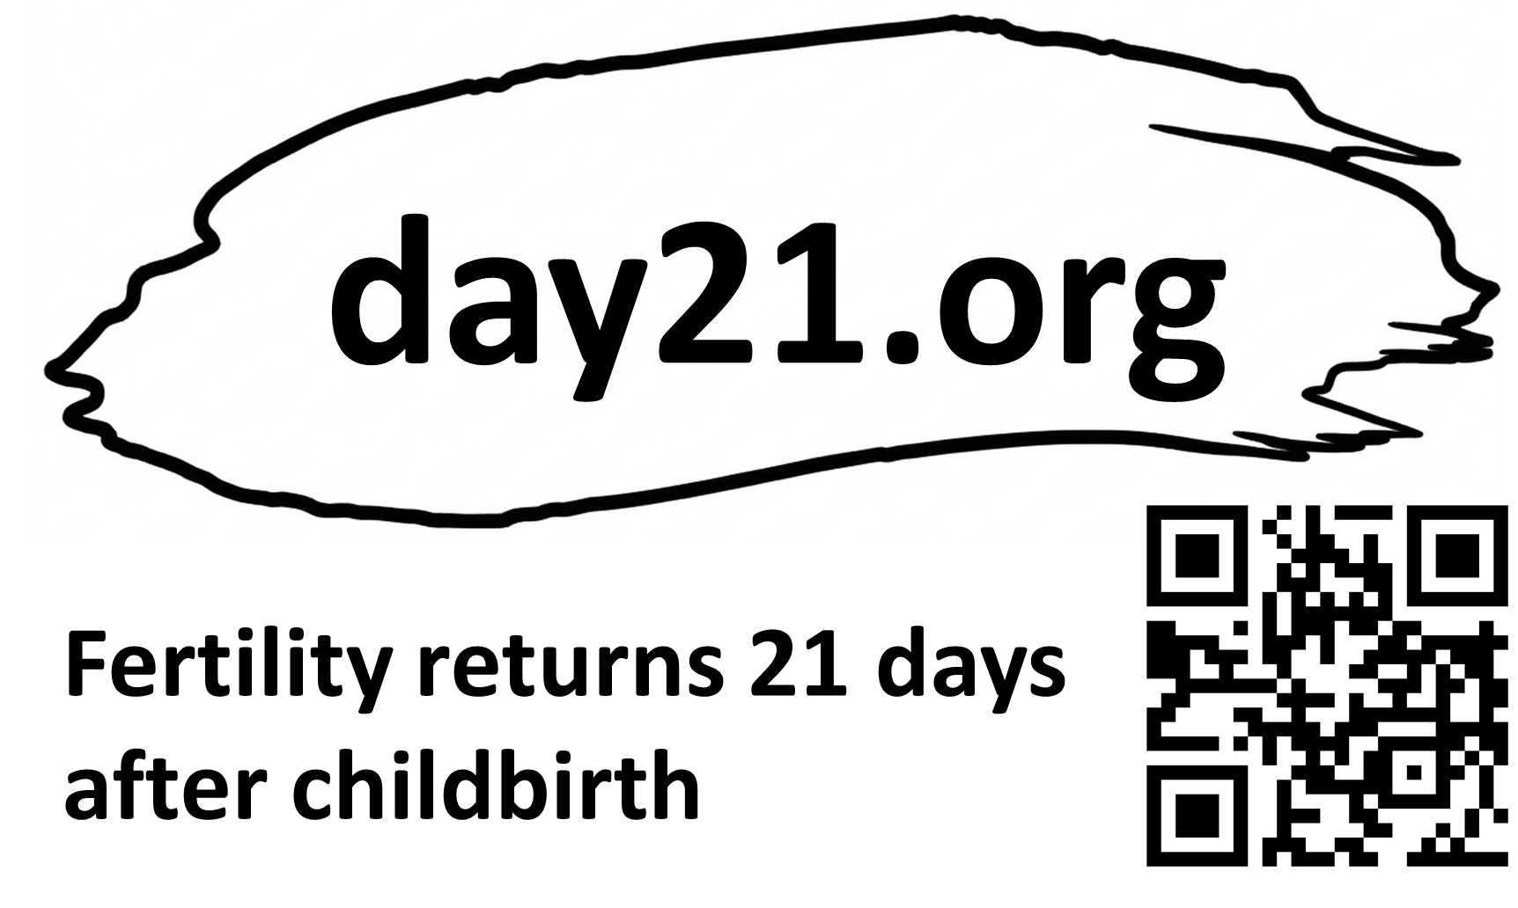
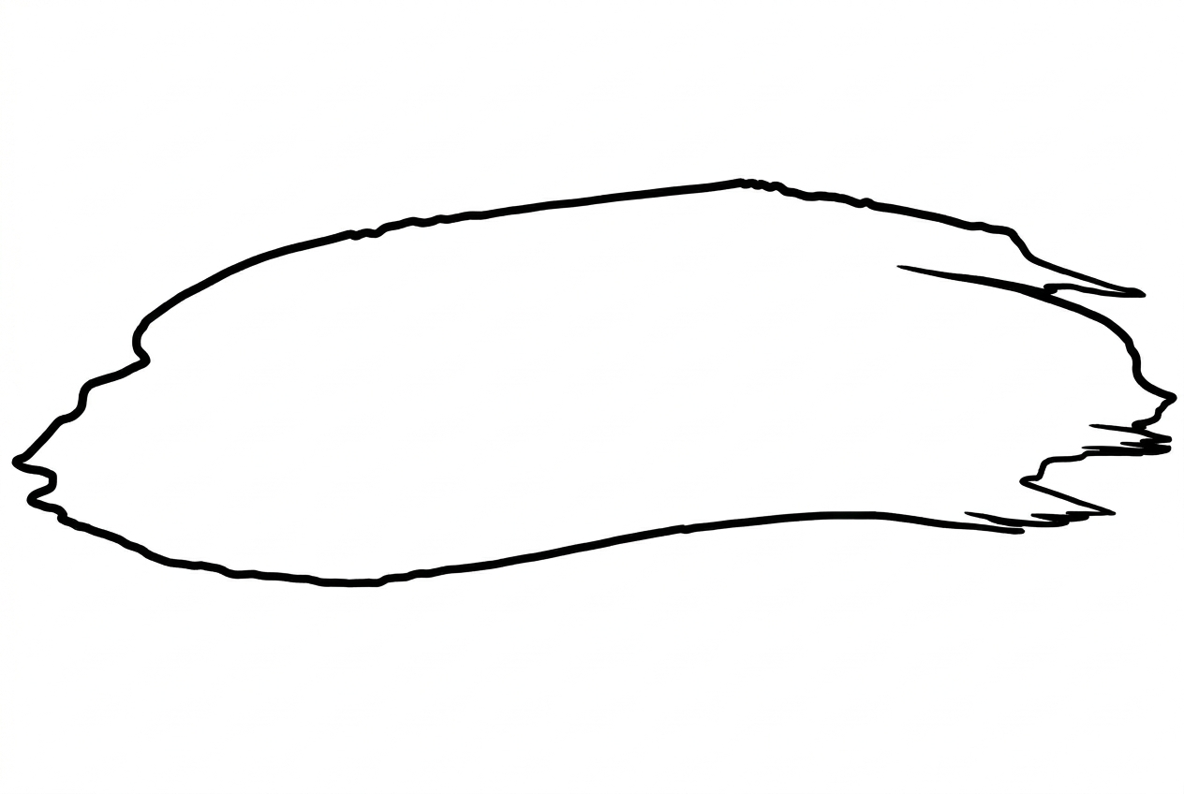

Slide 7
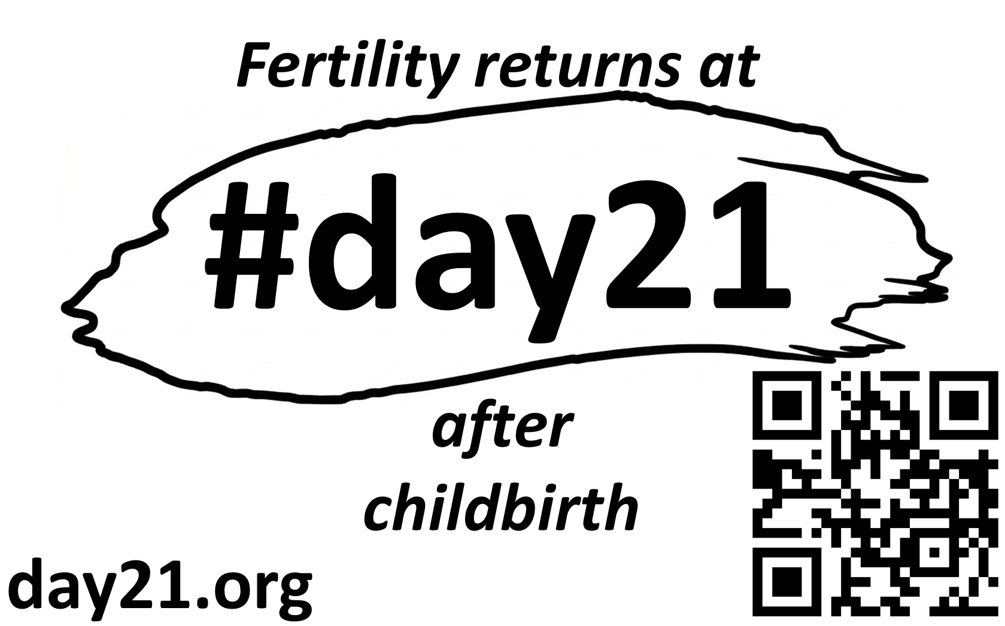

Slide 8

Fertility returns at
day21.org
after
childbirth
Dr Kayleigh Lawrence

Slide 9




Slide 10
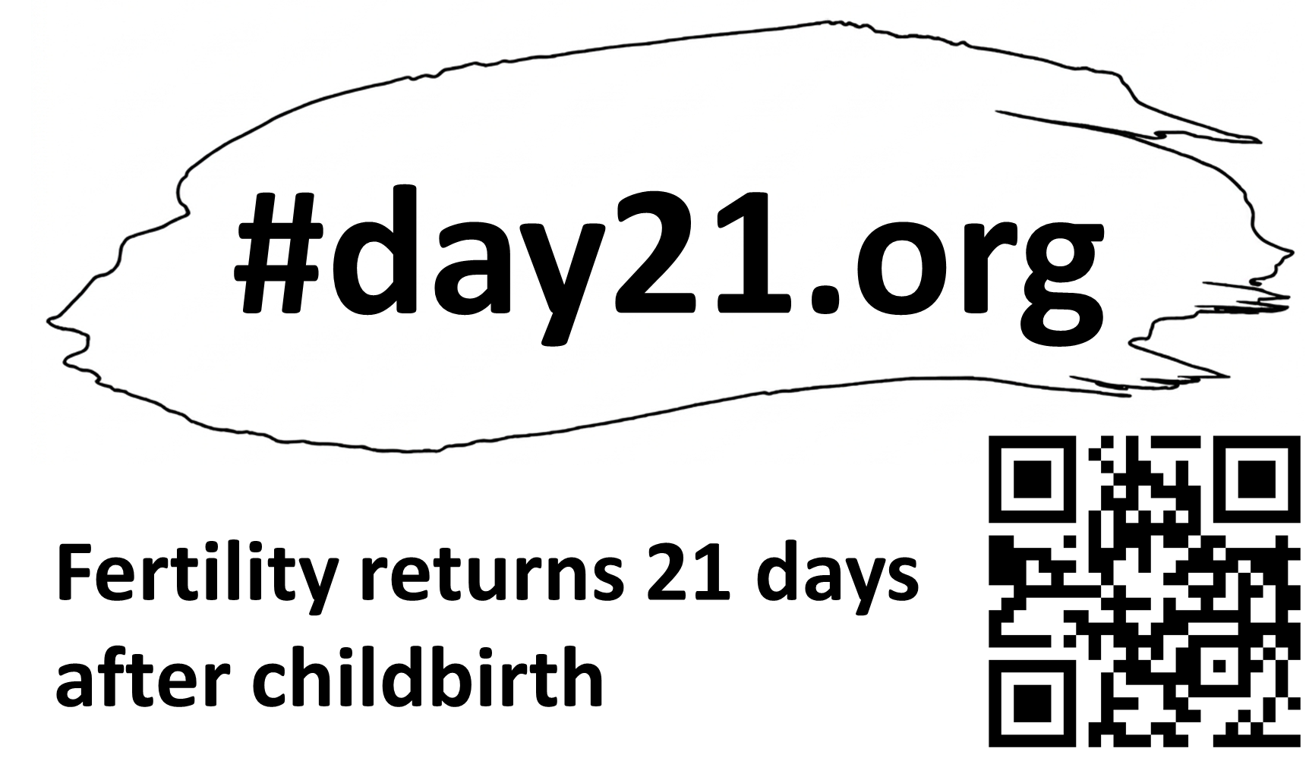

Slide 12
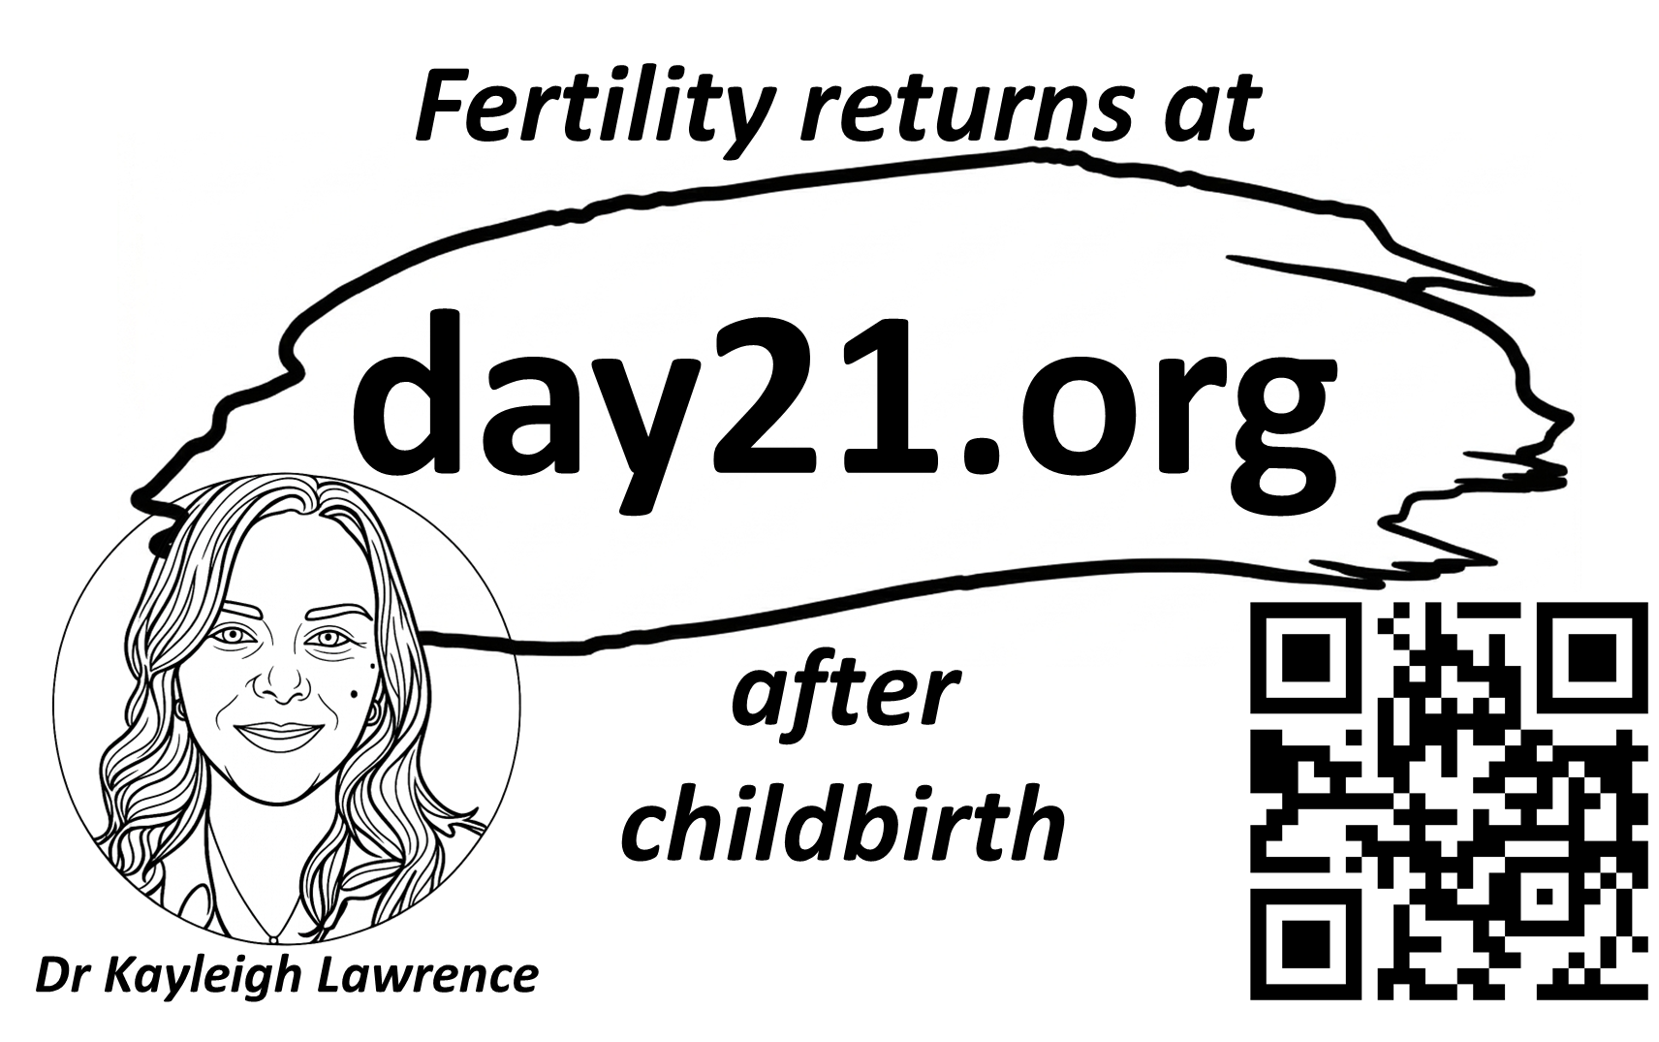

Slide 13


Slide 14
