Slide 1
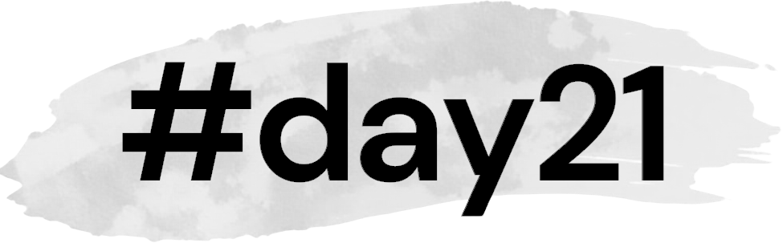

Fertility returns at day 21 after childbirth

Slide 3
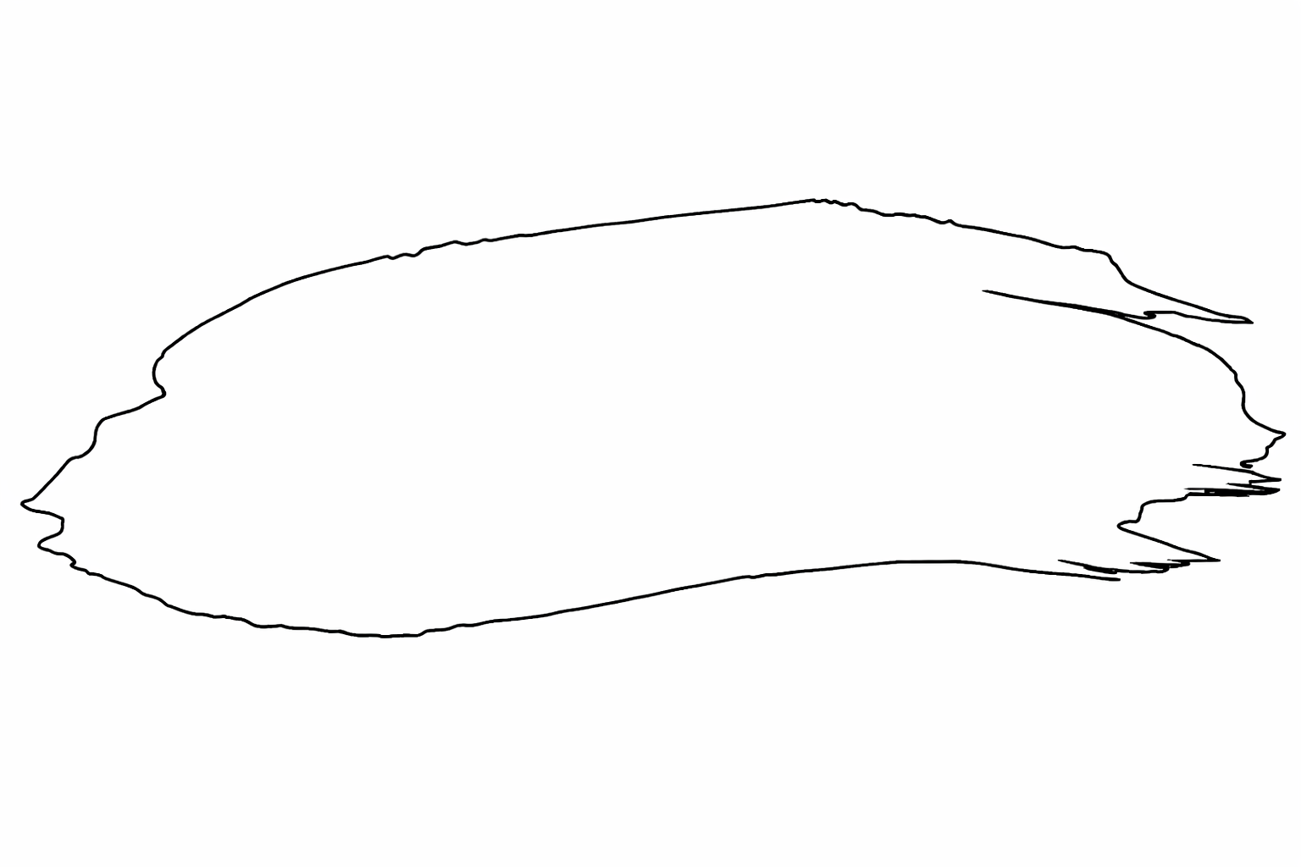


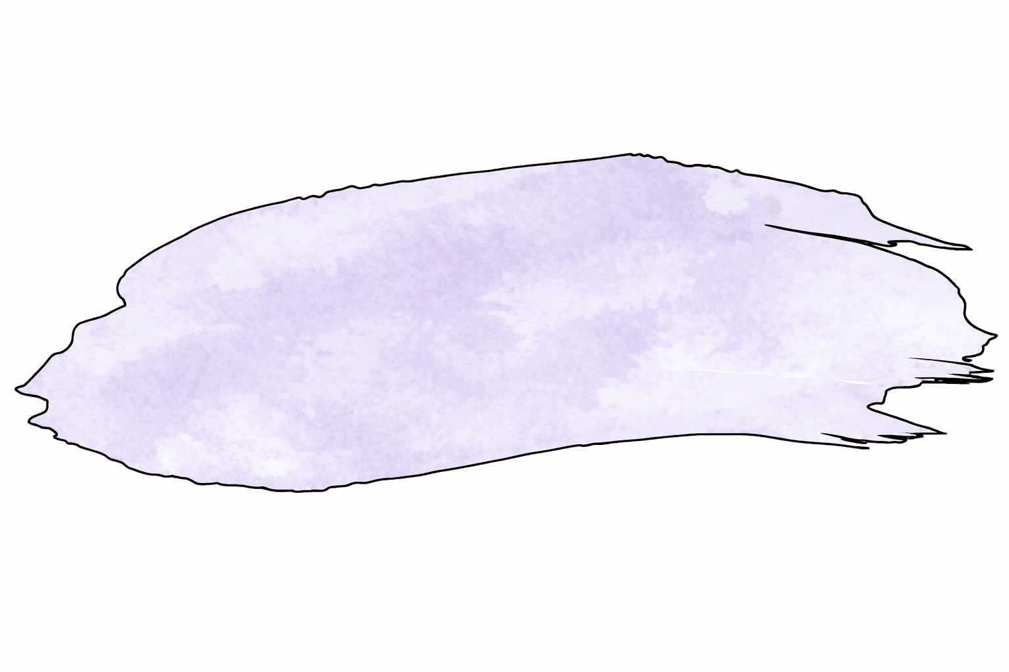
Effective printing width 48mm labels are 50x30mm
#day21

Slide 4


Slide 5
Effective printing width 48mm labels are 50x30mm
Effective printing width 48mm labels are 50x30mm
#day21.org
day21.org

Slide 6
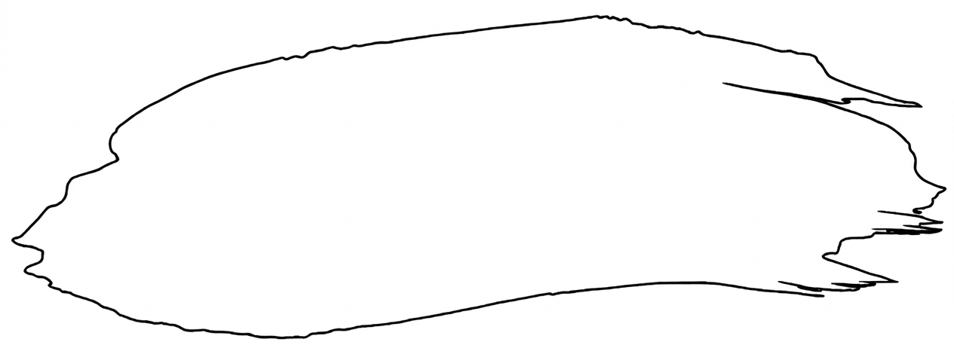
#day21.org
Fertility returns 21 days after childbirth

Slide 7
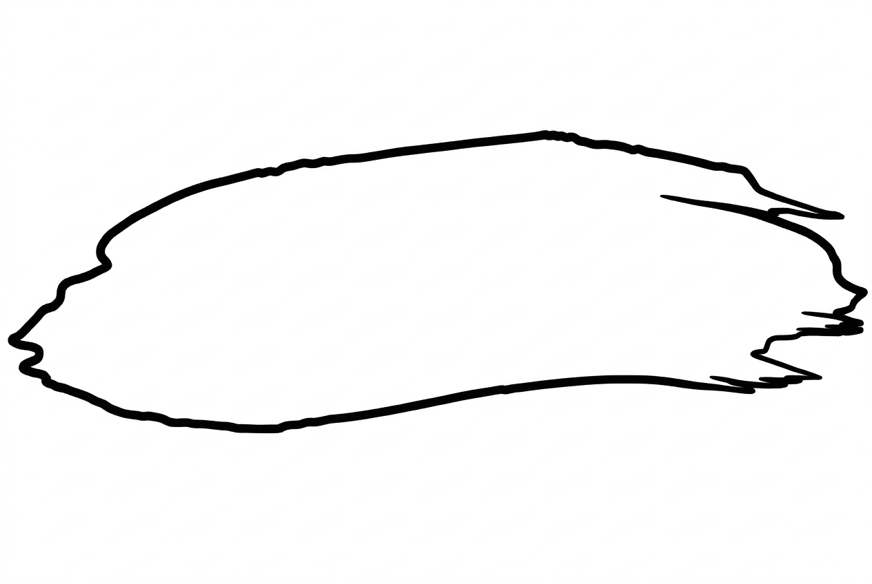
day21.org
Fertility returns 21 days after childbirth

Slide 8
Fertility returns at
#day21
after
childbirth
day21.org

Slide 9
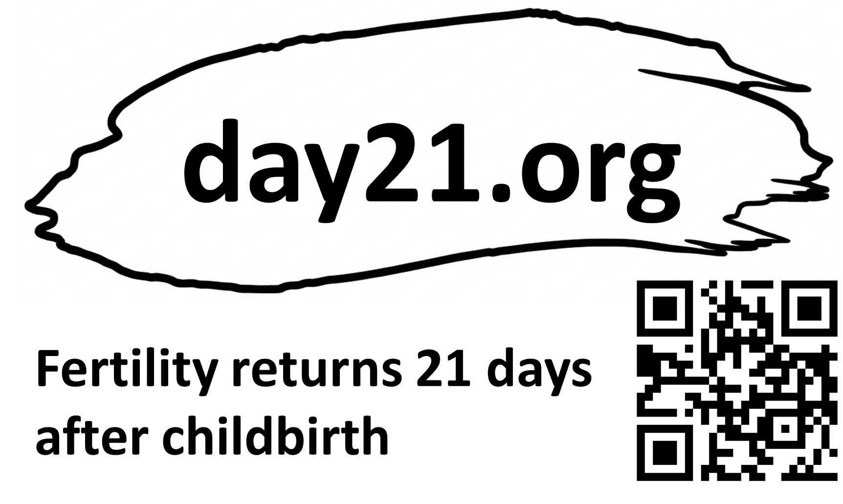
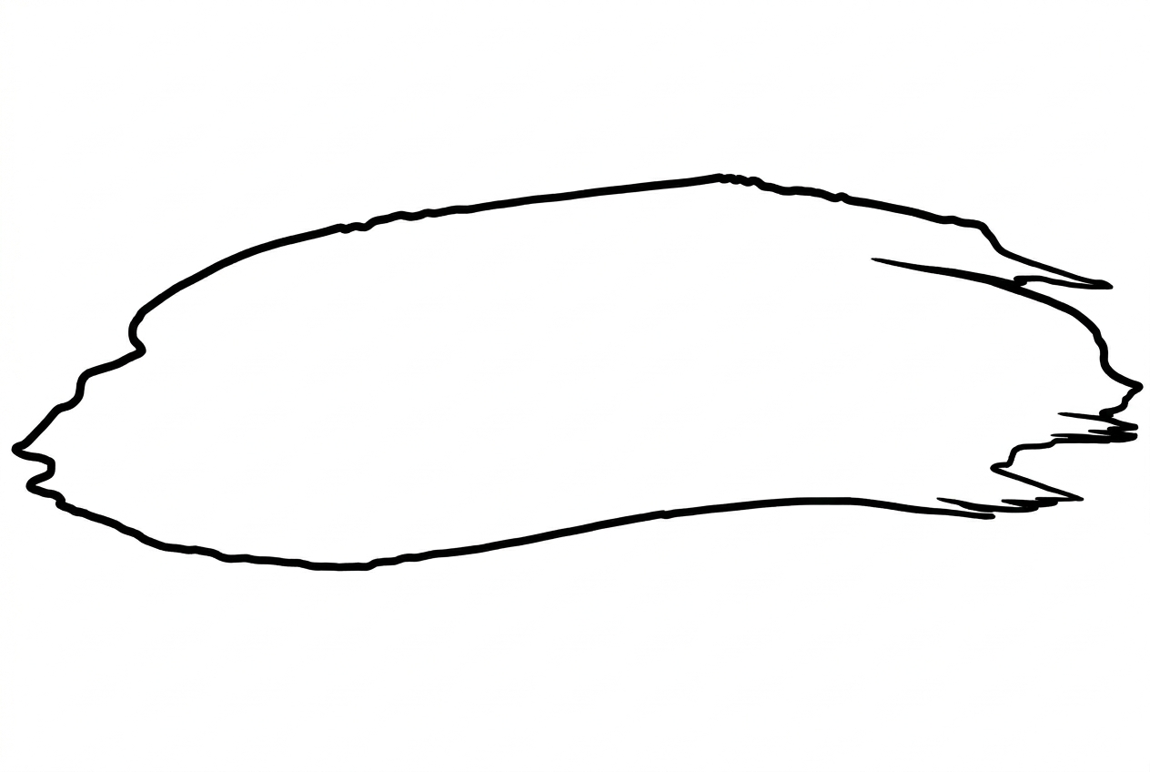

Slide 10
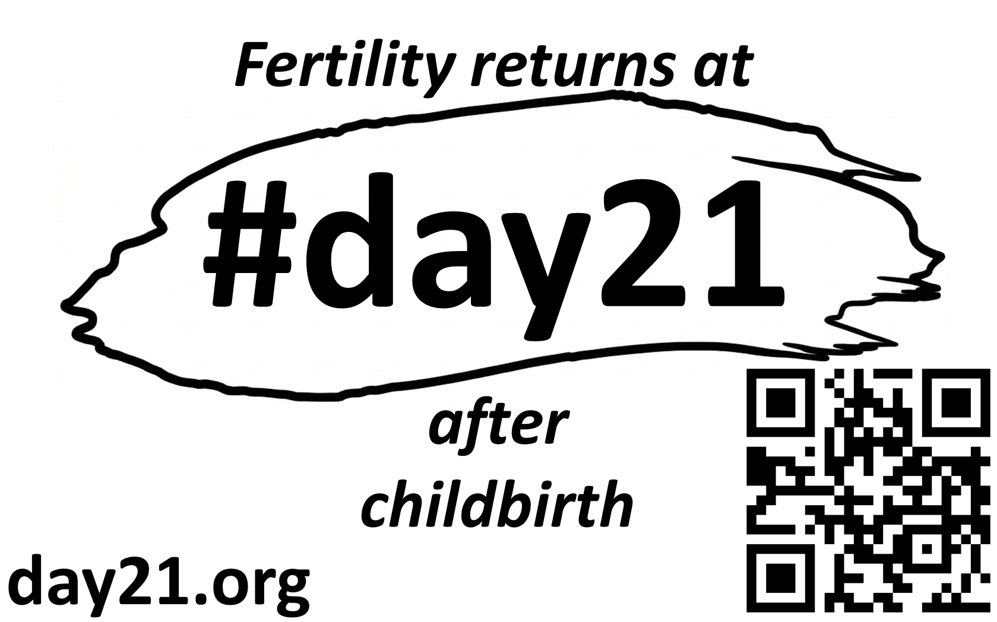

Slide 11

Fertility returns at
day21.org
after
childbirth
Dr Kayleigh Lawrence

Slide 12




Slide 13
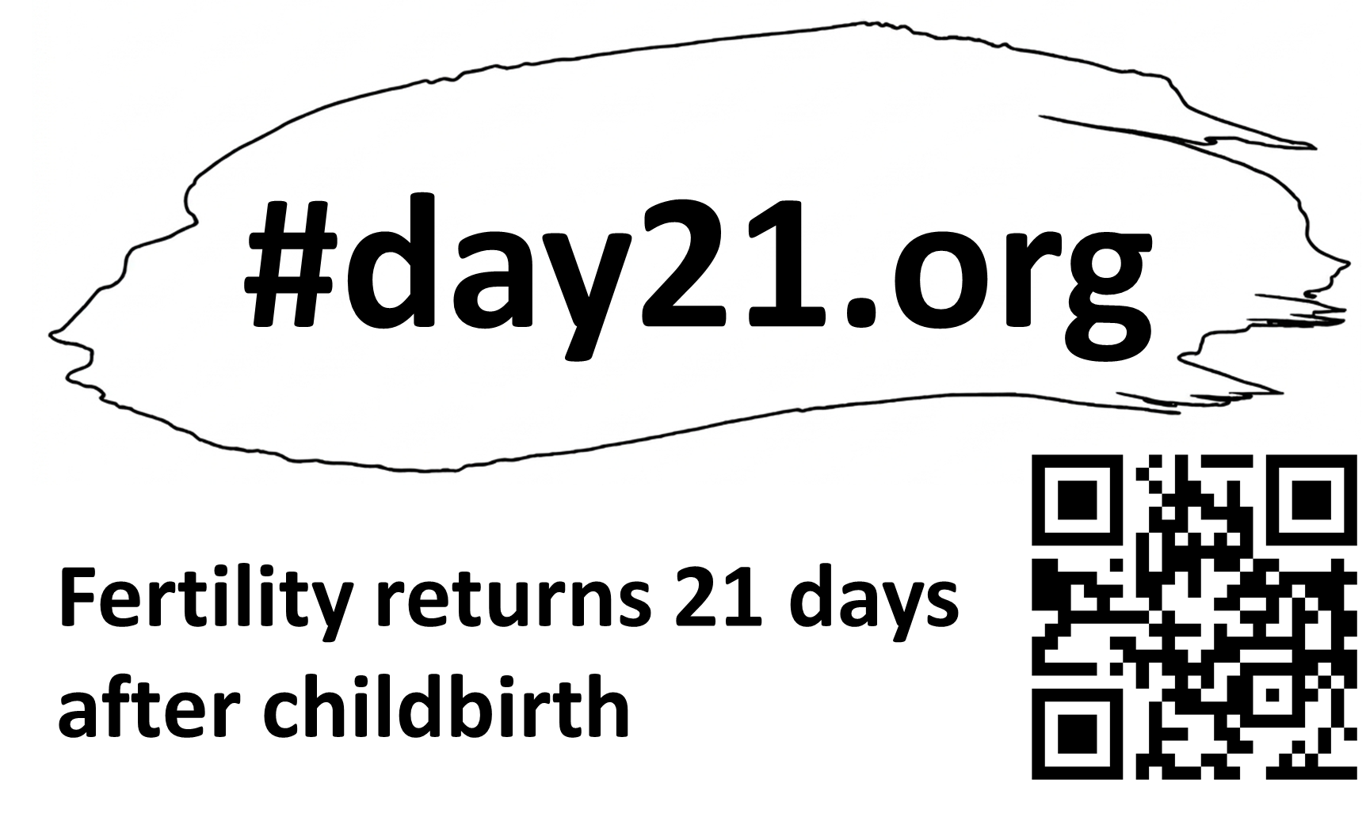

Slide 15
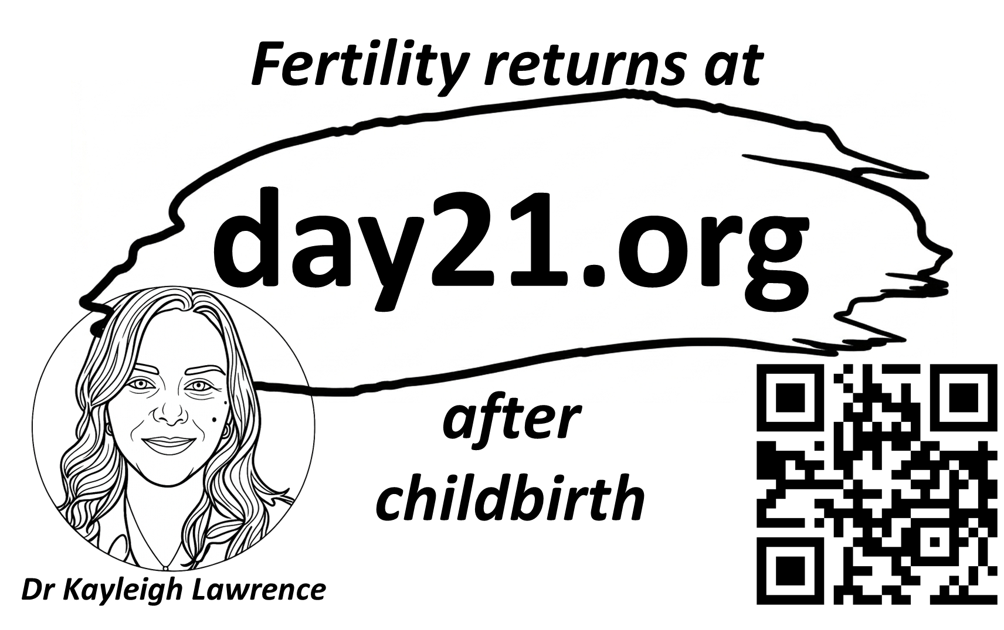

Slide 16


Slide 17
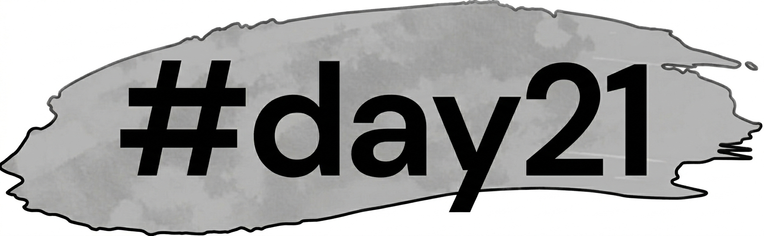

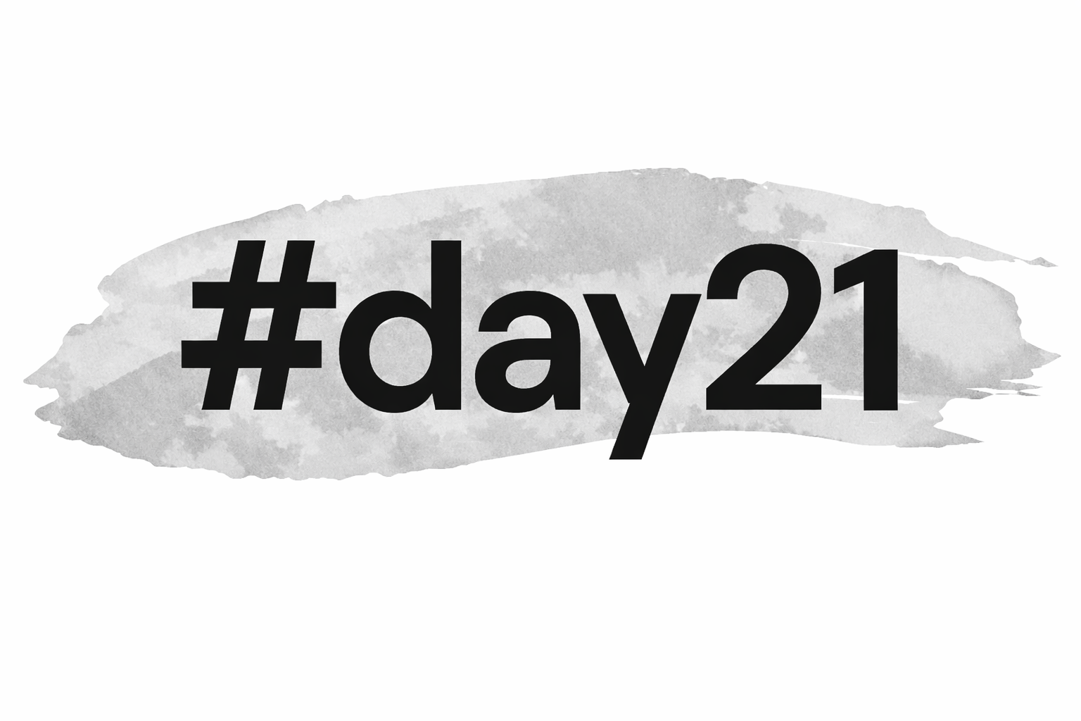

Slide 18

day21.org

Slide 19


