Slide 1
Digital Image Processing Final Project
Detection and Segmentation in Parotid Image

Slide 2
Outline
Background
Objective
Data
Evaluation
Other information

Slide 3
Background
The parotid gland is the largest of the three pairs of salivary glands in the human body, but parotid tumors are uncommon, accounting for only 0.3% of human tumors and 6% of head and neck tumors. Because of the rarity of the tumor, there are not many reports in the literature.
You need to design a system to identify parotid tumor type and segmentation using head and neck CT image dataset.

Slide 4
Objective
An accurate detection of defects is very important. There are three types: Cancer、Mix and Warthin.
Target :
Automatically detect and segment the defect during manufacturing.
Step 1. Detect parotid gland(left normal/right normal) from provided image.
Step 2. Segment the defective area at the meantime.

Slide 5
Data
100 image were captured each class.
The bounding boxes of defect was labeled by experts. The bounding box ground truth contains left-top and bottom-right coordinate (rectangle) in *.json file format.
We also provide the segmentation mask ground truth.

Slide 6
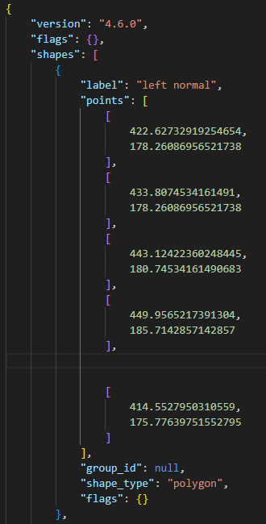
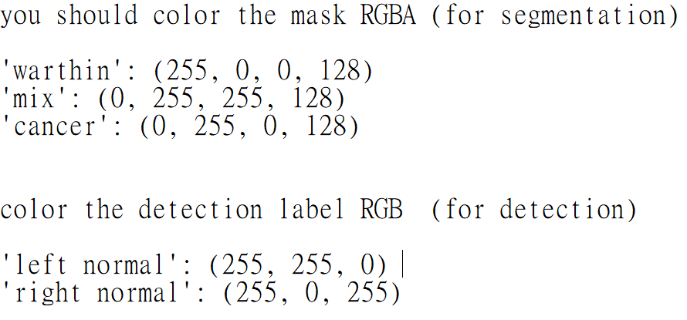
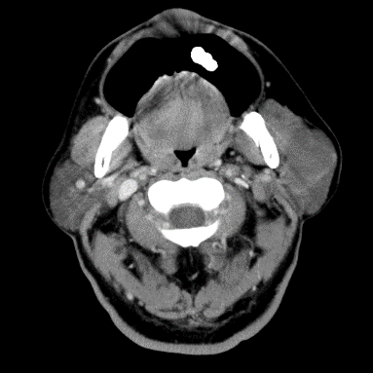
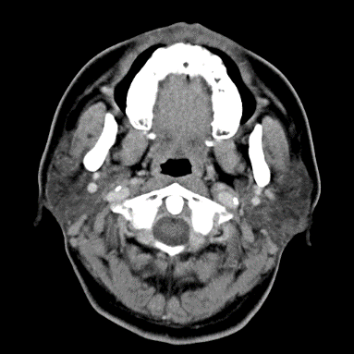
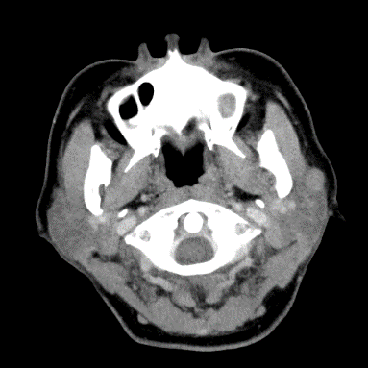
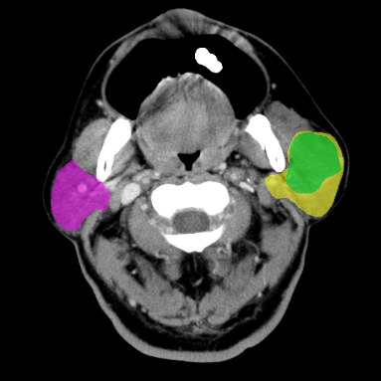
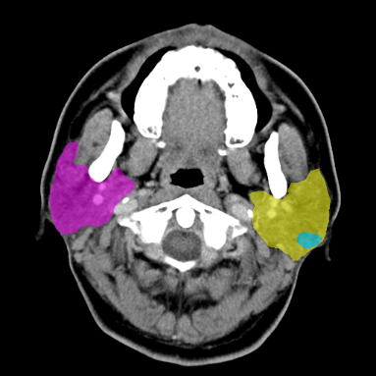
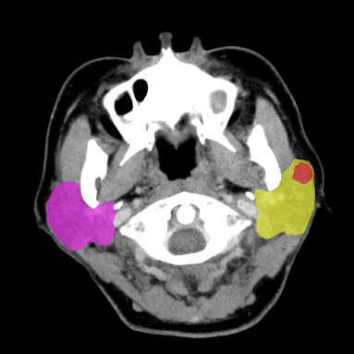
Data
Ground Truth bounding boxes format
Cancer
Mix
Warthin

Slide 7
Project Goal
You are asked to detect and segment the defects of manufacturing from given images.
You are given with total 300 images and ground truth annotations(mask and bounding box positions).
You can use the image processing skills as well as deep learning methods for this homework.

Slide 8
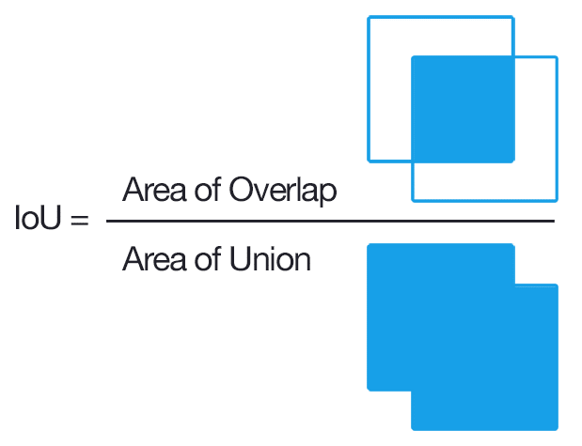

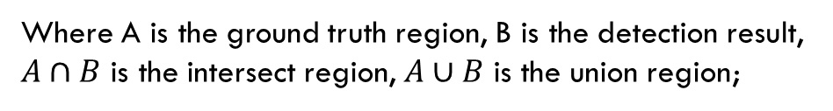
Evaluation
Use the Intersection over Union (IoU) to evaluate your detection result with the ground truth:
IoU = $\frac{A∩B}{A∪B}$
Where A is the ground truth region, B is the detection result,
$A∩B$ is the intersect region, $A∪B$ is the union region;

Slide 9
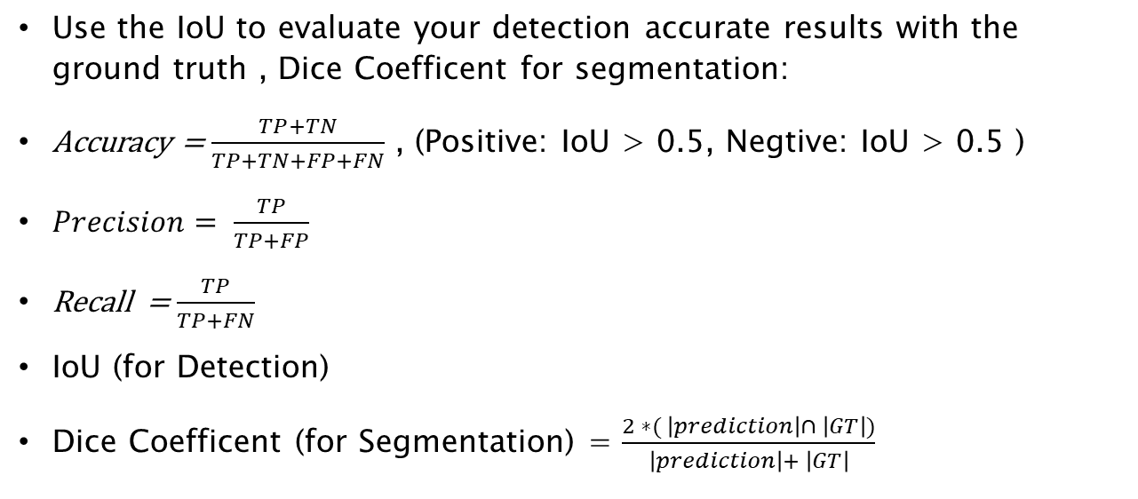
Evaluation
Use the IoU to evaluate your detection accurate results with the ground truth , Dice Coefficent for segmentation:
Accuracy = $\frac{TP+TN}{TP+TN+FP+FN}$ , (Positive: IoU > 0.5, Negtive: IoU > 0.5 )
$Precision= \frac{TP}{TP+FP}$
Recall = $\frac{TP}{TP+FN}$
IoU (for Detection)
Dice Coefficent (for Segmentation) = $\frac{2 ∗( \left|prediction\right|∩ \left|GT\right|)}{\left|prediction\right|+ \left|GT\right|}$

Slide 10
Requirement
1) Read a image folder and its ground truth from your program interface.
2) Run your program and let user choose any image to show the ground truth and predicted result (detection result and segmentation result) in the program interface.
3) Show the evaluation metric.
IoU
Accuracy
Precision
Recall
Dice Coefficent

Slide 11
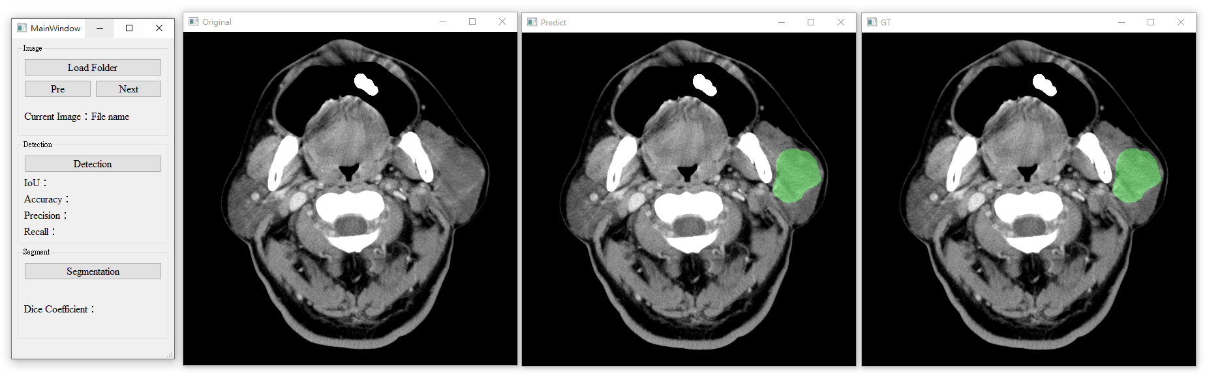
GUI LAYOUT eXAMPLE

Slide 12
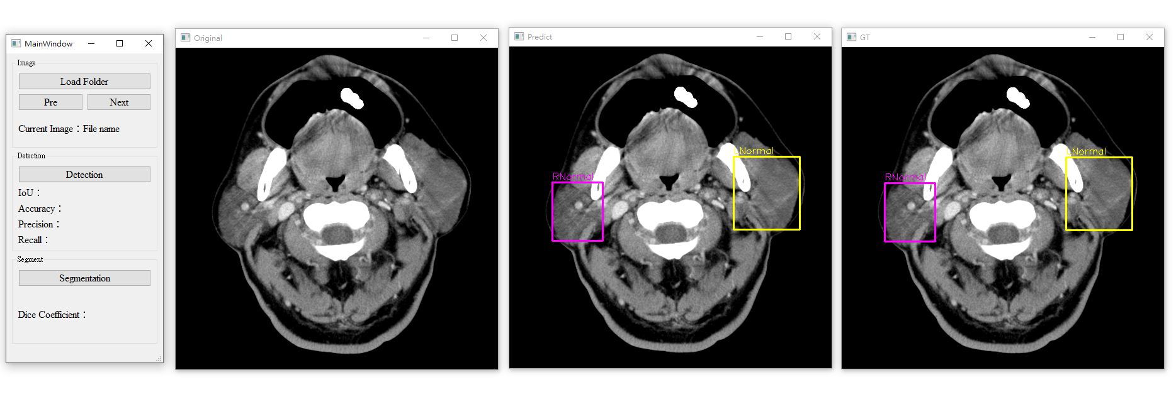
GUI LAYOUT eXAMPLE

Slide 13
GUI LAYOUT eXAMPLE

Slide 14
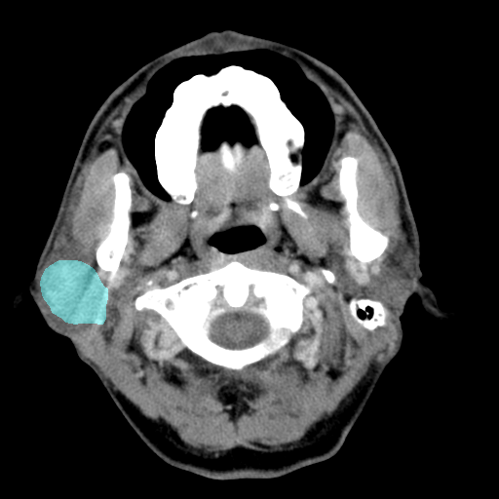
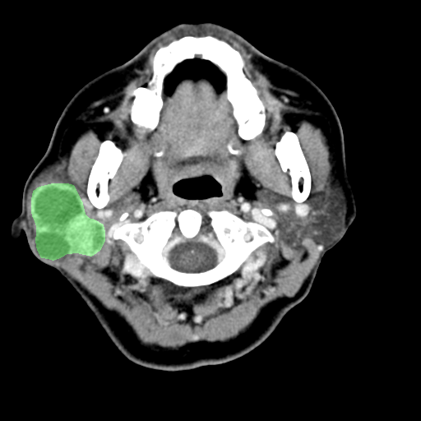
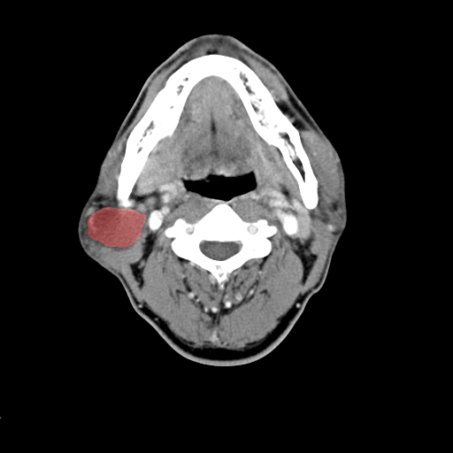
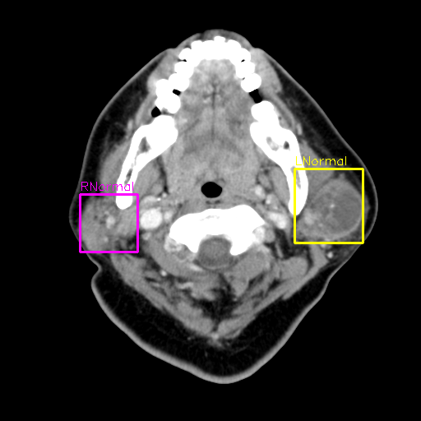
OUTPUT eXAMPLE
Mix
Cancer
Warthin
parotid gland

Slide 15
Evaluation
You should clearly show the number of training, validation and testing images of your evaluation.
If you are using training base methods, 4 fold cross-validation is required..
You should evaluation the detection and segmentation result of each fold and show the average of the metrics.
Round 1
f1
f2
f3
f4
Round 2
Blue: training
Yellow: testing
f1
f2
f3
f4
Round 3
f1
f2
f3
f4
Round 4
f1
f2
f3
f4

Slide 16
File Upload
Please compress the program source code, execution file(release mode) and report as a zip file and upload it to FTP “FinalProject” folder before 11:59 p.m. of 2024/01/7(Sun).
ftp://140.116.247.97 port:102
Id: imagehw
password: imagehw
The format of the zip file name :
[student id]_[version].zip
e.g. P78901234_VS.zip.
e.g. P78901234_PY.zip
Please add your version number if you have any new update
e.g. P78901234_VS_v02.zip

Slide 17
Notice
The report should be written in Chinese or English, and 4 pages at least. The report should include the questions, methods, results, discussion and conclusion. Please print it with your named on it and hand it in at the demonstration.
The demonstration will be held in Room 65702/4208 during 2024/01/08-01/12. The schedule will be announced in advance on the course web side. You can bring your laptop to demonstration.
If you cannot attend the scheduled demonstration, please inform the teaching assistant one week earlier for changing demo time.
Environment Requirement: Python with pytorch should be used when you are using deep learning methods.
It is not allowed to copy homework from other classmates, but discussions are encouraged.

Slide 18
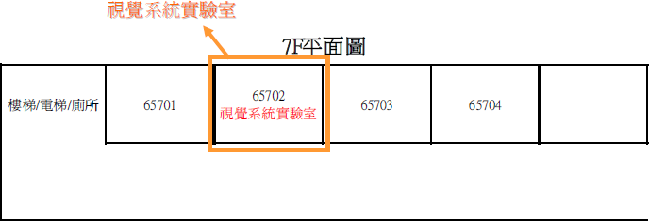
Vision System Lab (Room 65702)

Slide 19
Reference
Mask R-CNN. Kaiming He, Georgia Gkioxari, Piotr Dollár, and Ross Girshick. IEEE International Conference on Computer Vision (ICCV), 2017.
Faster R-CNN: Towards Real-Time Object Detection with Region Proposal Networks Shaoqing Ren, Kaiming He, Ross Girshick, and Jian Sun. Conference on Neural Information Processing Systems (NIPS), 2015.
Unet: Convolutional networks for biomedical image segmentation. In International Conference on Medical image computing and computer-assisted intervention, pages 234–241. Olaf Ronneberger, Philipp Fischer, and Thomas Brox.
Yolov4: Optimal speed and accuracy of object detection. arXiv preprint arXiv:2004.10934, 2020. Alexey Bochkovskiy, Chien-Yao Wang, and HongYuan Mark Liao.

Slide 20
Information
NCKU moodle
TA :
P76111377@gs.ncku.edu.tw
P76111173@gs.ncku.edu.tw
P76111775@gs.ncku.edu.tw
P76111432@gs.ncku.edu.tw

