Slide 1




CMP182 Computer Networks
Final Work
Neimar Marcos Assmann
Título do capítulo

Slide 2
In-band Network Telemetry (INT) with P4
Outline
  Proposal
  Network topology
  Overview about programing
  Show the operation
  Difficulties and conclusions

Slide 3
In-band Network Telemetry (INT) with P4
Proposal
  Based on link_monitor exercice from P4 Language tutorial
  INT data over ethernet packet
  Probe Packet
  INT Source = INT Sink
  INT Source need to know the network
    Based on next egress port

Slide 4
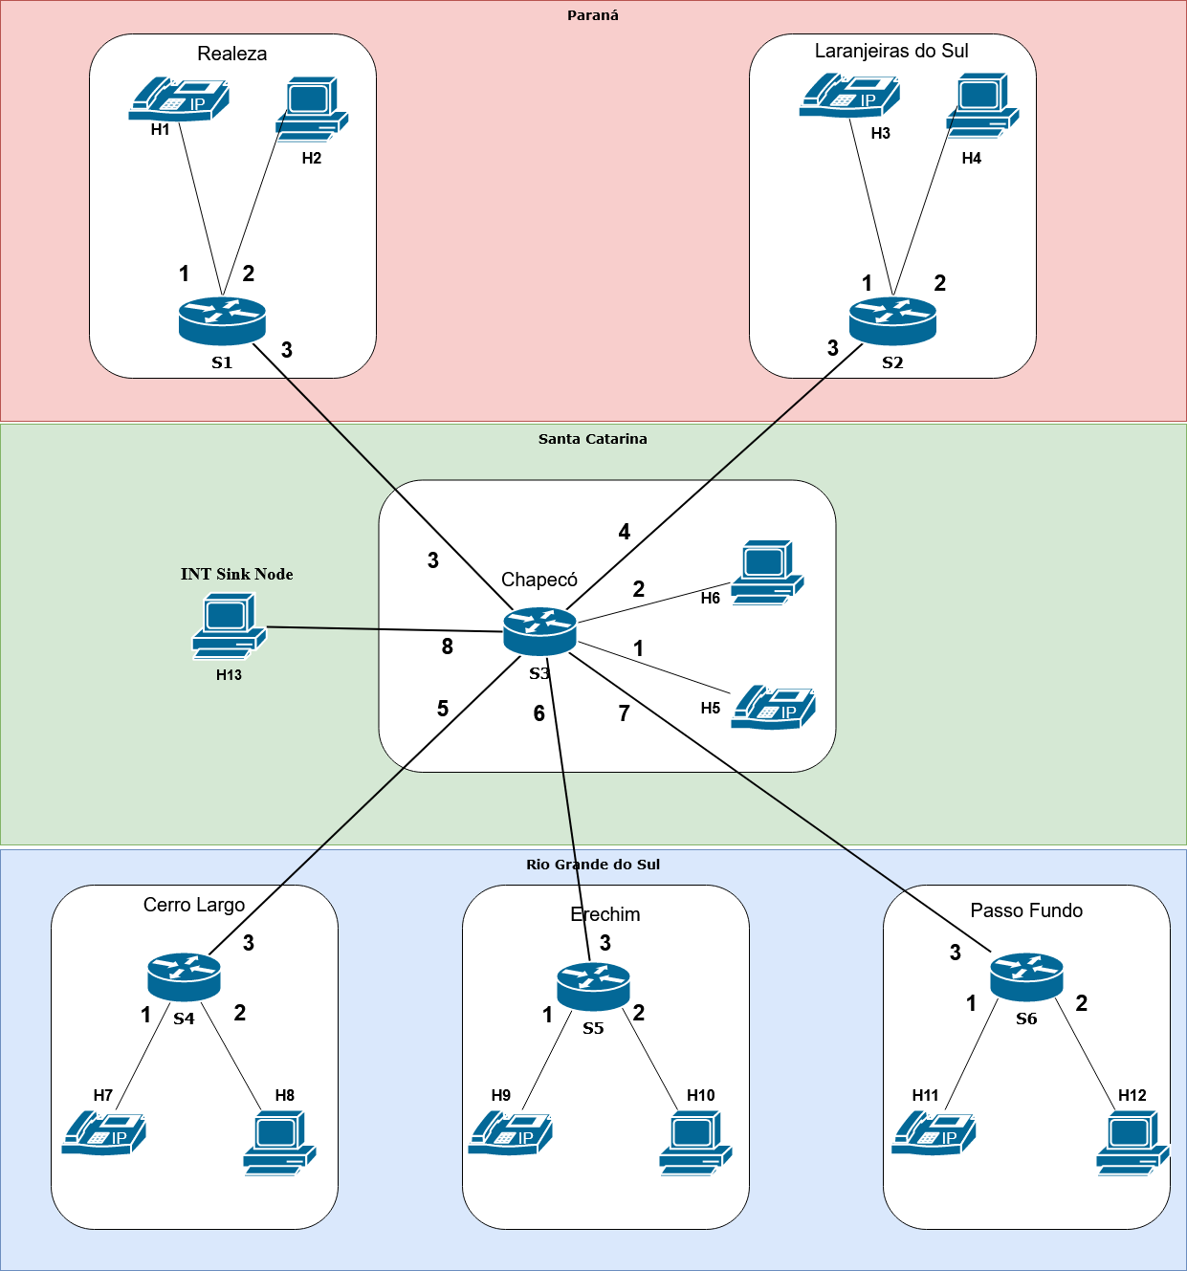
In-band Network Telemetry (INT) with P4
Network topology

Slide 5
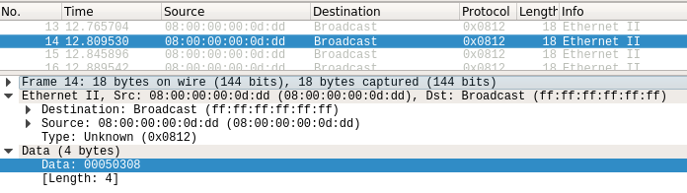
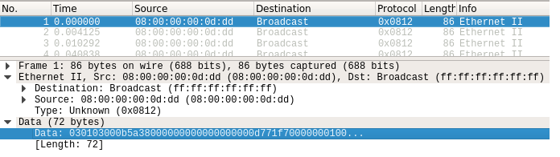
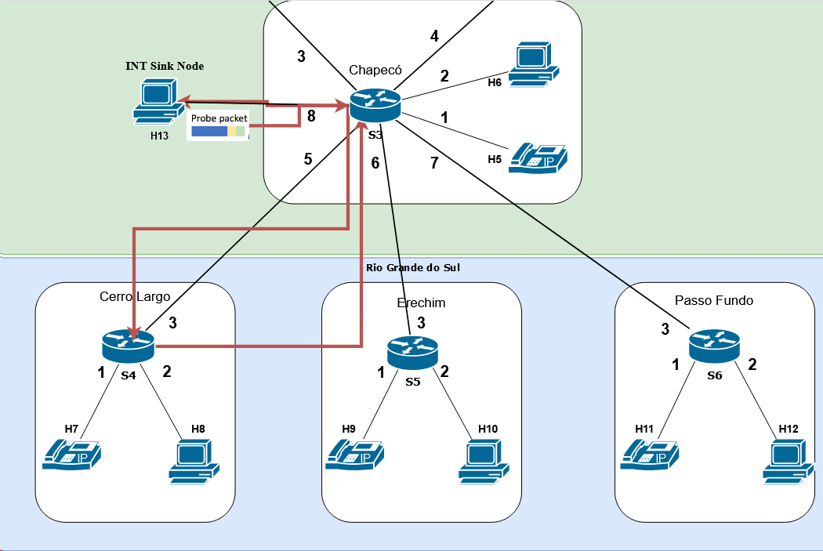
In-band Network Telemetry (INT) with P4
Probe Packet

Slide 6
In-band Network Telemetry (INT) with P4
Probe Packet – Header Types

Slide 7

Instituto de Informática
Título do capítulo
Obrigado !

