Slide 1
Software testing: the BLEEDING Edge!
Hot topics in software testing research

Slide 2
About me
Software Engineering Lab, CWRU
Specializing in software testing/reliability

Slide 3
About this talk
Inspiration
  Different companies have different test infrastructures
  Common goals for improving infrastructure
  Current buzzword: (more extensive) automation
  What’s next?

Slide 4
About this talk
Grains of salt
  I’m not a psychic
  I’m the most familiar with my own research

Slide 5
About this talk
Profiling
Operational testing
Test selection and prioritization
Domain-specific techniques

Slide 6
Profiling
Current profiling tools:
  performance/memory
    Rational Quantify, AQtime, BoundsChecker
  test code coverage
    Clover, GCT

Slide 7

Profiling: Data Flow/ Information Flow
Data
Processing
What happens between the time when a variable is defined, and when it is used?
  Object-Oriented decoupling/dependencies
  Security ramifications
  Trace the impact of a bug
Input
Validator
Web
Interface
Confidential
Data

Slide 8
Profiling: data flow
Explicit: y = x + z
Implicit: if(x > 3)
{
y = 12
}
else y = z

Slide 9
Profiling: function calls
Count how many times each function was called during one program execution
  Which functions show up in failed executions?
  Which functions are used the most?
  Which functions should be optimized more?
  Which functions appear together?

Slide 10
Profiling: basic block
More fine-grained than function call profiling, but answers the same questions.
if(someBool)
{
x = y;
doSomeStuff(foo);
}
else
{
x = z;
doDifferentStuff(foo);
}

Slide 11
Profiling: Operational
Collect data about the environment in which the software is running, and about the way that the software is being used.
  Range of inputs
  Most common data types
  Deployment environment

Slide 12
Profiling
Kinks to work out:
  High overhead
    Performance hit
    Code instrumentation
  Generates lots of data

Slide 13
Operational Testing
Current operational testing techniques:
  Alpha and Beta testing
  Core dump information (Microsoft)
  Feedback buttons

Slide 14
Operational Testing
The future (Observation-based testing):
  More information gathered in the field using profiling
  Statistical testing
  Capture/Replay

Slide 15
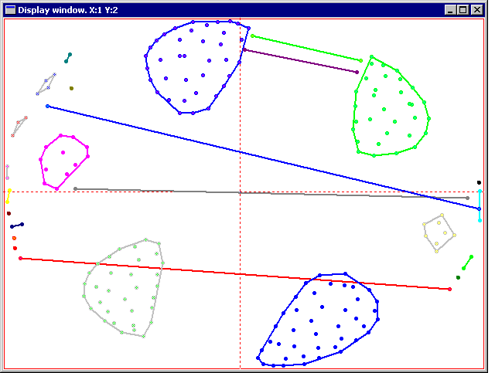
Operational Testing: user profiles
What can you do with all this data?
[ JTidy executions, courtesy of Pat Francis ]

Slide 16
Operational testing: user profiles
Cluster execution profiles to figure out:
  Which failures are related
  Which new failures are caused by faults we already know about
  Which faults are causing the most failures
  What profile data the failures have in common

Slide 17
Operational Testing: Statistical Testing
From profile data, calculate an operational distribution.
Make your offline tests random over the space of that distribution.
In English: figure out what people are actually doing with your software. Then make your tests reflect that.
  People might not be using software in the way that you expect
  The way that people use software will change over time

Slide 18
Operational Testing: Capture Replay
Some GUI test automation tools, e.g. WinRunner, already use capture replay.
Next step: capturing executions from the field and replaying them offline.
Useful from a beta-testing standpoint and from a fault-finding standpoint.

Slide 19
Operational Testing
Kinks to work out:
  Confidentiality issues
  Same issues as with profiling
    High overhead
    Code instrumentation
    Lots of data

Slide 20
Test Selection/Prioritization
Hot research topic
Big industry issue
Most research focuses on regression tests

Slide 21
Test Selection/Prioritization
Problems:
  test suites are big.
  some tests are better than others.
  limited amounts of resources/time/money
Suggested solution: Run only those tests that will be the most effective.

Slide 22
Test Selection/Prioritization
Sure, but what does “effective” mean in this context?
Effective test suites (and therefore, effectively prioritized or selected test suites) expose more faults at a lower cost, and do it consistently.

Slide 23
Test Selection/Prioritization
What’s likely to expose faults?
Or: which parts of the code have the most bugs?
Or: which behaviors cause the software to fail the most often?
Or: which tests exercise the most frequently used features?
Or: which tests achieve large amounts of code coverage as quickly as possible?

Slide 24
Test Selection/Prioritization
Run only tests that exercise changed code and code that depends on changed code
  Use control flow/data flow profiles
  Dependence graphs are less precise
Concentrate on code that has a history of being buggy
  Use function call/basic block profiles
Run only one test per bug
  Cluster execution profiles to find out which bug each test might find

Slide 25
Test Selection/Prioritization
Run the tests that cover the most code first.
Run the tests that haven’t been run in a while first.
Run the tests that exercise the most frequently called functions first.
Automation, profiling and operational testing can help us figure out which tests these are.

Slide 26
Test Selection/Prioritization
Granularity
  Fine-grained test suites are easier to prioritize
  Fine-grained test suites may pinpoint failures better
  Fine-grained test suites can cost more and take more time.

Slide 27
Domain-specific techniques
Current buzzwords in software testing research
  Domain-specific languages
  Components

Slide 28
More questions?
Contact me later: melinda@melindaminch.com

Slide 29
Sources/Additional reading
Masri, et al: Detecting and Debugging Insecure Information Flows. ISSRE 2004
James Bach:Test Automation Snake Oil
Podgurski, et al: Automated Support for Classifying Software Failure Reports. ICSE 2003
Gittens, et al: An Extended Operational Profile Model. ISSRE 2004

Slide 30
Sources/Additional reading
Rothermel, et al: Regression Test Selection for C++ Software. Softw. Test. Verif. Reliab. 2000
Elbaum, et al: Evaluating regression test suites based on their fault exposure capability. J. Softw. Maint: Res. Pract. 2000
Rothermel & Elbaum: Putting Your Best Tests Forward. IEEE Software, 2003

Slide 31
Sources/Additional Reading
http://testing.com
http://rational.com
http://automatedqa.com
http://numega.com
http://cenqua.com/clover/
http://mercury.com
http://jtidy.sourceforge.net/

