Slide 1

Blacklisting Spam Callers with Local Differential Privacy
Presented by: Joe-Ansel Puplava

Slide 2
Motivation
Spam phone calls have rapidly increased
Technological advances made robocalls cheaper and easier
Efforts to counter this attack from the US FTC and various smartphone apps
Mostly rely on blacklisting known numbers involved in spamming calls

Slide 3

Problem
Apps collect information that is private to the user
TrueCaller collects users’ contacts to learn which callers are legitimate
Phone honeypot records are not the reliable
Skewed towards business-oriented campaigns

Slide 4
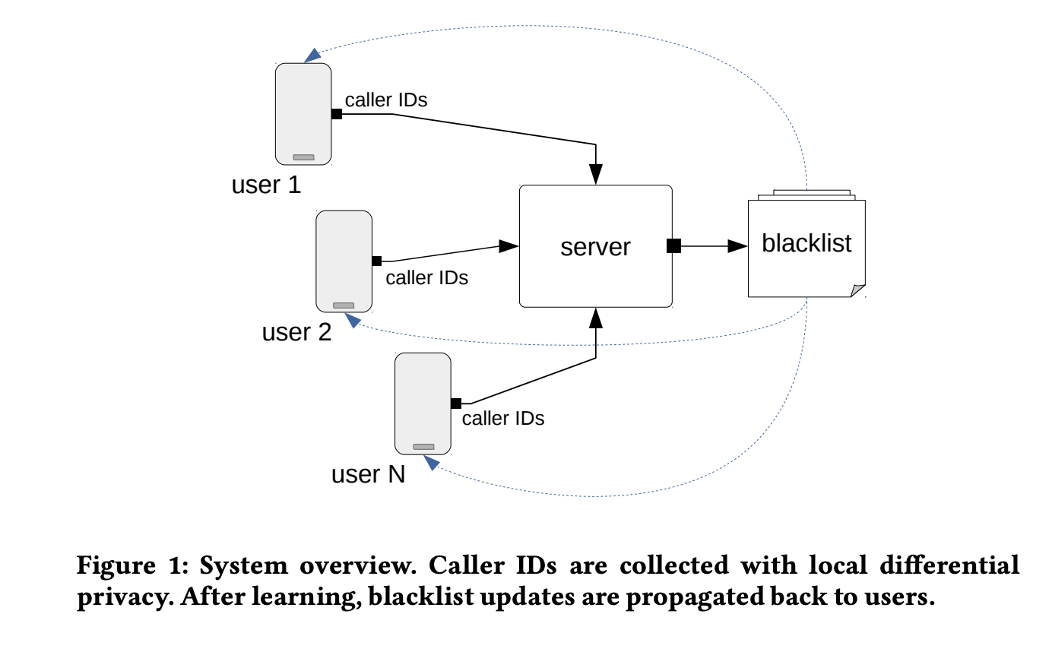
Problem Approach
Leverage Local Differential Privacy for generic heavy-hitter detection

Slide 5
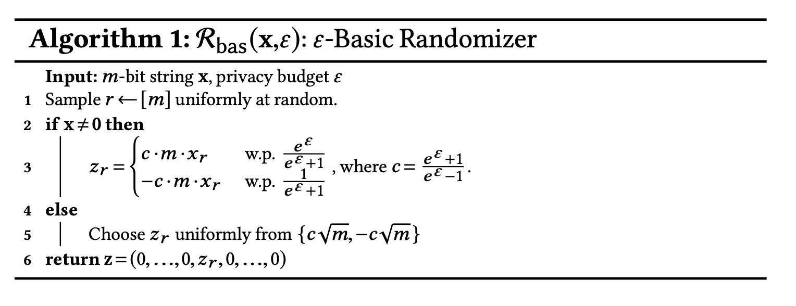
Implementation of LDP
Uses The Succinct Histogram Protocol
A ε-LDP protocol for detecting heavy hitters over a large domain V
The protocol applies after a few modifications
Encode the item, X, into a bit string making Y
Add noise to the item, Y, making Z and send Z to the server
Aggregates noisy reports and rounds to the nearest valid encoding, Yi.
Decode the heavy hitter, Yi, into Xi

Slide 6
Results
Blacklist utility
Maximum budget of ε = 15
Reasonable utility with ε = 10
It is possible to learn a phone blacklist that:
Preserves privacy
Maintains the utility of the blacklist
Notes:
A privacy budget that can provide more privacy while keeping a good performance trade-off isε =10 (withT =2,εHH =7,εOLH =3, and τ =143): our experimental evaluation shows an F1-score higher than 75% with the detection of more than 97 potential spam phone numbers per day, on average.

Slide 7
References
“Stop Unwanted Robocalls and Texts.” Federal Communications Commission, 30 January 2024, https://www.fcc.gov/consumers/guides/stop-unwanted-robocalls-and-texts.
Ucci, Daniele, et al. “Building a Collaborative Phone Blacklisting System with Local Differential Privacy.” Annual Computer Security Applications Conference, 2020, pp. 100–15. arXiv.org, https://doi.org/10.1145/3427228.3427239.
Bassily, Raef, and Adam Smith. “Local, Private, Efficient Protocols for Succinct Histograms.” Proceedings of the Forty-Seventh Annual ACM Symposium on Theory of Computing, 2015, pp. 127–35. arXiv.org, https://doi.org/10.1145/2746539.2746632.

