Slide 1
Master Artificial Intelligence
Natural Language Processing and Semantic Technologies
Esther Ademola
Jochen Schmidt - 5122741
Lennard Rose - 5122737
Marius Benkert

Slide 2
Outline?
Project Description
What is it about?
What is the final goal?
challenges? (mono /multilingual pdfs etc. pp.)
Project Management Stuff
project organization
progress monitoring
roles in the team
time planning
Scraper
Preprocessing
Building of the corpus
Outlook
where are we now and whats coming next semester?
achievements
future road map

Slide 3
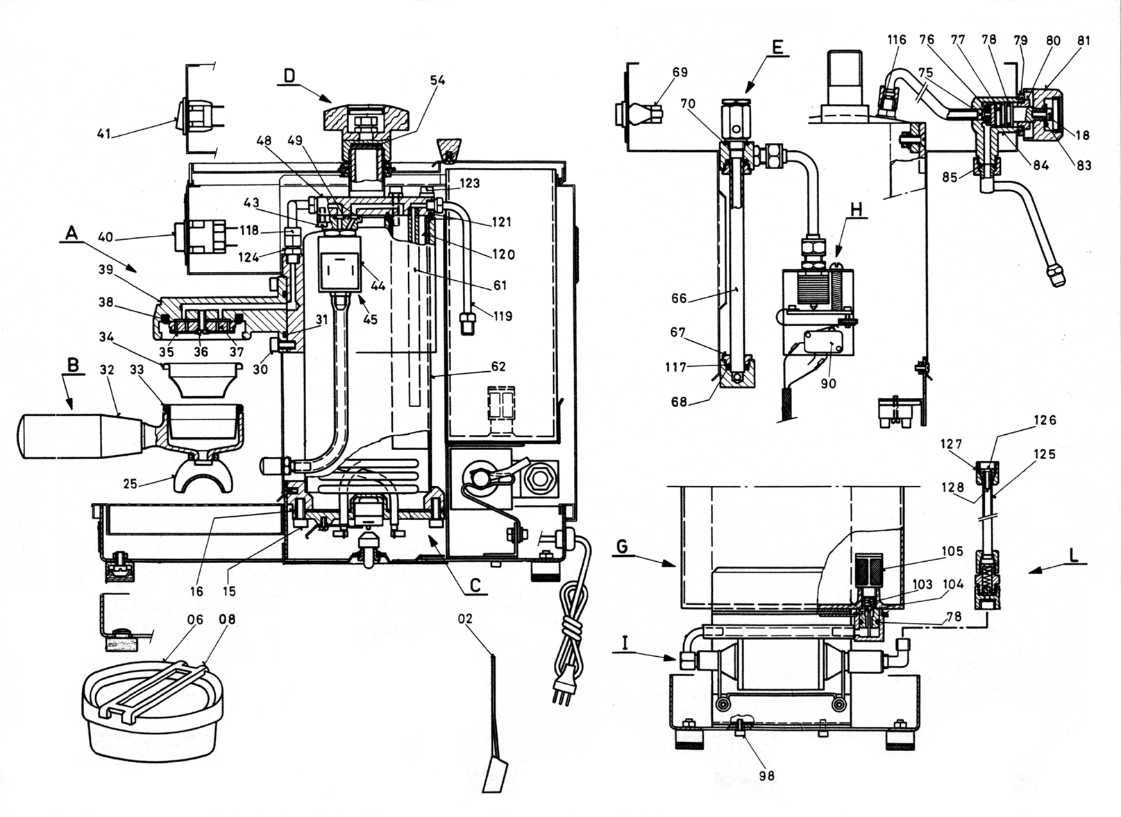
Goal
Build a system that is able to download and preprocess manuals and technical documents of coffee machines to do advanced text analysis on

Slide 4



Tasks
1st Semester:
Construction of a parallel, multilingual corpus
Crawl technical documents of a certain domain from the internet
Preprocess Documents
Align segments of documents that are available in mulitple languages
Output Format
Build a semantic representation of our domain
2nd Semester:
Perform advanced text analytics

Slide 5
What is a corpus?
A text corpus is a very large collection of text produced by real users of the language and used to analyze how words, phrases and language in general are used.
A corpus is also used for generating language databases used in predictive keyboards, spell check, grammar correction, text/speech understanding systems, text-to-speech modules, machine translation systems and many others.

Slide 6
Parallel, multilingual corpus
german
english
spanish
french
Ich bin menschlich
I am human
Soy humano
Je suis humain
Ich wohne in Berlin
I live in Berlin
Je vis à Berlin

Slide 7
Subtasks - needed?
Construction of a parallel, multilingual corpus
Crawl technical documents of a certain domain from the internet
Preprocess Documents
Align segments of documents that are available in mulitple languages
Output Format
Building a technical ontology
Build a semantic representation of your domain (e.g. coffee machine)
Text Analytics
Question answering
Text classification

Slide 8
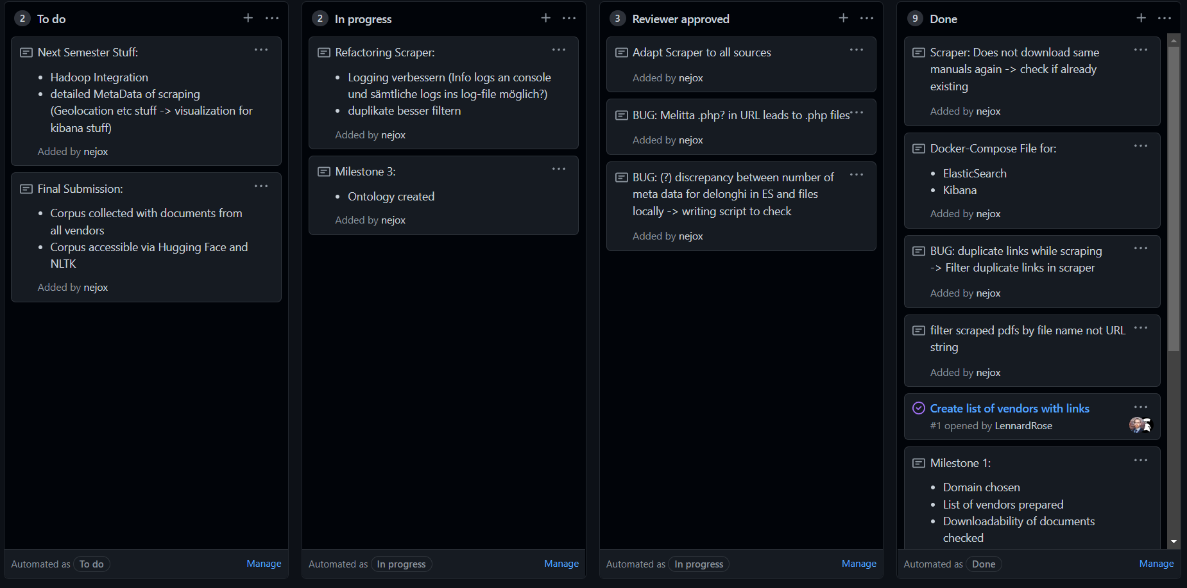
Project Management
Scrum-like process with weekly meetings
Milestone meetings with supervisor
Development organization via Github Projects

Slide 9


Roles in the team
CoffeeKraken
Pre-processing

Slide 10
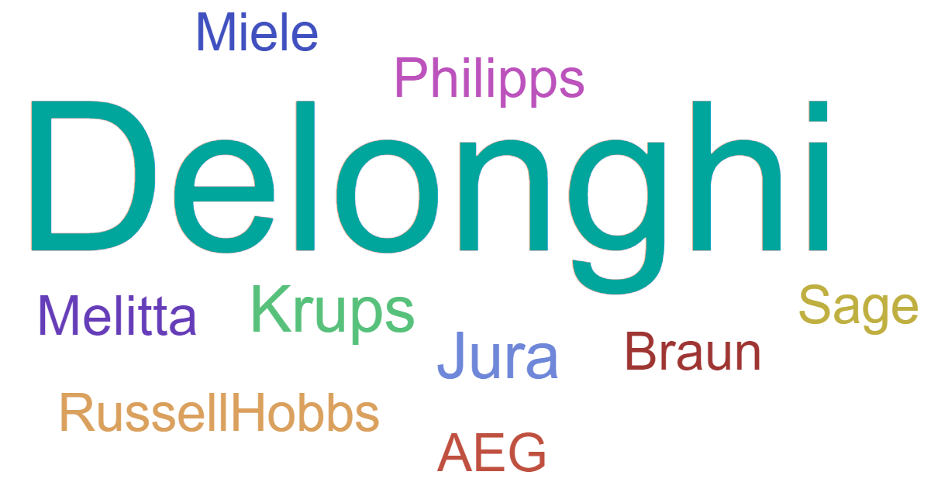
Web Crawling

Slide 11
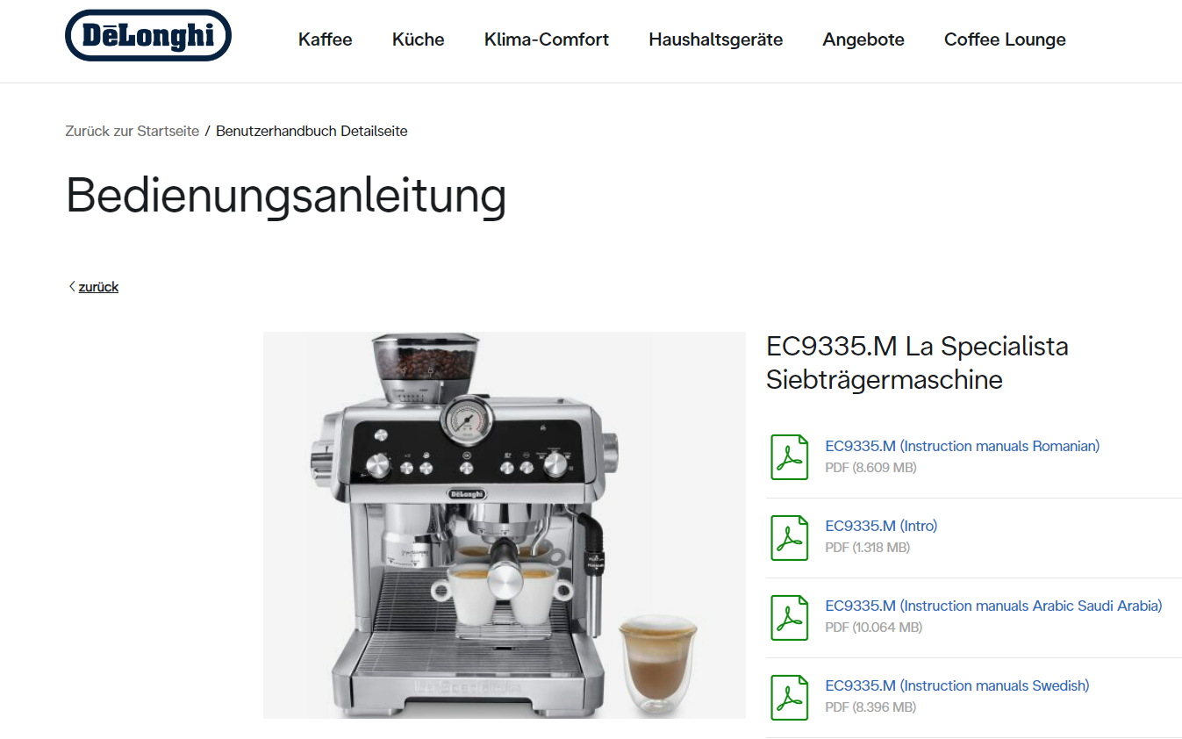
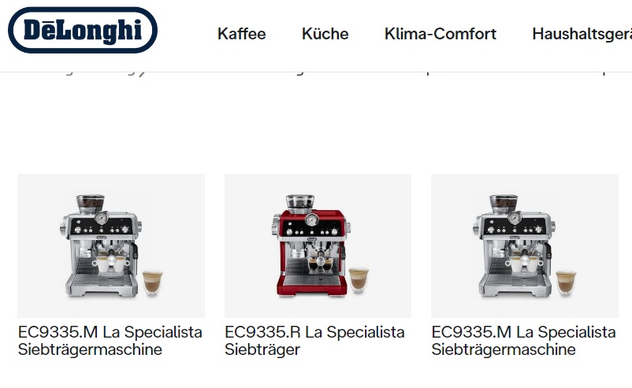
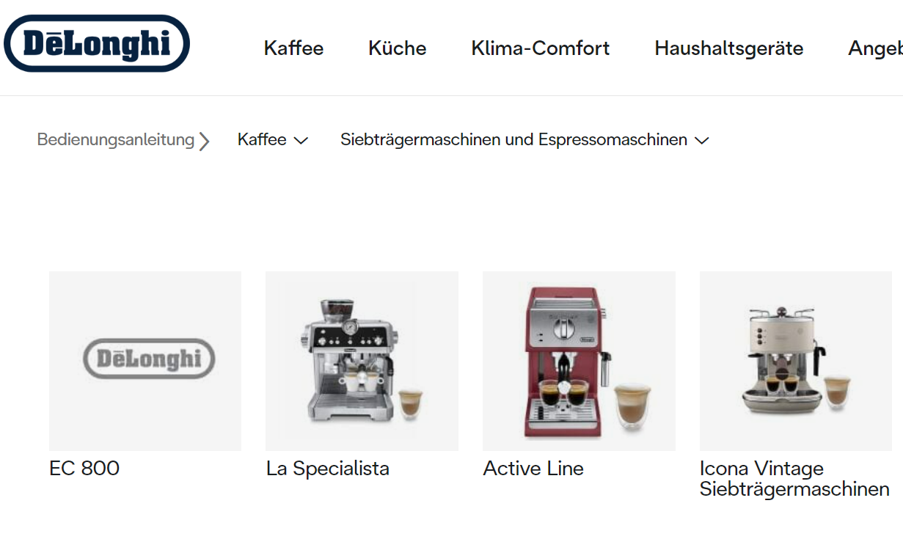
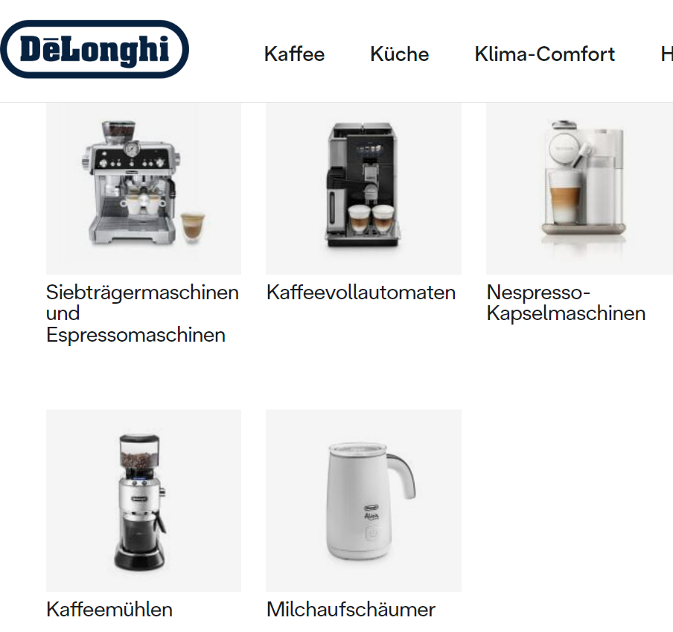
Web Crawling

Slide 12
Web Crawling
Overview
Espresso
Automatic
Moka
Filter
Model X
Model Y
Model X
Model Y
Model X
Model X
Model Y
Model Z
Manuals
Manuals
Manuals
Manuals
Manuals
Manuals
Manuals
Manuals

Slide 13
Web Crawling
{ "manufacturer_name": "Delonghi", "base_url": "https://www.delonghi.com/", "onlyDynamic": false, "paths": [ "de-de/manuals/produkte/kaffee/siebtraegermaschinen-und-espressomaschinen/c/manual_espresso_makers", "de-de/manuals/produkte/kaffee/kaffeevollautomaten/c/automatic_coffee_makers", "de-de/manuals/produkte/kaffee/nespresso-kapselmaschinen/c/nespresso_coffee_machines", "de-de/manuals/produkte/kaffee/kaffeemaschinen/c/filter_coffee_makers", "de-de/manuals/produkte/kaffee/moka/c/moka" ], "layers": [ { "html_tag": "div", "html_class": "dln-categoryBox", "css_selector" : ".dln-category-browser__category > div > a", "filter": [ { "condition_string": "//p/", "include_condition": false } ] } ], "pdf": { "html_tag": null, "html_class": null, "css_selector": ".dln-instruction-manuals__list > li > a", "filter" : [ { "condition_string": "intro", "include_condition": false } ] }, "meta" : { "manual_name" : ".dln-instruction-manuals__list > li span:first-of-type", "product_name" : ".dln-instruction-manuals__mainSubtitle" } }

Slide 14
Web Crawling
ElasticSearch
Metadata
Read Configs
Crawl websites
Save Data
End
Start
Manuals
Hadoop/LFS

Slide 15
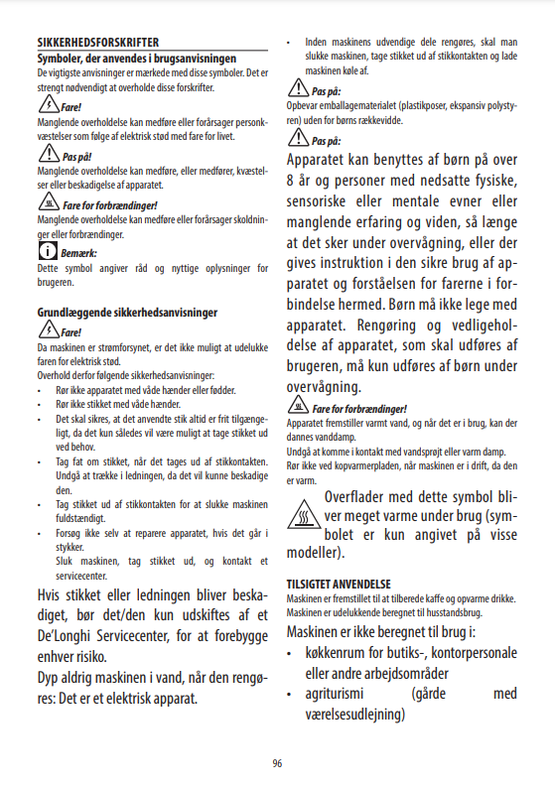
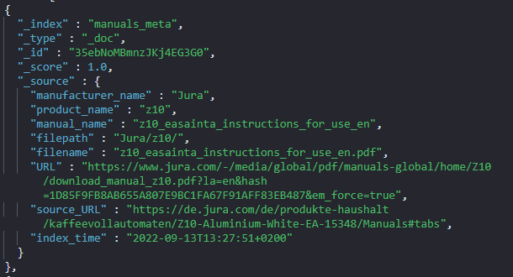
Web Crawling
Meta Data
Manual

Slide 16
Web Crawling
hdfs_client.py
elastic_search_client.py
HDFSClient
MOCKHDFSClient
MOCKElasticSeachClient
ElasticSearchClient
url_exists(URL, source_URL)
index_config(id, doc)
count_entries_by_product_and_manual(...)
abstract_client.py
FileClient {Abstract}
MetaClient {Abstract}
ManualClient {Abstract}
indexer.py
read_file(file_path)
index_meta_data(metadata_json)
get_manual_config(id)
save_as_file(file_path, filename, content)
get_latest_entry_URL(source_URL, region)
get_all_manual_configs( )
delete_meta_data(id)
utils.py
client_factory.py
<GLOBAL> config: JSON
get_meta_client() : MetaClient
init_global_config(config path)
get_manual_client() : ArticleClient
parse_date(date)
get_file_client() : FileClient
date_now( )
date_today( )
slugify(value, allow_unicode)
argument_parser_wrapper.py
manual_scraper.py
ArgumentParserWrapper
main.py
ManualScraper
parse_data_from_arguments( )
scrape(manual_config)

Slide 17
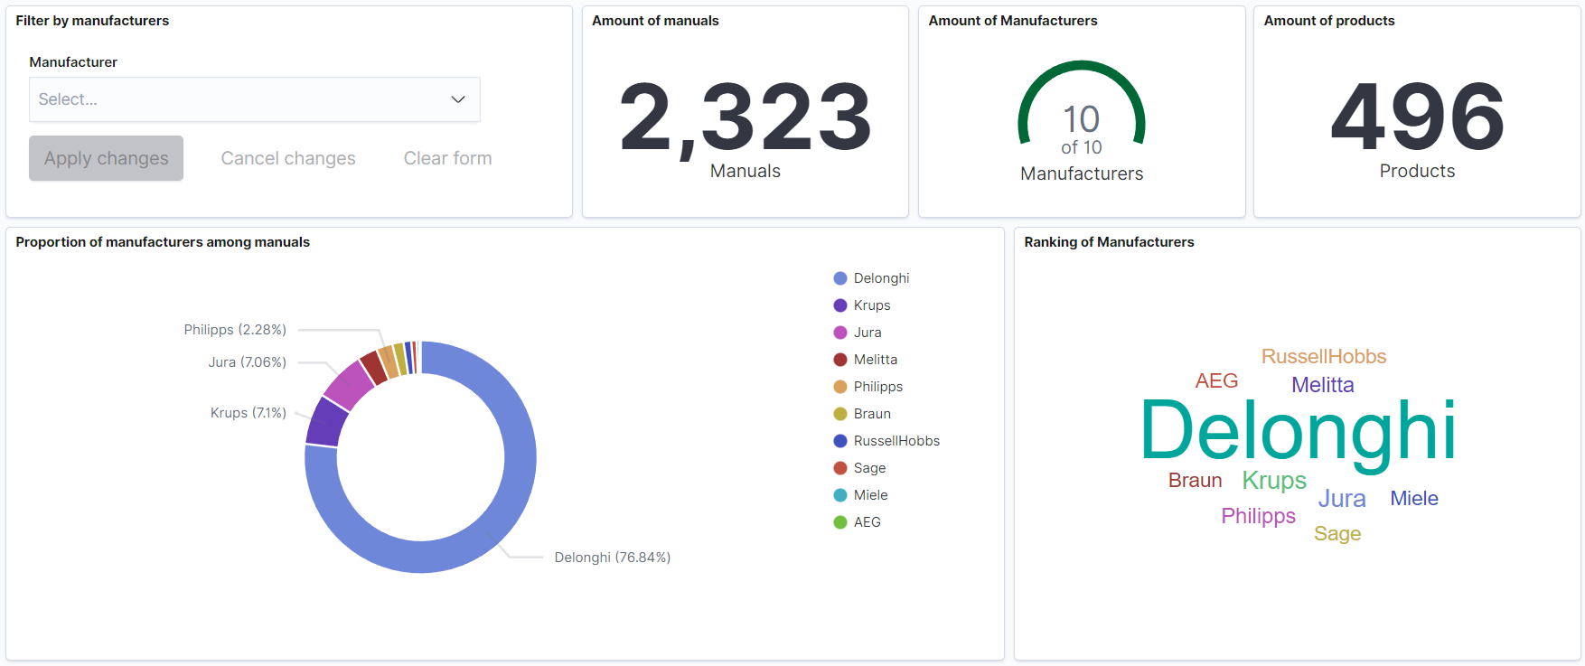
Web Crawling

Slide 18
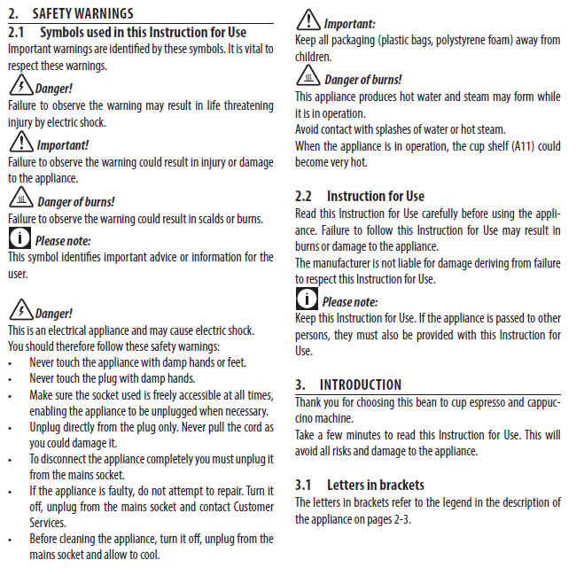
Preprocessing
The downloaded documents are only available in PDFs, as a result preprocessing steps are performed.
Extraction of text
Segmentation of text
Source: DeLonghi manual ECAM65085MS-167866

Slide 19

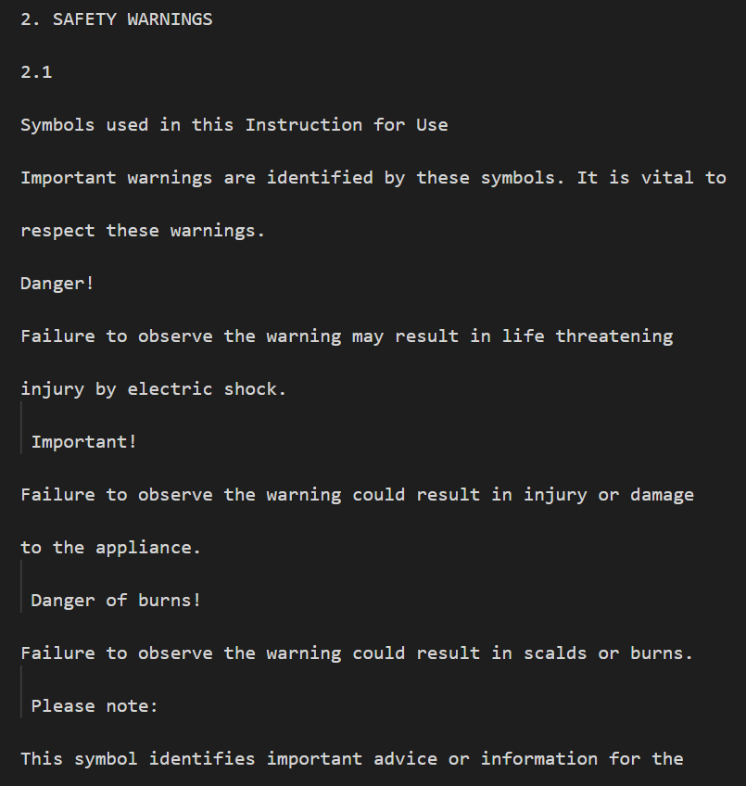
Preprocessing
Text Extraction
Text
Font
Font size
NOT SUFFICIENT

Slide 20
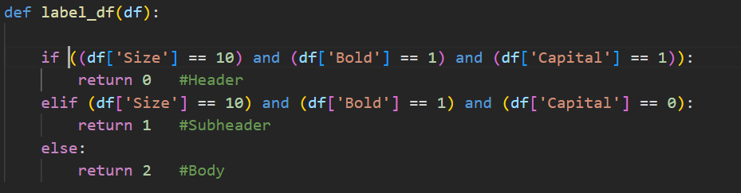
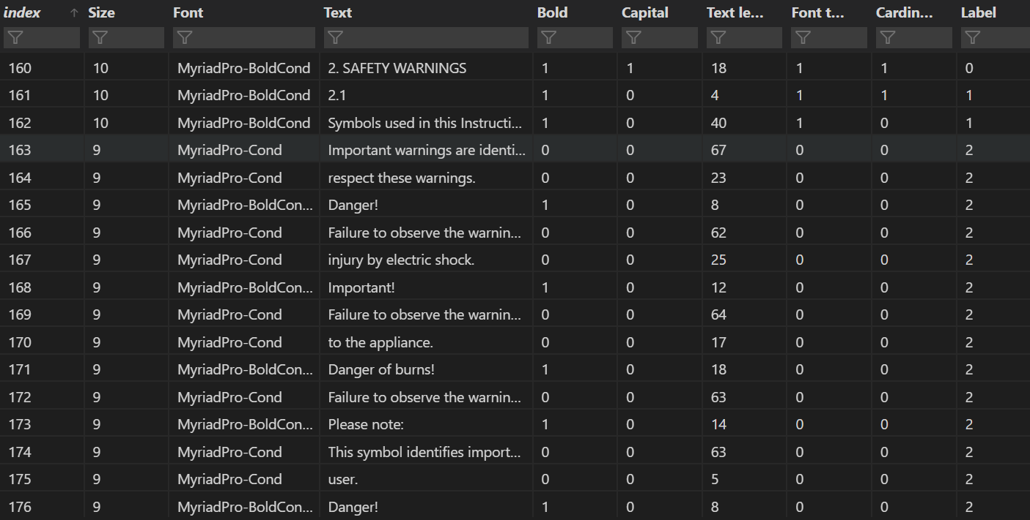
Preprocessing
Text Segmentation
Features Extraction
Data Labelling
Balancing of Data

Slide 21
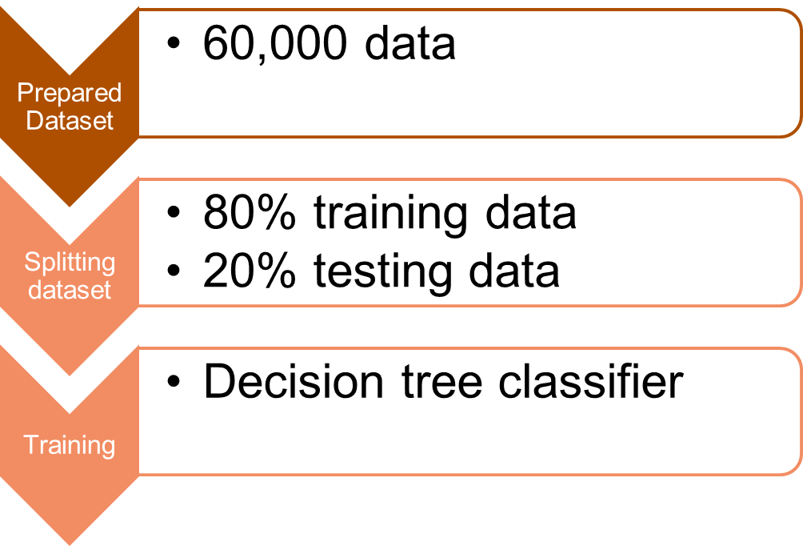
Preprocessing
Training of Dataset

Slide 22
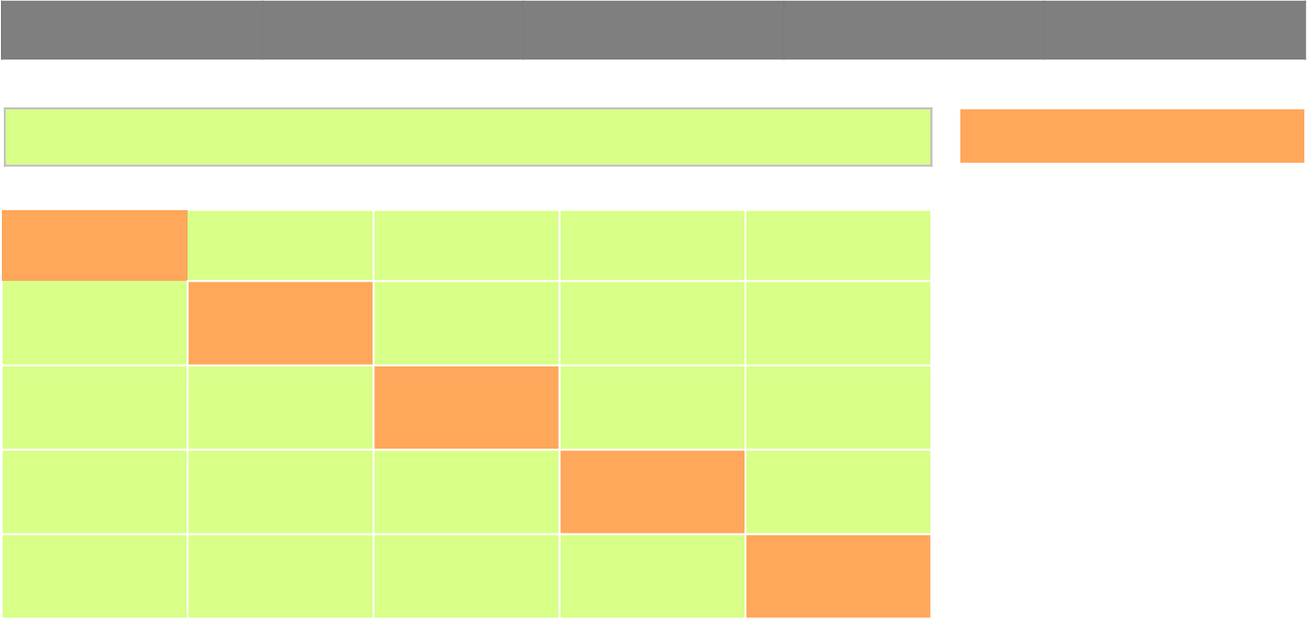
Preprocessing
Cross Validation
Training data
Test data
Cross validation scores
Fold 1
Fold 2
Fold 3
Fold 4
Fold 5
0.9969
0.9976
0.9975
0.9971
0.9972
𝚺 0.9973
Fold 1
Fold 2
Fold 3
Fold 4
Fold 5
Fold 1
Fold 2
Fold 3
Fold 4
Fold 5
Fold 2
Fold 3
Fold 4
Fold 5
Fold 1
Fold 1
Fold 2
Fold 3
Fold 4
Fold 5

Slide 23
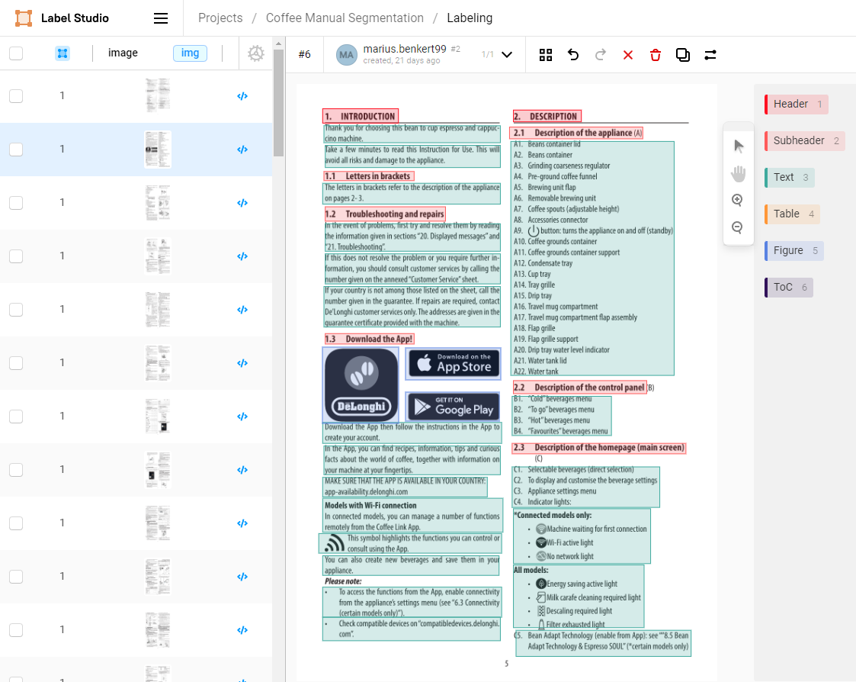


Preprocessing -
Object Recognition
+
Github

Slide 24
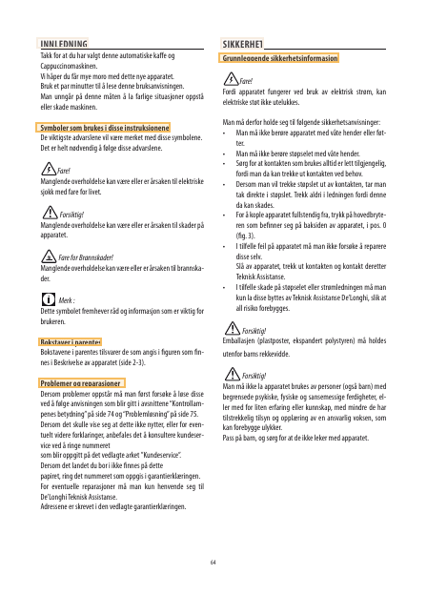
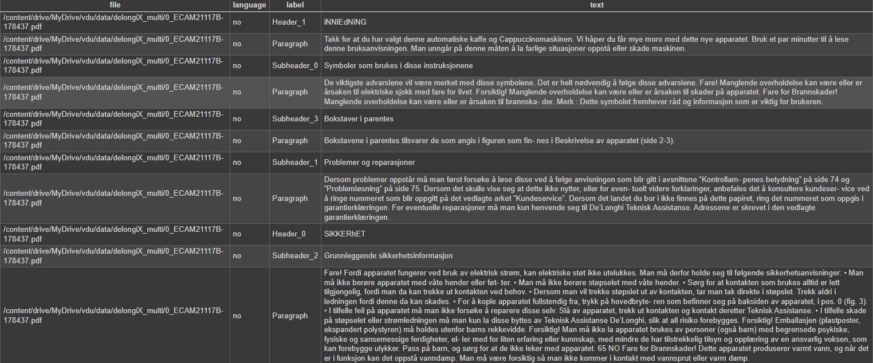
Preprocessing -
Object Recognition

Slide 25
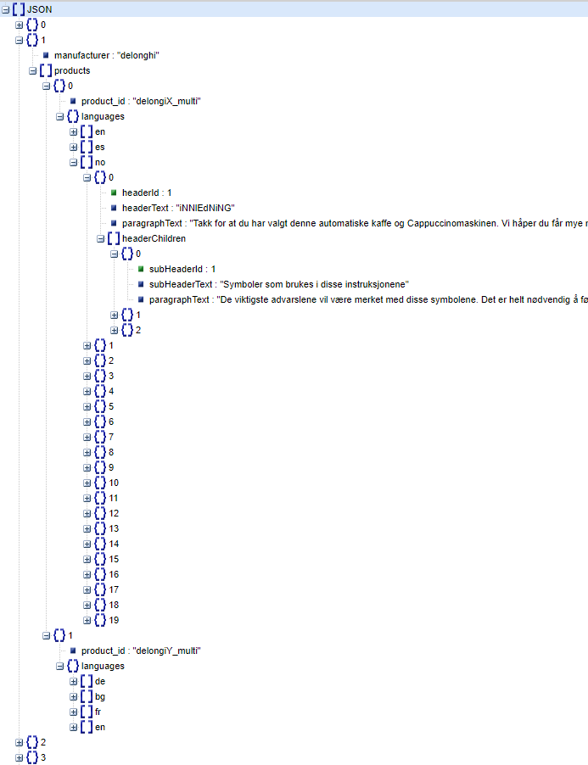
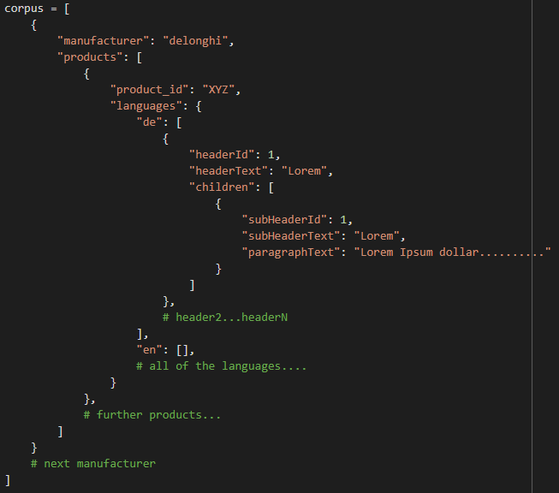
Preprocessing - Output

Slide 26
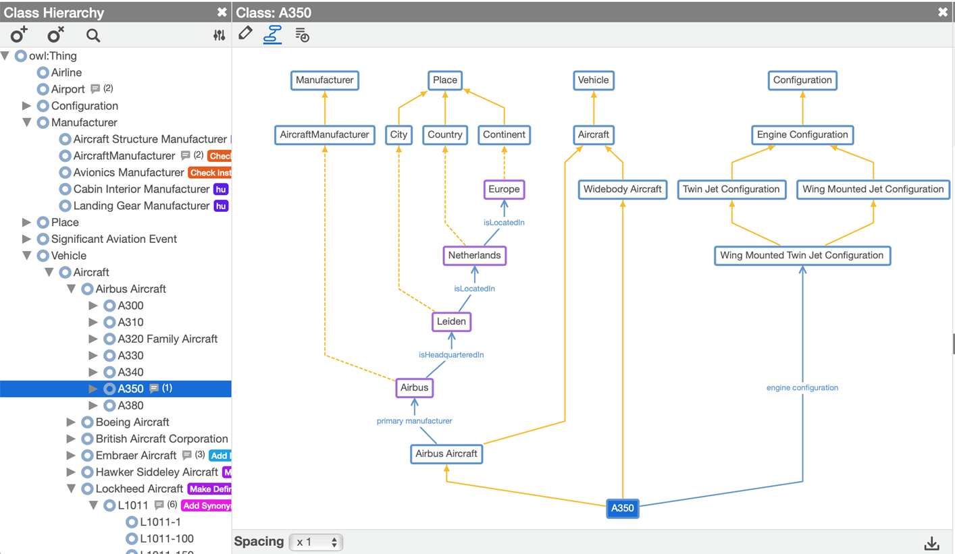
Ontology

Slide 27

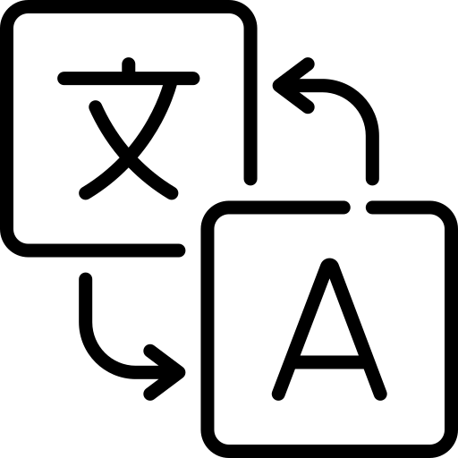


What’s coming next?
Add more filter/cleaning logic for the corpus
Assess which approach produces the better corpus
Build Ontology further
Decide on which ML tasks we want to tackle with built corpus
Corpus
Question
Answering
Translation
…
Text Classification
Summarization

