Slide 1
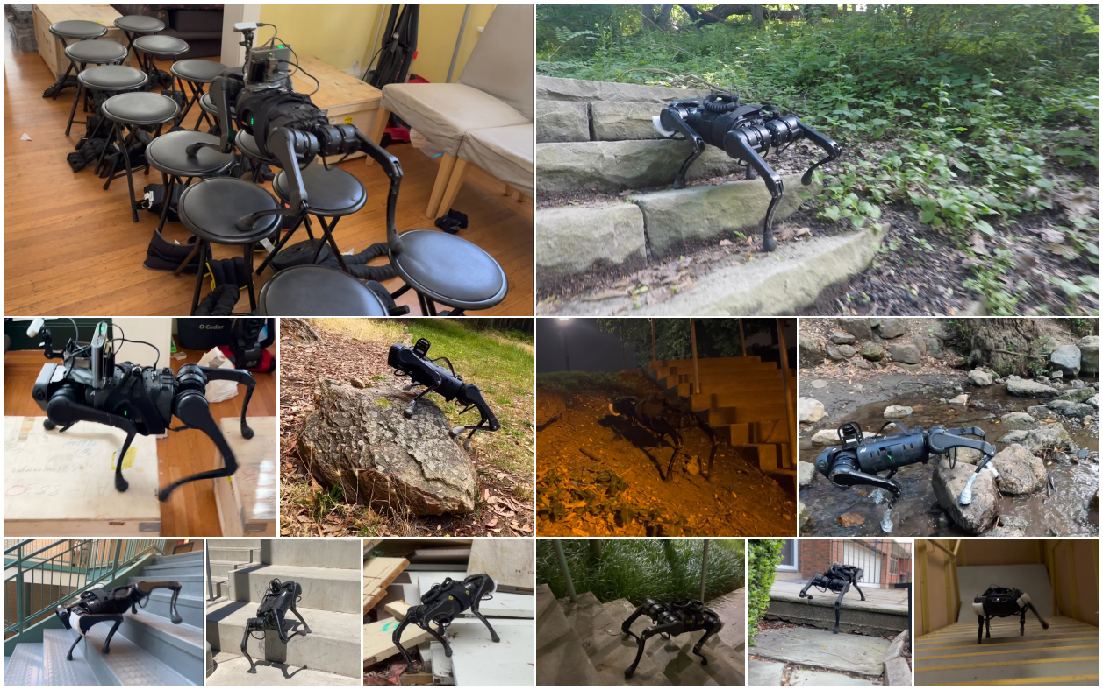

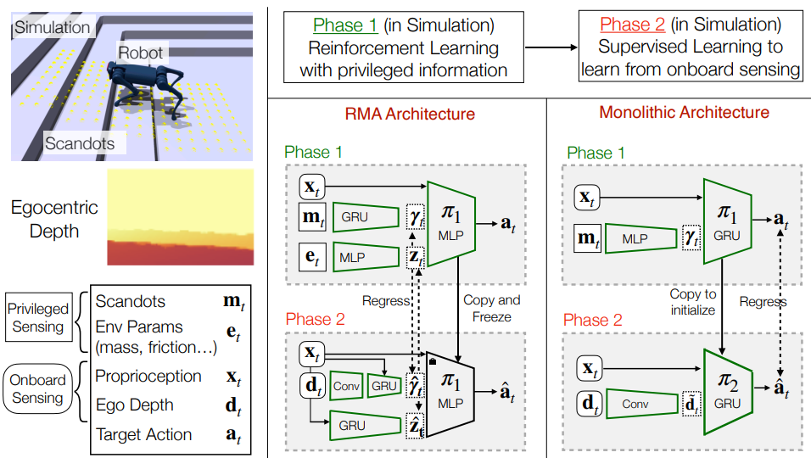


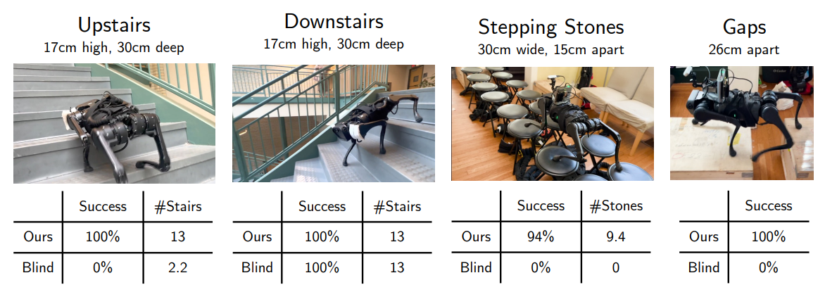



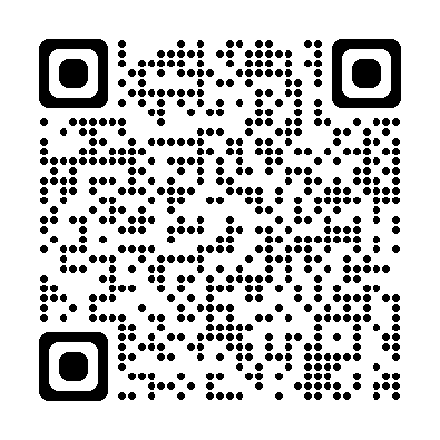

Vision is all you need
Ananye Agarwal, Ashish Kumar
End-To-End locomotion shows the potential for robots to
traverse challenging terrains
1. Introduction
Traditional approaches have decomposed the problem of locomotion into mapping and foothold tracking
This work presents the first end-to-end locomotion system capable of traversing different environments
2. Methods
Two-Step Training Phase in a simulation (Fig 1)
Reinforcement Learning of a policy with a light-weight variant of depth images
Supervised Learning on whole Depth Image to fine-tune the learned policy
Figure 1: We train our locomotion policy in two phases to avoid rendering depth for too many samples. In phase 1, we use RL to train a policy π 1 that has access to scandots that are cheap to compute. In phase 2, we use π 1 to provide ground truth actions which another policy π 2 is trained to imitate.
3. Results
Transferability of obtained policy in simulation to real-world without any fine-tuning
Possibility of traversing various environments with high success (Fig 2)
4. Conclusion
In certain instances this approach does not work well because of a mismatch between simulation and real world
Future work on leveraging data collected in the real world to yield better performances
Figure 2: We show success rates and time-to-failure (TTF) for our method and the blind baseline on curbs, stairs, stepping stones and gaps.
References
Agarwal, A. et al. (2022) Legged locomotion in challenging terrains using egocentric vision, arXiv.org. Available at: https://arxiv.org/abs/2211.07638 (Accessed: December 1, 2022).
Ashish Kumar Berkley
Ananye Agarwal Carnegie Mellon
Scan the QR-Code for more information and videos of the dog in action
ashish_@kumar.com
ananye@agarwal.com
@ashish_kumar
@ananye_agarwal

