Slide 1
Consul
with ansible

Slide 2
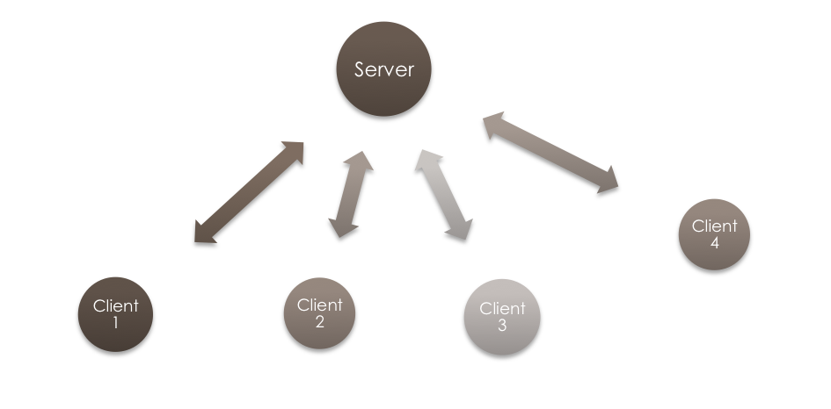
2 modes
Server (default)
    Web UI
    Catalog
    KV store
    DNS
Client
    service definition
    checks

Slide 3


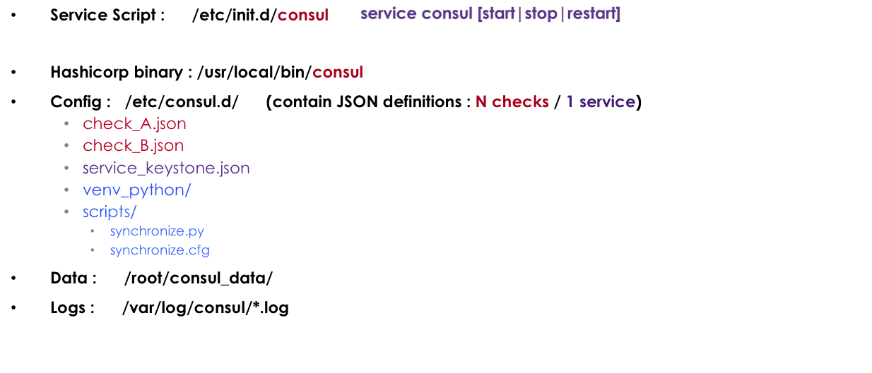

CONTENT

Slide 4
SERVICE CATALOG
  YAML in the role
  templates/definitions/services/keystone
    ---
    service:
    name: keystone
    port: 5000
    tags:
    - identity
    checks:
    - id: tcp_localhost_22
    name: TCP on port 22
    tcp: localhost:22
    interval: 5s
    timeout: 3s
  JSON on KV store
  kv/definitions/services/keystone
  {
  "service": {
  "checks": [
  {
  "id": "tcp_localhost_22",
  "interval": "5s",
  "name": "TCP on port 22",
  "tcp": "localhost:22",
  "timeout": "3s"
  }],
  "name": "keystone",
  "port": 5000,
  "tags": [
  "identity"
  ]
  }
  }
. get_url
. with_fileglob
. lookup('template',...)
from_yaml | to_json

Slide 5
SYNC MECANISM
  python 2.7 + virtualenv
  triggered by the watch definition
  {
  "watches": [{
  "type": "key",
  "key": "definitions/services/keystone",
  "handler": “./etc/consul.d/scripts/synchronize.py -c /etc/consul.d/scripts/synchronize.cfg"
  }]
  }
  From KV service definition → local JSON files for consul (/etc/consul.d/*.json)
{
"check": {
"id": "bash_check_disks",
"name": "Disk utilization",
"script": "df -PH",
"interval": "5s",
"timeout": "3s"
}
}
{
"check": {
"id": "tcp_localhost_5000",
"name": "Keystone API",
"tcp": "localhost:5000",
"interval": "5s",
"timeout": "3s"
}
}
{
"service": {
"name": "keystone",
"port": 5000,
"tags": ["identity"]
}
}
service_keystone.json
check_bash_check_disks.json
check_tcp_localhost_5000.json

Slide 6
Ansible Inventory
  [consul-servers]
  consul-server ansible_ssh_host=172.21.68.29
  [api]
  consul-client-1 ansible_ssh_host=172.21.70.176 inventory_service_name=api
  [keystone]
  consul-client-2 ansible_ssh_host=172.21.69.120 inventory_service_name=keystone
  consul-client-3 ansible_ssh_host=172.21.70.174 inventory_service_name=keystone
  [all:vars]
  ansible_ssh_user=ubuntu
  ansible_ssh_private_key_file=~/clef1.pem
  [all:children]
  consul-servers
  consul-clients
  [consul-clients:children]
  api
  keystone

Slide 7
Ansible Playbook
  ---
  - hosts: all
  gather_facts: True
  - hosts: consul-servers
  become: yes
  roles:
  - role: consul
  - hosts: consul-clients
  become: yes
  roles:
  - role: consul
  service_name: "{{ inventory_service_name }}"
  mode: client

Slide 8
COMMANDS
  ansible-playbook –i inventory consul.yml
  ansible-playbook –i inventory consul.yml --extra-vars “force=True”
  ansible-playbook –i inventory consul.yml --tags uninstall --extra-vars “force=True”
  ansible-playbook –i inventory consul.yml --tags apt --extra-vars “force=True”
  ansible-playbook –i inventory consul.yml --tags consul-binary --extra-vars “force=True”
  ansible-playbook –i inventory consul.yml --tags consul-service --extra-vars “force=True”
  ansible-playbook –i inventory consul.yml --tags catalog-services --extra-vars “force=True”
  ansible-playbook –i inventory consul.yml --tags consul-config --extra-vars “force=True”
  ansible-playbook –i inventory consul.yml --tags route-dns --extra-vars “force=True”

Slide 9
Catalog – Services
  http://{{host}}:8500/v1/catalog/services
  {
  "api": [
  "api"
  ]
  "consul": [
  "service-catalog",
  "dns"
  ],
  "keystone": [
  "identity"
  ]
  }
  http://{{host}}:8500/v1/catalog/service/api
  [
  {
  "Node": "consul-client-1",
  "Address": "172.16.0.81",
  "ServiceID": "api",
  "ServiceName": "api",
  "ServiceTags": ["api"],
  "ServiceAddress": "",
  "ServicePort": 8080,
  "ServiceEnableTagOverride": false,
  "CreateIndex": 116,
  "ModifyIndex": 116
}
  ]

Slide 10
Catalog – Nodes
  http://{{host}}:8500/v1/catalog/nodes
  [
  {
  "Node": "consul-client-1",
  "Address": "172.16.0.81",
  "TaggedAddresses": {
  "wan": "172.16.0.81"
  },
  "CreateIndex": 98,
  "ModifyIndex": 117
  },
  ...
  ]
  http://{{host}}:8500/v1/catalog/node/consul-client-1
  {
  "Node": { … },
  "Services": {
  "api": { … }
  }
  }
  }

Slide 11
Catalog – Health
  http://{{host}}:8500/v1/health/service/keystone
  [
  {
  "Node": { … },
  "Service": { … },
  "Checks": [
  {
  "Node": "consul-client-1",
  "CheckID": "serfHealth",
  ...
  },
  {
  "Node": "consul-client-1",
  "CheckID": "tcp_localhost_22",
  ...
  }
  ]
  },
  { … }
  ]
  http://{{host}}:8500/v1/health/state/critical
  [
  {
  "Node": "consul-client-2",
  "CheckID": "tcp_localhost_80",
  "Name": "TCP on port 80",
  "Status": "critical",
  "Notes": "",
  "Output": "dial tcp 127.0.0.1:80: getsockopt: connection refused",
  "ServiceID": "",
  "ServiceName": "",
  "CreateIndex": 355,
  "ModifyIndex": 14065
  }
  ]

Slide 12
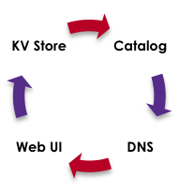
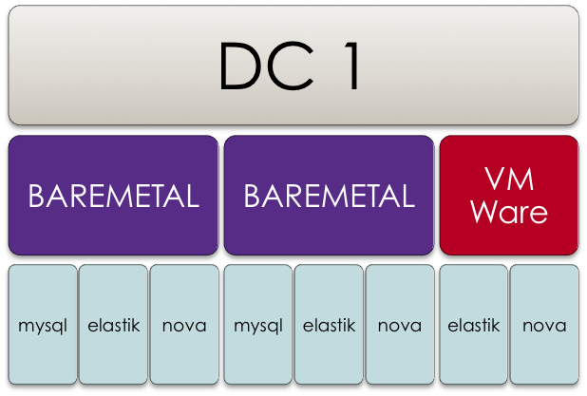
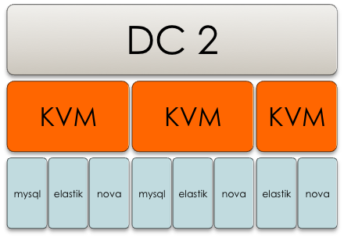

CONSUL with Docker
http://server:8500/v1/kv
http://server:8500/v1/catalog
http://server:8500/ui
mysql.service.consul.dc1
mysql.service.consul.dc2

