Slide 1
Data Science Project Customer segmentation

Slide 2
Introduction
In marketing, customer segmentation is the process of grouping customers by common traits.
Discerning buying habits by customer type helps to market appropriately.
This can help decide how to apportion the marketing budget.
In data science, clustering is the process of grouping objects by some common traits.

Slide 3
Tools And Technologies Used
K-means clustering
A machine learning technique for identifying and grouping similar data points together
Libraries
pandas 1.1.2v, numpy.seaborn
Jupyter Notebook
It is a open source interactive web tool known as a computational notebook

Slide 4
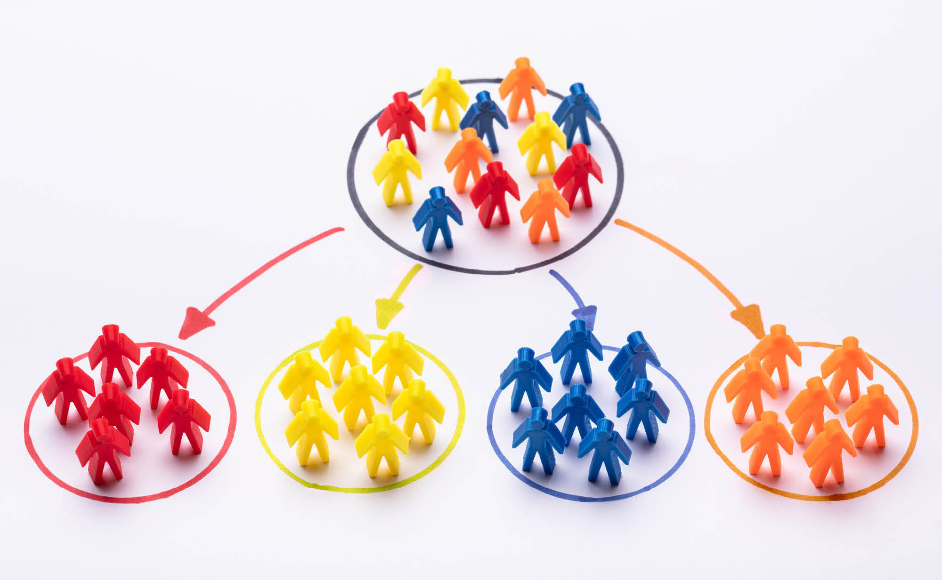
Simple Demonstration Of Customer Segmentation

Slide 5
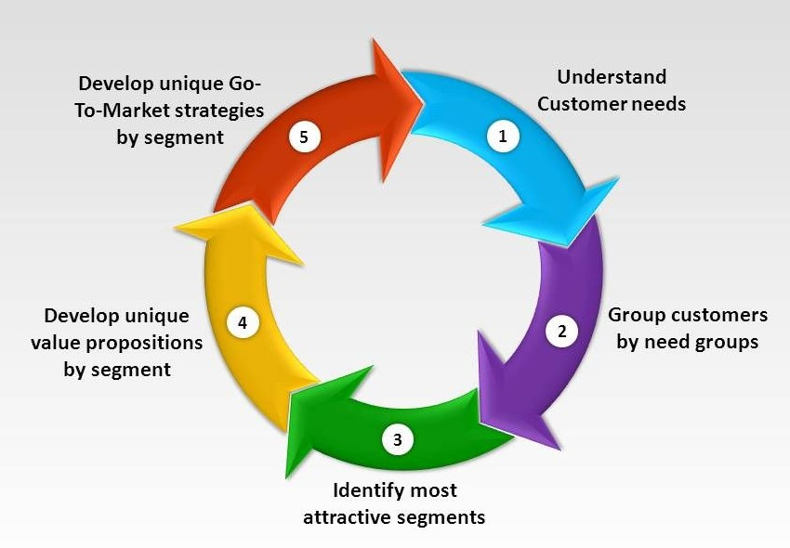
Process Of Customer Segmentation

Slide 6
Conclusion
A customer segmentation model allows for the effective allocation of marketing resources and the maximisation of cross and up-selling opportunities.
When a group of customers is sent an email that is specific to their needs, it's easier for companies to send those customers special offers.

Slide 7
Thank You
By
Neketha P.M

