Slide 1
22AIE304 DEEP LEARNING · FINAL REVIEW
I (in-phase)
Self-Supervised Masked Autoencoder Pretraining for Low-Label Automatic Modulation Classification Using IQ Signals
Q (quadrature)
Group 41
P V Nekha AM.SC.U4AIE24037
Vinayak S AM.SC.U4AIE24056
Monish T AM.SC.U4AIE24064
A real held-out test signal: QPSK at +30 dB SNR, first 160 of 1,024 samples (RadioML 2018.01A, test index 1,229)
B.Tech CSE (Artificial Intelligence)
Notes:
Introduce the team and the question: does masked-autoencoder pretraining on raw radio signals help when labels are scarce?

Slide 2
PROBLEM STATEMENT AND MOTIVATION
Modulation is hard to recognise with few labels and low SNR
Automatic modulation classification (AMC): identify how a received radio signal was modulated, e.g. QPSK or 16QAM, directly from its I/Q samples
Labels are expensive: each training signal needs a known transmitter setting, RF equipment and expert effort
Low signal-to-noise ratio (SNR) buries the modulation pattern in noise, so accuracy drops sharply
Unlabelled signals are plentiful. Self-supervised pretraining can learn signal structure from them first, then fine-tune with few labels
Same class (QPSK), I component, SNR +18 dB
Same class (QPSK), I component, SNR -10 dB
Real test signals: the pattern visible at +18 dB is lost in noise at −10 dB
Research question: does self-supervised CNN masked-autoencoder (MAE) pretraining improve AMC when labelled data is limited, compared with training the same CNN from scratch?
Group 41 · 22AIE304 Deep Learning · CNN-MAE for low-label AMC
2
Notes:
AMC is used in spectrum monitoring and cognitive radio. Labelling is the bottleneck; low SNR is the hard regime.

Slide 3
OBJECTIVES
Objectives: what we set out to do, and what was completed
1. Build a CNN classifier trained from scratch (the baseline)
Completed
2. Pretrain a CNN masked autoencoder on unlabelled raw IQ (1.79 M training signals)
Completed
3. Compare both at 1%, 5%, 10%, 25% and 100% labelled data
Completed
4. Analyse accuracy, macro-F1 and per-SNR behaviour
Completed
5. Investigate longer classifier fine-tuning (50 and 100 epochs, 1% labels)
Completed · exploratory
6. Cross-dataset transfer to RadioML 2016.10a
Completed · separate study
7. Linear probe with a frozen encoder; test whether reconstruction error predicts accuracy
Not done
Objectives 6–7 came from the mid-review plan. The transfer study is reported separately (11 classes, 128-sample signals): the transferred encoder was 0.009–0.012 macro-F1 below scratch at every budget.
Group 41 · 22AIE304 Deep Learning · CNN-MAE for low-label AMC
3
Notes:
Be explicit that the linear probe and the reconstruction-vs-accuracy link were planned but not run.

Slide 4
LITERATURE REVIEW AND RESEARCH GAP
Raw-IQ MAE exists; a controlled evaluation is missing
Study | Approach | Relevance / limitation for our question
O'Shea, Roy & Clancy (2018) | Supervised deep CNN on raw IQ; introduced RadioML 2018.01A | Strong baseline, but needs fully labelled data
Liu et al. (2021) | Self-contrastive pretraining + fine-tuning | Uses unlabelled signals; contrastive, not masked reconstruction
He et al. (2022) | Masked autoencoders (ViT) for images | Established masked reconstruction as SSL; built for images
Shi et al. (2024), GAF-MAE | MAE on Gramian Angular Field images of signals | Signals converted to images, not raw IQ
Liu et al. (2025), RIS-MAE | MAE directly on raw IQ for AMC | Closest prior work: proposes the method; not our controlled multi-budget comparison
Gap we address: does raw-IQ MAE pretraining help consistently across label budgets, random seeds and SNR levels, when compared with a like-for-like scratch baseline that shares the same CNN backbone and training recipe?
Group 41 · 22AIE304 Deep Learning · CNN-MAE for low-label AMC
4
Notes:
Kong 2023, Xiao 2024 (MCLHN) and Ma 2024 are in the reference list: contrastive or pseudo-label methods.

Slide 5
NOVELTY AND CONTRIBUTIONS
Our contribution: a careful experiment, not a new architecture
Controlled comparison
Five label budgets
Seed-level analysis
Scratch vs CNN-MAE with the same backbone, data and fine-tuning recipe
1%, 5%, 10%, 25%, 100%; nested, class-balanced subsets
3 paired seeds at 1–10%; paired differences and a paired t-test
Per-SNR analysis
Longer fine-tuning
Reproducible evidence
Accuracy across all 26 SNR levels, with the low-SNR band examined
Exploratory 50- and 100-epoch follow-ups at 1%, three seeds each
Manifests and hashes, verified figures, a working Streamlit demo
Not claimed: a new MAE architecture, the first raw-IQ MAE (RIS-MAE, 2025, came first), or state-of-the-art accuracy. Our encoder is a small patch-based CNN (55,544 parameters).
Group 41 · 22AIE304 Deep Learning · CNN-MAE for low-label AMC
5

Slide 6
DATASET
RadioML 2018.01A: 2.56 M labelled IQ signals, 24 classes
2,555,904
24
26
2 × 1,024
IQ signals
modulation classes
SNR levels, −20 to +30 dB (2 dB steps)
I/Q channels × time samples
Fixed split (70 / 15 / 15)
Train 1,789,132
Val 383,386
Test 383,386
Label budget | 1% | 5% | 10% | 25% | 100%
Labelled training signals | 17,883 | 89,451 | 178,914 | 447,281 | 1,789,132
Seeds (primary) | 3 | 3 | 3 | 1 | 1
Secondary: RadioML 2016.10a
220,000 signals · 11 classes · 2 × 128. Used only for the separate transfer study.
Source: DeepSig RadioML 2018.01A (O'Shea, Roy & Clancy, 2018; deepsig.ai/datasets). Validation for checkpoint selection uses a fixed 12,480-signal subset (20 per class × SNR) of the validation split.
Group 41 · 22AIE304 Deep Learning · CNN-MAE for low-label AMC
6

Slide 7
DATA PREPROCESSING AND LEAKAGE PREVENTION
Raw IQ input, fixed partitions, no test data in training
Load
HDF5 → float32 [1,024 × 2], transposed to [2 × 1,024]
Labels
One-hot → class index; SNR kept for splitting and analysis
Split
70/15/15, stratified by class × SNR, seed 42
Label budgets
Nested, class-balanced subsets of the training split, drawn once
Model input
Raw values: no normalisation, augmentation or hand-crafted features
Leakage controls
Checked vs not claimed
Loader rejects non-finite samples and invalid one-hot labels. Label subsets are balanced by class, not by SNR. No duplicate or missing-value filtering is performed.
Train, validation and test indices are disjoint (checked), and the same for every budget and seed
MAE pretraining sees only training signals, without labels; its checkpoint is chosen by validation MSE
Classifier checkpoints are chosen by validation macro-F1 on the fixed 12,480-signal subset
The 383,386 test signals are evaluated once per selected model, after training
Group 41 · 22AIE304 Deep Learning · CNN-MAE for low-label AMC
7

Slide 8
PROPOSED SYSTEM ARCHITECTURE
One CNN backbone; the two paths differ only in encoder start
STAGE 1 · SELF-SUPERVISED PRETRAINING (CNN-MAE only, no labels, 5 epochs)
Raw IQ
2 × 1,024, train split
16 patches × 64
mask 50%, keep 8
CNN patch encoder
visible patches only
Transformer decoder
2 layers + mask tokens
Reconstruct masked
MSE on masked only
transfer encoder weights
STAGE 2 · SUPERVISED FINE-TUNING (both paths, same labelled subset and recipe)
Path B
CNN-MAE
Labelled subset
1–100% of train
Pretrained encoder
weights from stage 1
Mean-pool → linear
16 patches → 24 classes
Evaluate & compare
val macro-F1 → pick epoch; test once (383,386)
Path A
Scratch
Labelled subset
same indices
Random-init encoder
same architecture
Mean-pool → linear
16 patches → 24 classes
Encoder per 64-sample patch: 3 × (Conv1d → BatchNorm → GELU), max-pooling, global average pool, linear → 128-d. The whole classifier (encoder + head) is fine-tuned in both paths. The decoder and positional embeddings are used only in pretraining.
Group 41 · 22AIE304 Deep Learning · CNN-MAE for low-label AMC
8
Notes:
Built from src/models/cnn.py, src/models/cnn_mae.py and experiments/train_classifier.py.

Slide 9
METHODOLOGY AND EXPERIMENTAL SETUP
Same fine-tuning recipe; only the initialisation changes
Why a CNN: 1-D convolutions learn local phase/amplitude patterns directly from raw I/Q
Self-supervised signal: hide half of the 16 patches and reconstruct them from the visible half
Transfer: copy the pretrained encoder; add a fresh linear head; fine-tune everything
Scratch baseline: same model and recipe from random initialisation, so any gap is due to pretraining
Setting | MAE pretraining | Classifier fine-tuning
Data | 1,789,132 train signals, no labels | labelled subset (1–100%)
Loss | MSE on masked patches | cross-entropy
Optimiser | AdamW, lr 1e-4, wd 1e-4 | AdamW, lr 1e-3, wd 1e-4
Schedule | cosine, 5 epochs, batch 64 | cosine, batch 128, grad-clip 1.0, FP16
Epochs | 5 | 10 primary · 50 / 100 exploratory
Selection | lowest validation MSE (epoch 5) | best validation macro-F1 (12,480)
Environment: Python 3.11, PyTorch 2.10.0 + CUDA 12.6, NVIDIA RTX 4050 Laptop GPU (6 GB). Pretraining took 4.9 h.
PRIMARY = 10 epochs, pre-specified
EXPLORATORY = 50 / 100 epochs, added later
Group 41 · 22AIE304 Deep Learning · CNN-MAE for low-label AMC
9

Slide 10
PRIMARY EXPERIMENT · TEST SET (383,386 SIGNALS)
Primary result: modest gain at 5%, no consistent advantage
Labels | Seeds | Scratch | CNN-MAE | Δ F1 | Δ acc.
1% | 3 | 0.2577 | 0.2566 | -0.0011 | +0.0041
5% | 3 | 0.3199 | 0.3320 | +0.0121 | +0.0106
10% | 3 | 0.3583 | 0.3571 | -0.0012 | +0.0031
25% | 1 | 0.3630 | 0.3629 | -0.0002 | +0.0028
100% | 1 | 0.3821 | 0.3838 | +0.0017 | +0.0017
Δ = CNN-MAE − scratch (F1 = macro-F1, acc. = accuracy). Macro-F1 = unweighted mean of per-class F1 over 24 classes.
5%: +0.0121 macro-F1 (2 of 3 seeds; paired t-test p = 0.29, not significant). At 1%, 10% and 25% MAE is marginally lower.
Mean over seeds (3 at 1–10%, 1 at 25% and 100%). The y-axis starts at 0.20.
Group 41 · 22AIE304 Deep Learning · CNN-MAE for low-label AMC
10
Notes:
Values from final_artifacts/tables/primary_summary.csv (recomputed from C:/dlruns/results). Accuracy deltas in the last column.

Slide 11
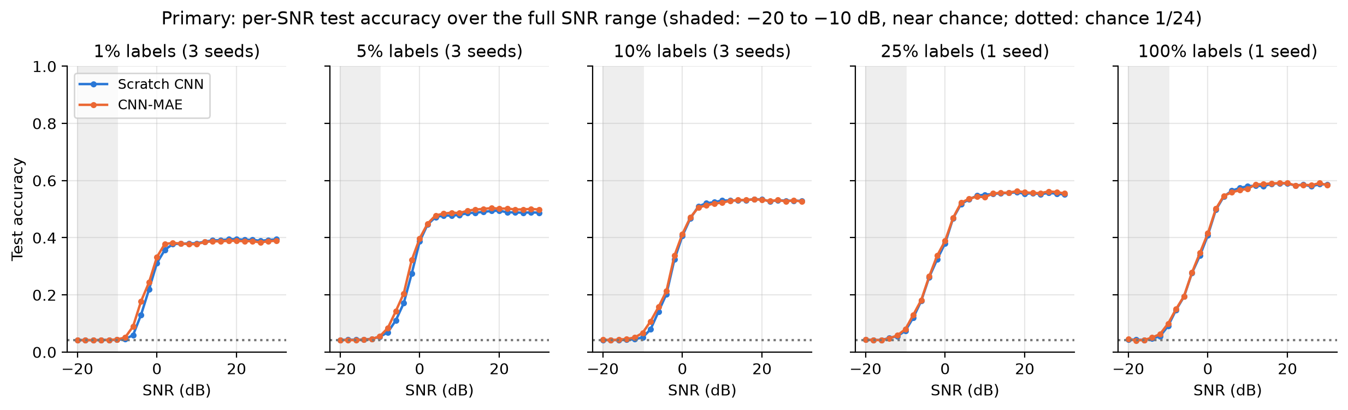
PRIMARY EXPERIMENT · PER-SNR TEST ACCURACY
Pretraining helps most at −8 to 0 dB with few labels
Labels | −20 to −10 dB acc. (scratch / MAE) | −8 to 0 dB: Δ acc. | ≥ 10 dB: Δ acc.
1% | 0.042 / 0.042 | +2.6 pp | -0.4 pp
5% | 0.045 / 0.045 | +2.8 pp | +1.0 pp
10% | 0.044 / 0.049 | +1.5 pp | -0.1 pp
25% | 0.051 / 0.052 | +0.7 pp | +0.2 pp
100% | 0.054 / 0.057 | +0.4 pp | +0.1 pp
Descriptive only: MAE's accuracy edge is largest at low-moderate SNR with few labels (+2.6 to +2.8 percentage points at 1–5%) and fades with more labels. Below −10 dB both are at chance (1/24 ≈ 0.042). Means over seeds; no per-SNR uncertainty.
Group 41 · 22AIE304 Deep Learning · CNN-MAE for low-label AMC
11
Notes:
Band means from final_artifacts/tables/primary_per_snr_accuracy.csv (mean over seeds; pp = percentage points).

Slide 12
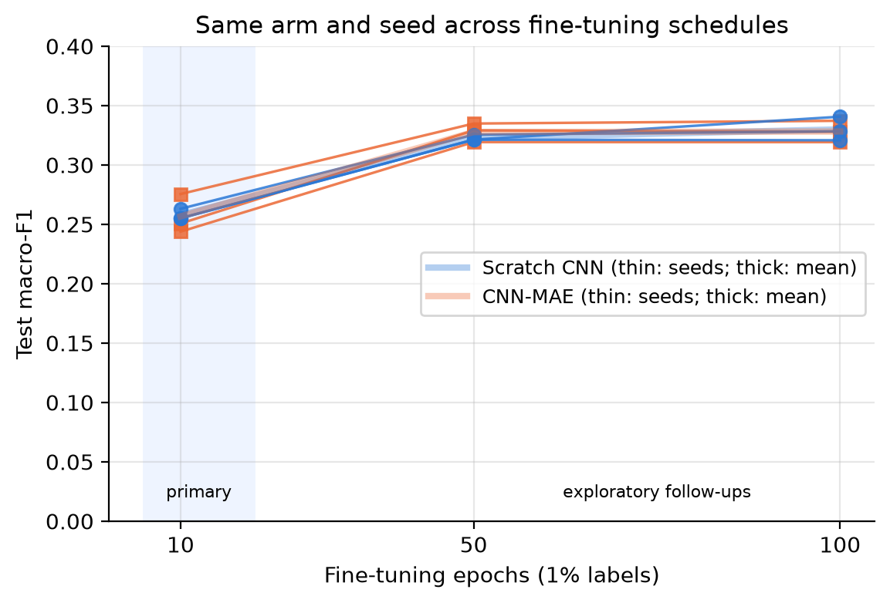
EXPLORATORY FOLLOW-UPS · 1% LABELS · 3 SEEDS
Longer fine-tuning lifts both; the MAE edge stays inconsistent
EXPLORATORY · designed after primary test results were seen
50 epochs
100 epochs
CNN-MAE 0.3277 ± 0.0079
Scratch 0.3227 ± 0.0024
CNN-MAE 0.3281 ± 0.0090
Scratch 0.3299 ± 0.0100
Paired Δ
+0.0051 ± 0.0062
Paired Δ
-0.0018 ± 0.0170
Per seed (42 / 43 / 44)
42: +0.0094
43: +0.0079
44: -0.0021
Per seed (42 / 43 / 44)
42: +0.0088
43: +0.0071
44: -0.0214
Every run gains +0.059 to +0.086 macro-F1 over its 10-epoch run; MAE leads in 2 of 3 seeds at both lengths.
Test macro-F1, mean ± SD over 3 seeds; Δ = CNN-MAE − scratch for the same seed.
Group 41 · 22AIE304 Deep Learning · CNN-MAE for low-label AMC
12
Notes:
The 100-epoch runs were trained anew (not continued). Seed 44 favours scratch by -0.0214 at 100 epochs, which flips the mean.

Slide 13
WRAPPING UP
Limitations, future work and conclusion
Limitations
Future work
Conclusion
No consistent MAE advantage in the primary grid
5% gain not significant (paired p = 0.29, 3 seeds)
25% and 100%: one seed each
Longer runs: exploratory, 3 seeds, one label budget
Noisy validation (BatchNorm statistics) affects epoch selection
Benchmark data, not over-the-air deployment
More paired seeds at every budget
Stabilise validation and checkpoint selection
Pre-specified study of mask ratio and pretraining length
Test whether reconstruction quality predicts accuracy
Per-SNR uncertainty estimates; controlled transfer studies
MAE pretraining gave modest gains in some settings: +0.012 macro-F1 at 5% labels, the low-SNR band at small budgets, and the 50-epoch follow-up. The evidence does not show a consistent advantage over training from scratch.
Take-home: with a small patch CNN, pretraining helped at the margins, but not reliably. Seeds and controls matter as much as the method.
Group 41 · 22AIE304 Deep Learning · CNN-MAE for low-label AMC
13

Slide 14
REFERENCES
References and questions
[1] T. J. O'Shea, T. Roy, T. C. Clancy, "Over-the-Air Deep Learning Based Radio Signal Classification," IEEE J. Sel. Topics Signal Process., vol. 12, no. 1, pp. 168–179, 2018.
[2] D. Liu, P. Wang, T. Wang, T. Abdelzaher, "Self-Contrastive Learning based Semi-Supervised Radio Modulation Classification," MILCOM 2021, pp. 777–782.
[3] K. He, X. Chen, S. Xie, Y. Li, P. Dollár, R. Girshick, "Masked Autoencoders Are Scalable Vision Learners," IEEE/CVF CVPR, 2022, pp. 16000–16009.
[4] W. Kong et al., "A Transformer-Based Contrastive Semi-Supervised Learning Framework for Automatic Modulation Recognition," IEEE TCCN, 2023.
[5] Y. Shi et al., "GAF-MAE: A Self-Supervised AMC Method Based on Gramian Angular Field and Masked Autoencoder," IEEE TCCN, 2024.
[6] C. Xiao et al., "MCLHN: Towards Automatic Modulation Classification via Masked Contrastive Learning With Hard Negatives," IEEE TWC, 2024.
[7] M. Ma, S. Liu, "Refined Semi-Supervised Modulation Classification: Integrating Consistency Regularization and Pseudo-Labeling," Future Internet, vol. 16, no. 2, art. 38, 2024.
[8] Y. Liu et al., "RIS-MAE: A Self-Supervised Modulation Classification Method Based on Raw IQ Signals and Masked Autoencoder," arXiv:2508.00274, 2025.
[9] DeepSig Inc., RadioML 2018.01A and 2016.10a datasets, https://www.deepsig.ai/datasets/.
Questions?
Live demo: Streamlit app (demo\app.py)
Group 41 · 22AIE304 Deep Learning · CNN-MAE for low-label AMC
14

