Slide 1
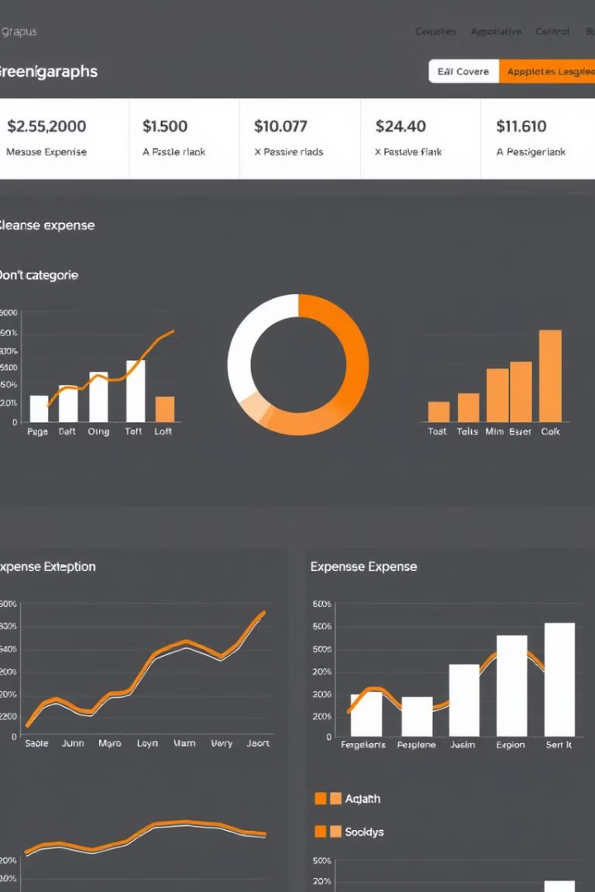
ExpenseTracker: AI-Powered Financial Management
ExpenseTracker revolutionizes personal finance with AI-driven insights. Our innovative platform adapts to user behaviors, providing dynamic budget recommendations and real-time spending alerts.
team: 1602-23-737-140 Dhanush
1602-23-737-178 Srikeerthana
1602-23-737-184 Surya

Slide 2
Reinventing Budget Planning
The Problem
Our Solution
The Impact
Traditional budgeting tools use rigid, static spending limits. These fail to account for individual habits and changing financial situations.
ExpenseTracker employs AI to analyze spending patterns and provide personalized recommendations. It adapts budgets in real-time, preventing overspending before it happens.
Users gain a deeper understanding of their finances. They make informed decisions, reducing stress and improving overall financial health.

Slide 3

Comprehensive Project Overview
1
Real-Time Monitoring
2
Income Management
Track expenses as they occur, providing instant insights into spending habits and budget status.
Easily input and categorize multiple income streams for a complete financial picture.
3
AI-Powered Suggestions
4
Adaptive Budgeting
Receive personalized spending recommendations based on historical data and financial goals.
Budgets automatically adjust to reflect changing spending patterns and income fluctuations.

Slide 4





Cutting-Edge Technology Stack
Python
MySQL
Versatile programming language powering our core logic and AI algorithms.
Robust database system ensuring secure and efficient storage of user financial data.
NumPy
Flask
Advanced numerical computing library for complex financial calculations and data analysis.
Lightweight web framework enabling rapid development and deployment of our application.

Slide 5

Object-Oriented Methodology
1
OOP Approach
Leveraging object-oriented programming for modular, maintainable, and scalable code architecture.
2
Key Classes
IncomeManager, ExpenseTracker, and BudgetAnalyzer form the backbone of our application.
3
Use Cases
Seamlessly handle income input, expense tracking, budget analysis, and overspending alerts.
4
Extensibility
Our OOP design allows for easy integration of new features and AI enhancements.

Slide 6
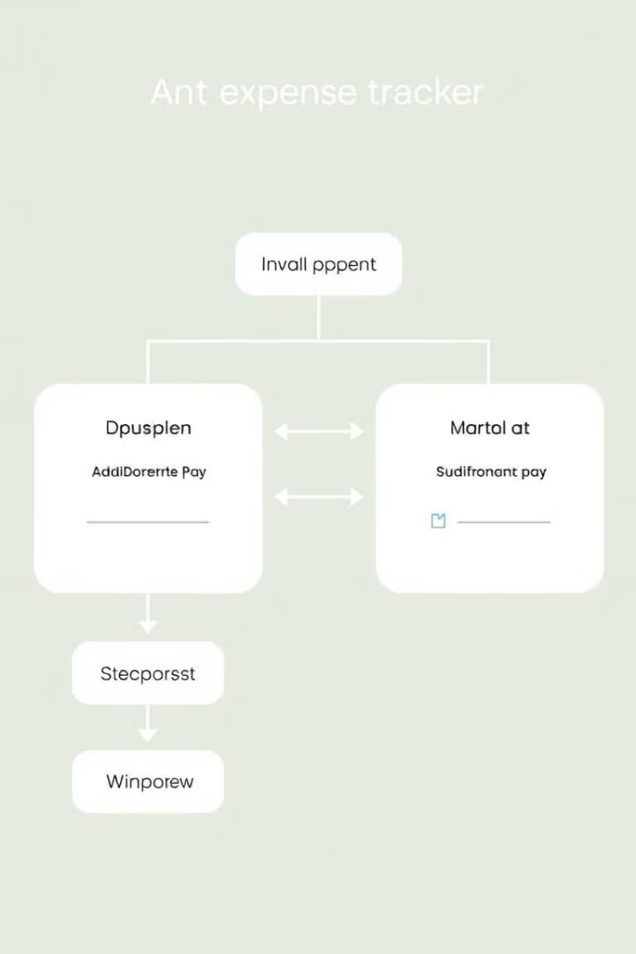
Sophisticated Architecture
Input Layer
Logic Core
Securely captures user financial data, including income, expenses, and spending habits.
Processes data through our expense tracking, budget adjustment, and AI suggestion engines.
Output Interface
Database Integration
Delivers actionable insights, including budget changes, warnings, and personalized financial advice.
Utilizes long-term data storage for continuous learning and improvement of AI algorithms.

Slide 7
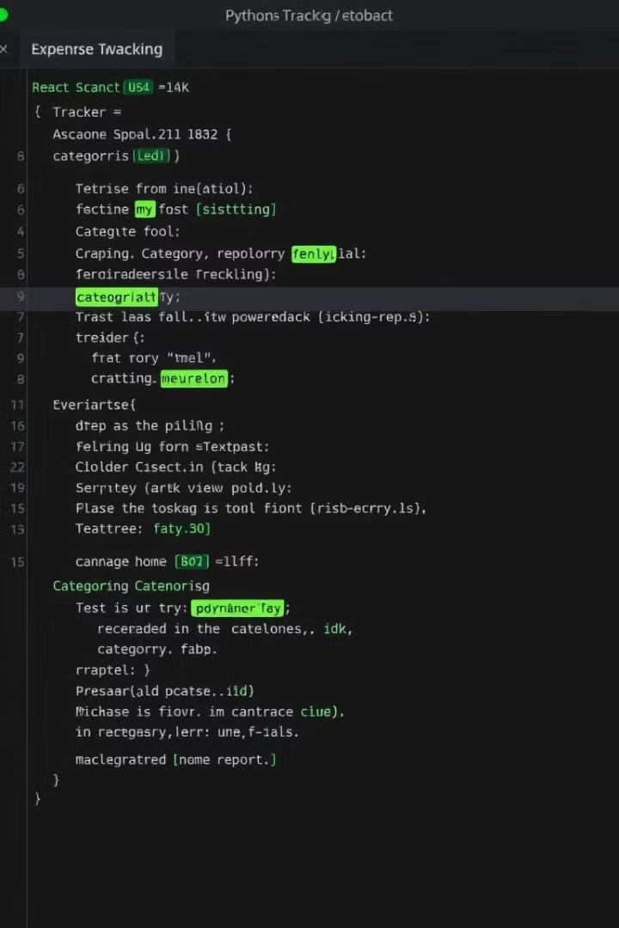
Robust Code Structure
Class
Primary Function
Key Method
IncomeManager
Income tracking and modification
update_income()
ExpenseTracker
Expense entry and categorization
add_expense()
BudgetAnalyzer
Budget analysis and adjustment
adjust_budget()
AIAdvisor
AI-powered financial suggestions
generate_insight()

Slide 8


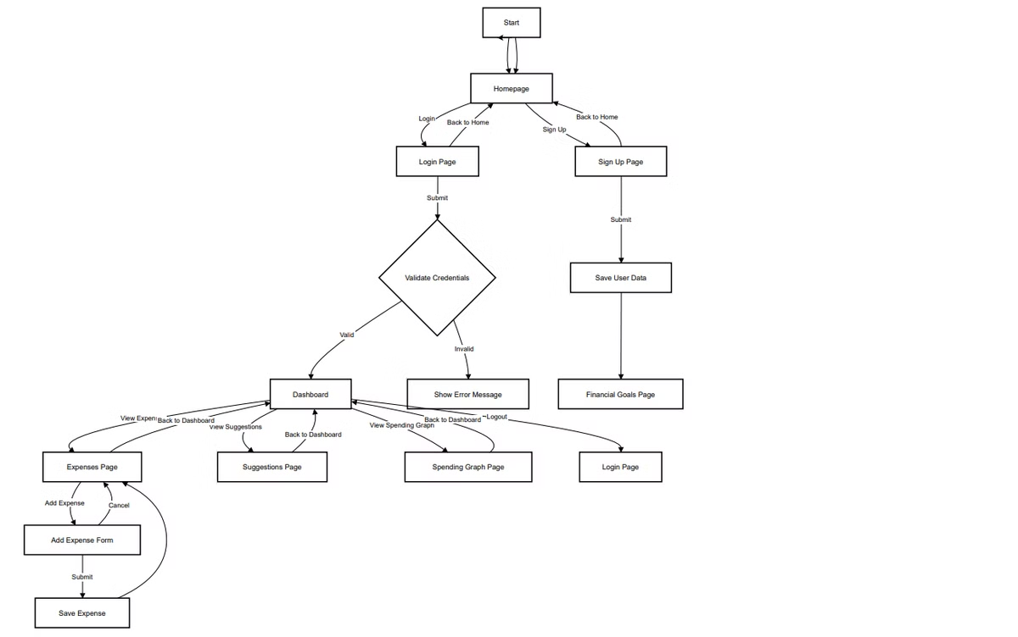



Intuitive User Flow
User Registration
Simple sign-up process captures essential financial information and goals.
Data Input
Users easily log income and expenses through a user-friendly interface.
AI Analysis
Our algorithms process data to generate personalized insights and recommendations.
User Action
Informed by AI suggestions, users make smart financial decisions and adjust budgets.

Slide 10
Project Status and Future Roadmap
Completed Milestones
In Progress
Future Plans
Core functionality implementation
AI module refinement
Analysis based on bank’s e-statements
Expense tracking modules
Advanced graph analysis
Integration with banking APIs
User registration system
UI/UX enhancements
Predictive financial modeling

