Slide 1
BACKGROUND SUBTRACTION
Subtract images
Convert to grayscale
Merge images
Generate mask
Presenter: Nguyen Khoa
Reference: Minh Dinh

Slide 2
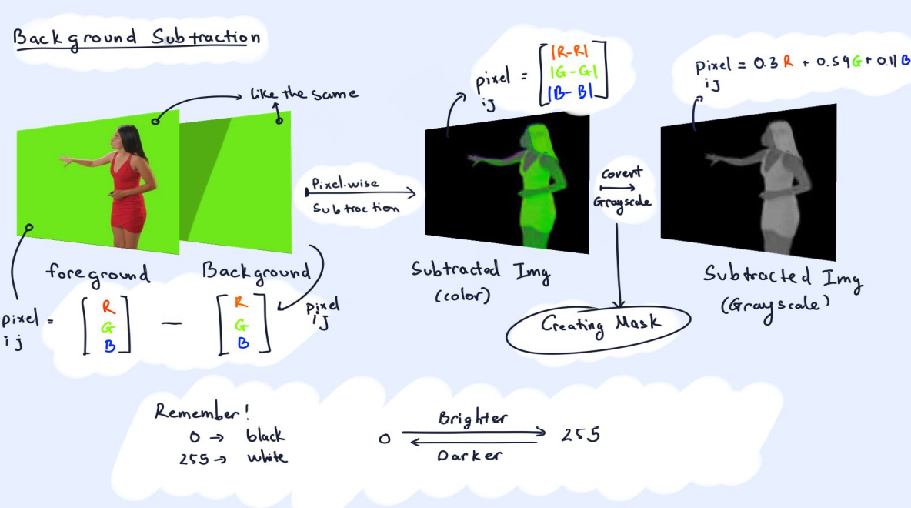

Slide 3
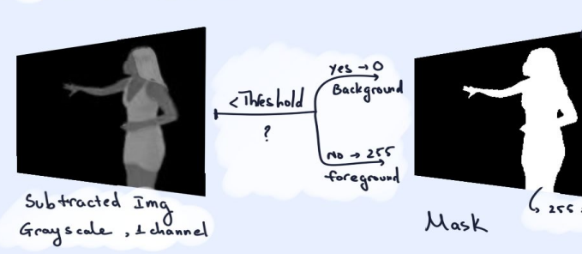
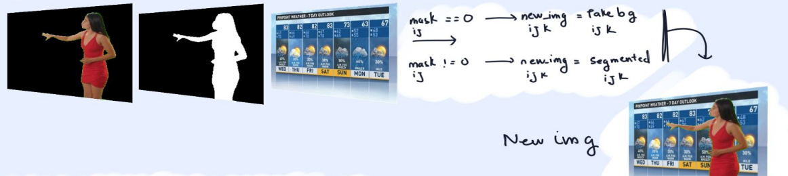

Slide 4
Thank you for listening

