Slide 1
2021-11-07
Operators
Function
Exercises

Slide 2
1. operators
1.1. Arithmetic operators
Operator | Description
+ | Add two operands
- | Substract second operand from the first
* | Multiplies two operands
/ | Divides numerator by de-numerator
% (Modulus Operator ) | Get remainder of an integer division
++ | Increases the integer value by one
-- | Decreases the integer value by one

Slide 3
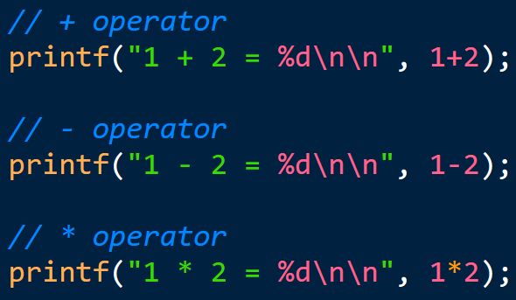
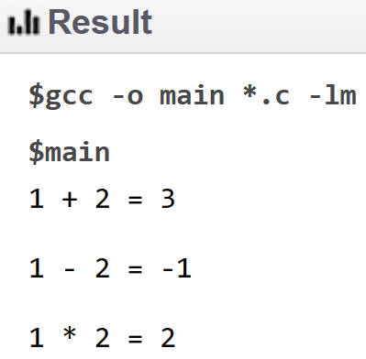
1. operators
1.1. Arithmetic operators

Slide 4
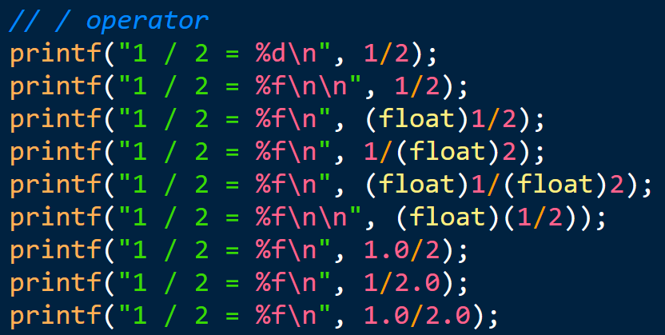
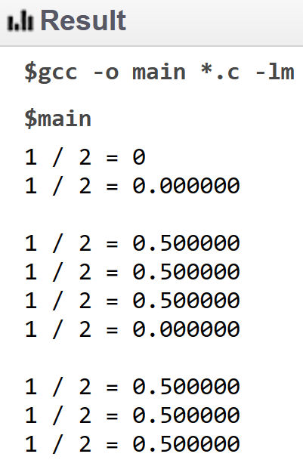
1. operators
1.1. Arithmetic operators

Slide 5
1. operators
1.2. Relational operators
Operator | Description
== | Return true if 2 operands are equal
!= | Return true if 2 operands are not equal
> | Return true if the left operand is greater than the right one
< | Return true if the left operand is less than the right one
>= | Return true if the left operand is greater than or equal to the right one
<= | Return true if the left operand is less than or equal to the right one

Slide 6
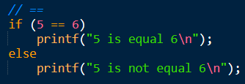

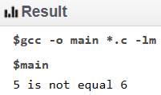


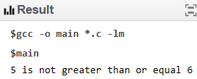
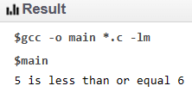
1. operators
1.2. Relational operators

Slide 7
1. operators
1.3. Assignment operators
Operator | Description
+= | C += A ⬄ C = C + A
-= | C -= A ⬄ C = C – A
*= | C *= A ⬄ C = C * A
/= | C /= A ⬄ C = C / A
%= | C %= A ⬄ C = C % A

Slide 8
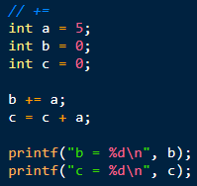
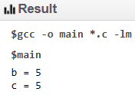
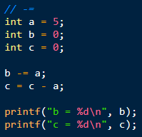
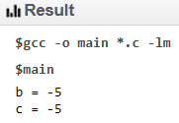
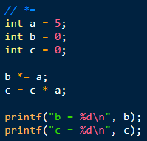
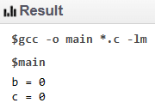
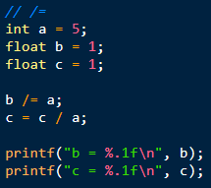
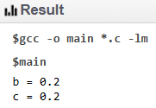
1. operators
1.3. Assignment operators

Slide 9
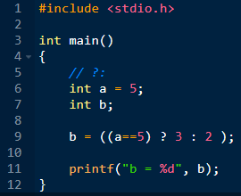
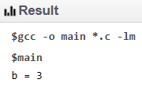
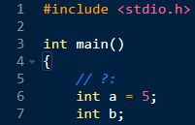
1. operators
1.4. conditional expression operators

Slide 10
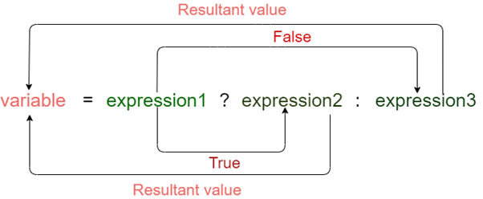
1. operators
1.4. conditional expression operators
Operator | Description
?: | Is condition is true ? Then X : otherwise Y

Slide 11
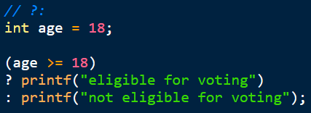
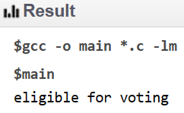
1. operators
1.4. conditional expression operators

Slide 12

2. function

Slide 13
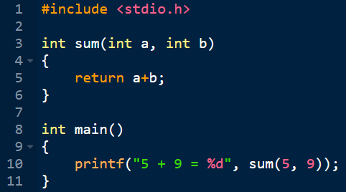
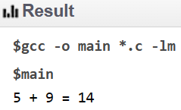
2. function

Slide 14
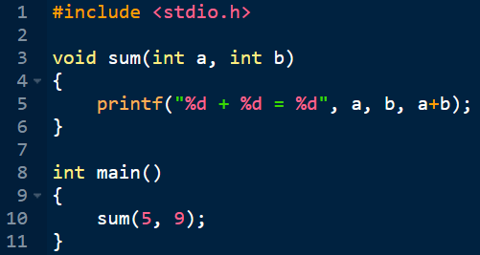
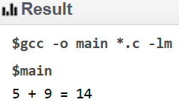
2. function

Slide 15
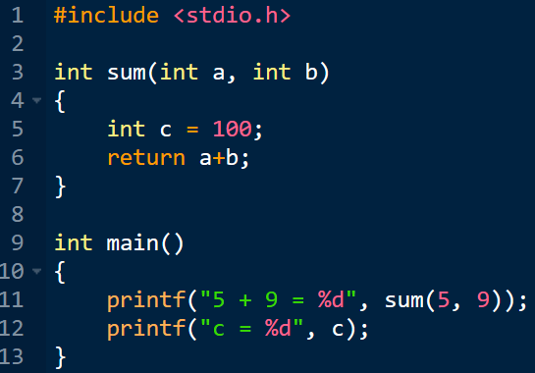

2. function

Slide 16
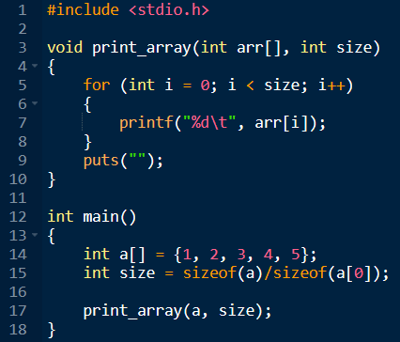
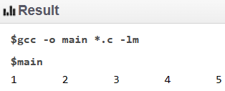
2. function

Slide 17
2. function

Slide 18
2. function

Slide 19
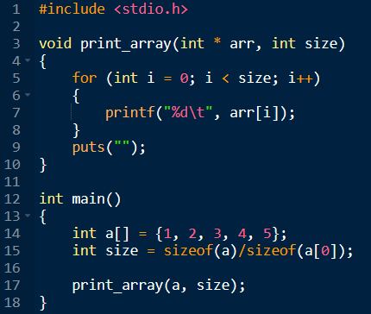
2. function

Slide 20
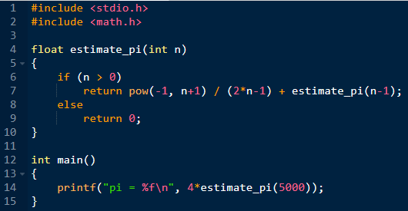
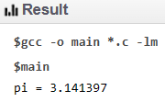
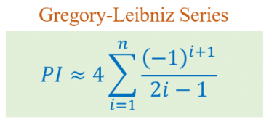
3. Exercises

Slide 21
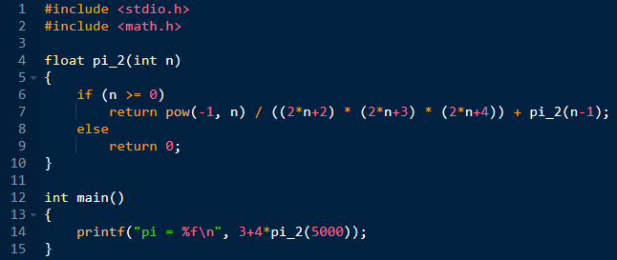
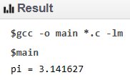

3. Exercises

Slide 22
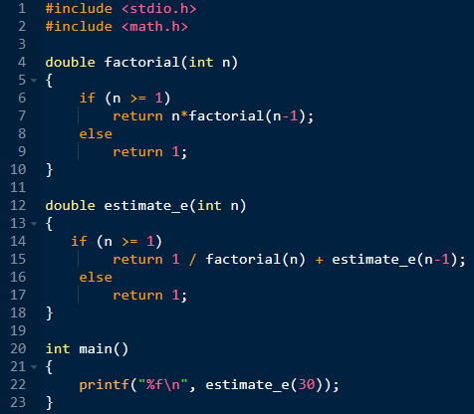
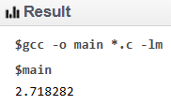

3. Exercises

Slide 23
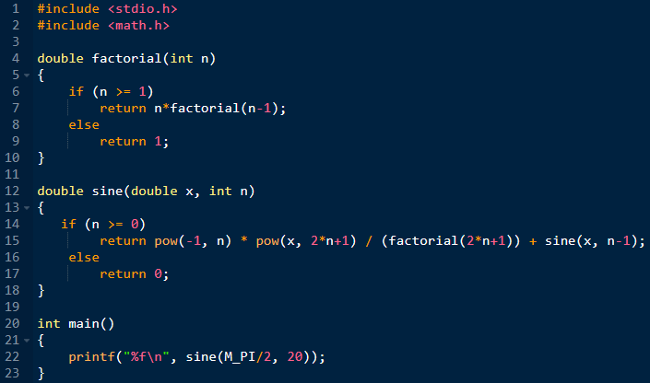
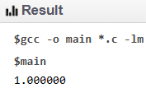
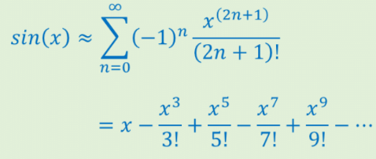
3. Exercises

Slide 24
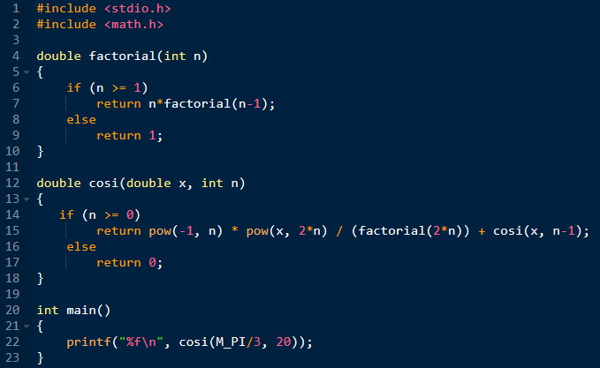
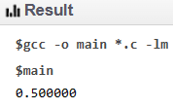
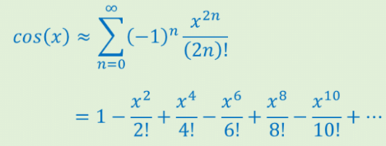
3. Exercises

Slide 25
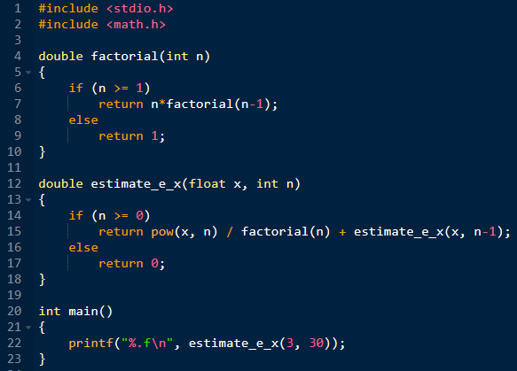
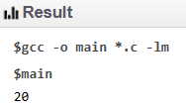
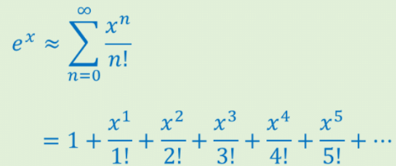
3. Exercises

