Slide 1
2021-11-14
If – else if – else
Nested if - else
For loop
Nested loop
Exercise 3
Presenter: Nguyen Khoa

Slide 2

1. If – else if - else

Slide 3
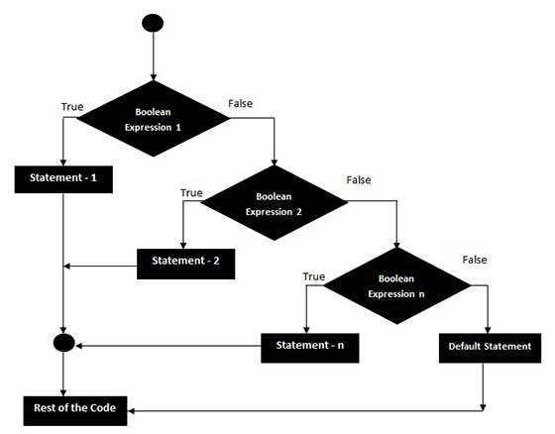
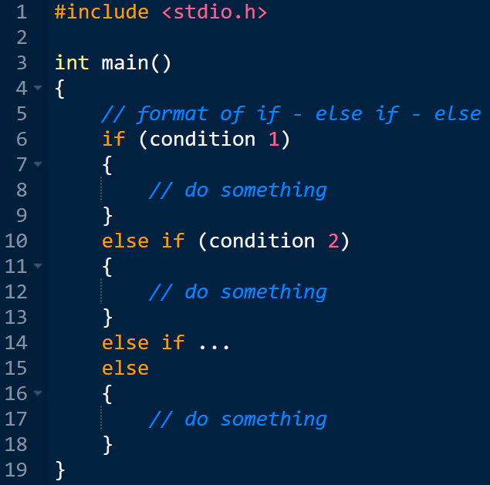
1. If – else if - else

Slide 4
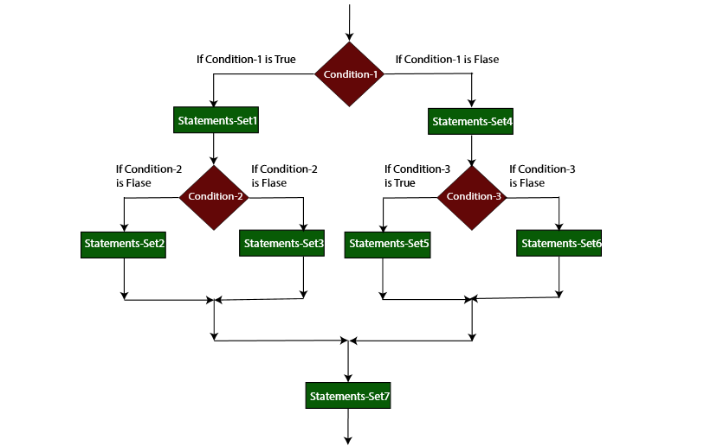
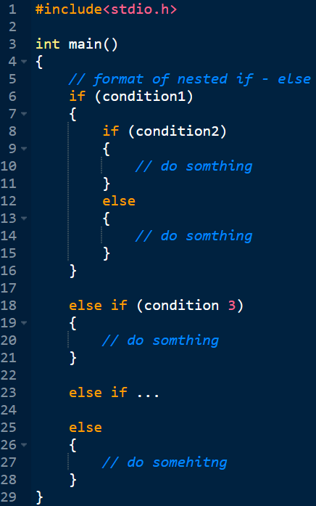
2. Nested if - else

Slide 5
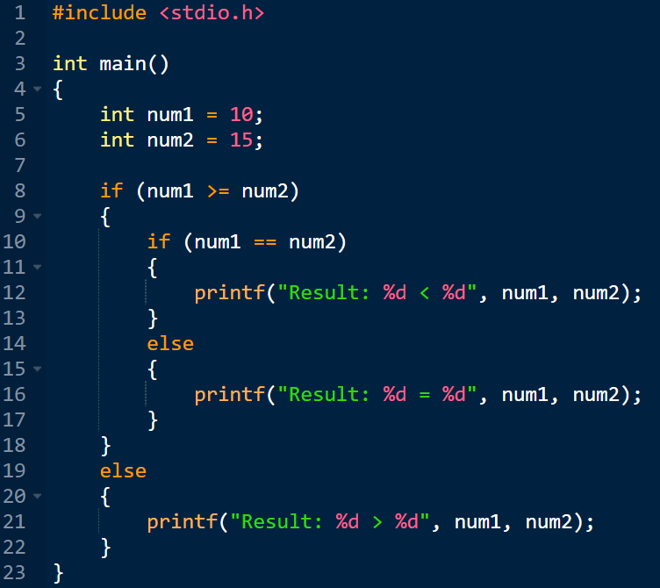
2. Nested if - else

Slide 6
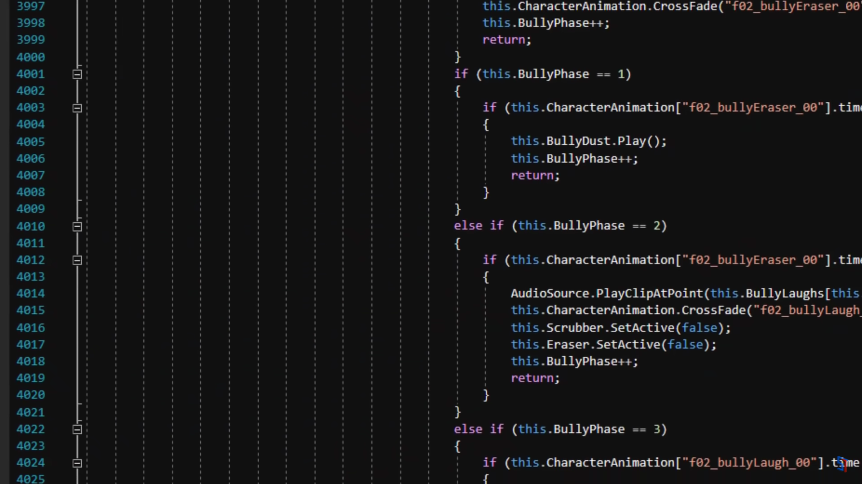
2. Nested if - else

Slide 7
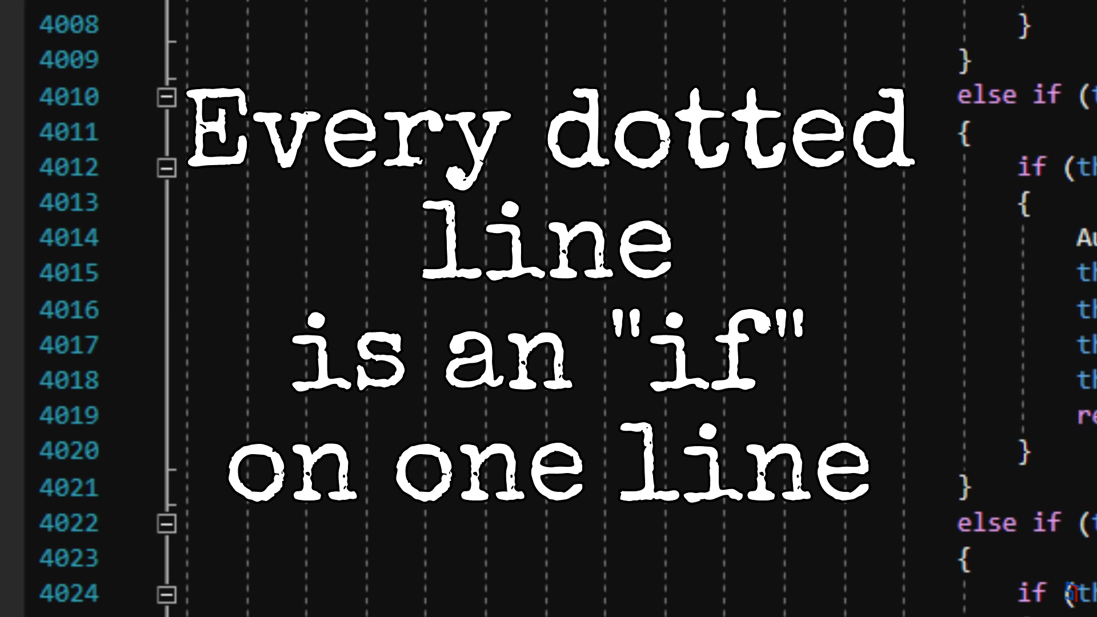
2. Nested if - else

Slide 8

2. Nested if - else

Slide 9
2. Nested if - else
DO NOT ABUSE NESTED IF - ELSE

Slide 10
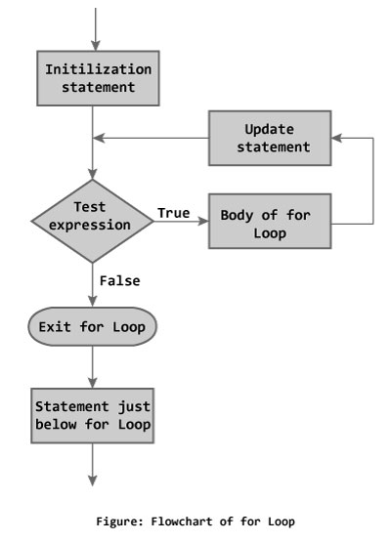
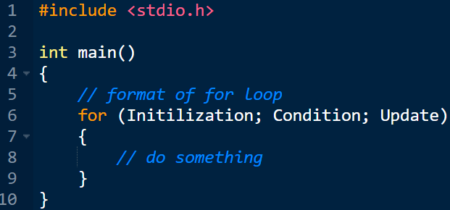
3. For loop

Slide 11
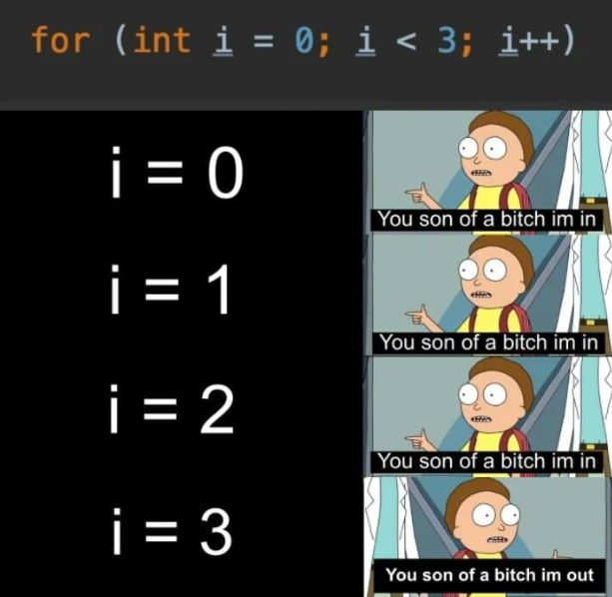
3. For loop

Slide 12
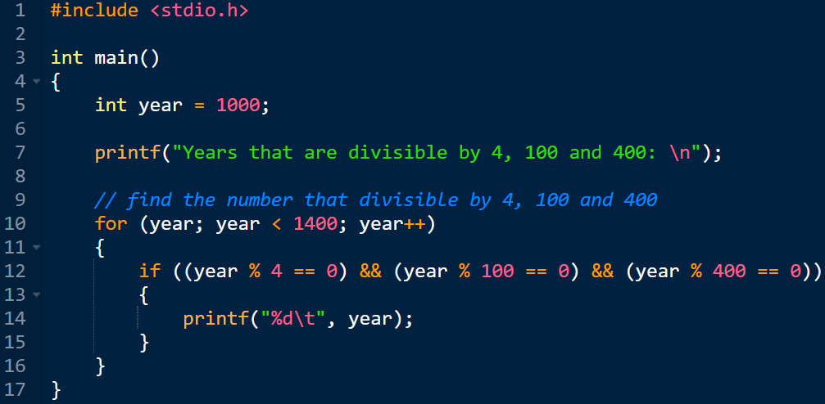

3. For loop

Slide 13
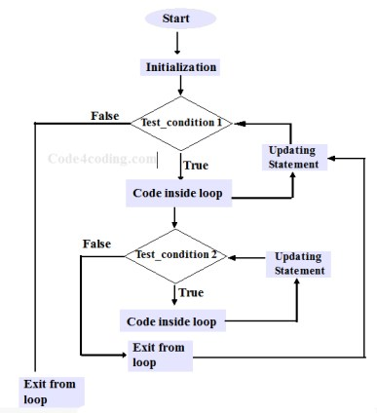
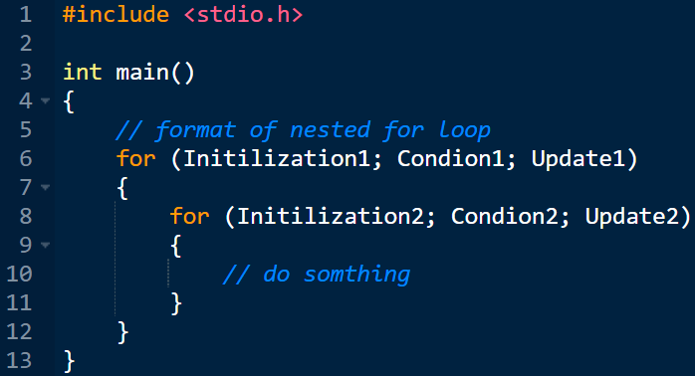
4. nested For loop

Slide 14
4. nested For loop
Two Sum: Find 2 numbers whose sum is equal to the desired number
1 | 2 | 3 | 4 | 5 | 6 | 7 | 8 | 9 | 10
…
1 | 2 | 3 | 4 | 5 | 6 | 7 | 8 | 9 | 10
1 | 2 | 3 | 4 | 5 | 6 | 7 | 8 | 9 | 10
1 | 2 | 3 | 4 | 5 | 6 | 7 | 8 | 9 | 10
1 | 2 | 3 | 4 | 5 | 6 | 7 | 8 | 9 | 10

Slide 15
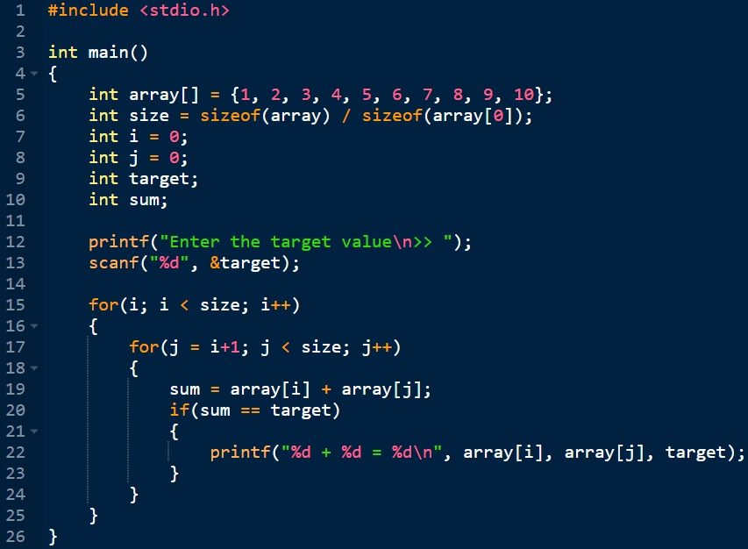
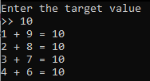
4. nested For loop

Slide 16
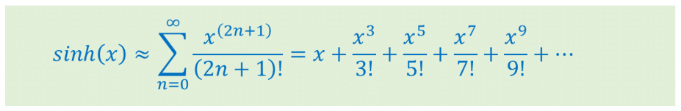
5. Exercise 3

Slide 17
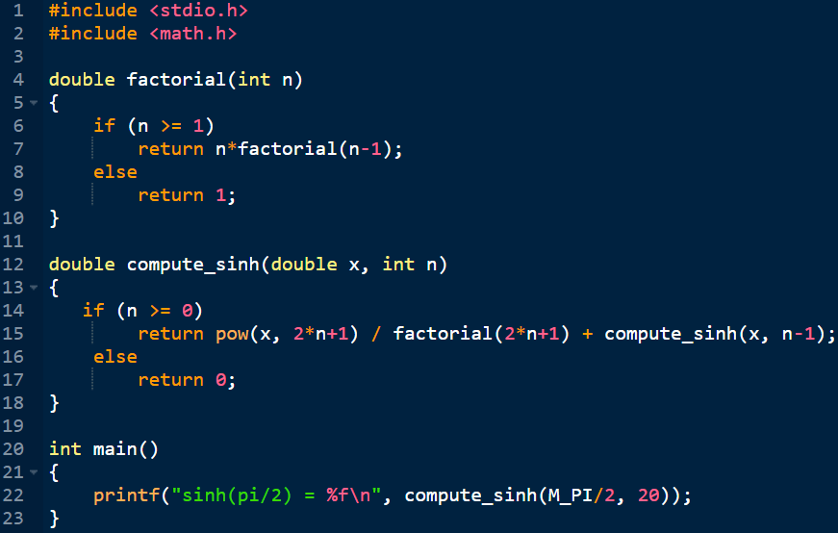
5. Exercise 3

Slide 18
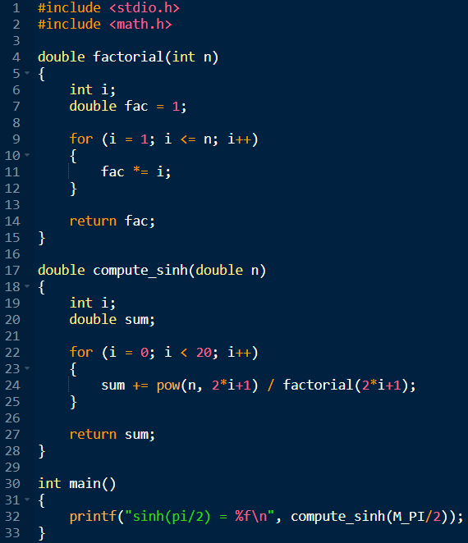
5. Exercise 3

Slide 19
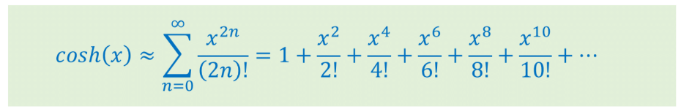
5. Exercise 3

Slide 20
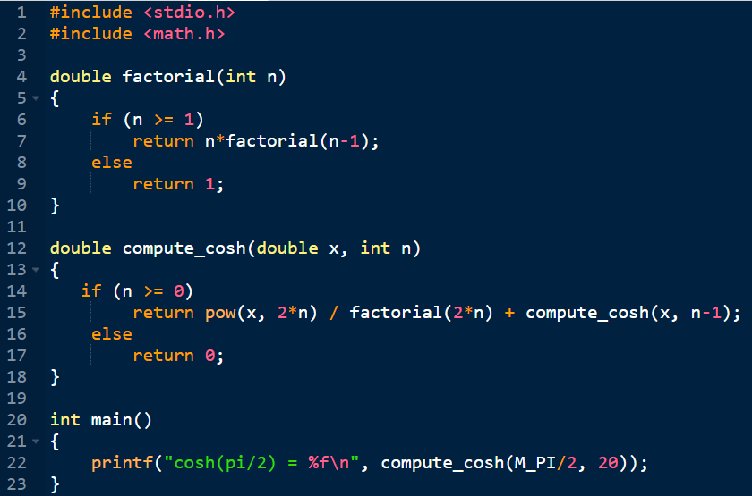
5. Exercise 3

Slide 21
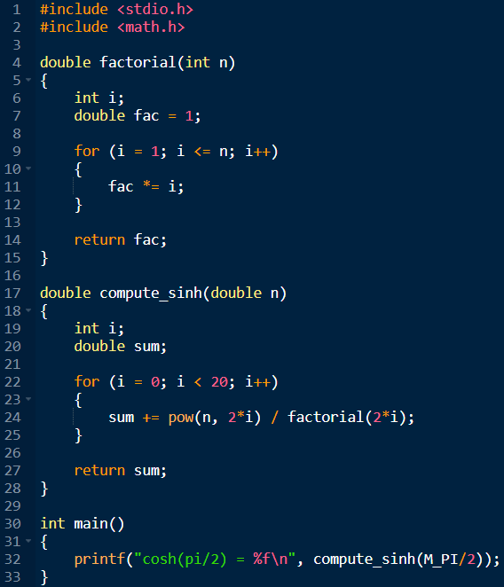
5. Exercise 3

Slide 22
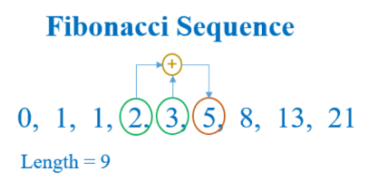
5. Exercise 3
0 | 1
+
=
0 | 1 | 1
0 | 1 | 1 | 2
0 | 1 | 1 | 2 | 3
0 | 1 | 1 | 2 | 3 | 5

Slide 23
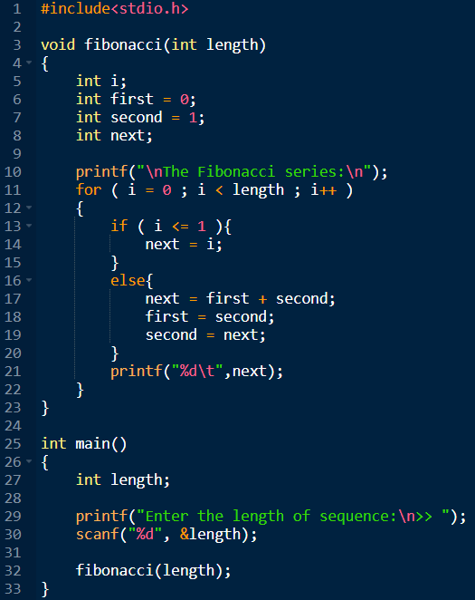

5. Exercise 3

Slide 24
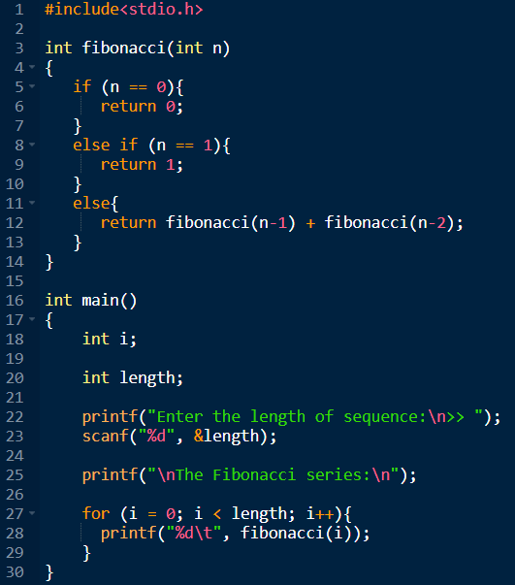

5. Exercise 3

