Slide 1

C Programming

Slide 2

Table of content
Running a basic C Program
IDE (Code Blocks)
Code Editor (Sublime Text)
Bonus (Code Formatter)
Self learning
Q&A
Error may have (running Code Editor)

Slide 3
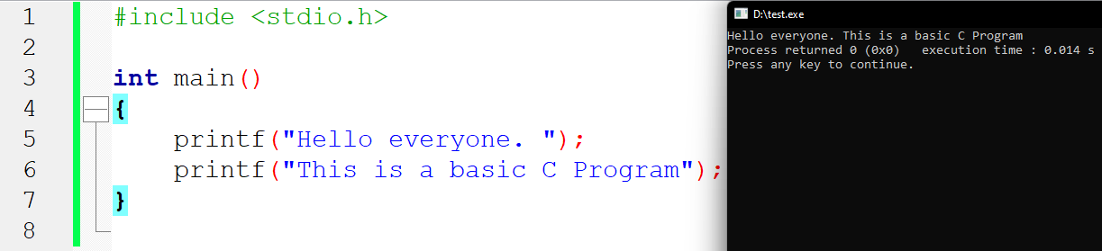
Running a basic C Program
IDE (Code Blocks)

Slide 4
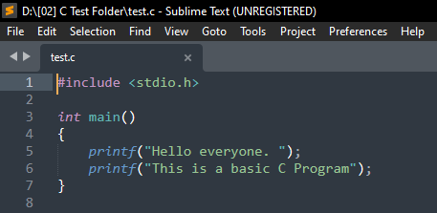
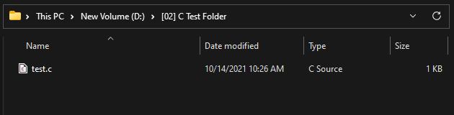
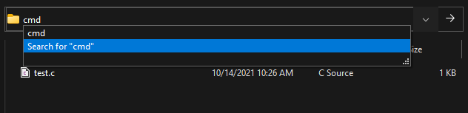
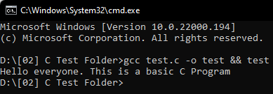
Running a basic C Program
Code Editor (Sublime Text)

Slide 5
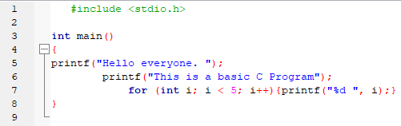
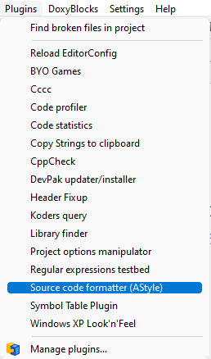
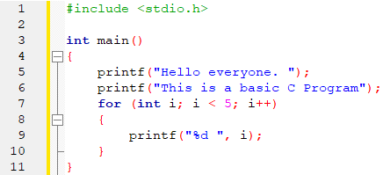
2)Bonus (Code Formatter)

Slide 6
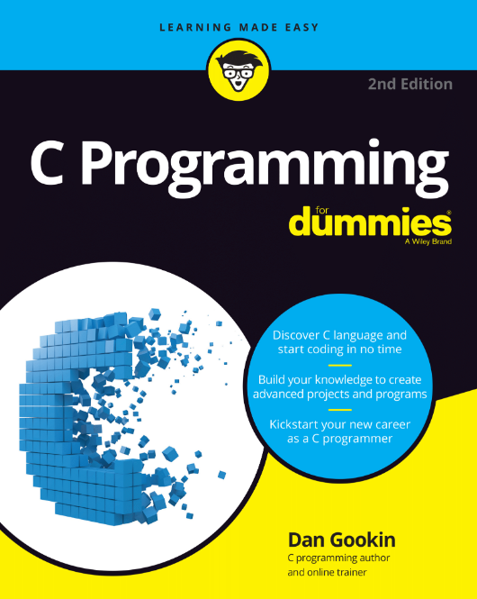
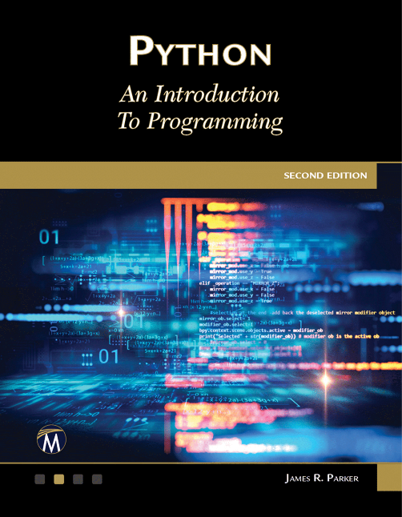
3)Self learning

Slide 7
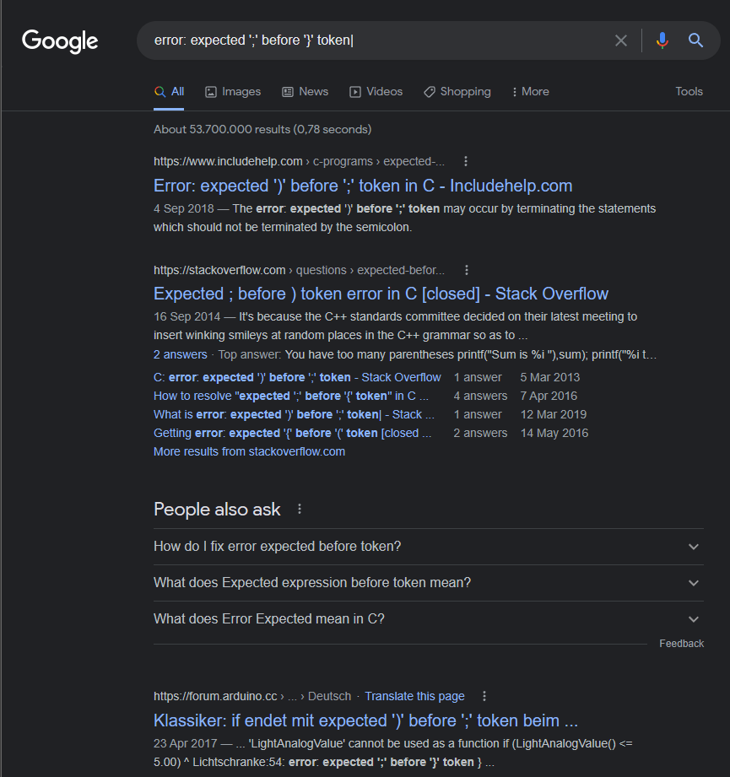
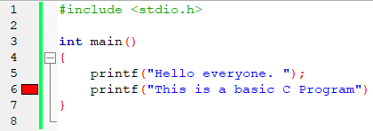
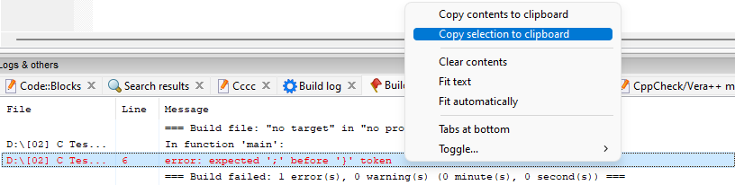
3)Self learning

Slide 8
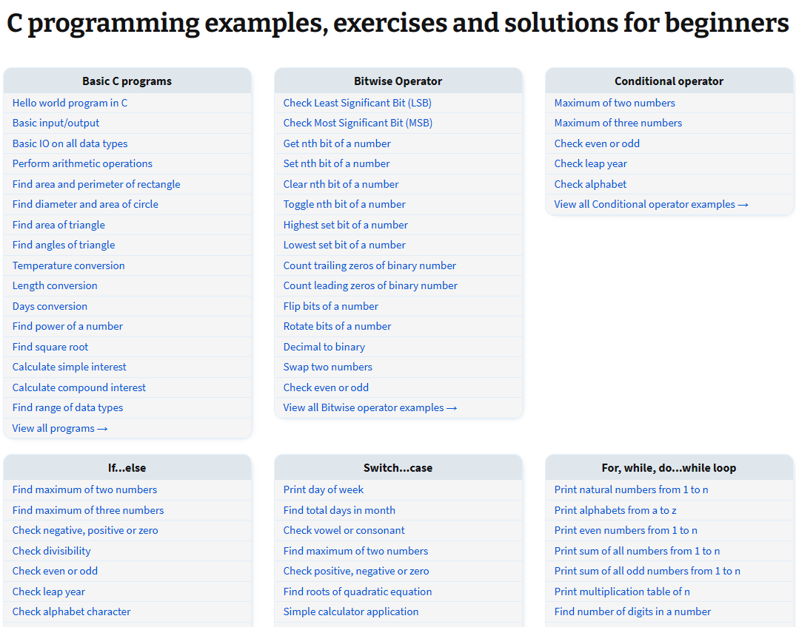
3)Self learning
https://codeforwin.org/c-programming-examples-exercises-solutions-beginners

Slide 9
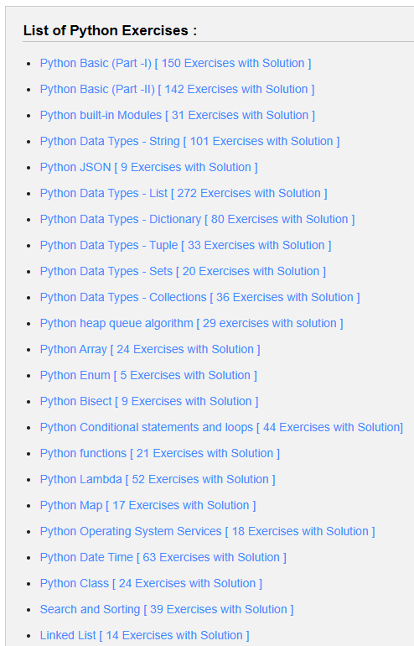
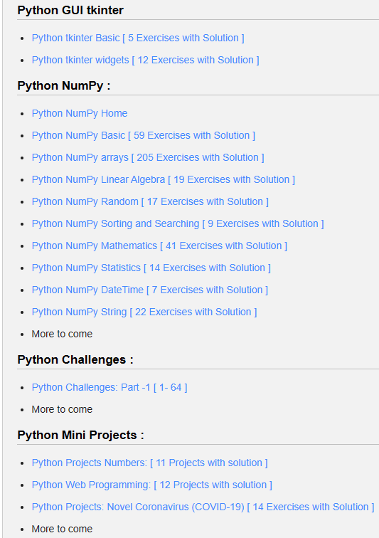
3)Self learning
https://www.w3resource.com/python-exercises/

Slide 10
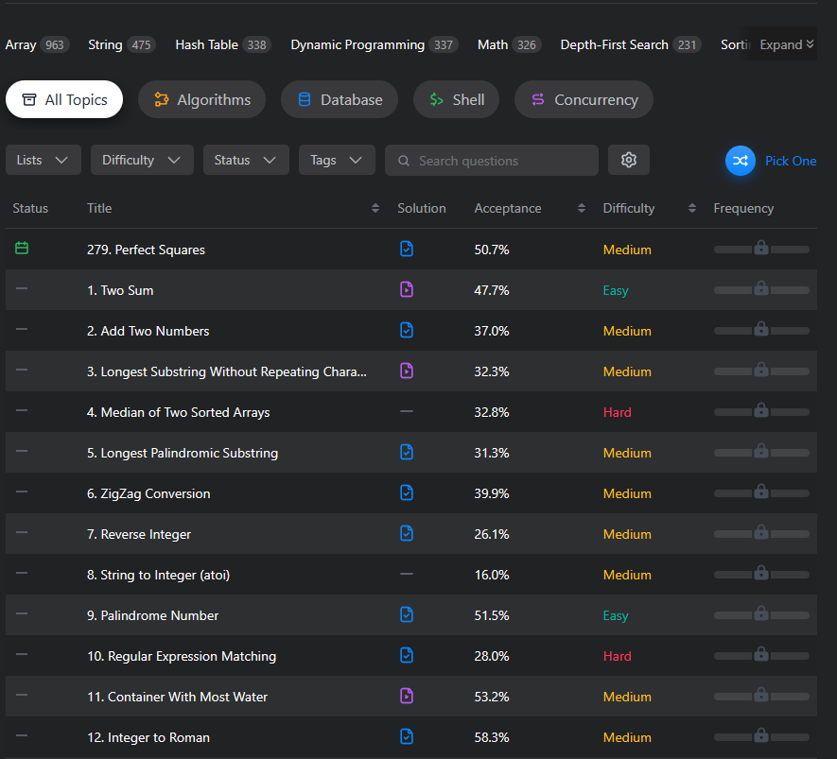
3)Self learning
https://leetcode.com/problemset/all/

Slide 11
4)Q&A

Slide 12
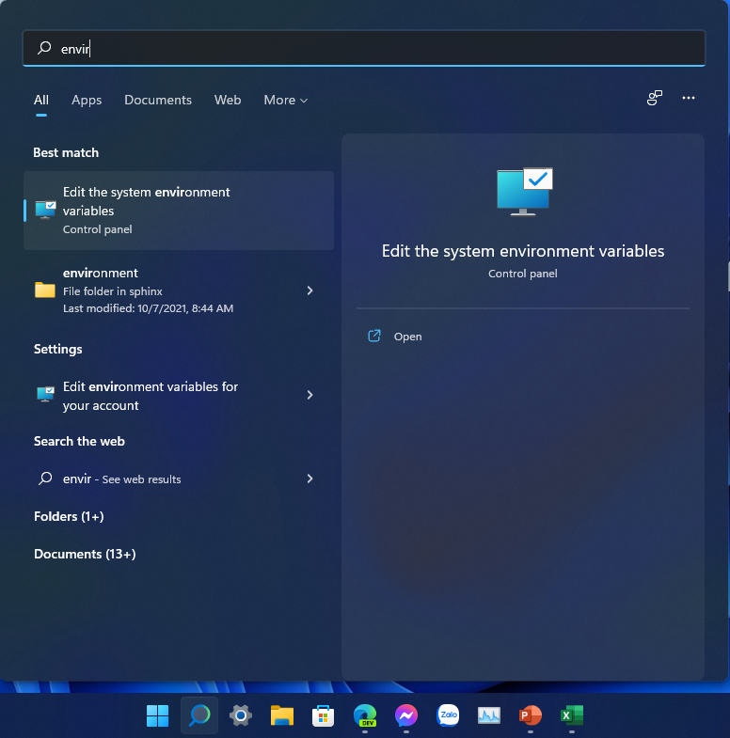
5)Error may have (running Code Editor)
"gcc is not recognized as an internal or external command"

Slide 13
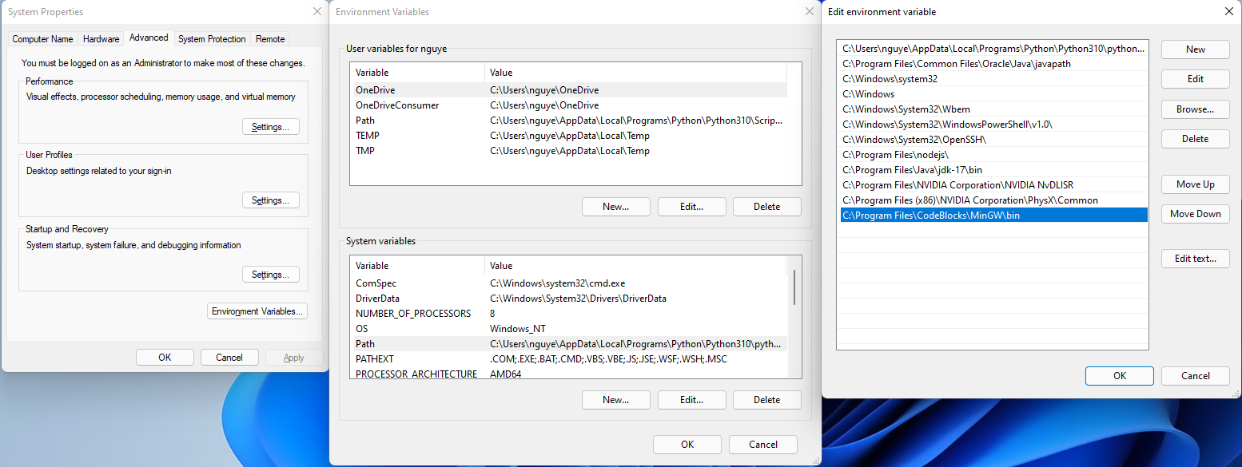
5)Error may have (running Code Editor)

Slide 14

Thank you for listening

