Slide 1
Review
Commenting
printf & puts
Data types
Built-in functions

Slide 2



Commenting
Ctrl + Shift + C: Comment a block
Ctrl + Shift + X: Un-comment a block

Slide 3



Printf & puts
puts(“”); = printf(“\n”);

Slide 4


Printf & puts
\n ➔ new line

Slide 5


Printf & puts
\t ➔ tab

Slide 6
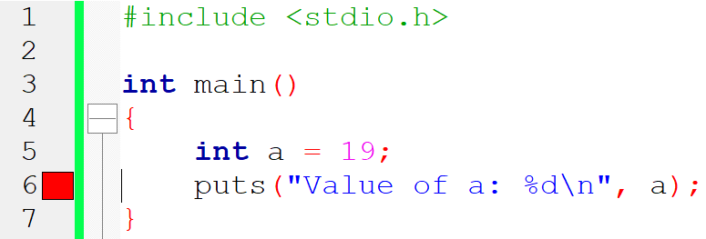

Printf & puts

Slide 7
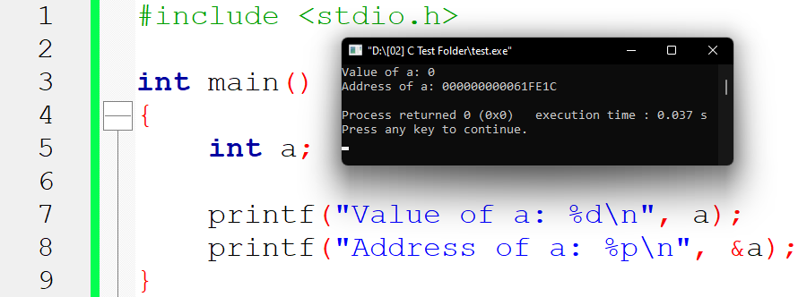
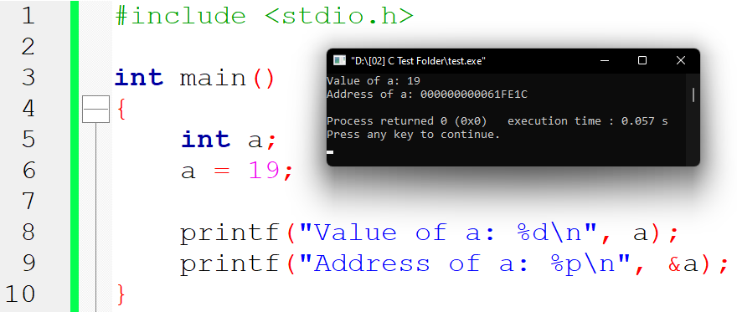
Data types

Slide 8
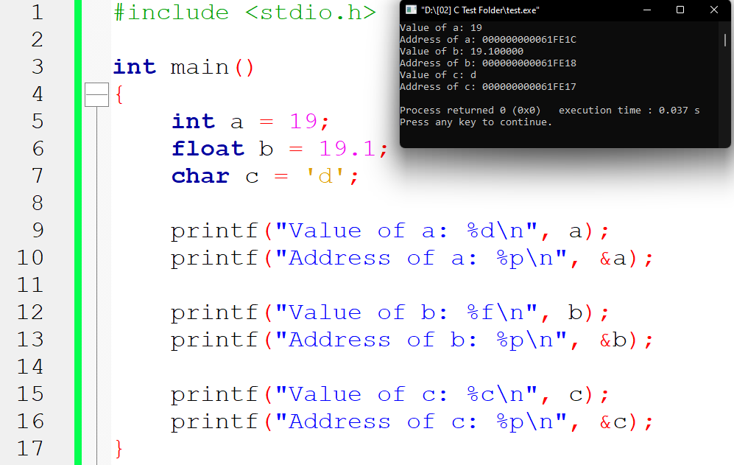
Data types

Slide 9

Data types
%d ➔ a
%p ➔ &a

Slide 10
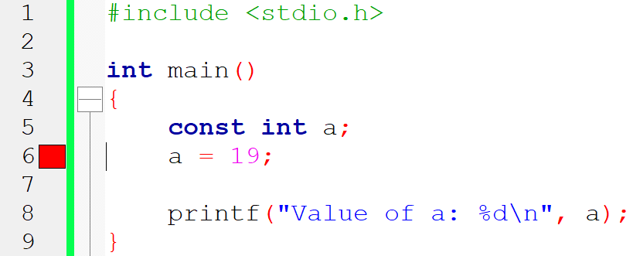
Data types

Slide 11
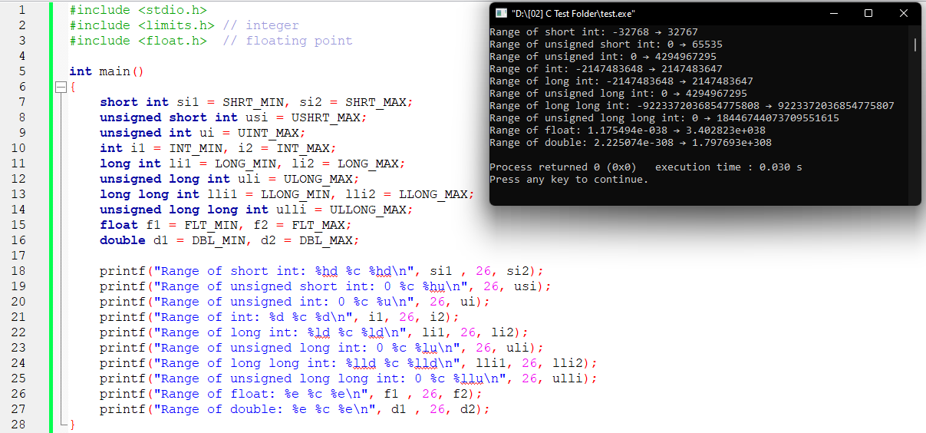
Data types

Slide 12
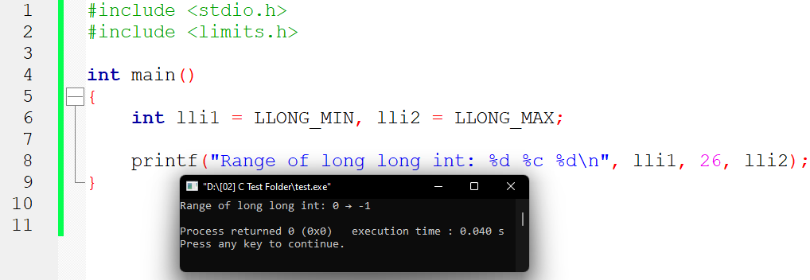
Data types

Slide 13
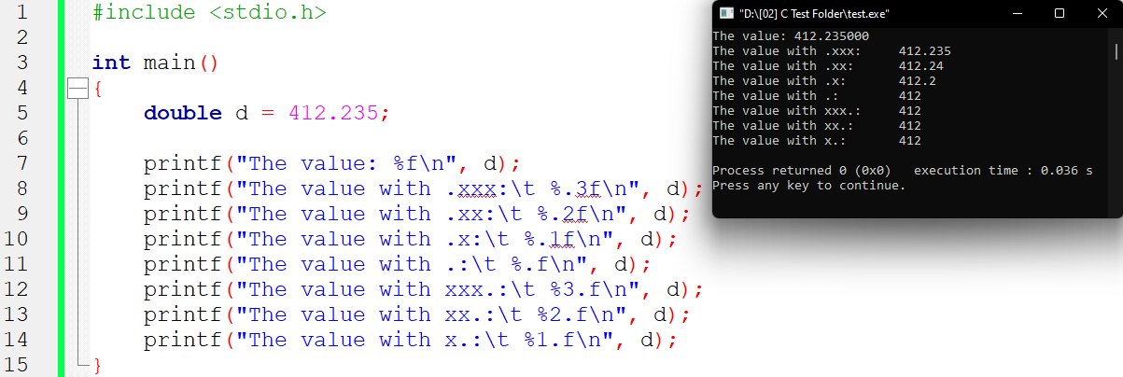
Data types

Slide 14
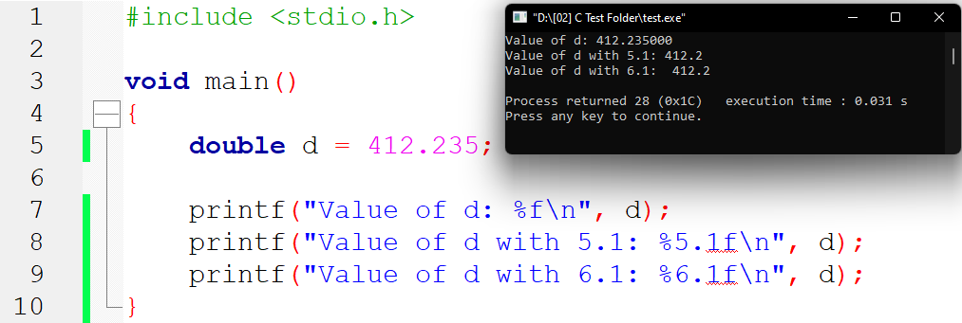
Data types

Slide 15

Data types

Slide 16
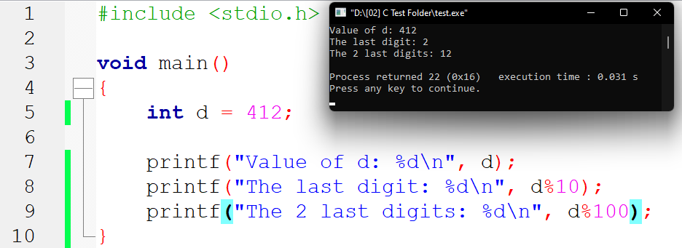
Data types

Slide 17
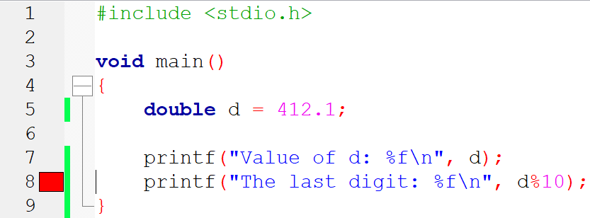
Data types

