Slide 1
2021-10-31
Built-in functions
if – else
Exercise assignment 1

Slide 2

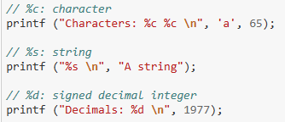

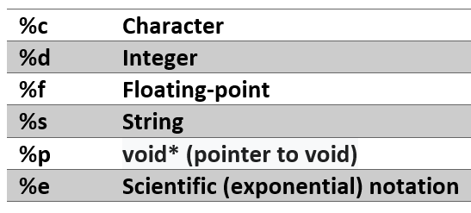
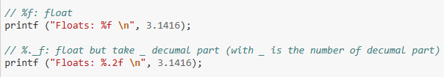
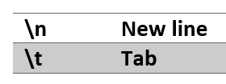

Built-in function
printf

Slide 3
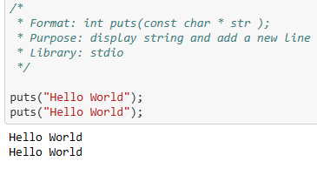
Built-in function
puts

Slide 4
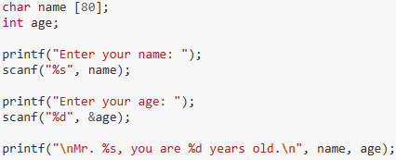

Built-in function
scanf

Slide 5

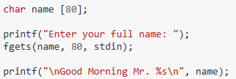

Built-in function
fgets

Slide 6
Built-in function
fgets

Slide 7



Built-in function
pow

Slide 8



Built-in function
sqrt

Slide 9


Built-in function
exp

Slide 10
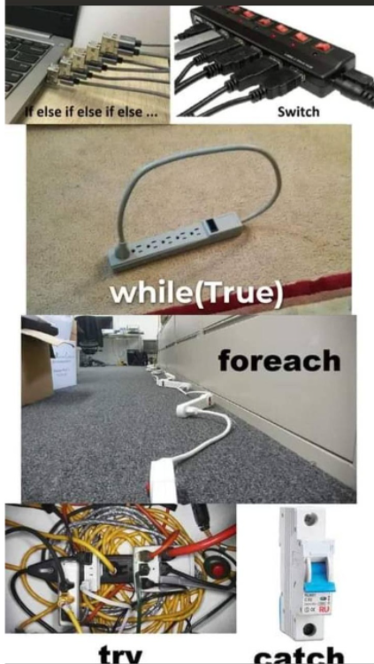
If - else

Slide 11
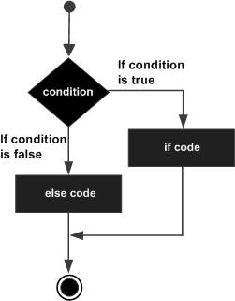
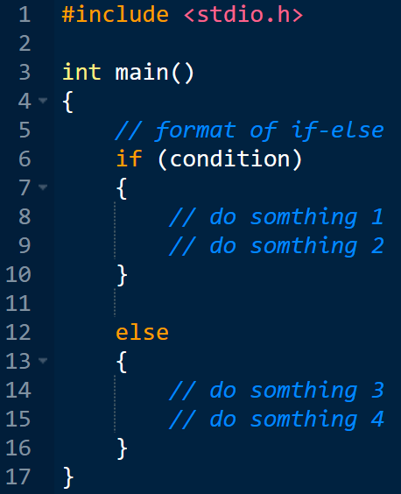
If - else

Slide 12
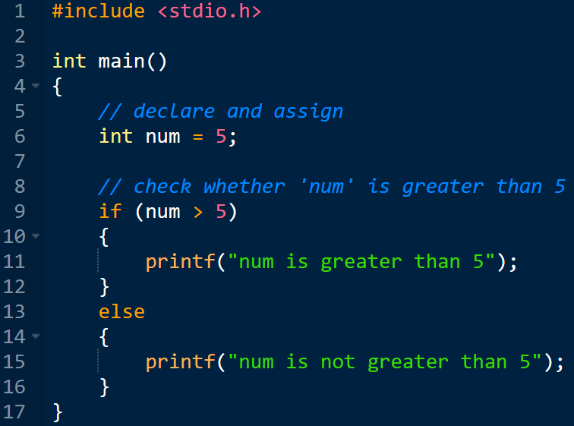
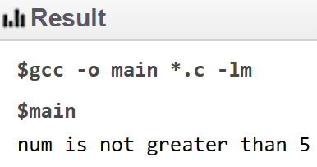
If - else

Slide 13
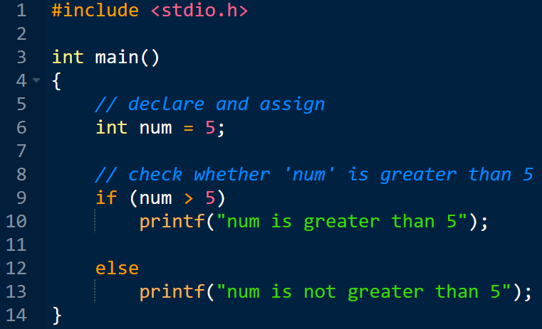
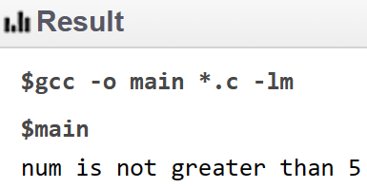
If - else

Slide 14
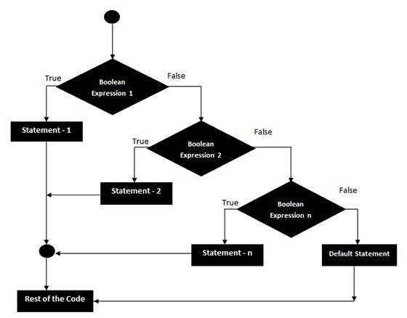
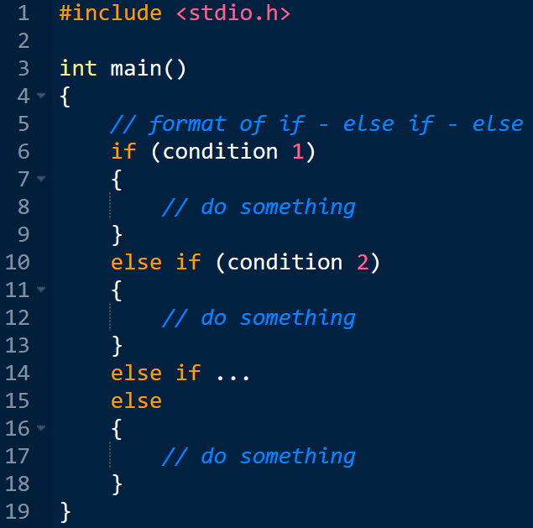
If - else

Slide 15
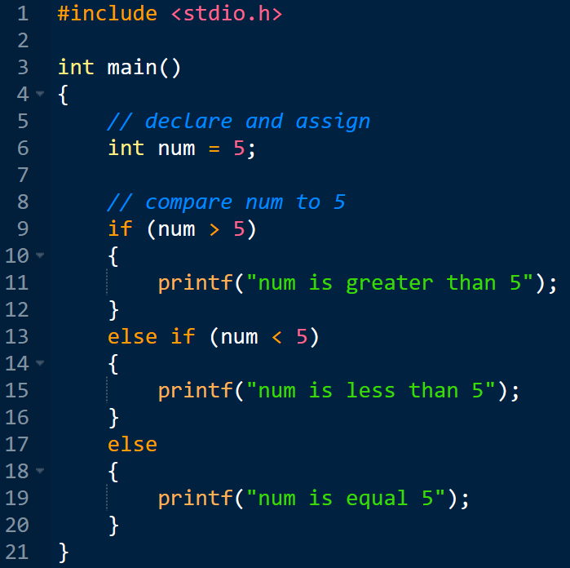
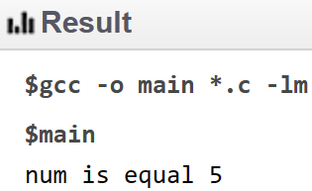
If - else

Slide 16
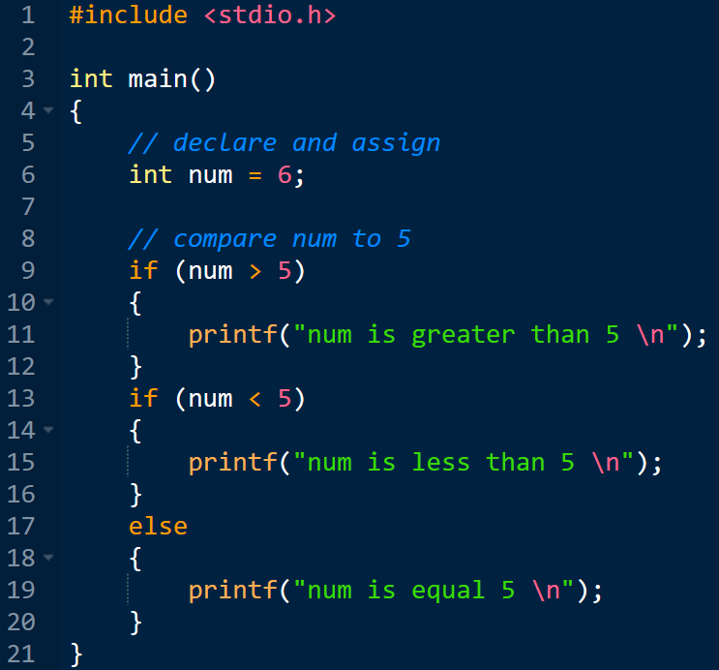
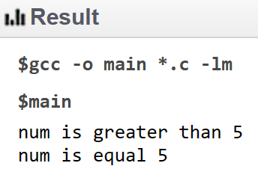
If - else

Slide 17


Exercise
Question 1: Write a program that gets an input number from a user and checks if the input is divisible by 4
scanf
modulo operator (%)

Slide 18
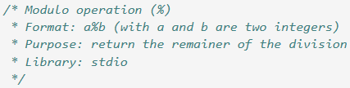

Exercise
%

Slide 19
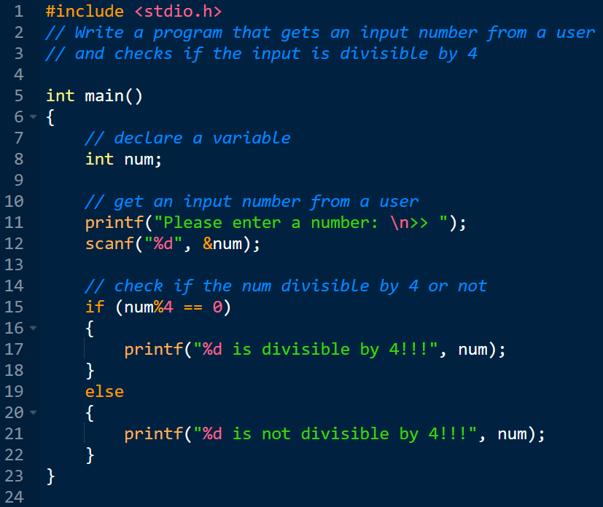


Exercise

Slide 20


Exercise
Question 3: Write a program to check whether a number (entered from a user) is a multiple of 7s or not.
scanf
Divisible by 7
%
Question 1

Slide 21

Exercise
Question 4: Write a program to check whether a number (entered from a user) is even or odd.
scanf
Divisible by 2
%
Question 1

Slide 22


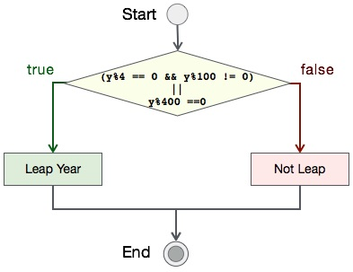
Exercise
Question 2: Write a program to check whether a given year (entered from a user) is a leap year or not
scanf

Slide 23
Exercise
A year (calender) = 365 (days)
A year (physical) = 365.2421875 (days)
4 years (calender) = 4 * 365 = 1460 (days)
4 years (physical) = 4 * 365.2421875 = 1,460.96875 (days)
Difference = 1,460.96875 – 1460 = 0.96875 (days)
Add 1 day into every 4 yeas
4 years (calender) = 4 * 365 + 1 = 1,461 (days)
Difference = 1,461 - 1,460.96875 = 0.03125 (days)
A century (calender) = 1,461 * 25 = 36,525 (days)
A century (physical) = 1,460.96875 * 25 = 36,524.21875 (days)
Difference = 36,524.21875 - 36,525 = -0.78125 (days)
Difference (4 centuries) = -0.78125 * 4 = -3,125 (days)
Minus 3 days into every 4 centuries
In 400 years, there are 4 years divisible by 4 and 100, but 1 one them divisible by 400

Slide 24
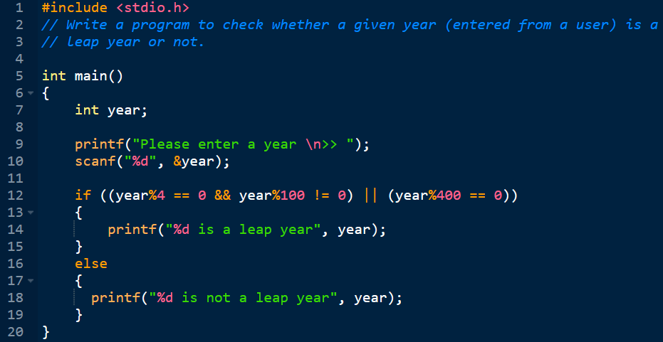


Exercise

Slide 25
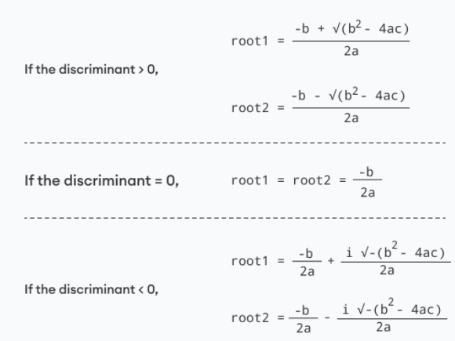


Exercise
Question 5: Write a program to find solutions for a quadratic equation. The program requires a user to
enter values for a, b, and c; and uses the printf function to print out its outputs.
scanf

Slide 26
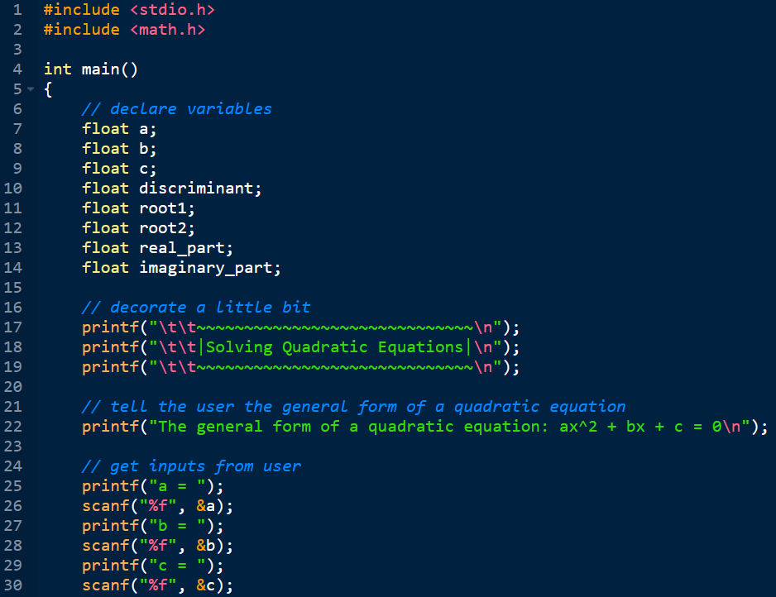
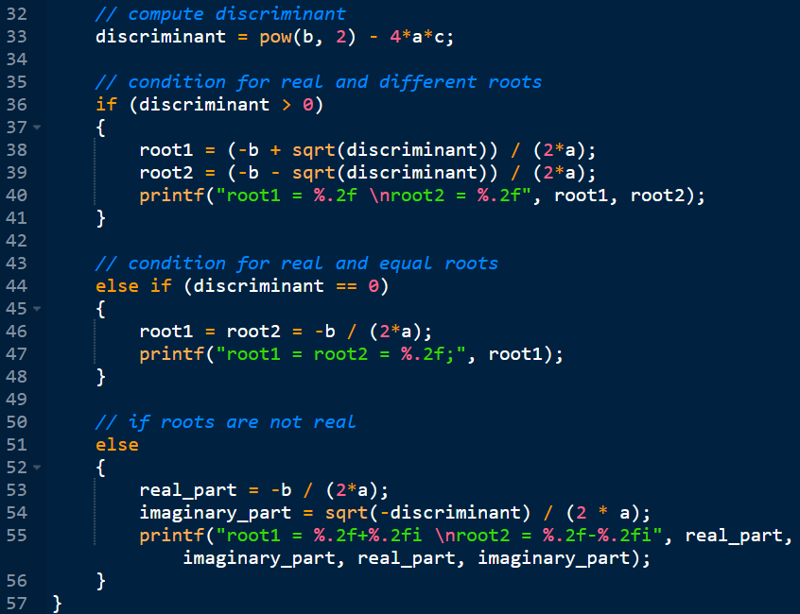
Exercise

Slide 27
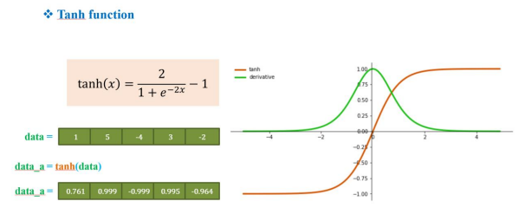
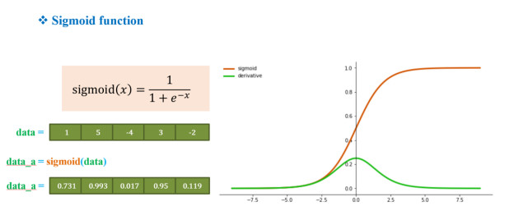
Exercise

Slide 28
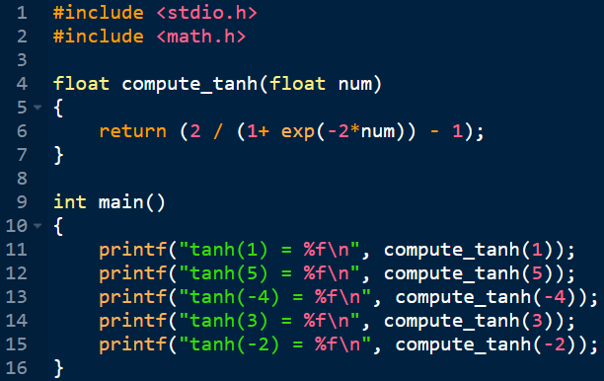

Exercise

Slide 29
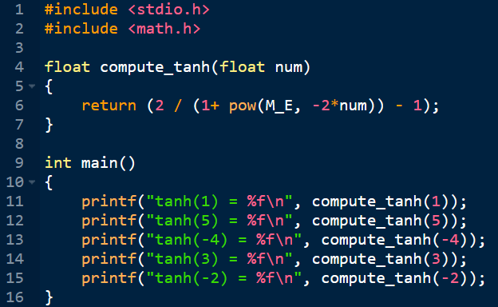
Exercise

Slide 30
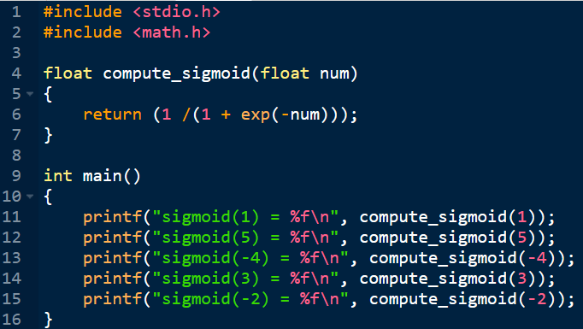

Exercise

