Slide 1
2021-11-21
Jupyter lab
variabls
If – elif – else
functions
Exercise 4
Presenter: Nguyen Khoa

Slide 2
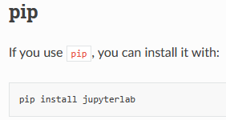
1. Jupyter lab
1.1. Installation

Slide 3
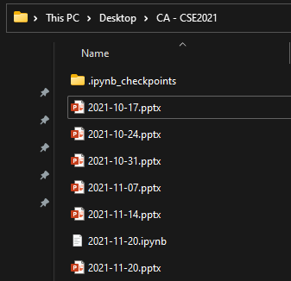
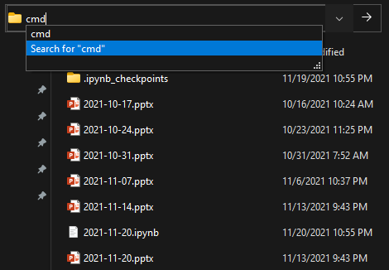

1. Jupyter lab
1.2. Usage

Slide 4
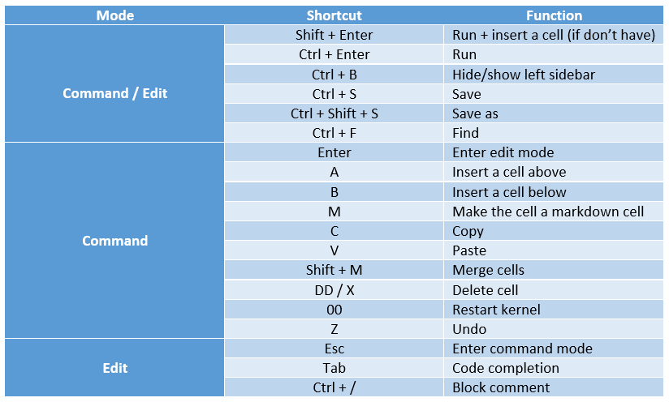
1. Jupyter lab
1.3. Shortcuts

Slide 5
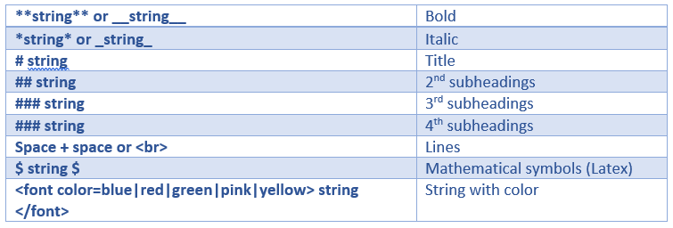
1. Jupyter lab
1.4. Markdown cheatsheet

Slide 6

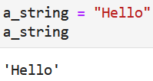
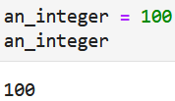
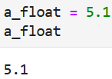
2. Variables

Slide 7
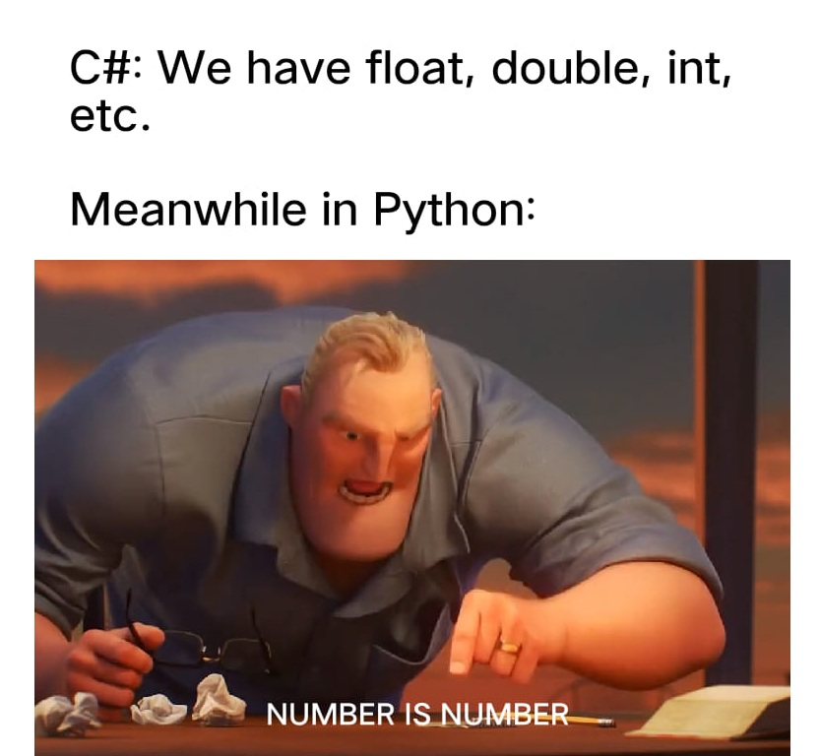
2. Variables

Slide 8
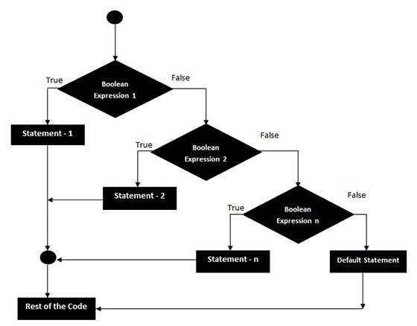
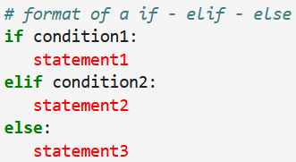
3. If – else if - else

Slide 9
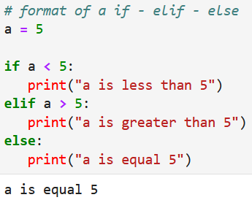
3. If – else if - else

Slide 10
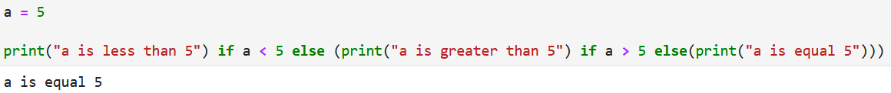
3. If – else if - else

Slide 11
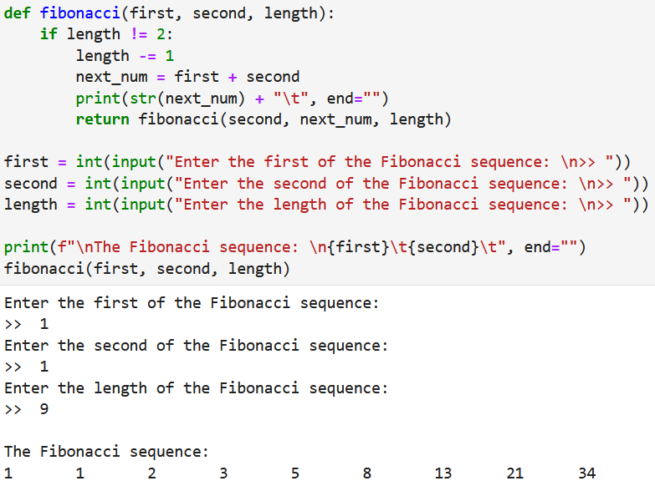
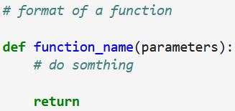
4. FUNCTIONS

Slide 12
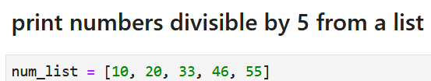
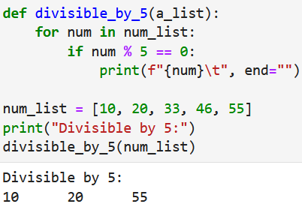
4. FUNCTIONS

Slide 13
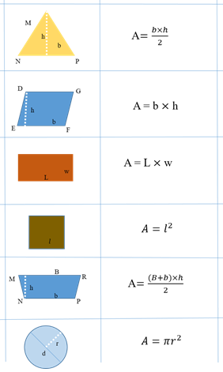
5. Exercise 4

Slide 14
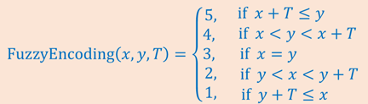
5. Exercise 4

