Slide 1
Actual deployment of the MTA-STS and how it is correctly followed?
Junbeom In
2023 10 30

Slide 2
Introduction
SMTP MTA Strict Transport Security (MTA-STS) is a mechanism enabling mail service providers (SPs) to declare their ability to receive Transport Layer Security (TLS) secure SMTP connections and to specify whether sending SMTP servers should refuse to deliver to MX hosts that do not offer TLS with a trusted server certificate.
Referenced RFC8461 document for this project

Slide 3
Objective
Assessment Goal:
Investigate real-world MTA-STS deployments
Uncover potential security flaws.
Central Question
How robust and foolproof are current MTA-STS deployments among major email services?

Slide 4
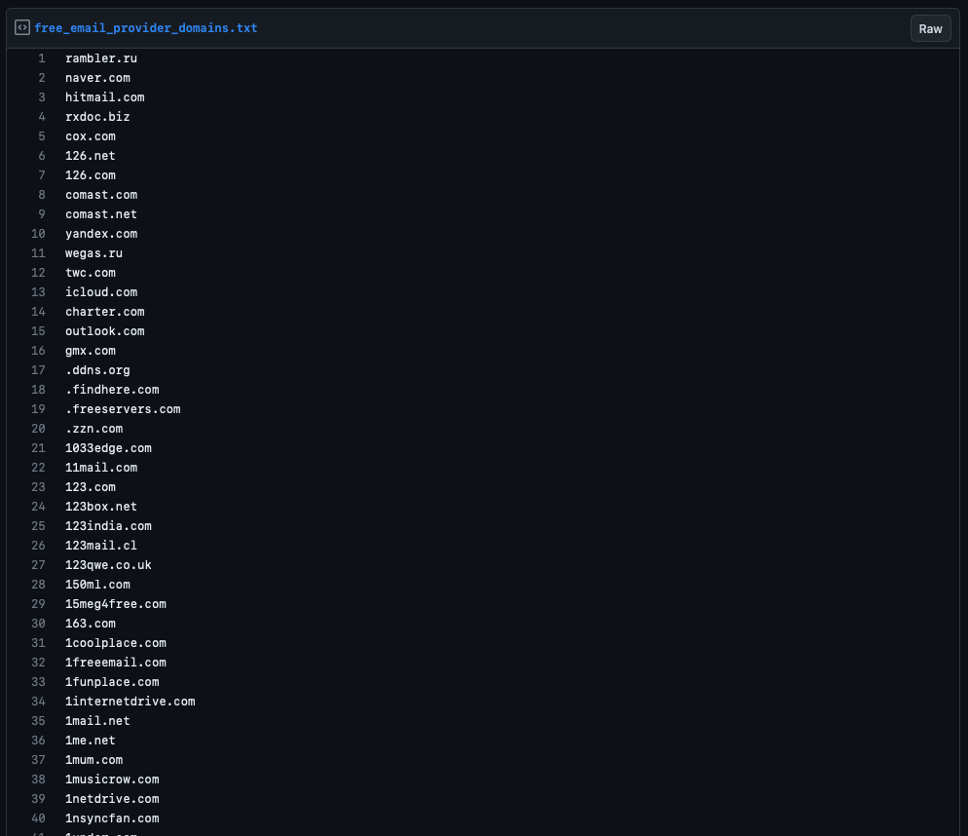

Methodology : Data Source
Point 1: Collection of free email service list from GitHub.
https://gist.github.com/Artistan/9662757
3752 common free email provider domains

Slide 5
Methodology : Testing
MX Record test
Check domain’s MX record
MTA-STS TXT Record test
Check if exist
Check if it’s correct
MTA-STS HTTP policy file test
Check if HTTP requests reach the server
Check if the HTTP response complies with the standards [RFC8461]

Slide 6
Methodology
def main(): filename = free_email_provider_domains.txt" checklf(filename) with open(filename, 'r') as file: lines = file.read().splitlines() # Split lines and remove potential newline at the end print("Total Lines : " + str(len(lines))) # Placeholder for data to be added to DataFrame data = [] for count, line in enumerate(lines, start=1): # Using enumerate for cleaner counting record = { "#": count, "Domain": line, "MX" : False, "MTA-STS TXT": None, "MTA-STS TXT VALIDATION": None, "MTA-STS HTTP": None, "MTA-STS HTTP VALIDATION" : None } mx_record = get_mxrecord(line) #If MX Account Exists if mx_record: record.update({"MX": True if mx_record else False}) mtasts_txt_record = get_mtasts_txt_record(line) #If MTA-STS TXT Record exist if mtasts_txt_record: record.update({"MTA-STS TXT": mtasts_txt_record if mx_record else None}) #Validate the MTA-STS record isMTASTSrecordValid= validate_mta_sts_string(mtasts_txt_record) record.update({"MTA-STS TXT VALIDATION": True if isMTASTSrecordValid else False}) #Retrieve MTASTS File MTASTSPolicy = fetch_and_validate_mta_sts_policy(line) record.update({"MTA-STS HTTP": MTASTSPolicy}) print(record) data.append(record) df = pandas.DataFrame(data) df.to_csv("analysis.csv")
Point 2: Testing the domain's MX record.
Point 3: Validation of the domain's MTA-STS TXT record.
Point 4: Requesting the domain's HTTP MTA-STS policy file

Slide 7
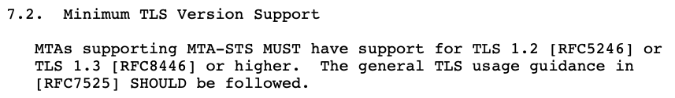
Findings
Many major Email services have incorrect MTA-STS deployments.
Incorrect TXT Record
_mta-sts.comast.com. 2789 IN TXT "v=spf1 -all"
Incorrect HTTPS Policy
mini-mail.com
<html><head><title>mta-sts.mini-mail.com</title></head><body><h1>mta-sts.mini-mail.com</h1><p>Coming soon.</p></body></html>
Incorrect TLS Version
321media.com
[SSL: TLSV1_ALERT_INTERNAL_ERROR] tlsv1 alert internal error (_ssl.c:997)

Slide 8
Findings
Many major Email services have incorrect MTA-STS deployments.
Incorrect Charset
outlook.com
ISO-8859-1
Incorrect HTTPS Policy
<html><head><title>mta-sts.cookiemonster.com</title></head><body><h1>mta-sts.cookiemonster.com</h1><p>Coming soon.</p></body></html>
Incorrect TLS Certificate
'[SSL: CERTIFICATE_VERIFY_FAILED] certificate verify failed: certificate has expired
Incorrect TLS Version
321media.com
[SSL: TLSV1_ALERT_INTERNAL_ERROR] tlsv1 alert internal error (_ssl.c:997)

Slide 9
Findings
Statistic
Out of 3,752 email servers,
237(6.3%) have an MTA-STS TXT record.
However, only 19(0.05%) of these servers possess valid MTA-STS TXTs

Slide 10
Data
Row Labels | Count of MTA-STS TXT VALIDATION
0ad094978b47130a6a809a0396525cae21191ed6; v=spf1 -all | 3
70e1df3b081bfa704dcdd783f4cc6d96a2651ed6; v=spf1 -all | 1
cd4bb828b5efce7b07bcf39c165f65cf31711ed6; v=spf1 -all | 1
dan-ownership-verification=3doasray; v=spf1 include:u2069692.wl.sendgrid.net -all | 1
f7adefdc93f635e0c1f1f96f4ac1bc3cf81b1ed6; v=spf1 -all | 1
google-site-verification=auBmiSR75NQyUlSKXd5U53dUzPGS1vA7mLaXQl8yAaU; v=spf1 include:emailsrvr.com ~all | 1
MS=ms25096263 | 1
mtc=ODU0ODBlNzEtODFjNC00ZWE1LTk2NmMtOTM2MGQyZDVlNmY0 | 1
type=1; v=spf1 exists:%{h}.h.%{ir}._spf.r-o-o-t.com ?all | 1
type=2; v=spf1 exists:%{h}.h.%{ir}._spf.cia-agent.com ?all | 1
v=spf1 -all | 89
v=spf1 -all; 0ad094978b47130a6a809a0396525cae21191ed6 | 1
v=spf1 -all; v=DMARC1; p=reject; sp=none | 1
v=spf1 ~all | 2
v=spf1 a mx ?all | 1
v=spf1 a mx ~all | 1
v=spf1 a ptr include:gci.net ~all | 1
v=spf1 include:bigpond.com -all | 1
v=spf1 include:bigpond.com ~all | 1
v=spf1 include:emailsrvr.com -all | 6
v=spf1 include:mailgun.org ~all | 2
v=spf1 include:sitespf.everyone.net ?all | 1
v=spf1 include:spf-claramail.mail.eu.clara.net ~all | 1
v=spf1 include:spf.jubii.dk -all | 2
v=spf1 include:spf.messagingengine.com ~all | 65
v=spf1 include:u2069692.wl.sendgrid.net -all; dan-ownership-verification=3doasray | 2
v=spf1 ip4:127.0.0.1 ~all | 1
v=spf1 ip4:195.23.133.192/26 ip4:195.23.134.160/28 include:_spfi.smail.eu -all | 1
v=spf1 ip4:213.222.32.66 ip4:95.43.224.11 +a +mx ~all | 1
v=spf1 ip4:66.96.128.0/18 ?all; v=spf1 include:spf.protection.outlook.com -all | 1
v=spf1 ip6:fd18:d113:9bed::/48 -all | 3
v=spf1 ip6:fd43:c0d1:c090::/48 -all | 19
v=spf1 ip6:fd6c:300e:6d05::/48 -all | 1
v=spf1 mx include:coxmail.com ?all | 1
v=spf1 redirect=forum.dk | 1
Mostly SPF Records

Slide 11
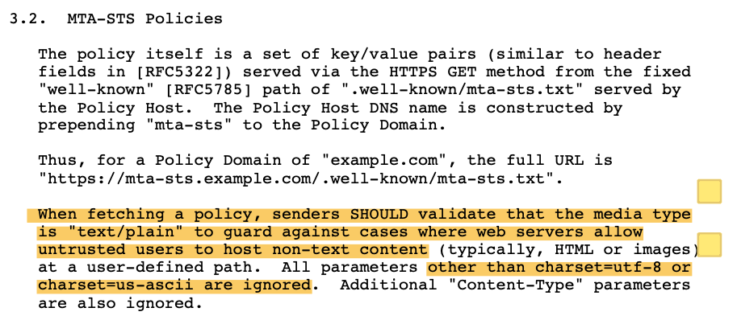
Findings
1 out of 3752 mail domains correctly follows the MTA-STS standard
Reason
The majority of MTA-STS Policy files do not utilize ASCII or utf8 encoding. – ISO-8859-1

Slide 12
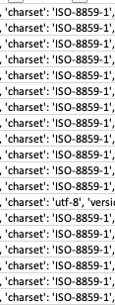
Data

Slide 13
Findings
1 out of 3752 mail domains correctly follows the MTA-STS standard
Reason
The majority of MTA-STS Policy files do not utilize ASCII or utf8 encoding. – ISO-8859-1

Slide 14
Limitation
The attempt to conduct the email Deliverability test was unsuccessful due to the following challenges:
ISPs, including those at school and home like Comcast, block port 25.
Difficulty in locating a cloud service that permits TCP port 25
Next Plan
Verifies the ability to derive TLS-RPT [RFC8461 Section 6].
Examines the occurrence frequency.
Ensures compliance on a per-domain basis.
Evaluate the implementation of CNAME records in MTA-STS.
Investigate the presence of CNAME record loops.
Validates the Certificate Authority (CA).
Addresses scenarios where the CA differs between HTTP and SMTP.
CACHE SERVER
Duplicated ID number in TXT record
DNS Record
CR vs CRLF

Slide 15
Testing
Policy Discovery:
It does this by querying the DNS for a TXT record at _mta-sts.example.com.
Fetching the Policy:
Making an HTTPS request to a predefined well-known location: https://mta-sts.example.com/.well-known/mta-sts.txt.
Policy Validation:
The sending MTA validates the SSL/TLS certificate of the mta-sts.example.com web server to ensure it's legitimate then parses the policy to understand the requirements set out by the recipient domain.
Handling Policy Failures:
If the sender's MTA can't establish a connection that meets the policy's requirements, the behavior depends on the policy mode:
Enforce Mode, Testing Mode, None Mode
Policy Caching:
To optimize the process and reduce the overhead for subsequent emails, the sender's MTA caches the MTA-STS policy for a duration specified in the policy (the max_age directive).
Until this cache expires, the sender's MTA will use the cached policy for any emails sent to the domain.
Reporting (optional):
TLSRPT

