Slide 1
数 字 逻 辑
Digital Logic Circuit
— Pinciples and Practices
丁 贤 庆
ahhfdxq@163.com

Slide 2

Home work
1.3.3 (2) (3)
1.3.4 (2) (3)
1.4.1 (2) (3)
1.4.3 (2) (3)

Slide 3


Representation of Negative
负数的表示
There are only 0 and 1 in the binary system!
How to represent signed numbers with finite binary digits?
Generally,
The number of positive had better equals negative’s.
Arithmetic operations had better be easy to accomplish.
The values of number had better be sequential.

Slide 4
Representation of Negative
负数的表示
If we only have three bits ...
用3位二进制描述数轴上的点
Origin
-1
-1
-1
-1
-1
-1
-1
-1
-1
-1
-1
+1
+1
+1
+1
+1
+1
+1
+1
+1
+1
...
101
110
111
000
001
010
011
100
101
110
111
000
001
010
011
100
101
110
111
000
001
010
...
Go back to the origin
Go back to the origin
+1
000
We can connect the 3-bit numbers into a circle.
111
001
-1
There are only 8 numbers in all.
110
010
8 is the Module for 3-bit number.
If D is any 3-bit number,
101
011
so, D = D + 8 = D - 8
100

Slide 5
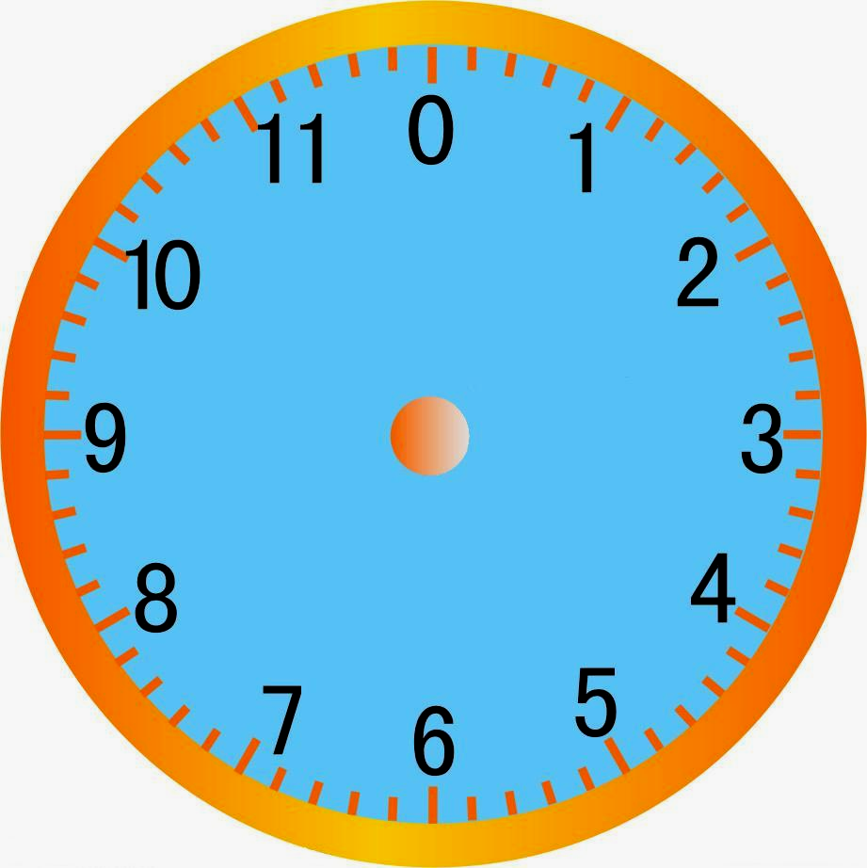
Representation of Negative
Example of Clock :
以钟表为例，模为12
Module is 12
7 = 7 + 12 = 7 - 12
But
how to represent signed numbers in binary system?
The simplest way is using one bit as the plus sign or the minus sign.
最简单的方法是：使用一个bit位来描述加号或者减号。

Slide 6

Representation of Negative
Signed-Magnitude Representation
0:正号 1：负号
Usually, the MSB is used as the sign bit. 0: plus, 1: minus
Why?
-1
-1
+1
+1
110
111
000
001
010
1111
0000
0001
Take 4-bit number for example:
1110
-7
+0
+1
0010
以4位bit数为例
-6
+2
1101
0011
A signed-magnitude number is also called a True Code (原码).
-5
+3
1100
-4
-1
+1
+4
0100
It has an equal number of positive and negative integers.（直接在数值位的前面加上一个bit符号位。）
-3
+5
1011
0101
-2
+6
1010
-1
-0
+7
0110
An n-bit integer range is :
– ( 2^{n-1} – 1) ~ + ( 2^{n-1} – 1)
1001
0111
1000
图中红色的bit位为符号位

Slide 7
Representation of Negative
Signed-Magnitude Representation
Take 8-bit numbers for example:
A = 0101 1101₂ = +93₁₀
–A = 1101 1101₂ = –93₁₀
B = 1110 1011₂ = –107₁₀
–B = 0110 1011₂ = +107₁₀
上面的原码中，红色的bit位为符号位，符号位后面的都是数值位。
Advantage of Signed-Magnitude :
Negating a number is very easy.
—— Just need to change its sign.

Slide 8


Representation of Negative
Signed-Magnitude Representation
But
Disadvantage of Signed-Magnitude :
There are two representations of Zero:
0000 0000₂ = +0₁₀ 1000 0000₂ = –0₁₀
原码中0有两种不同的表示形式
A – B ≠ A + ( – B)
原码直接计算时，存在A – B ≠ A + ( – B)
For example:
So, we have to design a Subtracter as well!
89 - 52=?
Cost will increase !
89 +(- 52)=?
1 | 1 | 1 | 1 | 0 | 0 | 0 | 0 |  | Carry
 | 0 | 1 | 0 | 1 | 1 | 0 | 0 | 1 | +89
+ | 1 | 0 | 1 | 1 | 0 | 1 | 0 | 0 | -52
The result is wrong!
 | 0 | 0 | 0 | 0 | 1 | 1 | 0 | 1 | +13

Slide 9

Representation of Negative
负数的表示
正数的原码、反码、补码相同。
How to realize A - B = A + (-B)
Assume A and B are n-bit numbers.
M is the Module of n-bit number.
A - B = A + M - B
计算时，存在A – B = A + (M – B)
M-B is another n-bit number.
-(-B) = B
Can M-B represent -B ?
Yes !
M-(M-B)
= B
计算时， 能否用(M – B)代替 （-B）?
M-B can be called Complement of B.
(M – B)称为B的补；
We use [ ] to represent the Complement.
[B]_{补}= M-B

Slide 10

Representation of Negative
Two’s-Complement Representation
关于“2的补”表示法
（-B）与(M – B)对应
于图中的同一个位置
Take 4-bit number for example:
以4位数为例：4位二进制数对应的模是16
There is only one Zero !
The Module is 16₁₀ .
0000
0001
1111
（-0）_{补} = 16₁₀- 0₁₀ = 0000₂ = +0₁₀
1110
+0
0010
-1
+1
（-1）_{补} = 16₁₀- 1₁₀ = 1111₂
-2
+2
（-2）_{补} = 16₁₀- 2₁₀ = 1110₂
1101
0011
……
-3
+3
（-8）_{补} = 16₁₀- 8₁₀ = 1000₂
+1
1100
-4
-1
+4
0100
It has an equal number of positive and negative integers.
-5
+5
1011
0101
The MSB can also be used as the sign bit. 0 = plus , 1= minus
-6
+6
1010
-7
-8
+7
0110
An n-bit integer range is :
– 2^{n-1} ~ + ( 2^{n-1} – 1)
1001
1000
0111
1000₂ can only be one number！
+8 or -8?

Slide 11
Representation of Negative
Example of Addition:
有了补码就可以很容易的实现正数与负数的运算了。
0 | 0 | 1 | 0 | 0 | Carry
 | 0 | 0 | 1 | 0 | +2
+ | 0 | 0 | 1 | 1 | +3
 | 0 | 1 | 0 | 1 | +5
1 | 1 | 1 | 1 | 0 | Carry
 | 1 | 0 | 1 | 1 | -5
+ | 1 | 1 | 0 | 1 | -3
 | 1 | 0 | 0 | 0 | -8
0 | 0 | 0 | 1 | 0 | Carry
 | 0 | 1 | 0 | 1 | +5
+ | 1 | 0 | 0 | 1 | -7
 | 1 | 1 | 1 | 0 | -2
Correct!
Correct!
Correct!
A negative integer is just the Complement of its positive integer !
For example: 1101₂ = 10000₂ – 0011₂ = Module – 0011₂
-3
+16
+3
+16
+3
A – B = A + Module – B = A + (–B)
∴ Subtracter is not necessary !

Slide 12
Representation of Negative
Advantage of Two’s-Complement :
There is only one representation of Zero:
0000 0000₂ = 0₁₀
Subtraction can be performed by the adder.
The adder only needs to perform the standard addition.

Slide 13
About complement number
Radix-Complement
— Generally
An n- digit number D D = d_{n–1}d_{n–2}· · ·d₁d₀ . ( Radix is r )
r ^{n} = 1000....0 ( n zeros after 1)
r ^{n} is the Module of n- digit numbers. D + Module = D
The radix-complement of D is obtained by subtracting it from r ^{n}.
It can be called r’s complement of D.
r’s complement of D = r ^{n}- D = Module- D
If D is between 1 and r ^{n} – 1, this subtraction produces another number between 1 and r ^{n} - 1.
What is the result of this subtraction if D is 0?
Zero’s radix-complement is Zero. There is only one zero!

Slide 14
About complement number
Radix-Complement
For decimal number system r = 10
The radix-complement of an n-digit decimal number is obtained by subtracting it from 10 ^{n} (Module).
It can be called 10’s complement.
10’s complement of D = 10 ^{n}- D = Module- D

Slide 15
About complement number
Radix-Complement
For octal number system r = 8
The radix-complement of an n-digit octal number is obtained by subtracting it from 8 ^{n} (Module).
It can be called 8’s complement.
8’s complement of D = 8 ^{n}- D = Module- D

Slide 16
About complement number
Radix-Complement
For binary number system r = 2
The radix-complement of an n-bit binary number is obtained by subtracting it from 2 ^{n} (Module).
It can be called 2’s complement or Two’s complement.
2’s complement of D = 2 ^{n}- D = Module- D

Slide 17
About complement number
Example of Clock :
Module is 12
What time is three hours before eight o’clock?
8 – 3 = 8 + 12 – 3
= 8 + 9
= 17
= 17 – 12
= 5
9 is the 12’s complement of 3.

Slide 18
About complement number
Diminished Radix-Complement
An n-digit number D
D = d_{n–1}d_{n–2}· · ·d₁d₀ . ( Radix is r )
r ^{n} -1 (Module -1)的优点
The diminished radix-complement of D is obtained by subtracting it from r ^{n} -1 (Module -1).
If X is the biggest digit symbol in this number system (i.e. X = r -1), then
r ^{n} -1 = XX...X ( There are n X s )
The complement of r ^{n} -1 means XX...X ’s complement .
So it can be called X s’ complement ( i.e. (r -1) s’ complement ).
(r- 1) s’ complement of D = (r ^{n}- 1)- D = (Module- 1)- D

Slide 19

About complement number
Is the diminished radix-complement easy to obtain
An n-digit number D D = d_{n–1}d_{n–2}· · ·d₁d₀ . ( Radix is r )
If X is the biggest digit symbol in this number system
(i.e. X = r -1), then
r ^{n} -1 = XX...X ( There are n X s)
The diminished radix-complement of D is
  (r ^{n}-1)- D
X X · · · X X
y_{i} will be the X ’s complement of d_{i} .
-
d_{n–1} d_{n–2}· · · d₁ d₀
y_{n–1} y_{n–2} · · · y₁ y₀
There is no Borrow !
∴ The diminished radix-complement of D can be obtained by
complementing the individual digits. Easier!

Slide 20
About complement number
Diminished Radix-Complement
For decimal number system r = 10
The diminished radix-complement of an n-digit decimal number is obtained by subtracting it from 10 ^{n} -1 (Module -1).
9 is the biggest digit symbol in decimal number system (i.e. 9 = 10 -1), then
10 ^{n} -1 = 99....9 ( There are n 9 s )
The complement of 10 ^{n} - 1 means 99...9 ’s complement .
So it can be called 9 s’ complement .
9 s’ complement of D = (10 ^{n}-1)- D

Slide 21
About complement number
Diminished Radix-Complement
For octal number system r = 8
The diminished radix-complement of an n-digit octal number is obtained by subtracting it from 8 ^{n} -1 (Module -1).
7 is the biggest digit symbol in decimal number system (i.e. 7 = 8 -1), then
8 ^{n} -1 = 77....7 ( There are n 7 s )
The complement of 8 ^{n} - 1 means 77...7’s complement .
So it can be called 7 s’ complement .
7 s’ complement of D = (8 ^{n}- 1)- D

Slide 22
About complement number
Diminished Radix-Complement
For binary number system r = 2
The diminished radix-complement of an n-bit binary number is obtained by subtracting it from 2 ^{n} -1 (Module -1).
1 is the biggest digit symbol in binary number system (i.e. 1 = 2 -1), then
2 ^{n} -1 = 11...1 ( There are n 1 s )
The complement of 2 ^{n} -1 means 11...1’s complement .
So it can be called 1 s’ complement (or Ones’ complement ).
1s’ complement of D = (2 ^{n}- 1)- D

Slide 23
Representation of Negative
Ones’-Complement Representation
—— Bitwise Invertion （按位求反）
反码
Negate a number by inverting each bit.
0000
1111
0001
Take 4-bit number for example:
1110
-0
+0
+1
0010
（以4bit 位数为例）
-1
+2
1101
0011
-2
+3
Can we use Ones’ complement to represent negative integers?
1100
-3
+1
+4
0100
-1
-4
+5
1011
0101
-5
+6
1010
-6
-7
+7
0110
1001
1000
0111

Slide 24
Representation of Negative
Ones’-Complement Representation
—— Bitwise Invertion （按位求反）
反码
Negate a number by inverting each bit.
0000
1111
0001
Take 4-bit number for example:
1110
-0
+0
+1
0010
（以4bit 位数为例）
-1
+2
It has an equal number of positive and negative integers.
1101
0011
-2
+3
1100
-3
+1
+4
0100
-1
The MSB can also be used as the sign bit. 0 = plus , 1= minus
-4
+5
1011
0101
-5
+6
An n-bit integer range is :
– ( 2^{n-1} – 1) ~ + ( 2^{n-1} – 1)
1010
-6
-7
+7
0110
1001
1000
0111

Slide 25
Representation of Negative
反码计算
Take 8-bit numbers for example:
（以8bit 位数为例）
A = 0101 1101₂ = +93₁₀
–A = 1010 0010₂ = –93₁₀
89-75 = ？
B = 1001 0100₂ = –107₁₀
–B = 0110 1011₂ = +107₁₀
89+（-75）= ？
If A – B = A + ( – B) ?
Example of Addition:
Wrong!
0 | 0 | 0 | 0 | 0 | 0 | 0 | 0 |  | Carry
 | 0 | 1 | 0 | 1 | 1 | 0 | 0 | 1 | +89
+ | 1 | 0 | 1 | 0 | 0 | 0 | 1 | 0 | -93
 | 1 | 1 | 1 | 1 | 1 | 0 | 1 | 1 | -4
1 | 1 | 1 | 1 | 0 | 0 | 0 | 0 |  | Carry
 | 0 | 1 | 0 | 1 | 1 | 0 | 0 | 1 | +89
+ | 1 | 0 | 1 | 1 | 0 | 1 | 0 | 0 | -75
 | 0 | 0 | 0 | 0 | 1 | 1 | 0 | 1
 |  |  |  |  |  |  |  |  | +13
+ |  |  |  |  |  |  |  | 1
 | 0 | 0 | 0 | 0 | 1 | 1 | 1 | 0 | +14
Correct!
If there is a carry out of the MSB, add 1 to the result.
Correct!
Subtracter is not necessary !

Slide 26
Representation of Negative
Advantage of Ones’-Complement :
反码的优点
Negating a number is very easy.
—— Just need to invert each bit.
Subtraction can be performed by the adder.
Disadvantage of Ones’-Complement :
There are two representations of Zero:
0000 0000₂ = +0₁₀ 1111 1111₂ = –0₁₀
（0的反码有两种不同的形式。）
The adder will be a little bit complex (need to detect the carry).

Slide 27
Representation of Negative
Cost Comparison
正数的原码、反码、补码相同。
负数的原码、反码、补码不同。
Signed-Magnitude Representation (原码)
Needs :
Inverter ( to invert the sign bit)
Detector (to examine the number’s sign)
Adder (to perform addition)
Subtractor (to perform subtraction)
Ones’-Complement Representation (反码)
Needs :
Inverter ( to invert all bits)
Adder (to perform addition)
Detector (to detect the carry of MSB)
Two’s-Complement Representation (补码)
The best
Needs :
Inverter ( to invert all bits)
Adder (to perform addition)

Slide 28
Sum-up for the complement
Decimal
Signed-Magnitude
Ones’ complement
Two’s complement
-8
——
——
1000
-7
1111
1000
1001
-6
1110
1001
1010
-5
1101
1010
1011
-4
1100
1011
1100
-3
1011
1100
1101
-2
1010
1101
1110
-1
1001
1110
1111
0
1000或0000
1111或0000
0000
1
0001
0001
0001
2
0010
0010
0010
3
0011
0011
0011
4
0100
0100
0100
5
0101
0101
0101
6
0110
0110
0110
7
0111
0111
0111

Slide 29
Representation of Negative
Two’s-Complement Representation
关于“2的补”表示法
（-B）与(M – B)对应
于图中的同一个位置
Take 4-bit number for example:
以4位数为例：4位二进制数对应的模是16
There is only one Zero !
The Module is 16₁₀ .
0000
0001
1111
（-0）_{补} = 16₁₀- 0₁₀ = 0000₂ = +0₁₀
1110
+0
0010
-1
+1
（-1）_{补} = 16₁₀- 1₁₀ = 1111₂
-2
+2
（-2）_{补} = 16₁₀- 2₁₀ = 1110₂
1101
0011
……
-3
+3
（-8）_{补} = 16₁₀- 8₁₀ = 1000₂
+1
1100
-4
-1
+4
0100
It has an equal number of positive and negative integers.
-5
+5
1011
0101
The MSB can also be used as the sign bit. 0 = plus , 1= minus
-6
+6
1010
-7
-8
+7
0110
An n-bit integer range is :
– 2^{n-1} ~ + ( 2^{n-1} – 1)
1001
1000
0111
1000₂ can only be one number！
+8 or -8?

Slide 30
Representation of Negative
Ones’-Complement Representation
—— Bitwise Invertion （按位求反）
反码
Negate a number by inverting each bit.
0000
1111
0001
Take 4-bit number for example:
1110
-0
+0
+1
0010
（以4bit 位数为例）
-1
+2
1101
0011
-2
+3
Can we use Ones’ complement to represent negative integers?
1100
-3
+1
+4
0100
-1
-4
+5
1011
0101
-5
+6
1010
-6
-7
+7
0110
1001
1000
0111

Slide 31
About overflow
运算溢出的分类：
溢出不关指超出存储空间，还有出错
Overflow : the result exceeds the number ranges.
Condition : two numbers have the same sign.
Checking: the sign of the result is different!
Solving : increase the data width !
Examples:
0
1
1
1
1
1
1
1
1
0
0
0
+
0
0
0
1
+
1
0
0
0
+
0
1
1
1
1
0
0
0
0
1
1
1
1
1
1
1
overflow
overflow
no overflow
(两个正数相加的结果
造成符号位为1)
(两个负数相加的结果
造成符号位为0)

Slide 32
Binary Codes for Decimal
十进制数的编码
Most people are accustomed to using Decimal.
BCD (Binary-Coded Decimal, 8421 Code)
BCD编码
Decimal | BCD(8421)
0 | 0000
1 | 0001
2 | 0010
3 | 0011
4 | 0100
5 | 0101
6 | 0110
7 | 0111
8 | 1000
9 | 1001
Unused Code Words
 | 1010
 | 1011
 | 1100
 | 1101
 | 1110
 | 1111
Natural code (just like 4-bit binary numbers)
Each digit is weighted.
It has 10 valid code words and 6 invalid code words.
BCD编码：将十进制中的0~9这十个数码，每个数码用一个4位的二进制数来表示。

Slide 33
Binary Codes for Decimal
Addition of BCD Digits
BCD码的加法运算
5
0101
4
0100
+
9
+
1001
+
5
+
0101
14
1110
>9, 无效码字
9
1001
≤9, 有效码字
+
0110
+6
修正
1
0100
进位->10+4
8
1000
9
1001
+
8
+
1000
+
9
+
1001
16
1
0000
>9, 无效码字
18
1
0010
>9, 无效码字
+
0110
+6
修正
+
0110
+6
修正
1
0110
进位->10+6
1
1000
进位->10+8

Slide 34
Binary Codes for Decimal
Subtraction of BCD Digits
BCD码的减法运算
'
'
1
0001
-
9
-
1001
2
'
'
1000
MSB有借位，结果无效
-
0110
-6
修正
0010
正确
8
'
'
'
1000
-
5
-
0101
3
0011
MSB无借位，结果有效

Slide 35
Binary Codes for Decimal
2421 Code
2421编码
Decimal | 2421
0 | 0000
1 | 0001
2 | 0010
3 | 0011
4 | 0100
5 | 1011
6 | 1100
7 | 1101
8 | 1110
9 | 1111
Unused Code Words
 | 0101
 | 0110
 | 0111
 | 1000
 | 1001
 | 1010
Each digit is weighted.
Self-complementing
Easy to obtain 9s’ complement.
MSB indicates higher/lower part.
It has 10 valid code words and 6 invalid code words.

Slide 36
Binary Codes for Decimal
Excess-3 Code
余3码：等于8421BCD码对应的加上 “0011”
8421 code + ‘0011’
Decimal | Excess-3
0 | 0011
1 | 0100
2 | 0101
3 | 0110
4 | 0111
5 | 1000
6 | 1001
7 | 1010
8 | 1011
9 | 1100
Unused Code Words
 | 0000
 | 0001
 | 0010
 | 1101
 | 1110
 | 1111
A wider rang of underflow/overflow
Digits isn’t weighted.
Self-complementing
Easy to obtain 9s’ complement.
MSB indicates higher/lower part.
It has 10 valid code words and 6 invalid code words.

Slide 37
Binary Codes for Decimal
Examples:
Use BCD code for a decimal number: A = 1946
8421 code : A = 0001 1001 0100 0110
2421 code : A = 0001 1111 0100 1100
Excess-3 code: A = 0100 1100 0111 1001

Slide 38
Gray Code
格雷码
Mechanical Encoding
111
000
111
000
110
001
110
001
0
0
1
0
?
?
101
010
101
010
100
011
100
011
Four possible values: 000, 001, 010, 011

Slide 39

Gray Code
格雷码
Gray Mechanical Encoding
Target: Code for continues changed numbers (in binary system) to prevent wrong code happened in transition time.
Property : In each pair of successive code words, only one bit changes.
100
000
Two possible values: 001, 011.
Both are valid.
101
001
0
?
1
111
011
最高位的0和1只改变一次!
最大数回到0也只有一位码元不同!
110
010

Slide 40
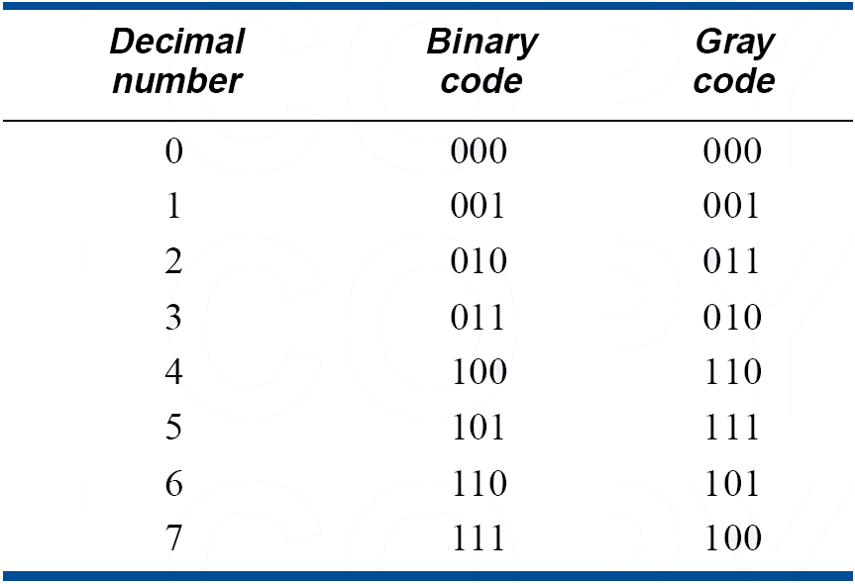
Gray Code
格雷码
Table 2
A comparison of 3-bit binary code and Gray code
Reflected
镜面放射对称。

Slide 41
Gray Code
格雷码
Gray Code Constructing
Method 1：Recursive Constructing
The first 2^{n} code words
n+1 bits Gray code, n=0
0
0
0
The first 2^{n} code words
n+1 bits Gray code, n=1
0
0
1
0
1
1
The last 2^{n} code words
0
1
0
n+1 bits Gray code, n=2
1
1
0
1
1
1
1
0
1
The last 2^{n} code words
1
0
0

Slide 42
Gray Code
格雷码
Gray Code Constructing
Method 2：Direct Constructing
方法2：直接构造格雷码
异或运算实现
From binary number to Gray code
The width is same, the MSB is same;
From right to left, if a bit in binary number is same as its right bit,
the gray bit is 0. If it is different, the gray bit is 1.
Examples:
Binary number: 1001 0010
Gray codes: 1101 1011

Slide 43
Gray Code
Translation between Gray Code and Binary Code
Binary code:
b_{n-1} b_{n-2} b_{n-1} …b₁ b₀
Gray code:
g_{n-1} g_{n-2} g_{n-1} …g₁ g₀
g_{i} = b_{i+1}⊕b_{i}
g_{n-1} = b_{n-1}⊕0 = b_{n-1}
∵A = B⊕C
C = A⊕B
B = A⊕C
∴ b_{i} = b_{i+1}⊕g_{i}
b_{n-1} = g_{n-1}⊕0 = g_{n-1}

Slide 44
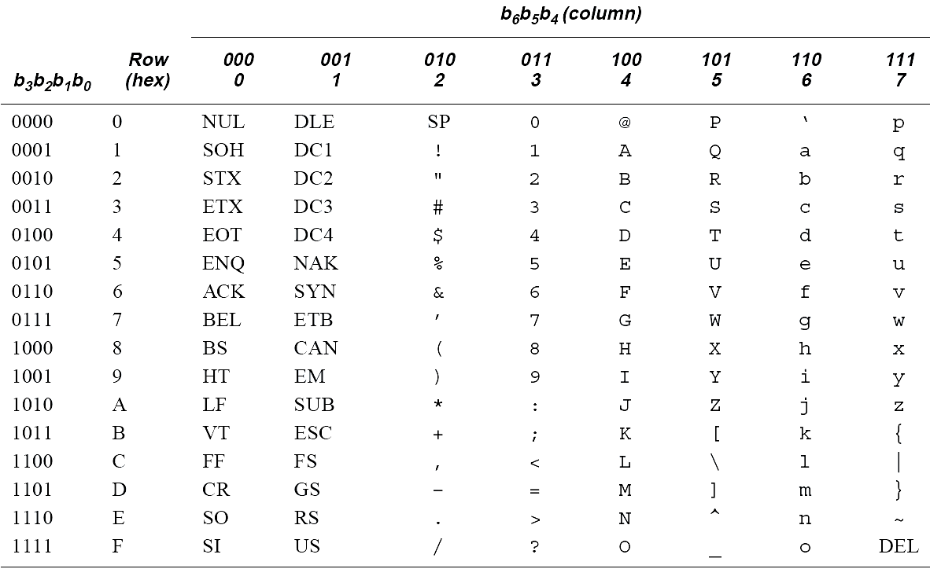
Character Codes
ASCII 编码
ASCII Code
128 Keyboard signs , 7-bit

Slide 45
Character Codes
例如：How are you!
包含“H”“o”“w” “空格”……“!”等12个字符。对应的12个字符的ASCII 编码排列如下：
1001000 1101111 1110111 0100000
1100001 1110010 1100101 0100000
1111001 1101111 1110101 0100001
12 characters

Slide 46
DIGITAL CONCEPTS WORDS
Analog [ 模拟 ] Digital [ 数字的 ]
Binary [ 二进制 ] Bit [ 位 ]
Pulse [ 脉冲 ] Clock [ 时钟 ]
Timing diagram [ 时序图 ] Data [ 数据 ]
Serial [ 串行 ] Parallel [ 并行 ]
Logic [ 逻辑 ]
常用的专业词汇

Slide 47
Discrete [ 离散的 ] Clarity [ 清楚 ]
Amplifier [ 放大器 ] Reproduction [ 复制品 ] Compact disk [ 光盘 ] Laser [ 激光 ]
Diode [ 二极管 ] Optical [ 光学的 ]
Code [ 编码 ] TTL [ 晶体管-晶体管逻辑 ] Edge [ 边沿 ] Amplitude [ 幅值 ]
Overlap [ 重叠 ] Transition [ 转换 ]
Reciprocal [ 倒数 ] Instantaneously [ 同时 ]
Stray capacitive [ 杂散电容 ] Duty cycle [ 占空比 ]

Slide 48
Digital Logic Circuit
— Pinciples and Practices
Digital Logic Circuit
— Pinciples and Practices
Chapter 2
Switching Algebra and Gate Circuit

Slide 49

A digital system consists of digital circuits.
A digital circuit consists of digital devices.
A digital device consists of transistors.
A digital device is a basic unit of digital design!

Slide 50




Digital Devices
Why not windows?
The most basic digital devices are called gates.
There are three most important gates.
AND Gate
It has two inputs and one output.
Equation
Truth Table
Symbol
F = A · B
A | B | F
0 | 0 | 0
0 | 1 | 0
1 | 0 | 0
1 | 1 | 1
A
F
ANSI, IEEE Standard
B
A
F
IEC Standard
B
A
F
China Standard
B

Slide 51



Digital Devices
OR Gate
It has two inputs and one output.
Equation
Truth Table
Symbol
F = A + B
A | B | F
0 | 0 | 0
0 | 1 | 1
1 | 0 | 1
1 | 1 | 1
A
ANSI, IEEE Standard
F
B
A
F
IEC Standard
B
A
F
China Standard
B

Slide 52




Digital Devices
NOT Gate ( Inverter, INV )
It has one input and one output.
Equation
Truth Table
Symbol
A | F
0 | 1
1 | 0
ANSI, IEEE Standard
A
F
A
F
IEC Standard
They have logic function!
A
F
China Standard
Any digital function can be realized by them!

Slide 53



Digital Devices
Other Gates
Buffer
It has one input and one output.
Equation
Truth Table
Symbol
F = A
A | F
0 | 0
1 | 1
A
F
ANSI, IEEE Standard
A
F
IEC Standard
A
F
China Standard

Slide 54




Digital Devices
Other Gates
NAND
It has two inputs and one output.
Equation
Truth Table
Symbol
A | B | F
0 | 0 | 1
0 | 1 | 1
1 | 0 | 1
1 | 1 | 0
A
ANSI, IEEE Standard
F
B
A
F
IEC Standard
B
A
F
China Standard
B

Slide 55




Digital Devices
Other Gates
NOR
It has two inputs and one output.
Equation
Truth Table
Symbol
A | B | F
0 | 0 | 1
0 | 1 | 0
1 | 0 | 0
1 | 1 | 0
A
F
ANSI, IEEE Standard
B
A
F
IEC Standard
B
A
F
China Standard
B

Slide 56
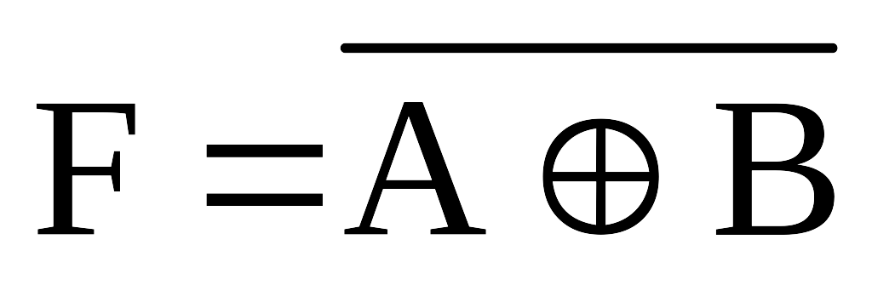



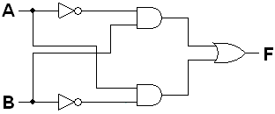

Digital Devices
Other Gates
XOR
It has two inputs and one output.
Equation
Symbol
Truth Table
A | B | F
0 | 0 | 0
0 | 1 | 1
1 | 0 | 1
1 | 1 | 0
A
ANSI, IEEE Standard
F
B
A
F
IEC Standard
B
A
F
China Standard
B

Slide 57





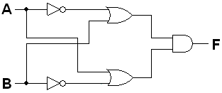

Digital Devices
Other Gates
XNOR
It has two inputs and one output.
Equation
Symbol
F = A ⊙ B
Truth Table
A
ANSI, IEEE Standard
F
A | B | F
0 | 0 | 1
0 | 1 | 0
1 | 0 | 0
1 | 1 | 1
B
A
F
IEC Standard
B
A
F
China Standard
B

