Slide 1
Lecture-1
Matrices

Slide 2
Syllabus
Introduction to vectors, their products, matrices and systems of linear equations; Solving linear equations: Gaussian elimination, inverse and transpose of a matrix, factorization into A = LU; Vector spaces and subspaces: four fundamental subspaces, solving Ax = 0 and Ax = b, independence, basis and dimension, dimensions of the four subspaces; Orthogonality: orthogonality of the four subspaces, projections, least squares, orthonormal bases and Gram-Schmidt; Determinants: properties, formulas, Cramer’s rule, inverses and volumes; Eigenvalues and eigenvectors: eigendecomposition, systems of differential equations, symmetric and positive definite matrices; Singular value decomposition (SVD): bases and matrices in the SVD, geometry of the SVD; Linear transformations: the matrices of linear transformations; Complex vectors and matrices: complex numbers, polar coordinates, Hermitian and unitary matrices; Applications of linear algebra in computer science and engineering.

Slide 3
Reference Books
Linear Algebra
Linear Algebra and Its Applications by Gilbert Strang.
Elementary Linear Algebra: Applications Version by Howard Anton and Chris Rorres.
Schaum’s Outline of Theory and Problems of Linear Algebra by Seymour Lipschutz and Marc Lars Lipson.
Matrices and Linear Transformations by Mohammad Iman Ali.
Elementary Linear Algebra with Applications by Bernard Kolman.
Schaum’s Outline of Theory and Problems of Matrices by Frank Ayres, Jr.

Slide 4
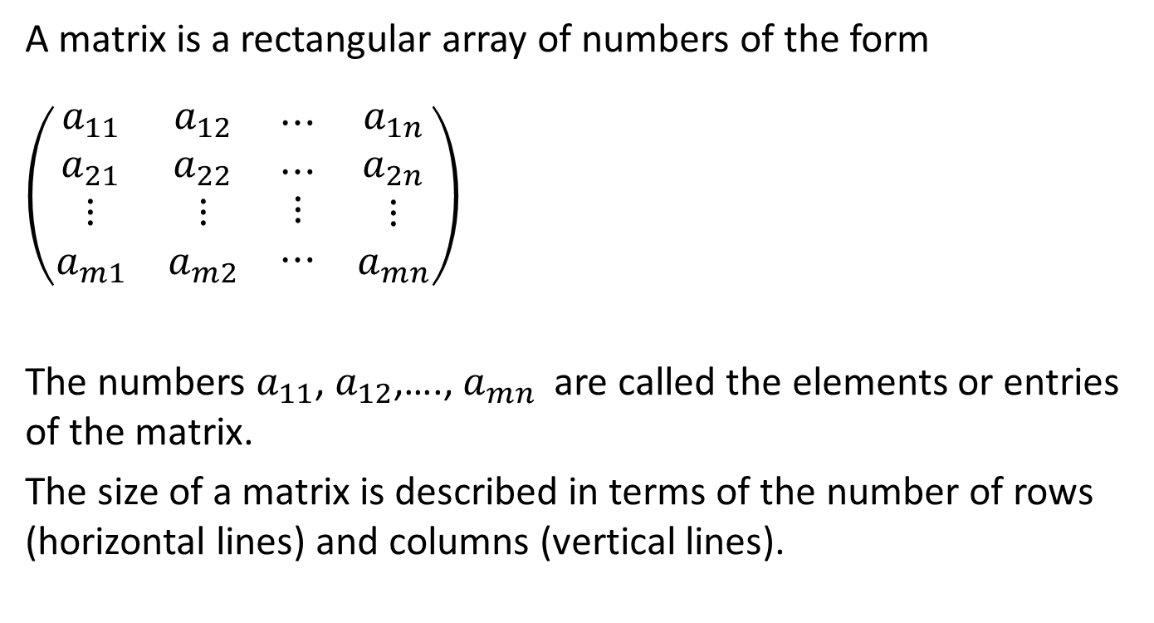
What is a matrix ?
A matrix is a rectangular array of numbers of the form
$\left(\begin{matrix}\begin{matrix}a_{11} \\ a_{21} \\ \begin{matrix}⋮ \\ a_{m1}\end{matrix}\end{matrix} & \begin{matrix}\begin{matrix}a_{12} \\ a_{22} \\ \begin{matrix}⋮ \\ a_{m2}\end{matrix}\end{matrix} & \begin{matrix}⋯ \\ ⋯ \\ \begin{matrix}⋮ \\ ⋯\end{matrix}\end{matrix} & \begin{matrix}a_{1n} \\ a_{2n} \\ \begin{matrix}⋮ \\ a_{mn}\end{matrix}\end{matrix}\end{matrix}\end{matrix}\right)$
The numbers $a_{11}$, $a_{12}$,…., $a_{mn}$ are called the elements or entries of the matrix.
The size of a matrix is described in terms of the number of rows (horizontal lines) and columns (vertical lines).

Slide 5
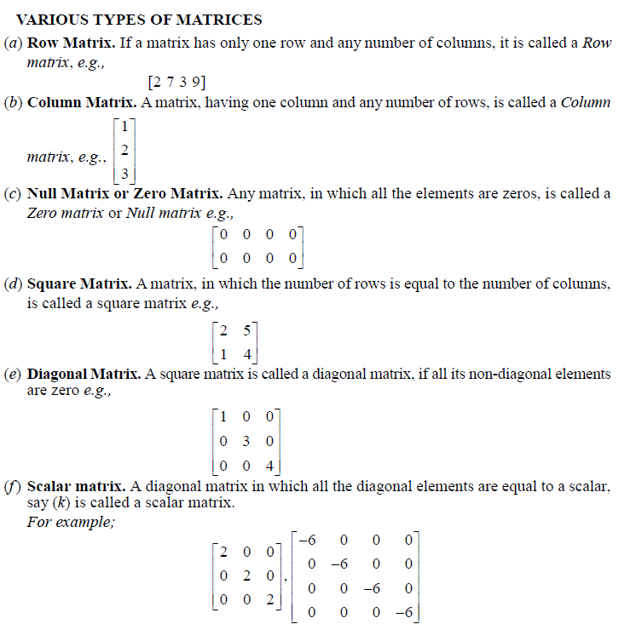

Slide 6
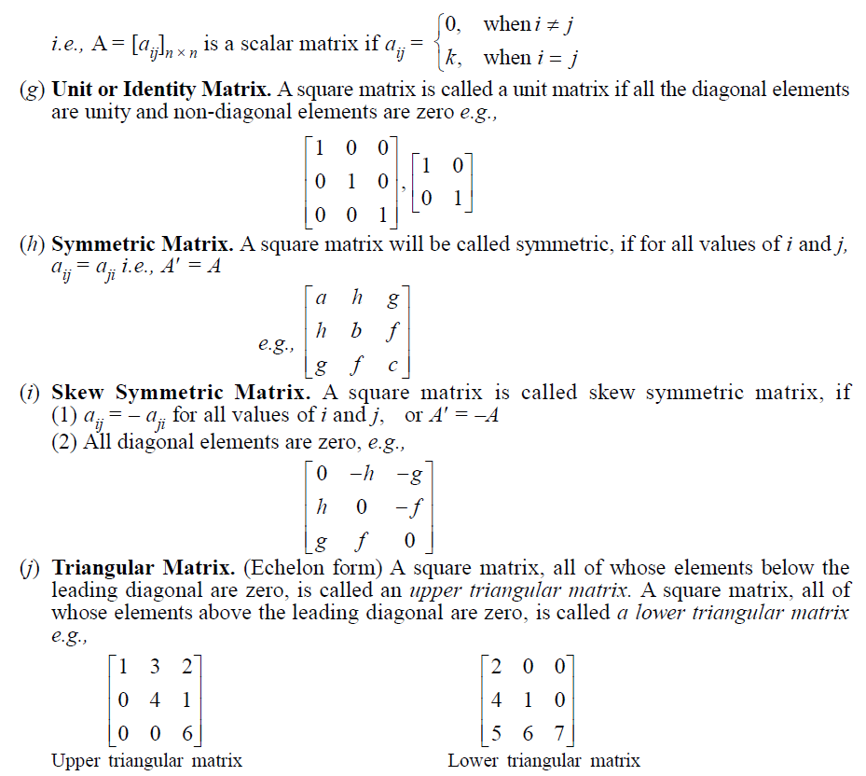

Slide 7
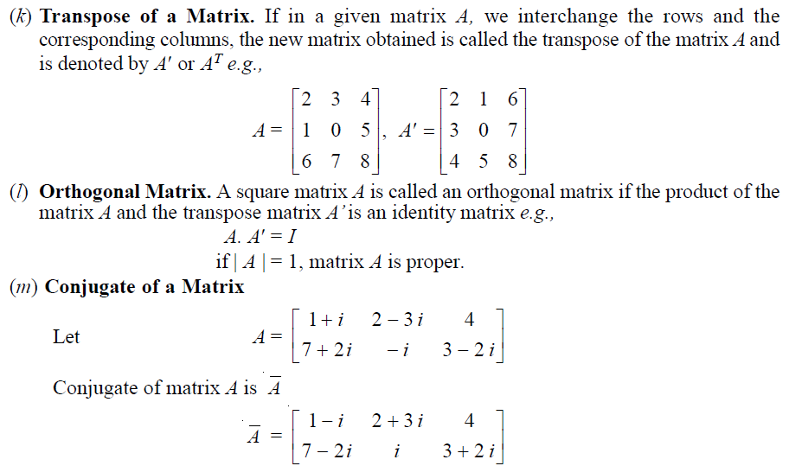

Slide 8
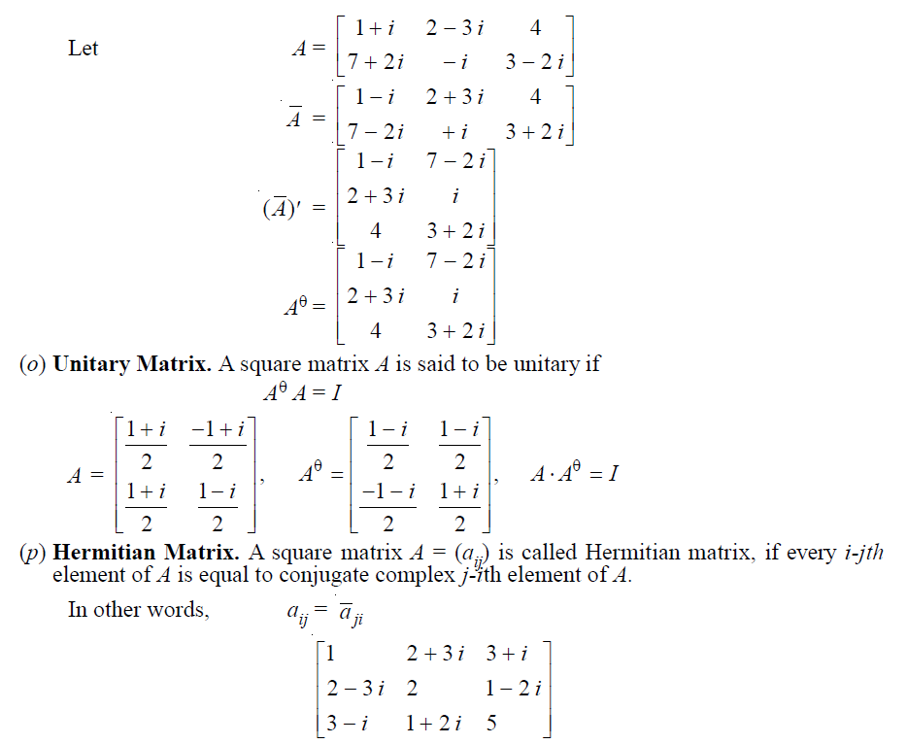

Slide 9
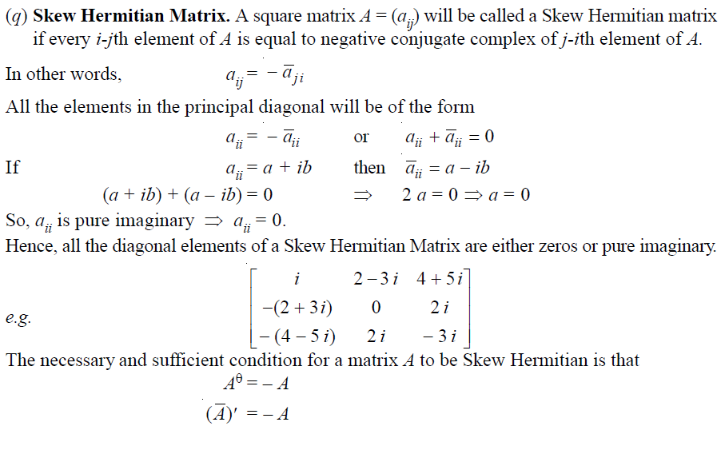

Slide 10
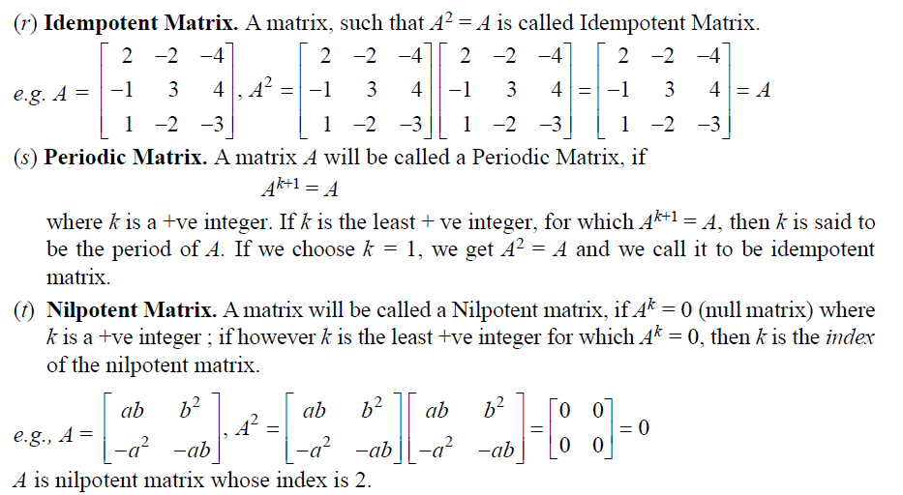

Slide 11
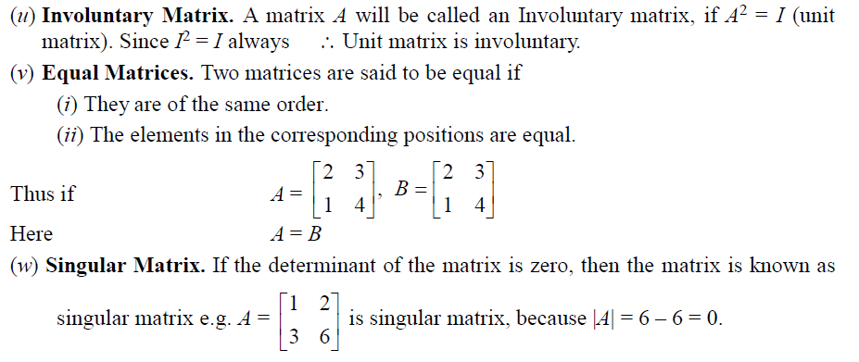

Slide 12
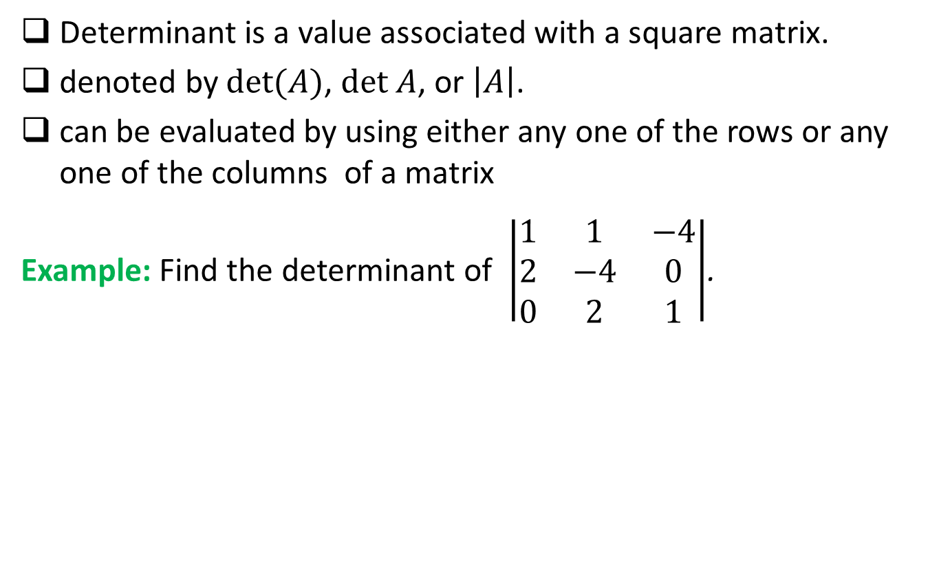
Determinant
Determinant is a value associated with a square matrix.
denoted by $det(A)$, $det A$, or $\left|A\right|$.
can be evaluated by using either any one of the rows or any one of the columns of a matrix
Example: Find the determinant of $\left|\begin{matrix}1 & 1 & −4 \\ 2 & −4 & 0 \\ 0 & 2 & 1\end{matrix}\right|$.

Slide 13

Example
For the matrix$A=\left[\begin{matrix}10 & −4 & 4α \\ −1 & 2 & 0 \\ 1 & α & −2\end{matrix}\right],$determine the value(s) of$α$for which $A$ will be singular.

