Slide 1



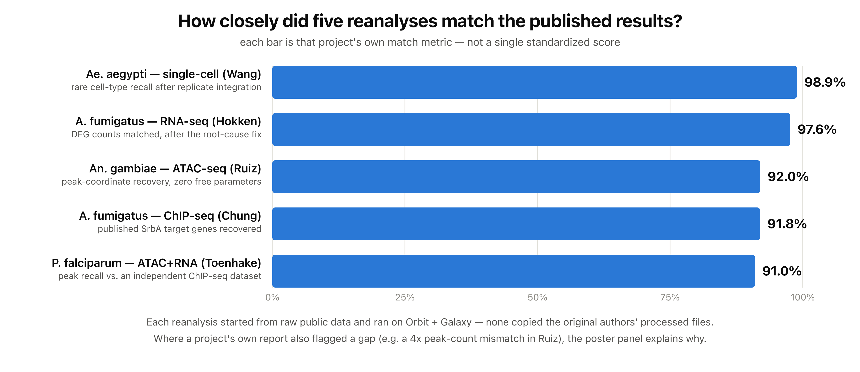
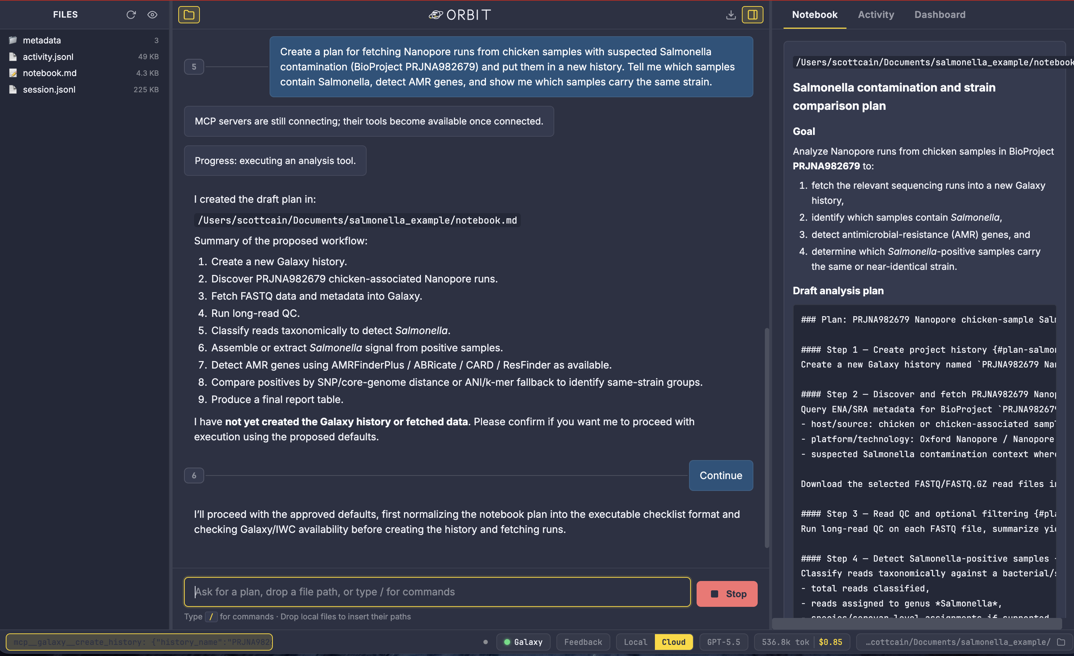
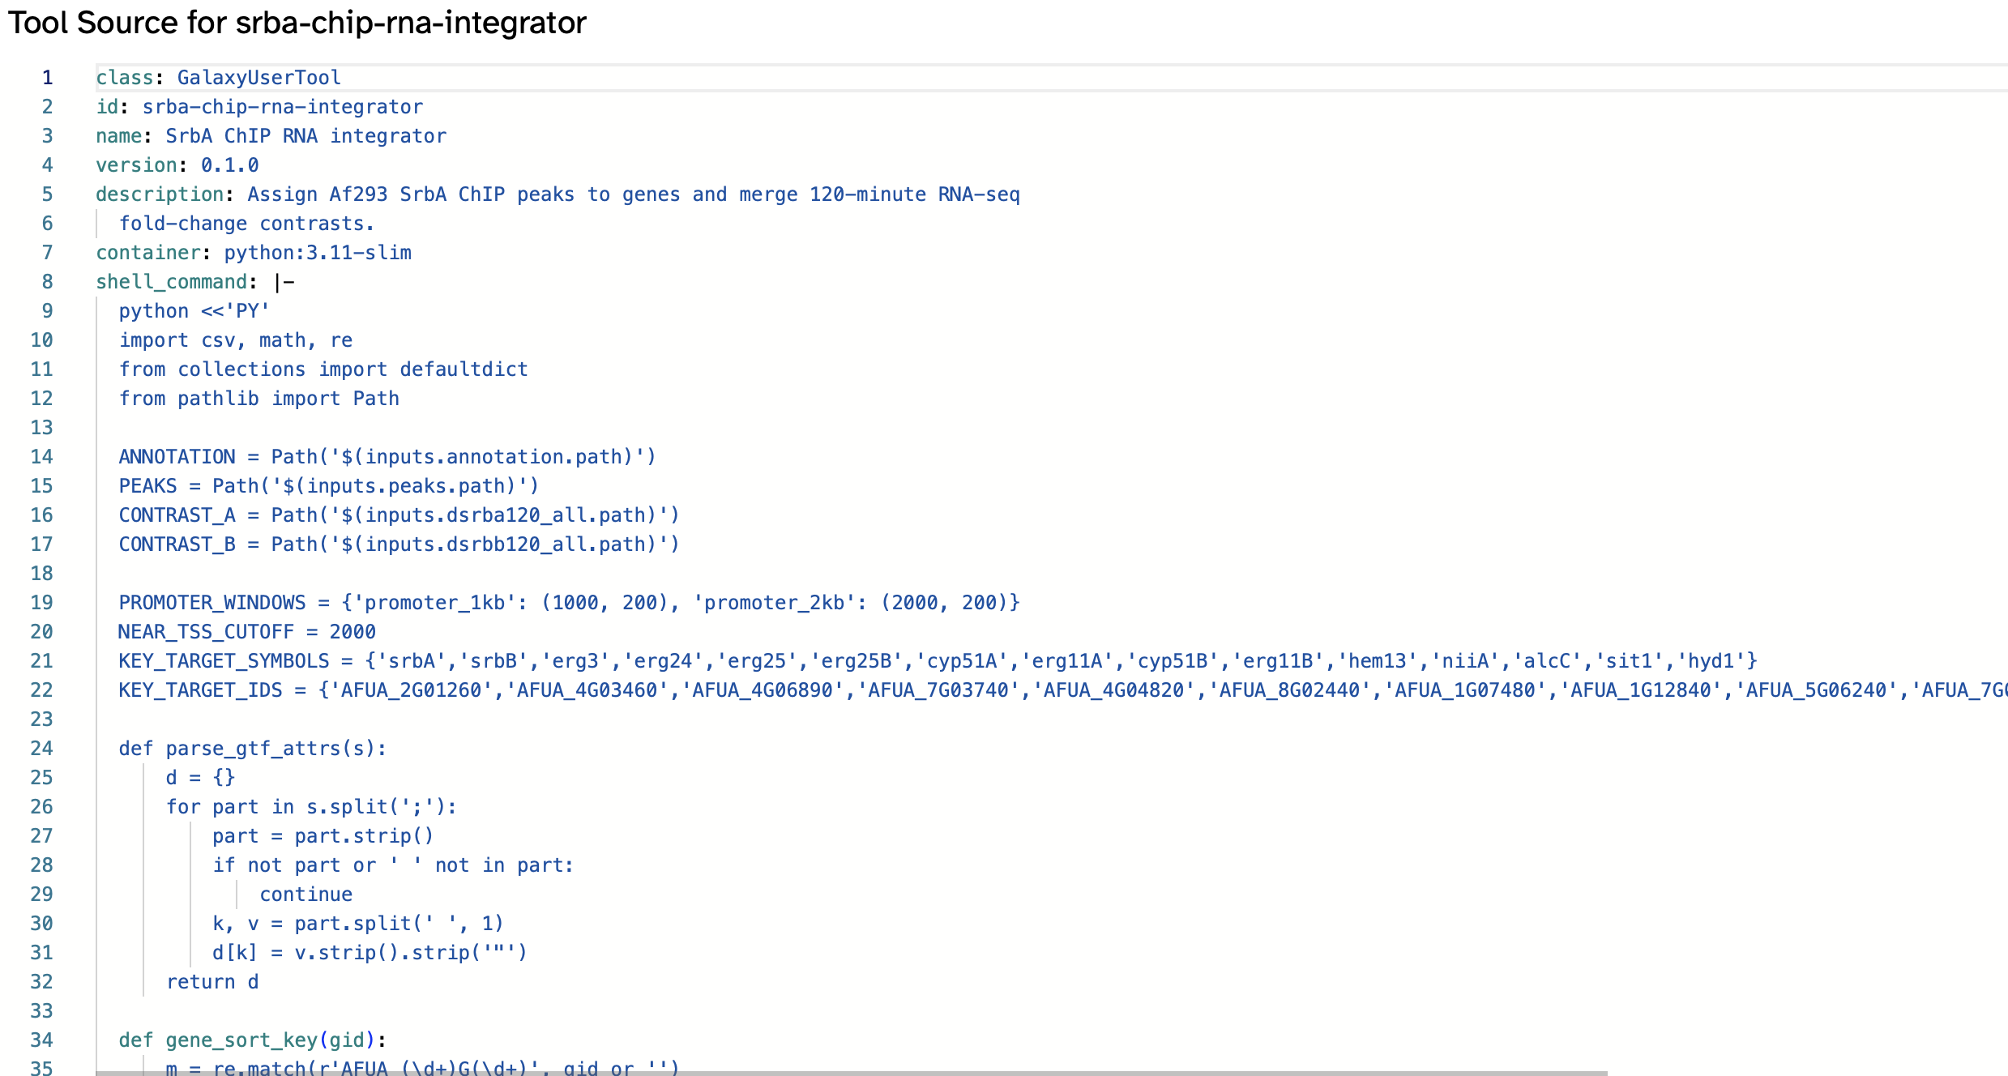
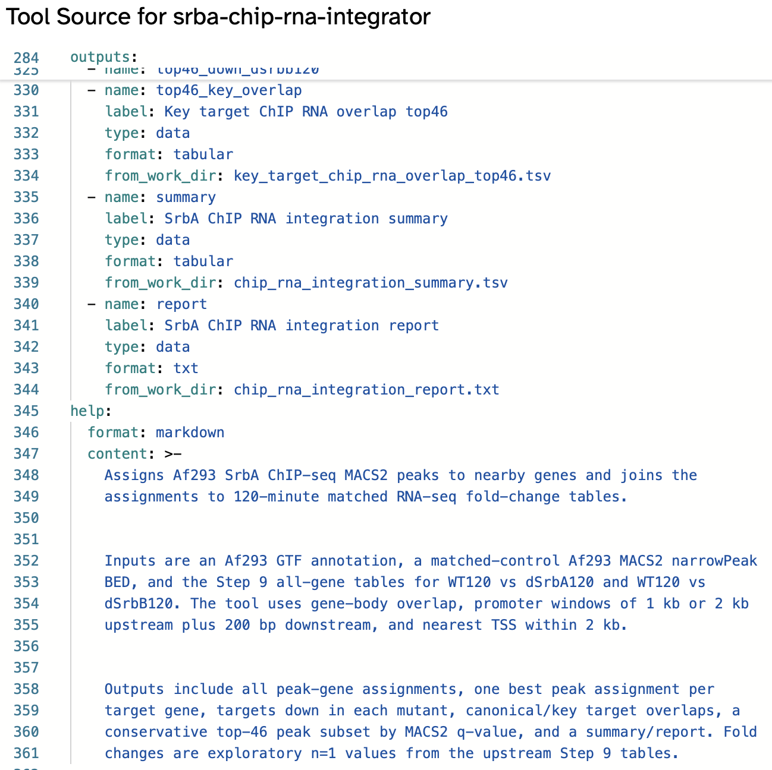
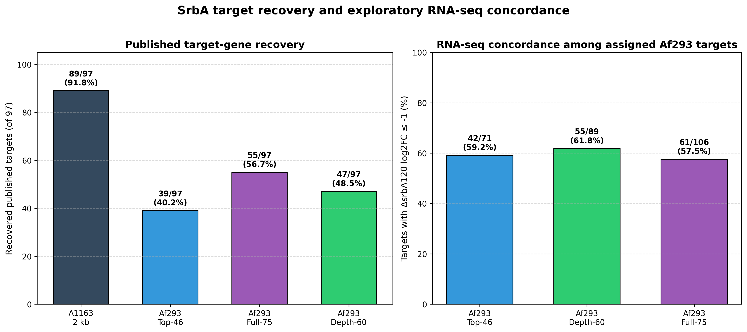
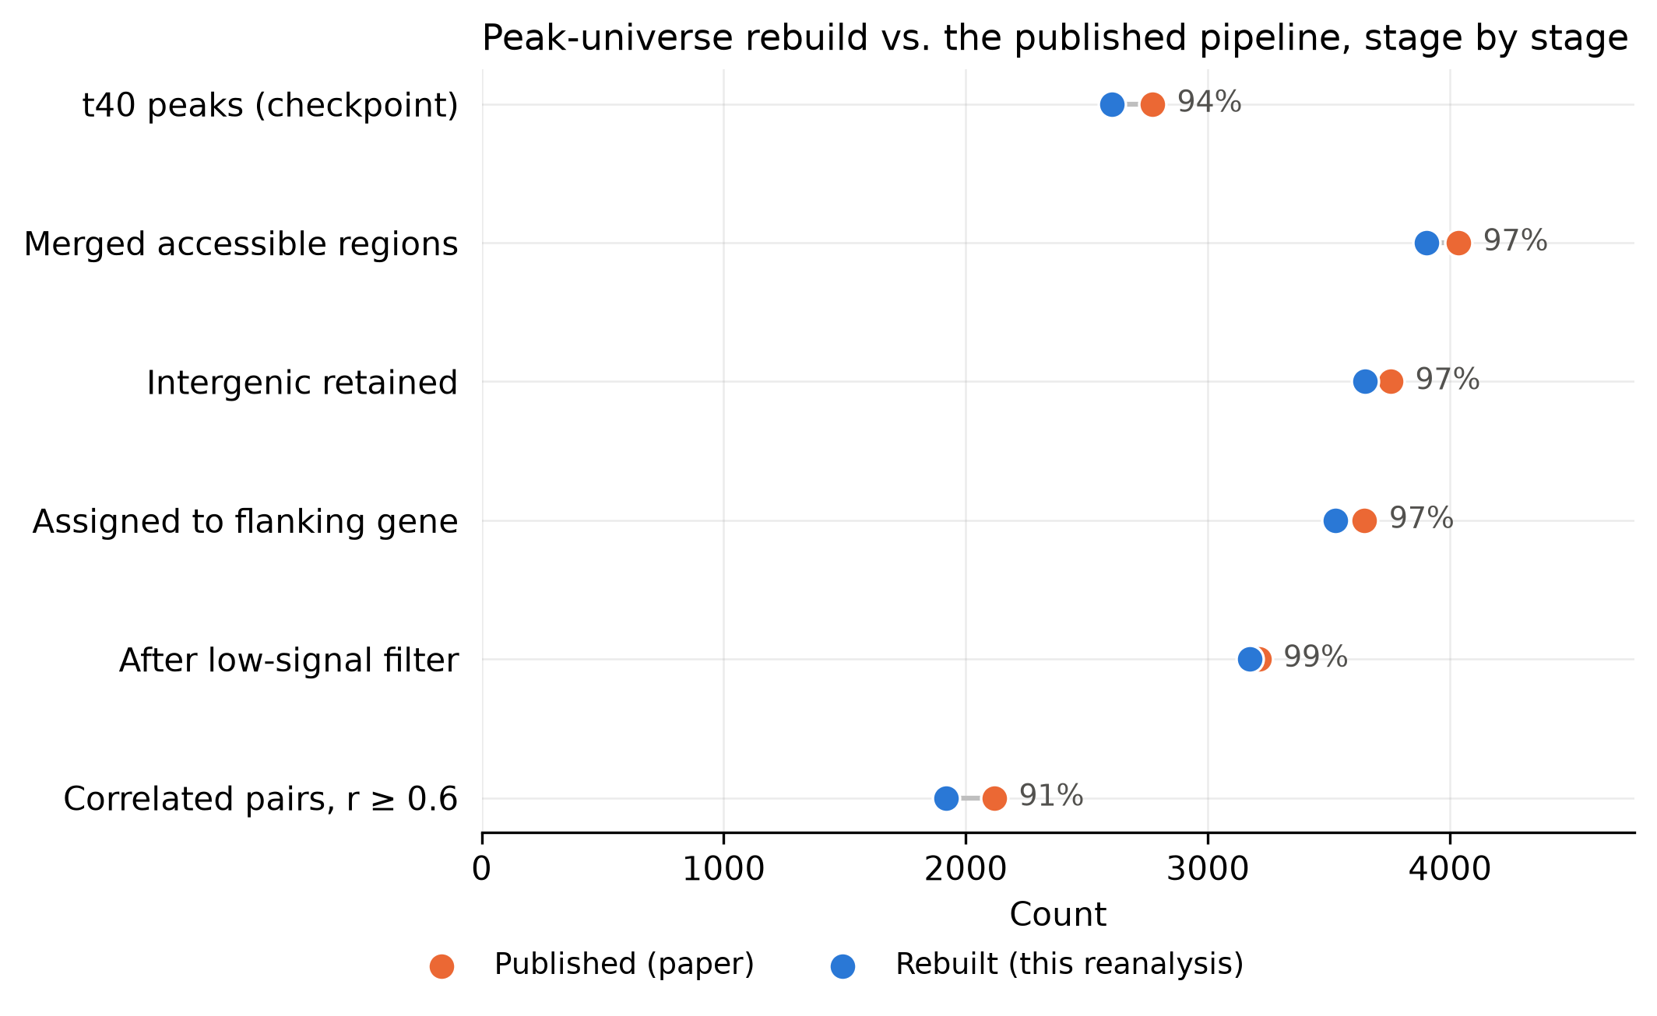
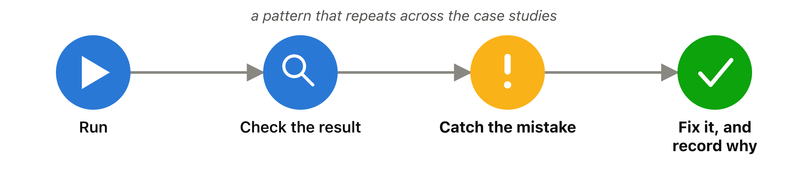
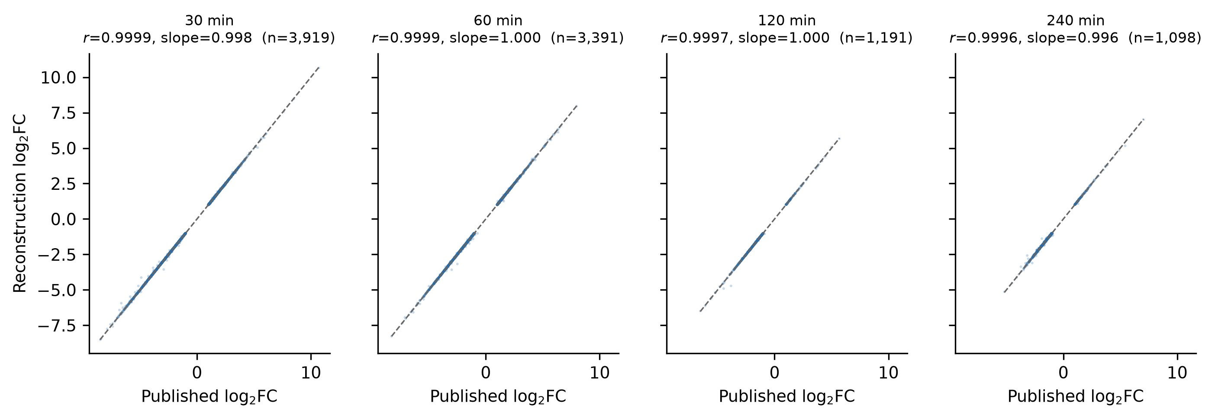
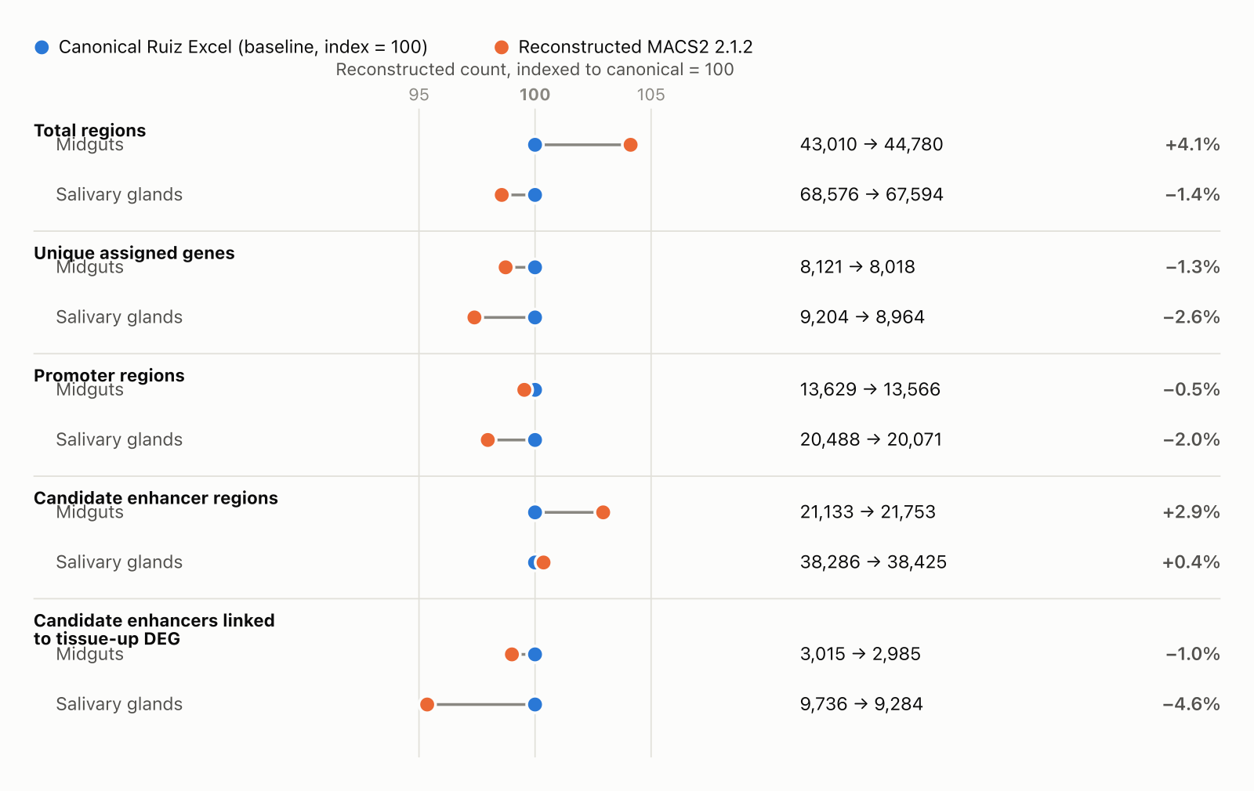
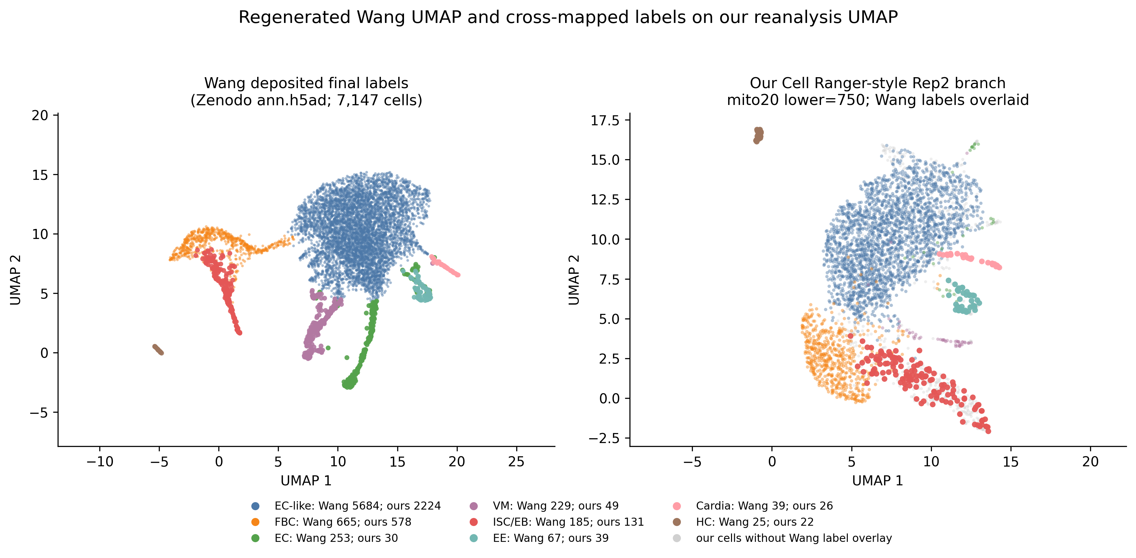
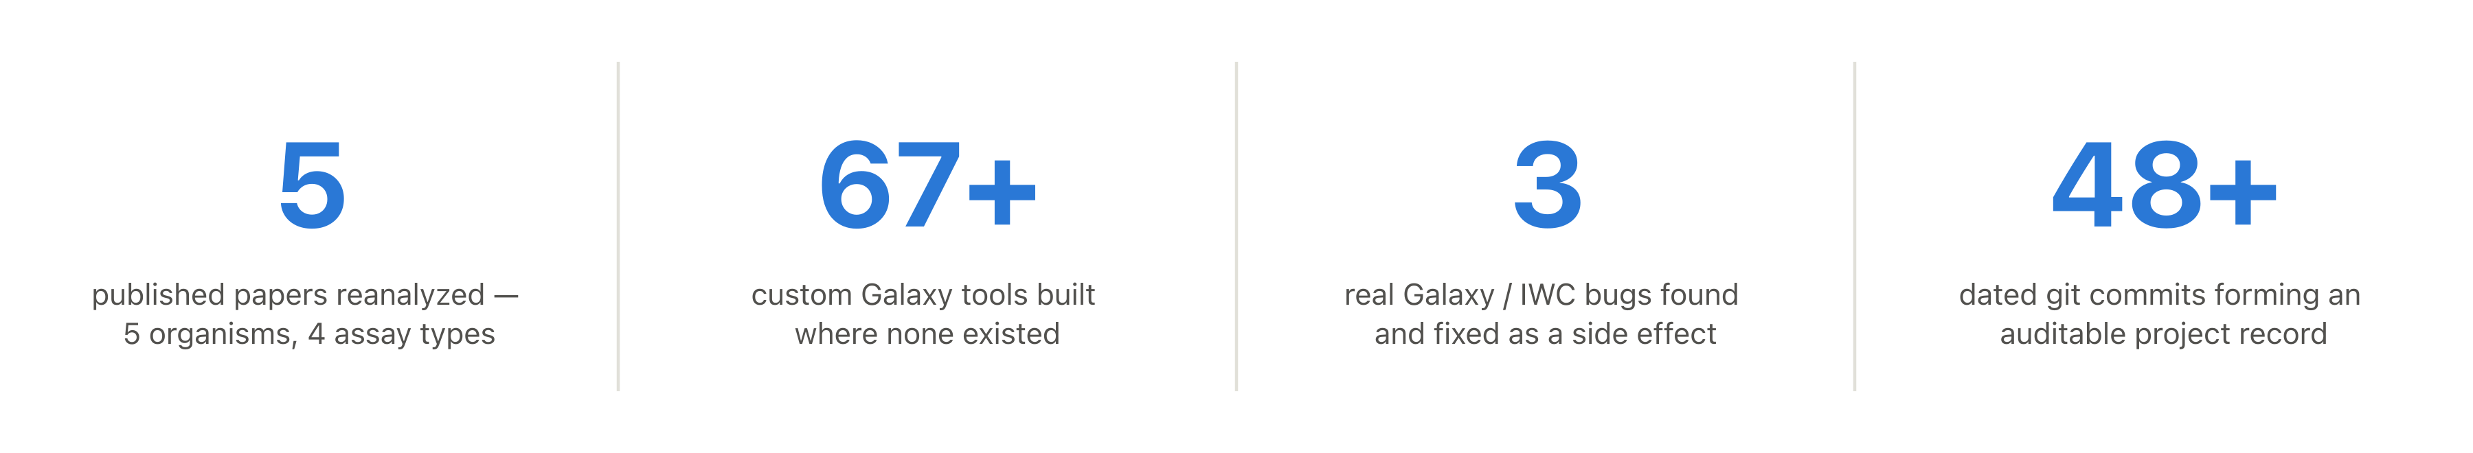

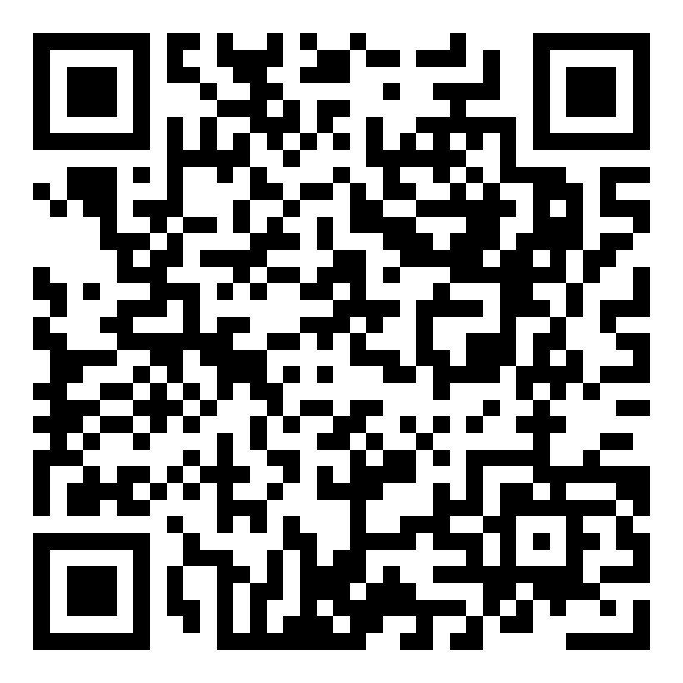
Orbit and Galaxy User-Defined Tools for
Reproducible, Auditable Computational Biology
Dannon Baker^{1,6}, Scott Cain^{2,6}, Marius van den Beek^{2,6}, John Chilton^{2,6}, Danielle Callan^{2,6}, Steven Weaver³, Nate Coraor^{2,6}, Kelsey Beavers⁴, Michael C. Schatz^{1,6}, Björn Grüning^{5,6,7}, Sergei L. Kosakovsky Pond³, and Anton Nekrutenko^{2,6}
¹Dept. of Biology, Johns Hopkins University ²Dept. of Biochemistry & Molecular Biology, Penn State University ³Institute for Genomics & Evolutionary Medicine, Dept. of Biology, Temple University ⁴Texas Advanced Computing Center, UT Austin ⁵Dept. of Computer Science, University of Freiburg ⁶galaxyproject.org ⁷usegalaxy.eu
Five published genomics papers, reanalyzed end-to-end from raw data with an AI agent (Orbit) orchestrating Galaxy and its User-Defined Tools — and an honest account of what matched, what didn’t, and why.
Biological Data Science, CSHL, November, 2026
Abstract
Computational reproducibility in genomics is often undermined not by the standard steps of an analysis — alignment, peak calling, quantification — but by the manuscript-specific “glue” that connects them: custom filtering, integration, and comparison logic that typically lives in untracked local scripts or notebooks tied to a particular machine's software state. We present a workflow that pairs Orbit, an AI-enabled analysis environment, with Galaxy's User-Defined Tools (UDTs) to keep this custom logic inside Galaxy as biocontainer-packaged jobs running on shared HPC or cloud infrastructure, with every input, parameter, and output captured as Galaxy history provenance. Because each UDT is a versioned container rather than a notebook cell tied to a particular interpreter and library snapshot, these steps stay executable and reproducible long after the original analysis, avoiding the software rot that erodes notebook-based workflows as dependencies drift. We apply this workflow to reproduce two published papers directly from raw sequencing data. Reanalyzing Chung et al. (2014), a ChIP-seq/RNA-seq study defining a 97-gene SrbA regulon in Aspergillus fumigatus, Orbit coordinated reference and workflow discovery through BRC-Analytics and ran eight custom UDTs for RNA-seq contrasts, ChIP/RNA integration, and paper-concordance scoring, surfacing an input-control depth imbalance that had distorted peak calling and recovering 89 of 97 published targets outright — with all but one of the remaining eight traced to a decade of annotation coordinate drift rather than lost ChIP-seq signal. Reanalyzing Toenhake et al. (2018), an ATAC-seq/RNA-seq study in Plasmodium falciparum, UDTs handled chromosome renaming in GTF, alignment filtering, and peak-to-gene integration, recovering 94–96% of the paper's published correlated gene-peak pairs against the authors' deposited peak universe. In both cases, routing custom analysis through UDTs — including logic authored and orchestrated by Orbit itself — converted manuscript-specific glue into shareable, containerized Galaxy histories with full job-level provenance. This shows that AI-assisted analysis need not come at the cost of reproducibility or durability: captured as versioned, rerunnable jobs on shared infrastructure rather than as opaque local scripts or notebooks, AI-agent-driven analysis can be at least as inspectable, reproducible, and long-lived as one written entirely by hand.
How a session runs
Describe the goal
Plain language, in chat
Records it
Notebook.md + git commit
Agent drafts a plan
Checks IWC first
Runs the step
Local/hybrid/Galaxy
You approve (2x)
Nothing runs until you say
An example UDT that assigns SrbA ChIP-seq peaks to genes and merges them with matched RNA-seq fold-change data in a single run, replacing what would otherwise be a multi-step manual join.
Orbit, in an actual session — files, chat/plan, and notebook panes
Nothing executes, and nothing is written to the record, until the user approves it — twice.
Aspergillus fumigatus · ChIP-seq — Chung et al. 2014
Plasmodium falciparum · ATAC-seq + RNA-seq — Toenhake et al. 2018
Recovery of the paper's 97 published SrbA target genes (left) and RNA-seq concordance among Af293-assigned targets (right), across four peak-calling designs.
Peak-universe rebuild vs. the published pipeline, stage by stage — published counts (orange) vs. this reanalysis (blue), with percent match labeled at each step.
• 8 custom Galaxy UDTs ran the manuscript-specific steps: RNA-seq contrasts, ChIP/RNA integration, and paper-concordance scoring.
• A depth imbalance between input controls — easy to miss in a notebook — surfaced as an inspectable Galaxy job and was corrected.
• 89 of 97 published SrbA target genes recovered outright; all but one of the rest traced to a decade of annotation coordinate drift, not lost signal.
• UDTs handled chromosome renaming, alignment filtering, and peak-to-gene integration — across two genome annotation releases, run side by side on purpose.
• 94–96% of the paper’s correlated gene–peak pairs recovered using the authors’ deposited peaks; 91% recall / 96% precision rebuilding the peak universe from raw reads alone.
• An apparent 4× shortfall turned out to be a smoke-test tool mistaken for a peak caller — not a flaw in the published method.
Caught its own mistake: a “verified” tool link meant nothing — re-audited by exporting the real UDT definitions.
Declared the paper “irreproducible,” then found its own placeholder peak-caller — a named, versioned UDT — and reversed the verdict in 24 hours.
A. fumigatus RNA-seq — Hokken 2018
An. gambiae ATAC-seq — Ruiz 2021
Ae. aegypti single-cell — Wang 2024
Reanalysis log2FC vs. the paper's log2FC at each timepoint (r, slope shown); dashed line is y = x.
Canonical (paper) vs. independently reconstructed region counts, across five regulatory summaries.
Left: UMAP from Wang et al.'s deposited labels. Right: this reanalysis's UMAP with those labels cross-mapped onto matching barcodes.
• DEG counts initially missed the paper by 31–56% at later timepoints — traced to a modeling choice, not bad data.
• Fixed to within 2.4% of published counts; AspGD’s retirement replaced with custom GO-enrichment UDTs.
• Checked its own workflow design against the IWC registry — and overturned its own earlier assumption when the evidence didn’t support it.
• One UDT failed three different ways in a single afternoon — each diagnosed and fixed, logged by version.
• Peak coordinates reproduced with zero free parameters (92%); published peak counts did not — and the project says so plainly.
• Pre-registered a blind cross-tissue validation test rather than trust a fitted parameter — and reported “inconclusive” when that was the honest answer.
• Reanalysis filed 3 real upstream Galaxy / IWC bugs and contributed 3 reusable Skills — benefits beyond this one paper.
• A background process once silently erased notebook entries — recovered from the raw activity log two months later.
• Built a Cell Ranger-style reference for a mosquito genome Galaxy had no recipe for — down to fixing non-standard mitochondrial gene naming.
AI-assisted analysis doesn’t have to trade away reproducibility.
Captured as versioned, auditable Galaxy jobs rather than opaque local scripts, it can be at least as inspectable and durable as analysis written entirely by hand.
Learn about Orbit
galaxyproject.org/agents/orbit
Join the UDT beta
udt-signup.galaxyproject.org

