Slide 1
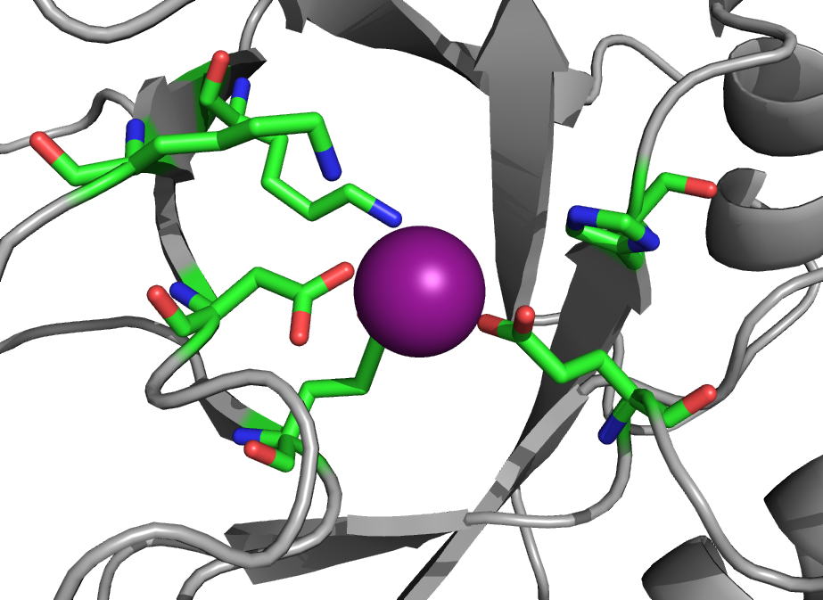
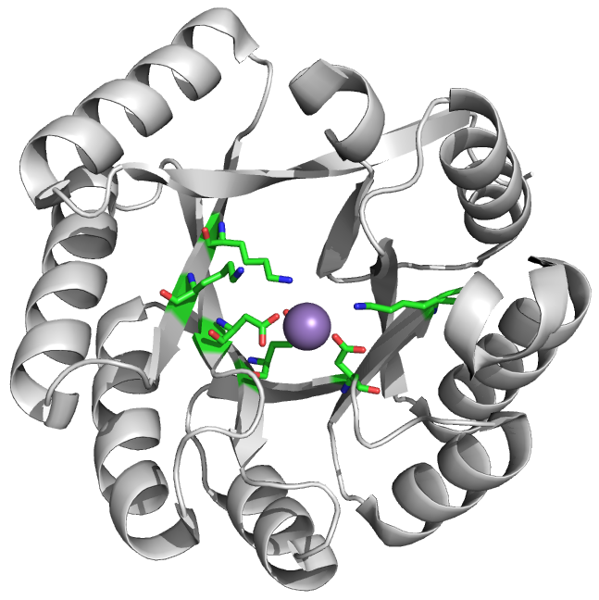
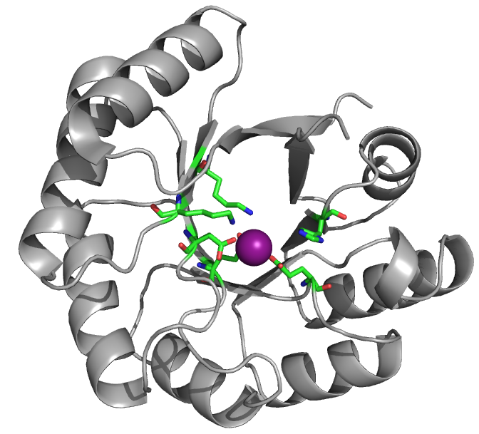
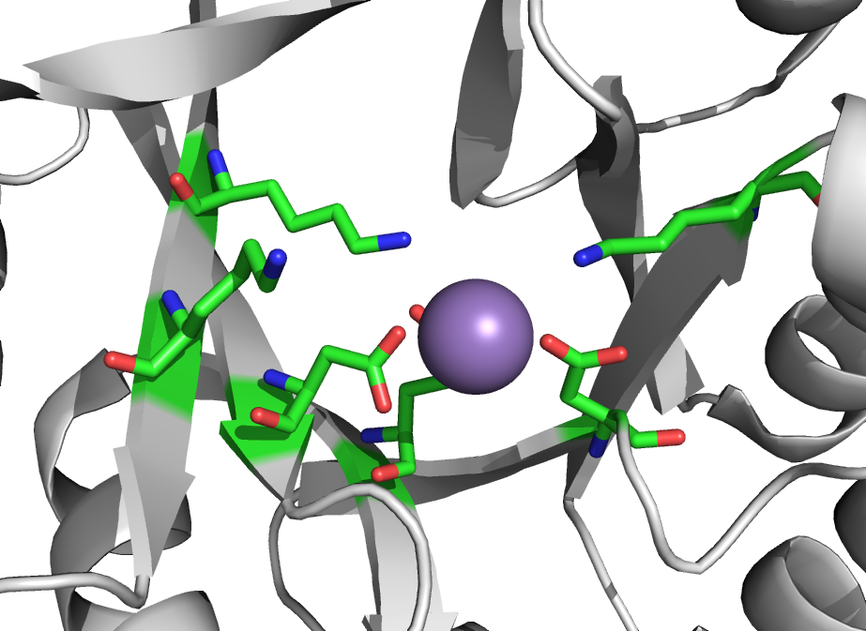
Mandelate racemase and muconate lactonizing enzyme
Mandelate racemase (2mnr)
EC 5.1.2.2
Fold: TIM-Barrel
Muconate lactonizing enzyme (1muc)
EC 5.5.1.1
Fold: TIM-Barrel
Same structure, different functions, but similar chemical mechanism

Slide 2
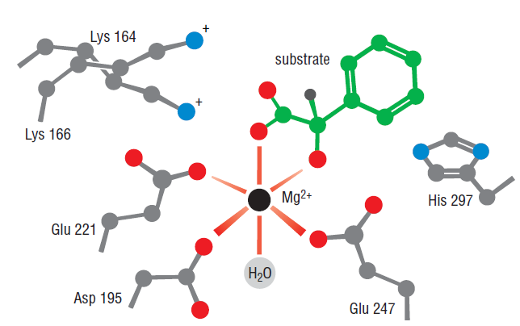
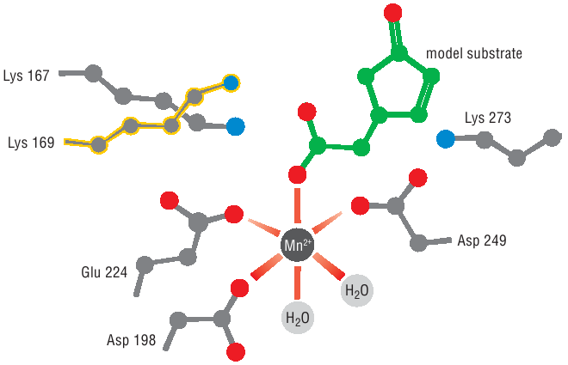
Active site of the enzyme
Mandelate racemase (2mnr)
Muconate lactonizing enzyme (1muc)

Slide 3
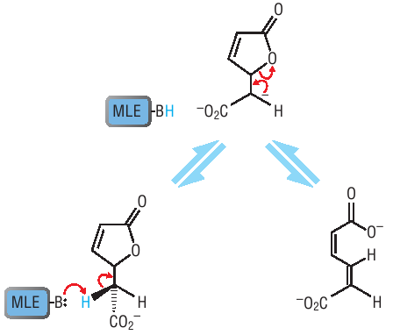
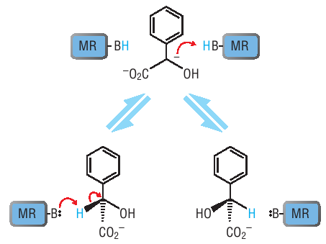
Multi-step biochemical reactions through elementary chemical function
Although the substrates are different, the core step in the catalytic mechanism is similar

Slide 4
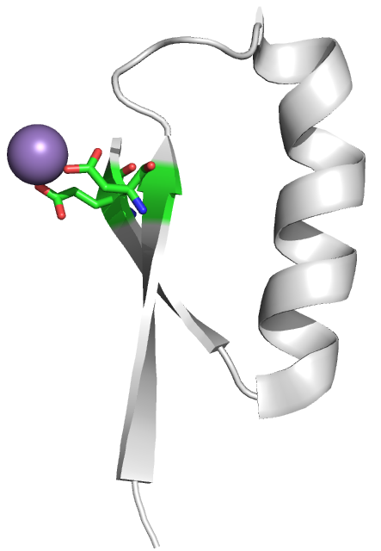
Units of elementary function
Many multi-step biochemical reactions share common steps where the same elementary function is performed
What is the unit of the elementary function?

