Slide 1
Sound Waves and Ultrasound

Slide 2
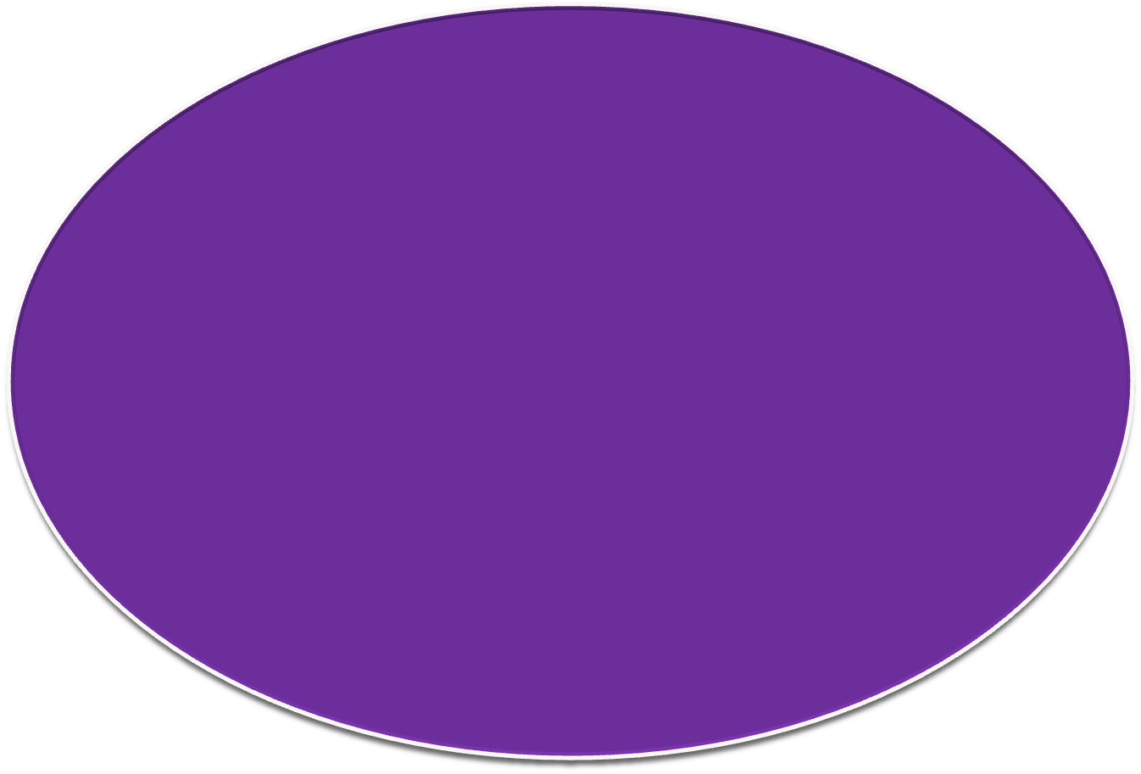
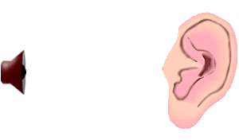

Slide 3
Sound Waves
Sound waves are mechanical
Require a medium for transmission
Sound is formed by the vibration or movement of air or liquid.
When a sound is made the vibrations make the surrounding particles in the air or liquid vibrate.
The sound makes the molecules compress and expand and bump into each other.
Sound waves with frequencies in the range of human hearing, i.e. 20 Hz to 20KHz.

Slide 4



Sound waves and ultrasound waves follow the rules of propagation and reflection similar to those that govern light waves in that they can be
Reflection- to throw back the sound wave at the interface of two materials.
Refraction- to bend the sound wave at the interface of two materials, i.e. the waves are transmitted.
Absorption- attenuation of a sound wave by “relaxation” or frictional processes in the medium that convert acoustic energy to heat, i.e. some portion of the waves in not transmitted.

Slide 5
Speed Of Sound
Depends upon the compressibility of material.
v is the speed of sound in the medium, λ is the wavelength, and f is the frequency of the wave (i.e., 1/T)
v = f λ or
c = f λ
Speed is low in air, higher in soft tissue and highest in bone;
air(331 m/s)< soft tissue(1540 m/s)< bone(3360 m/s) .

Slide 6
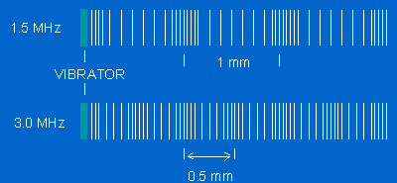
Ultrasound Frequency
The wavelength of ultrasound for diagnostic purposes should be on the order of 1mm or less.
The wavelength of sound decreases as frequency(MHz) increases.
Diagnostic imaging typically uses frequencies between 20 KHz to 1 MHz.

Slide 7
Formation Of Ultrasound Waves
Ultrasound waves are generated by electrically vibrating a transducer.
  - like piston in a water
The wave length of ultrasound wave is distance between two bands of compression and rarefaction.

Slide 8
1. Characteristics of Sound
Frequency
Frequency (f) is the number of times the wave oscillates through a cycle each second (sec) (Hertz: Hz or cycles/sec)
  Infra sound < 15 Hz
  Audible sound ~ 15 Hz - 20 kHz
  Ultrasound > 20 kHz; for medical usage typically 2-10 MHz with specialized ultrasound applications up to 50 MHz
period (τ) - the time duration of one wave cycle: τ = 1/f

Slide 9
1. Characteristics of Sound
Speed
The speed or velocity of sound is the distance traveled by the wave per unit time and is equal to the wavelength divided by the period (1/f)
  speed = wavelength / period
  speed = wavelength x frequency
  c = λf
  c [m/sec] = λ [m] * f [1/sec]
Speed of sound is dependent on the propagation medium and varies widely in different materials

Slide 10
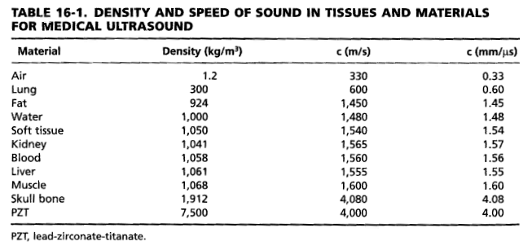
1. Characteristics of Sound
Speed
←
←
←
←
←
←
A highly compressible medium such as air, has a low speed of sound, while a less compressible medium such as bone has a higher speed of sound
The difference in the speed of sound at tissue boundaries is a fundamental cause of contrast in an ultrasound image
c.f. Bushberg, et al. The Essential Physics of Medical Imaging, 2nd ed., p. 472.

Slide 11
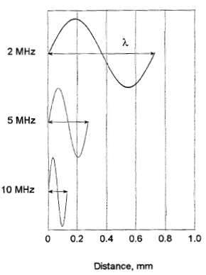
1. Characteristics of Sound
Wavelength, Frequency and Speed
The ultrasound frequency is unaffected by changes in sound speed as the acoustic beam propagates through various media
Thus, the ultrasound wavelength is dependent on the medium (c = λf )
A change in speed at an interface between two media causes a change in wavelength
Higher frequency sound has shorter wavelength
c.f. Bushberg, et al. The Essential Physics of Medical Imaging, 2nd ed., p. 472.

Slide 12
Frequencies
  Ultrasound – Greater then 20000 Hz
  Infrasound – Less than 20 Hz
  Therapeutic ultrasound – 0.5 to 5MHz
    1 to 3 M Hz

Slide 13
The HC-SR04 Ultrasonic Distance Sensor
The HC-SR04 Ultrasonic Distance Sensor is an inexpensive device that is very useful for robotics and test equipment projects. This tiny sensor is capable of measuring the distance between itself and the nearest solid object, which is really good information to have if you’re trying to avoid driving into a wall!
This ultrasonic distance sensor is capable of measuring distances between 2 cm to 400 cm.
Notes:
The HC-SR04 Ultrasonic Distance Sensor
The HC-SR04 Ultrasonic Distance Sensor is an inexpensive device that is very useful for robotics and test equipment projects. This tiny sensor is capable of measuring the distance between itself and the nearest solid object, which is really good information to have if you’re trying to avoid driving into a wall!
The HC-SR04 can be hooked directly to an Arduino or other microcontroller and it operates on 5 volts. It can also be used with the Raspberry Pi, however since the HC-SR04 requires 5-volt logic you’ll need a couple of resistors to interface it with the Pi’s 3.3 volt GPIO port.
This ultrasonic distance sensor is capable of measuring distances between 2 cm to 400 cm (that’s about an inch to 13 feet for those of you who don’t “speak” Metric). It’s a low current device so it’s suitable for battery powered devices. And as a bonus it even looks cool, like a pair of Wall-E Robot eyes for your latest robotic invention!

Slide 14
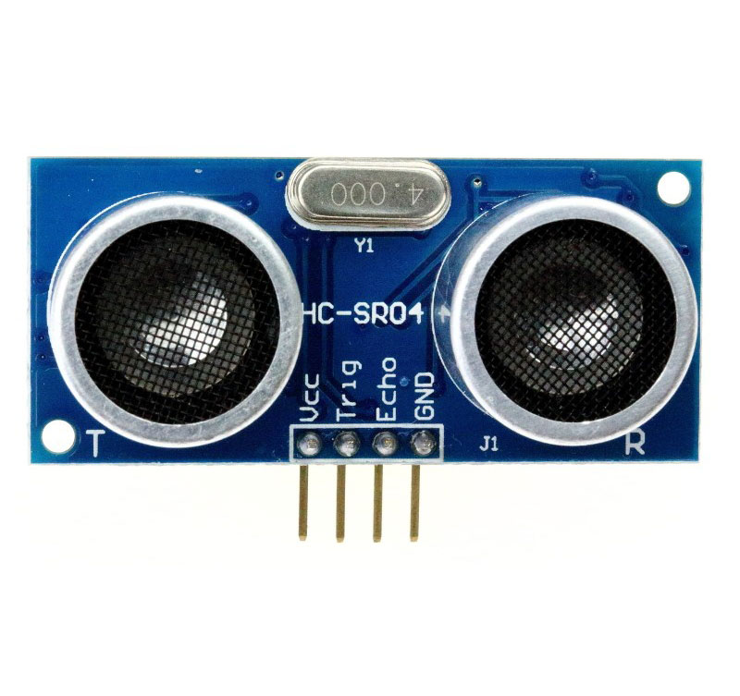

Slide 15
How the HC-SR04 Works
Ultrasonic distance sensors use pulses of ultrasonic sound (sound above the range of human hearing) to detect the distance between them and nearby solid objects. The sensors consist of two main components:
An Ultrasonic Transmitter – This transmits the ultrasonic sound pulses, it operates at 40 KHz
An Ultrasonic Receiver – The receiver listens for the transmitted pulses. If it receives them it produces an output pulse whose width can be used to determine the distance the pulse travelled.

Slide 16
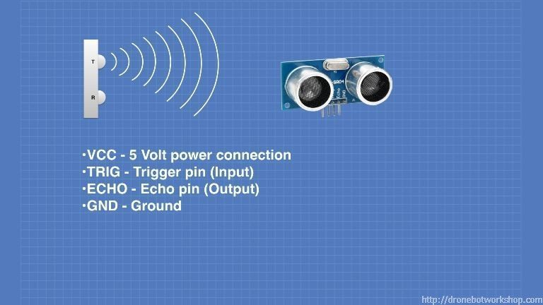

Slide 17
The device operates as follows:
A 5 volt pulse of at least 10 uS (10 microseconds) in duration is applied to the Trigger pin.
The HC-SR04 responds by transmitting a burst of eight pulses at 40 KHz. This 8-pulse pattern makes the “ultrasonic signature” from the device unique, allowing the receiver to discriminate between the transmitted pattern and the ultrasonic background noise.
The eight ultrasonic pulses travel through the air away from the transmitter. Meanwhile the Echo pin goes high to start forming the beginning of the echo-back signal

Slide 18
If the pulse in NOT reflected back then the Echo signal will timeout after 38 mS (38 milliseconds) and return low. This produces a 38 mS pulse that indicates no obstruction within the range of the sensor.
If the pulse IS reflected back the Echo pin goes low when the signal is received. This produces a pulse whose width varies between 150 uS to 25 mS, depending upon the time it took for the signal to be received.
The width of the received pulse is used to calculate the distance to the reflected object. Remember that the pulse indicates the time it took for the signal to be sent out and reflected back so to get the distance you’ll need to divide your result in half.

Slide 19


