Slide 1
TEAM 27 BYTE KARMA
THEME NAME : KARMA SMART METER
MEMBERS : MONIKA RAI (Team Captain) NEKVINDER SINGH
MOHIT NAGAR

Slide 2
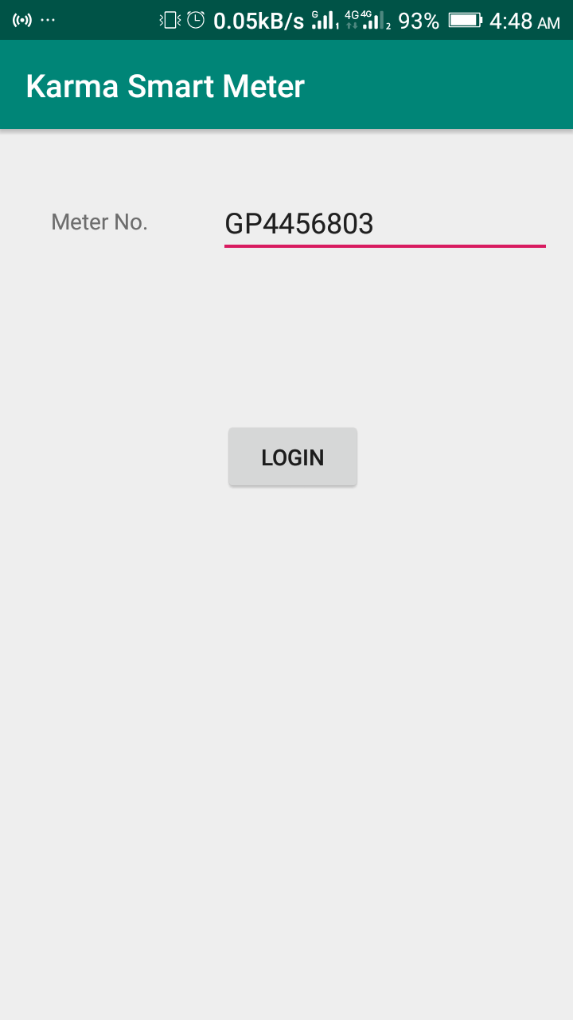
KARMA SMART METER
CLIENT SIDE:-
INTERFACES(Show User Profile)
LOGIN
Login using Meter Number
DATA access from webserver or cached copy from server

Slide 3
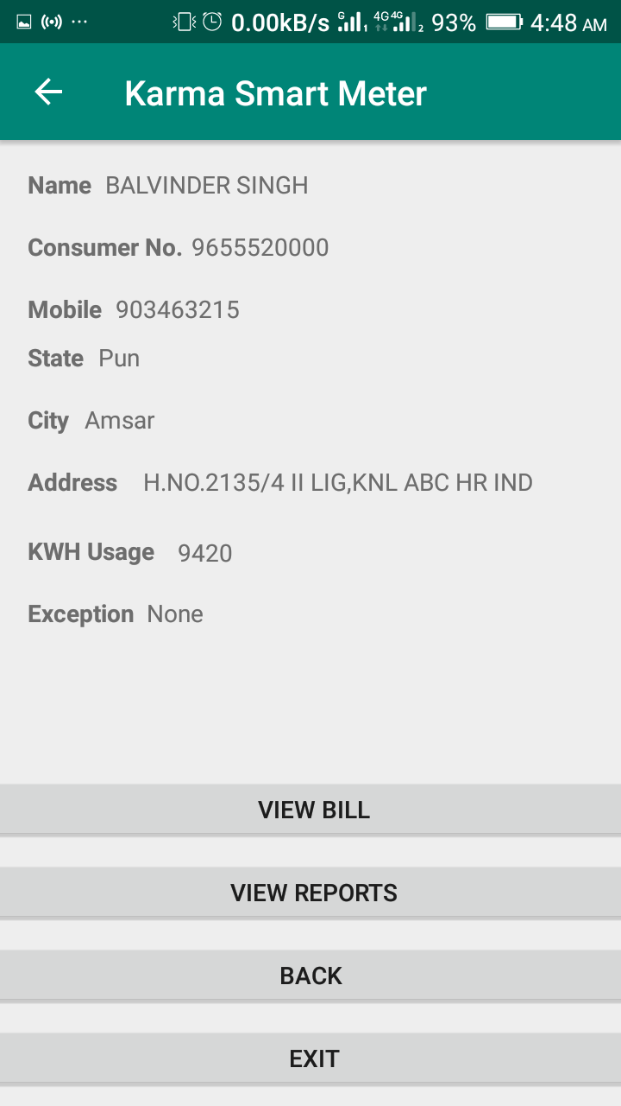
PROFILING : This phase comprise of client sided details such that-
USER PROFILE
USAGE
BILL
PAYMENT PORTALS
User Profile : It contains personal information about user such as Name , Father’s Name , Phone number, Consumer number , State, City, etc.

Slide 4
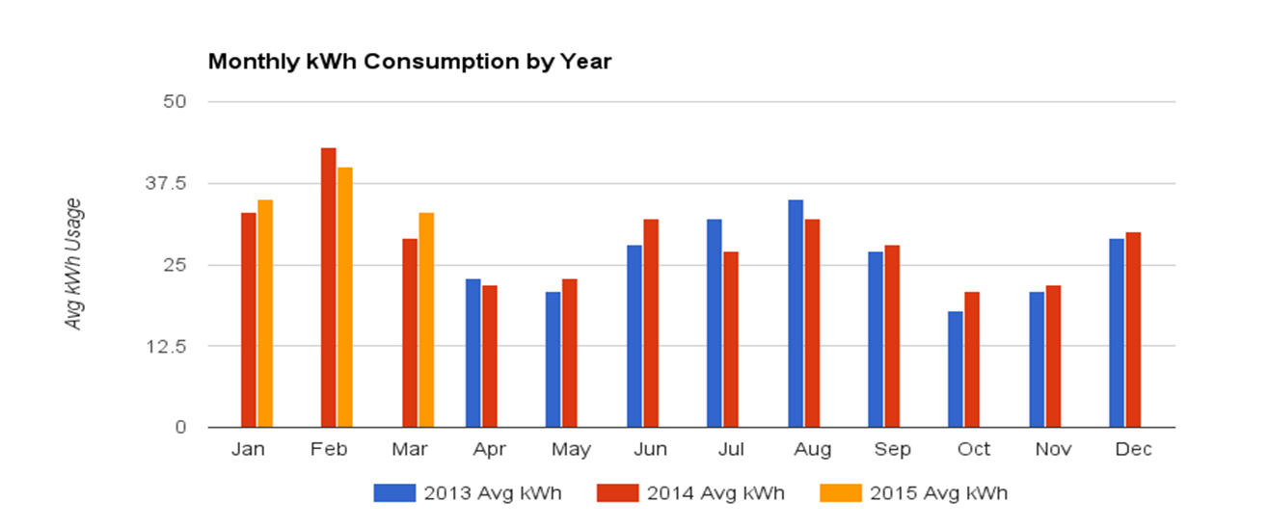
Usage : People use electricity for lighting, heating, cooling, and refrigeration and for operating appliances, computers, electronics, machinery, and public transportation systems.
This whole monthly and yearly usage of electricity is shown by a graph

Slide 5
This above graph represents the average monthly and yearly consumption of electricity. The various year are shown using different colours. At some places the consumption of electricity is very high compared to others there is no specific pattern in the increment and decrement of electricity usage.

Slide 6
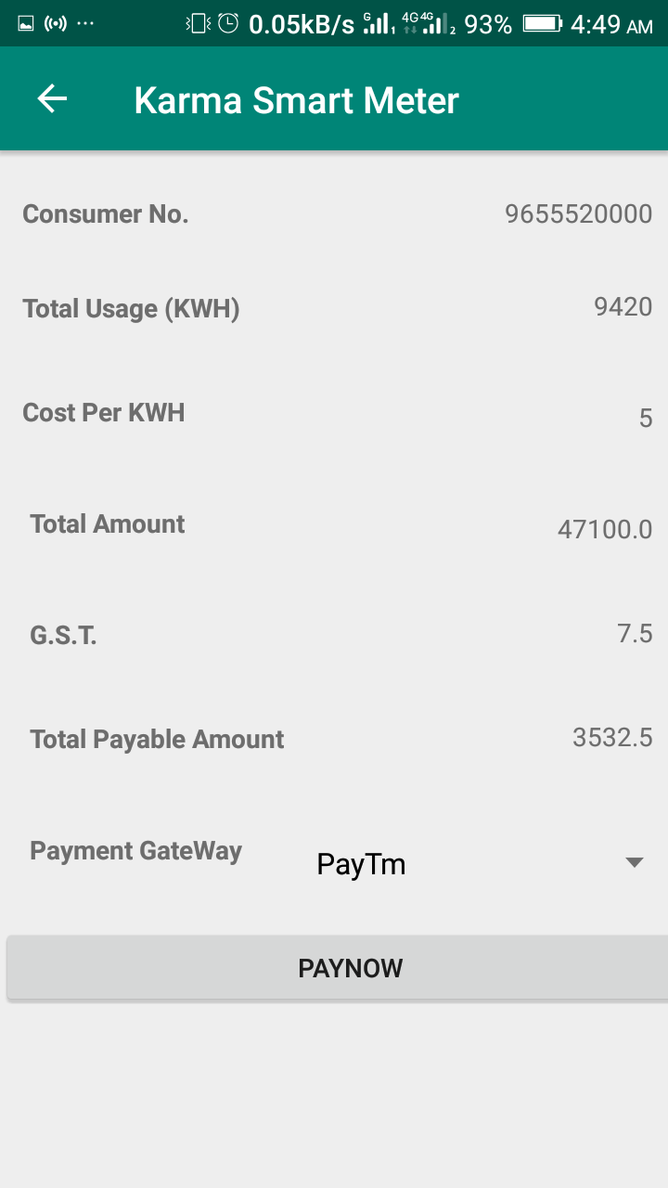
Bill : An itemized statement of money owed for electricity used. To be paid on a assigned date termed as “Due Date”. If you don’t pay your bill till due date additional charges may apply. But this theme provide us a facility of giving warnings to the user 2-3 days before due date.

Slide 7
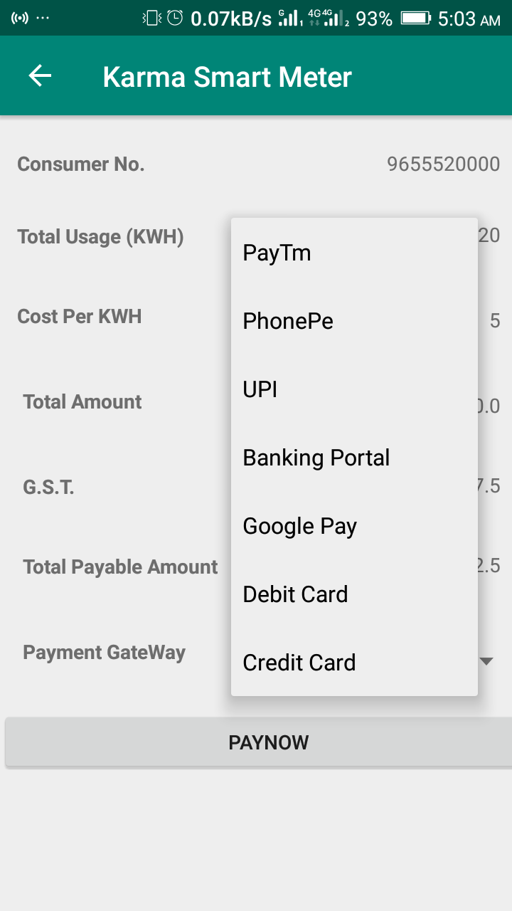
Payment Portals : This facilitates the user with different payment methods such as-
Paytm
PhonePe
BHIM UPI
Google Pay
Debit card
Credit card

Slide 8
REPORT
The following points are discussed here-
Seasonal Comparison : The average electricity usage of winter marks the highest among the four seasons with 1,547 kWh which is followed by summer (1,360 kWh), spring (1,207 kWh) and autumn (1,054 kWh). According to the result of the above simple comparison, the electricity consumed for thermal comfort can be easily estimated.
Day versus Night Comparison : It shows the comparison in the electricity usage of day and night.
Some acronyms like “peak” and “off-peak” are widely used when it comes to electricity.

Slide 9
- An 'off-peak hours' price for 8 hours per day (usually between 10 pm and 6 am, although the actual times are set by the electricity grid operator) - A 'peak hours' price set slightly higher than the base tariff price for the rest of the day.
Early Notifier for Overhead Usage
Prevailing time with low average load to reschedule tasks at times of peak voltage to reduce heavy loads on providers.

Slide 10
NOTIFIER
All notifications generated at the client side are generated from server of providers in order to manipulate the users to use respective schemes. And these manipulations are done in a way so that user feel like he is making his benefit out of that scheme but at the end both providers as well as clients are at the profit side.
The maximum limit ,this limit will be set by user itself which will be the maximum amount of electricity one would probably consume per month. Once this limit is crossed the user will automatically get notified that he has reached his max limit whether he likes to continue or not if yes then they have to pay extra charges for that usage which will be directly included in the bill.
Time of use Tariff : This could be defined as if the demand of the electricity is at its “off peak” usage phase then providers will provide the user to access the electricity at low tariff in limited duration of time in such a manner so that the provider will not face any loss in future.

Slide 11
GOVERNMENT/PROVIDER SIDE:-
DEMAND – RESPONSE :-
The demand and response should be proportional to each other. As the demand rises the response must be increased to fulfil the needs of clients. The imbalance in their ratios led to sudden power cuts.
REDUCE SUDDEN POWER CUTS :-
If the demand and response ratio is maintaining its balanced form then their will be reduction in sudden power cuts.

Slide 12
REDUCE MAN POWER :-
As we start using more smart meter the less we will require man power as the main purpose of smart meter ,the generation of bill which can be fulfilled without any man power.
By reducing the man power, the financial resources consuming factors will also get reduced that can be further utilized in other aspects.
TIME OF USE TARIFF :-
They are providing electricity 24hrs/day but by changing tariff at peak load can gain more benefits.

