Slide 1
Islamophobia Detector
Mohammed Alabdullatif, Nelofer Arjumand, and Emily Sallenback

Slide 2
Motivation: Rise in Islamophobia
The US: Trump’s presidency → rise in Islamophobia
His rhetoric: “I think Islam hates us.” (Trump, 2016)
His policies: the “Muslim ban”

Slide 3
Motivation: Rise in Islamophobia
The US: Trump’s presidency → rise in Islamophobia
His rhetoric: “I think Islam hates us.” (Trump, 2016)
His policies: the “Muslim ban”
Europe: populism → rise in Islamophobia
France: proposed bans on minors wearing a hijab in public

Slide 4
Motivation: Rise in Islamophobia
The US: Trump’s presidency → rise in Islamophobia
His rhetoric: “I think Islam hates us.” (Trump, 2016)
His policies: the “Muslim ban”
Europe: populism → rise in Islamophobia
France: proposed bans on minors wearing a hijab in public
Worldwide: Protests against the Iranian gov’t → Islamophobia
People wrongly equate the oppressive gov’t with Islam

Slide 5
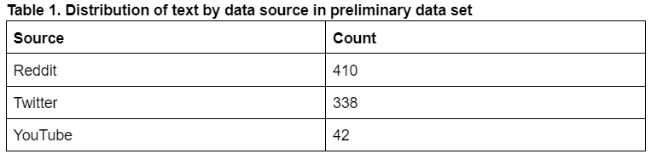
Data Collection
Data was collected from three sources: Twitter, Reddit, and YouTube
Twitter & Reddit data were collected programmatically; YouTube was collected manually
The data set is imbalanced: only 17% of the data is Islamophobic
Most Islamophobia was from Reddit

Slide 6
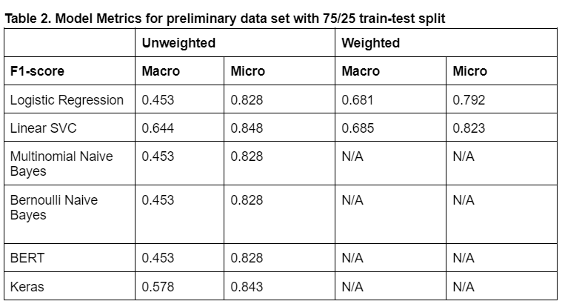
Model Selection

Slide 7
Model Selection

Slide 8
Model Selection
Notes:
Other models labeled everything not islmaphobic

Slide 9
Demo
Python Flask website hosted locally
Linear SVC model trained over the whole data set (N=1000)
Prometheus and Grafana to display the data
User can input new data to add to the visualization

Slide 10
Demo
Python Flask website hosted locally
Linear SVC model trained over the final data set (N=1000)
Prometheus and Grafana to display the data
User can input new data to add to the visualization
Time to see!

Slide 11
Conclusion
Islamophobia is hard to detect – Linear SVC does well but still has room for improvement

Slide 12
Conclusion
Islamophobia is hard to detect – Linear SVC does well but still has room for improvement
The data to train is hard to find because the platforms already effectively remove hate speech
Weighting helps mitigate the imbalanced data set problem

Slide 13
Conclusion
Islamophobia is hard to detect – Linear SVC does well but still has room for improvement
The data to train is hard to find because the platforms already effectively remove hate speech
Weighting helps mitigate the imbalanced data set problem
Instances of sarcasm confuse the model
Sarcastic use of “religion of peace” → model associates “peace” with Islamophobia

