Slide 1

Automated llms.txt Generator
Making a site legible to answer engines
https://llms-txt-nela-taeb.vercel.app
Nela Taeb | FDE Candidate
Notes:
Quick framing before I open anything: the take-home asked for a tool that generates an
llms.txt file for a domain and keeps it current. What I built is a deployed Next.js app
that takes a URL, crawls the site, and produces a spec-valid llms.txt, then monitors that
site and re-publishes the file when the content actually changes.
I also went past the spec in two places, because a file that is merely valid is not
necessarily useful: an AI-readiness audit that grades how the domain looks to real answer
engine crawlers, and a retrieval eval that measures whether the generated index can
actually route a question to the right page.
The app is live at the URL on this slide — everything I show is running in production on
Vercel with Neon Postgres behind it.

Slide 2
Agenda
What I'll walk through
01
Problem & the standard
02
Product overview and the core pipeline
03
Beyond spec: audit and retrieval eval
04
Live demo
05
Technical deep dive, component by component
06
Trade-offs and what I'd build next
Notes:
Structure: I'll spend the first few minutes on why llms.txt matters and what the spec
actually requires, then show the product and the pipeline end to end. After the demo I go
component by component — crawl, extract, rank, group, render, validate, monitor, persist —
with the trade-off I made in each one. I'll close on what I would build next if this were
a real product rather than a take-home.
If you want to interrupt at any point, please do — the deep-dive slides are independent,
so we can spend the time wherever it's most useful for you.

Slide 3
The Problem
AI answers are the new front page
Discovery moved
HTML is hostile to agents
Answer engines reply instead of returning ten links.
Nav, banners and JS shells bury the content.
Context budgets are small
Hand-authoring doesn't scale
A crawler reads a fraction of a site, if any.
Someone must curate — and re-curate on every change.
Notes:
The reason this file exists at all: for a growing share of queries, nobody sees a results
page any more. ChatGPT, Perplexity and Google's AI surfaces read a handful of sources and
synthesise an answer, and if the model can't cheaply read your site, your brand is simply
absent from that answer. That's exactly the visibility problem Profound sells into.
Why is a website hard to read? A marketing page is mostly navigation, cookie banners,
tracking scripts and client-rendered shells. An agent with a limited context window burns
most of it on markup before it reaches the paragraph that mattered — and on a
client-rendered SPA it may extract nothing at all.
llms.txt is the proposed fix, and the analogy is robots.txt: one file at a well-known path
that tells an agent where to look. The difference is that robots.txt is exclusion and
llms.txt is curation — you have to choose the right pages and describe them well.
And that curation is the actual work. A docs site with a few hundred pages needs someone
to pick which ones matter, write a one-line summary for each, and then keep that in sync
every time docs, pricing or product pages ship. That's what I automated.

Slide 4
The Standard
What llms.txt has to look like
H1 — required
# Profound
> AI search visibility platform.
## Documentation
- [Quickstart](/docs/quickstart): first crawl
- [API](/docs/api): REST endpoints
## Optional
- [Privacy](/legal/privacy): policy
one title, first line
Blockquote — summary
what the site is, in a sentence
H2 sections of link lists
[title](url): note
Optional — the escape hatch
safe to skip under context pressure
markdown, /llms.txt, one H1 — validated on every render
Notes:
The spec at llmstxt.org is deliberately small, which is why it's easy to produce something
that looks right and is actually invalid. The shape: exactly one H1 with the site name; an
optional blockquote that summarises the site; then free-form detail; then H2 sections,
each of which is a markdown list of links, each link optionally followed by a colon and a
short note.
Two details drive most of my design. First, the notes matter more than the links — the
note is the only signal an agent has for choosing between two plausible pages, so a bad
description is worse than a missing page. Second, the trailing "Optional" section is the
spec's explicit escape hatch: anything an agent can safely skip when it's short on context
goes there. I use it for legal pages and for the overflow beyond my link budget.
There's also llms-full.txt, which inlines page content rather than linking to it. I
generate it on request, but it's a different trade: complete, but far too big for most
context windows.

Slide 5
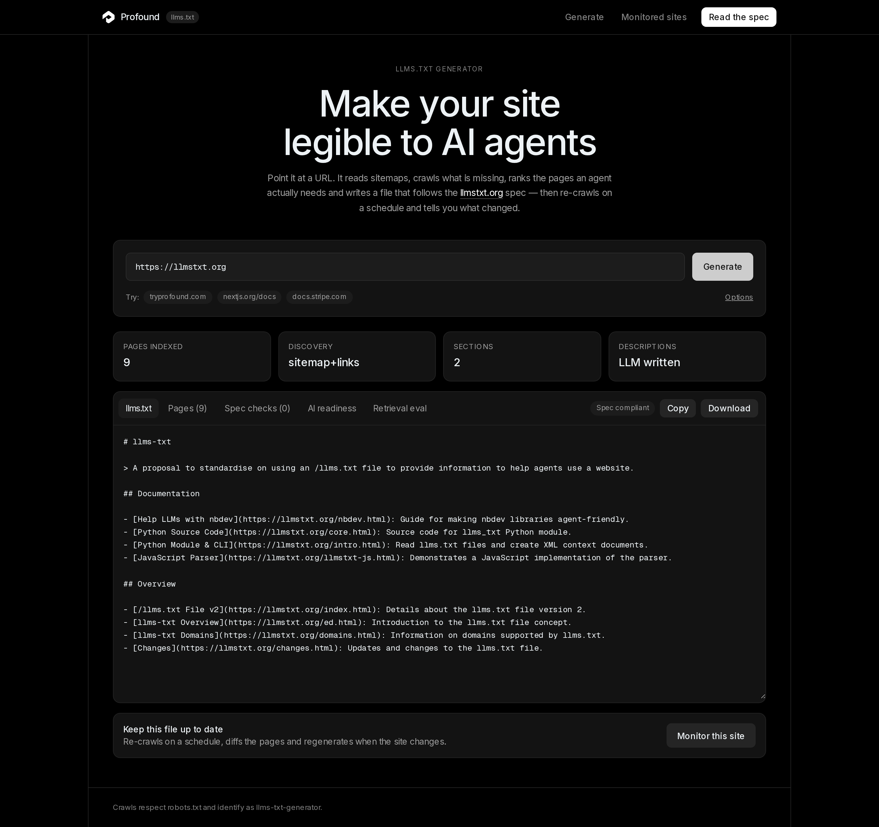
Product Overview
Paste a URL, get a maintained file
Generate
crawl → rank → sections → llms.txt
Validate
graded against the spec, in the UI
Monitor
daily re-crawl, page-level diffs
Serve
/s/{siteId}/llms.txt, text/plain
tryprofound.com — crawled, grouped, spec compliant
Notes:
The product surface is deliberately one input. You paste a domain, and within about a
minute you have a spec-valid llms.txt, a validation report next to it, and — if you tick
monitoring — a permanent URL that always serves the current version of that file.
Four verbs. Generate is the pipeline I'll show next. Validate re-parses the rendered text
and grades it, so the score describes the exact bytes a consumer would download rather
than the builder's intentions. Monitor re-crawls on a daily cron and diffs page by page.
Serve exposes the latest snapshot at a stable URL, as text/plain, so a customer can proxy
it from their own domain without redeploying anything.
Worth saying explicitly: no database and no API key are required to run it. Without
DATABASE_URL it falls back to an in-memory store, and without an OpenAI key the
heuristics produce the whole file. The LLM only improves wording.

Slide 6
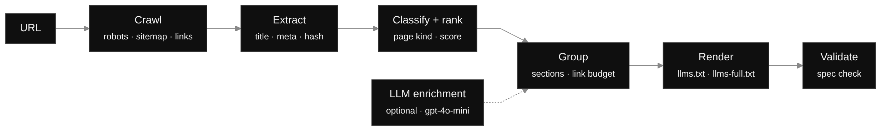
How it works
The core pipeline
Every stage is a pure function over serializable state.
A crawl can pause, persist and resume across serverless requests.
Notes:
Left to right: a URL comes in; the crawler resolves robots.txt and sitemaps and collects
pages; extraction pulls title, description, canonical, links and a content hash out of
each one; classification assigns a page kind and a score; grouping turns the ranked list
into sections under a link budget; rendering emits the markdown; validation re-parses it.
The important property is the one written at the bottom: each stage is a pure function
from serializable state to serializable state. That isn't architectural purity for its
own sake — it's what makes the crawl survive a serverless platform. Any stage can stop
mid-way, be written to Postgres, and picked up by a different Lambda invocation.
LLM enrichment hangs off the side deliberately. It sees only the pages the crawler already
found and can rewrite titles, section names and descriptions — it never contributes a URL,
so it cannot hallucinate a page into the file. If the key is missing, the deterministic
path still produces a valid document.

Slide 7
Beyond the spec
Two features the brief didn't ask for
AI-readiness audit
Retrieval eval
Six real bot probes, cloaking detection, weighted checks → an A–F grade with a fix per failure.
Two LLMs, eight questions: can an agent holding only the file reach the right page?
valid ≠ reachable
valid ≠ useful
both are numbers, not opinions
Notes:
The brief asked for generation plus automated updates. I added two things because the
obvious question after "is the file valid?" is "does it do anything?", and validity
answers neither of the two ways this fails in the real world.
First failure mode: the file is perfect but the crawler never gets to read it — robots.txt
blocks GPTBot, or a WAF serves a challenge page to anything that isn't a browser. The
audit tests that directly by fetching the site as each named bot and comparing what came
back with a browser-like baseline, so it catches cloaking that a normal crawl never sees.
Second failure mode: the file is fetched and parsed, but the descriptions are so generic
that the agent picks the wrong link. The retrieval eval quantifies that with a
writer/reader pair — I'll show the mechanics later.
Both were also chosen because they're the questions Profound's customers ask: why am I
invisible in AI answers, and what do I change first.

Slide 8
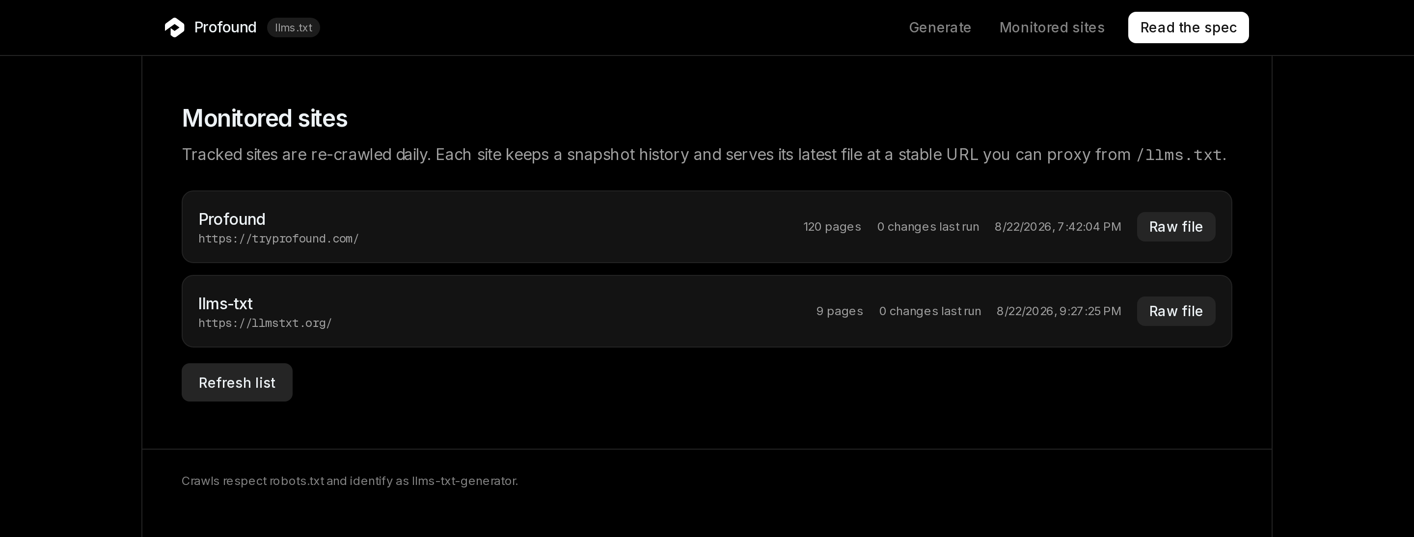
Live Demo
What I'll show
1 — Generate
paste a domain, watch slices progress
2 — Inspect
sections, notes, validation report
3 — Monitor
track, refresh, page-level diff
tracked sites, last check, served file URL
4 — Audit + eval
grade the domain, score the file
https://llms-txt-nela-taeb.vercel.app
Notes:
Demo script, in case I lose the network and have to talk through screenshots.
One: paste tryprofound.com and hit generate. Progress ticks in slices rather than sitting
on a spinner, because each slice is its own request — that's the serverless constraint
showing through in the UX, and it's a feature: you can see how far it got.
Two: the result. Sections come from page kind, the ordering comes from the ranking score,
and each link has a note. Next to it, the validation panel grades the exact rendered text.
Three: tick monitoring and hit refresh. If nothing changed, you get "no changes" and no
snapshot is written; if something changed, you get a page-level diff — added, removed,
edited — and a new snapshot. The file URL underneath is stable across all of that.
Four: run the audit and the retrieval eval on the same result, which is the natural
segue into the two deep-dive slides later.

Slide 9
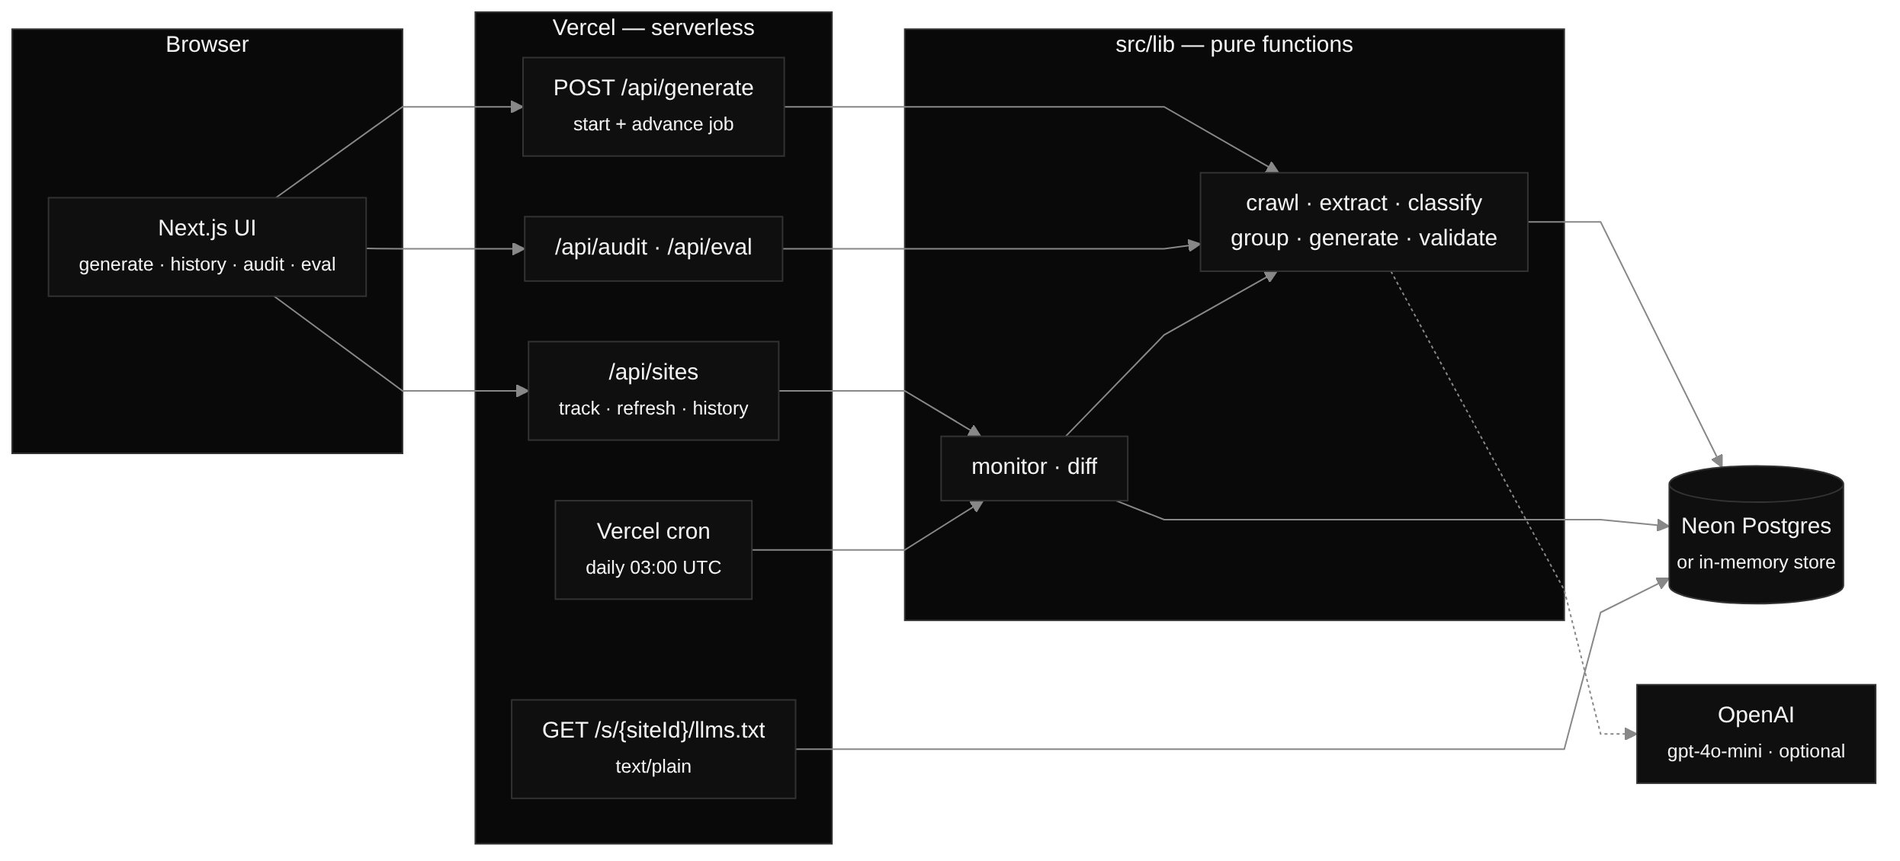
Technical Deep Dive
System architecture
Next.js 15 · TypeScript · Vercel functions + cron · Neon Postgres · Vitest
Notes:
The whole thing is one Next.js 15 app on Vercel. Route handlers are thin: parse and
validate input with Zod, call a library function, return JSON. All the logic lives in
src/lib as plain TypeScript functions with no framework or platform imports, which is why
it's straightforward to unit test — the test suite never boots a server.
Three entry points into the same pipeline. /api/generate starts and advances a job.
/api/sites tracks, refreshes and lists history. /api/audit and /api/eval run the two
beyond-spec features against an existing result. The cron endpoint calls the same
refreshSite() the manual button does, so there's exactly one refresh code path.
Persistence is behind a Store interface with two implementations: Neon Postgres in
production, in-memory for local and for CI. And GET /s/{siteId}/llms.txt reads the latest
snapshot straight from the store, so serving is a database read rather than a crawl.
The dotted edge is the OpenAI call — optional, and only ever enrichment.

Slide 10
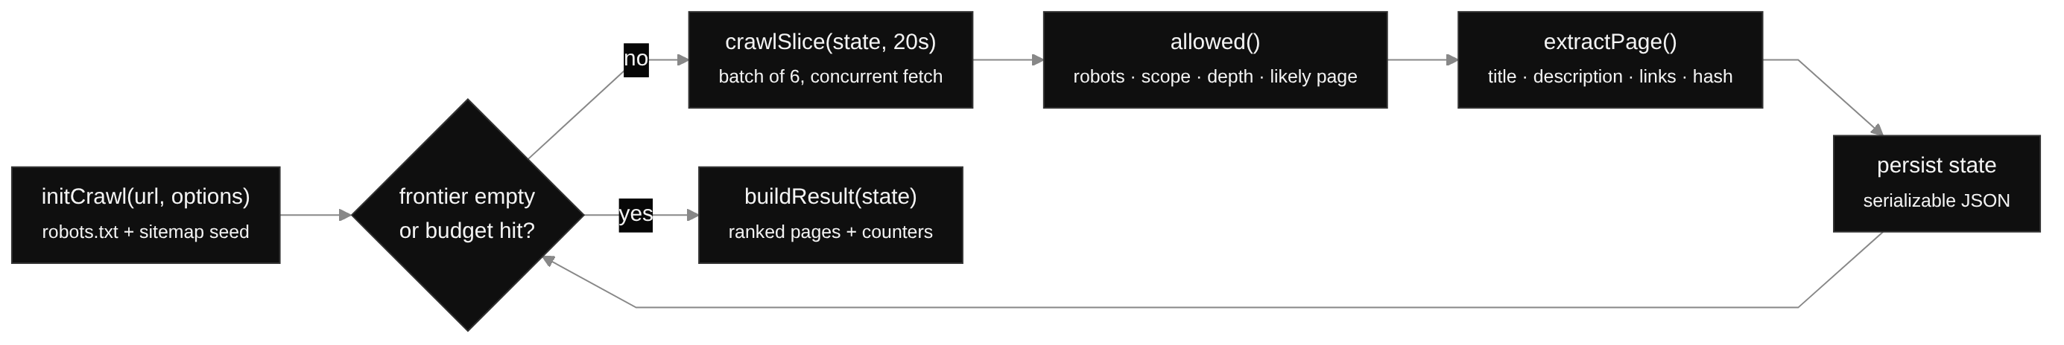
Deep Dive — Crawl
Slice-based, resumable crawling
Sitemap first, links as fallback
Polite and bounded
links still supply nav + inbound signals
crawl-delay ≤ 2s, concurrency 6, 120 pages
Trade-off more state to serialize, but the crawl never dies at the serverless timeout.
Notes:
The constraint that shaped this component: a Vercel function has a hard execution limit,
and crawling a hundred pages politely takes longer than that. The usual answer is a
queue and a worker; I didn't want to add that infrastructure for a take-home, so I made
the crawl itself interruptible.
initCrawl resolves robots.txt, collects sitemap URLs and returns a state object — frontier,
visited set, pages, inbound-link counts, nav URLs, counters. crawlSlice takes that state
and a millisecond budget, fetches batches of six concurrently until the budget or the page
cap is hit, and returns new state. The route persists it and returns progress; the browser
calls again. So a crawl is a loop of ordinary HTTP requests, each one comfortably inside
the timeout.
Sitemaps first because they give breadth for one or two fetches, including sitemap indexes
and gzipped sitemaps. Link crawling still runs, partly as a fallback for sites without a
usable sitemap, and partly because I need the link graph: inbound counts and navigation
membership are two of the strongest ranking signals I have.
Politeness is not optional if you're going to point this at other people's sites: robots
is respected by default, crawl-delay is honoured but capped at two seconds so one hostile
value can't hang a run, and concurrency is six.

Slide 11
Deep Dive — Extract
Turning HTML into a page record
Title
Description
h1 → og:title → <title>, site suffix stripped
meta → og → twitter → JSON-LD → first sentences
Identity
Signals
canonical URL, normalized; sha content hash
nav membership, inbound links, word count, markdown alternate
<link rel="alternate" type="text/markdown" href="/docs/api.md"> → preferred link target
Notes:
Extraction is Cheerio, not a browser, and it's a cascade of fallbacks per field because
every site is wrong in a different way. Title: h1, then og:title, then the title tag, with
the trailing " | Site Name" suffix stripped so section lists don't read like a stutter.
Description: meta description, then Open Graph, then Twitter cards, then JSON-LD, and only
then the first couple of sentences of body text.
Two things here are load-bearing later. The canonical URL is resolved and normalized —
trailing slashes, index files, tracking params, fragment stripping — because otherwise the
same page shows up three times in the file and the duplicate-page check in the audit
misfires. And every page gets a sha content hash over the fields that matter, which is
what makes monitoring cheap: a refresh compares hashes rather than diffing text.
The markdown alternate is a small detail with a big payoff. If a site publishes a
text/markdown alternate — increasingly common in docs tooling — I link to that instead of
the HTML page, so the agent gets clean prose with no markup to strip.

Slide 12
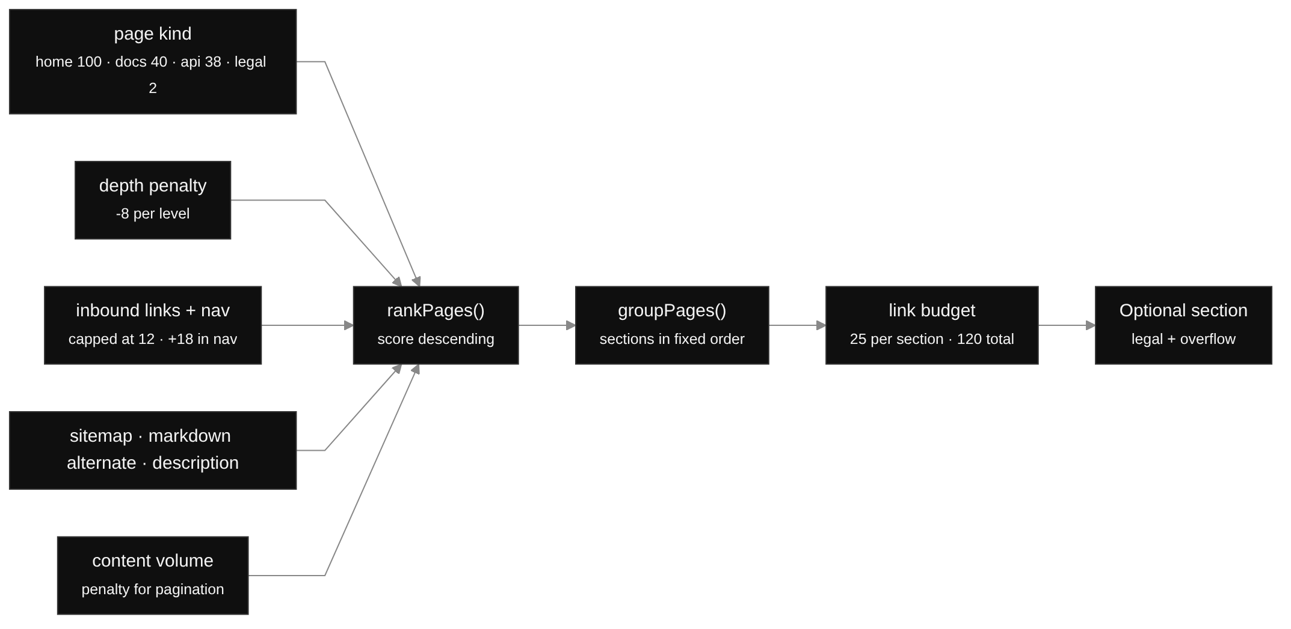
Deep Dive — Rank & Group
Which pages earn a place
Readable formula, not a model
Budget forces a choice
every placement is explainable to a customer
overflow and legal fall into Optional
Trade-off hand-tuned weights are transparent and free; embeddings would generalise better at a model call per page.
Notes:
A crawl of a real site returns far more pages than belong in an index, so something has to
choose. scorePage is deliberately a readable formula rather than a model: page kind sets
the base — home 100, docs 40, api 38, guides 34, product 26, legal 2 — then depth costs 8
per level, inbound links add 2.5 each up to a cap, being in the navigation adds 18,
appearing in the sitemap, having a markdown alternate and having a real description all
add, and content volume adds a little with penalties for pagination-style paths.
I can defend every one of those numbers in an interview, which is exactly the point: when
a customer asks why their pricing page ranked below the API reference, I can answer from
the formula instead of shrugging at a model.
Grouping then walks the ranked list into fixed-order sections by page kind — Overview,
Documentation, API Reference, Guides, and so on — under a link budget of 25 per section
and 120 overall. Oversized "Other" buckets get split by top-level path so you don't get one
section with sixty links. Legal pages and everything past the budget fall into Optional,
which is the spec's own escape hatch for agents under context pressure.
The honest weakness: the weights encode my assumptions about how sites are laid out. They
do well on docs-shaped and marketing-shaped sites and less well on, say, an e-commerce
catalogue. Clustering embeddings would generalise, at the cost of a model call per page
and a much harder answer to "why is this page here".

Slide 13
Deep Dive — Render
From ranked sections to markdown
Deterministic document model
## API Reference
- [REST API](/docs/api): endpoints,
auth and rate limits
- [Webhooks](/docs/webhooks): event
payloads and retries
buildDocument() → renderLlmsTxt(): one shape, one writer
Notes are the product
extracted description, trimmed to a single clause
llms-full.txt on request
same structure, page text inlined
Trade-off heuristic notes are instant and safe; LLM notes read better but need a key — and never add a URL.
Notes:
Rendering is split in two on purpose: buildDocument produces a typed document — title,
summary, sections, links, notes — and renderLlmsTxt turns that into markdown. Nothing else
in the codebase writes llms.txt syntax, so there's one place where the format lives, and
the validator can be written against the output without sharing code with the builder.
The notes are where the quality actually is. A link line without a note is nearly useless
to an agent choosing between two pages, so each note comes from the best description I
could extract, trimmed to a single clause. When an OpenAI key is present, gpt-4o-mini
rewrites titles, section names and notes in one batched call — but it's handed the list of
pages and asked only to relabel them. It never returns URLs, which is the guardrail that
makes the optional model safe to enable.
llms-full.txt uses the same document and inlines page text. It's genuinely useful for a
small docs site and completely impractical for a large one, so it's opt-in.

Slide 14
Deep Dive — Validate
Grading the exact bytes we emit
Re-parse, don't trust
Errors
the checker reads the rendered text, not the builder's state
missing/duplicate H1, content before title, malformed links, H3+
Warnings
One function, three callers
duplicate URLs, missing summary, links without notes
generator UI, POST /api/validate, the audit
Trade-off re-parsing costs milliseconds and buys an independent check on the bytes we ship.
Notes:
validateLlmsTxt takes a string and returns errors and warnings. The deliberate choice is
that it re-parses the rendered document rather than inspecting the in-memory model. If the
renderer has a bug, a state-based check would happily agree with it; a text-based check
catches it. That's also what lets me point the same function at somebody else's live
/llms.txt during the audit, where I have no model at all — only bytes.
The severity split follows the spec: structural violations are errors — no H1, more than
one H1, content before the title, link lines that don't parse, headings deeper than H2.
Things that are legal but degrade usefulness are warnings — the same URL listed twice, a
missing summary blockquote, links with no note.
Three callers share it: the generator UI grades every result inline, POST /api/validate
lets you paste an arbitrary file, and the audit uses it on whatever the domain is already
serving. One definition of "valid", no drift.

Slide 15
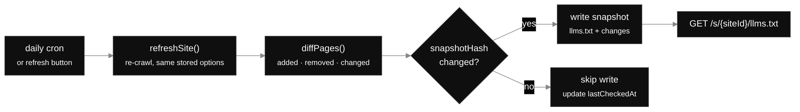
Deep Dive — Monitor
Keeping the file current
one refreshSite() behind both the daily cron and the manual button
Trade-off hash diffing makes 'nothing changed' nearly free, but a formatting-only edit is invisible to it.
Notes:
Automated updates were an explicit requirement, and the naive version — re-render nightly
and store the result — produces a history where every day looks like a change and nobody
can see what actually happened.
So the unit of comparison is the page, not the file. Every page carries a content hash;
diffPages compares the previous snapshot's pages with the new crawl and reports added,
removed and changed URLs, including what moved in the title or description. Those page
hashes roll up into a snapshot hash. If the snapshot hash is unchanged, I update
lastCheckedAt and write nothing. If it changed, I store a new snapshot with the diff
attached.
Two consequences. History stays legible — the timeline only contains days where something
really happened — and storage stays small, because I drop page text from stored snapshots
unless llms-full.txt needs it.
Both triggers call the same function, which matters more than it sounds: the daily Vercel
cron and the Refresh button in the UI cannot drift apart. The cost of the hash approach is
that a change which doesn't affect the hashed fields — pure formatting, say — reads as no
change at all. For this use case that's the right side of the trade.

Slide 16
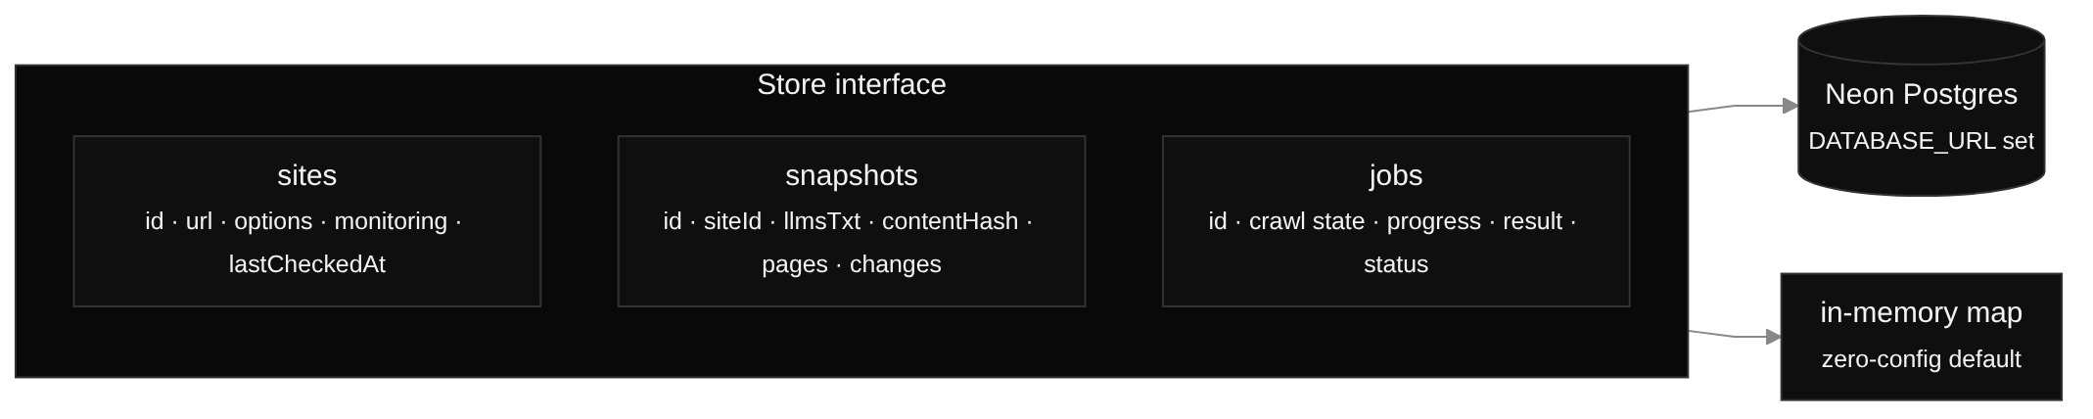
Deep Dive — Persistence
Two stores, one interface
Zero-config default
no DATABASE_URL → in-memory; the app still runs end to end
Schema on first use
no migration step to run before a deploy
Jobs are state, not threads
a crawl in progress is a row, so any instance can advance it
Trade-off one interface keeps local runs and CI dependency-free, at the cost of writing every query twice.
Notes:
Three tables. Sites: the tracked domain, its crawl options, whether monitoring is on, and
when it was last checked. Snapshots: the rendered llms.txt, its content hash, the page
records and the diff, one row per actual change. Jobs: an in-flight crawl — the serialized
crawl state, progress, and the finished result.
That jobs table is what makes the slice-based crawl work on serverless. The crawl isn't a
thread anybody has to keep alive; it's a row. Whichever function instance handles the next
request loads the state, advances it by one slice, and writes it back.
Everything goes through a Store interface with a Neon Postgres implementation and an
in-memory one. It means you can clone the repo and run the app with no infrastructure at
all, and the whole test suite runs without a database. The price is honest: two
implementations to keep in sync, and I can't reach for Postgres-specific features like
JSONB indexes or LISTEN/NOTIFY without breaking the in-memory path.
Schema is created on first use rather than through a migration tool — right call for a
take-home, first thing I'd replace with real migrations in production.

Slide 17
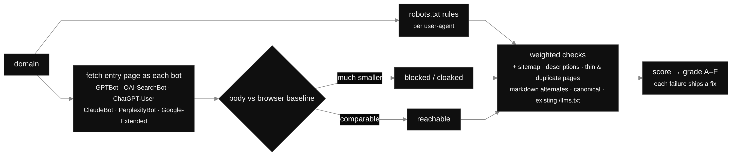
Beyond Spec — Audit
How an answer engine sees the domain
Weighted score → A–F grade
Use case
every failing check ships the concrete fix
why a brand is invisible, and what to change first
Trade-off live bot probes cost seconds and politeness budget, so the audit is opt-in.
Notes:
The audit answers "can an answer engine reach this content at all", and it does it by
measurement rather than by linting.
For each of six named agents — GPTBot, OAI-SearchBot, ChatGPT-User, ClaudeBot,
PerplexityBot and Google-Extended — I evaluate the site's robots.txt with that exact
user-agent, then actually fetch the entry page identifying as that bot. The response is
compared with a browser-like baseline fetch. If GPTBot gets a fraction of the bytes a
browser gets, that's a WAF challenge page or a JS stub, and it's the single most common
reason a brand is missing from AI answers. You cannot detect that by reading robots.txt.
Around that sit content checks: sitemap coverage, missing descriptions, thin and duplicate
pages, markdown alternates, canonical tags, whether content is server-rendered — plus, if
the domain already publishes an /llms.txt, I fetch it, validate it, and compare it against
my fresh crawl to find stale links and pages the live file never mentions.
The checks are weighted into a score and a grade, A down to F, and every failure carries
the specific fix. That's the deliverable a customer can act on: not "you scored 62" but
"GPTBot is blocked by this line in robots.txt, and 40 of your docs pages have no
description".

Slide 18
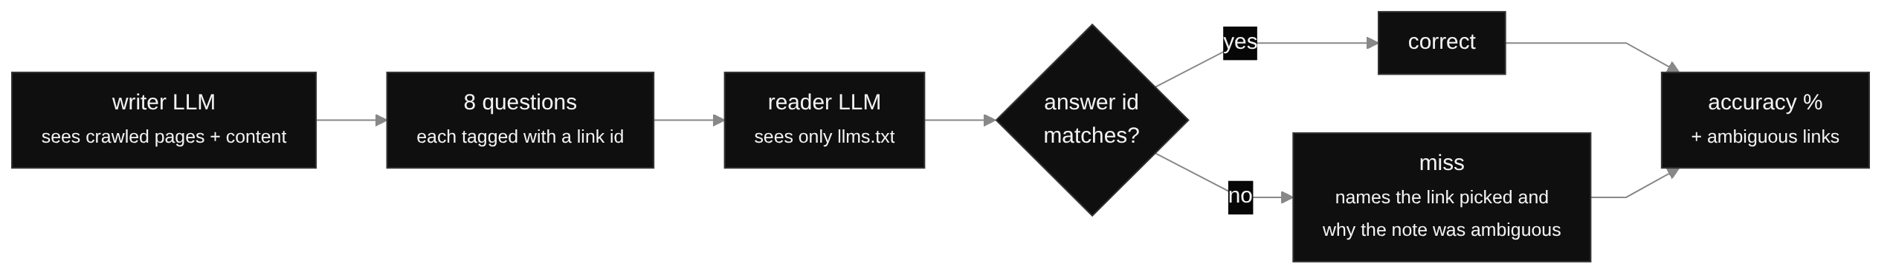
Beyond Spec — Eval
Is the file actually usable?
Ids cross the wire, not URLs
Misses are actionable
a hallucinated answer misses instead of scoring
names the note that failed to disambiguate
Trade-off two model calls per run cost money and vary slightly, but eight questions still catch vague notes.
Notes:
This is the one I'd defend hardest as a product idea. A file can be perfectly valid and
still useless, because the notes don't distinguish between pages. The eval measures that.
A writer model sees the crawled pages with their content and writes eight questions a real
user might ask, each tagged with the link id that should answer it. A reader model then
sees only the generated llms.txt — no page content — and answers each question by choosing
a link id. Accuracy is how often the reader lands on the page the writer had in mind.
The design detail that makes it trustworthy: both sides exchange numbered ids, never URLs.
If the reader invents something, the id doesn't resolve and it's a miss — it can't get
silent credit for a plausible-looking URL.
And the failures are the useful output. Every miss names the link that was chosen instead
and why its note didn't disambiguate, which is precisely the description to rewrite. Run
it before and after an edit and you can see whether the file got better, which is what
turns this from a vibe into a regression test.

Slide 19
Engineering
Trade-offs I'd defend
01
Slices over one long request
survives the timeout; costs serialized state
02
Heuristics first, LLM optional
always valid without a key; the model only relabels
03
Hash diffing over re-render comparison
cheap no-ops; misses formatting-only edits
04
Audit and eval opt-in
keeps generation fast; two extra clicks
05
Interface over two stores
zero-config and testable; every query written twice
Notes:
Pulling the trade-offs into one place, because this is usually the part of the interview
that matters.
Slice crawling: I chose more moving parts over a crawl that dies at 60 seconds. The state
has to be serializable and each slice is a round-trip, but progress is visible and nothing
is lost when a function is recycled.
Heuristics first: the deterministic path always produces a spec-valid file. The model is
strictly an enhancement, and it's structurally prevented from inventing URLs. A missing
key degrades wording, never correctness.
Hash diffing: cheap no-ops and readable history, in exchange for being blind to changes
that don't touch the hashed fields.
Opt-in audit and eval: six bot probes plus two LLM calls would double the latency of every
generation for a feature most runs don't need.
Two store implementations: worth it for a project that has to be clonable and testable
without infrastructure; the first thing I'd collapse if this became a real product.
On testing, since it usually comes up: the suite is Vitest over the pure functions — robots
and sitemap parsing including wildcards, anchors, indexes and gzip; extraction fallbacks
and URL normalization; classification and ranking order; sectioning and link budgets;
validation errors and warnings; snapshot diffing; and audit scoring. Plus lint, typecheck
and build in the same command.

Slide 20
Roadmap
What I'd build next
01
Headless rendering for JS-only sites
fall back to a browser on thin pages only
02
Embeddings for ranking and sectioning
name sections from content, not URL paths
03
Incremental recrawl
ETag / If-Modified-Since, per-page scheduling
04
Event-driven refresh
sitemap lastmod or a deploy webhook — minutes, not hours
05
Score trends over time
audit and eval are both better as a time series
https://llms-txt-nela-taeb.vercel.app
Nela Taeb — thank you
Notes:
Five things, roughly in the order I'd do them.
Headless rendering: the biggest correctness gap. A fully client-rendered site extracts as
an empty page today. I'd keep Cheerio as the fast path and fall back to a real browser
only for pages that come back suspiciously thin, so I pay for it on the few pages that
need it.
Embeddings: cluster page embeddings to derive sections from what pages are about rather
than from URL segments, and use similarity to catch near-duplicates the hash misses. The
cost is explainability, so I'd want the heuristic score kept alongside it.
Incremental recrawl: right now a refresh re-crawls the whole site. ETag and
If-Modified-Since plus per-page scheduling — hot docs pages hourly, legal pages monthly —
would cut the daily cost by an order of magnitude on a large site.
Event-driven refresh: polling a sitemap's lastmod, or better, a CMS or deploy webhook, so
the file is minutes behind a publish instead of up to a day.
And trends: both the audit grade and the retrieval accuracy are far more interesting as a
line over time than as a single number — that's the dashboard I'd build if this were a
product rather than a take-home.
That's the tour — happy to go deeper anywhere, and the live app is on the screen if you'd
like to throw a domain at it.

