Slide 1
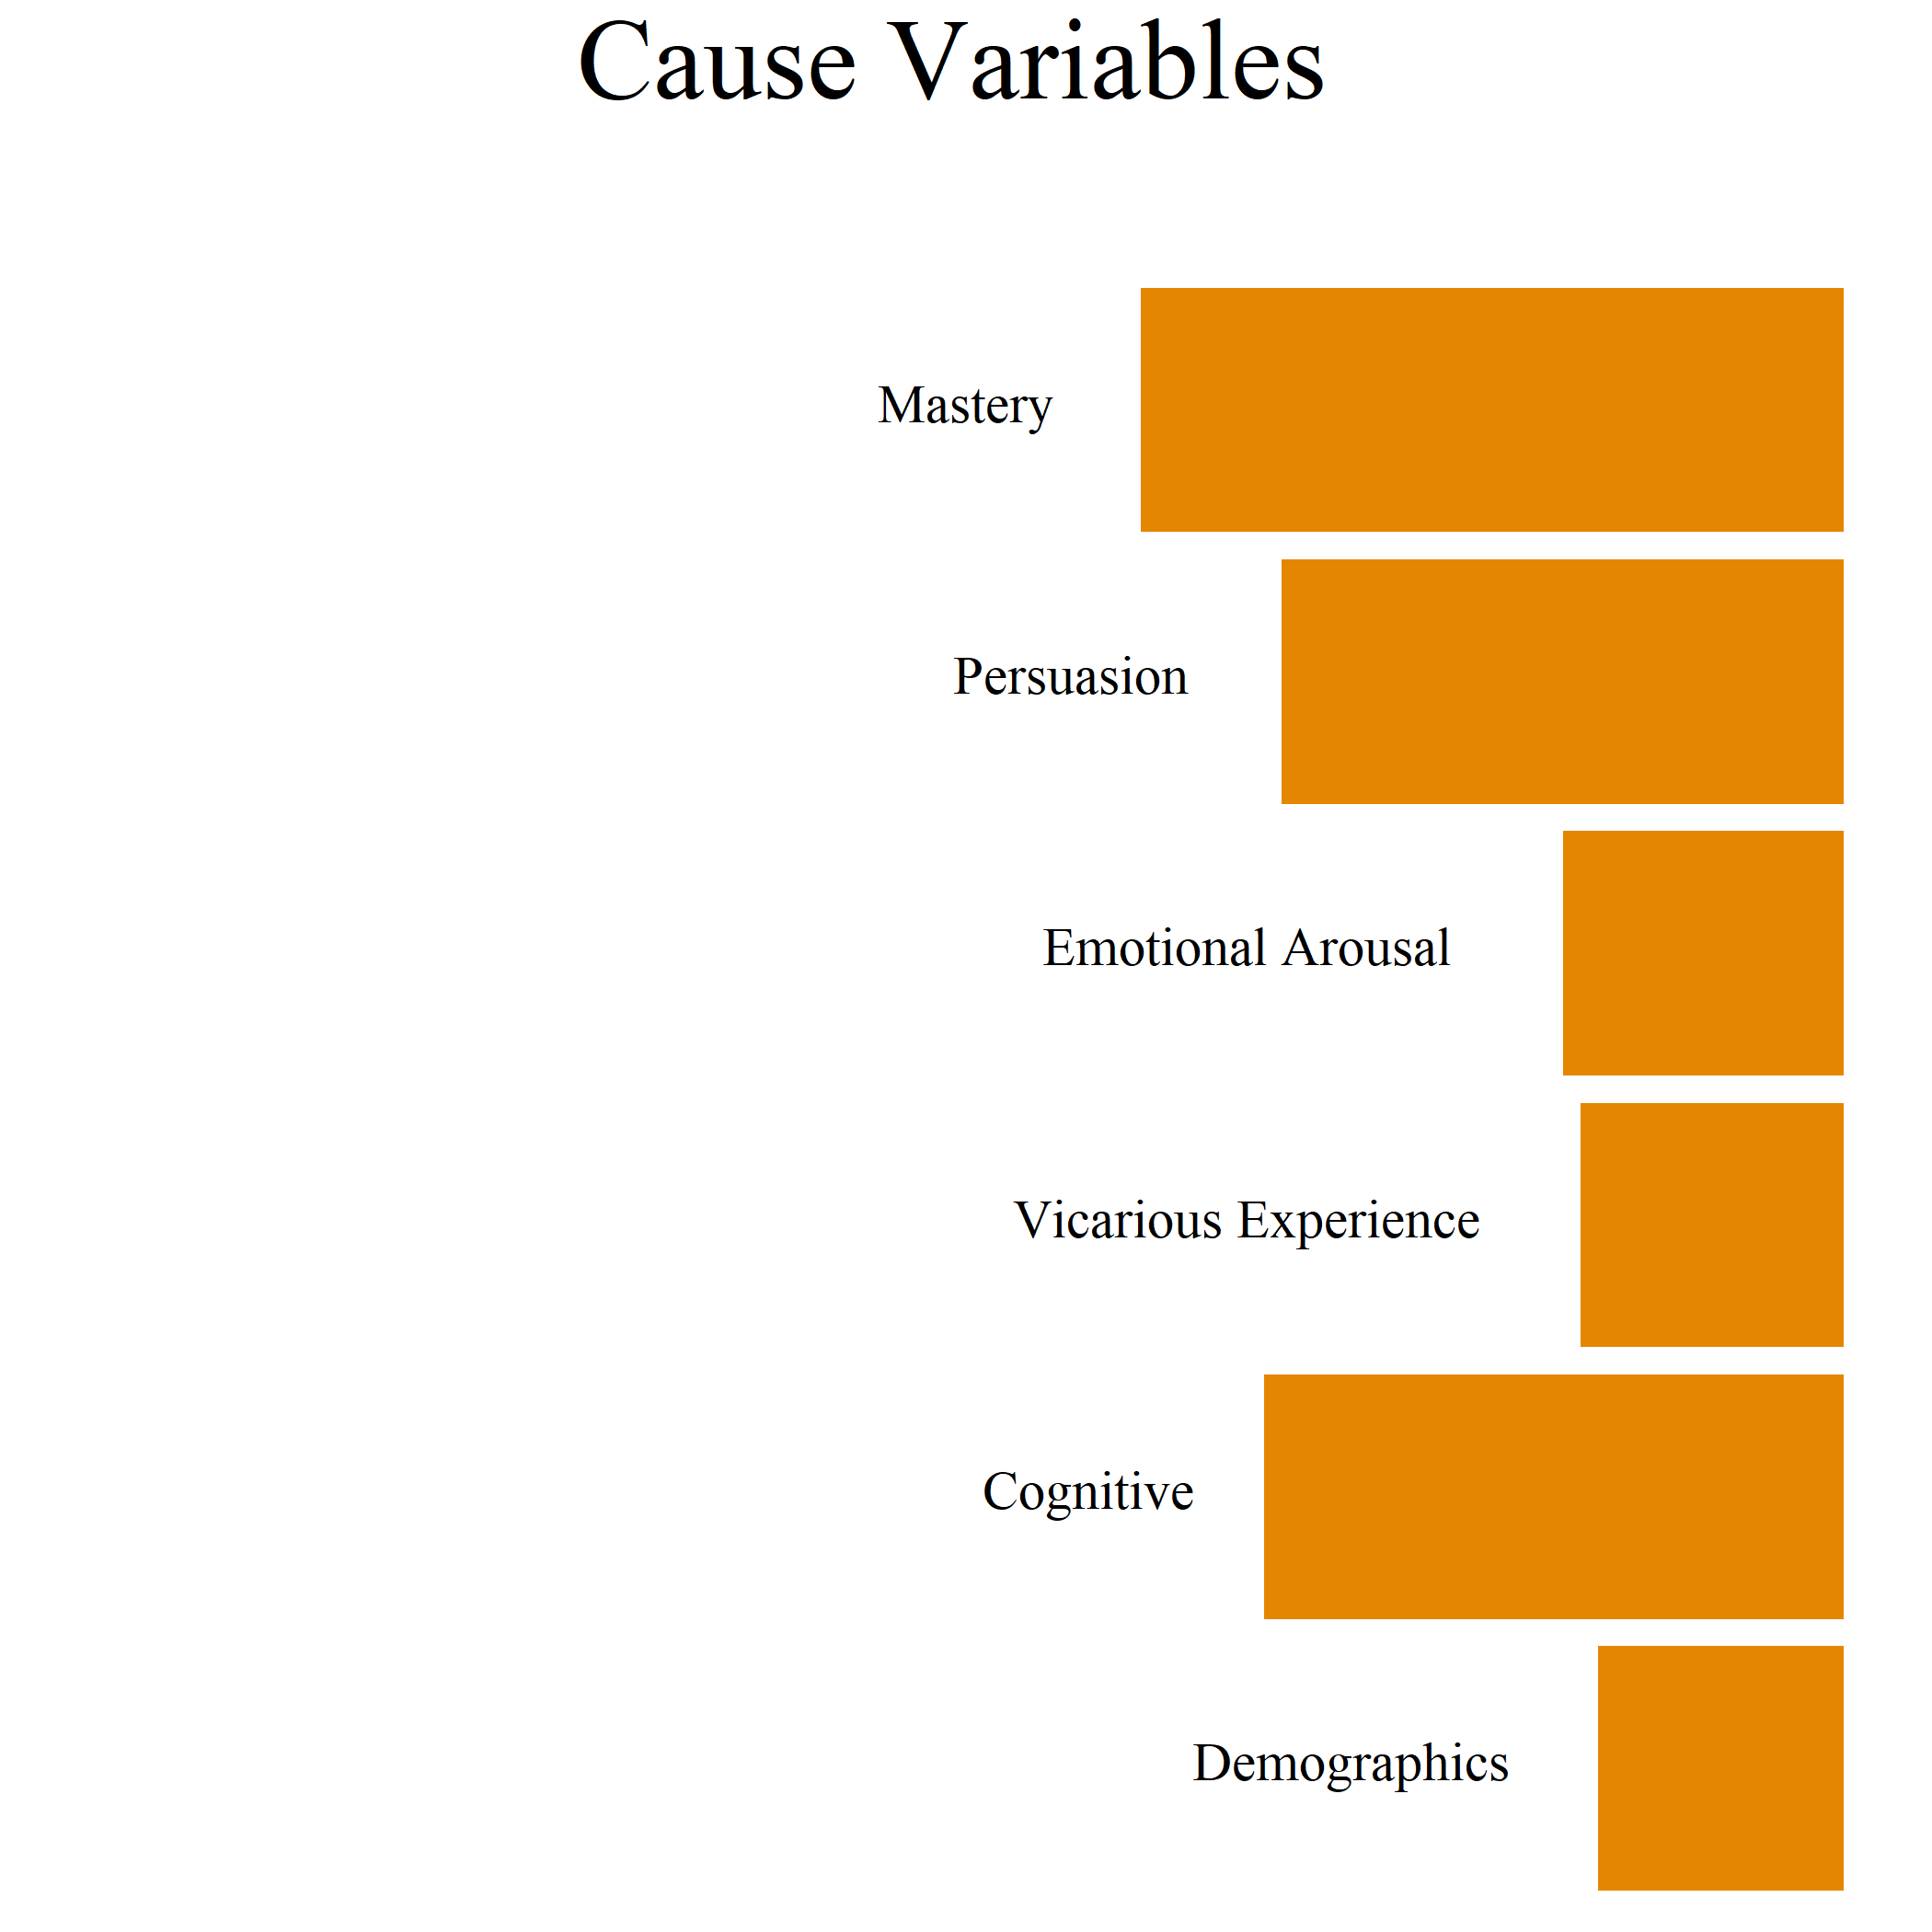
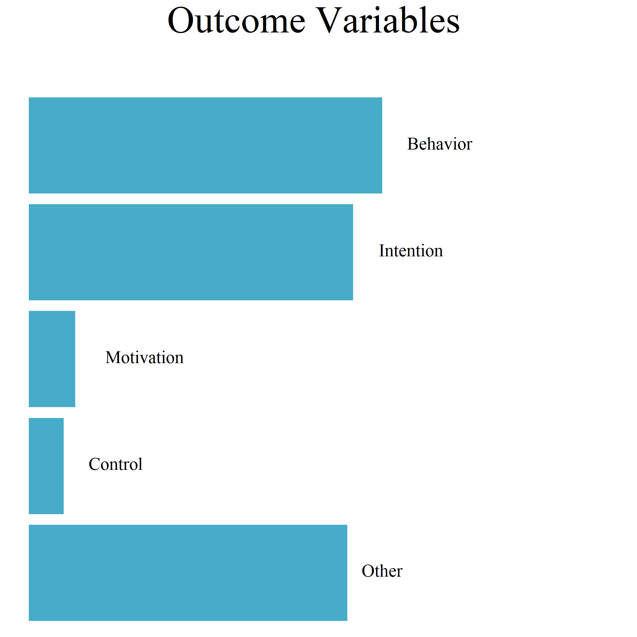
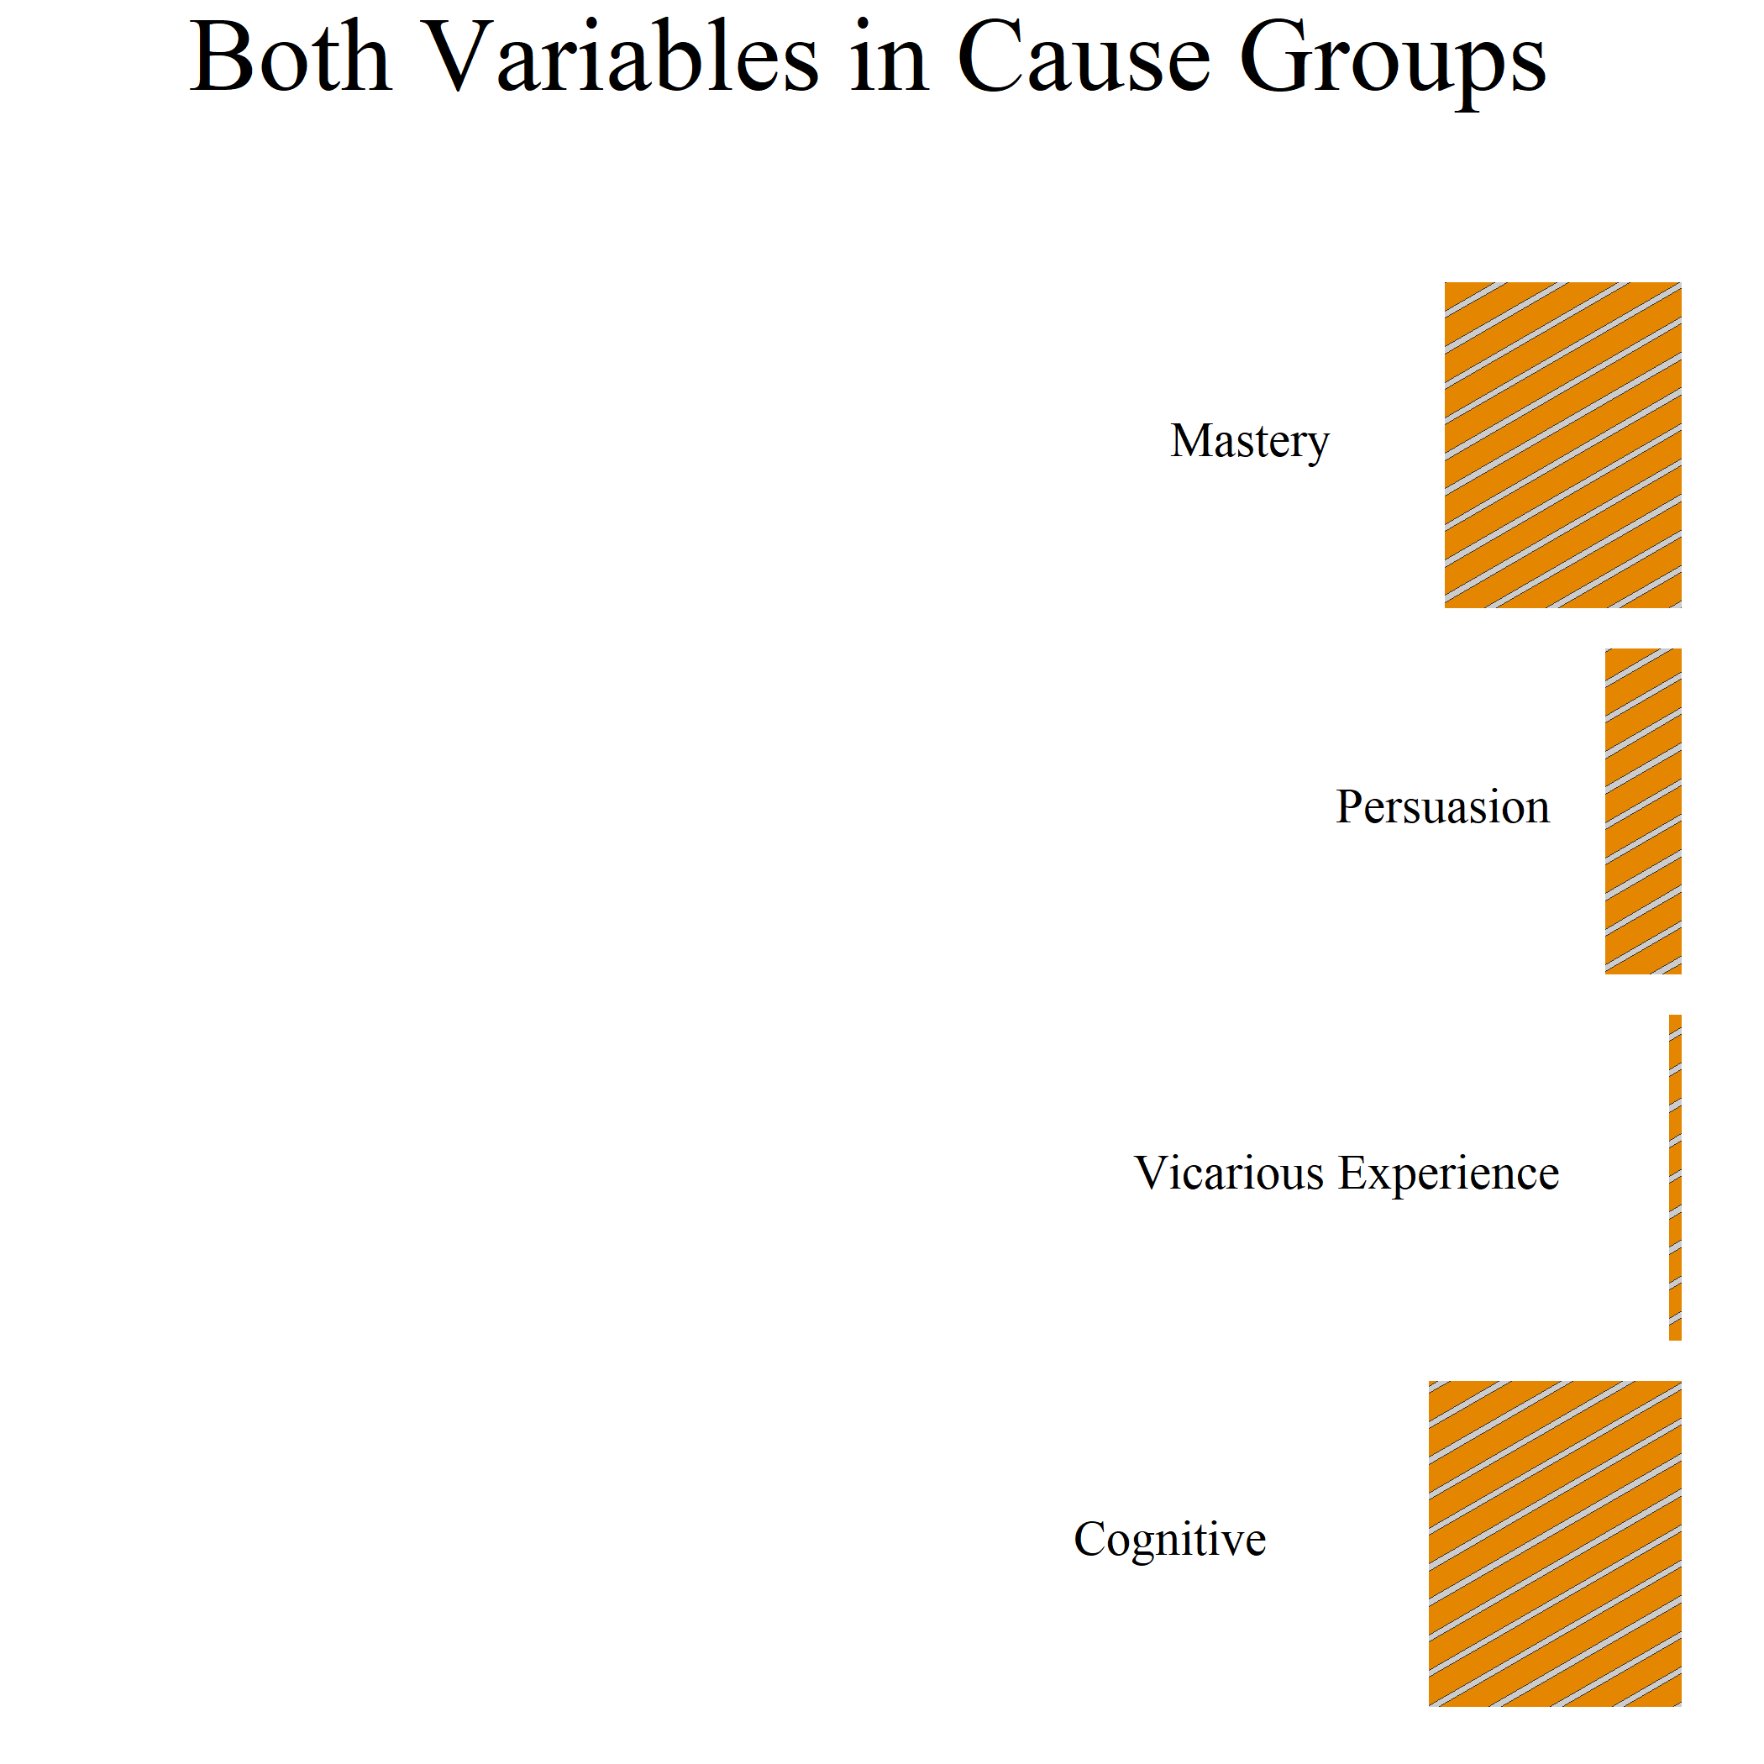
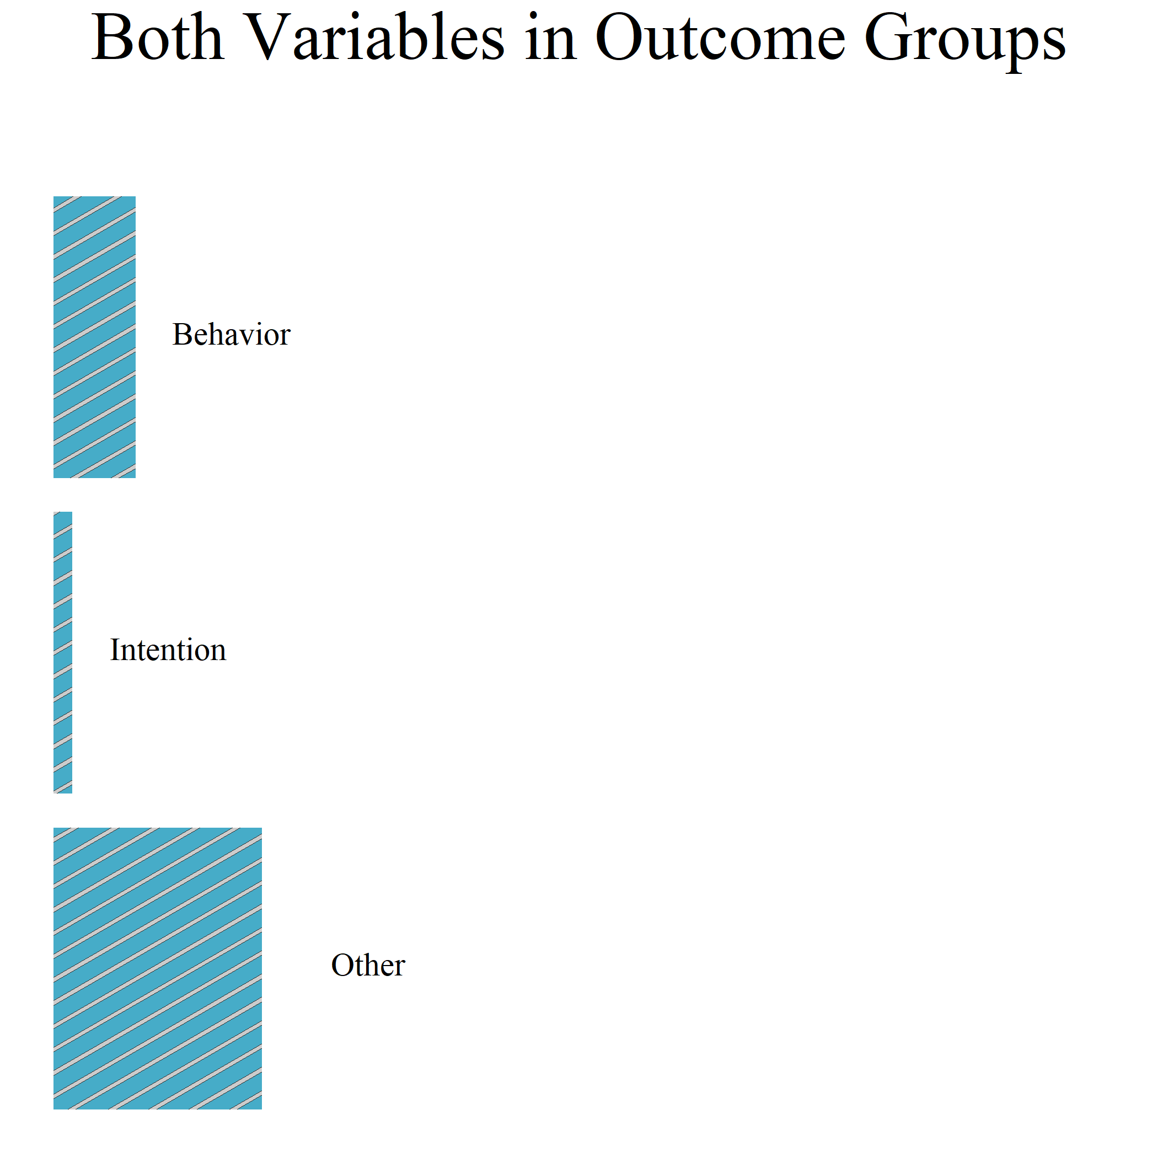
Mastery Experience
40
(Verbal) Persuasion
32
Self-Efficacy
61
Behavior
16
56
Intention
Emotional Arousal
Vicarious Experience
8
Motivation
15
Cognitive Variables
33
6
Control
Other
14
Demographics
55
Other
Cause Variables
Outcome Variables
Mastery Experience
Behavior
15
8
(Verbal) Persuasion
Intention
5
2
1
Vicarious Experience
Other
20
16
Cognitive Variables
Outcome and Cause Variables

Slide 2
Self-Efficacy
Mastery Experience
40
(Verbal) Persuasion
32
61
Behavior
Mastery Experience
Behavior
16
15
8
56
Intention
Emotional Arousal
(Verbal) Persuasion
Intention
Vicarious Experience
5
2
8
Motivation
15
Cognitive Variables
33
1
Vicarious Experience
Other
20
6
Control
Other
Cognitive Variables
14
16
Demographics
55
Other
Cause Variables
Outcome and Cause Variables
Outcome Variables

