Slide 1
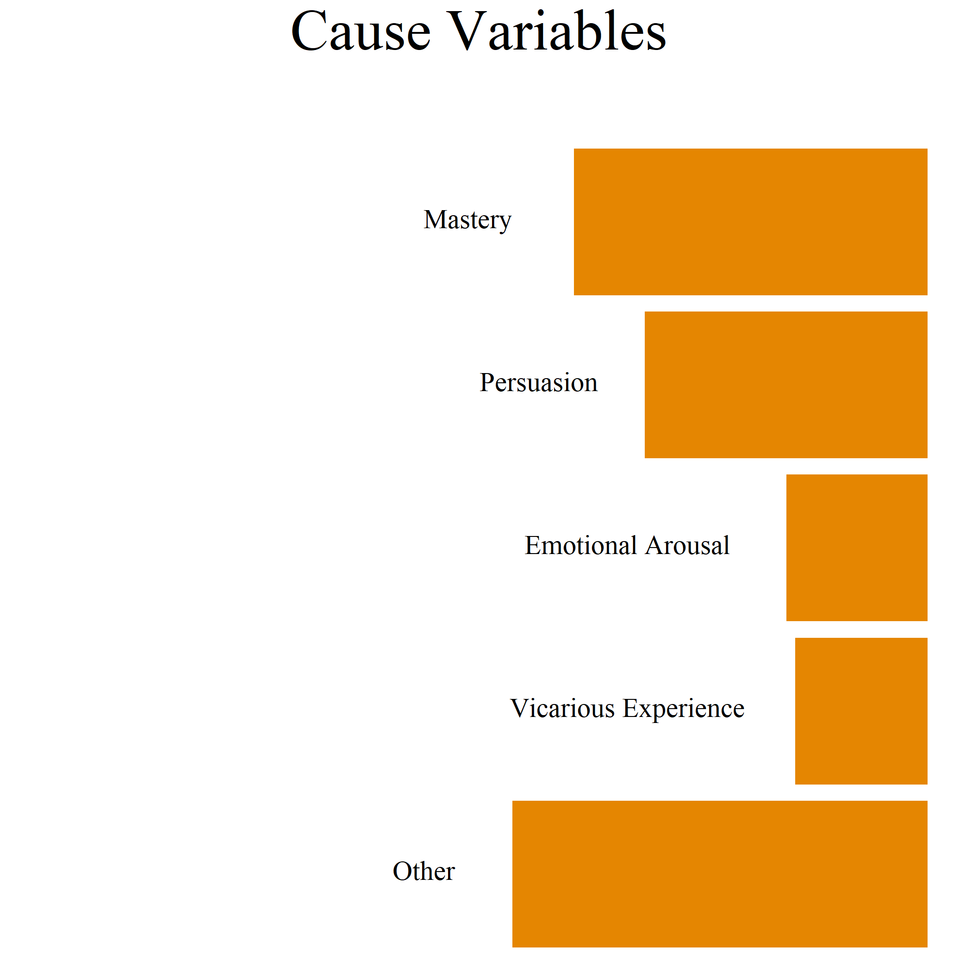
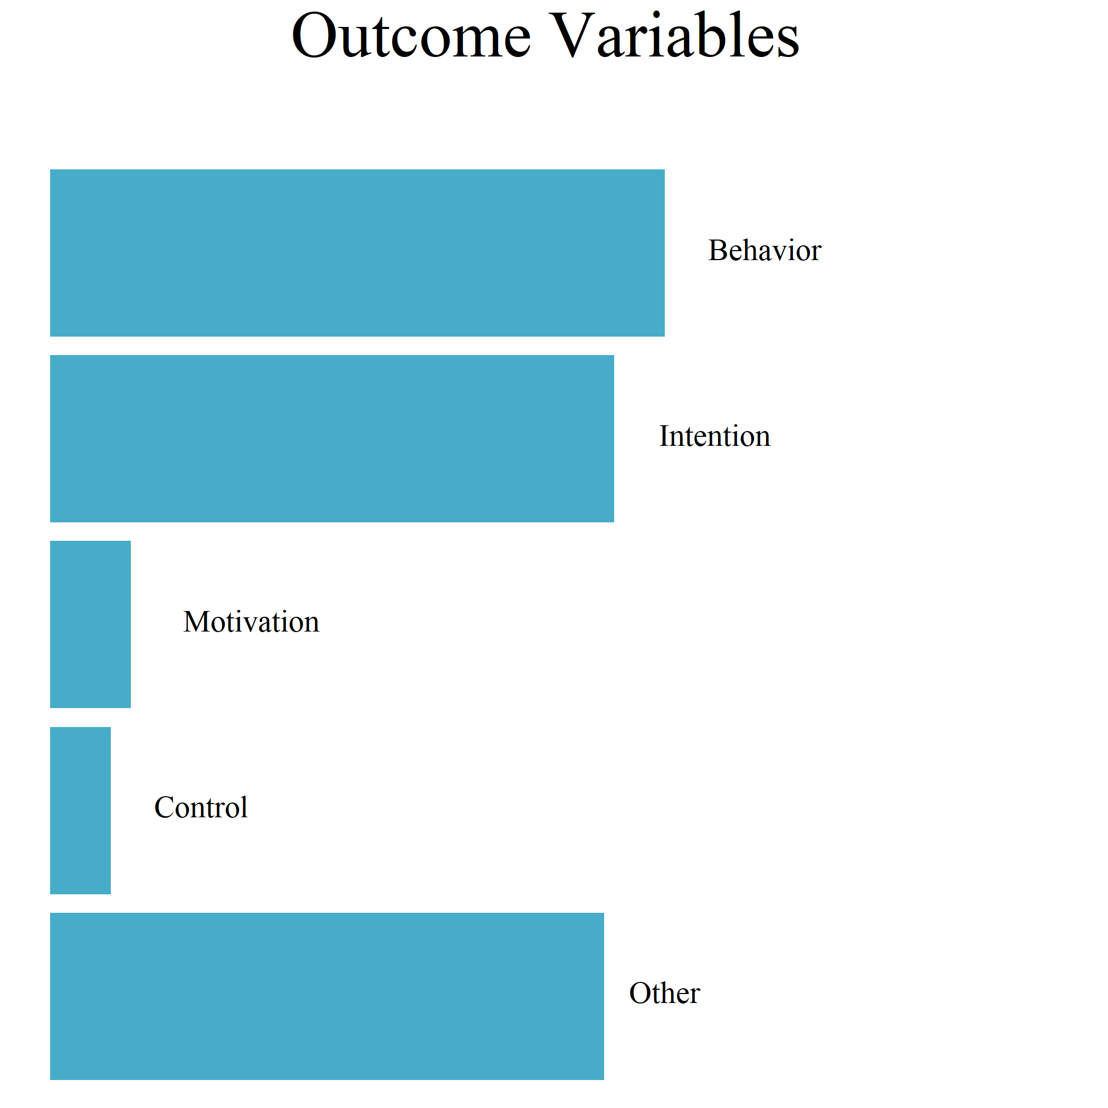
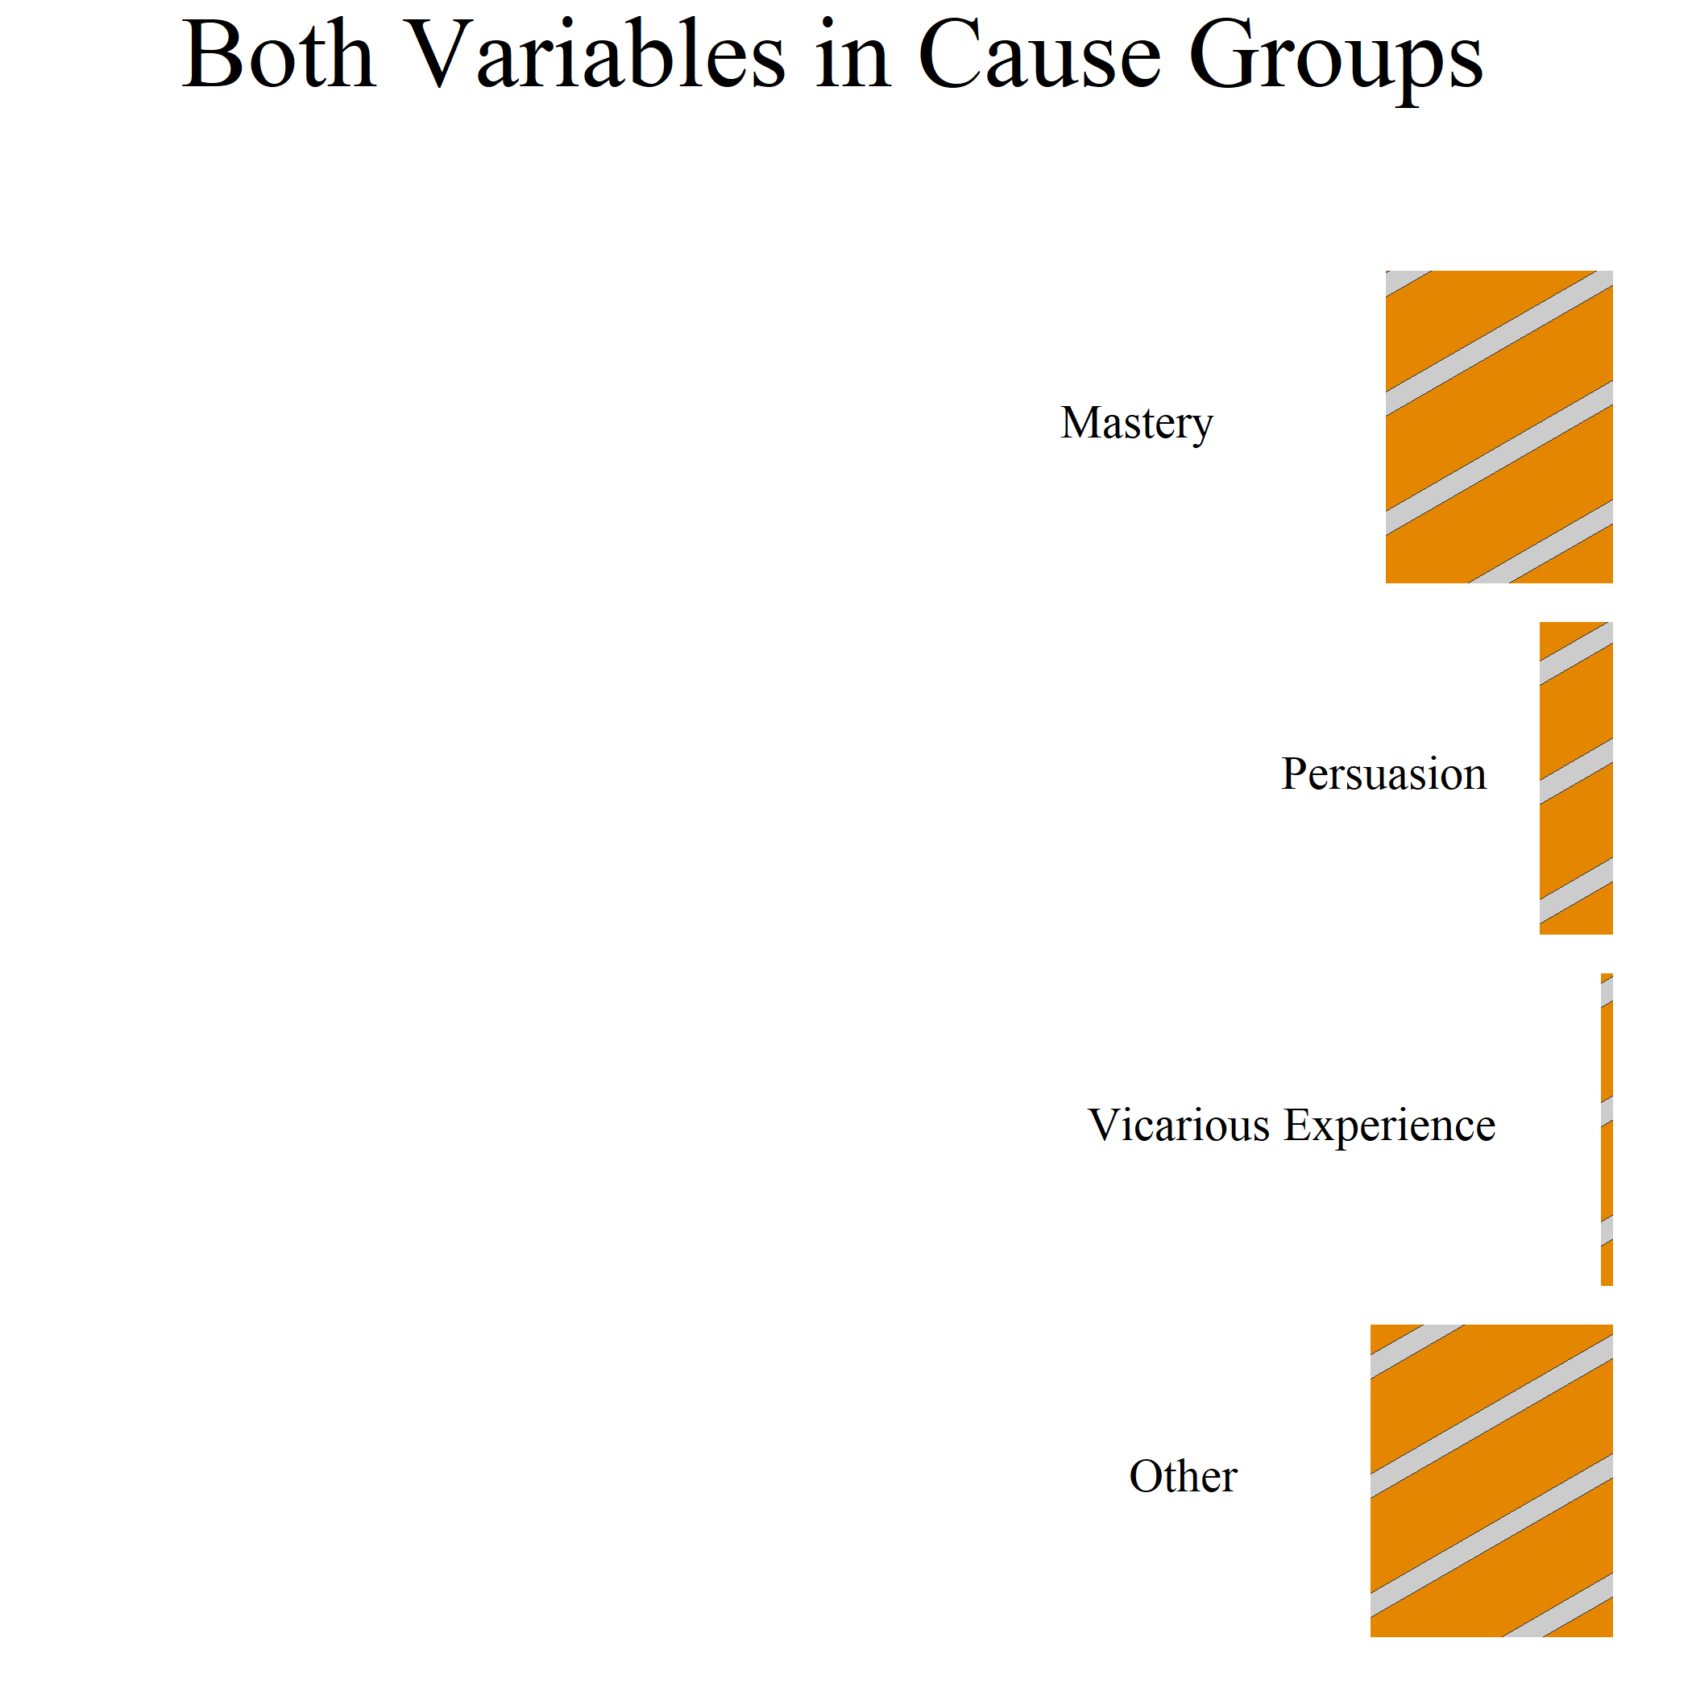
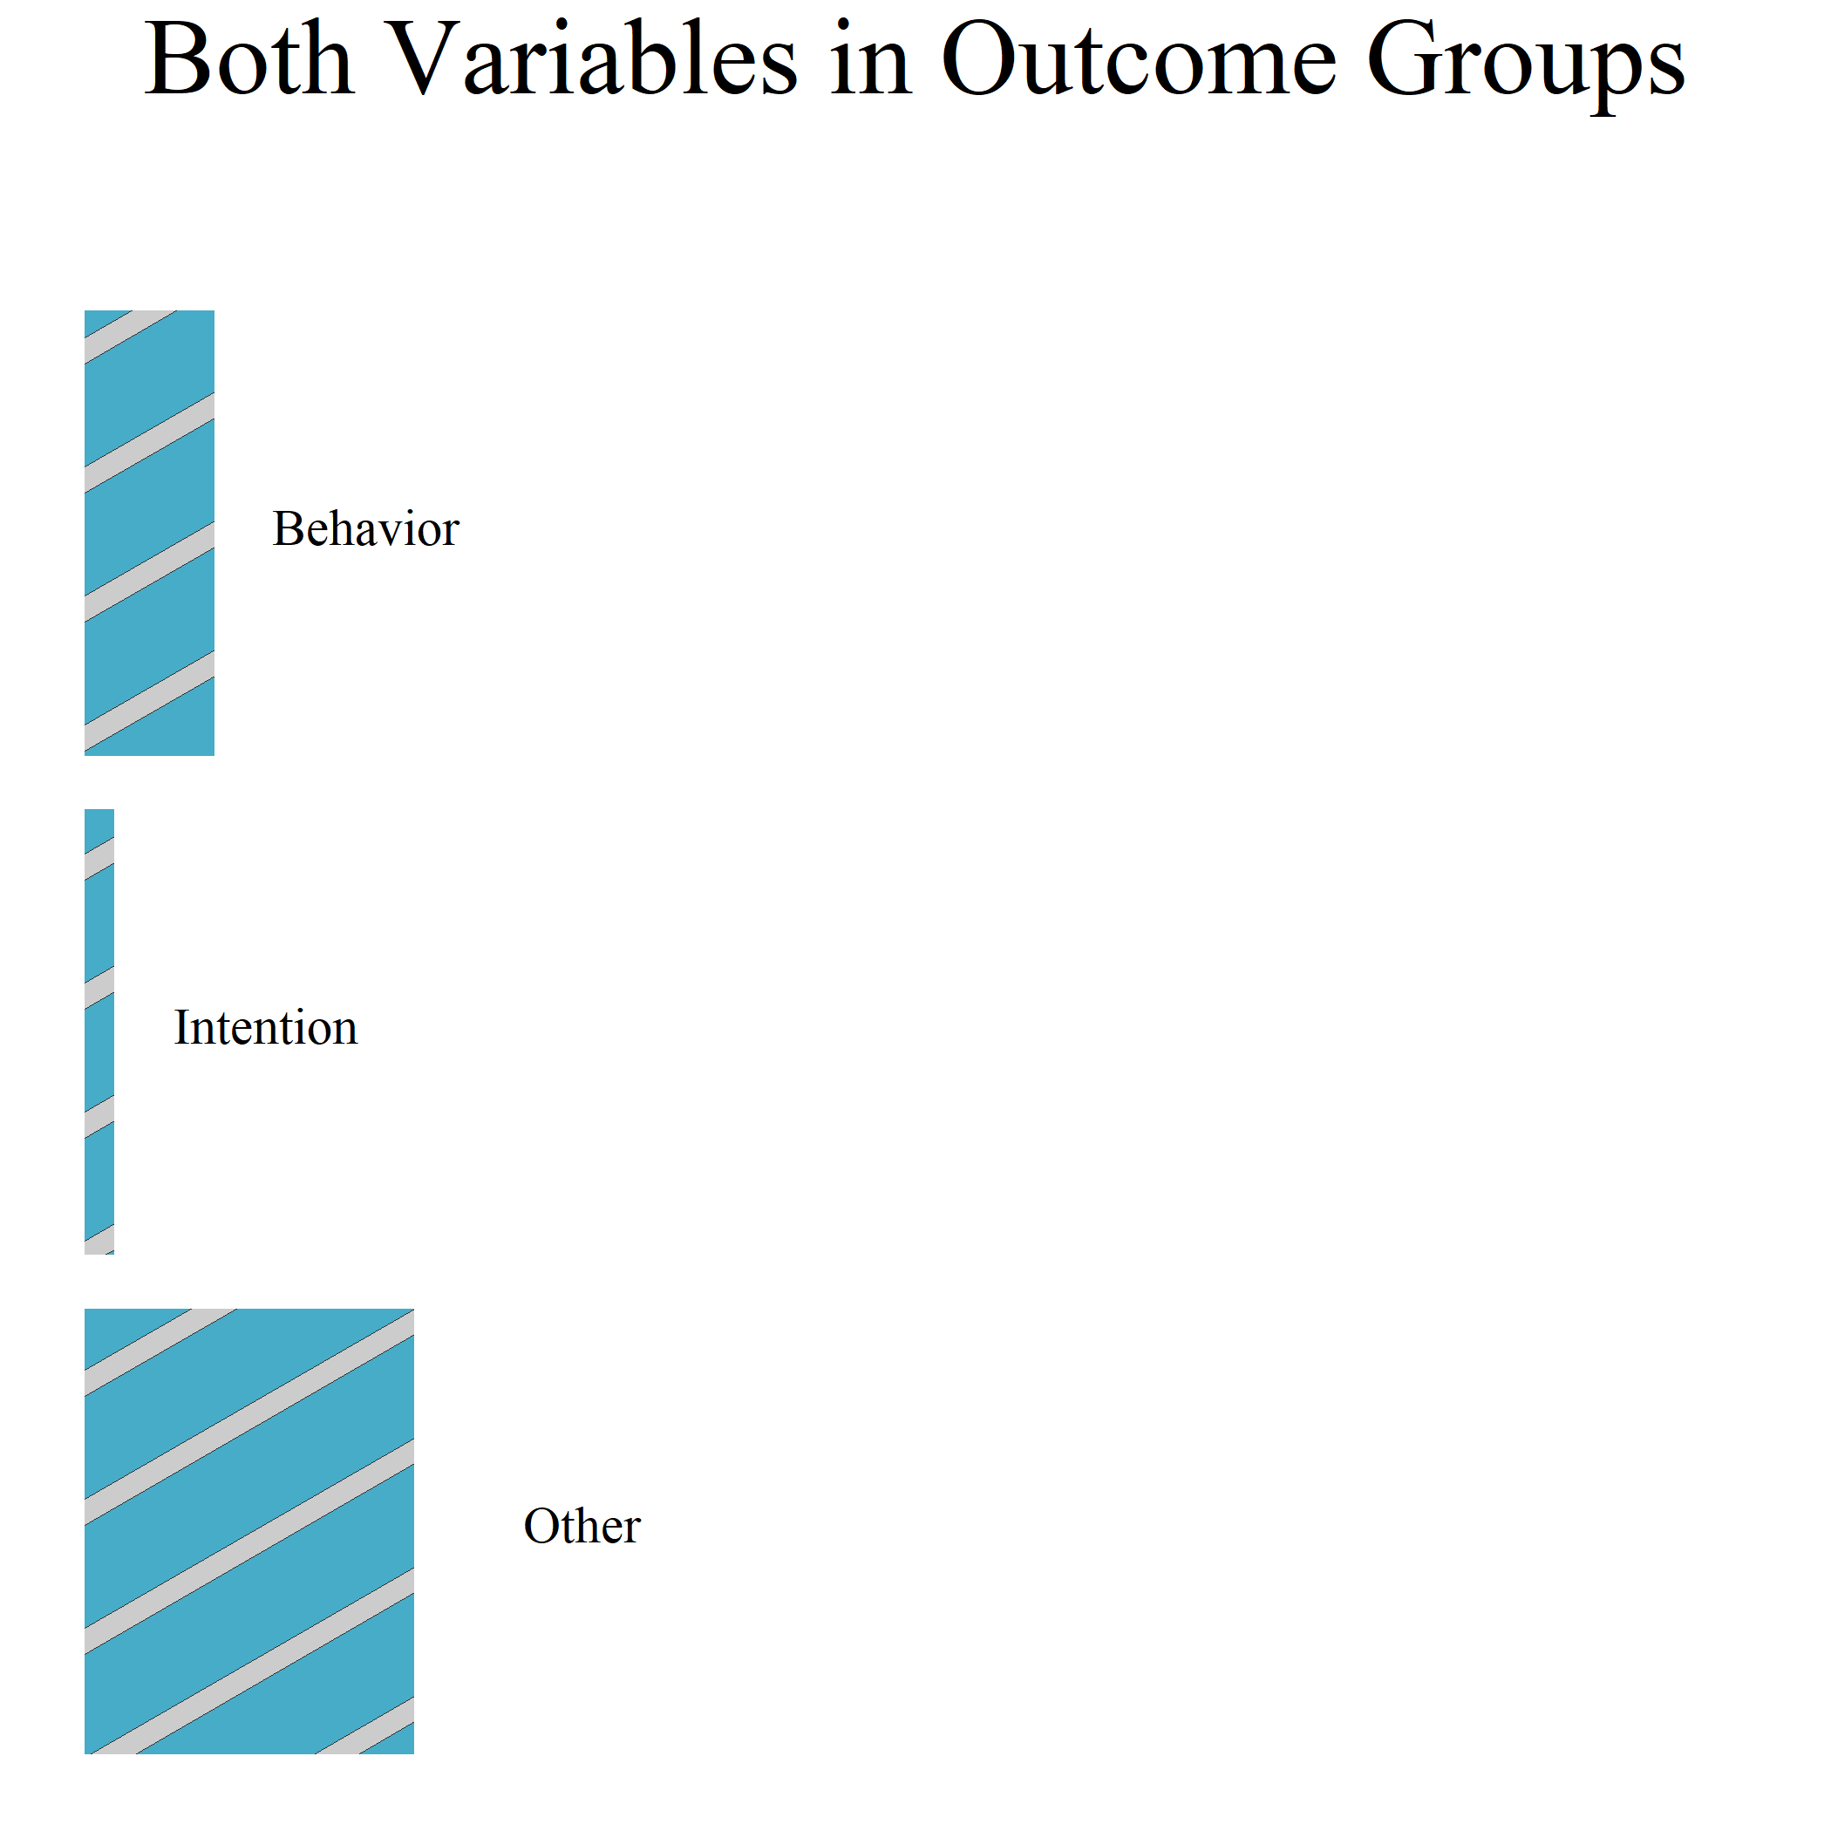
Mastery Experience
40
Self-Efficacy
61
Behavior
(Verbal) Persuasion
32
56
Intention
16
8
Motivation
Emotional Arousal
Vicarious Experience
Control
15
6
Other
47
55
Other
Cause Variables
Outcome Variables
Mastery Experience
Behavior
15
8
(Verbal) Persuasion
Intention
5
2
1
Vicarious Experience
Other
20
16
Other
Outcome and Cause Variables

Slide 2
Self-Efficacy
Mastery Experience
40
61
Behavior
Mastery Experience
56
Intention
32
Behavior
(Verbal) Persuasion
15
8
(Verbal) Persuasion
Intention
8
Motivation
16
5
2
Emotional Arousal
Vicarious Experience
1
Vicarious Experience
Other
6
Control
15
20
Other
47
16
Other
55
Other
Cause Variables
Outcome and Cause Variables
Outcome Variables

