Slide 1


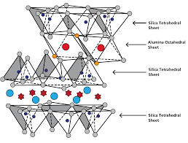
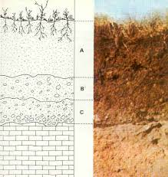
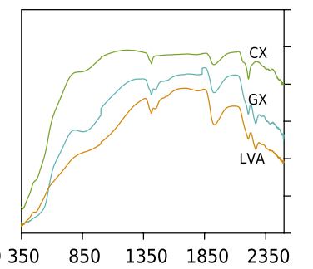
University of São Paulo “Luiz de Queiroz” College of Agriculture
Soil mineralogy estimates by spectroscopy
Nélida E. Q. Silvero
PhD candidate in Soil and Plant Nutrition
Piracicaba - 2021

Slide 2

Agenda
Soil spectra and mineralogy
Basics behind mineralogy estimation from spectra
Estimates and mapping in R software

Slide 3
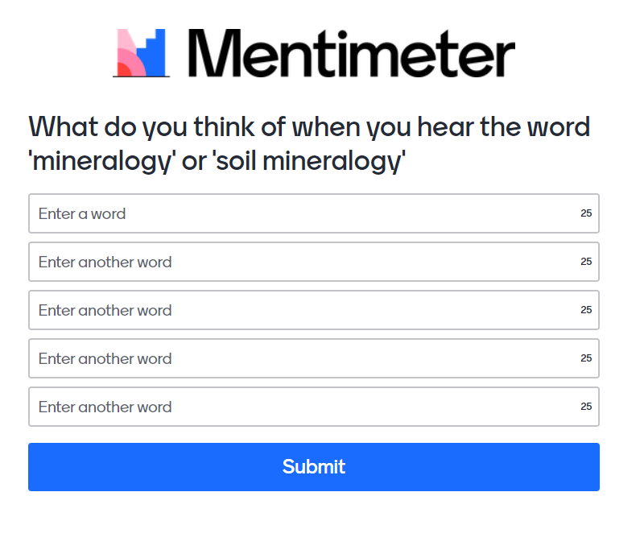

Survey
https://www.menti.com/zwdufay66x

Slide 4



Soil minerals
Hm
Soil “DNA”
Gt
2:1
Kt
Fertility
P-absorption
SOC stock
Pollution
Raw materials
Etc.
Gb

Slide 5
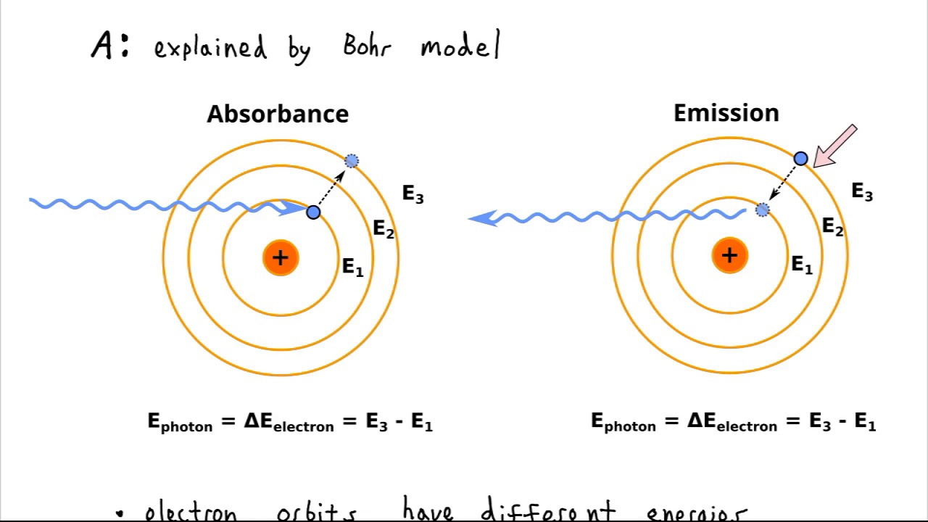
Kt-Gb
Hm
Gt

Slide 6
Goethite (Gt)
2nd Derivative of KM function of Hm, Gt and Soil
Hematite (Hm)
Soil
Continuum Removed of Kt, Gb and Soil
Gibbsite (Gb)
OH⁻
Kaolinite (Kt)
OH⁻
Wavelengths (µm)
Wavelengths (µm)

Slide 7
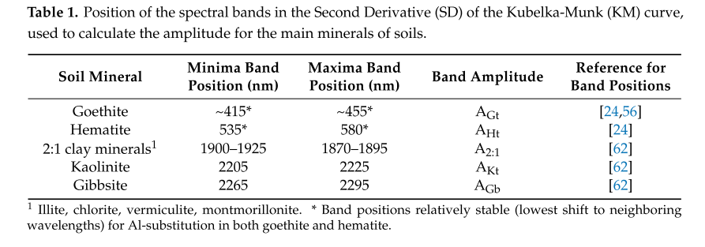
Poppiel et al. (2020)

Slide 8
How minerals can be estimated from spectra?
Soil spectra
Normalization/Smoothing
Kubelka-Munk function
Continuum removal
Second derivative of the KM function
Amplitude of the selected spectral regions
Regression analysis if you have real laboratory data

Slide 9
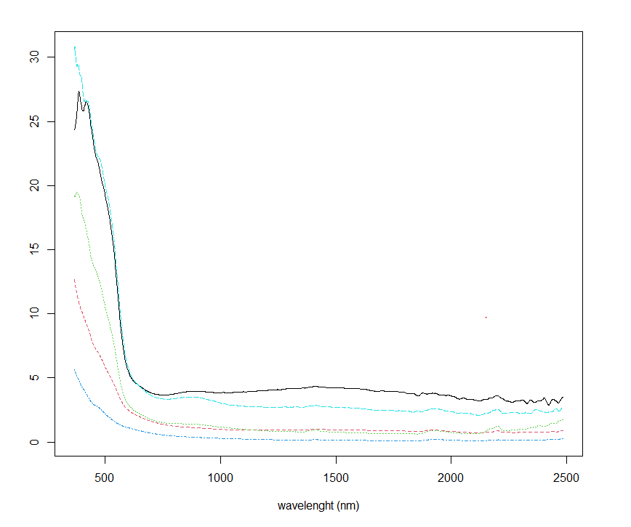
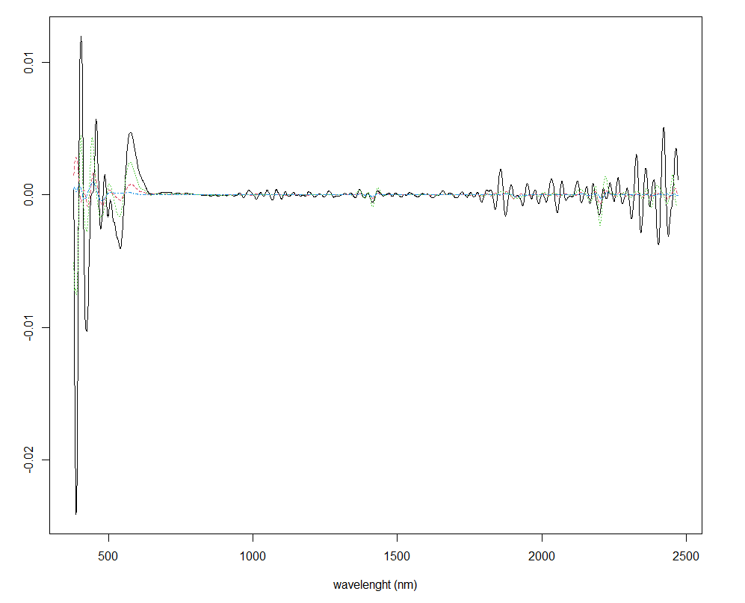
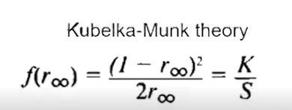
How minerals can be estimated from spectra?
Second derivative of the KM function

Slide 10
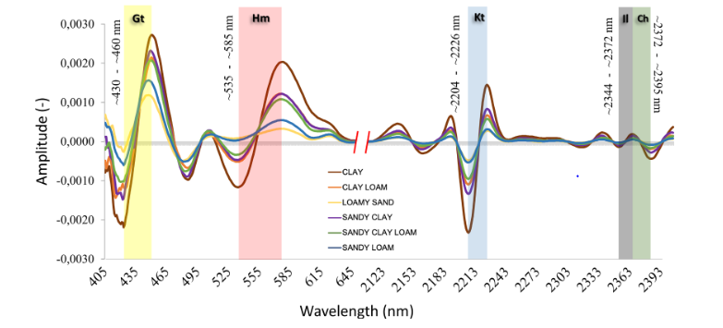
How minerals can be estimated from spectra?
(Coblinski et al., 2021)

Slide 11
How minerals can be estimated from spectra?
Soil spectra
Normalization/Smoothing
Kubelka-Munk function
Continuum removal
Second derivative of the KM function
Amplitude of the selected spectral regions
Regression analysis if you have real laboratory data

Slide 12
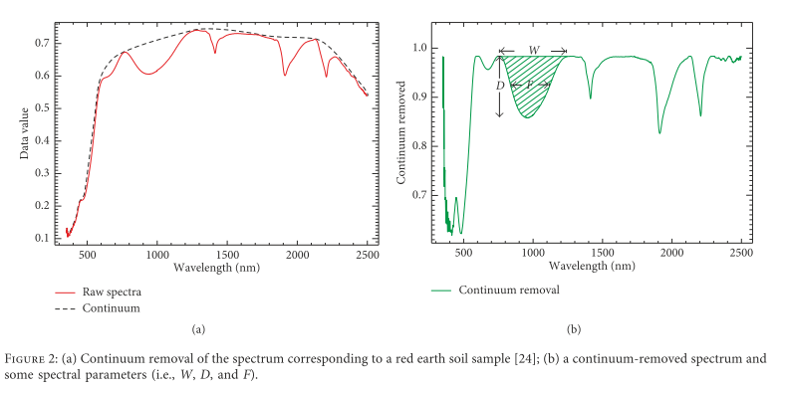
How minerals can be estimated from spectra?
Fang et al. (2019)

Slide 13
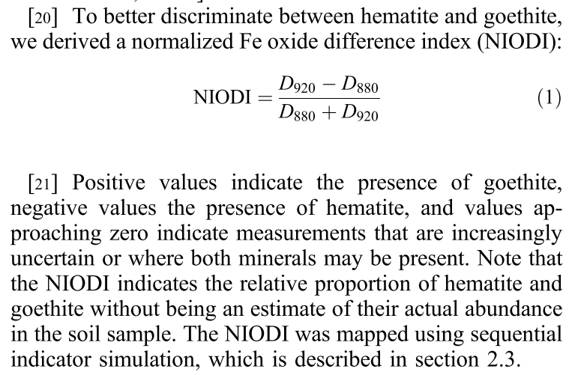
How minerals can be estimated from spectra?
Viscarra Rossel et al. (2010)

Slide 14
References
Bahia, A.S.R. de S., Marques, J., Siqueira, D.S., 2015. Procedures using diffuse reflectance spectroscopy for estimating hematite and goethite in Oxisols of São Paulo, Brazil. Geoderma Reg. 5, 150–156. https://doi.org/10.1016/j.geodrs.2015.04.006
Barron, V., Torrent, J., 1986. Use of the Kubelka-Munk Theory to study the influence of iron oxides on Soil Color. J. Soil Sci. 37, 499–510. https://doi.org/doi.org/10.1111/j.1365-2389.1986.tb00382.x
Camargo, L.A., Marques, J., Barr??n, V., Alleoni, L.R.F., Barbosa, R.S., Pereira, G.T., 2015. Mapping of clay, iron oxide and adsorbed phosphate in Oxisols using diffuse reflectance spectroscopy. Geoderma 251–252, 124–132. https://doi.org/10.1016/j.geoderma.2015.03.027
Cudahy, T., Caccetta, M., Thomas, M., Hewson, R., Abrams, M., Kato, M., Kashimura, O., Ninomiya, Y., Yamaguchi, Y., Collings, S., Laukamp, C., Ong, C., Lau, I., Rodger, A., Chia, J., Warren, P., Woodcock, R., Fraser, R., Rankine, T., Vote, J., De Caritat, P., English, P., Meyer, D., Doescher, C., Fu, B., Shi, P., Mitchell, R., 2016. Satellite-derived mineral mapping and monitoring of weathering, deposition and erosion. Sci. Rep. 6, 57198–57199. https://doi.org/10.1038/srep23702
Demattê, J.A.M., Nanni, M.R., Formaggio, A.R., Epiphanio, J.C.N., 2007. Spectral reflectance for the mineralogical evaluation of Brazilian low clay activity soils. Int. J. Remote Sens. 28, 4537–4559. https://doi.org/10.1080/01431160701250408
Ducart, D.F., Moreira Silva, A., Labouré, C., Toledo, B., Mozer De Assis, L., 2016. Mapping iron oxides with Landsat-8/OLI and EO-1/Hyperion imagery from the Serra Norte iron deposits in the Carajás Mineral Province, Brazil. Brazilian J. Geol. 46, 331–349. https://doi.org/10.1590/2317-4889201620160023
Fang, Q., Hong, H., Zhao, L., Kukolich, S., Yin, K., Wang, C., 2018. Visible and Near-Infrared Reflectance Spectroscopy for Investigating Soil Mineralogy: A Review. https://doi.org/10.1155/2018/3168974
Fernandes, K., Marques Júnior, J., Bahia, A.S.R. de S., Demattê, J.A.M., Ribon, A.A., 2020. Landscape-scale spatial variability of kaolinite-gibbsite ratio in tropical soils detected by diffuse reflectance spectroscopy. Catena 195, 104795. https://doi.org/10.1016/j.catena.2020.104795
Kurata, K., Yamaguchi, Y., 2019. Integration and Visualization of Mineralogical and Topographical Information Derived from ASTER and DEM Data. Remote Sens. 11, 162. https://doi.org/10.3390/rs11020162
Mendes, W. de S., Demattê, J.A.M., Bonfatti, B.R., de Resende, M.E.B., Campos, L.R., Saraiva da Costa, A.C., 2021. A novel framework to estimate soil mineralogy using soil spectroscopy. Appl. Geochemistry 127, 104909. https://doi.org/10.1016/j.apgeochem.2021.104909
Poppiel, R.R., Lacerda, M.P.C., Rizzo, R., Safanelli, J.L., Bonfatti, B.R., Silvero, N.E.Q., Demattê, J.A.M., 2020. Soil Color and Mineralogy Mapping Using Proximal and Remote Sensing in Midwest Brazil. Remote Sens. 12, 1197. https://doi.org/10.3390/rs12071197
Silvero, N.E.Q., Di Raimo, L.A.D.L., Pereira, G.S., Magalhães, L.P. de, Terra, F. da S., Dassan, M.A.A., Salazar, D.F.U., Demattê, J.A.M., 2020. Effects of water, organic matter, and iron forms in mid-IR spectra of soils: Assessments from laboratory to satellite-simulated data. Geoderma 375, 114480. https://doi.org/10.1016/j.geoderma.2020.114480
Viscarra Rossel, R.A., 2011. Fine-resolution multiscale mapping of clay minerals in Australian soils measured with near infrared spectra. J. Geophys. Res. 116, F04023. https://doi.org/10.1029/2011JF001977
Viscarra Rossel, R.A., Bui, E.N., De Caritat, P., Mckenzie, N.J., 2010. Mapping iron oxides and the color of Australian soil using visible–near-infrared reflectance spectra. J. Geophys. Res 115, 4031. https://doi.org/10.1029/2009JF001645

