Slide 1
CREDIT EDA
INSIGHTS AND RECOMMENDATIONS

Slide 2
CURRENT APPLICATION

Slide 3
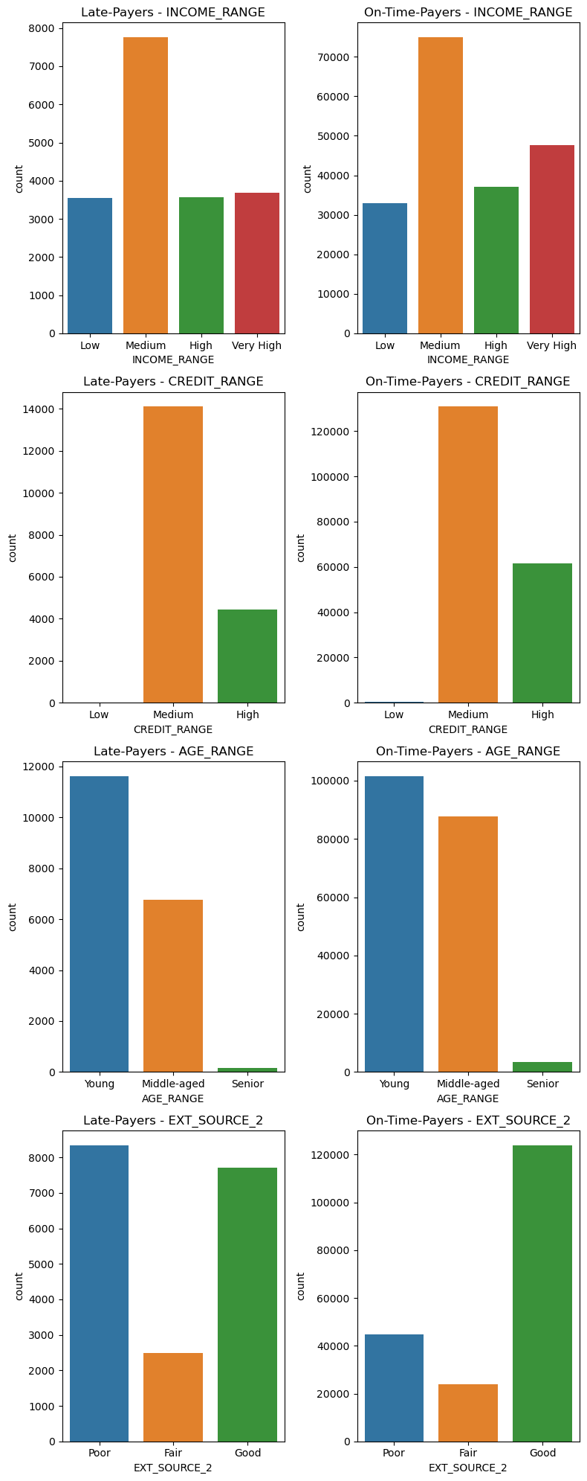

Slide 4
INCOME_GROUP - Medium income group have more count in Target 0 and Target 1
2.CREDIT_RANGE - The target 0 and target 1 is more for Medium Credit Limit
AGE_GROPUP - Middle-aged are more in TARGET 0. Mostly young age group are the latepayers . Age does seem like influencing default.
4.EXT_SOURCE_2 - People with Poor credit score are less likely to pay on time .So it influences the default factor.

Slide 5
MERGED DATA
(CURRENT AND PREVIOUS APPLICATION)

Slide 6
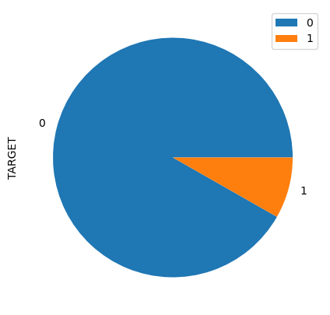
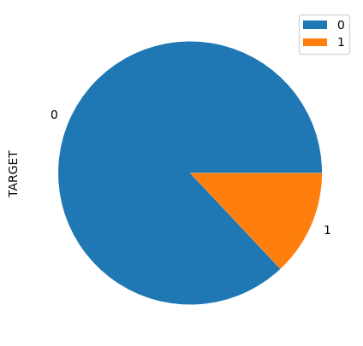
APPROVED AND REFUSED
Approved
Refused
Target 0 and 1 for : Approved 0 0.92 1 0.08 Name: TARGET, dtype: float64
Target 0 and 1 for : Refused 0 0.87 1 0.13 Name: TARGET, dtype: float64
It is visible that the refused offeres of previous application has more defaulters i.e almost 13% and approved also have but 0.08%

Slide 7
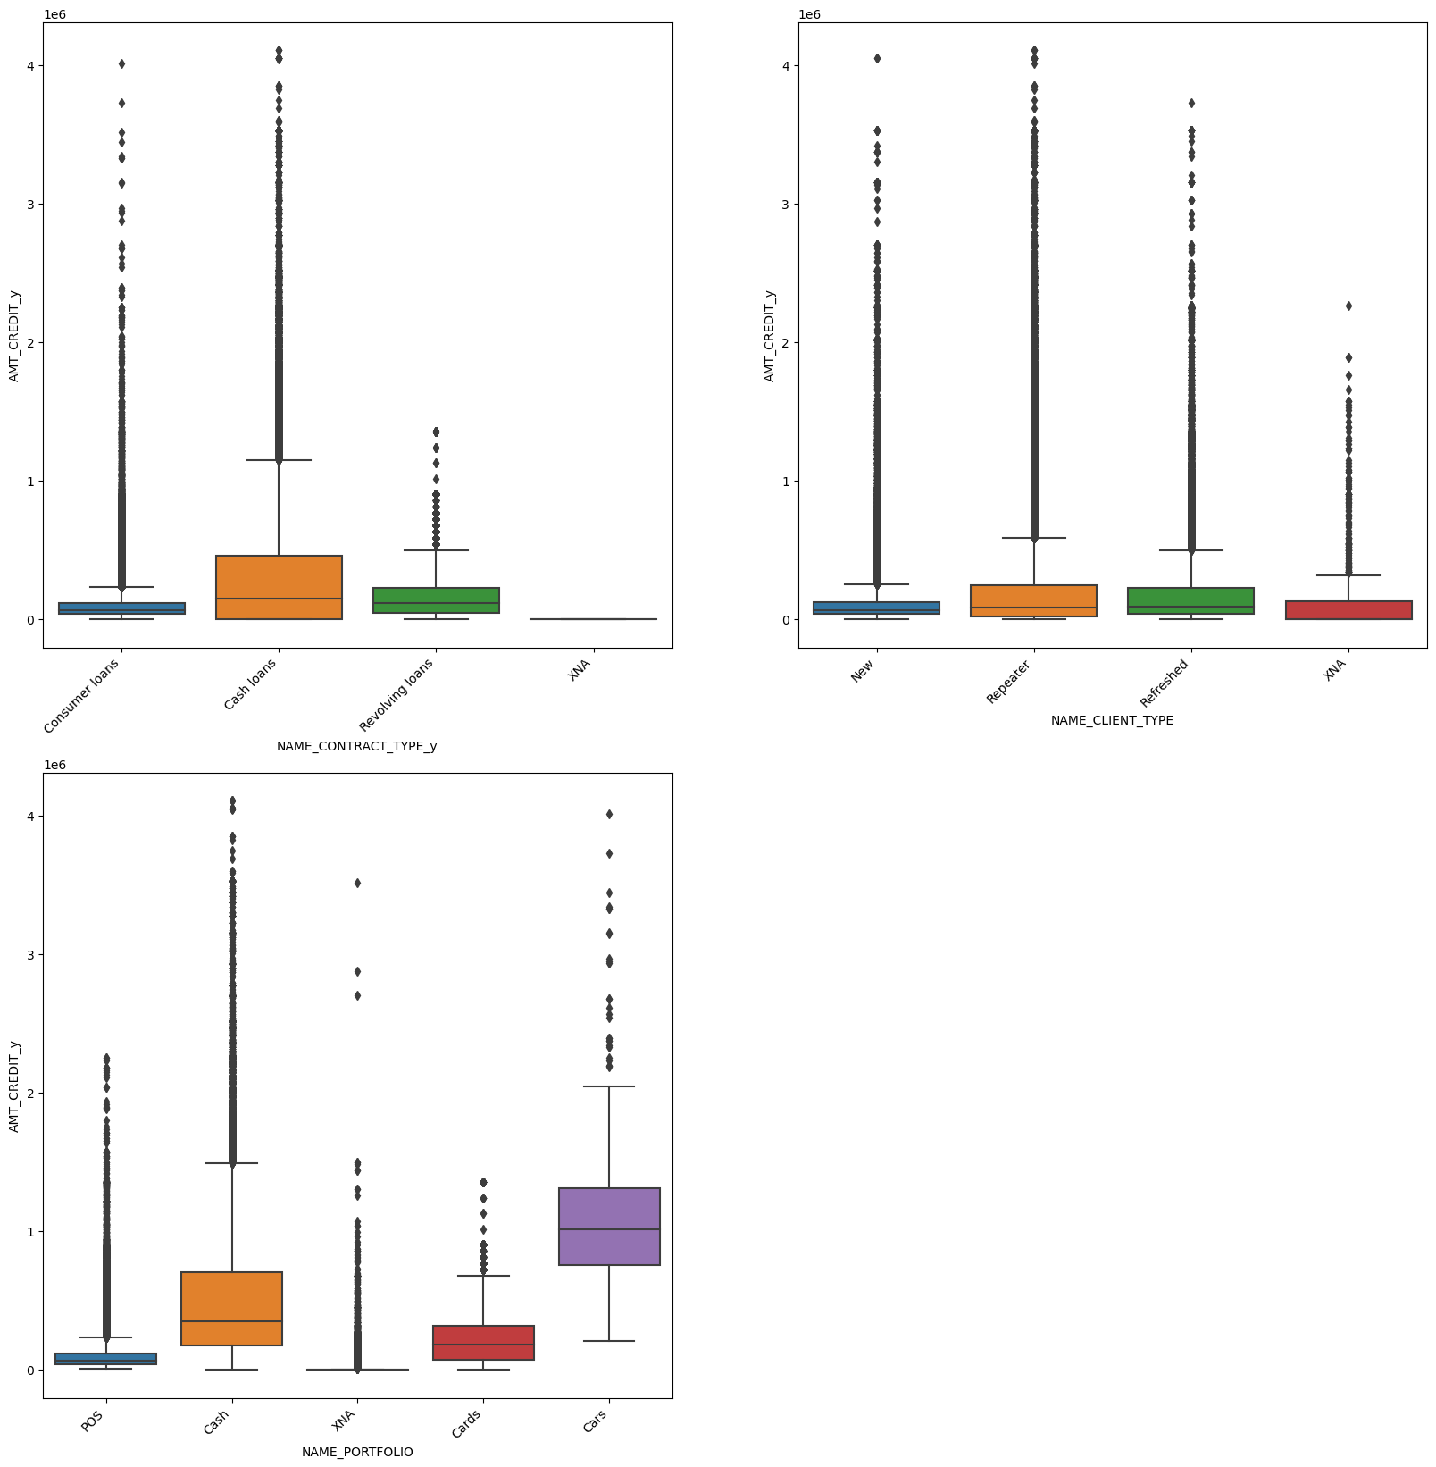
AMOUNT CREDIT ANALYSIS

Slide 8
1.The amnt credited is higher for Cash Loans than revolving and consumer loans
2.The amnt credit is more for Repeaters and refreshed than new applicants
3.The loan with portfolio Cars are more amount credited followed by Cash.

Slide 9
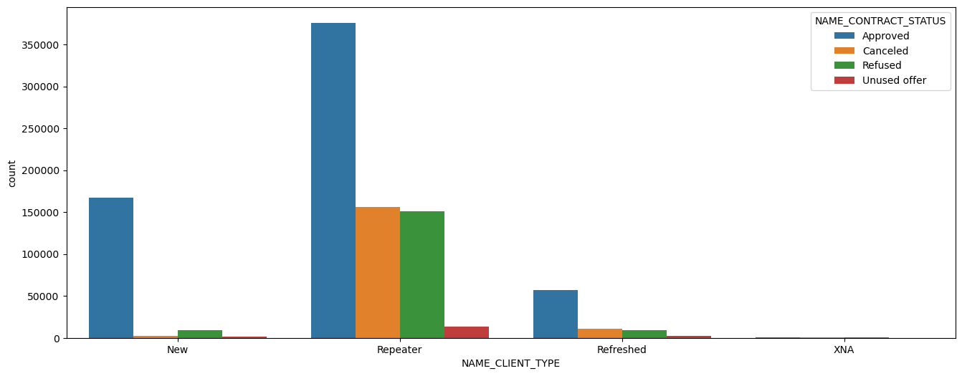
Client Type and Contract Status
1.For the repeater clients the approval happens more then comes for New clients
2.The repeater clients plays a good role cos most of approved,canceled,refused contracts are for Repeater clients

Slide 10
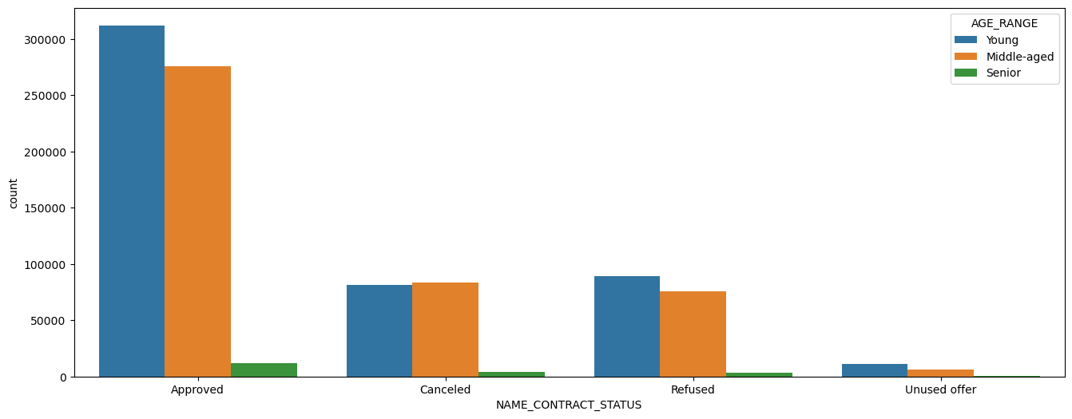
Age group and Contract Status
The young and middle aged age groups have most of the approved loans .Senior people are very less compared to other age groups when it comes to approval,cancelled and refused

Slide 11
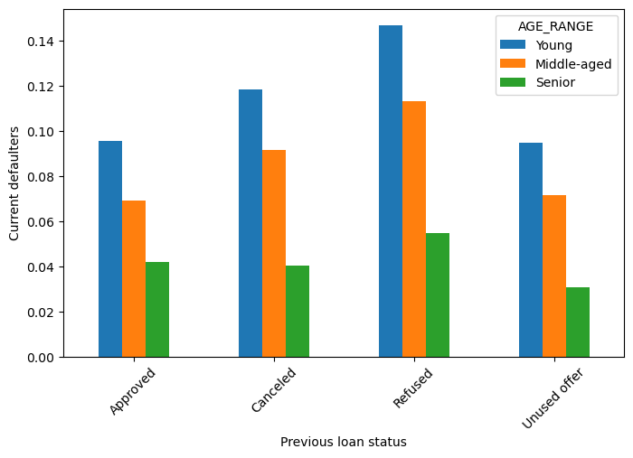
#AGE RANGE-PREVIOUS LOAN STATUS-CURRENT DEFAULTERS
The refused and cancelled applicants of previous credits have more current defaulters mostly in the young group

Slide 12
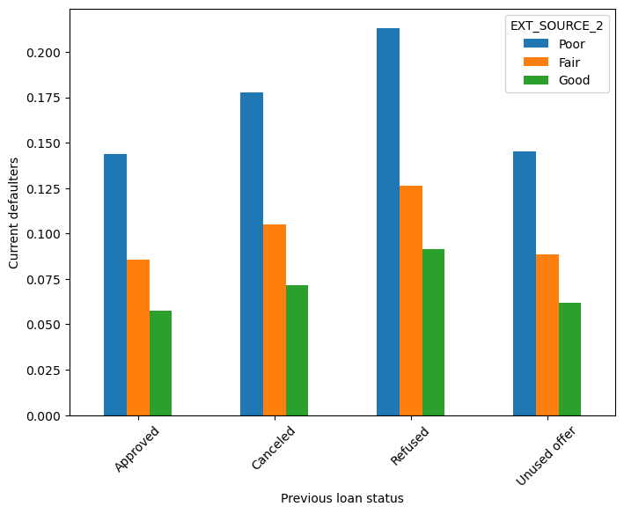
EXT_SOURCE_2-PREVIOUS LOAN STATUS-CURRENT DEFAULTERS
In all contract status applicants with poor credit score is having more defaulters and good credit score has less defaulters .

Slide 13
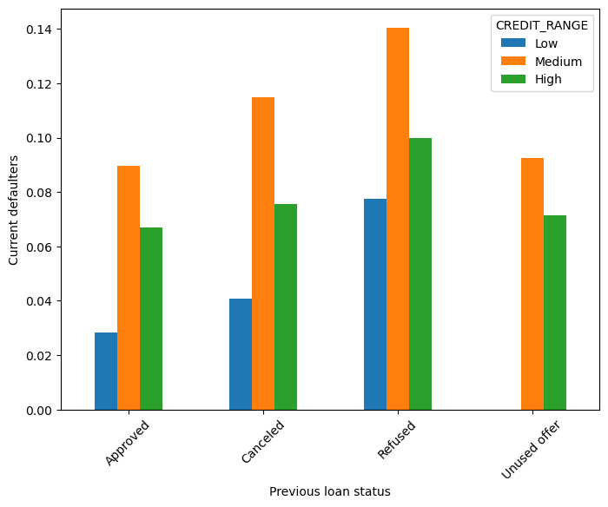
#AMOUNT CREDIT-PREVIOUS LOAN STATUS-CURRENT DEFAULTERS
In all the status the Medium Credit range tend to have more defaulters than high credit amount

Slide 14
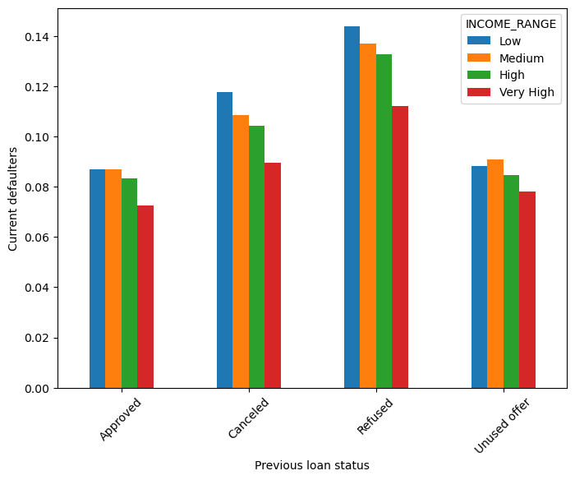
#INCOME RANGE-PREVIOUS LOAN STATUS-CURRENT DEFAULTERS
In Unused offer the medium range seems to have more defaulters when in all other cases the low income group have more defaulters

Slide 15
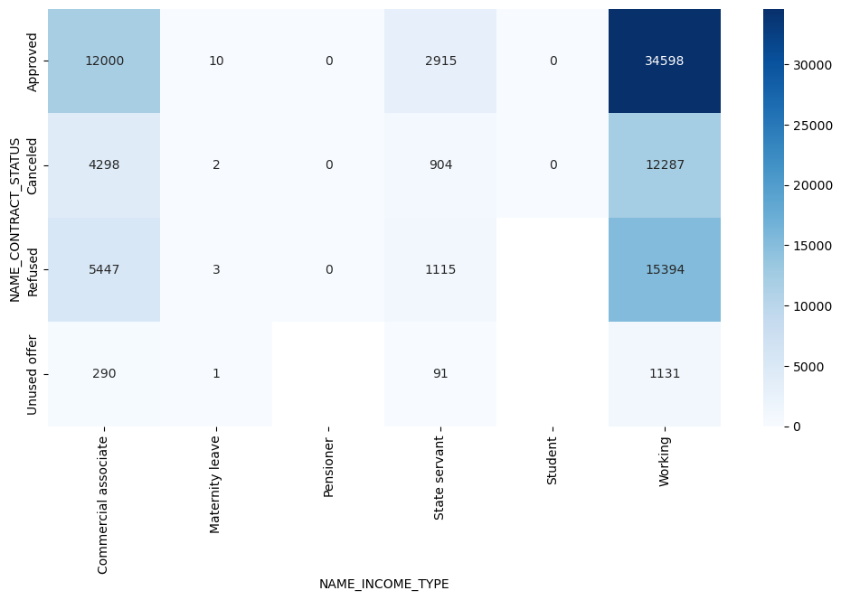
"NAME_CONTRACT_STATUS", "NAME_INCOME_TYPE",aggregating on Target
Target 1 is default, higher on the above matrix shows correlation to default.
Working applicant with Approved status have defaulted in highest numbers
Previous applications with Refused, Cancelled, Unused loans also have default which is a matter of concern. This indicates that the financial company had Refused/cancelled previous application, but has approved the current and is facing default on these loans.
4.14,389 applicanst of working class were REFUSED earlier and now have defaulted.

Slide 16
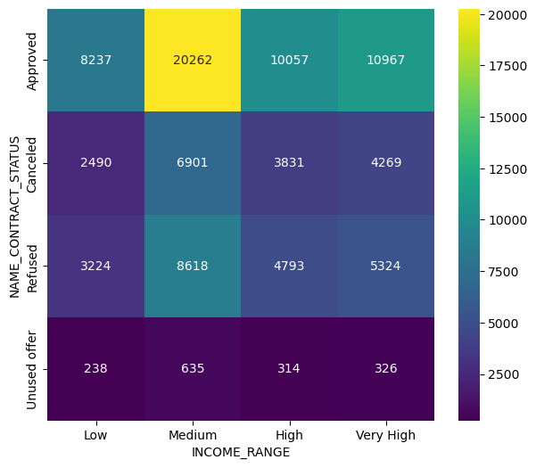
"NAME_CONTRACT_STATUS", "INCOME_RANGE",aggregating on Target
The Medium Income group applicants have most of the approved loans

Slide 17
Key Indicators of an Applicant's Likelihood to Repay:
NAME_EDUCATION_TYPE: Applicants with academic degrees exhibit a lower default rate.
NAME_INCOME_TYPE: Students and businessmen have shown no defaults.
YEARS_BIRTH: Individuals aged 50 and above have a significantly lower likelihood of defaulting.
YEARS_EMPLOYED: Clients with over 40 years of experience demonstrate a default rate of less than 1%.
AMT_INCOME_TOTAL: Applicants with incomes exceeding 700,000 are less prone to defaulting.

Slide 18
Determining Factor for Applicant Default Prediction:
1. CODE_GENDER: Male applicants exhibit a relatively higher default rate.
2. NAME_FAMILY_STATUS: Individuals with civil marriages or those who are single tend to have a higher default frequency.
3. NAME_EDUCATION_TYPE: Applicants with lower secondary and secondary education levels.
4. NAME_INCOME_TYPE: Clients on maternity leave or unemployed have a notable default rate.
5. OCCUPATION_TYPE: It's advisable to avoid low-skill laborers, drivers, waiters/barmen staff, security staff, laborers, and cooking staff due to their significant default risk.
6. YEARS_BIRTH: Be cautious with young individuals aged 20-40 as they have a higher probability of defaulting.
7. YEARS_EMPLOYED: Applicants with less than 5 years of employment experience tend to have a higher default rate.
9. AMT_GOODS_PRICE: Default risk increases when the credit amount exceeds 3 million.

Slide 19
Suggestions
Which all categories can we consider providing loans with elevated interest rates. This strategy serves to counterbalance potential defaults and safeguard against business losses in the following scenarios:
NAME_HOUSING_TYPE: A substantial portion of loan applicants resides in rented apartments or with their parents. Offering loans to individuals in this category can help mitigate potential losses in the event of defaults.
AMT_CREDIT: Applicants seeking loans within the 300,000 to 600,000 range demonstrate a higher likelihood of default. Introducing higher interest rates specifically for this credit range is a prudent approach.
AMT_INCOME: Given that roughly 90% of applicants have a total income of less than 300,000 and exhibit a heightened default risk, extending loans with increased interest rates for this income bracket can assist in risk management.
CNT_CHILDREN & CNT_FAM_MEMBERS: Clients with 4 to 8 children face a considerably elevated default rate. Implementing higher interest rates on loans for this group can effectively address default risks.

Slide 20
CONCLUSION
Groups Highly Recommended(Non Defaulters)
1. Clients who were approved in their previous applications.
2. Individuals with a higher level of education and a correspondingly higher income.
3. Clients with strong external source scores.
4. Elderly individuals across all categories.
5. Married clients, as compared to clients with other family statuses.
6. Female clients tend to exhibit more favorable characteristics than male clients.
Groups with High Risk(Defaulters)
1. Clients who previously had their applications refused, canceled, or unused.
2. Individuals with low incomes who have a history of application refusals.
3. Unemployed clients.
4. Clients with low external source scores.
5. Young clients are relatively riskier compared to middle-aged and senior citizens.
6. Clients with lower secondary and secondary levels of education tend to pose higher risks.

