Slide 1
Webshop – final presentation
The BreakFast Company huber3, nells1, burkt4
Web Programming

Slide 2
Agenda
Intro
Live demo
Technologies used
Features implemented
Distribution of work
Lessons learnt

Slide 3
Intro: Target User and Requirements
Peter, a businessman;
male, 45, works as a banker, travels daily from cities by train (first class), he collects art as a hobby, he is kind of a snob, accustomed to certain standard of living, high income.
Peter likes his routine therefore he would like to place standing orders per weekday, so he doesn't have to place a order daily. But it should still be possible to change the standard order or to be able to suspend it, when he goes on business trips.

Slide 4
Intro: Target User and Requirements
Anna, girl with lactose intolerance
female, 25, studies psychology and history, works part time in a library, likes reading books, lives in a living community, medium income
Anna loves breakfast and is her most important meal of the day. To find a bakery or restaurant with lactose free products is sometimes difficult. She would like to see which products are suitable for her lactose intolerance.

Slide 5
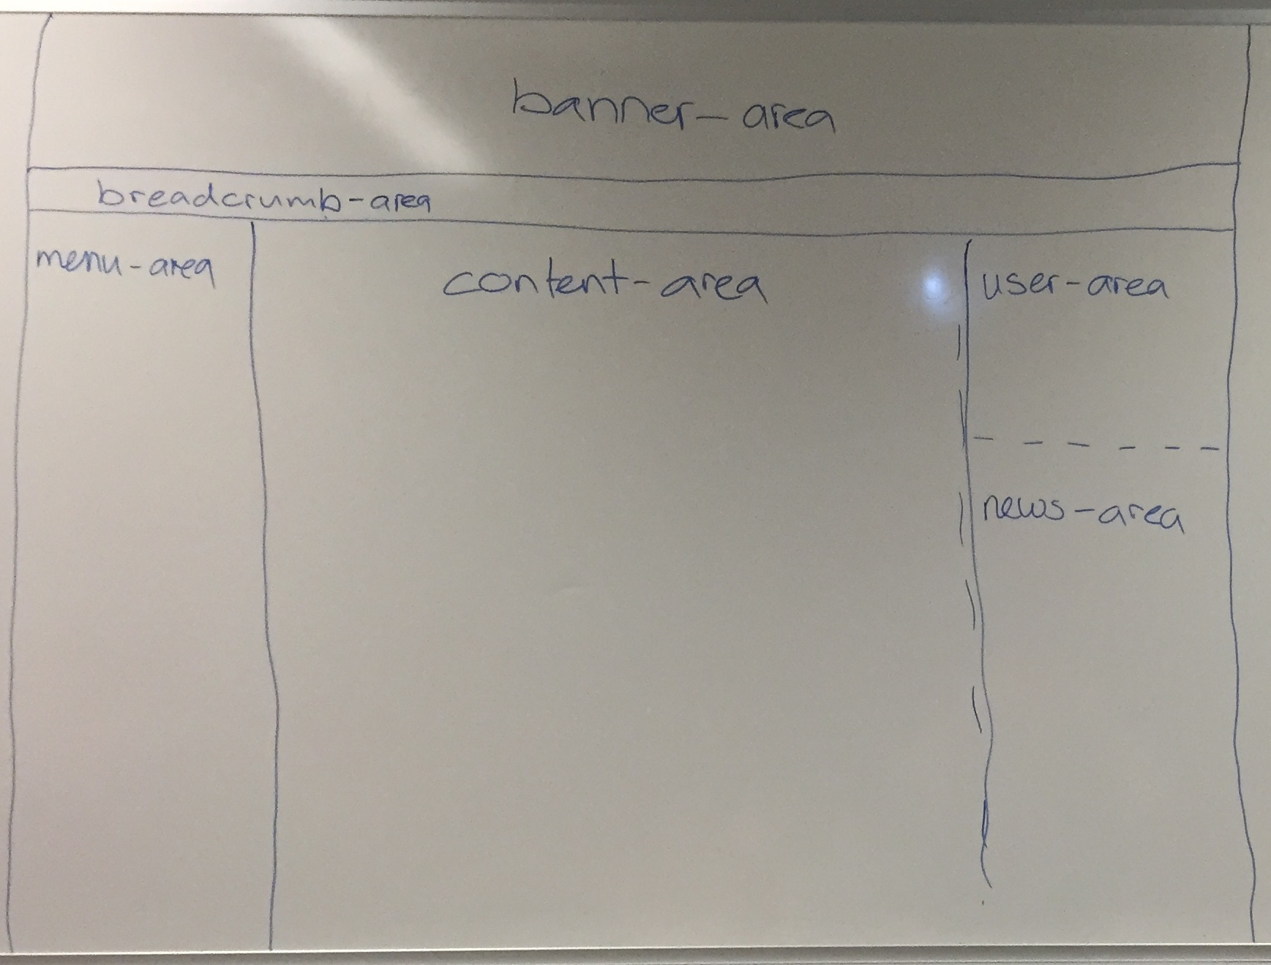
Intro: General Design

Slide 6
Live Demo
Enjoy!

Slide 7
Technologies used
HTML, CSS and JavaScript
PHP and MySQL (using mysqli library)
Cookies (Save language settings)
Session (Basket and user information)
REST (GoogleMaps, Skype Status)
AJAX (Productsearch)
HTML templates (On About us and Contact page)
RegEx

Slide 8
Features implemented – General Design
4.2: Dynamic Navigation Menu
7.3: DHTML
5.1: External PHP Files
5.2: Multi-Page PHP File
5.3: Multiple Languages
8.1: Cookies

Slide 9
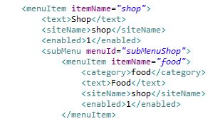
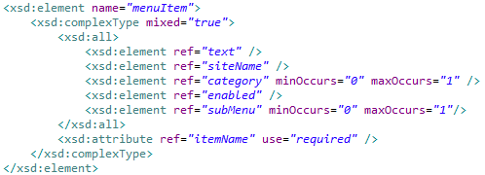
Features implemented – General Design
XML Menu validated against XSD-schema
Navigation menu is generated dynamically using XML-file
Menu structure can easily be changed via XML-file

Slide 10
Features implemented – Product Shop
4.3: List of Products
6.1: "Buy Now" Links
6.2: Select Options
8.2: Shopping Cart
9.1: OO Shopping Cart
9.2 : OO Product List
10.1: Database Schema Design
10.3: PHP Integration
12.1: AJAX

Slide 11
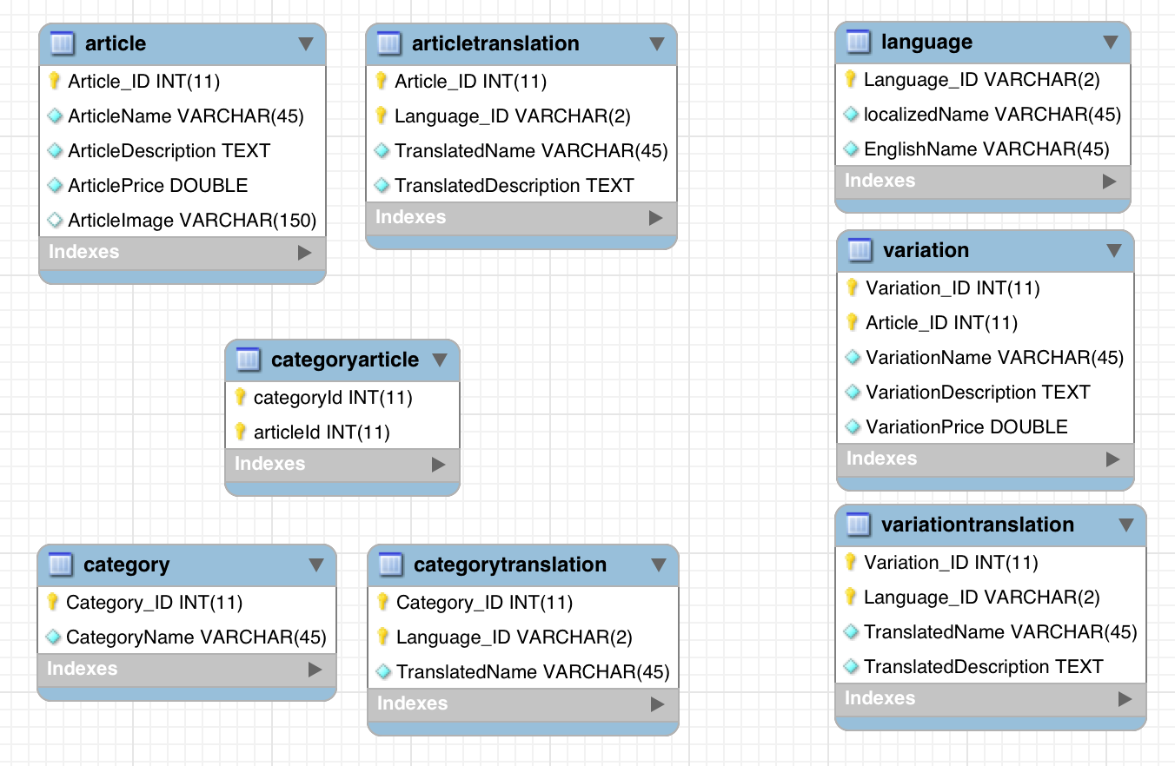
Features implemented – Product Shop

Slide 12
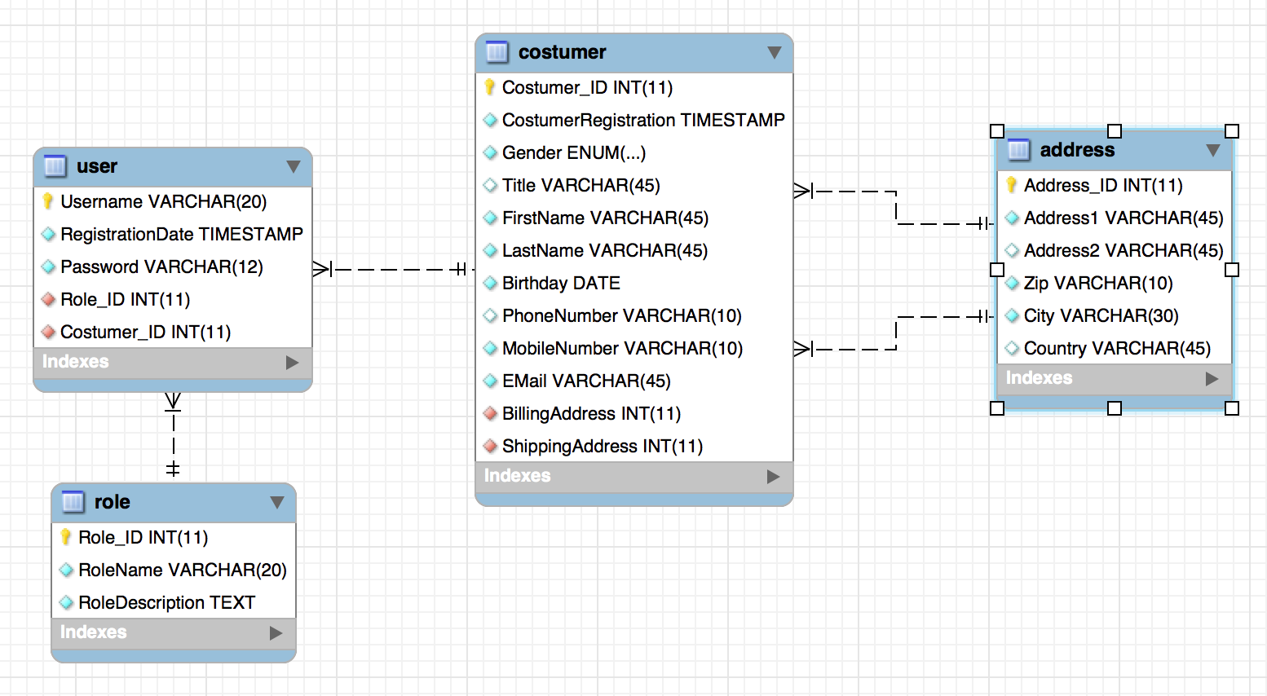
Features implemented – Product Shop

Slide 13
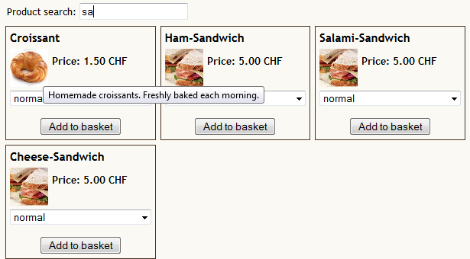
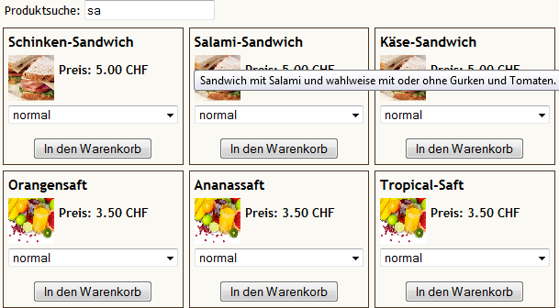
Features implemented – Product Shop

Slide 14
Features implemented – Ordering Process
6.3: Shipping Address
6.4: Confirmation
7.1: Purchase Confirmation
7.2: Form Validation
12.3: Regular Expressions

Slide 15
Features implemented - Administration
10.4: Administrator
8.3: User Accounts
9.3: Even more OO

Slide 16
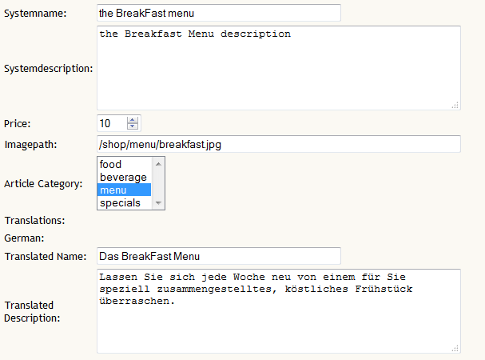
Features implemented - Administration

Slide 17
Features implemented – About us / Contact
11.1: Web Service Integration
12.2: HTML Templates

Slide 18
Distribution of work
Weekly meetings to discuss and distribute tasks
key tasks and decisions were worked on by the whole group
additional Skype Sessions to discuss results were planned when needed
General tasks of team members:
Huber3: Layout, Design, XML, XSD, Patchworking, Database
Nells1: Webservices, Mailing, Ordering process, User Login
Burkt4: ProductList (x3 ;-) ), Validation, Regex, Administration
Exact distriubtion of tasks is written in the project diary

Slide 19
Lessons learnt
Multi-Language complicates things a lot
Defining a solid structure is key
We are still not sure how to handle includes properly
Best practice in general?!

